Slide 1
GFO-22-306 Pre-Application Workshop
PEER-Hydro: Precipitation Enhancement and Environmental Research for Hydropower Generation
Energy Research and Development Division, California Energy Commission
Presenter: Julia Harnad, Energy-Related Environmental Research Team
Date: March 21, 2023

Slide 2
Agenda
Time | Item
10:00 am | Welcome and Introduction
10:05 am | Solicitation Background EPIC Research Program Purpose of Solicitation Available Funding
10:25 am | Application Requirements Project Group Requirements Attachments Submission Process Evaluation Process
11:00 am | Q&As
12:00 pm | Adjourn

Slide 3
Housekeeping
This workshop will be recorded.
Participants will be muted during the presentation. Please ask your question in the Q&A window.
Updates on solicitation documents including this presentation will be posted at the Grant Funding Opportunity’s webpage: https://www.energy.ca.gov/solicitations/2023-03/gfo-22-306-precipitation-enhancement-and-environmental-research-hydropower

Slide 4
Commitment to Diversity
The Energy Commission adopted a resolution strengthening its commitment to diversity in our funding programs. The Energy Commission continues to encourage disadvantaged and underrepresented businesses and communities to engage in and benefit from our many programs.
To meet this commitment, Energy Commission staff conducts outreach efforts and activities to:
Engage with disadvantaged and underrepresented groups throughout the state.
Notify potential new applicants about the Energy Commission’s funding opportunities.
Assist applicants in understanding how to apply for funding from the Energy Commission’s programs.
Survey participants to measure progress in diversity outreach efforts.

Slide 5
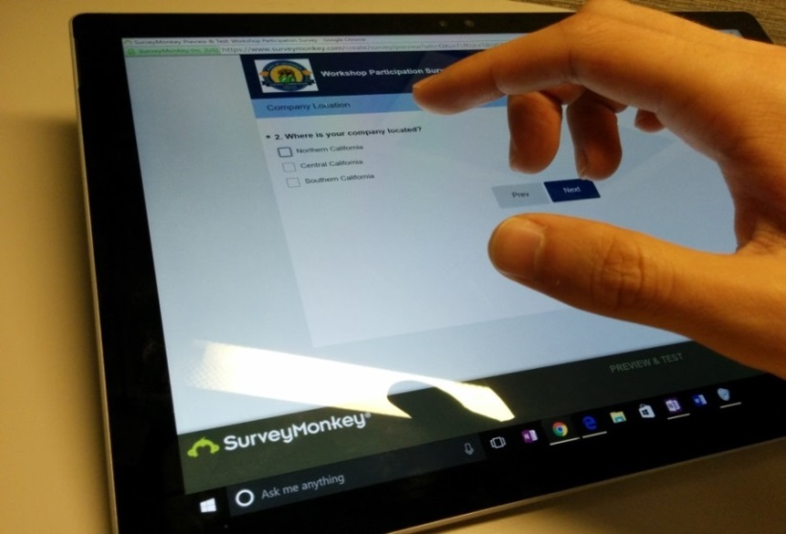
We Want to Hear From You!
Participation Survey
Survey responses will be summarized anonymously to track attendance of underrepresented groups in our workshops for public reporting purposes.
Online participants, please use this link: https://forms.office.com/g/UjX9qnJXTQ
Thanks!

Slide 6
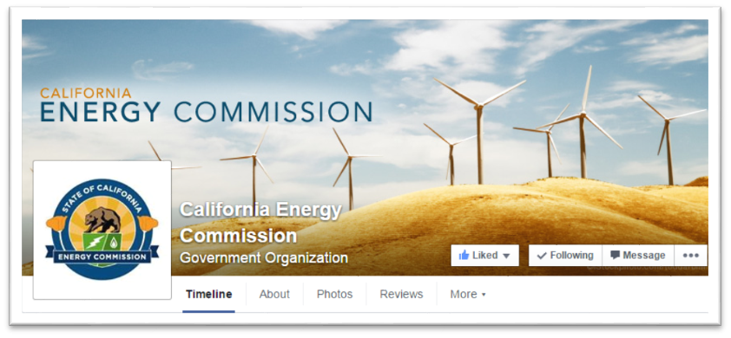
Connect With Us

Slide 7
Find a Partner on EmpowerInnovation.net
Empower Innovation strives to accelerate your clean tech journey with easy access to funding opportunities from the Energy Commission and other funding providers, curated resources and events, and connections to people and organizations.
FIND A PARTNER
Announce your interest in this funding opportunity and message other interested parties to find potential partners.
RESOURCES & TOOLS
Browse the collection of resources for clean tech innovators including Resource Libraries, Funding Sources, Tools, and Databases.
https://www.empowerinnovation.net/en/custom/funding/view/37748

Slide 8
EmpowerInnovation.net

Slide 9
Policy Drivers
AB 32, Global Warming Solutions Act of 2006: reduce GHG emissions to 1990 levels by 2020.​
SB 32, California Global Warming Solutions Act of 2006 emissions limit: statewide GHG emissions are reduced to 40% below the 1990 level by 2030.
SB 100, The 100 Percent Clean Energy Act of 2018: requires that 60% of California’s electricity be powered by renewable & zero-carbon sources by 2030 and 100 % by 2045.
Executive Order B-55-18: established a new statewide goal to achieve carbon neutrality no later than 2045.​
Executive Order B-30-15: establishes a new interim statewide GHG emission reduction target to reduced GHGs to 40% below 1990 levels by 2030, to ensure CA meets its target of reducing GHGs to 80% below 1990 levels by 2050.
Integrated Energy Policy Report (IEPR): California Public Resources Code Section 25302 requires the Energy Commission to release a biennial report that provides an overview of major energy trends and issues facing the state.​

Slide 10
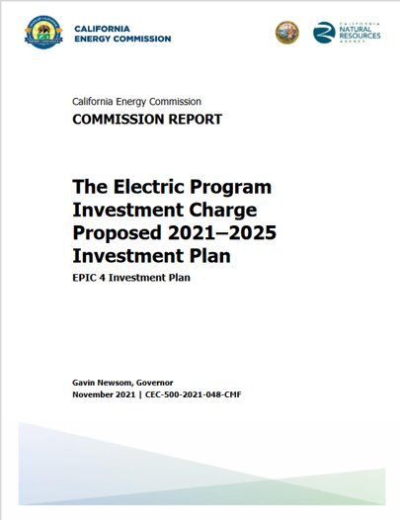
EPIC Funding Source
Electric Program Investment Charge Investment Plan 2021-25 strategic objective: “Inform California’s Transition to an equitable, zero-carbon energy system that is climate-resilient and meets environmental goals” (Chapter 7).
This supports:
Initiative 44, “ Integrating Climate-Resilience in Electricity System Planning”
Initiative 45, “ Advancing the Environmental Sustainability of Energy Deployments”
Investment Plan: https://www.energy.ca.gov/proceedings/energy-commission-proceedings/electric-program-investment-charge-2021-2025-investment
10

Slide 11
Solicitation Background
Hydroelectric power is a critical element of California’s electricity system
Cloud seeding:
Conducted over 70+ years
Various programs currently operating in California
Recent scientific advances now enable improved verification and modeling
Approximately 50 permitted California hydropower facilities will begin relicensing in the next 13 years by the Federal Energy Regulatory Commission (FERC) and must meet environmental requirements.

Slide 12
Purpose of Solicitation
Funding research to increase and sustain hydropower generation in California
Specifically, funded research will:
Contribute to more effective precipitation enhancement strategies, and
Provide better information and tools to reduce the environmental effects of hydropower operations

Slide 13
Potential Benefits of Solicitation
Fund applied research to advance strategies for managing California’s hydropower resources for optimal contribution to grid operations
Increase sustainable zero-carbon, fast-ramping, flexible energy resources
Contribute to more effective precipitation enhancement that would increase water resources for California’s electricity sector
Expand integration of environmental protection and reduce possible environmental impacts of hydropower operations

Slide 14
Available Funding
Project Group | Available Funding | Minimum Award Amount | Maximum Award Amount
Group 1: Advancing Precipitation Enhancement Strategies | $2,000,000 | $1,800,000 | $2,000,000
Group 2: Research to Inform the FERC Hydropower Relicensing Process | $1,500,000 | $250,000 | $500,000

Slide 15
Match Funding
5% of match funding is required.
Match funding contributors must submit match funding commitment letters that meet the requirements. Failure to do so will disqualify the match funding commitment from consideration.
Refer to the Solicitation Manual for more details on match funding.

Slide 16
Group 1: Advancing Precipitation Enhancement Strategies
Funding Amount: $2,000,000
Background:
There have been advances in our understanding of orographic precipitation enhancement (cloud seeding)
There are opportunities to advance the science and practice of cloudseeding in California to increase water supplies and hydropower generation

Slide 17
Group 1: Advancing Precipitation Enhancement Strategies
Successful Applicant must demonstrate:
A clearly articulated and scientifically justified approach to how the research will lead to more effective cloud seeding efforts for hydropower generation
A well-articulated approach to the assessment of benefits of cloud seeding using meaningful metrics (e.g., $/acre-foot) including hydropower generation and water resources relevant to the electricity sector
Expertise in coordinating with relevant precipitation enhancement and electricity sector experts and stakeholders

Slide 18
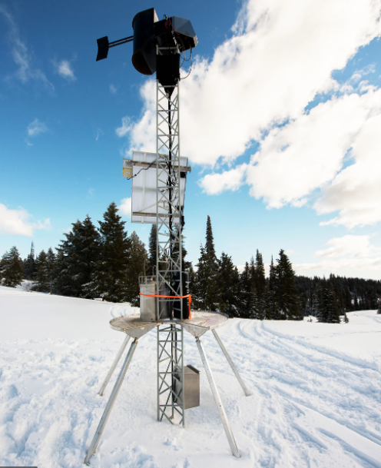
Group 1: Advancing Precipitation Enhancement Strategies
Research may assess:
Effects of background aerosols on enhancement
Impact of higher temperatures
New seeding and transport agents
Research may develop new strategies and tools to:
Forecast and detect seeding opportunities in real time
Improve targeting and transport modeling

Slide 19
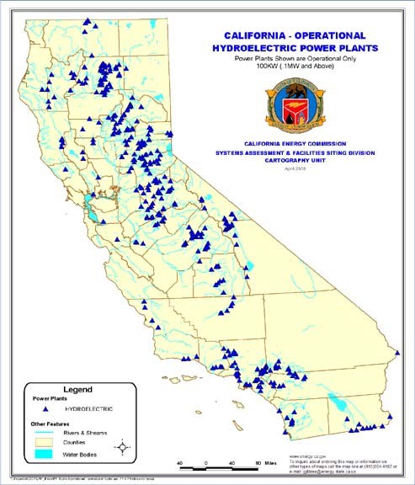
Group 2: Research to Inform the FERC Hydropower Relicensing Process
Funding Amount: $1,500,000
Background:
All non-federal hydropower projects are subject to licensing by the Federal Energy Regulatory Commission (FERC)
Over 50 permitted facilities (~2,471 MW) will begin relicensing process between now and 2036
Relicensing process offers a window of opportunity to address environmental issues before licenses are issued for 30 or 50 years.

Slide 20
Group 2: Research to Inform the FERC Hydropower Relicensing Process
Applicants must
Address and clearly describe how the proposed research will advance and inform the identification and mitigation of the effects of hydropower generation on California's freshwater ecosystems
Existing practices/information should be described as well as how the proposed research will better science
Show how the research will inform decision making in the FERC hydropower licensing and/or relicensing processes

Slide 21
Group 2: Research to Inform the FERC Hydropower Relicensing Process
Research must address aquatic ecosystems including both biotic and abiotic components.
Inform the FERC relicensing process, providing the best available science for environmental assessments of topics like:
Innovative approaches to instream flow determinations
Ways to manage sedimentation
Thermal tolerance of native fish and amphibian species
The role water thermal refugia play, and how they respond with different instream flows
Improved water year predictions
New or improved innovative environmental assessment and monitoring tools and techniques

Slide 22
Eligible Applicants
This is an open solicitation for public and private entities.
Applicants must accept the EPIC terms and conditions.
Standard, UC, and DOE T&Cs available online: https://www.energy.ca.gov/funding-opportunities/funding-resources
Applicants are encouraged to register with the California Secretary of State, as all recipients must be registered and in good standing to enter into an agreement with the Energy Commission: http://www.sos.ca.gov

Slide 23
Application Requirements
Each Applicant must complete and | include the following:
1. Executive Summary (.docx) | 7. CEQA Compliance Form (.docx)
2. Project Narrative (.docx) | 8. References and Work Product Form (.docx, .pdf)
3. Project Team (.docx, .pdf) | 9. Commitment and Support Letters (.pdf)
4. Scope of Work (.docx) | 10. Project Performance Metrics
5. Project Schedule (.xlsx) | 11. Applicant Declaration (.docx)
6. Budget (entered into ECAMs and/or .xlsx)

Slide 24
Project Narrative (Attachment 2)
This is your opportunity to explain the entirety of the project. The narrative should explain:
How does your project advance science and technology?
Why is your project necessary and important to California?
What is your project approach and how will each major task be implemented?
How will the project be completed in the term proposed?
How will the project outcomes benefit electric ratepayers?
Address the requirements for your group as described in Section I.C.
Respond to the scoring criteria described in Section IV.F.

Slide 25
Scope of Work (Attachment 4)
Tell us exactly what you are proposing to do in your project.
Scope of Work should be consistent with project narrative, budget and schedule.
Identify what will be deliver to the Energy Commission.
Be sure to include in the technical tasks:
At least one product deliverable per task.
Address requirements in Section I.C. under Project Focus.
Be sure to include in the Project Schedule (Attachment 6):
Product deliverables that correspond with the Scope of Work.
Realistic dates on when product deliverables can be completed.

Slide 26
Commitment and Support Letter Forms (Attachment 9)
Follow guidelines provided for commitment and support letters.
Commitment letters are required for entities or individuals that are committing match funding, testing/demonstration sites, including the Prime.
Support letters describe a project stakeholder’s interest or involvement in the project.
All applicants must submit at least one support letter.
Match funding must be supported by a match fund commitment letter.
Any project partners that will make contributions to the project (other than match and sites) must submit a commitment letter.
Limit to two pages per letter, excluding the cover page.

Slide 27
GFO Submission Requirements (1)
Applications will be submitted through the Energy Commission Agreement Management System, available at: https://ecams.energy.ca.gov/
Applicants must have or create a user account in order to apply for this solicitation. To create an account, please see the guidance document titled User Registration Instructions
Note: One account manager per organization, but users can be added by account manager

Slide 28
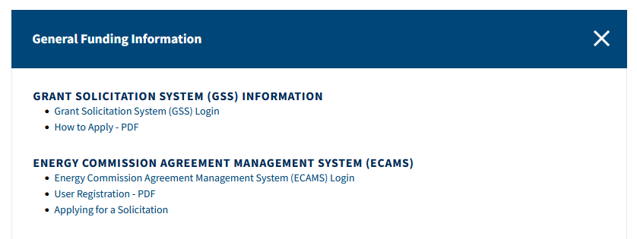
GFO Submission Requirements (2)
For detailed instructions on how to submit an application, please see the Applying for a Solicitation guidance document.
Both of the referenced guidance documents are available at https://www.energy.ca.gov/funding-opportunities/funding-resources under General Funding Information.
Any questions about the ECAMS system can be sent to ECAMS.SalesforceSupport@Energy.ca.gov

Slide 29
GFO Submission Requirements (3)
Electronic files, other than those requiring signatures, must be in the format that they are provided in the solicitation.
Application documents should meet formatting requirements, and page recommendations provided in the solicitation manual.
Attachments requiring signatures (Support/Commitment Letters) may be scanned and submitted in PDF format.

Slide 30
APPLICATION WARNING
START THE PROCESS EARLY!
Applications must be fully submitted BEFORE the deadline listed in the solicitation manual
The ECAMS system will not allow submission after the deadline
Applications in the process of being submitted prior to the deadline will NOT be accepted after the deadline
Applications will NOT be accepted after the deadline

Slide 31
Application Review
We recommend you carefully review your application both before and after submission.
Verify that all necessary documents have been uploaded.
Verify that all documents uploaded are the accurate version you intend to submit as your final.
Verify that your documents are not marked "confidential" unless the solicitation allows specific material to be confidential. Most solicitations do not allow submission of confidential information.
Verify that your match commitment letters accurately reflect the match amounts included in your budgets, including the match provided by the prime applicant.
Verify that support and commitment letters are included, if required.
Verify that amounts entered within the system's budget (if any) concur with information included on uploaded budget worksheets.

Slide 32
How will my Application be Evaluated? Application Screening
Admin Screening Process
Energy Commission staff screens applications per criteria in Section IV.E.
Criteria are evaluated on a pass/fail basis.
Applicants must pass all screening criteria or the application will be disqualified.
Some Reasons for Disqualification
Application is not submitted by the specified due date and time.
Application does not include one or more support letters.
Application contains confidential material.

Slide 33
How will my Application be Evaluated? Application Scoring
Evaluation Committee applies the scoring scale to the scoring criteria.
Applications must obtain a minimum passing score of 52.5 points for Criteria 1-4 in order to continue evaluation.
Applications must obtain a minimum passing score of 70 points for Criteria 1-7 in order to be considered for funding.
Review Section IV of the manual and ensure the application provides a clear and complete response to each scoring criteria.
Scoring Criteria | Maximum Points
1. Technical Merit | 15
2. Technical Approach | 25
3. Impacts and Benefits for CA IOU Ratepayers | 20
4. Team Qualifications, Capabilities, and Resources | 15
5. Budget and Cost-Effectiveness | 10
6. CEC Funds Spent in California | 10
7. Ratio of Direct Labor Costs to Indirect Costs | 5
Total | 100
Minimum Points to Pass | 70

Slide 34
How will my Application be Evaluated? Application Scoring – Preference Points
Passing applications (score of 70 or more from Criteria 1-7) will be considered for bonus points for match funding.
Scoring Criteria | Maximum Points
8. Match Funds | 10
Total Bonus Points | 10
Up to 5 points will be awarded based on the percentage of proposed cash relative to the total match contributions using the Match Scoring Table in the Scoring Criteria.
The remaining 5 points may be awarded to applications that exceed the minimum match requirements up to 100 percent using the Exceeds Minimum Match Scoring table.
Refer to the Solicitation Manual for more details on the match funding scoring criteria.

Slide 35
Next Steps After Grant Award
Notice of Proposed Award: Shows total proposed funding amounts, rank order of applicants by project group, and the amount of each proposed award.
Agreement Development: Proposal documents will be processed into a legal agreement.
Failure to Execute: The Energy Commission reserves the right to cancel the pending award if an agreement cannot be successfully executed with an applicant.
Project Start: Recipients may begin work on the project only after the agreement is fully executed (approved at an Energy Commission business meeting and signed by the Recipient and the Energy Commission).

Slide 36
Key Dates
Activity | Date
Solicitation Release | 3/08/2023
Pre-Application Workshop | 3/21/2023 at 10:30 am
Deadline for Written Questions | 4/05/2023 at 5:00 pm
Anticipated Distribution of Questions and Answers | Week of 4/24/2023
Support for Application Submission in ECAMS | Ongoing until 5/10/2023 at 5:00 pm
Deadline to Submit Applications | 5/10/2023 at 11:59 pm
Anticipated Notice of Proposed Award Posting | Week of July 10, 2023
Anticipated Energy Commission Business Meeting | September 13, 2023
Anticipated Agreement Start Date | October 1, 2023
Anticipated Agreement End Date | March 31, 2026

Slide 37
Questions and Answers
Please chat your question in the Question and Answers window or raise your hand and you will be called on to unmute yourself. Please remember to introduce yourself by stating your name and affiliation. (Feature found under the Participants panel)
Keep questions under 2 minutes to allow time for others.
Note that our official response will be given in writing and posted on the GFO webpage.

Slide 38
Additional Questions
Please send all questions related to GFO-22-306 to:
Crystal Willis
Commission Agreement Officer
715 P Street, MS-18
Sacramento, CA 95814
Crystal.Willis@energy.ca.gov
Deadline to submit questions:
Wednesday, April 5, 2023, 5:00 PM

Slide 39
Thank You!

