Slide 1
Proposition 39 K-12 Program and
Energy Conservation Assistance Act
2018-19 Progress Report
Update Presentation to the Citizens Oversight Board
Jim Holland
February 13, 2020
California Energy Commission

Slide 2
This is the fifth Energy Commission progress report to the
Citizens Oversight Board

Slide 3
Agenda
Report Overview
  Proposition 39 K-12 Program
Energy Conservation Assistance Act, Education Subaccount (ECAA-Ed)
Bright Schools Program
School Bus Replacement Program

Slide 4
Report Overview

Slide 5
Energy Commission’s Report to the Citizens Oversight Board
Report includes four program components:
  Proposition 39 K-12 Program (Grants)
  Energy Conservation Assistance Act - Education Subaccount (Loans)
  Bright Schools Program (Technical Assistance)
  School Bus Replacement Program
Reporting period:
  December 19, 2013 through June 30, 2019

Slide 6
Clean Energy Job Creation Fund Appropriations
Category | FY 2013-14 (in millions) | FY 2014-15 (in millions) | FY 2015-16 (in millions) | FY 2016-17 (in millions) | FY 2017-18 (in millions) | TOTALS (in millions)
K-12 Program | $381.0 | $279.0 | $313.4 | $398.8 | $376.2 | $1,748.4
ECAA-Ed | $28.0 | $28.0 | $0 | $0 | $0 | $56.0
TOTALS | $409.0 | $307.0 | $313.4 | $398.8 | $376.2 | $1,804.4

Slide 7
Proposition 39 K-12 Program

Slide 8
Local Education Agencies (LEA)Types Receiving Funding

Slide 9
Allocations by LEA Type

Slide 10
Overview of Amendment Process
(no new EEP approvals in FY 2018-19)
LEA makes a request to amend Energy Expenditure Plan (EEP) that was previously approved; Staff reviews amendment request and generates amendment request form for LEA.
LEA submits amendment request form; Supervisor opens EEP for amending by LEA.
LEA submits amended EEP; Staff reviews and approves amended EEP. No additional funding or sites are allowed through the amendment.
  221 amendments approved in FY 2018-19.
  825 EEPs have had an amendment done at least once during the life of the Prop 39 Program. This represents approximately 40% of the total number of EEPs submitted.

Slide 11
Proposition 39 K-12 Funding Approved and Spent

Slide 12
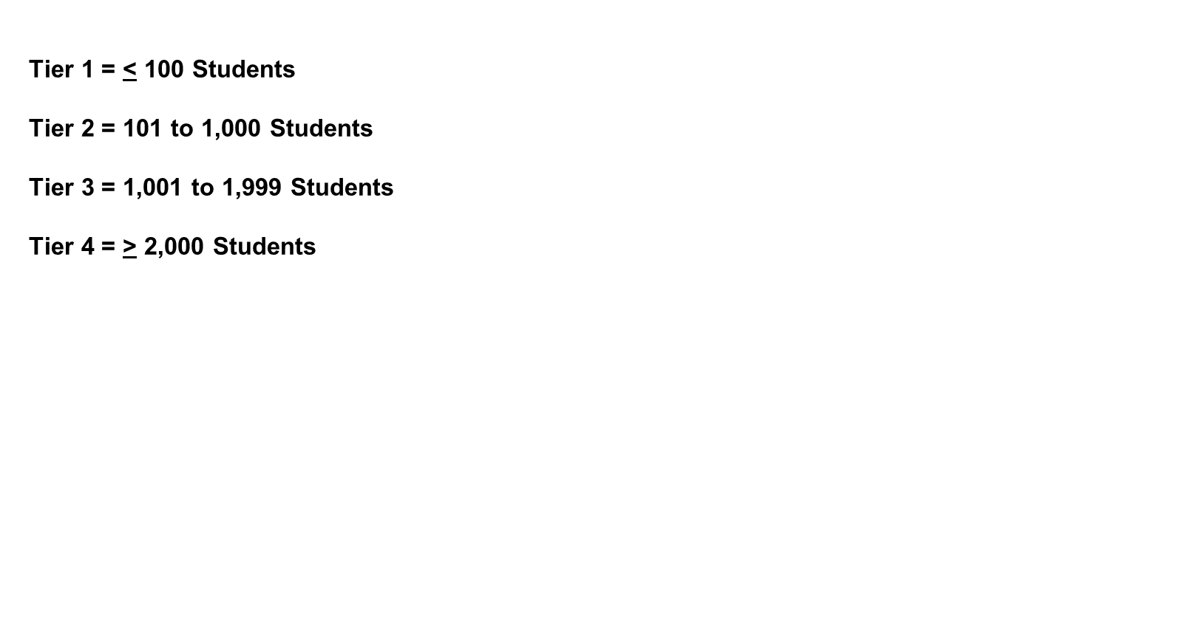
LEA Participation by Tier Level
Tier Levels | LEA Participation Since Proposition 39 inception (By Number of LEAs)
Tier 1 | 164 out of 238 (69%)
Tier 2 | 957 out of 1,307 (73%)
Tier 3 | 152 out of 171 (89%)
Tier 4 | 468 out of 473 (99%)

Slide 13
Cumulative Energy Expenditure Plan Approvals

Slide 14
Eligible Energy Efficiency Measures
Lighting Systems
Heating and Air-Conditioning
(HVAC) Retrofits
Controls (e.g., Thermostats)
Pumps and Motors
Plug Loads
Building Insulation
Clean Energy Generation ((Solar Photovoltaic (PV))

Slide 15
Summary of Implemented Energy Measure Categories (as of June 30, 2019)
Energy Measure Category | Total # of Measures Approved | Total % of Measures Approved | Total Project Cost of Measures Approved | Total % of Project Cost of Measures Approved
Lighting | 12,663 | 54.4% | $743,333,247 | 41%
HVAC & Lighting Controls | 4,890 | 21% | $152,859,197 | 9%
HVAC | 3,360 | 14.5% | $600,372,504 | 33%
Other Energy Efficiency Measures | 1,788 | 7.7% | $120,300,595 | 7%
Self-Generation (PV) | 568 | 2.4% | $175,646,992 | 10%
TOTALS | 23,269 | 100% | $1,792,512,535 | 100%

Slide 16
Accomplishments
Slide title

Slide 17
Cumulative Summary of
Final Project Completion Reports
Category | Last Report (as of June 2018) | Current Report (as of June 2019)
Number of Completed EEPs | 292 | 522
Funding
Total Gross Project Cost | $190 million | $367 million
Prop 39 Share | $153 million | $318 million
Leveraged Funding | $37 million | $49 million
Annual Energy Savings
kWh Savings | 63,925,295 | 125,712,267
Therm Savings | 225,828 | 344,789
CO₂ equivalent emissions reduction | 22,191 tons | 43,060 tons
SIR | 1.36 | 1.37
Total Cost Savings | $11.9 million | $23.4 million

Slide 18
Looking Ahead
Amendments are still being processed. Almost half of the approved EEPs have undergone an amendment at least once.
Annual reporting will resume in July of 2020. Close to 1,000 annual reports will be generated at that time.
Final project completion reports are ongoing. Based on overall numbers at this time, 1,599 final project completion reports will need to be filed by September 30, 2021.

Slide 19
Energy Conservation Assistance Act-Education Subaccount (ECAA-Ed)

Slide 20
ECAA-Ed Funding
Fiscal Year | ECAA-Ed Financing (Energy Project Loans) | Bright Schools (Technical Assistance) | TOTAL
2013-14 | $25,291,524 | $2,708,476 | $28,000,000
2014-15 | $25,200,000 | $2,800,000 | $28,000,000
2015-16 | 0 | 0 | 0
2016-17 | 0 | 0 | 0
2017-18 | 0 | 0 | 0
2018-19 | 0 | 0 | 0
TOTALS | $50,491,524 | $5,508,476 | $56,000,000

Slide 21
ECAA-Ed Loan Program Status
(as of June 30, 2019)
Loan Status | Number of Loans | Loan Funds Spent (in millions)
Loans With Final Project Completion Reports | 28 | $43.1
Completed Loan Projects (Final Reports Due after 6/30/19) | 3 | $4.8
Loans Still in Construction | 4 | $4.4
Totals | 35 | $52.3

Slide 22
ECAA-Ed Competitive Loan Program
First Program Opportunity Notice (PON) released in February 2019 for $36 million.
First ECAA-Ed Competitive loans approved in December 2019: Seven loans approved totaling $6.7 million.
Second PON scheduled for release in February 2020 for $38 million.
(Full report on the ECAA-Ed Competitive Loan Program to be briefed at the March 2020 Citizens Oversight Board meeting)

Slide 23
Bright Schools Program

Slide 24
Technical Assistance
Provides assistance to identify energy saving measures at existing facilities
Energy Audits
Third Party Proposal Review
Professional Engineering Support Services

Slide 25
Bright Schools Program
Expenditures
Bright Schools Program Allocations and Expenditures as of June 30, 2019
Allocations and Expenditures
Total Allocation | $5,600,000
Amount Reallocated to ECAA-Ed Loan Program | $91,524
Expenditures as of 6/30/19 | $3,331,199
Contract Balance | $2,177,277

Slide 26
Bright Schools Program
Accomplishments
195 technical assistance grants:
  158 energy audits
  22 EEP preparations
  15 project bid specifications
80 Bright Schools Program energy audits have been used to support Prop 39 EEPs
Identified measures estimated to save
  28,626 MWh
  305,025 therms of natural gas

Slide 27
School Bus Replacement Program

Slide 28
Senate Bill 110 Funding
Funding: $75 million
Eligible applicants: school districts, county offices of education, and joint power authorities
Priority given to the oldest school buses, school buses operating in disadvantaged communities, or to schools that have a majority of students eligible for free or reduced-price meals in the prior year
Any replaced school bus must be scrapped

Slide 29
Program Components and Funding
Three complementary funding components:
School Bus Replacement: to replace the oldest, dirtiest diesel school buses with battery electric school buses - $75 million (SB 110)
Charging Infrastructure - $14 million (Clean Transportation Program)
Workforce Training - $1 million (Clean Transportation Program)

Slide 30
School Bus Replacement Program Awards
Region | Number of Awardees | Number of Buses Awarded | Total Number of Seats Funded | Total Bus Award | Total Infrastructure Award
North | 18 | 59 | 3,183 | $18,581,444 | $3,540,000
Central | 23 | 58 | 3,662 | $18,974,613 | $3,480,000
South | 11 | 57 | 3,090 | $18,719,024 | $3,420,000
Los Angeles | 12 | 59 | 2,250 | $18,638,763 | $3,540,000
Totals | 64 | 233 | 12,185 | $74,913,844 | $13,980,000

Slide 31
Questions
Prop 39 Webpage: https://www.energy.ca.gov/programs-and-topics/programs/california-clean-energy-jobs-act-proposition-39-k-12-program
Prop 39 Hotline:
(855) 380-8722 [toll-free in-state]
(916) 653-0392
Prop 39 Email:
Prop39@energy.ca.gov
School Bus Webpage:
https://www.energy.ca.gov/programs-and-topics/programs/school-bus-replacement-program
School Bus Hotline:
(855) 279-6381
School Bus Email:
Schoolbusprogram@energy.ca.gov

