Slide 1
Office of Commissioner Gallardo
California Energy Commission | www.energy.ca.gov
May 2023

Slide 2
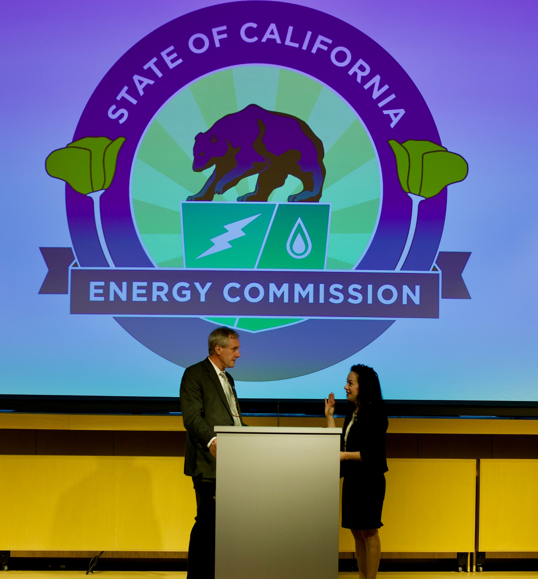
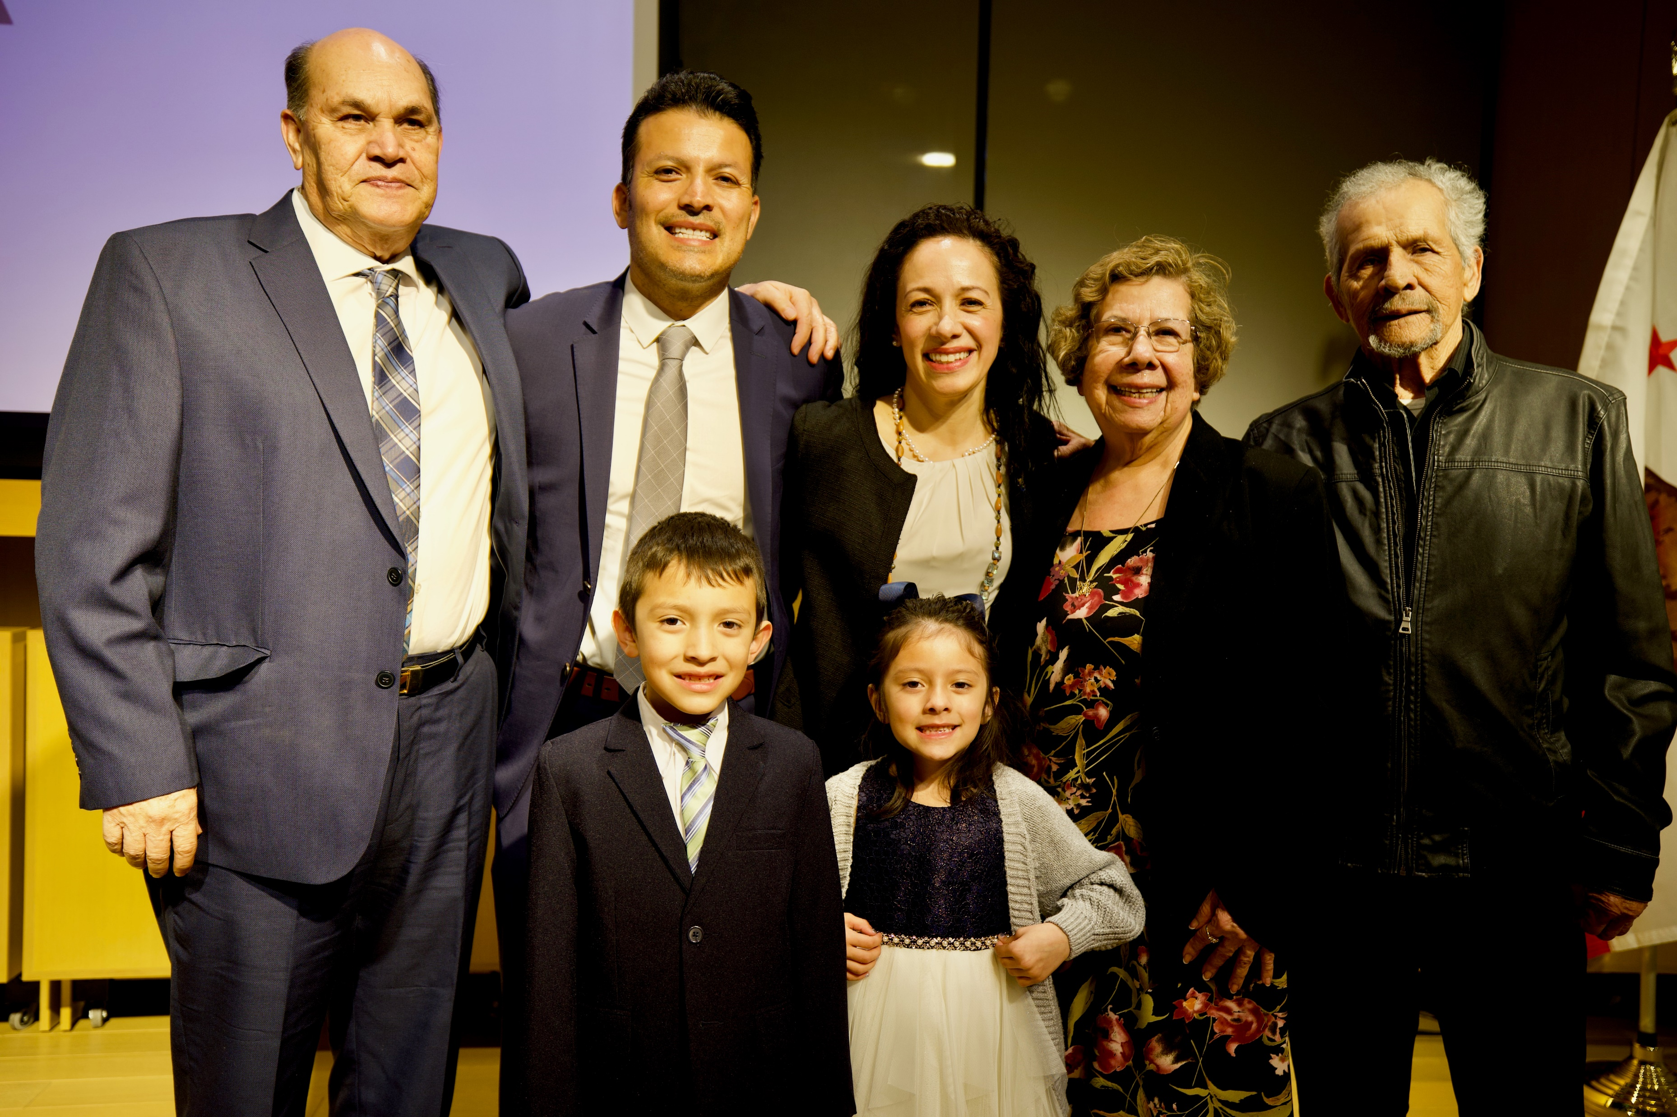
Reflections

Slide 3
Pathways to Prosperity
Removing Barriers for Clean Energy
STEP
RREDI
Lithium Valley Vision
Relationship Building
Funding Opportunities
Equity
JAEDI & PAO+
Clean Energy Hall of Fame Awards

Slide 4

Clean Energy Hall of Fame Awards
12/7/2023

Slide 5
JAEDI Communities of Practice
Language Access
Patricia Carlos
Commissioner McAllister?
Larry Rillera
Vice Chair Gunda?
Supplier Diversity
Pierre Washington
Commissioner Gallardo
Workforce Development
Outreach & Engagement
Rachel Salazar
Chair Hochschild?
Taylor Marvin
Commissioner Monahan?
Benefits Development

Slide 6
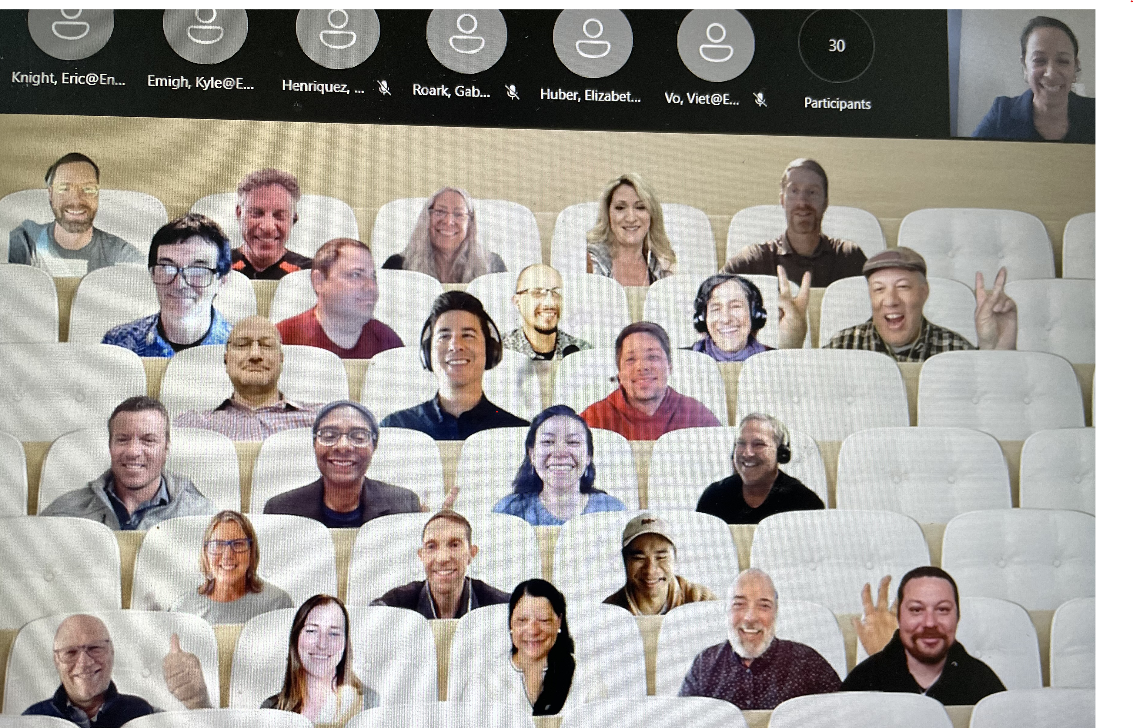
Siting and Renewable Infrastructure

Slide 7
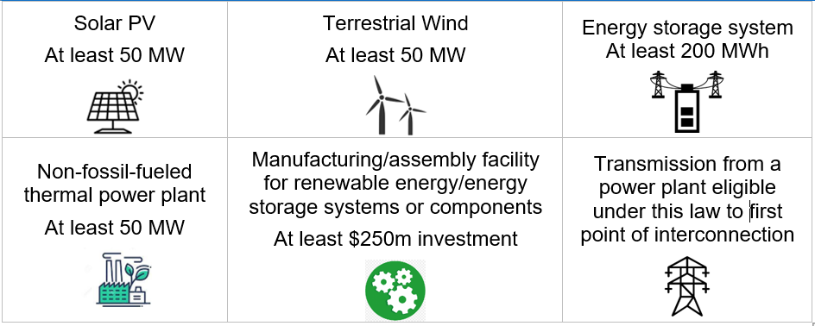
AB 205: Permitting for Clean Energy Projects

Slide 8
Process and Milestones
30 Days
Notice of Preparation (Day 3)
Initiate Tribal Consultation (Day 5)
150 Days
Draft EIR and Notice of Availability Published (Day 150)
270 Days
Final EIR (By Day 240)
CEC Business Meeting Decision (By Day 270)
Info/Scoping Meeting (Day 30)
Draft EIR Public Comment (60 Days from published date)
Discovery Request Due (30 Day Turnaround)
Draft EIR Workshop (20 – 40 Days from published date)
Partner Agencies Applicable Permit Issuance (By Day 360)

Slide 9
Outreach and Engagement
Tribal Consultation
Project Area Advertising
Public Workshop for Draft EIR
Public Info & Scoping Meeting

Slide 10
Findings to Approve Projects
Paying Prevailing Wage to Skilled and Trained Workforce
Signed Community Benefits Agreement
Complies with Applicable Laws, Ordinances, Regulations, Standards or Required for Public Convenience or Necessity
Overall Net Positive Economic Benefit to Local Government
CEQA for Project that Would Have Significant Effect on Environment

Slide 11
Economic and Community Benefits
WHO? Local government and coalition of 1 or more CBOs
  workforce development and training organizations
  labor unions
  social justice advocates
  local governmental entities
  California Native American Tribes
  other orgs that represent community interests
WHAT? economic benefits
  employment growth
  housing development
  infrastructure and environmental improvements
  assistance to public schools and education
  assistance to public safety agencies and departments
  property taxes and sales and use tax revenues

Slide 12

Ideas
DACAG experts
Workshop
Research

Slide 13
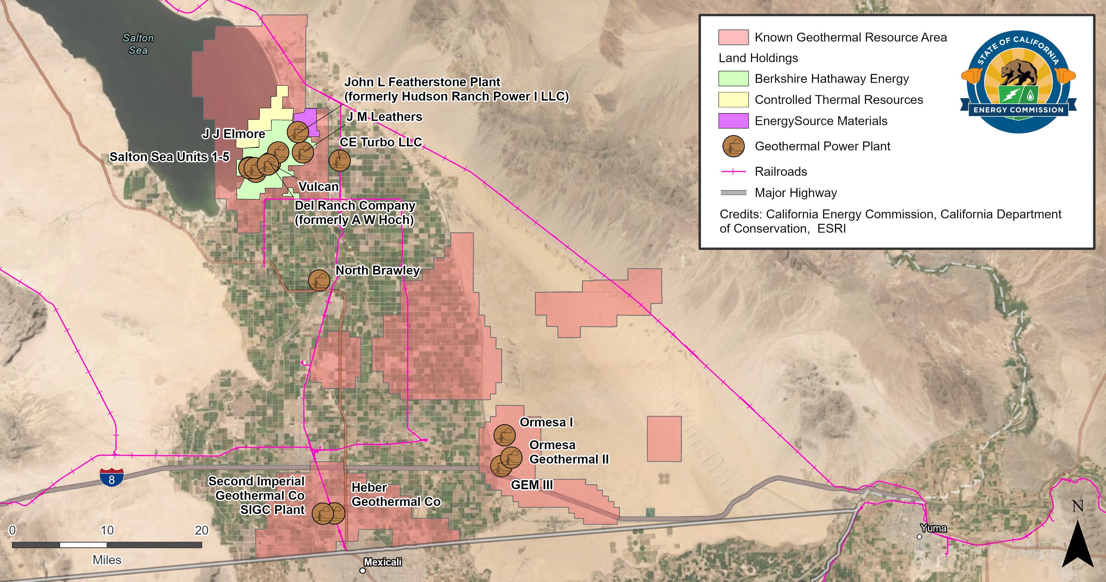
Lithium
Valley
Vision

Slide 14
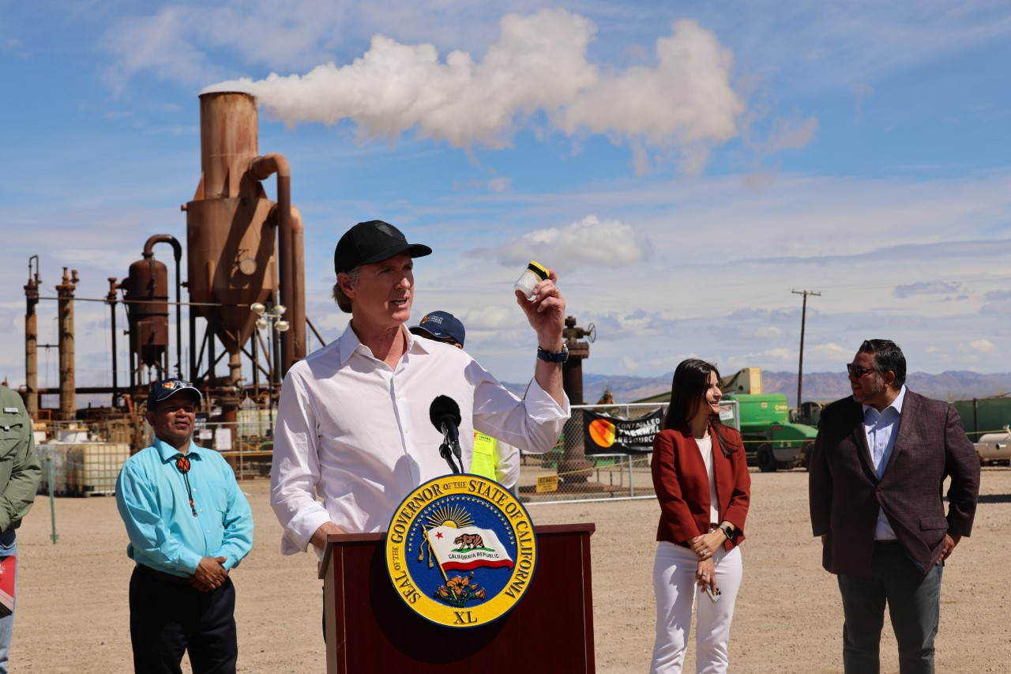
Milestones
Dec 2022 Submitted Lithium Valley Commission Report to the Legislature
Jan 2023 PBS
March 2023 Governor’s visit
April 2023 DOE visit
May 2023 60 Minutes

Slide 15
Focus
Lithium Valley
Funding
Relationships
Planning

Slide 16
Opportunities
  Establish a Lithium Valley priority permitting process that includes additional resources for agency action on applications for geothermal, DLE, and related manufacturing, production, or assembly projects identified by the state as essential to the development and growth of Lithium Valley.
  State should increase funding – and identify alternative funding sources — for research and development, start-up companies, and expansion of lithium battery and battery component manufacturing and recycling, especially cathode production using lithium produced through environmentally preferable methods.
  Federal, state, and local governments should foster collaboration across the supply chain of lithium related technologies by creating networks, meetings, and other forums that regularly bring business, research, Tribes, communities, and government agencies together to identify short- and long-term economic opportunities.
  State and County should establish a business service center in Imperial County to facilitate access to business development incentive programs to benefit residents of disadvantaged communities, Tribal members, small businesses, and entrepreneurs.

Slide 17
Opportunities cntd.
Provide resources for local and state agencies and Tribes to proactively seek and leverage existing federal funding opportunities to invest in infrastructure in the Salton Sea region, including funding made available through IIJA and the IRA.
Provide capacity building funds, such as grants, and other resources (e.g., childcare for parents to attend meetings) for Tribes and community members to engage with federal, state, and local permitting agencies.
Establish standards for state and local permitting agencies to provide communities and Tribes with plain language written communications about geothermal power plant and DLE facility applications, the permitting processes to review the applications, and post-approval monitoring and enforcement. Information provided should also include education about the materials and processes used in DLE and lithium processing facilities, the final and intermediate products created, and any waste streams that must be managed.
Develop best practice guidance for CEQA lead agencies when initiating communications and consultation with Tribes providing reasonable time for Tribal governments to evaluate written materials; and recognizing the specific cultural, historical, public health, and ecological context of the Salton Sea region.

