Slide 1
Recruitment & Outreach
May 12, 2023

Slide 2
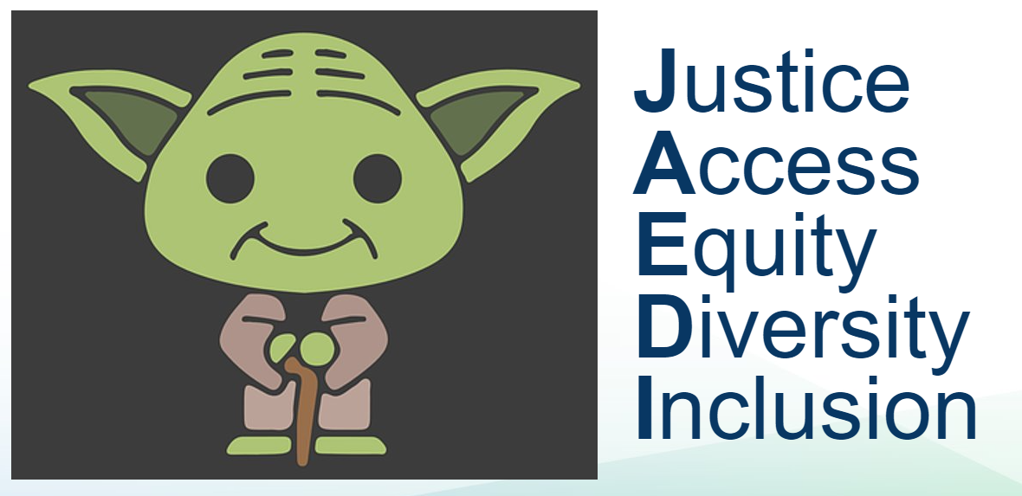
CEC Value Proposition
Meaningful, impactful, fascinating work
Telework-friendly environment
JAEDI in all we do
Collegial environment
State benefits; CEC benefits (e.g. mentoring, training)

Slide 3
Recruitment & Outreach Unit
​
Jessica Gee, Recruitment and Outreach Specialist
Samantha Villegas, Recruitment and Outreach Manager
Bjorn Shepard, Recruitment and Outreach Analyst
Bradley Cornelius, Recruitment and Outreach Analyst
You: Recruitment is everybody’s job; we have 700 recruiters
​ ​

Slide 4
Recruitment Tools
Engage with a qualified and diverse talent pool
Perform direct outreach and counseling
Simplify a complicated process
Utilize 21st century tools
Social media (e.g. LinkedIn, Facebook, Instagram)
Hiring platforms (e.g. Monster, Indeed, Zip Recruiter)
Leadership engagement
Career fairs
Engage CEC staff (affinity groups)
Partner with energy-based institutions (e.g. universities, trade groups)
Place targeted ads
Notes:
Additional insights for Drew
-Tools include: Social media (LinkedIn, Facebook, Instagram), hiring platforms (Zip recruiter, Indeed, Monster), targeted ads, leadership engagement, direct outreach and counseling, career fairs,

Slide 5
LinkedIn Groups – Diversity, Equity, and Inclusion
The CEC team has connected with more than 106 groups, including:
Notes:
LinkedIn Connections
Additional insights for Drew
-Our recruiters are each connected to various private groups that house professionals that chose to connect with that particular group. During the recruiting phase we advertise our positions to these groups.
-We have made a significant effort to join as many diverse and affiliated groups as an effort to support Diversity, Equity & Inclusion. We continue to build those connections as they are discovered.
-Within these groups the recruitment team is able to “headhunt,” within that group (identify and approach (a suitable person employed elsewhere) to fill a business position.)

Slide 6
Recent Social Media Results
Since October 2022:
1,300 matches
160 applicants
14 positions filled
Notes:
Have not been able to track candidates who see our outreach (social media posts, email blasts, newsletters, etc.) but do not seek R&O assistance.

Slide 7
Thank You

