Slide 1
Energy Data and Capabilities
Jason Harville, Director
Enterprise Data and Analytics

Slide 2
Agenda
Update on current status
Near term efforts and new capabilities
Security and privacy

Slide 3
Status Update
Data Visualizations
5 new
5 in review
Data Submission Portal
5 apps in development
Interval Meter Data
5/6 utilities up to date
Many in development
5 years of data
SB-2 support

Slide 4
Staffing Up
Significantly increasing workload capacity
New data engineering unit in ITSB
Project management and data visualization positions
Contractor support
Filling 6 positions total, with potentially 2 more in support of SB-2

Slide 5
Data Warehouse v2.0
Data Warehouse Redesign
New tooling and contractor support
Performance optimizations → cost savings
Our first data mart
Complete by end of Summer
Widespread staff access across multiple datasets

Slide 6
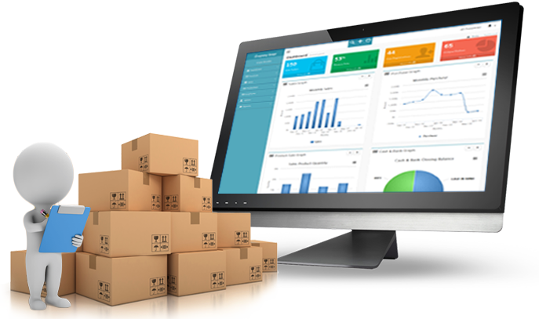
Data Catalog
Commission-wide inventory of data assets
All of our most important data
Foundation for prioritizing new data pipelines
Targeting end of year for completion
The resulting catalog will enable
Precise data lineage
Quick identification of data quality issues
Searchable interface for staff to find and understand our data

Slide 7
Security and Privacy
Physical security met via certified cloud partners and best practices for access and permissions.
Privacy concerns require collaboration
Data sharing and privacy workshop last January
Contractor developing framework for privacy and data access standards
A foundation to build on with external experts and public input

Slide 8
Summary
5 years of interval meter data
Scaling up data onboarding
Improving capabilities to work with and access data
Intergovernmental data sharing at scale
Rapidly building interactive visualizations for the public
Exploring partnership with CPUC for visualizing statewide energy and demographic data
Building out data and dashboards to support reliability
Mandates for hourly demand forecasting and hourly analysis of energy efficiency measures
Developing standards to protect privacy while getting data where it is needed

