Slide 1
Global Trends in Clean Power
BNEF presentation for California Energy Commission
Helen Kou
Senior Associate at BloombergNEF
Notes:
Hello my name is Helen Kou and I am a senior associate at BloombergNEF – Today I will be providing an overview of global trends in clean power

Slide 2
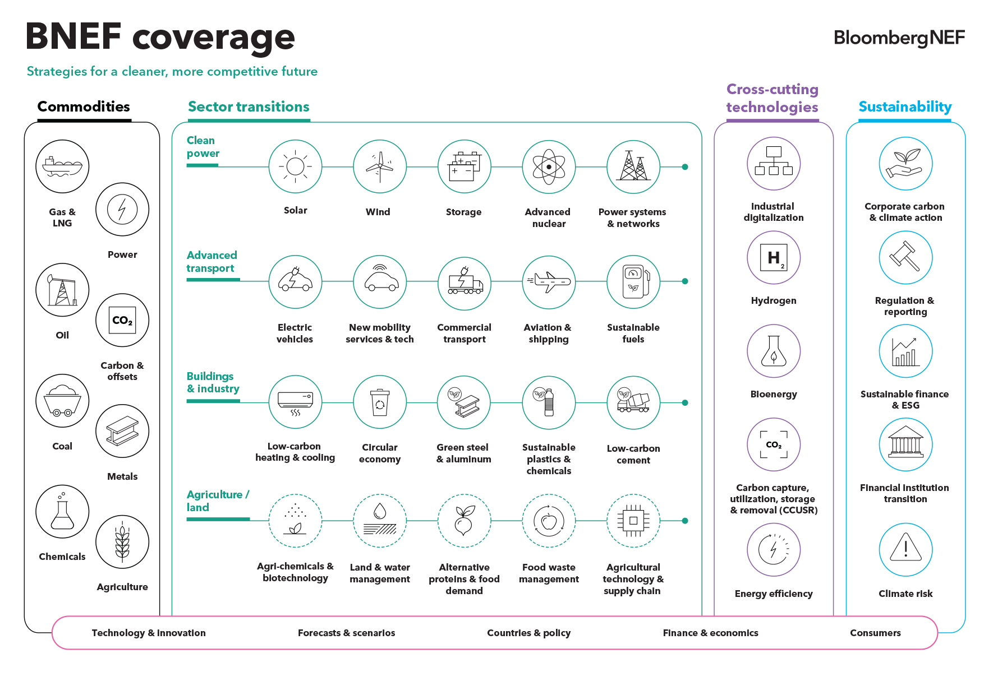
Notes:
Now before I begin, I want to give a quick introduction about BNEF. BloombergNEF is a market insight and research division of Bloomberg lp.
We cover global commodity markets and the technologies driving the low-carbon economy transition.
Our analysis looks at pathways for the various sectors to adapt to the energy transition.
And we help commodity trading, corporate strategy, finance and policy professionals navigate this change.

Slide 3
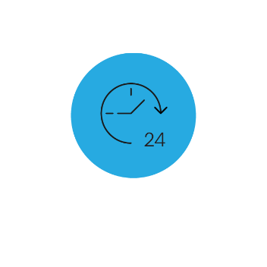









Buffeted by competing forces, where does the momentum lie?
Source: Clipart-Library
Notes:
With many competing forces pushing storage deployments forwards or pulling demand back. But in this massive game of tug of war. companies have an opportunity drive growth and disruption.
rising costs and policy uncertainty as well as geopolitics

Slide 4
Climate ambition has reached a high point
The past five years

Slide 5



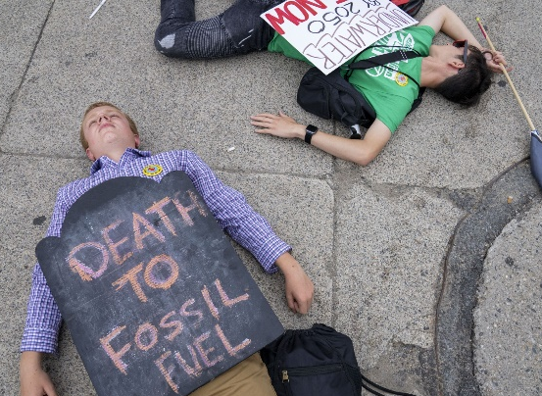

Source: Intergovernmental Panel on Climate Change, Bloomberg Mercury
Notes:
The past few years felt like a period of unending increases in ambition for decarbonization
You can basically draw a line from the release of the IPCC’s report on 1.5 degrees warming in 2018
To the first-ever net-zero targets for the UK and EU in 2019
And in alignment to changing demographics and political sentiments increased government ambitions around the world.

Slide 6
Over 90% of global emissions are covered by government net-zero targets
Climate ambition has reached a high point
Share of global emissions covered by regional, national and state-level net-zero targets
January 2021
Today*
Source: BloombergNEF. Note: *As of January 2023. Includes EU emission targets
Notes:
These two pie charts shows the share of global emissions covered by some regional, national, or state level net zero target.
At the start of 2021 55% , of global emissions were covered by a net-zero target in force or under discussion. As of January 2023, that number’s grown to 91%
Note includes EU

Slide 7
Energy transition investment surged past $1 trillion in 2022
Climate ambition has reached a high point
Energy transition and fossil fuel investment from 2018-2022
Source: BloombergNEF, IEA. Note: Fossil fuel investment values were derived from the IEA World Energy Investment 2022 report. 2022 fossil fuel investments are BNEF estimates, and include upstream, midstream, downstream sectors and unabated fossil power generation.
Notes:
On the back of this growing global commitment, investment in the energy transition has kept reaching new record highs.
Investment in the energy transition has shot up since 2018. Last year, BNEF tracked $1.1 trillion of dollars invested– the first time we’ve exceeded $1 trillion as a global community.
31% YoY rise

Slide 8
Energy transition investment on par with fossil fuels
Climate ambition has reached a high point
Energy transition and fossil fuel investment from 2018-2022
Source: BloombergNEF, IEA. Note: Fossil fuel investment values were derived from the IEA World Energy Investment 2022 report. 2022 fossil fuel investments are BNEF estimates, and include upstream, midstream, downstream sectors and unabated fossil power generation.
Notes:
But lets compare this to fossil fuel spending-=
Glass half full = For the first time, energy transition investment has caught up with fossil fuels investment in 2022
Glass half empty = there is still a long way to go – and there is a disconnect between what our climate ambition show versus the actual energy investments across the global economy.
But we are making strides –
2018-2021 is IEA data converted into $ nominal using CPI
2022 is IEA estimate + BI company filings for oil and gas firms, used high range of what came from that exercise (eg, min/max increase in company spend that we’ve seen in terms of yearly jumps over past four years)
Coal, oil, gas midstream, upstream and downstream as well as power generation from gas and coal. (doesn’t include boilers, ICE vehicles)
Light green bar = driven by demand

Slide 9
Climate ambition has reached a high point
Global investment in energy transition by sector
Source: BloombergNEF. Note: Start-years differ by sector but all sectors are present from 2019 onwards; see Appendix for more detail. Nuclear figures start in 2015.
Notes:
Dig in to those energy transition investment numbers

Slide 10
Clean power investment remains strong
Climate ambition has reached a high point
Global investment in energy transition by sector
Source: BloombergNEF. Note: Start-years differ by sector but all sectors are present from 2019 onwards; see Appendix for more detail. Nuclear figures start in 2015.
Notes:
Clean power investments remains strong – reaching more than 500 billion in 2022

Slide 11
Electrification is driving the acceleration
Climate ambition has reached a high point
Global investment in energy transition by sector
Source: BloombergNEF. Note: Start-years differ by sector but all sectors are present from 2019 onwards; see Appendix for more detail. Nuclear figures start in 2015.
Notes:
But actually, electrification is driving the acceleration

Slide 12
Electrification is driving the acceleration
Climate ambition has reached a high point
Electrified transport spending by category
Global investment in heat pumps by region
Source: BloombergNEF. Note: * Electrified transport investment includes spending on vehicles and charging infrastructure. 2022 investment numbers are based on preliminary EV sales data. Totals include estimated vehicle prices. We do not capture private charging investment for commercial vehicles.
Source: BloombergNEF, European Heat Pump Association, US Air-Conditioning, Heating and Refrigeration Institute (AHRI), Heating, Refrigeration and Air Conditioning Institute of Canada (HRAI), Qianzhan Industry Research Institute, Japan Refrigeration and Air Conditioning Association (JRAIA), consumer websites. Note: Investment calculated as sales multiplied by the average cost for equipment and installation for a typical single-family home. Currency conversion based on average exchange rate over the course of a year.
Notes:
This is especially from electric vehicles but also from heat pumps, which are growing steadily across the Americas,

Slide 13
Less-mature technologies are starting to scale
Climate ambition has reached a high point
Global investment in energy transition by sector
Source: BloombergNEF. Note: Start-years differ by sector but all sectors are present from 2019 onwards; see Appendix for more detail. Nuclear figures start in 2015.
Notes:
Less-mature technologies are starting to scale
- Although these are small slivers of in the bar chat today

Slide 14
Less-mature technologies are starting to scale
Climate ambition has reached a high point
Hydrogen investment by category
Carbon capture and storage investment by sector
Source: BloombergNEF
Source: BloombergNEF. Note: includes corporate R&D to develop first phases of specific CCS projects, government R&D, venture capital funding for direct air capture plants and point source technologies.
Notes:
They are are an essential part of a low-carbon pathway
Hgydrogen
CCS
So I’ve shown a lot of slides that show bar chats moving upwards….the point is to say data shows that there is a significant amount of momentum in the industry..

Slide 15
A net-zero future is still within reach
Electrification, clean power and new technologies are key
Notes:
Every year we conduct the new energy outlook, our view on how the energy system will evolve through 2050.

Slide 16
Net Zero Scenario: A sector-led approach to carbon budgets based on known technology solutions
A net-zero future is still within reach
Cost-competitive pathway
Source: BloombergNEF. Note: Charts rebased to 2022 = 100.
Notes:
We take a sectors-led approach and divide sectors into three groups
First group is cost competitive technologies
- Road and power go fastest

Slide 17
Net Zero Scenario: A sector-led approach to carbon budgets based on known technology solutions
A net-zero future is still within reach
Cost-competitive pathway
Known technologies
Source: BloombergNEF. Note: Charts rebased to 2022 = 100.
Notes:
Second group is Known technologies: we probably know what the solutions are, but they are hard to implement
- buildings, rail

Slide 18
Net Zero Scenario: A sector-led approach to carbon budgets based on known technology solutions
A net-zero future is still within reach
Cost-competitive pathway
Known technologies
Hard-to-abate
Source: BloombergNEF. Note: Charts rebased to 2022 = 100.
Notes:
Third Is hard to abate,
Notable that some emissions are still fast-rising in the NZS, for example aviation following recovery from Covid-19
This year we have done a deeper dive into the options for steel and aluminum

Slide 19
Clean power, electrification, new technologies are key for net zero
A net-zero future is still within reach
CO2 emissions reductions-Net Zero Scenario (NZS) versus a No Transition scenario (ETS)
4x Rise in carbon capture and storage, 2050 vs 2030
5x Rise in final hydrogen consumption, 2050 vs 2022
7x Rise in primary clean power production, 2050 vs 2022
Source: BloombergNEF New Energy Outlook 2022 Net-Zero Scenario.
Notes:
This chart summarizes our analysis nicely - The top black dotted line is our emission forecast under a no transition scenario by 2050- that is roughly 50GTCO2 per year. And the area chart shows the sources of abatement in our net zero path.
We see an important role for those new technologies we just discussed, like CCS and hydrogen, which grow 4x and 5x respectively.
Clean power and electrification are key – with clean power production rising 7x from 2022 levels
Note: net zero pathway that is constrained by a carbon budget that aligns with around 1.77 degrees of warming.

Slide 20
How we make things and consume energy will have to change…
A net-zero future is still within reach
Final energy mix by sector under the Net Zero Scenario
Industry
Transport
Buildings
Source: BloombergNEF.
Notes:
The way these solutions plays out varies by sector. In these three charts we are looking at energy demand based on energy source.
Transport energy demand changes markedly thanks to widespread electrification. Moving away from combustion to electrification makes transport much more efficient, as there is much less final energy required to do the same work of moving a vehicle. As that electricity supply is decarbonized, too, there is minimal loss from initial to final energy. The result is that by mid-century, oil consumption in transport effectively vanishes - while at the same time, total final energy consumption drops almost half.
The Building sector energy demand continues growing through the mid-2030s, but rapid electrification is also needed.
Hydrogen emerges as a carrier for the sector in the 2030s, but it does not play a major role in building sector final energy.

Slide 21
How we make things and consume energy will have to change…
A net-zero future is still within reach
Final energy mix by sector under the Net Zero Scenario
Industry
Source: BloombergNEF.
Notes:
Industry energy consumption continues to rise through mid-century in the NZS. However, the energy mix changes significantly. We know this is also where hydrogen makes the biggest impact in absolute terms, as input in industrial processes..
But fundamentally we will need more clean electricity, less coal and gas.

Slide 22
How we make things and consume energy will have to change…
A net-zero future is still within reach
Final energy mix by sector under the Net Zero Scenario
Industry
Transport
Source: BloombergNEF.
Notes:
Transport energy demand changes significantly due to widespread electrification. Moving away from combustion to electric vehicles makes transport much more efficient as well.
There is much less final energy required to do the same work of moving a vehicle. As that electricity supply is decarbonized, too, there is minimal loss from initial to final energy. The result is that by mid-century, oil consumption in transport effectively vanishes - while at the same time, total final energy consumption drops almost half.

Slide 23
How we make things and consume energy will have to change…
A net-zero future is still within reach
Final energy mix by sector under the Net Zero Scenario
Industry
Transport
Buildings
Source: BloombergNEF.
Notes:
The Building sector energy demand continues growing through the mid-2030s, but rapid electrification is also needed.
What should be abundantly clear is electrification is key to a decarbonized world

Slide 24
Electrification will triple the size of the power system in the Net Zero Scenario
A net-zero future is still within reach
Electricity demand:
Economic Transition Scenario
Net Zero Scenario
Source: BloombergNEF. Note: Electricity demand net of generation losses.
Source: BloombergNEF. Note: Electricity demand net of generation losses.
Notes:
And with electrification the power system must grow.
These two charts show electricity demand under two scenarios: the economic scenario and the net zero scenario:
The Energy Transition Scenario requires about 40,000TWh of power generation in 2050, 60% more than today. The fastest growing demand comes from electrified transport, growing from about 1% in 2022 to 15% in 2050.
The Net Zero Scenario, however, requires more than 80,000 terawatt-hours of generation, more than triple today’s amount. A significant portion of this additional energy is needed to produce hydrogen, about the same amount of power we use in the energy system today across all demand sources.

Slide 25
…and the move to clean power will be supercharged
A net-zero future is still within reach
Fossil fuel generation under the NZS
Low-carbon generation under the NZS
Source: BloombergNEF New Energy Outlook 2022 Net Zero Scenario
Source: BloombergNEF New Energy Outlook 2022 Net Zero Scenario
Notes:
As power demand grows, the power mix will also change – supercharging renewables.
In the Net Zero Scenario, wind and solar power are more than three-quarters of total power generation.
While wind and solar dominate growth, meanwhile nuclear power also expands its role beginning in the 2030s.
We will also se a shift low-carbon firm capacity (storage, hydrogen and nuclear) will roughly be equivalent in size to existing fossil fuels by 2050, but running at very a low capacity factor – often sub-10% after the 2040s
This requires a rethink of the role of firm capacity in the power system.
Ok so we know from a global perspective – clean power is undeniably essential. So this is where we need to get to, and much of the change needs to start this decade.
Note: What we are seeing is an asset swap
Total firm capacity Unabated coal approaches zero by mid-century, and unabated gas capacity remains stable but does not grow.
All growth in firm capacity comes from abated fossil generation, or from hydrogen and nuclear which have no net emissions.
That increase in capacity is essential to provide a stable and reliable power system with a high penetration of variable renewable energy – but these generators will operate at low load factors.
In the Net Zero Scenario, load factors for almost every firm capacity generator type decline dramatically between the mid-2020s and 2050. Coal load factors drop to barely 10%, and gas load factor approaches zero.
For a country like Sweden the change may be less dramatic – you already have a lot of renewables and are highly interconnected. But those interconnections could rise in importance, and curtailment of renewables will increasingly be a feature not a bug of a least-cost system

Slide 26
Scaling up clean power deployment remains a challenging
Will government targets outstrip reality?
Notes:
But - So clearly the path to scaling up renewables in line with net zero won’t be easy. Without change, we risk seeing government targets outstrip reality

Slide 27
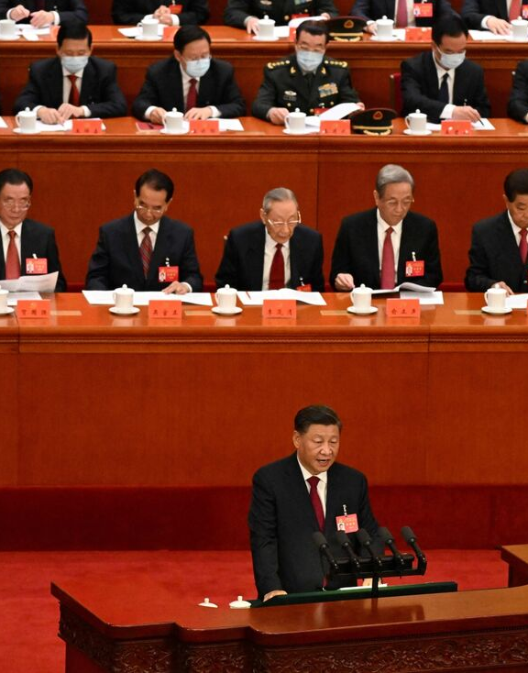


Ambitious targets
Source: Bloomberg Mercury
Notes:
Over the past year, major markets, administrations and governing entities, have announced new or expanded ambitious targets for emissions and clean power- yet at analysts at BNEF find that meeting these goals can be extremely difficult.

Slide 28
Ambitious targets, ambiguous outlook
Scaling up clean power deployment
Wind turbine capacity forecast vs government goals
Source: BloombergNEF. Note: Bars show BloombergNEF forecast. Considers announced country-level installation targets for the latest target date within the horizon of BNEF's forecast. We assume the lower end of Colombia’s (CO) 0.2 to 1GW-by-2030 target in the chart. Vietnam’s offshore wind target has not been finalized and excludes nearshore projects while we include them in our forecast. Norway has an offshore wind target of 30GW by 2040; we forecast that the country will install 4.6GW by 2035.
Notes:
This chart shows set wind capacity targets which are in diamond dots for various targets and in most cases, we do not expect most markets will reach their GW target.

Slide 29
Ambitious targets, ambiguous outlook
Energy storage targets versus expected deployments by target date
Source: BloombergNEF Note: India’s target is estimated, based off our assumptions on expected renewable generation by 2030. Turkey’s deployment is calculated based off its 2035 7.5GW target.
Notes:
The same is true for energy storage….
(Note: China, India, South Korea, Greece, Turkey and New York)
As a short-term bandage, government entities have approved millions in subsidies and schemes. These subsidies boost deployment but highlight the underlying challenge that batteries are not yet economically attractive in most parts of the world.
(Note: India, Japan, Australia, the European Union, Italy and Spain )
Policymakers and regulators must take steps to ensure that
batteries compete fairly with other technologies, rather than relying solely on subsidies, which can
lead to dwindling deployments when phased out

Slide 30



Thee challenges to overcome for greater renewable energy deployment
Scaling up clean power deployment
Supply chains
(eg, vessels)
Rising costs
(eg, equipment, labor rates,
debt, interest rates)
Grids and infrastructure
(eg, interconnection
and capacity)
Source: Wikimedia Commons, BloombergNEF
Notes:
There are several reasons why renewables face multiple challenges to scale up- some key issues
Logistical supply chain constraints can continue to be a concern – especially for offshore wind
Rising costs that impact labor rates, debt and interest rates
But there is also increased challenges around gaining a grid interconnection, phasing out existing coal or getting new projects permitted and through environmental approvals

Slide 31
Thee challenges to overcome for greater renewable energy deployment
Scaling up clean power deployment
Supply chains
(eg, vessels)
Source: Wikimedia Commons, BloombergNEF

Slide 32

Ports spent much of the pandemic congested
Battery supply chains
Number of ships at the port of Los Angeles
Source: Bloomberg {WCIDSHLA Index}
Notes:
First is logistics: Pandemic-related restrictions and high demand for products caused port congestion throughout the past two years. Like all other goods and services, congestion left batteries stuck at ports, causing project delays.
This chart shows number of ships at the port of Los Angeles, one of the world's largest ports.
You can see from the chart the ebb and flow of port congestion as the U.S. locked down through different pandemic waves… In September 2021 when port congestion was at its worst, there were 84 ships at the port. This caused many delays for storage projects that were supposed to come online in q4 2021.

Slide 33

Port congestion has been easing throughout 2022, removing another bottleneck
Battery supply chains
Number of ships at the port of Los Angeles
Source: Bloomberg {WCIDSHLA Index}
Notes:
Throughout 2022 port congestion has eased and we are slowly returning to pre-pandemic levels of throughput. Yet we know 2021 port congestion constrains are still causing some project delays across 2023.

Slide 34
Thee challenges to overcome for greater renewable energy deployment
Scaling up clean power deployment
Supply chains
(eg, vessels)
Rising costs
(eg, equipment, labor rates,
debt, interest rates)
Source: Wikimedia Commons, BloombergNEF

Slide 35
Rising material spot prices raised clean energy equipment costs
Supply chain drama will soon be over
Source: BloombergNEF, Bloomberg Terminal. Note: Data rebased to 1 on earliest available date in January 2020. Shanghai-LA freight rates used, steel reflects North America costs, while aluminum and copper are China prices – more details as well as Bloomberg Terminal tickers available in the Excel attached to the report. Run {97<GO>} on Terminal or click here to access the Excel.
Notes:
It’s not just energy prices that were up. Across the world, commodity prices for the input materials to the energy transition – everything from steel to copper to lithium to polysilicon – have gone up in price
And this has translated to higher equipment costs for solar, wind and batteries. The impact of this is likely to be felt for a while even as prices come down – especially for wind and battery storage

Slide 36
But it is not just raw materials, labor costs have increased as well
Average hourly earnings of utility production employee
Source: US Bureau of Labor Statistics, BloombergNEF

Slide 37
Onshore wind turbine prices have risen 30% from pre-pandemic levels
Entering a new era for the energy transition
Onshore wind turbine contract prices
Source: BloombergNEF. Note: U.S. turbine supply contracts typically excludes installation and commissioning cost. European and Latin American turbine supply contracts typically include installation and commissioning costs.
Notes:
Our onshore wind turbine price index has risen 30% compared to pre-pandemic levels, and is unlikely to come down immediately as wind turbine manufacturers look to recover their margins

Slide 38
Energy storage system costs rose 27% from 2021-2020
Entering a new era for the energy transition
Historical prices for turnkey energy storage systems of four-hour duration
Source: BloombergNEF. Note: Historical prices have been adjusted using June 2021 to June 2022 inflation rates based on US Consumer Price Index (CPI).
Notes:
And we tracked a first-ever rise in the costs of energy storage systems during 2022 as well, with prices from our December report up 27% from a year ago.
With many of today’s contracts supporting projects later this decade, especially for wind or for US storage, the higher prices will be felt for a while.

Slide 39
LCOEs are rising for the first time in history, driven by supply chains, inflation and pricier debt
Entering a new era for the energy transition
Change in global LCOEs, 2H 2021 through 1H 2022
Impact of China on offshore wind LCOE benchmark
Source: BloombergNEF. Note: The global benchmarks are country-weighted levelized cost of electricity (LCOE) averages using the latest annual capacity additions. Offshore wind includes offshore transmission costs. LCOEs do not include subsidies or tax credits.
Notes:
LCOEs rose for first time in history due to those supply chain constraints, as well as pressures from inflation and higher costs of debt
It may look like wind bucks the trend, but that’s due to specific dynamics in China (see chart on left)
Ultimately, gas and coal also rose – and more so than renewables
Solar or onshore wind are the cheapest source of electricity in countries representing 96% of global electricity generation

Slide 40
Thee challenges to overcome for greater renewable energy deployment
Scaling up clean power deployment
Supply chains
(eg, vessels)
Rising costs
(eg, equipment, labor rates,
debt, interest rates)
Grids and infrastructure
(eg, interconnection
and capacity)
Source: Wikimedia Commons, BloombergNEF

Slide 41
Renewable deployment is stifled by grid connection queues
Scaling up clean power deployment
Grid connections queues for wind and solar in select countries
Europe
US
Source: BloombergNEF, Lawrence Berkeley National Lab, National Grid, Electricity Northwest, Northern Powergrid, SSE Networks, Scottish Power Energy Networks, UK Power Networks, Terna, Red Electrica, French Ministry of Ecological Transition. Note: UK data is as of December 2022, Spain as of August 2022, Italy as of end-2021, France as of October 2022 and the US as of end-2021. Battery hybrid projects are included. Wind includes both onshore and offshore sites.
Notes:
There are huge pipelines of projects around the world waiting in grid interconnection queues, In fact, our analysis estimates that renewable capacity equivalent to 85% of Europe’s 2030 renewable energy target is currently stuck in the grid interconnection queue of just five countries: UK, France, Italy, Germany and Spain.
and more as well being help up by permitting and not-in-my-backyard-ism. Permitting and interconnection timelines can now take up to 8 years in Europe, and our estimates are that it takes around 6 years to get environmental permits in Sweden – making this country one of the worst offenders for permits at least.

Slide 42
The grid becomes more decentralized, needs $21 trillion of investments
A net-zero future is still within reach
Distribution of generation mix by plant size in 2030, Europe, NZS
Cumulative global grid investment, NZS
Source: BloombergNEF. Note: gas includes some hydrogen.
Source: BloombergNEF.
Notes:
Another crucial building block of a successful transition to net-zero is the electricity grid.
Transitioning to cleaner electricity generation dominated by renewables means that power grids worldwide become much more decentralized, and that the distribution grid plays a much more important role than transmission in the future.
By 2050, the median power plant size across the world drops from almost a gigwatt today to just 150MW in the NZS. This is over six times smaller than today. This is driven by the decommissioning of large coal, gas and nuclear plants and the adoption of wind and PV.
You can see this on the left-hand chart, which shows the distribution of the generation mix by plant size in 2030 in Europe under the NZS. On the left in bright yellow, you see small-scale, behind-the-meter PV installed by households and businesses. These systems thend to relatively small. The majority of generation is supplied by wind and solar plants with an average size of between 10MW and 100MW. They tend to be connected to the distribution grid at lower voltages. Large-scale gas and nuclear plants with a capacity of 1GW or more play a small role.
Over the next 28 years, a cumulative $21.$ trillion need to be invested in the power grid to be able to connect generating sources and storage to consumers. This is around 60% higher compared to what is spent under our Economic Transition Scenario. The majority of investments go into the distribution grid to connect renewables and new consumers. Greater reliance and flows on the distribution grid also mean that we need to ensure greater redundancy, enabling bi-directional flow, and enhancing remote monitoring.

Slide 43
At least $21.4 trillion needs to be invested in electricity grids by 2050
A full system transformation
Breakdown of global grid investment in net zero scenario 2022-2050
Source: BloombergNEF
Notes:
At least $21.4 trillion needs to be invested in electricity grids by 2050
Breakdown of global grid investment in net zero scenario 2022-2050
Driver: New connection
Voltage: The majority of investments go into the distribution grid to connect renewables and new consumers. Greater reliance and flows on the distribution grid also mean that we need to ensure greater redundancy, enabling bi-directional flow, and enhancing remote monitoring.
Digital: Digitalization, which helps improve and extend the utilization of the grid infrastructure, represents 24%, or $5.1 trillion
Region: the US makes u roughly 20% of the $21.4 trillion needs to be invested in electricity grids by 2050 to support a global net zero trajectory.
New technology around power flow and advanced conductors
Note: This is around 60% higher compared to what is spent under our Economic Transition Scenario

Slide 44
Entering a new era for the energy transition
Countries vie for clean power dominance, system volatility rises
Notes:
So that’s where we need to get to, and much of the change needs to start this decade. But we’re starting this journey at a time when the energy transition is under increased strain from rising costs and countries vying to own their share of the pie.

Slide 45



China dominates clean energy manufacturing capacity
Wind
Nacelle
Separator
Electrolyte
Anode
Lithium-ion batteries
Cathode
Cell
Polysilicon
Wafer and ingot
Solar PV
Cell
Module
Source: BloombergNEF. Note: By factory location. PV, hydrogen and battery components expressed in MW, MWh, m² or tons. Nickel is the class 1 variety, and lithium is in lithium carbonate equivalent. H₂ is hydrogen. Data as of October 2022 except electrolyzers (which refer to 2021) and nacelle data (which are for 2020).
Notes:
This is for several reasons:
-Huge domestic market
-Enabling policies
-Access to skilled labor and cheap electricity
-Years of manufacturing expertise and know-how
-Built out adjacent supply chains

Slide 46
China dominates clean energy manufacturing capacity
Wind
Nacelle
Separator
Electrolyte
Anode
Lithium-ion batteries
Cathode
Cell
Polysilicon
Wafer and ingot
Solar PV
Cell
Module
Source: BloombergNEF. Note: By factory location. PV, hydrogen and battery components expressed in MW, MWh, m² or tons. Nickel is the class 1 variety, and lithium is in lithium carbonate equivalent. H₂ is hydrogen. Data as of October 2022 except electrolyzers (which refer to 2021) and nacelle data (which are for 2020).
Notes:
The US has a larger share of the global supply chain in wind than for other techs, so let’s dive into that

Slide 47
The US is a major wind supply chain hub, alongside China, Europe and India
Source: BloombergNEF. Note: Data as of September 25, 2020. Includes only operational factories.
Notes:
All the little points

Slide 48
US-manufactured components account for most of a wind turbine’s value
Source: BloombergNEF, USITC, LBNL. Note: Includes blade, tower, gearbox, generator, converter, bearing, yaw and pitch, and balance of nacelle.
APAC = Asia Pacific. EMEA = Europe, Middle East and Africa. AMER = Americas.
Notes:
When we take a look at the average wind turbine installed in the US, around 57% of its value is attributed to domestically-made components. Thus, while the US does rely on imports from other countries, it’s able to produce the majority value of a wind turbine at home.

Slide 49
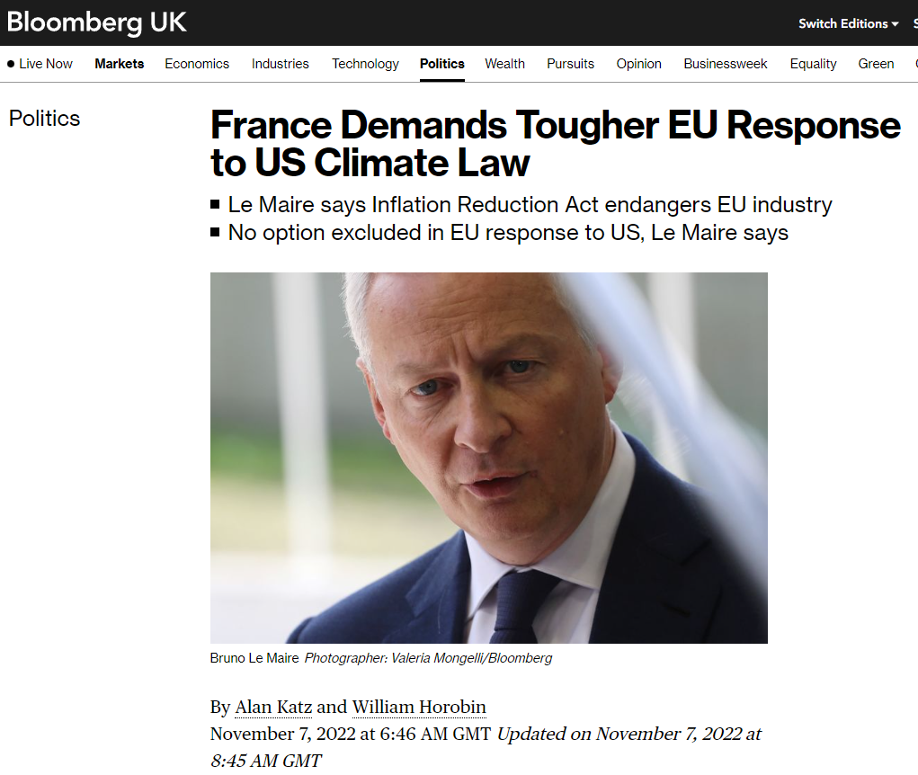
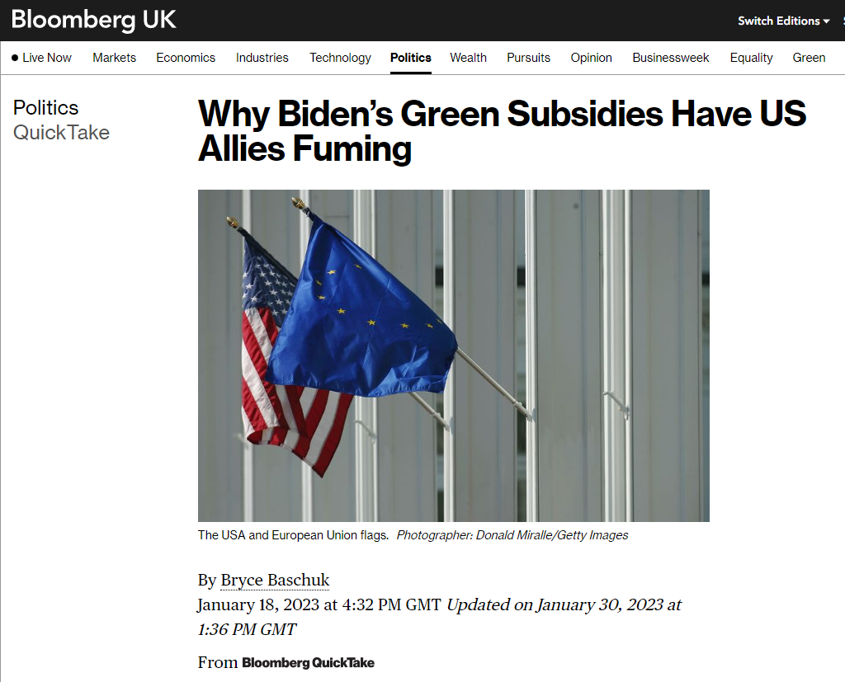
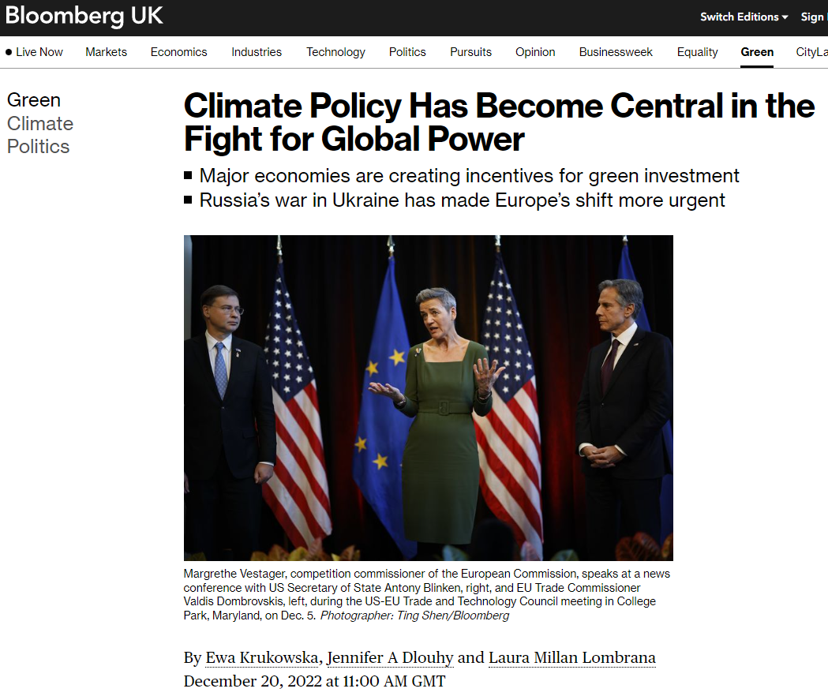
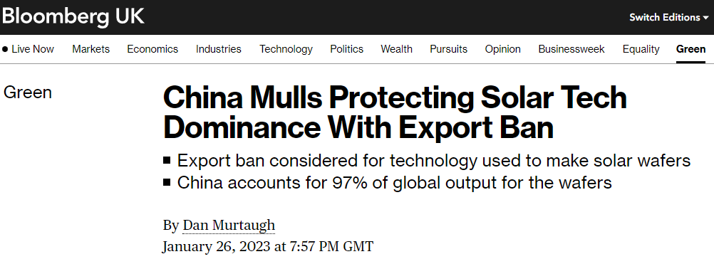
International competition is ratcheting
Entering a new era for the energy transition
Source: Bloomberg LP
Notes:
And in so doing has sparked a trade war, with US, Europe and China especially vying to own their share of the energy transition supply chain
Turkey and India doing similar things with solar

Slide 50

US passes landmark climate legislation
Scaling up clean power deployment
Source: Bloomberg LP
Notes:
And while the US is complicating the geopolitical landscape with the inflation reduction act

Slide 51
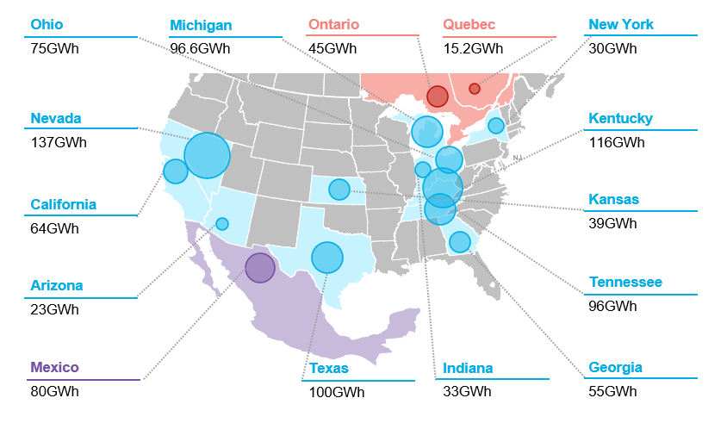
Battery manufacturing capacity are on the rise
Battery manufacturing projects announced since IRA passage
Source: BloombergNEF. Note: Dates for fully commissioned plants correspond to the data when the last phase was commissioned. Bubble size corresponds total capacity commissioned, under construction and announced.

Slide 52
Battery investments and manufacturing capacity are on the rise
North America EV and battery investments planned post-IRA
Global Li-ion cell manufacturing capacity
Source: BloombergNEF, company press releases. Note: Includes investments in the North America region through April 3, 2023. ‘Multiple categories’ investments do not disclose how much is dedicated to each category.
Source: BloombergNEF
Notes:
Around $58 billion in investments for the EV and battery storage market
Li-ion cell manufacturing capacity in the Americas with grow to be 12x larger than what it was at the end of last year

Slide 53
IRA has also driven wind plants to expand and reopen
Source: American Clean Power Association, BloombergNEF. Note: Only includes onshore wind facilities. Nacelle includes assembly and component manufacturing.
Notes:
And although we’re starting at a higher level for wind, the legislation has also driven several wind plants to expand and reopen

Slide 54
IRA has inspired a huge influx of solar module factory announcements
Source: BloombergNEF
Notes:
Striped blue bars represent announced capacity
If all of these companies make true on their announcements, this will increase the US’s solar module manufacturing capacity 7-fold

Slide 55
Shifting to local manufacturing often comes at added cost
Entering a new era for the energy transition
Estimated per unit capex for solar factories, by geography
Source: BloombergNEF, company filings, interviews
Notes:
And this risks adding further to the costs of the transition, because often the costs of manufacturing in these markets is way more expensive. For instance, solar manufacturing today is dominated by China – but manufacturing solar in Europe or the US could increase costs nearly five-fold

Slide 56
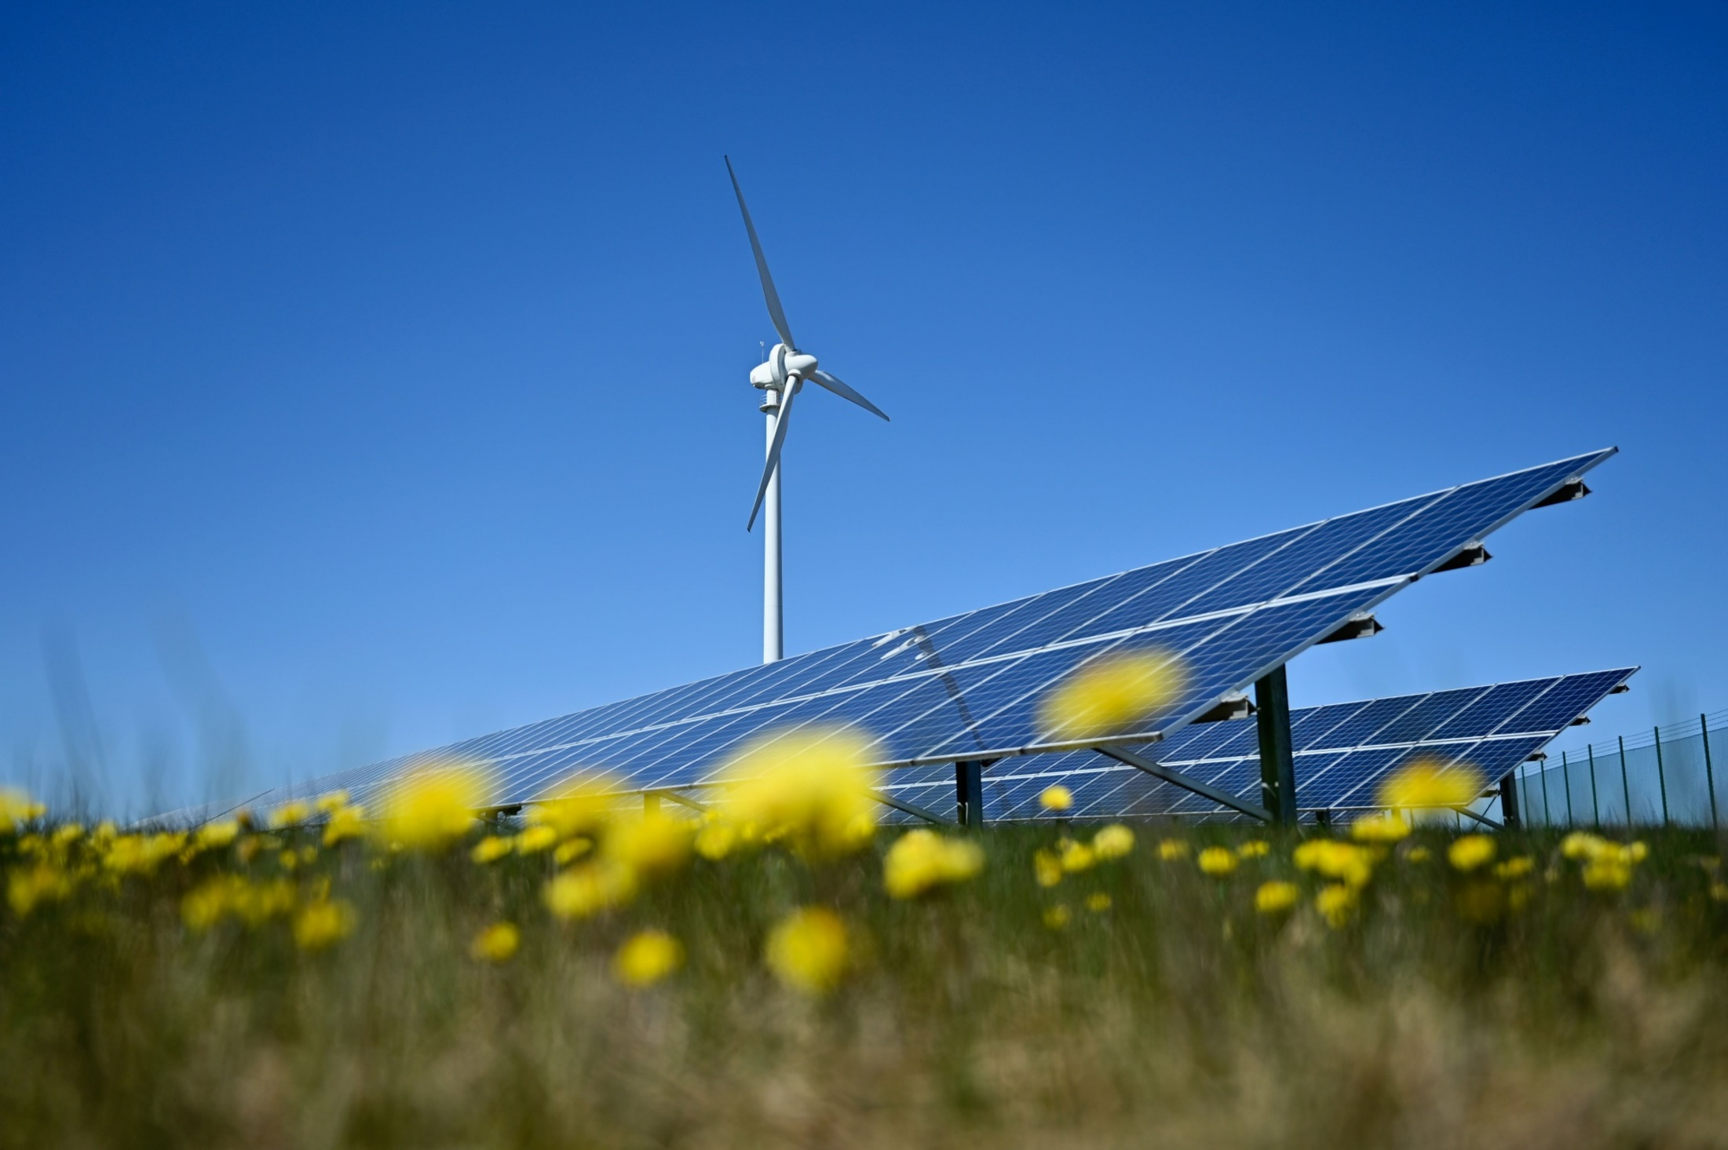
There are many positive signs that clean power will overcome these challenges
Scaling up clean power deployment
Source: Bloomberg LP
Notes:
Now despite this doom and gloom story, there is still a lot of positive signs that renewables will ramp up

Slide 57
IRA drove an increase of over 100GW in our clean energy forecast to 2030
+38GW (36%)
Wind
+63GW (21%)
Solar
+20GW (24%)
Storage
Source: BloombergNEF. Note: ESS = energy storage system.

Slide 58
LCOEs are rising for the first time in history, driven by supply chains, inflation and pricier debt
Scaling up clean power deployment
Change in global LCOEs, 2H 2021 through 1H 2022
Impact of China on offshore wind LCOE benchmark
Source: BloombergNEF. Note: The global benchmarks are country-weighted levelized cost of electricity (LCOE) averages using the latest annual capacity additions. Offshore wind includes offshore transmission costs. LCOEs do not include subsidies or tax credits.
Notes:
I mentioned previously that levelized costs are on the rise – but so are the ones for fossil fuels

Slide 59
Solar or onshore wind is the cheapest source of electricity in countries representing 96% of global electricity generation
Scaling up clean power deployment
Cheapest source of bulk generation, 2H 2022
Source: BloombergNEF.
Notes:
And wind and solar are still the cheapest source of electricity in countries representing 96% of global electricity markets

Slide 60
Clean energy still has the enduring advantage
Scaling up clean power deployment
Global levelized cost of electricity benchmarks
Source: BloombergNEF
Notes:
Plus the cost gap between renewables and fossil fuels has continued to grow, so that cost edge for renewables just keeps on growing

Slide 61
Buffeted by competing forces, where does the momentum lie?
Source: Clipart-Library
Notes:
With many competing forces pushing storage deployments forwards or pulling demand back. But in this massive game of tug of war. companies have an opportunity drive growth and disruption. Today I am going to walk you through these competing forces starting with

Slide 62
Copyright and disclaimer

Slide 63
Helen Kou

