Slide 1
Cal-Adapt: Interagency Vision for an Expanding Enterprise
Looking forward: an expanding enterprise
Organization and leadership
New developments to support electricity sector planning
Localization of downscaled data
Observation platform

Slide 2
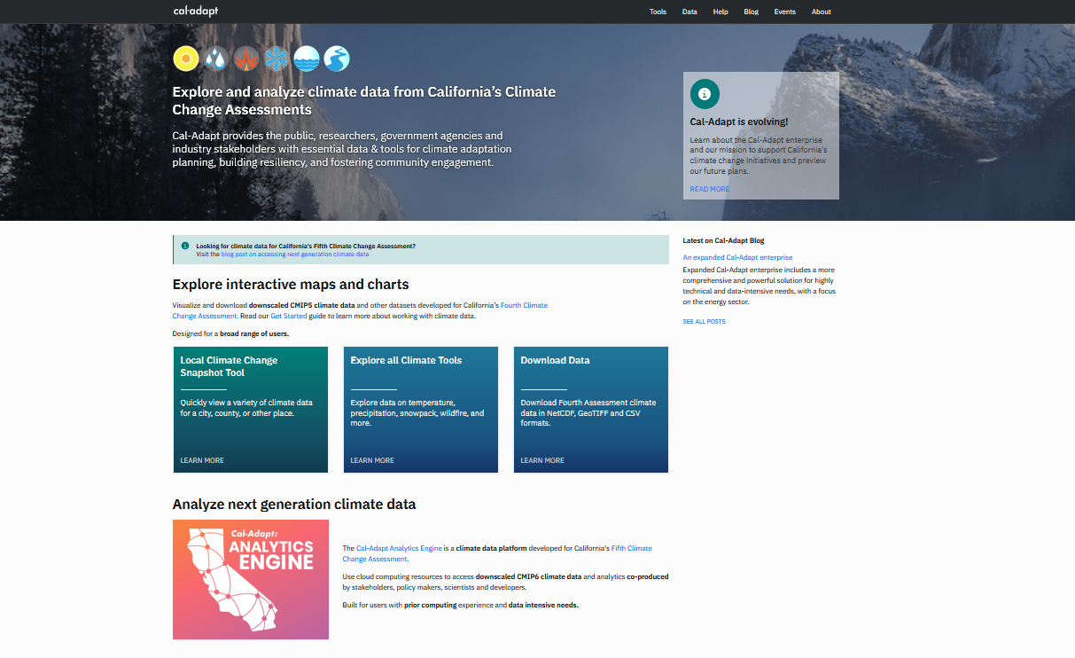
2

Slide 3
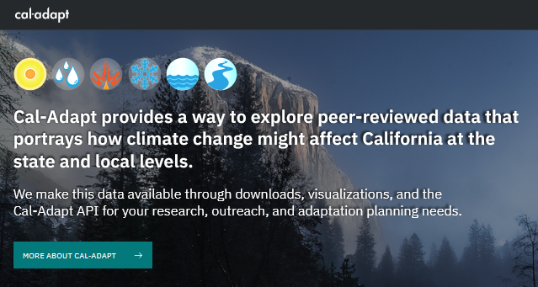
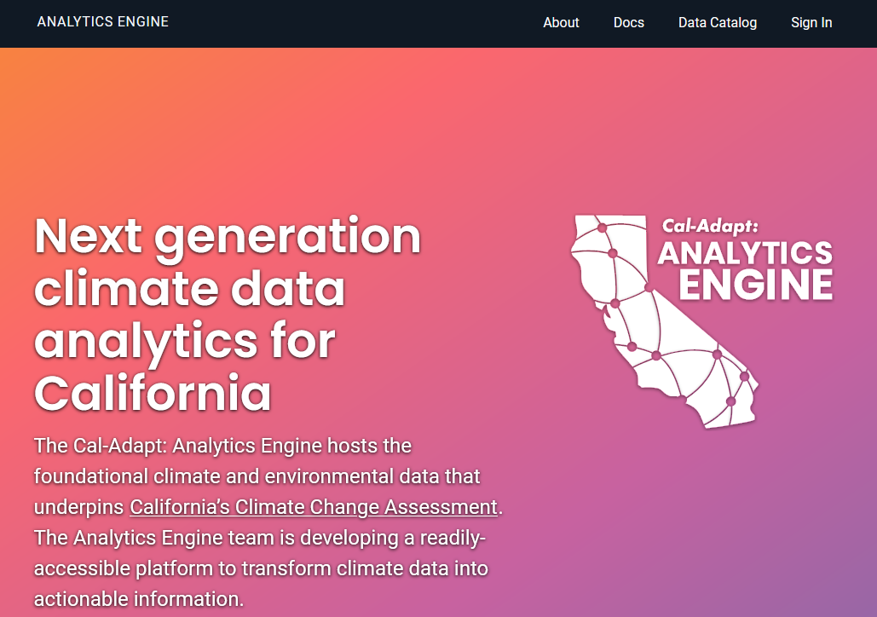
An Expanded Cal-Adapt Enterprise
Analytics engine
~ 1 Pb data
Energy resilience
CEC-funded
Visualizations + web application
Interactive
~ 10 Tb data
CEC, OPR
Observation platform
Quality-controlled historical data
CEC-funded
See TN239954, docketed October 12, 2021: Cal-Adapt governance, responsibilities, data management.

Slide 4
Multiple Grants Support the Expanded Enterprise
Analytics engine
- EPC-20-007, Susan Wilhelm, CEC manager
Visualizations + web application
- EPC-21-038, Mithra Moezzi, CEC manager
- OPR funding forthcoming, Ben McMahan
Observation platform
- PIR-19-006, Mithra Moezzi, CEC manager
See TN239954, docketed October 12, 2021: Cal-Adapt governance, responsibilities, data management.

Slide 5
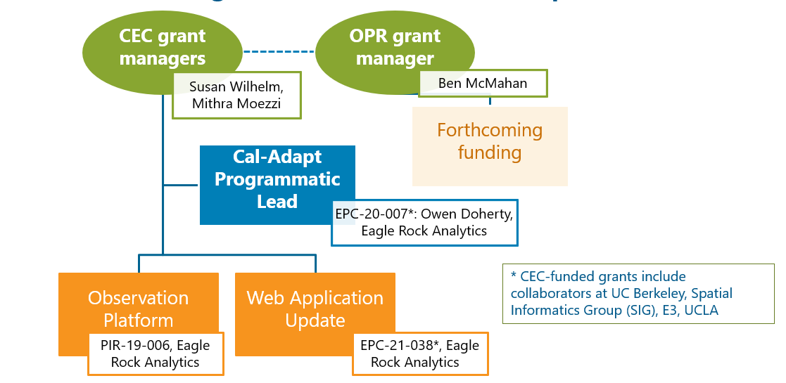
Organization and Leadership
See TN239954, docketed October 12, 2021: Cal-Adapt governance, responsibilities, data management.

Slide 6
Contributors to the Cal-Adapt Enterprise
Cal-Adapt programmatic lead
Execute development of data platform + web application
Science advisor, stakeholder engagement
Data contributors
Ongoing grants (Fifth Assessment projections)
Cal-Adapt continues to manifest the work of a coalition of collaborators.

Slide 7
Cal-Adapt’s expanded enterprise: Roles, responsibilities, and authorities
Publicly docketed memo* released October 2021 indicates:
Cal-Adapt development will be directed by staff at CEC and OPR, who will rely on a combination of internal resources and competitively awarded grant agreements to execute the vision of the State of California and brand Cal-Adapt as a product of the State.
The Cal-Adapt programmatic lead represents Cal-Adapt in the scientific community, makes decisions that support harmonization and alignment across grants, provides guidance and direction to web application development.
Hosting, maintenance and development: The responsibility for supporting hosting, maintaining, and developing Cal-Adapt visualizations and the web application resides within Cal-Adapt web application development grants.
Data management plan: Each component of Cal-Adapt shall maintain a data management plan, to be approved by their funding agency.
* See docketed memo #TN239954, released October 4, 2021, for clarification of roles, responsibilities, and authorities that impact multiple funding streams, institutions, and/or grants.

Slide 8
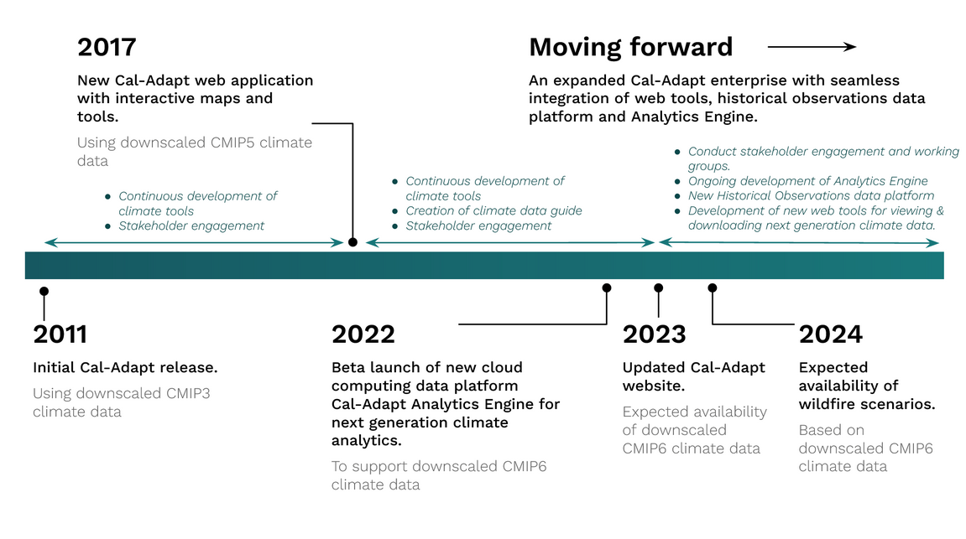
8

Slide 9
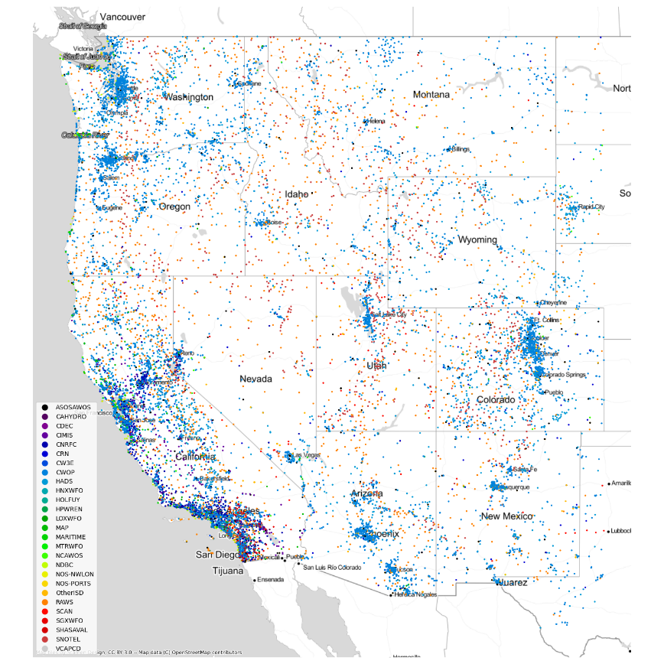
Democratizing Data: WECC-Wide Observations

Slide 10
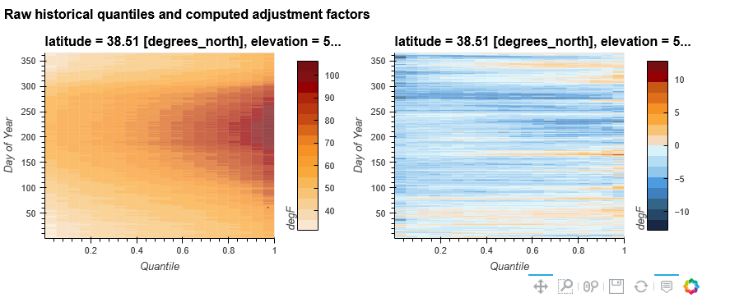
New Developments to Support Electricity Planning: Localization of Downscaled Projections

