Slide 1
Science to Action: Fifth Assessment and ICARP Climate Services
Processes for adoption of climate projections data and scenarios
Use of data to support ICARP climate services
Neil Matouka and Ben McMahan,
Governor’s Office of Planning and Research (OPR)

Slide 2
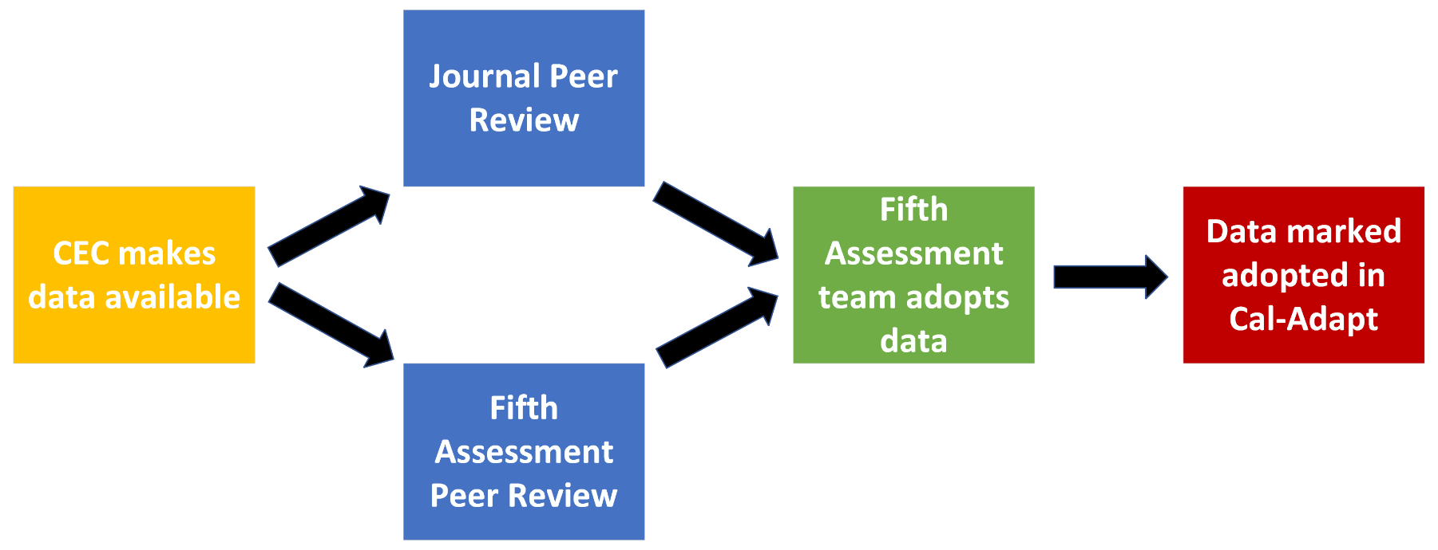
Fifth Assessment Data Adoption Process

Slide 3
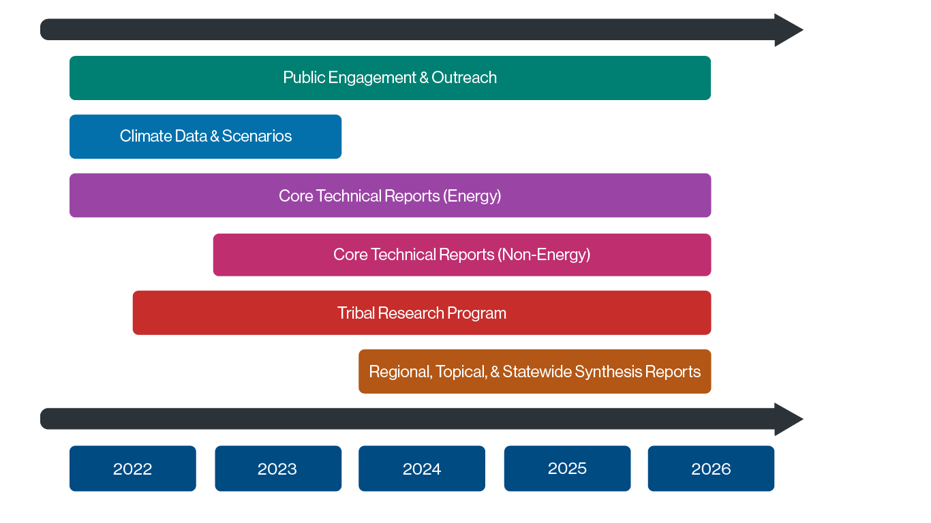
Fifth Assessment Implementation Timeline
Climate Data as Input

Slide 4
Background & Context
Cal-Adapt as a State product co-managed in an interagency collaboration between CEC and OPR with support from technical leads (ERA)
TN239123 (p. 3), docketed August 2, 2021: describes expanded Cal-Adapt enterprise
TN239954, docketed October 12, 2021: Cal-Adapt governance, responsibilities, data management
Cal-Adapt an excellent resource to inform decision-making
With updated structure and Fifth Assessment Data Inbound
Opportunity to update and expand Cal-Adapt – Particularly around the role of climate (data) services and decision support

Slide 5
OPR/ICARP Priorities
Maintain existing level of decision support – best practices – Cal-Adapt as an open State resource
Identify opportunities for new or improved tools and applications, and expand and support the network of users
Enhance connections and integrations between science and decision making
Evaluate Impact – tracking outcomes of use and integration of climate services

Slide 6
Role of Climate Services
Data, Decision Support, but what else?
OPR ICARP - Climate Services Team
User-informed resource development (the what?)
Contextual guidance (the why?)
Technical assistance on use (the how?)
Case study examples that illustrate use (the so what?)
Cal-Adapt as a framework to support decision making
In close collaboration with the Fifth Assessment Team at OPR
Aligned with larger portfolio of resources for decision support

Slide 7
Fifth Assessment - Foundation
Fifth Assessment Data
Data Visualizations & Climate Services
User Needs Assessment
RFP - Cal-Adapt Updates
Showcase for new research, data, and climate services
New science applications and data for California, and
Framework to support policy and decision making
How to facilitate connection and ease of use between research and data from the Fifth Assessment, and ensure these data and resources are accessible to wider audience of end-users

Slide 8
Data Visualizations and Climate Services
Fifth Assessment Data
Data Visualizations & Climate Services
User Needs Assessment
RFP - Cal-Adapt Updates
New/Updated Content and Information
Tailored information
Curated guidance
Streamlined tools and resources
Emphasis on robust data/information and ease of use/design
What can streamline workflow for existing users?
What are some onramps for new users?
How to extend the value and utility of Cal-Adapt to a wider audience?

Slide 9
Cal-Adapt User Needs Assessment
Fifth Assessment Data
Data Visualizations & Climate Services
User Needs Assessment
RFP - Cal-Adapt Updates
Underway in 2023
In parallel with Adaptation Clearinghouse user needs assessment
Priority Areas
Assess existing resources
Identify Gaps and Opportunities
Focus on areas for improvement, optimization, or expansion
User Assessment Activities and Outcomes
Ux Assessment and Competitive/Comparative Analysis
Stakeholder interviews & User Engagement
Recommendations - update strategies and priority areas
Options - Prototypes of Cal-Adapt Visualizations and Resources

Slide 10
RFP – Cal-Adapt Updates
Fifth Assessment Data
Data Visualizations & Climate Services
User Needs Assessment
RFP - Cal-Adapt Updates
Planned for release in second half of 2023
Design and Implement Cal-Adapt updates based on user needs assessment, strategic priorities, and gaps and opportunities
Emphasis on novel visualizations and sectoral applications
Expanding relevance/utility for wide range of sectors
Aligned with other State/OPR resources

Slide 11
Climate Services Data + (support, guidance, context)
Fifth Assessment Data
Data Visualizations & Climate Services
User Needs Assessment
RFP - Cal-Adapt Updates
Innovative visualizations using updated data and expanding the user base of Cal-Adapt users.
How to make this a more useful state resource across various sectors and decision contexts?

Slide 12
Climate Services Data + (support, guidance, context)
Fifth Assessment Data
Data Visualizations & Climate Services
User Needs Assessment
RFP - Cal-Adapt Updates
New tools or resources for targeted use and technical assistance to connect decision makers with relevant data
Can we integrate/connect to policy or other relevant planning and guidance resources?
How do we support expanded use with range of sectors/users?

Slide 13
Climate Services Data + (support, guidance, context)
Fifth Assessment Data
Data Visualizations & Climate Services
User Needs Assessment
RFP - Cal-Adapt Updates
Build out a suite of resources available to address climate related challenges, connect science to policy
Transparency and clarity around data/metadata, process/methods, and use-cases for data
Evaluate impact and track examples of use in decision contexts or planning

Slide 14
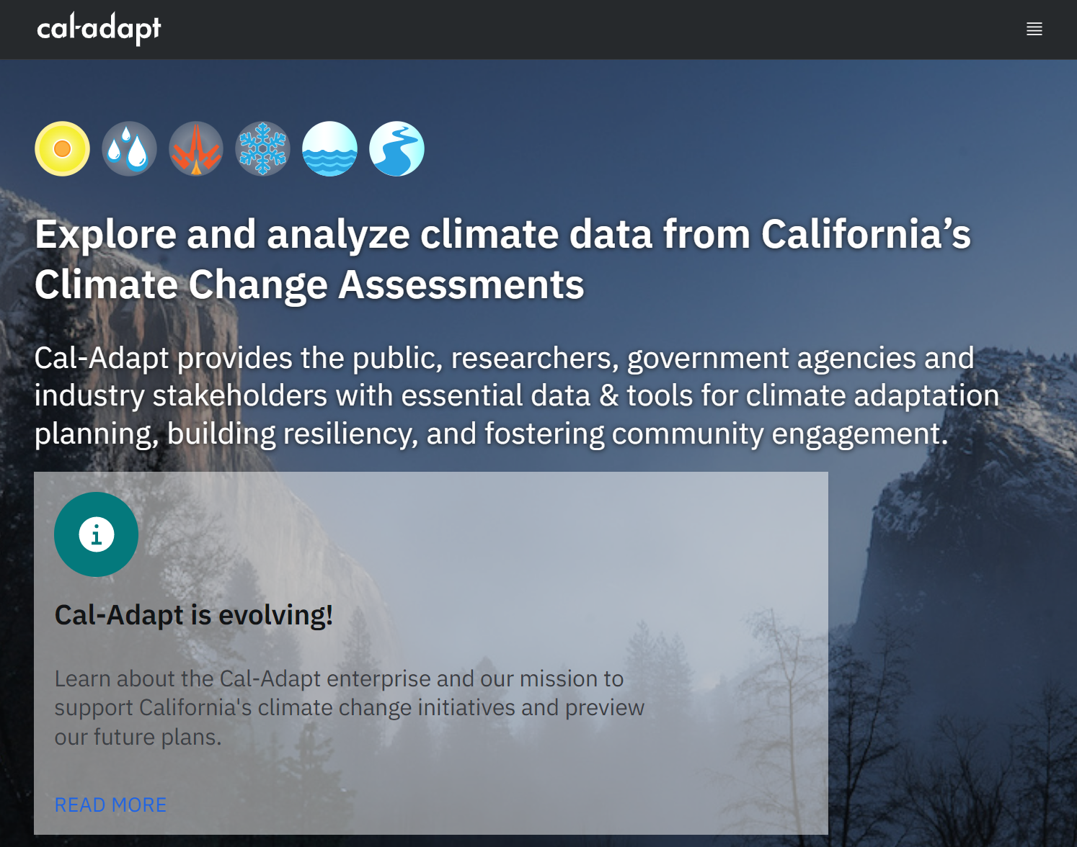
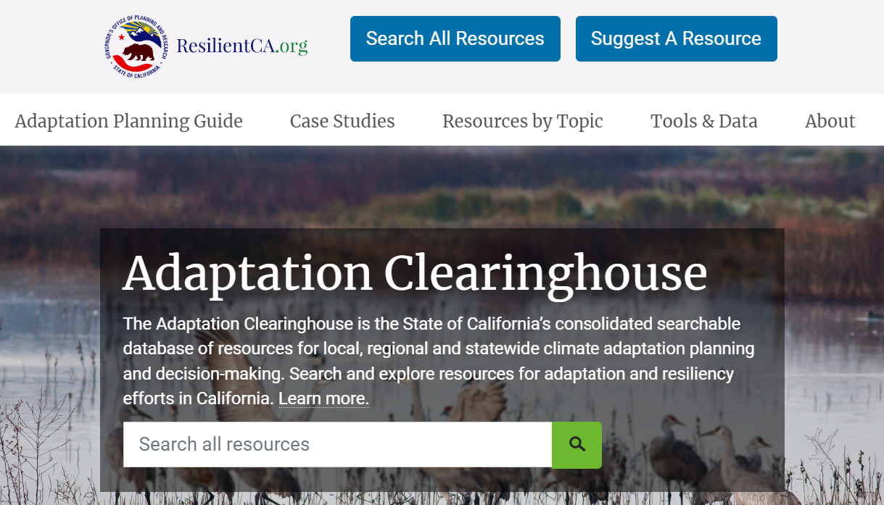
Linked to broader OPR climate services investment and partnership with CEC
Coordination on priorities and strategic direction for Cal-Adapt
OPR Integration across
the Adaptation Clearinghouse (case studies, policy support),
the VCP (identifying and prioritizing frontline communities)
Cal-Adapt – a robust data platform for climate data services.

