Slide 1
EPC-20-006 Group 1 Overview
Development of Climate Projections for California
and Identification of Priority Projections*
A collaboration amongst SIO/UCSD, UCLA and UC Berkeley
Sponsored by the California Energy Commission through the Electric Program Investment Charge (EPIC) program
*Now called General Use Projections

Slide 2
Types of Downscaled Data
** Variables: Tmin, Tmax, precipitation, diurnal temperature range, RH min, RH max, surface downward shortwave, vector winds

Slide 3
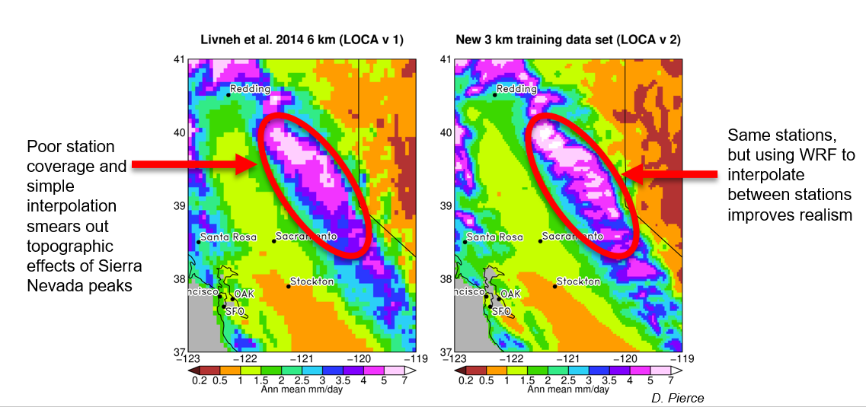
New, higher resolution training data uses WRF to interpolate between stations for more realistic precipitation

Slide 4
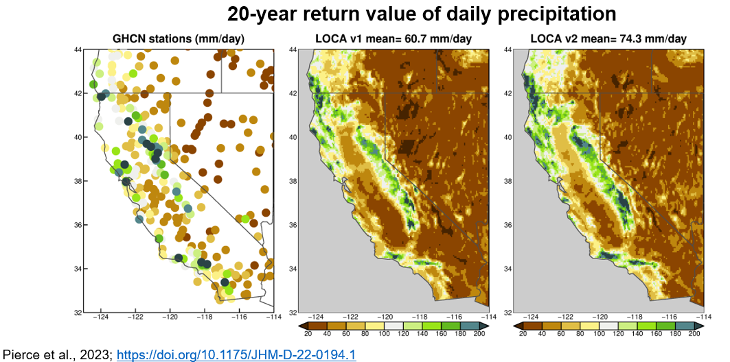
New ensemble bias correction scheme better represents extreme precipitation events

Slide 5
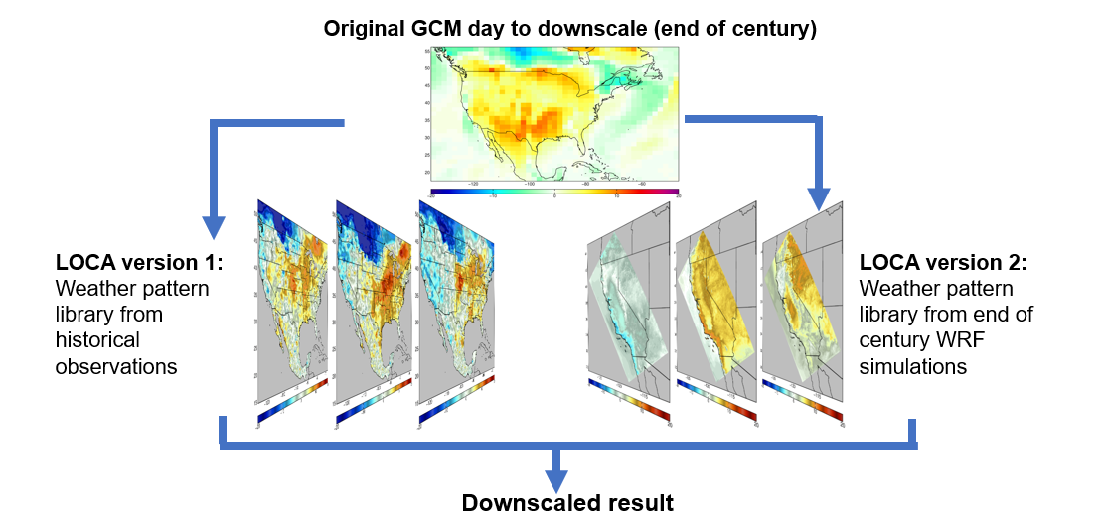
New hybrid downscaling scheme uses WRF-projected future weather patterns at the end of the century
New method limits the stationarity assumption

Slide 6
More data available to address stakeholder needs
1. More variables to answer stakeholder questions
LOCA 1: Tmin, Tmax, P, 10-meter windspeed, daily min and max of relative humidity; downward solar radiation
LOCA 2: Tmin, Tmax, P, 10-meter windspeed; daily min and max of relative humidity; downward solar radiation, 10-meter U, V wind components (vector wind), specific humidity
2. More emissions scenarios to explore possible futures
LOCA 1: 2 RCPs: 4.5, 8.5 (“medium-low” and “high”)
LOCA 2: 3 SSPs: 245, 370, 585 (“medium-low”, “medium”, and “high”. Earth currently close to SSP 370)
3. More ensemble members available for stakeholders who need to evaluate natural variability
LOCA 1: Only one ensemble member available
LOCA 2: Up to 10 ensemble members (determined by what the original GCMs made available)
4. Potentially more hourly data available
LOCA 1: Hourly temperature data at 32 stations
LOCA 2: Hourly temperature data at 32 stations, potentially other variables and stations if stakeholders have access to observed data they can share with us for training the model

Slide 7
Summary: LOCA version 2 improvements
Improved, higher resolution training data set
New approach better depicts effects of California’s topography; 3 km vs. 6 km in version 1
Improved representation of precipitation extremes
Critical for flooding and water management
Hybrid downscaling scheme
More realistic projections for coming decades
Limits stationarity assumption
More variables
Supports a wider range of stakeholder applications
More runs, multiple ensemble members
Allows better understanding of uncertainty, natural variability, and extremes
More emissions scenarios
Better understanding of possible future human/societal/policy choices

Slide 8
General Use Projections (previously known as “Priority Projections”)
What are General Use Projections?
A subset of the 199 downscaled LOCA Hybrid GCM runs that are recommended to use in order to capture that range of projections
Why have General Use Projections?
Using common projections between analyses support coordination, comparisons and collaboration across jurisdictional and other types of boundaries
Should I only use the General Use Projections?
No, it is always better to use the full set of runs if you are able. Using the General Use Projections is the minimum number of projections that should be used in any analysis

Slide 9
Deciding General Use Projections
Eligibility to be considered for General Use Projections
Only considering model runs that have all the LOCA variables
(e.g. dismiss model runs which didn’t save daily winds)
Only considering models that have a SSP370 scenario
Will try to include some WRF models
Model skill is already included in the 15 model selection, but additional skill factors may be included
Selection of Metrics for General Use Projections
Metrics have been pared down to a small number because too many uncorrelated metrics would average out the scores of the models, reducing the ability of the metrics to usefully distinguish between models.
Need to ensure that metrics show a meaningful range
Favor metrics that are simple variables, avoid those that are derivatives of several variables.
Target SSP370 with a 2045-2074 mid-century period
Every metric needs a weight to calculate the final combined model score

Slide 10
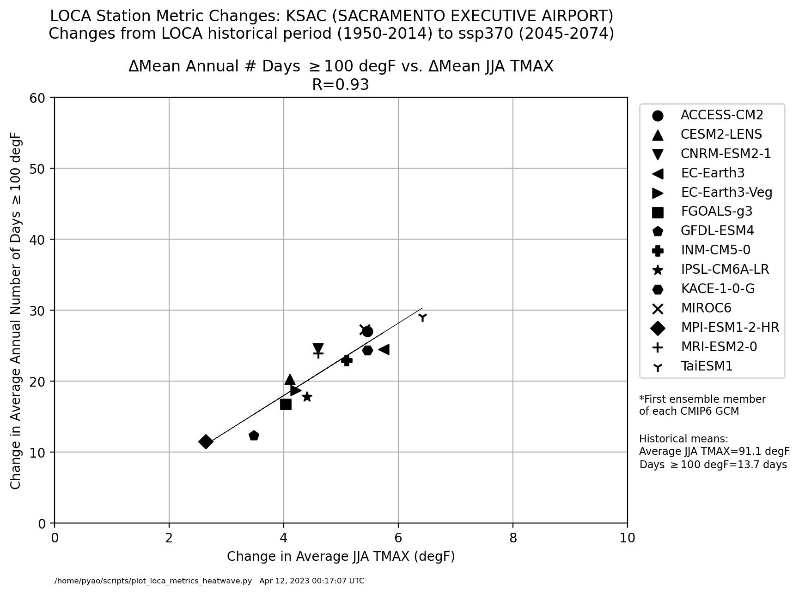
General Use Projections Selection Metrics
Average summer daily max temperature (population weighted)
Indicator of different types of heatwaves
P. Yao

Slide 11
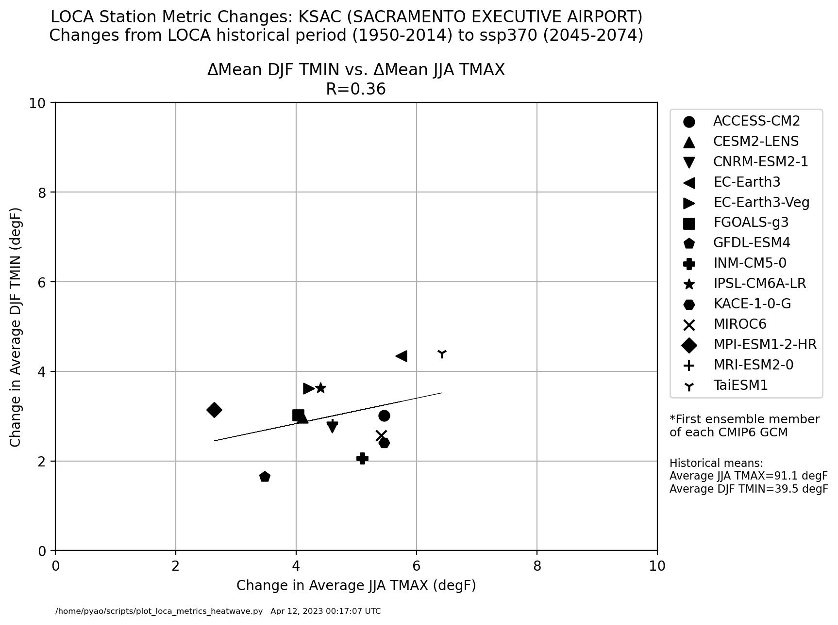
General Use Projections Selection Metrics, continued
Average summer daily max temperature (population weighted)
Indicator of different types of heatwaves
~ P. Yao

Slide 12
General Use Projections Selection Metrics, continued
Average summer daily max temperature (population weighted)
Indicator of different types of heatwaves
Daily winter minimum temperature
Captures trends for coolest part of the year & heating use

Slide 13
General Use Projections Selection Metrics, continued
Average summer daily max temperature (population weighted)
Indicator of different types of heatwaves
Daily winter minimum temperature
Captures trends for coolest part of the year & heating use
Annually averaged precipitation volume
Captures changes in the overall precipitation
Number of daily events exceeding 95th percentile
Capture the frequency of extreme events which relates to all the wet metrics
* Need to assess range in the models. May change to changes in wind power in generation area.

Slide 14
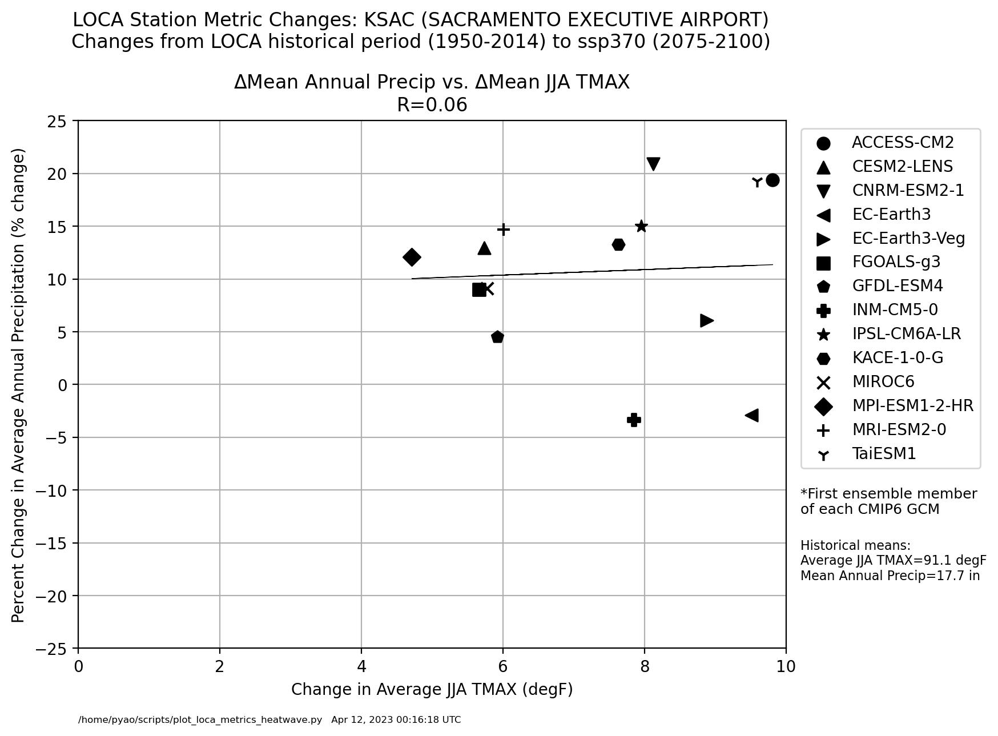
General Use Projections Selection Metrics, continued
Annually averaged precipitation volume
Captures changes in the overall precipitation
Number of daily events exceeding 95th percentile
Capture the frequency of extreme events which relates to all the wet metrics

Slide 15
General Use Projections Selection Metrics, continued
Average summer daily max temperature (population weighted)
Indicator of different types of heatwaves
Daily winter minimum temperature
Captures trends for coolest part of the year & heating use
Annually averaged precipitation volume
Captures changes in the overall precipitation
Number of daily events exceeding 95th percentile
Capture the frequency of extreme events which relates to all the wet metrics
Dry Spell intensity (lowest total precipitation in 10-year period)
Captures a balance of acute and extreme drought events
Combined frequency and intensity of downslope winds (Santa Ana & Diablo Winds)*
Captures changes in high wind events that can be impactful to fire weather
* Need to assess range in the models. May change to changes in wind power in generation area.

