Slide 1
Climate Data and Analysis Working Group: Purpose, Ongoing Research, Future Topics
Energy-Related Environmental Research
Energy Research & Development Division
September 7, 2022

Slide 2
Housekeeping
Meetings are not recorded (but materials will be posted)
Welcome candid exchange
Please “raise hand” to speak
Please mute when not speaking
You can reach us at: cdawg@energy.ca.gov
Please raise hand and unmute yourself to talk.
Phone controls: press *6 to mute/unmute, *9 to raise hand.

Slide 3
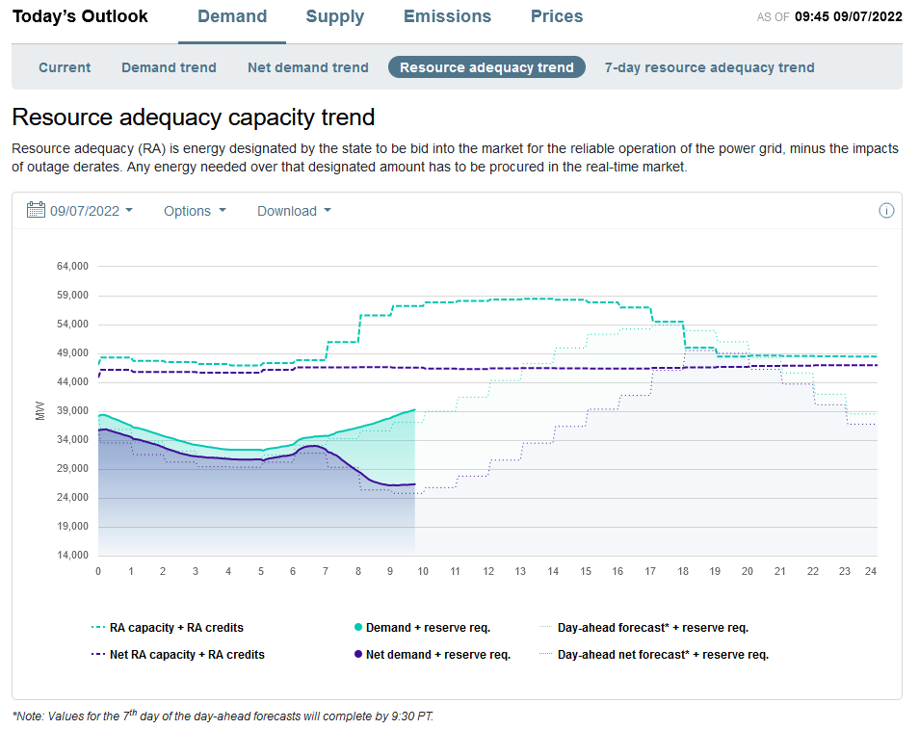
Please conserve energy (4-9 PM)
source: https://www.caiso.com/TodaysOutlook/Pages/default.aspx#section-ra-capacity-trend

Slide 4
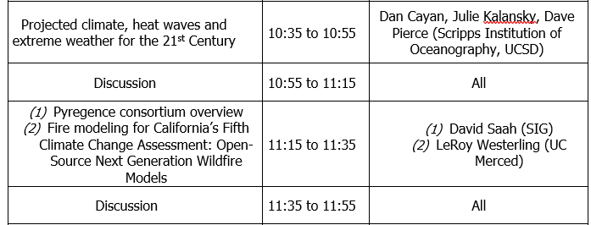
Today’s Agenda
Notes:
Why are we here?
Below: Div-approved messaging based on communication w/ Cmr Vaccaro
A- C-DAWG provides a presence for the portfolio of CEC-funded research at the interface of climate change and California's energy system. Ongoing and completed grants are now listed on the C-DAWG website
B- We think it’s important for CEC’s energy-related environmental research team to host a sustained forum of exchange between researchers, energy stakeholders who need to use climate-related data & analysis, and CEC staff
Historically, each grant has had to stand up engagement de novo. This risks incurring stakeholder fatigue; plus some of our more technical grants are less equipped to engage stakeholders effectively and in a timely fashion.
The C-DAWG will create a consolidated forum for engagement, helping to engage key stakeholders more effectively across our entire portfolio as well as on questions beyond our ongoing portfolio (e.g., informing execution of EPIC 4).
C- Promote effectively, timely knowledge transfer… and two-way communication.
D- Elicit input on key decisions… particularly important as we work toward research products that inform energy sector adaptation and research as well as the broader portfolio of California's climate change assessments (which N-TK will talk about later).

Slide 5
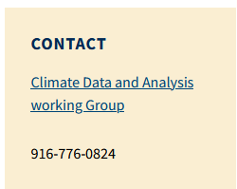
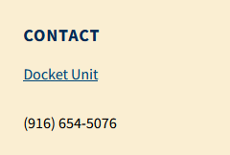
We’d love to hear from you!
Email (cdawg@energy.ca.gov) or call us
Submit* to docket (docket@energy.ca.gov)
* Please include “19-ERDD-01” and a brief description in subject line
Notes:
Quarterly-ish meetings, opportunity to suggest discussion items; welcome hearing from you!

Slide 6
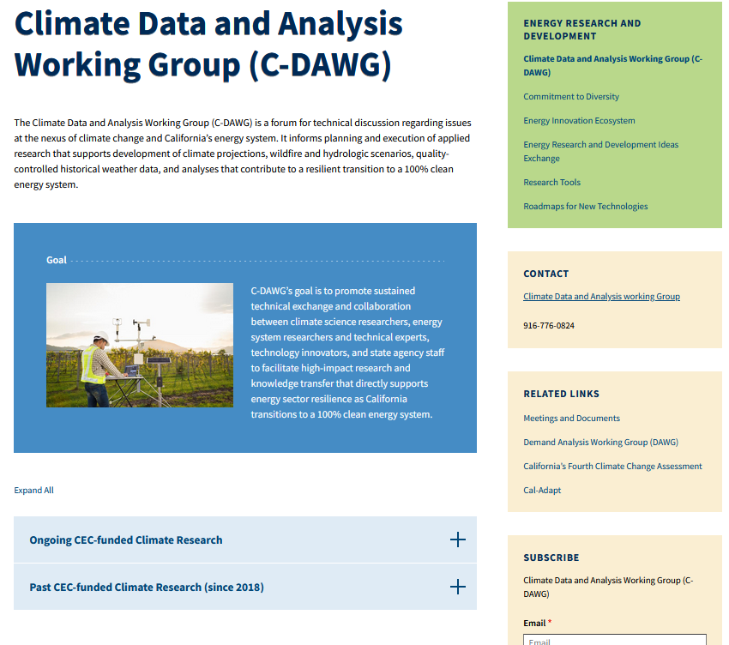
C-DAWG Landing Page

