Slide 1
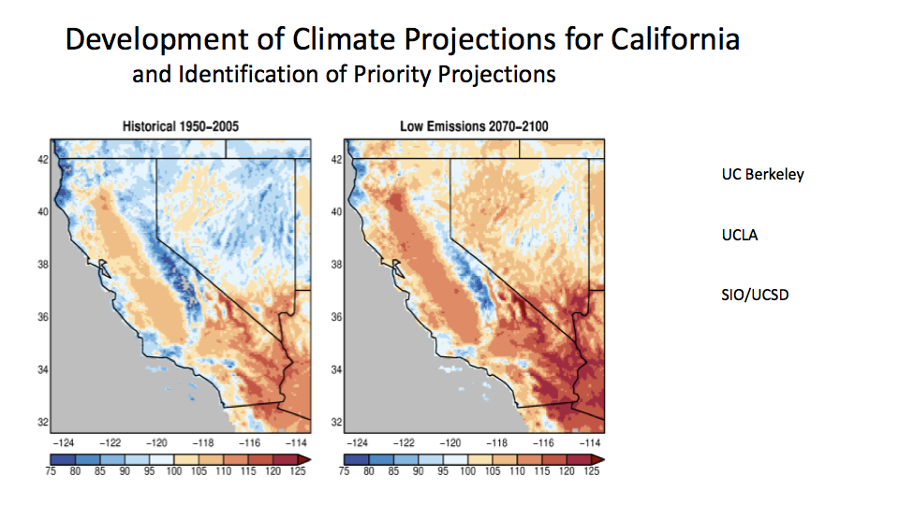
Projected climate, heat waves and extreme weather
for the 21st Century
Dan Cayan, Dave Pierce, Julie Kalansky, Scripps Institution of Oceanography, UCSD
C-DAWG 9/7/2022
A collaboration btw
SIO/UCSD, UCLA and UC Berkley
Supported by CEC, EPC-20-00-006
“Development of Climate Projections for California
and Identification of Priority Projections”
Results will also support California’s
5th Climate Change Assessment

Slide 2
What’s New from the Climate Scenarios Project?
Downscaling CMIP6 GCMs to 3 km (previously 6 km and CMIP5 models)
Dynamical downscaling (UCLA Hall, Rahimi et al) of 4+ GCMs
high temporal resolution for many variables; hourly for 21 variables
3. LOCA statistical downscaling (SIO/UCSD D Pierce) provides high volume set of scenarios
3 SSPs and multiple ensemble members for SSP and GCMs based on available CMIP6 GCM data. Limited set of variables
A separate National scale effort is supplying a form of LOCA downscaled T, P, humidity to 5th National Climate Assessment
downscaling to selected individual stations to produce hourly temperature
Hybrid WRF-LOCA downscaling approach avoids stationarity constraint
no longer limited to historical analogues only) in providing analogues for future climate.
Three hydrologic models will be used to produce daily stream flow
for network of statewide gage sites, incorporating daily historical data for modeling
New Sea Level projections based on CMIP6 weather and climate forcing,
selected tide gage locations Align w recently commenced Revised California SLR Guidance

Slide 3
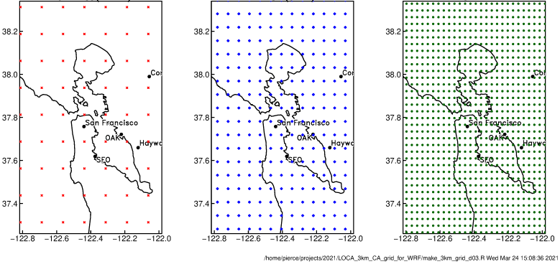
Grid resolution across model generations
CMIP3 era (12 km) CMIP5 era (6 km) CMIP6 era (3 km)

Slide 4
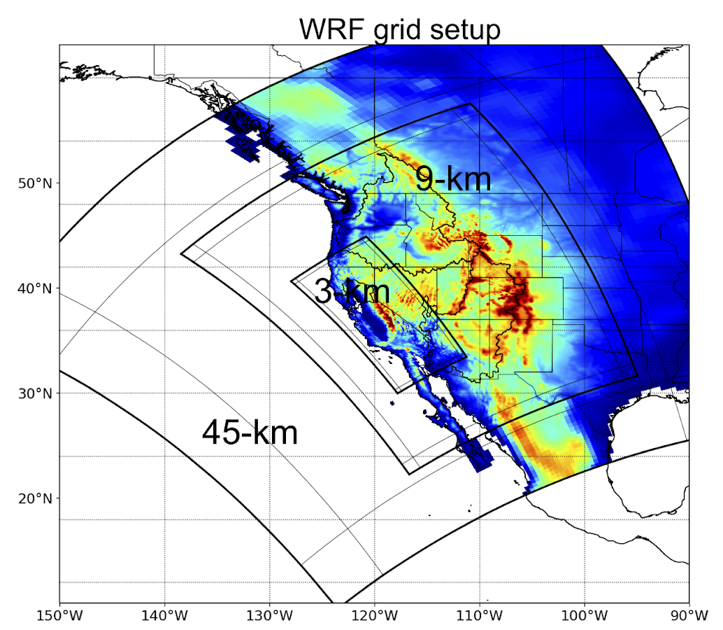
Dynamical downscaling
Alex Hall, Stefan Rahimi-Esfarjani, UCLA
Benefits:
Higher temporal resolution than statistical downscaling
Incorporate changes in the dynamics associate with climate change (i.e. no stationarity assumption).
Cons:
GCMS available for downscaling are limited
Computationally expensive
Benefits from bias correction

Slide 5
LOCA-Hybrid Downscaling
Statistical approach that is less computational expensive so can work through more model runs than dynamical downscaling
Adds models, emission scenarios, and ensemble members to WRF results
Will use WRF output in LOCA2 training to improve estimates of future change (hybrid statistical-dynamical downscaling)
Includes bias correction
Output
  Downscale 15 GCMs
  3 SSP’s (emissions scenarios), SSP245, SSP370, SSP585
  Multiple ensemble members available for some models
  Temperature, precipitation, humidity, wind, surface solar
  Daily data
  Bias corrected to match available observations over historical periods
  Station LOCA data for temperature will be available

Slide 6
Project Goals and Objectives
CEC EPC-20-006 Projections Project
Identify a subset of ~15 CMIP6 climate models that are suitable for California climate change assessments and ~4 “priority projections” for energy sector stakeholders and other state agencies who want or need to work with a reduced data set;
Produce downscaled historical and future climate projections describing surface weather, hydrology and sea level variation at high spatial (3 km) and temporal resolution;
Work with Analytic Engine collaborators to distribute useful and understandable climate data to the stakeholder with emphasis upon scenarios, events and episodes that are important and impactful.

Slide 7
Observed 2020 daytime Tmax
Southern California Coast
What can we expect
in future decades?
Kristen Guirguis, SIO

Slide 8
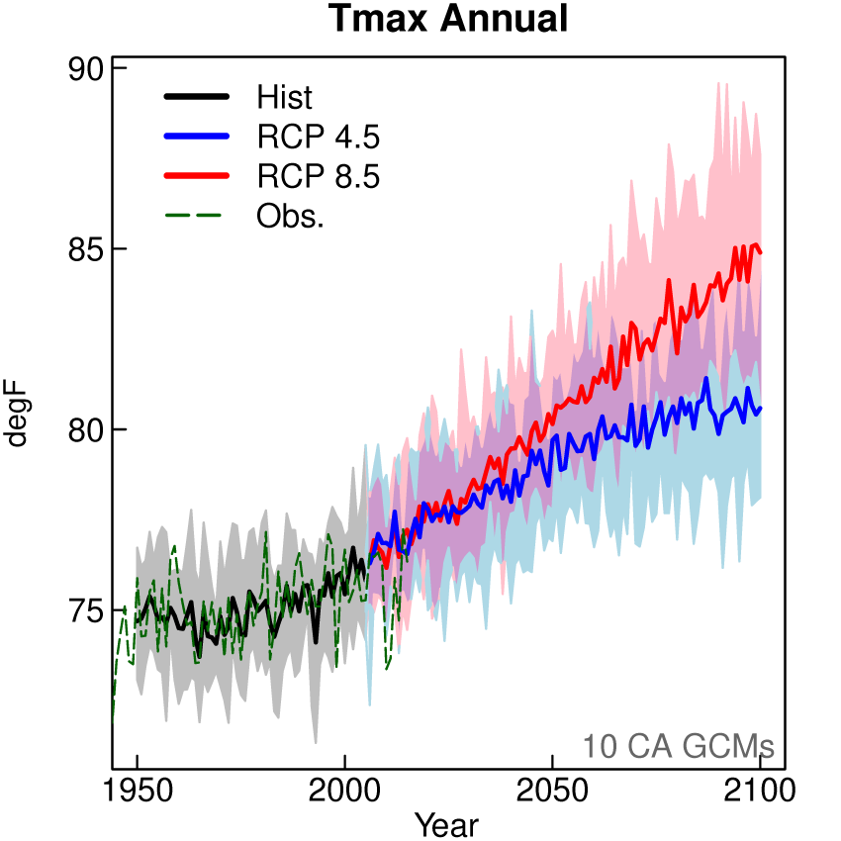
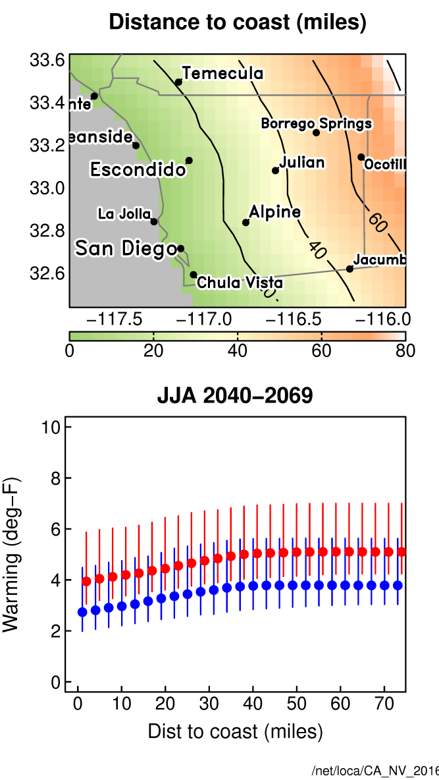
climate model projected WARMING is SUBSTANTIAL
Due to greenhouse gas build-up we are already warming and committed to more warming
amount of warming in future depends on greenhouse gas emissions
Along coastal margin, warming will likely be less than inland because ocean buffers temperature rise
San Diego County
+2ºC

Slide 9
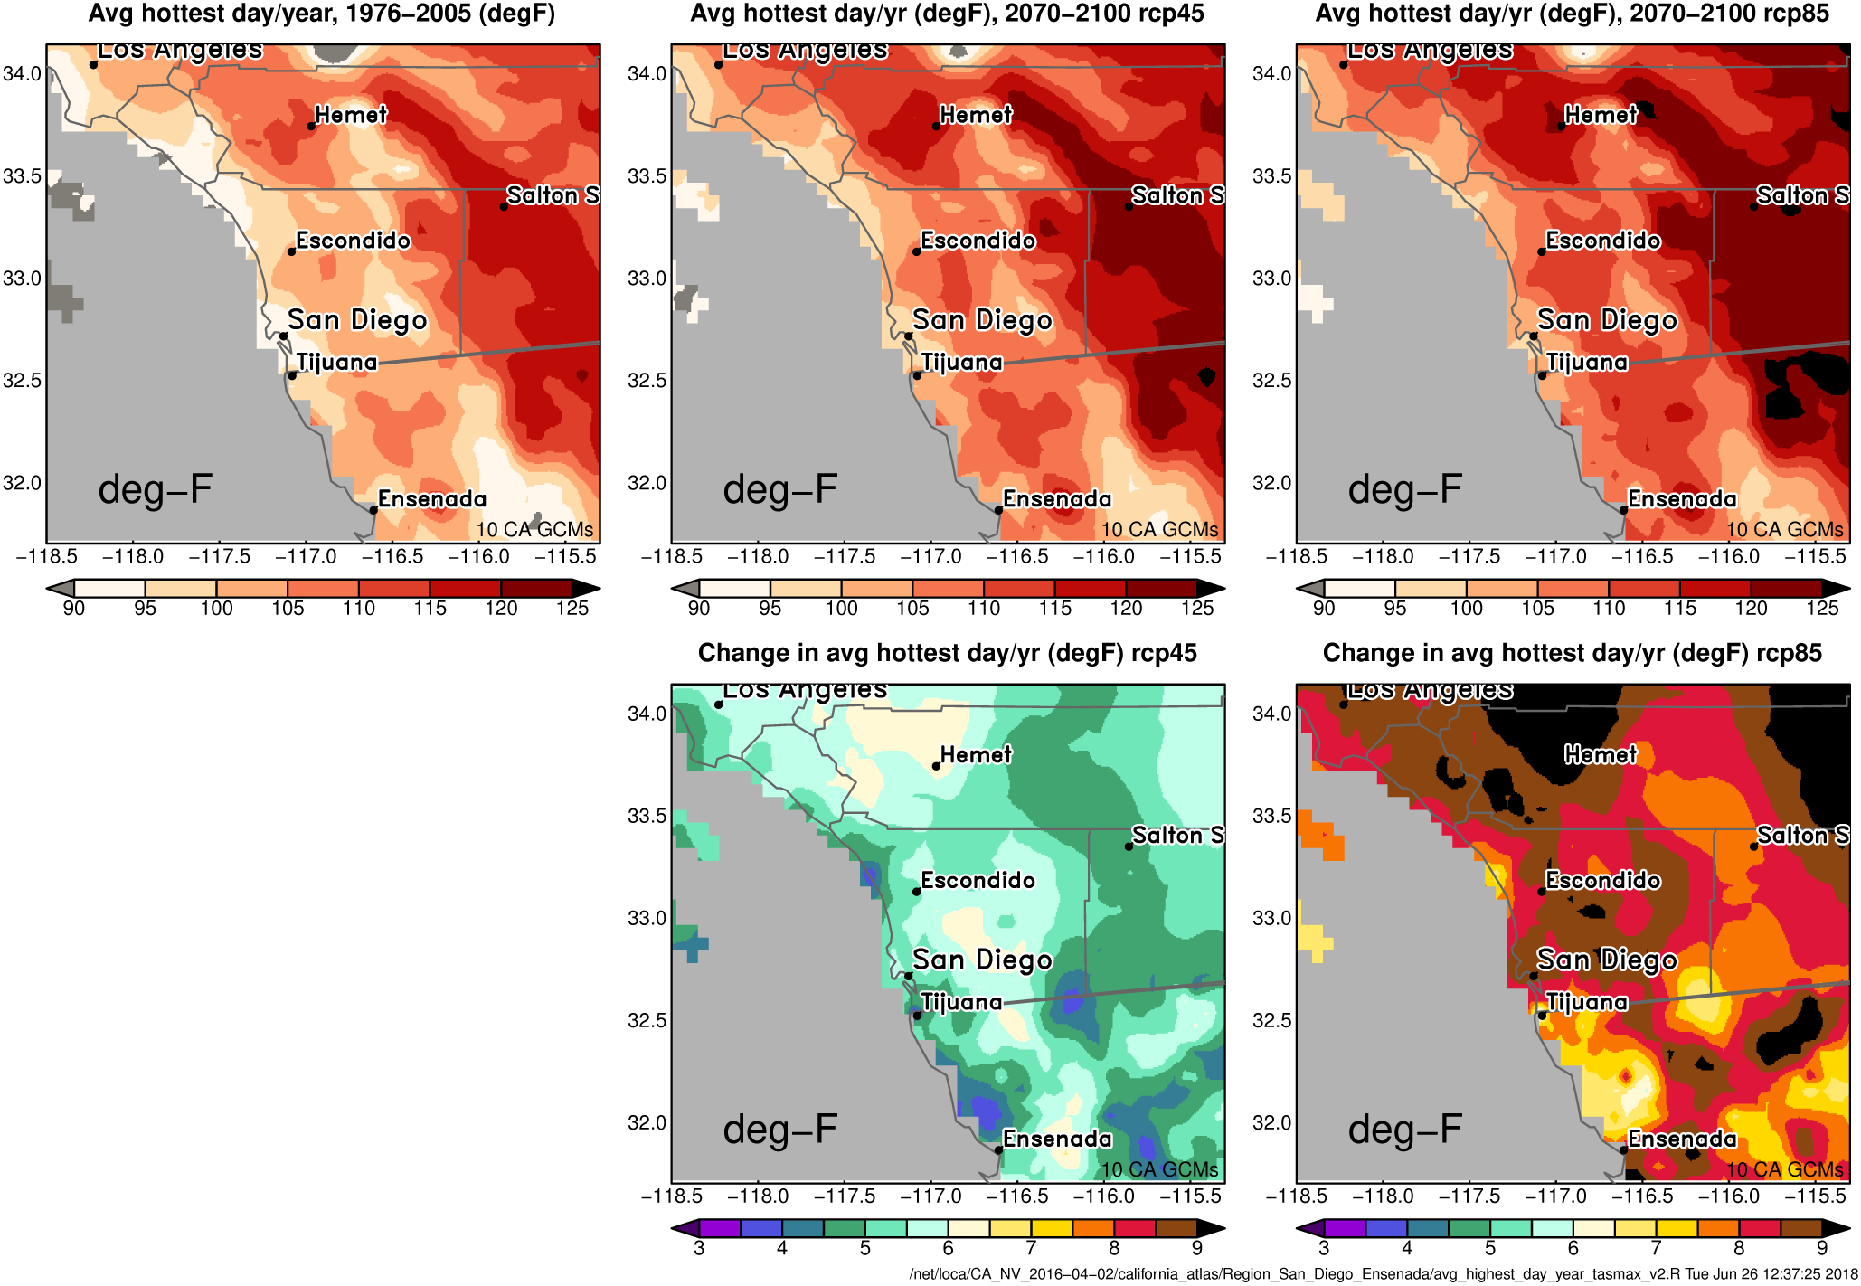
Large set of downscaled projections provides
lens to quantify Hot Extremes
Change (deg F) Warmest day of the Year 2070-2100 vs. 1976-2005
Lower emissions
the duration and number of heat waves are also projected to increase
widespread consequences– e.g. health, energy and water demand, ecosystems

Slide 10
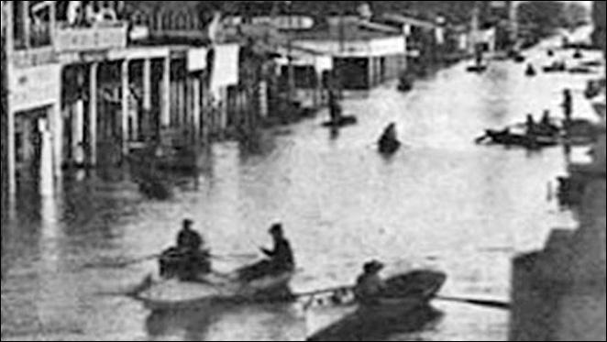
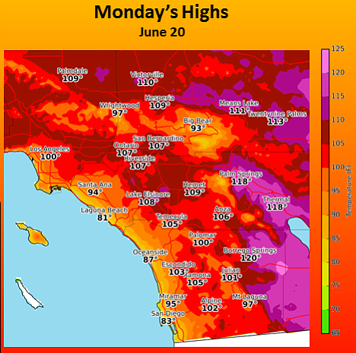
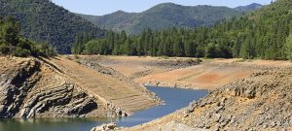
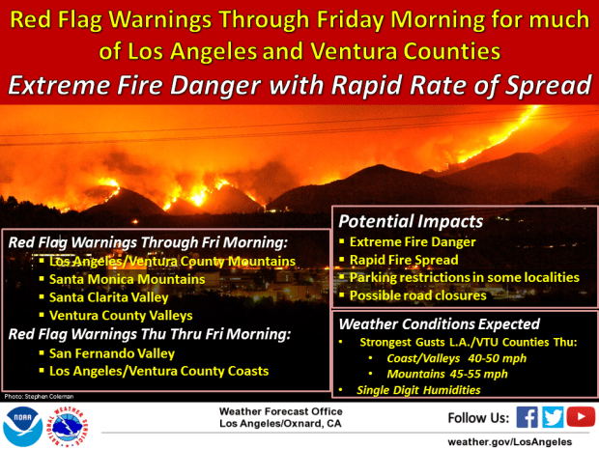
Targeted Extreme Case Studies to inform planning and adaptation
Droughts
Fire Weather
1862 Flood
Heat
Waves
Photo credit: PPIC
Photo credit: NWS
Photo credit: NWS
Photo credit: NWS
WITH ENERGY SECTOR STAKEHOLDERS identify 15 cases of great planning relevance for stakeholders using the multiple LOCA downscaled GCMS*
Dynamically downscale the 15 events with WRF
Explore physical mechanism underlying the the events
Produce data for all climate variables at subdaily resolution
If relevant conduct hydrologic modeling
Seeking Advice and Feedback from
Energy Community
Full variable suite of variables allow for more detailed modeling of impacts on
energy and water infrastructure, carbon, fire, and ecosystem modeling.
*Potential for 5th Assessment team to provide input

Slide 11
Deliverables and Time Table
CMIP 6 Model Evaluation for Dynamic Downscaling
Dynamical Downscaling of 4 CMIP6 GCM
Green shaded tasks are completed
dates are best estimates
Bias Correction selected daily variables
WRF historical and WRF CMIP6 Projections
LOCA Hybrid downscaling 15 CMIP6 GCM
Oct-Dec 2022
Hydrologic Model Validation
Priority Projections selected
Jul 2023
Hydrologic Model from LOCA downscaling
Apr-Jun 2023
15 Dynamically Downscaled Target Cases
Nov 2023
SLR Projections
Nov 2023

Slide 12
Extra slides

Slide 13
Data and Analyses Produced
Global Model Evaluation (report completed and can be shared upon request)
4 Dynamically Downscaled GCMs using WRF
  All SSP370: CESM2; EC-Earth3-Veg, CNRM-ESM2-1, FGOALSg-3
  3 km over CA and 9 km of over Western US; 1980-2100
  Up to 10 more dynamically downscaled GCMs will be available in winter 2022/23; leveraging other funding and supercomputing proposal; all will be SSP370
15 LOCA WRF-Hybrid downscaling
  15 models, SSP 245, 370 and 585, multiple ensemble members
  3 km over CA, daily, 1950-2100
Hydrologic Modeling
  3 models (Noah-MP, VIC, Sum)
  Daily variables including stream flow
  5 LOCA models and 4 WRF models
Projection of hourly sea level at select locations; 1950-2100
Selection of Priority Projections (not the same as the 4 WRF GCMs)
Targeted downscaling cases based on engagement with IOUs
Informed by Engagement with IOUs, Energy sector stakeholders, CEC, and intergrant coordination via use cases, working groups, meetings
Notes:
over CA

Slide 14
Priority Projections *
Numerous models; some stakeholders might want to use subset
Last time picked 4 priority projections with input from stakeholders:
Hot/Dry model
Cool/Wet model
Most average model
Most different model from first 3
  Considerations
      Will again require iteration with stakeholders: What aspects of the full data set do we want to capture?
      Would be good to have at least 1 or 2 priority projections be the WRF results?
      How many priority projections is the right number?
*Potential for 5th Assessment team to provide input

Slide 15
Downscaling 101
Dynamical downscaling gives depth
  Large number of variables
  Less assumptions of the future being like history (still some due to parameterizations)
  Computationally expensive, so limited models/scenarios/ensemble members
  Higher temporal resolution possible
  Benefits from bias correction
Statistical downscaling gives breadth
  Affordable means many models/scenarios/ensemble members
  Fewer variables: temperature, precipitation, humidity, wind, surface solar insolation
  Will be using LOCA2
    Improved representation of extremes, especially precipitation
    Bias correction is part of the process
Hybrid statistical/dynamical downscaling
  Statistical downscaling will be trained using information from WRF dynamical downscaling
  Help capture some aspects of the WRF results in the statistical output; limits stationarity assumptions
  Still requires data for downscaling to be saved by the GCM

Slide 16
Dynamical downscaling - Variables
Tier 3 variables: 37 select daily high-priority variables pertinent to the surface energy and water budgets, integrated quantities, and daily extremes
Tier 2 Variables: 21 select hourly variables informed by engagement with hydrologic, and fire modelers
Recently added, 10 m daily mean windspeed [m/s] ‘

Slide 17
Project Timeline
CMIP6 Model
Evaluation for
Dynamical Downscaling
Dynamical Downscaling of 4 CMIP6 GCM
Fall 2021
Early 2022
Bias Correction historical and dynamical downscaled data
LOCA Hybrid Downscaling of 15 CMIP6 GCM
Hydrologic Model Validation
Priority Projections selected
Hydrologic Model from LOCA downscaling
Stakeholder Engagement
Late 2022
Mid 2023
15 Dynamically Downscaled Target Cases
Sea Level Projections
Finalize Reports, Data Transfer
Project Completion
Fall 2023
Projects points of 5th Assessment team to provide input
Winter 2024

Slide 18
Stakeholder Engagement - Approach
Iterative & regular feedback throughout project, coordinated with other CEC grants/projects
Use both structured and unstructured methods:
  Semi-structured interviews, workshops, focus-groups, surveys
  Emails, conversations, feedback on documents, approach, overall progress
Gather technical feedback both directly and indirectly
'Direct’ feedback on GCM selection & modeling
'Indirect’ feedback on data needs
Variables, spatial, temporal scales
Develop stakeholder map
Comments on approach document, mock-results, etc.
Identify & prioritize ‘use-cases’ to elicit specific info
Co-develop technical work plans (with A.E.)*
*Analytics Engine

Slide 19
Stakeholder Engagement - Goals
Understand how data will be used by stakeholders to inform:
  GCM selection criteria and associated metrics
  Required variables, scales, number of ensemble members, etc.
  Extreme event ‘stress cases’ of interest for targeted downscaling
Document additional research questions relevant to stakeholder needs

Slide 20
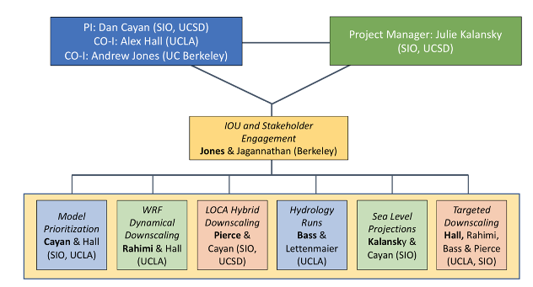
Project Team & Structure

Slide 21
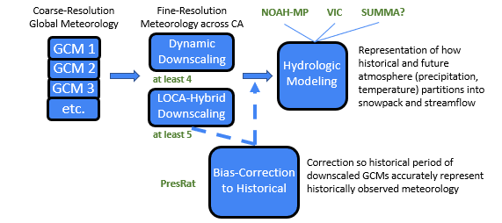
Future Hydrology
at least 18 1980-2100 Simulations: 2 per downscaled GCM * 9 downscaled GCMs

Slide 22
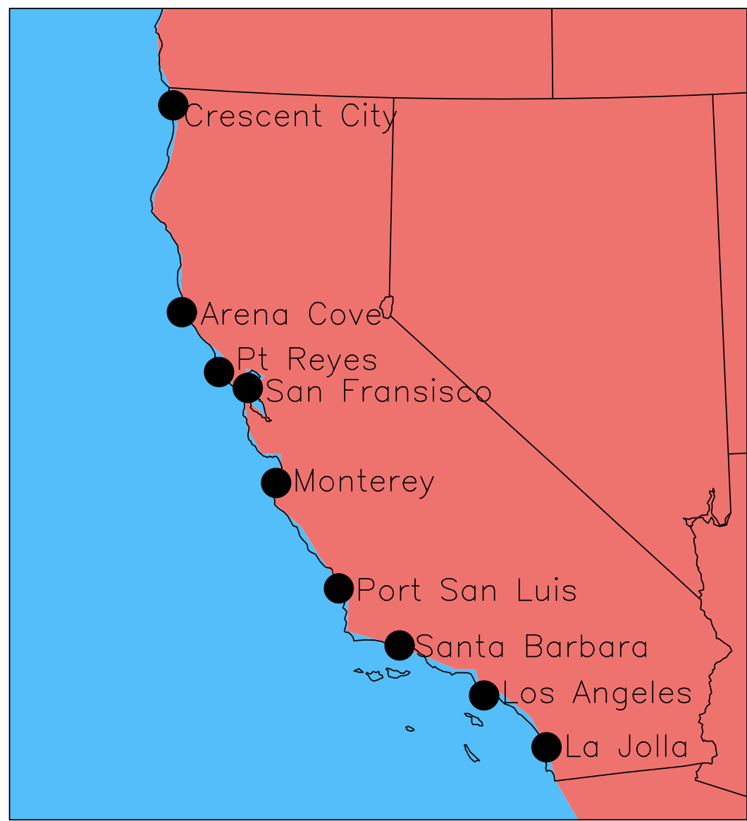
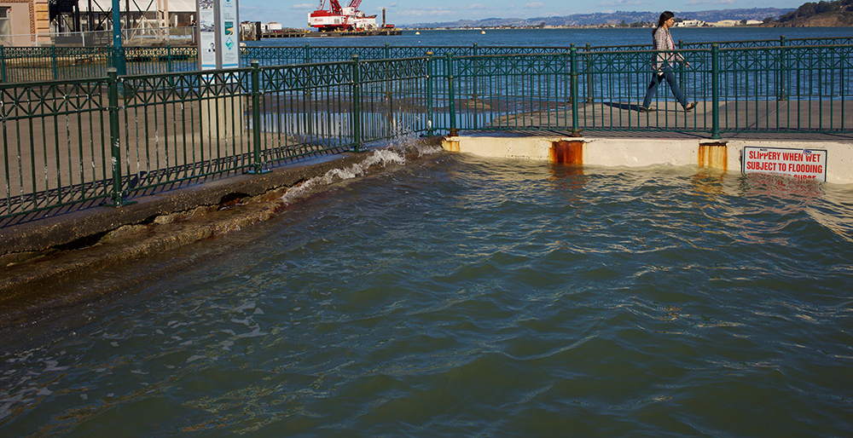
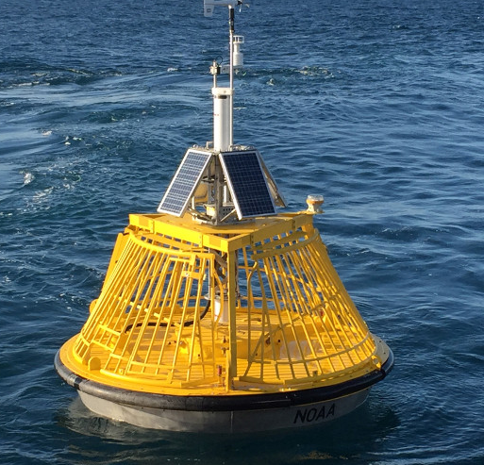
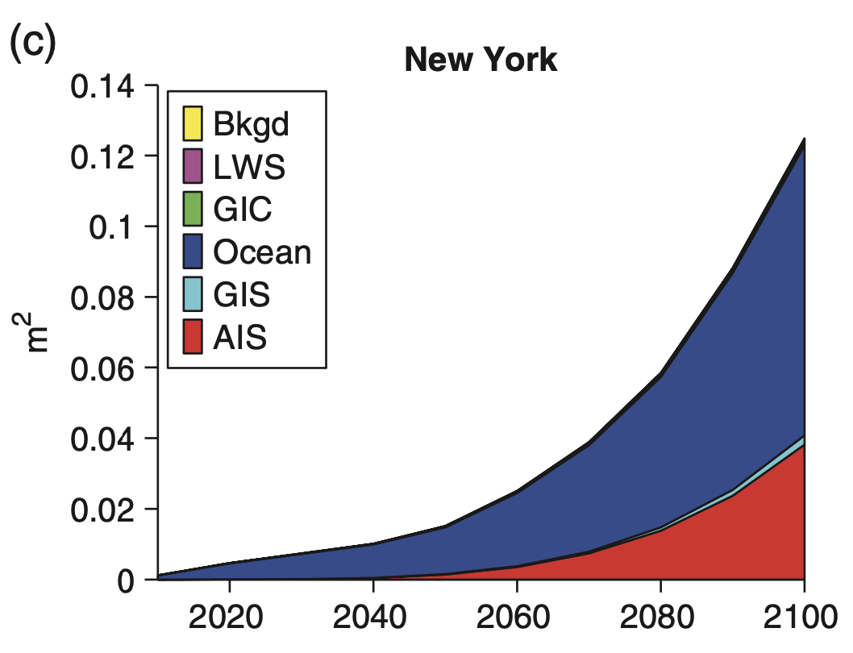
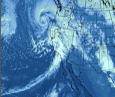
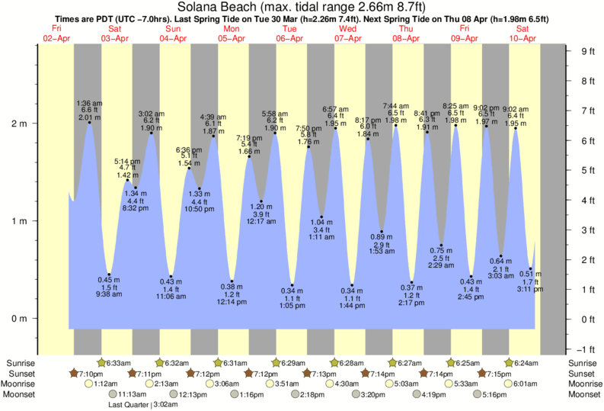
Future Sea Level Extremes
Projection
Total Water Level
Input: What secular
sea level rise scenarios should be used
Photo Credit: Bay Nature Magazine
Projections do not include: wave height or wave run-up
Kopp et al., 2014
Tides
Ocean/Atmosphere
winds, low pressure, ocean temp, ENSO
Secular
sea level rise

Slide 23
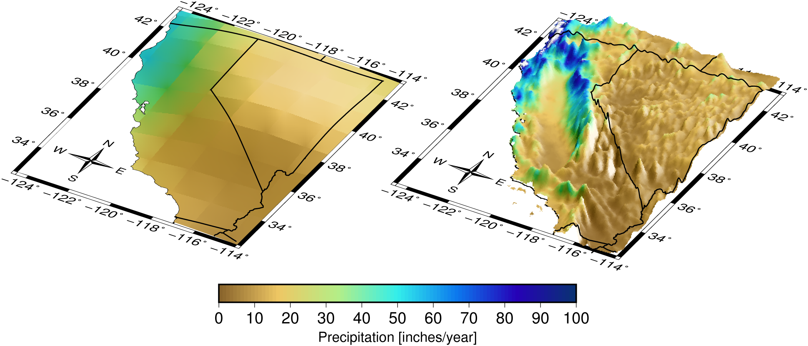
LOCA Requirements
Requirements
Fine spatial resolution training data
Coarse spatial resolution data saved from the GCM's you are downscaling

Slide 24
Blank slide

Slide 25
Bias correction
“No model is correct, but some are useful”
We know that GCMs and WRF are highly useful
Bias correction tries to remove residual model errors when compared to observations
LOCA2’s bias correction, PresRat, has a minor update:
  Previously only had one ensemble member per model
  Now many models have multiple ensemble members
  More extreme information gives better estimation of rare but highly damaging extreme events

Slide 26
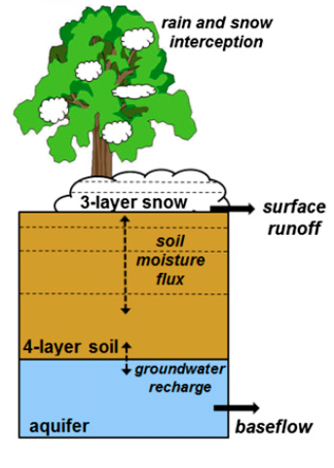
Hydrologic Modeling Overview
Modeling Team
Dr. Benjamin Bass – Postdoctoral Scholar, UCLA Center for Climate Science
Dr. Dennis Lettenmaier – Professor in UCLA Geography and Lead of UCLA’s Land Surface Hydrology Research Group
Inputs
Hydrologic Model
Outputs
Precipitation
2-m temperature
2-m specific humidity
10-m horizontal wind
surface pressure
short/long-wave radiation
Runoff / Streamflow
Snowpack
Evapotranspiration
Soil Moisture
Modified from
Mendoza et al. 2015
Spatial Resolution: 3 km CA grid (*except streamflow provided at selected point locations)
Time-Resolution: Daily for 1980-2100 (available down to 3-hr)
Important for: water supply, flood risk (i.e. reservoir/channel design), hydropower, ecology/recreation

Slide 27
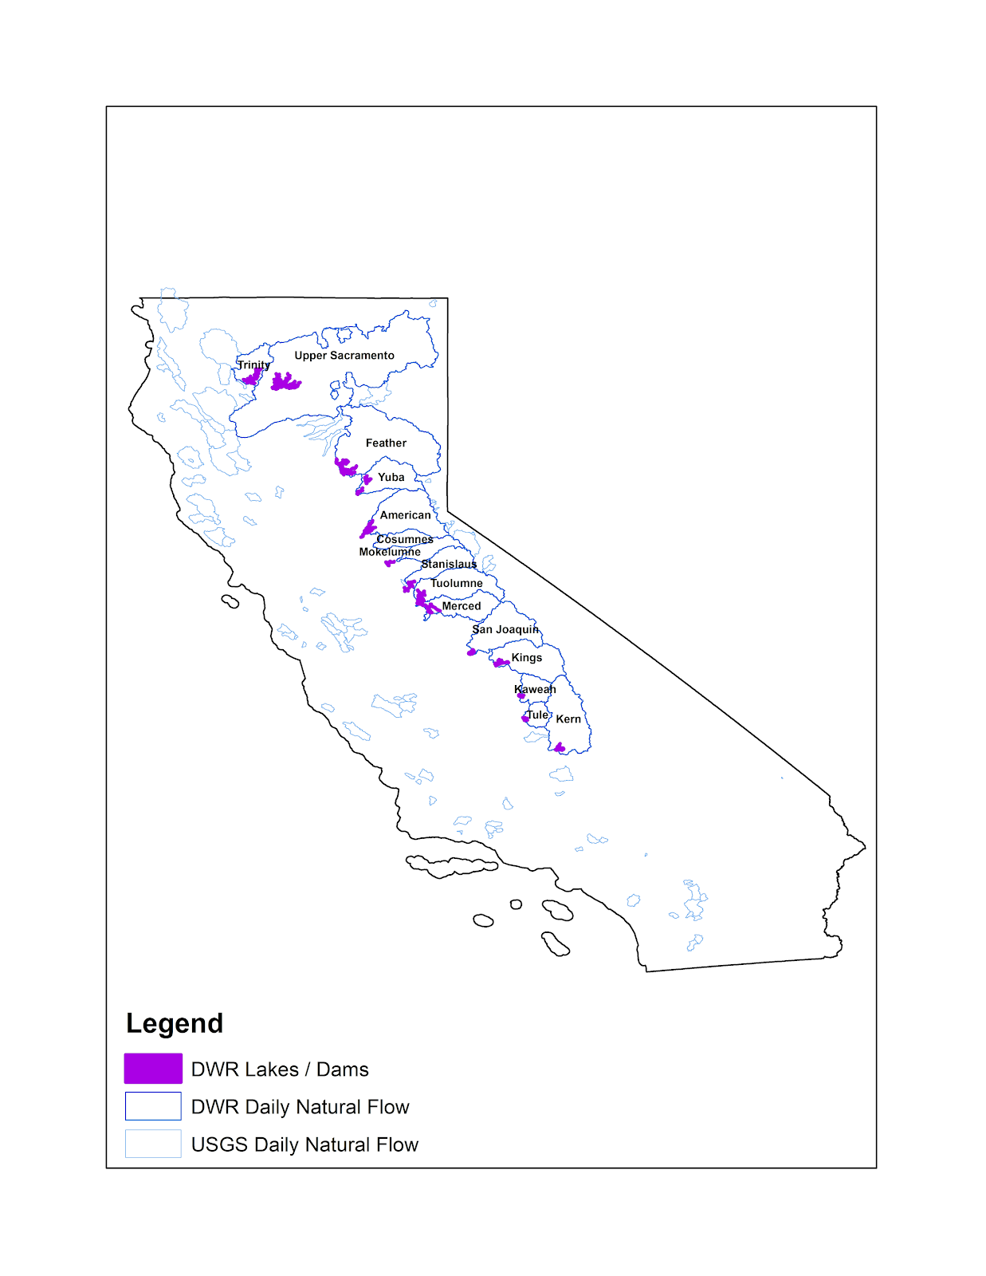
Validation of Historical Hydrology
Watersheds with natural streamflow observations
Calibration: Update hydrologic model to accurately represent historical streamflow
Historical Meteorology
(Livneh)
x1,000 simulations w/ unique
hydrologic
(soil) properties that are poorly observed
Hydrologic
Model
From the 1,000 simulations, the set of parameters that performs best in representing a given watershed’s historical streamflow is used
*snowpack will also be validated against using Margulis Gridded SWE dataset
Notes:
*for historical period Livneh dataset will be used as met forcing – this dataset has been validated and widely used for hydrologic analysis

Slide 28
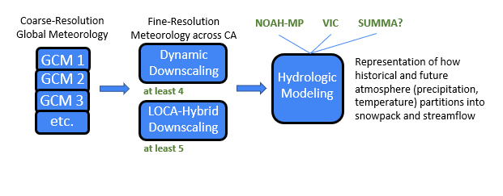
Future Hydrology Model Framework

Slide 29
Timeline and Summary Report
Date | Product
Spring 2022 | Calibrated/Validated Hydrologic Models
Spring 2023 | Hydrologic Simulation of Downscaled GCMs
Fall 2023 | Simulate Relevant Downscaled Target Case Studies
Spring 2025 | Summary Report
Example Analysis for Summary Report
Streamflow (for selected watersheds): Annual Water Budget volume and timing, change in frequency/magnitude of extreme high-flow (floods) and low-flow (droughts) events
Snowpack: change in peak snowpack and timing across Sierra Nevada’s
Uncertainty in future hydrologic projections (recall total of at least 18 simulations): Sign/Magnitude change due to GCM, Downscaling method, Bias-Correction, Hydrologic Model
Notes:
Frequency/magnitude: for example what is considered a 100-yr event today may become a 50-yr event in the future, having important implications for reservoir/channel sizing
Uncertainty: i.e. for a given GCM what has a larger impact on results: bias-correction technique or hydrologic model choice? For a given hydrologic model, what has a larger impact downscaling method or bias-correction technique?

Slide 30
Who are stakeholders?
Tentative Stakeholder Groups
Category 1: Direct users of data
Category 2: Agencies in electricity decision-making space
Category 3: Broader 5th assessment data users
Main stakeholders are IOUs, associated users of climate info & those impacted by how info is used to make decisions
Will engage with different groups for different stages of the project as appropriate
State agencies, Investor-Owned Utilities
Other utilities & electricity sector agencies: Municipal owned utilities, PoUs, CCAs, etc.
Applied Research Groups: CEC sponsored researchers, Users of Cal-Adapt data
Interest Groups: Community based orgs, EJ orgs, consultants, etc.
Others

Slide 31
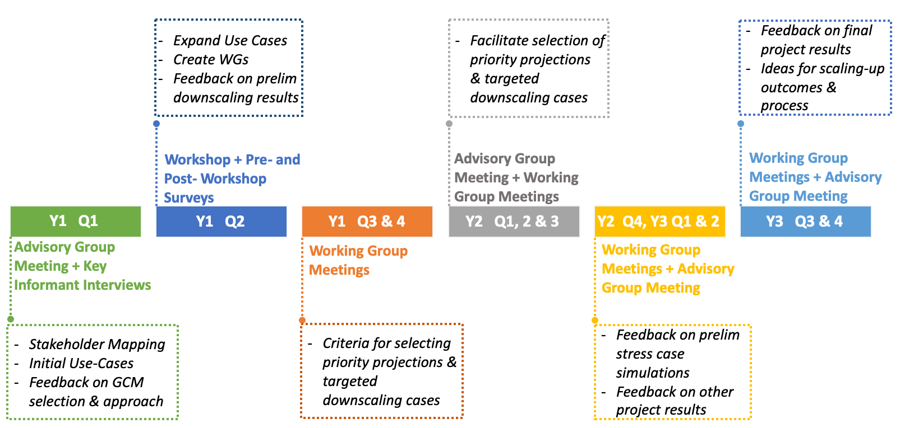
Timeline of Activities

Slide 32
Step 1: Key Informant Interviews (Apr-Jun)
Semi-structured interviews with select people having in-depth knowledge of the sector
Goals:
  Feedback on high-level approach document, variables, scales, etc.
    GCM selection feedback
  Understand prior use of climate data and issues
  Develop stakeholder map for climate information use in the sector
  Identify broad, preliminary use-cases

Slide 33
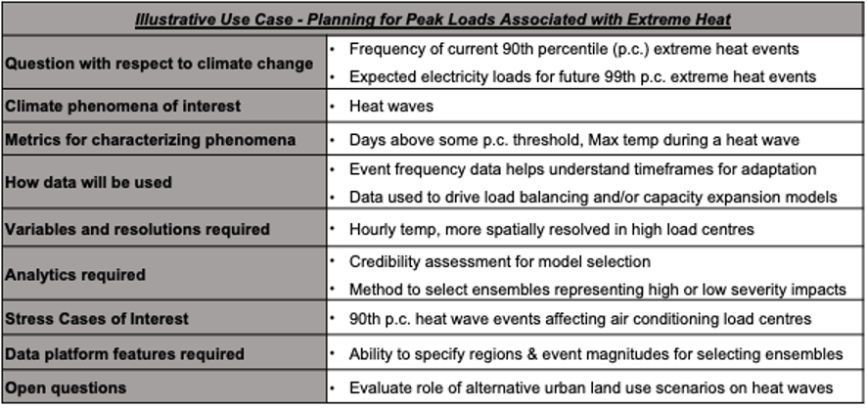
Step 2: Workshop + Surveys (late summer/early fall)
Engage expanded stakeholder groups
Goals:
  Expand on + prioritize use-cases
  Feedback on downscaling results & GCM selection
  Input on creation of Working Groups
  Begin discussing targeted downscaling

Slide 34
Step 3: Ongoing Working Group Meetings
Iterative feedback on downscaling results
Refinement of use cases
Selection of targeted downscaling cases

Slide 35
Outputs
Stakeholder Engagement Plan
  Framework for stakeholder interviews, focus groups, workshops, etc.
Stakeholder Engagement Report
  Stakeholder Map
  Use-Case Tables including metrics of relevance, variables, spatial and temporal scales, etc. and how they relate to actual decisions or uses.
  15 or more stakeholder-informed targeted downscaling cases
Publications as appropriate

Slide 36
Timeline
 | Previous Assessment | Current Iteration
Spatial Resolution | ~6km | 3km; streamflow produced for additional CA watershed
Time-Resolution | Daily for all variables Except Monthly Streamflow | Daily for all variables including streamflow
Hydrologic Models | VIC | VIC, NOAH-MP, SUMMA
Forcing Data | Statistically Downscaled GCMs | Dynamic and Statistically Downscaled GCMs
Fall-Winter 2021
Summer 2022
Spring 2023
Fall 2023
Spring 2025
Set-Up and Baseline Hydrology Performance
Calibrate/Validate Hydrologic Models
Hydrologic Simulation of Downscaled GCMs
Evaluate Target Case Studies
Analysis and Summary Report
Notes:
Example Analysis for Summary Report
Streamflow (for selected watersheds): Annual Water Budget volume and timing, change in frequency/magnitude of extreme high-flow (floods) and low-flow (droughts) events
Snowpack: change in peak snowpack and timing across Sierra Nevada’s
Uncertainty in future hydrologic projections (recall total of at least 18 simulations): Sign/Magnitude change due to GCM, Downscaling method, Bias-Correction, Hydrologic Model

