Slide 1


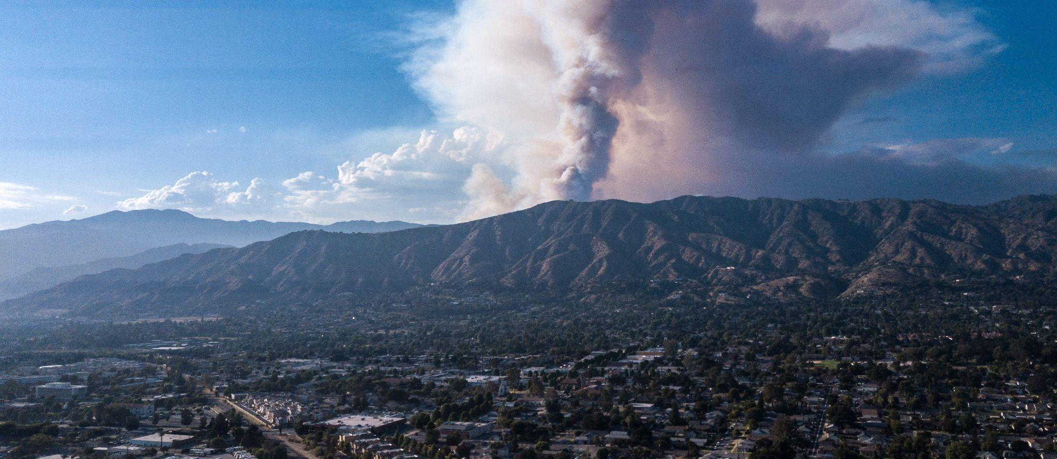
Forest Fire Research and Simulations for the Fifth California Climate Assessment: Open-source Next Generation Wildfire Models
Climate Data and Analysis Working Group (C-DAWG)
September 7, 2022
Primary Funding Provided by:
California Energy Commission – EPIC Program (EPC-18-026)
David Stoms, PhD
Commission Agreement Manager
California Energy Commission
LeRoy Westerling, PhD
Professor of Management of Complex Systems
UC Merced
David Saah, PhD
Principal Investigator
University of San Francisco and Spatial Informatics Group
Shane Romsos, MSc
Project Manager
Spatial Informatics Group

Slide 2


















Research Collaborators

Slide 3







HIGHLIGHT OF PROJECT TASKS
Principal Investigator
David Saah, PhD
Project Management
Shane Romsos
California Energy Commission Commission Agreement Manager
David Stoms, PhD
Technical Advisory Committee
Extreme Weather & Wildfire
Fuel Mapping & Fire Physics
Wildfire Forecasting
Climate Change & Fire Projections
Lead - Janice Coen, PhD
Lead – Scott Stephens, PhD
Lead – Chris Lautenberger, PhD
Lead – Leroy Westerling, PhD
Tasks
Tasks
Tasks
Tasks
Historical fire weather analysis
Weather station optimization model & tool
Pilot test of upper air profiler
Small- and large-scale fire physics experiments
Tree mortality mapping and fuels recruitment projections
Fuels characterization and mapping
Develop models to provide near-term fire forecast at a fine scale
Produce decision support tools
Cost-benefit analysis
Develop coupled statistical/dynamical fire-climate-vegetation models
Forward concepts for decision support tools
Support California’s 5th climate assessment

Slide 4




Overview of project
Science
Models
Tools
Implement
Impact
FIRE BEHAVIOR
FORECAST TOOLS
ELECTRIC UTILITIES
NEXT GENERATION WILDFIRE MODELS
SAFE, RELIABLE, COST EFFECTIVE AND RESILIENT GRID
EXTREME WEATHER
WILDFIRE RISK PROJECTIONS
5TH CLIMATE CHANGE ASSESSMENT, CA
Notes:
Pathway from science to impact - a more resilient grid

Slide 5
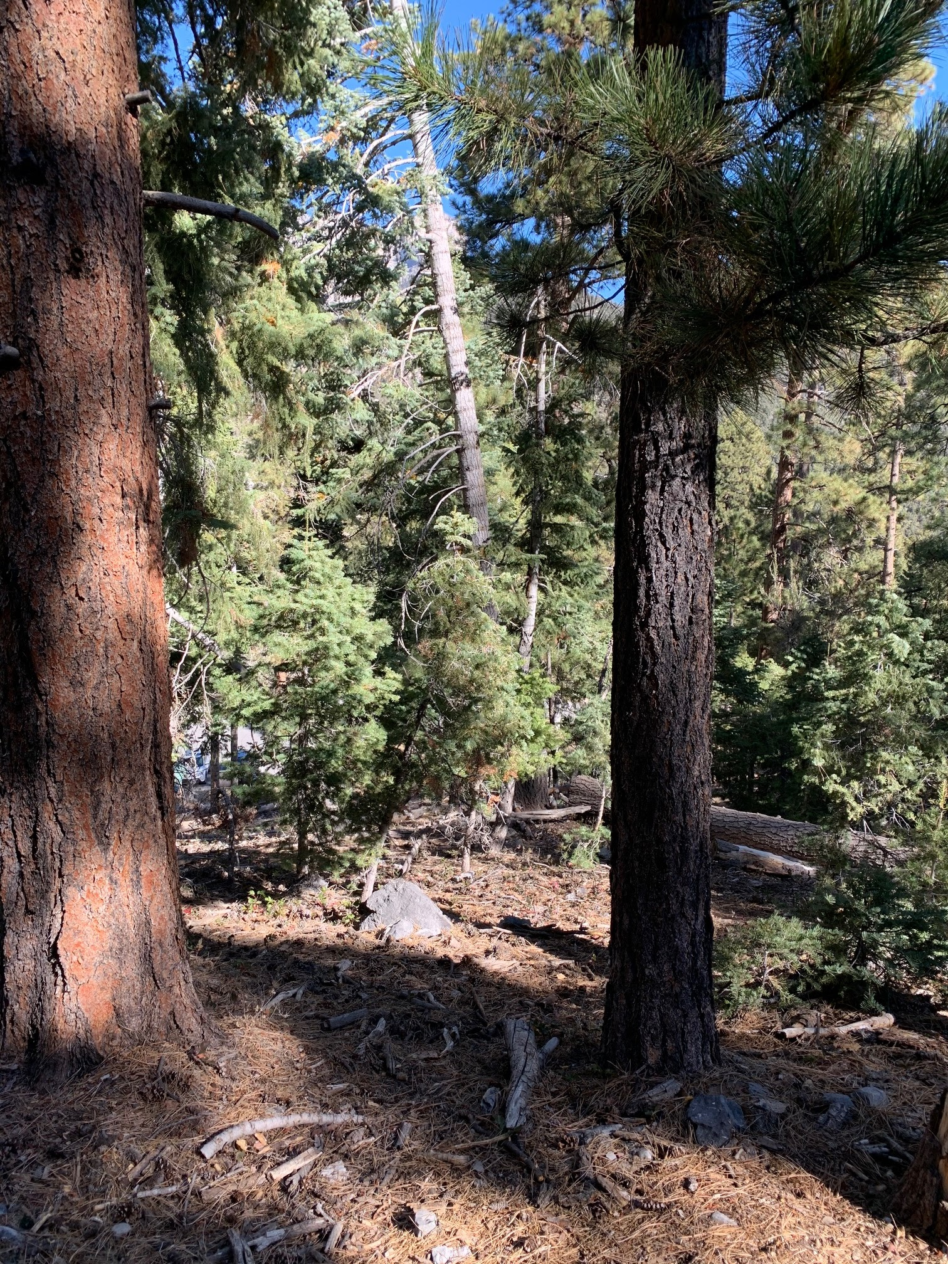
Forest Fire Research and Simulations for the Fifth California Climate Assessment
LeRoy Westerling, PhD
UC Merced

Slide 6
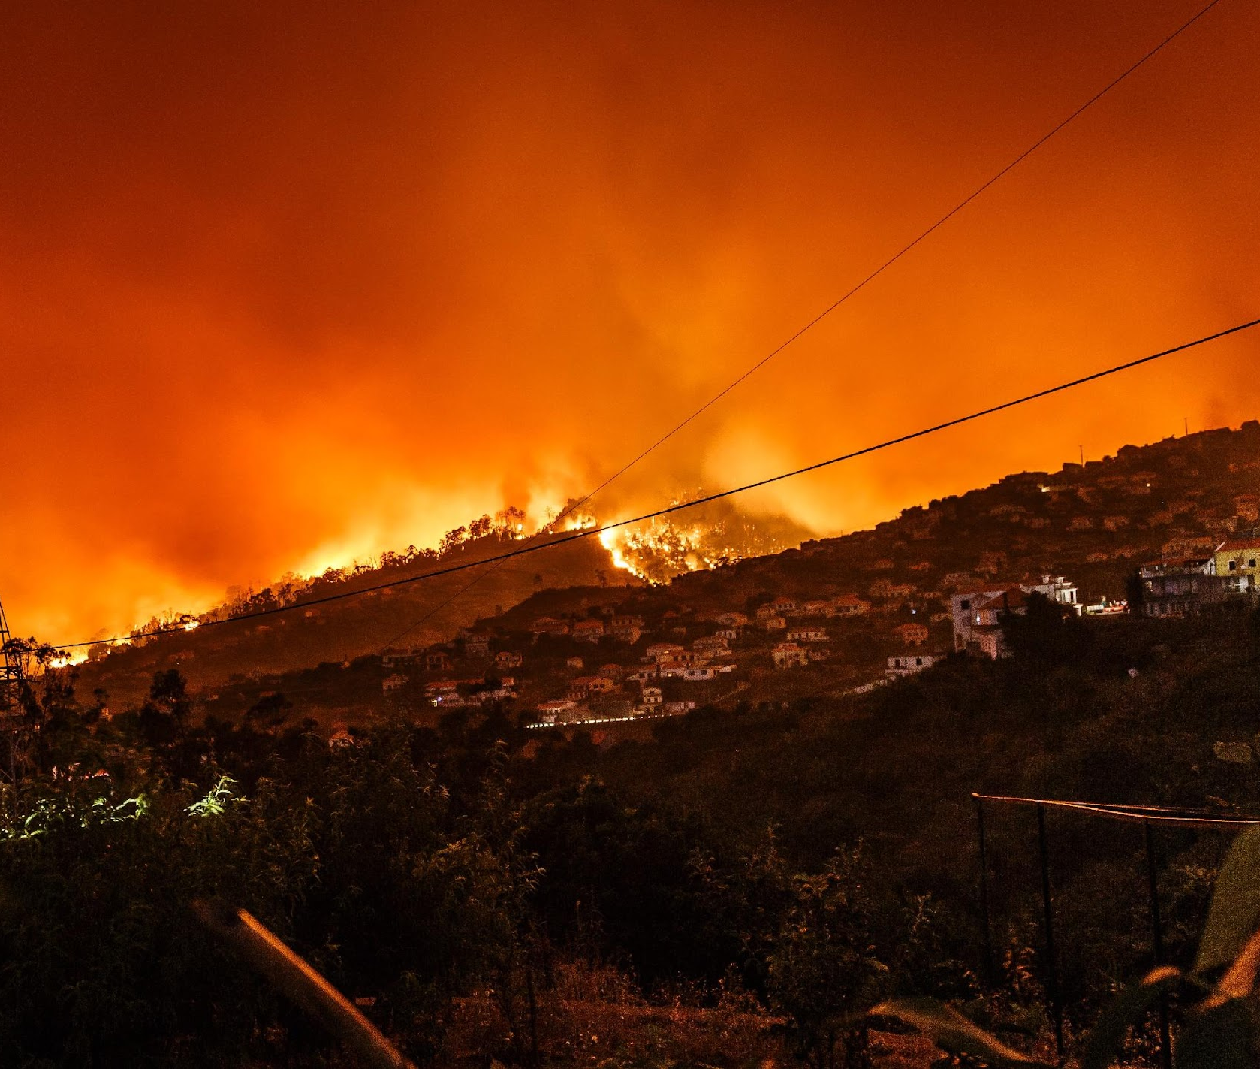
Background and Presentation Purpose
Overview
Seek feedback to constrain or expand model runs
Computational capacity + current funding supports limited model runs + uncertainties about when data will be available and processing time
Initial runs expected to be completed by December 2022
Different feedback needed on
  SSPs/RCPs
  GCMs
  Vegetation management scenarios
  Land use scenarios

Slide 7
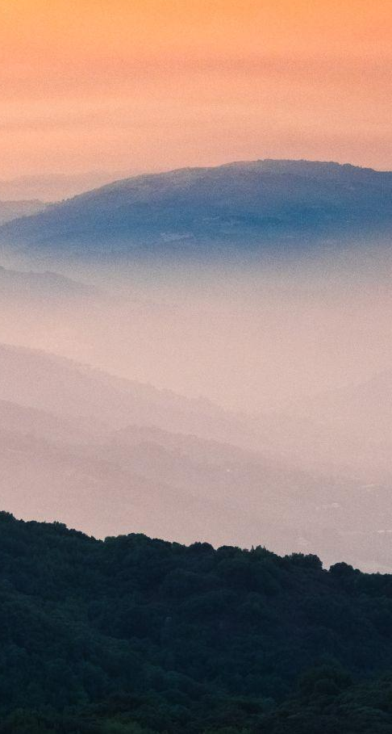

CLIMATE CHANGE & FIRE PROJECTIONS WORKGROUP (WORKGROUP 4)
Goal:
Develop the next generation of coupled statistical and dynamical fire-climate-vegetation models to run long-term (to end-of-century) wildfire risk projections and incorporate best in-class science and technology to enhance the models.

Slide 8
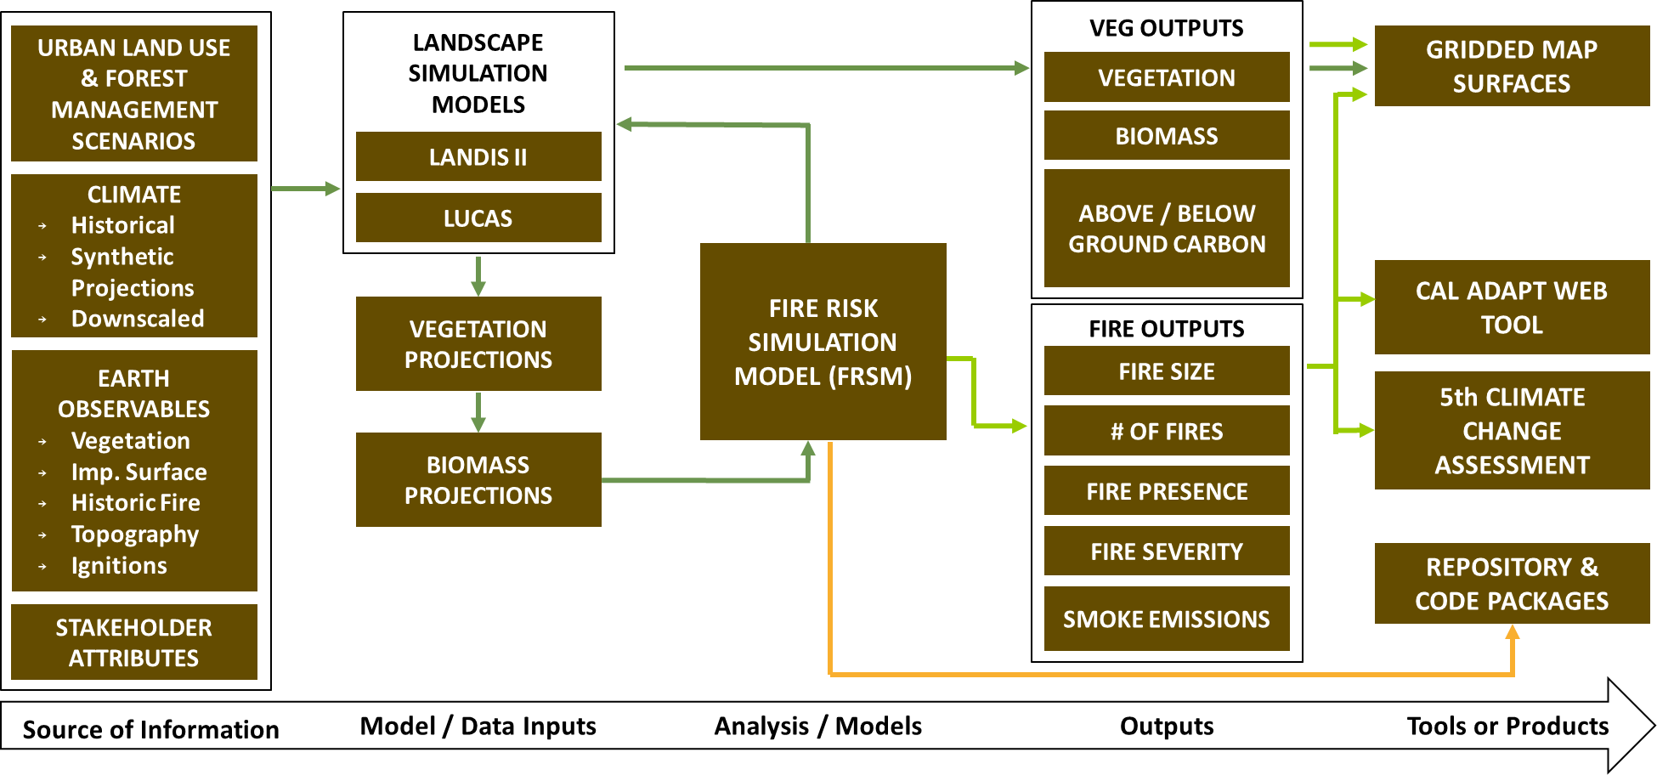
MODELING FRAMEWORK

Slide 9
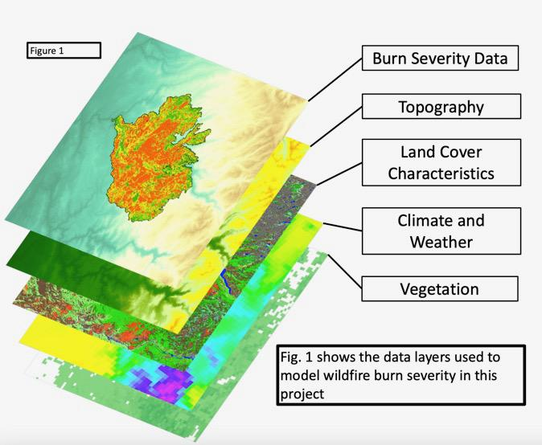
Simulating fire severity maps integrates across dynamic vegetation modeling
Downscaled climate
Fuels treatment scenarios
Land use scenarios

Slide 10
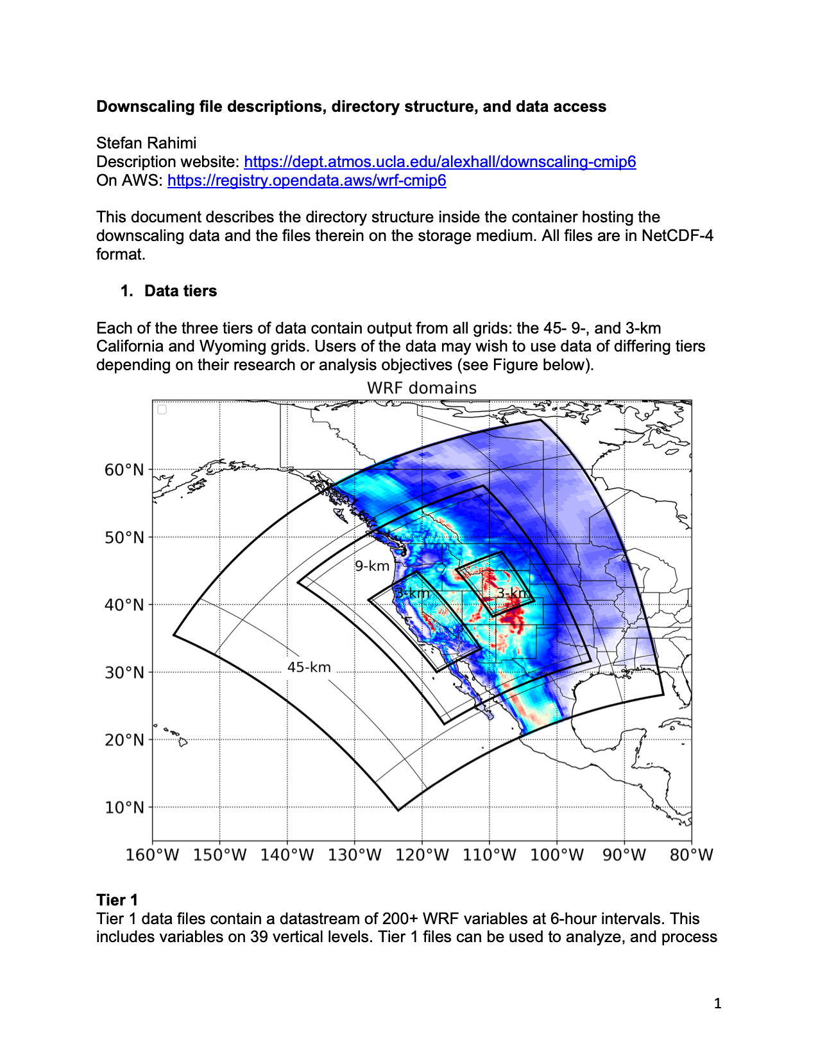
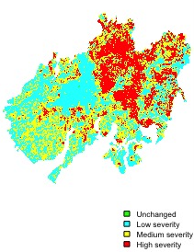
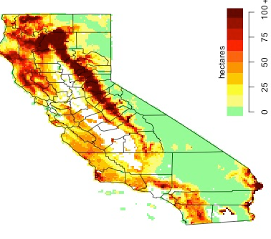
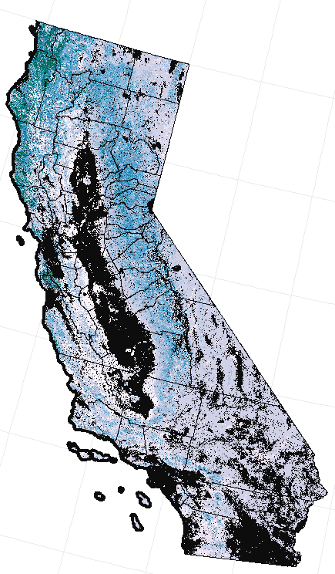
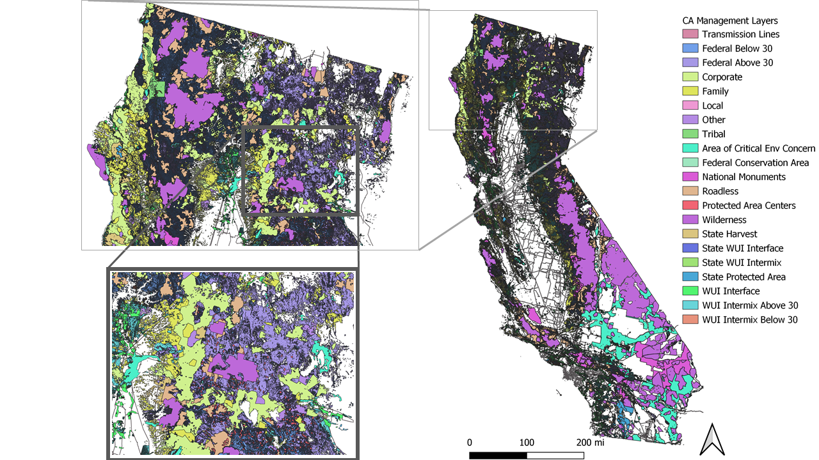
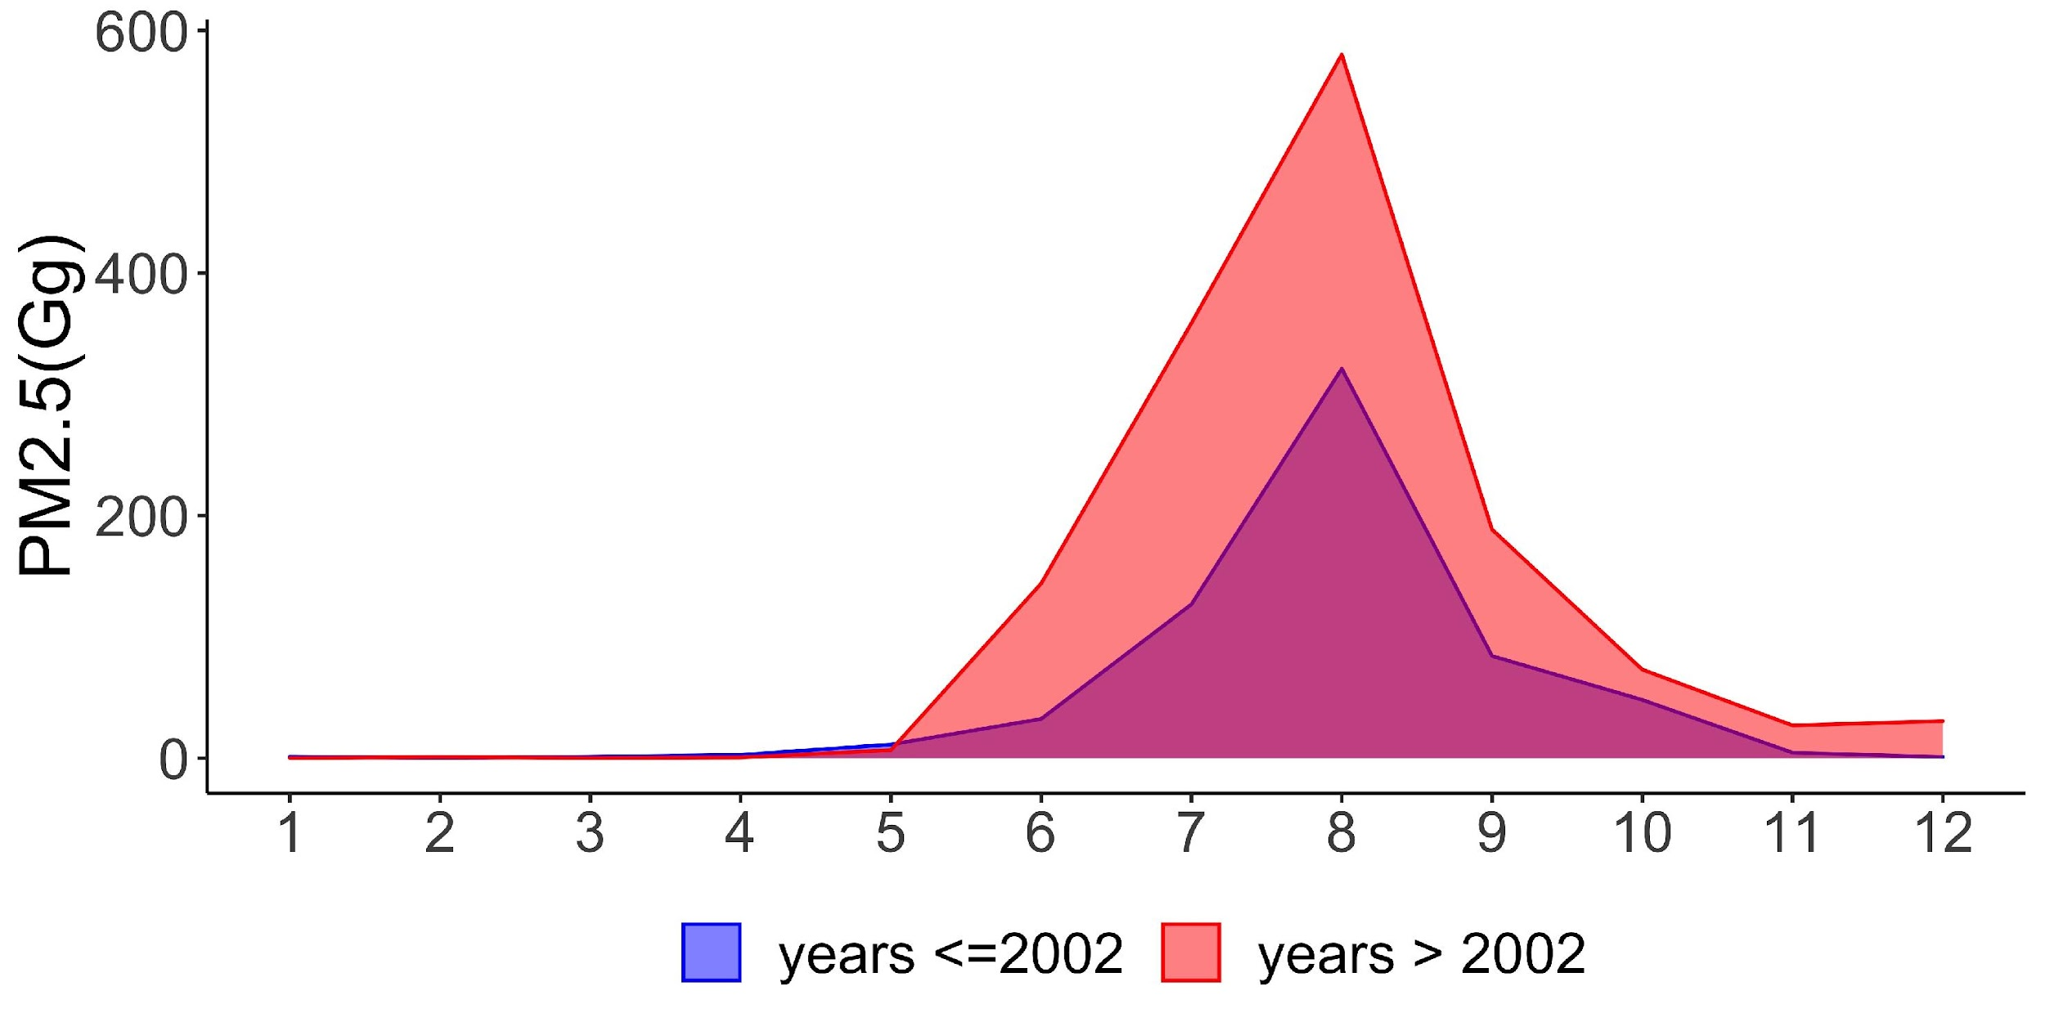
FIRE RISK SIMULATION MODELS
Climate
Individual Wildfire Severity Map Simulations
Hazard Maps
Models
Vegetation
Management & Land Use
+
Smoke Emissions
INPUTS
OUTPUTS

Slide 11
CLIMATE SCENARIOS
More GCM runs through mid C to explore impacts of drought variability on wildfire through mid-century
A few GCM runs through end C to explore consequences of low and high temperature trends through end century
We will continue processing additional scenarios until the project period runs out, with some uncertainty about the total #.
Our questions are really:
what are your priorities?
(2) what is the minimum set of required scenarios? (we hope to exceed these!)

Slide 12
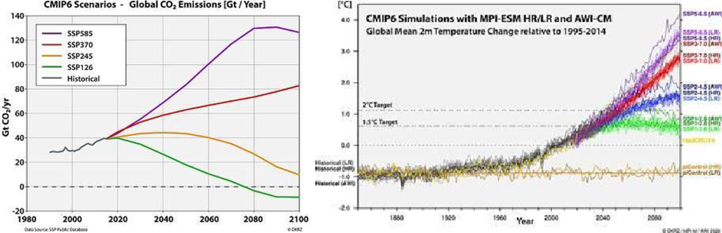
GHG EMISSION SCENARIOS

Slide 13
GHG EMISSION SCENARIOS (cont.)
What is more important: the global emissions scenario, or the temperature trajectory, regardless of method to determine both?
Bracket current trajectory … SSP2-4.5 and SSP5-8.5? Should we consider others? What is a reasonable high-end for global emissions?
Notable:
  More emissions scenarios compete with other scenario dimensions (e.g. drought intensity and timing, fuels and urban development) for computational resources.
  SSP5-8.5 may be unrealistically high in late century given current renewable energy trends, but other Earth system feedbacks could drive concentrations higher

Slide 14

PROPOSED EVALUATION PATHWAY - GHG EMISSION SCENARIOS AND CLIMATE MODELS
GHG Emission Scenarios
    Model two GHG emission scenarios to bound extremes (chosen from SSP2-4.5, SSP3-7.0, and SSP5-8.5) - across four or more climate models through mid-century?
    Which/how many GHG emission scenarios for end-of-century projections? How many GCMs through end-of-century?
    Climate Models (GCMs)
  Use GCMs selected through UCSD/Scripps Project for mid-century projections? What’s more important: the # and specific GCMs to use, or the drought scenarios they illuminate? We have not evaluated any scenarios yet…
  Do you prefer specific GCM(s) (or climate run characteristics?!?) for end of century wildfire risk projections (2065 to 2100)?

Slide 15
VEGETATION MANAGEMENT SCENARIOS
Explore impacts of 'Business as Usual’ (BAU) vs 'High Ambition' vegetation management through mid-century.
Evaluate one scenario after 2064? Which (BAU vs. high ambitions)?
E.g,. Maintenance management after 2064.
At this point, the 1 million acre scenario we derived from published policy goals is “wrapped”… additional resources would be required to implement another scenario.

Slide 16
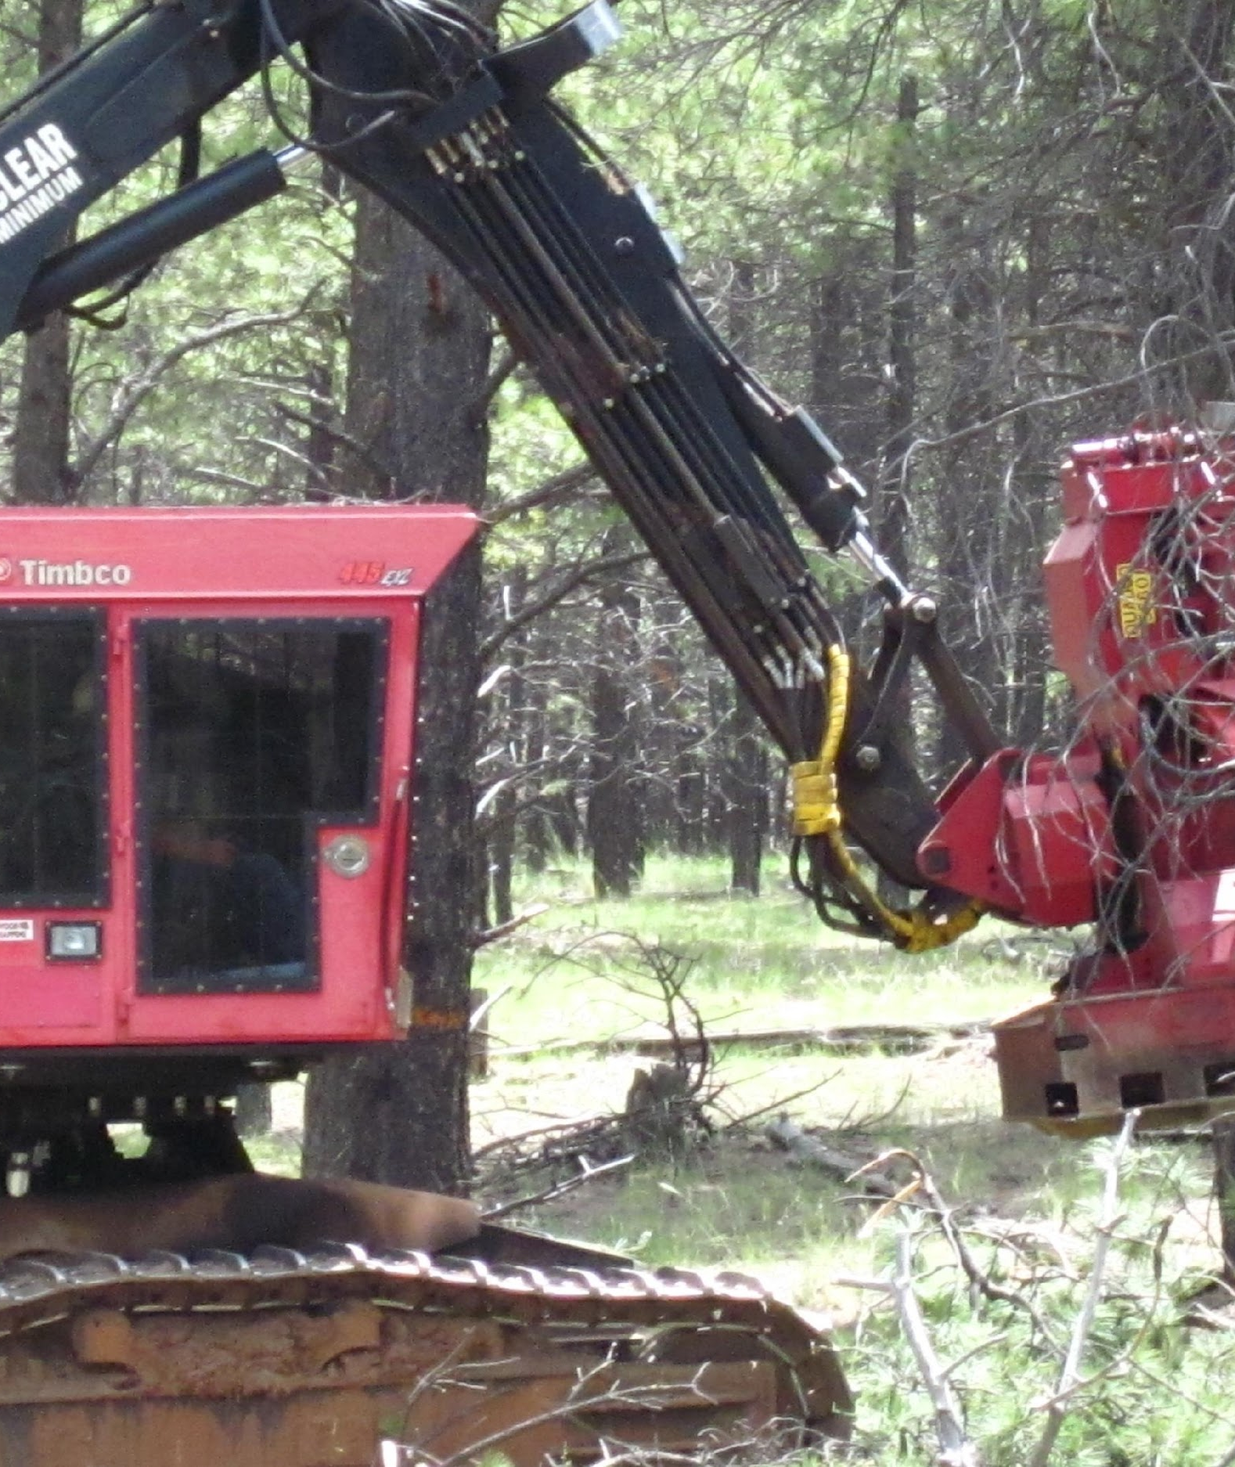
PROPOSED VEGETATION MANAGEMENT SCENARIOS
High Ambition Scenario:
  Current CA management policy (i.e., 2021 Resilience Action Plan)
  Treat 1 million acres/year
  Initially target WUI and high fire threat areas, followed by areas designated as moderate and low threat areas
  Maintenance treatments maintained to end of century (1 million acres/year).
Business as Usual Scenario:
  Treat ~440k acres/year
  Typically associated with WU
Question: is it acceptable to switch to “maintenance” mode after 2064… i.e., no new treatment areas, just maintaining fuel structure (mostly with fire)?

Slide 17
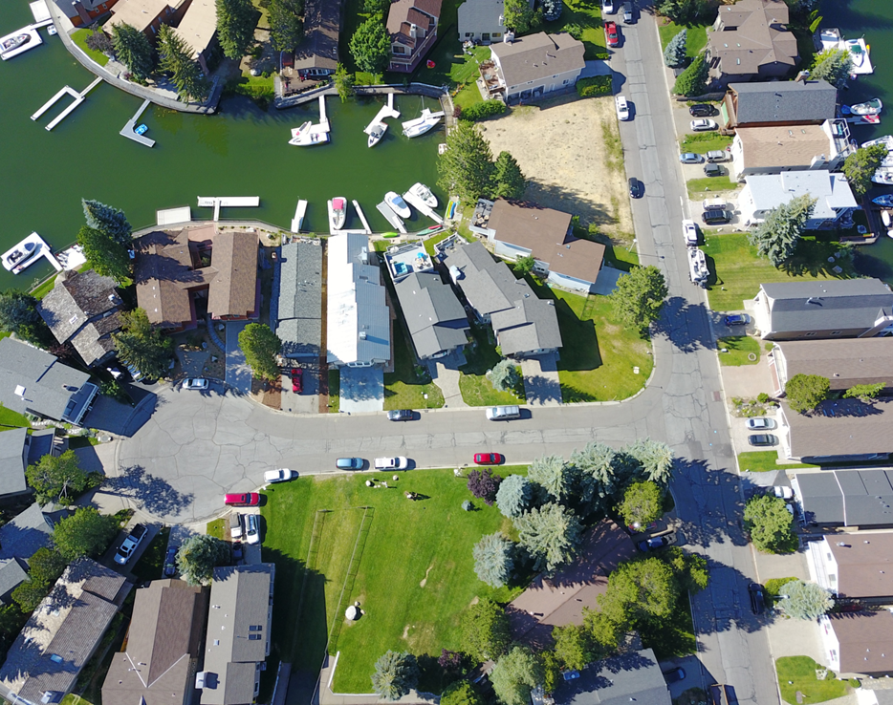
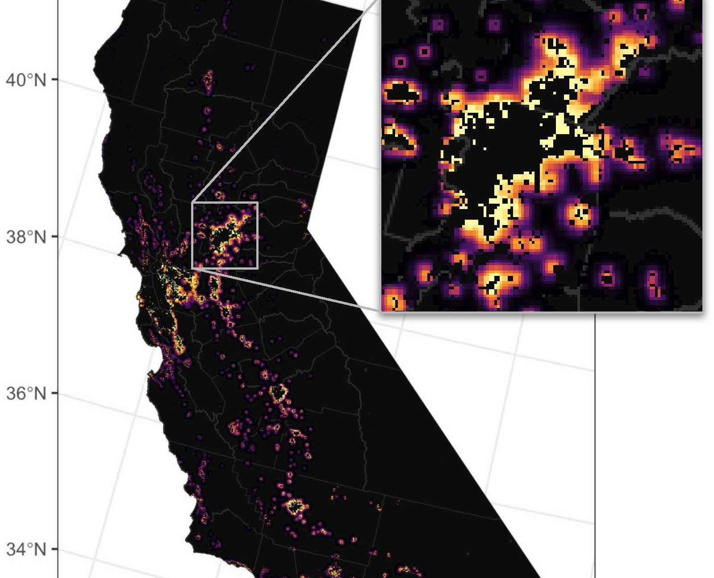
URBAN DEVELOPMENT SCENARIOS
Explore impacts of low vs. high urban sprawl through mid-century
Propose to evaluate just one scenario after 2064? Which?
  E.g., maintain/clamp urban growth after 2064
How to incorporate other land use considerations?
  E.g., 30X30, SB100 goals, WUI controls, SGMA goals
  How much sprawl vs how concentrated?
These scenarios have not been implemented yet… these can be tailored to your requirements if we get them soon.

Slide 18
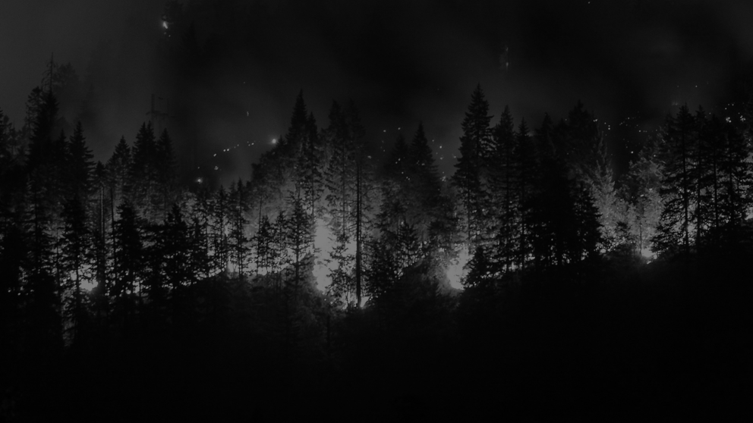

Project Contacts:
Ashley Conrad-Saydah, Stakeholder Liaison - acsaydah@sig-gis.com
LeRoy Westerling, Wildfire Projections Lead - lwesterling@ucmerced.edu
David Saah, Principal Investigator - dsaah@sig-gis.org
Shane Romsos, Project Manager – sromsos@sig-gis.com
Project Website - https://pyregence.org/

Slide 19
Thank You

