Slide 1
Later this fall…
Warming Level Framework via the Cal-Adapt Analytics Engine
An Energy Sector Focused Historical Weather Data Platform
Other ideas?
Please raise hand and unmute yourself to talk.
Phone controls: press *6 to mute/unmute, *9 to raise hand.
Notes:
Group brainstorm on discussion items; welcome hearing from you!

Slide 2
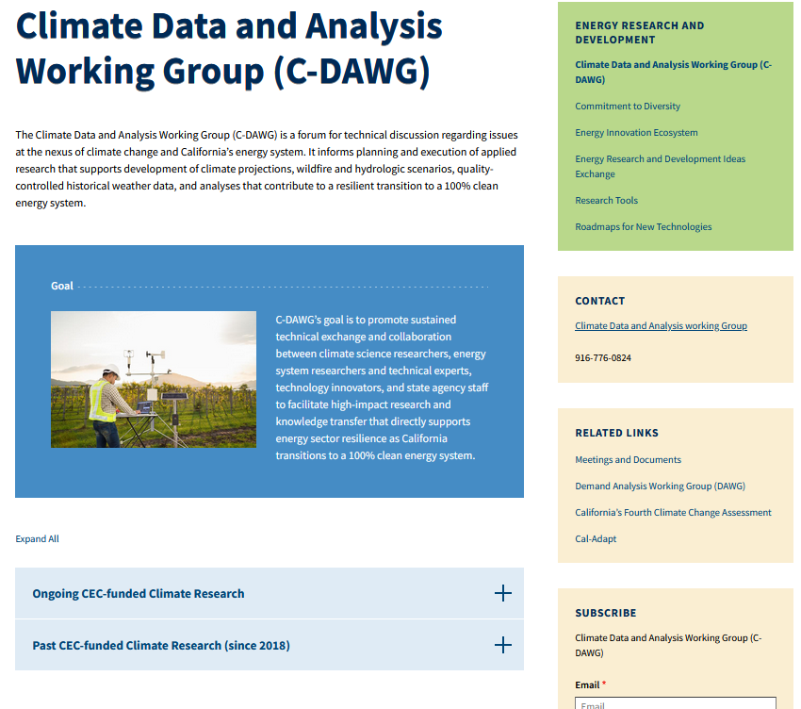
Thank you!

