Slide 1
Kick-Off Meeting
Administrative Items
Presented by the Contracts, Grants and Loans Office
California Energy Commission

Slide 2
Roles of Key Participants
Commission Agreement Manager (CAM)
  First point of contact for all inquiries and correspondence
Contracts, Grants and Loans Office (CGL) and Accounting Offices
  CGL Address used to submit confidential deliverables/products
  Accounting address used to submit all other deliverables/products
  No individuals identified
Legal Notices
  For use when sending legal notices to the Commission per the agreement terms.

Slide 3
Agreement Term
Funds have a limited period in which they must be expended. All expenditures must occur within the approved term of the agreement.
Approved term = Effective Date (Date signed by Energy Commission) to End Term Date

Slide 4
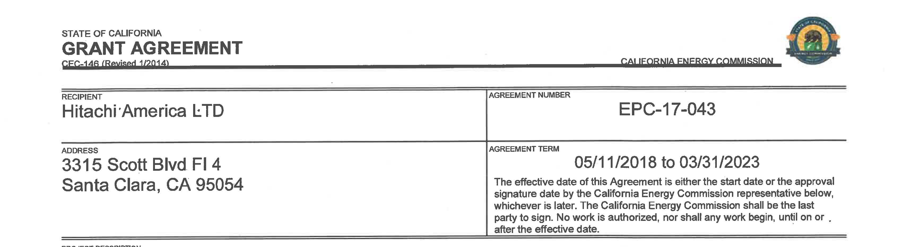
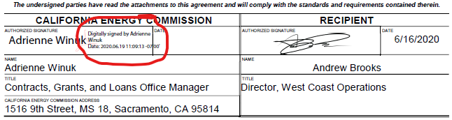
Effective Date
Later of start date and signature date by Energy Commission (or DGS if applicable in contracts)
Earliest date to incur reimbursable or match costs
  (See CAM for exception for ARFVTP)
Effective date in this example is 6/22/18

Slide 5
End Term Date and Extensions
End Term Date
  Found in the Agreement Term box on signature page
  Last date to incur costs
Extensions to Term End Date
  Require formal amendment
  Must have a strong justification
  Requires management approval inside Energy Commission
  May not be possible outside of the funding period (liquidation period)
Extensions to Deliverable/Product Due Dates
  Permissible within term of agreement with approval from CAM

Slide 6
Invoicing
Invoice Templates
Progress Reports
Reimbursement for Actual Incurred Costs
Match
Retention
Invoice Process

Slide 7
Invoicing – Templates
Energy Commission Website –
  Funding > Funding Resources page
  Under General Funding Information
Different templates for Contracts and Grants
Must submit required back-up in addition to the template
Submit Monthly or Quarterly
  Consistent with the frequency of the Progress Reports

Slide 8
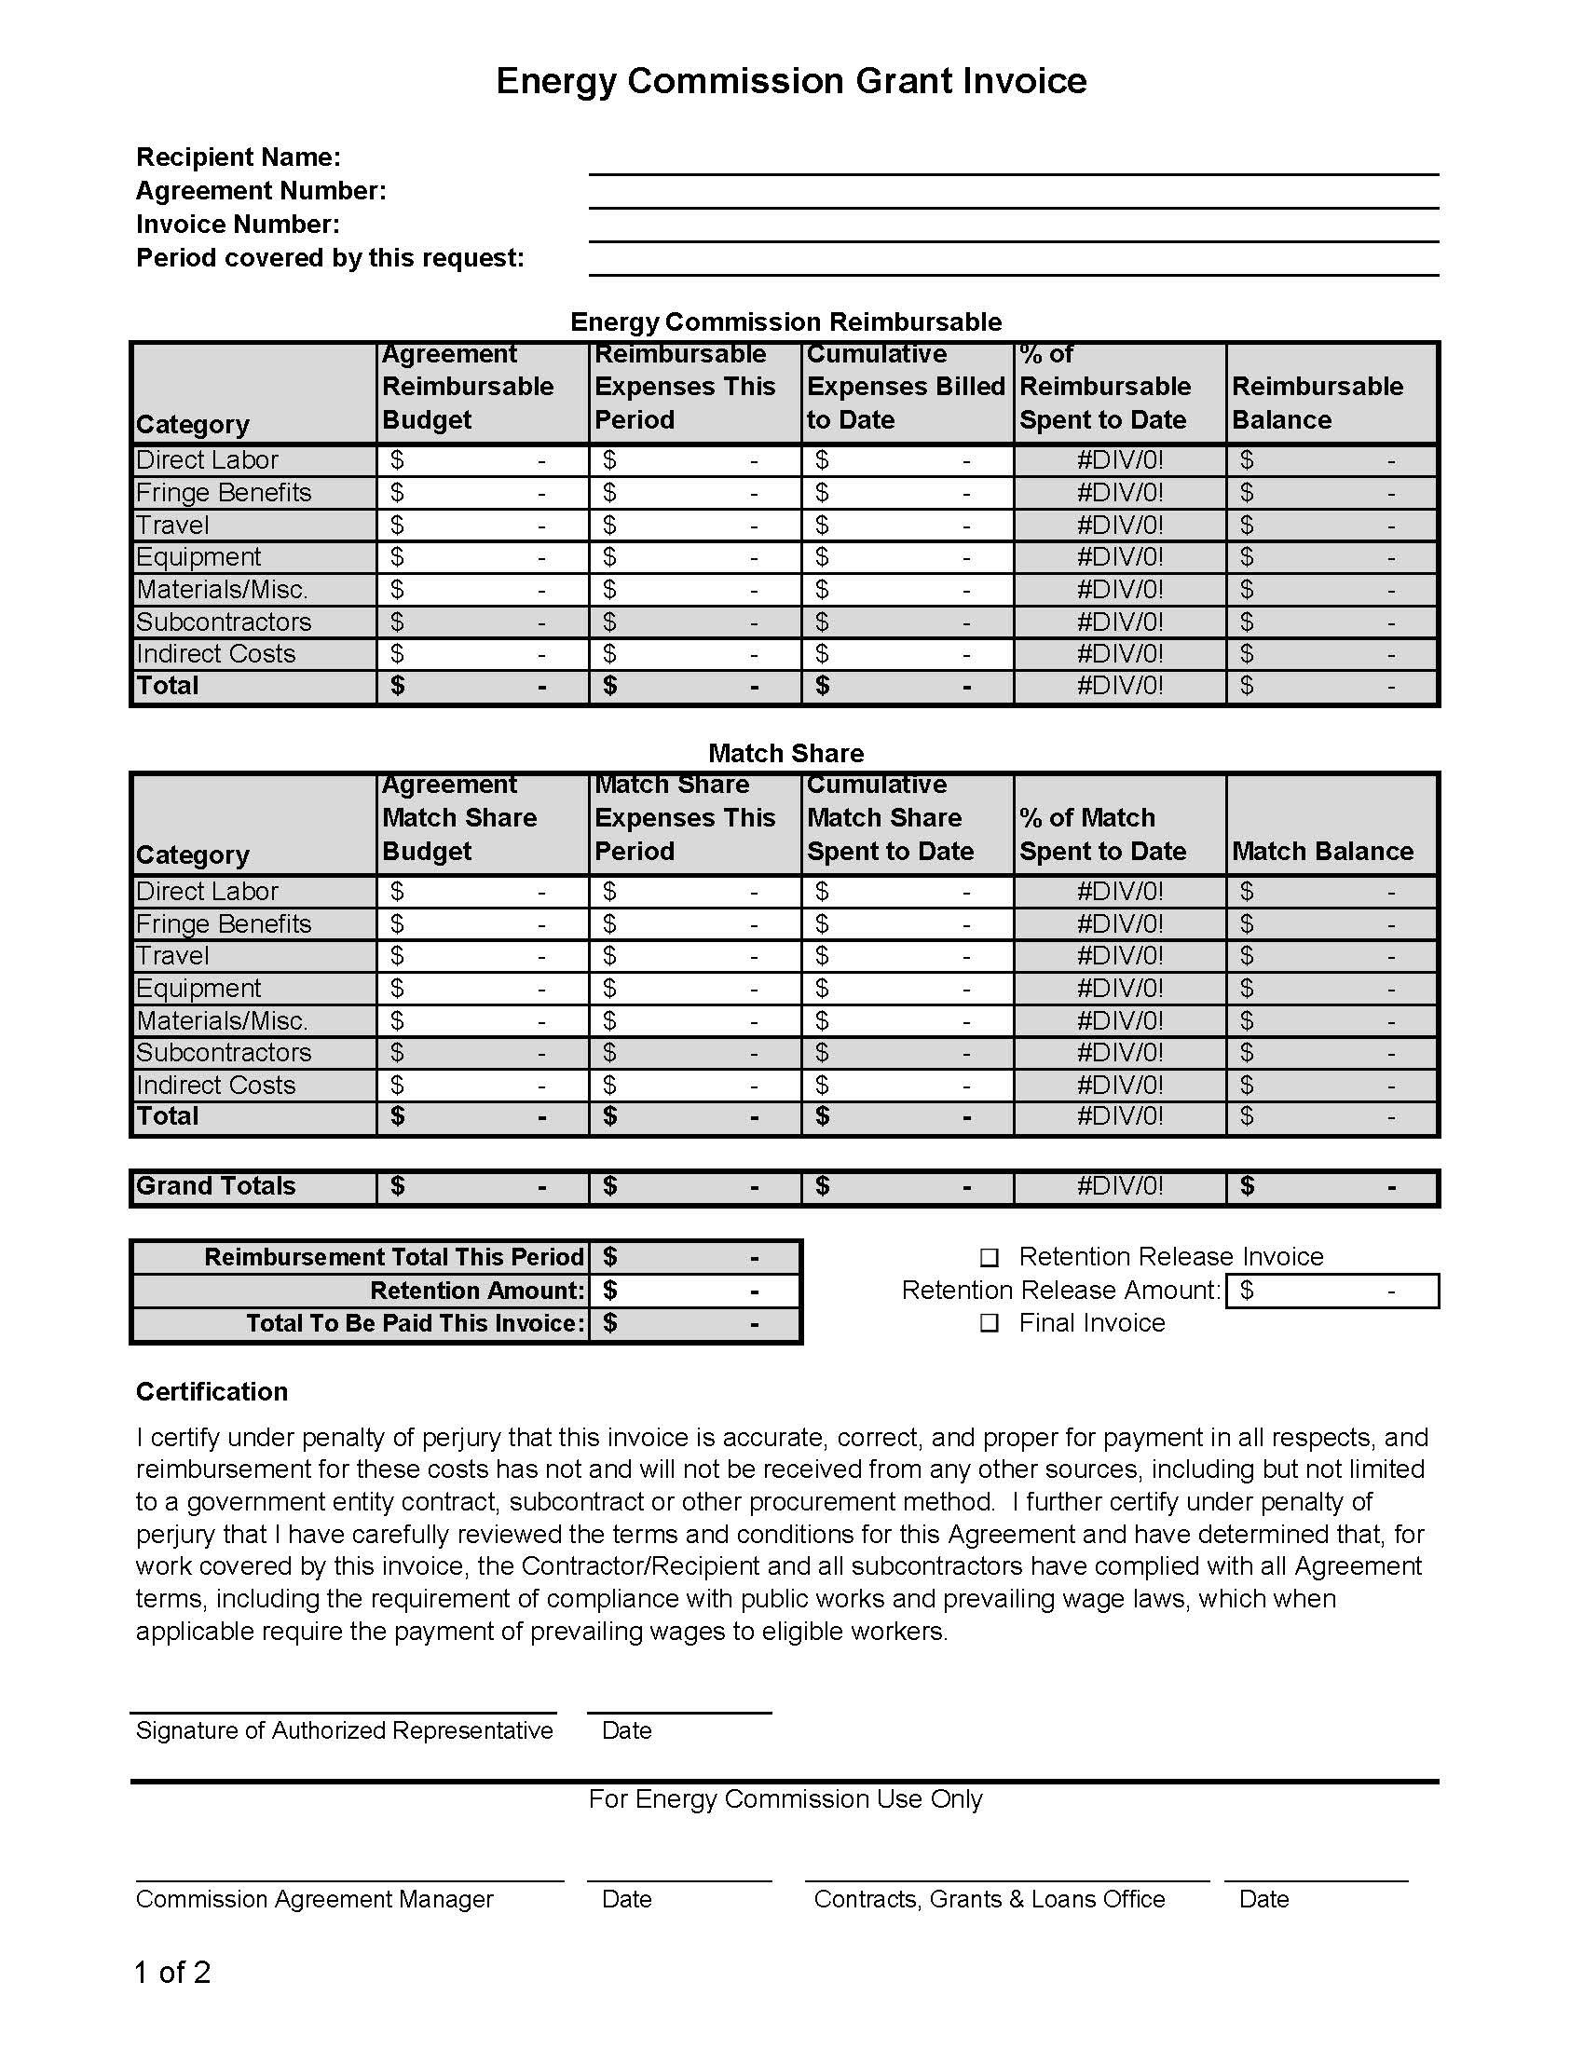
Invoicing – Templates
Top portion includes: Company name, Agreement Number, Invoice Number and Period of Request
Invoice Number should be sequential and include Agreement number for easier reference later.

Slide 9
Invoicing – Templates
Reimbursable Expenses by Category
Enter Budget, Expenses this Period and Cumulative Expenses Billed to Date
Percent of Budget Spent and Reimbursable Balance will automatically calculate
Identify potential overages early and request approval from CAM

Slide 10
Invoicing – Templates
Match Share Expenses by Category
Enter Budget, Expenses this Period and Cumulative Expenses Billed to Date
Percent of Match Spent and Match Balance will automatically calculate

Slide 11
Invoicing – Templates
Reimbursable Total will automatically calculate
Contractor/Recipient must enter Retention amount
  10% of total reimbursable invoice amount unless otherwise approved in the agreement or by CAM
Certification and Signature

Slide 12
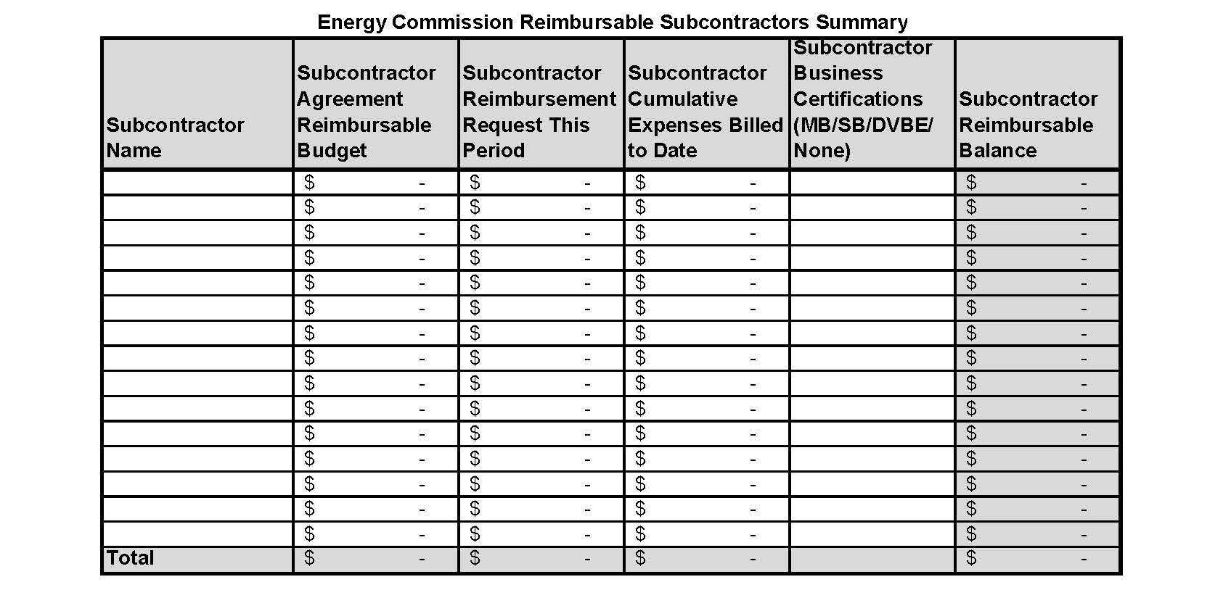
Invoicing – Templates
Page 2 (Top – Reimbursable, Bottom – Match) Budget, Reimbursement Request this Period and Cumulative Expenses to date by Subcontractor
Identify any CA state certifications the sub may have including Small Business or Disabled Veteran Business Enterprise (DVBE)
Must be supported by Subcontractor invoices

Slide 13
Invoicing – Progress Reports
Monthly or Quarterly per the Scope of Work and consistent with the frequency of invoices
Progress Report and Invoice period must match
Must demonstrate to the CAM why the amounts invoiced are appropriate for reimbursement
Identify any potential problems with staying on schedule or within budget

Slide 14
Reimbursement for Actual Incurred Costs - Labor
2 components for labor:
  Time (Labor Hours or %Monthly Effort)
  Labor Rate

Slide 15
Reimbursement for Actual Incurred Costs – Labor (Time)
Invoices do not require timesheets
Invoices require Individual’s Name, Classification, and Hours or % Monthly Effort
Timesheets must be available to auditor
Timesheets must track all hours, not just project hours
Timesheets must be certified by employee and approved by supervisor

Slide 16
Reimbursement for Actual Incurred Costs – Labor (Rate)
Claimed rates must be based on what the employee is actually paid (not including fringe benefits or other mark-ups)
Reimburse for actual rate up to the budgeted rate cap
Auditor will look at W-2 and divide by 2,080 (typical # of work hours in a year)

Slide 17
Reimbursement for Actual Incurred Costs – Fringe Benefits (FB)
No required back-up for invoices
Reimburse for actual rate up to the budgeted rate cap
Contractor/Recipient must be able to support the claimed FB rate in an audit:
  List of all FB and actual cost of benefits
  Documentation of Total Payroll
  Review actual costs each year and only claim what is supported

Slide 18
Reimbursement for Actual Incurred Costs – Indirect Costs
No required back-up for invoices
Reimburse for actual rate up to the budgeted rate cap
Must be based on a documented indirect cost allocation plan
  List of all indirect costs
  Choose a basis to allocate those costs
  Must allocate to more than one project
  Must be based on actual costs and updated each year
  Only claim what is supported up to the rate cap

Slide 19
Reimbursement for Actual Incurred Costs – Other Direct Costs
Materials, Miscellaneous and Equipment:
  Invoice back-up must include receipts for each item
Travel:
  Only pre-approved trips are reimbursable
  Travel and Per Diem Memo online with link in terms
  Receipts for most items
  Must indicate departure and return dates and times
Subcontractor Costs:
  Must include Subcontractor invoices
  Same level of detail on invoice as required in that subcontractor’s budget

Slide 20
Reimbursement for Actual Incurred Costs – Other Direct Costs
Other Direct Costs – Audits
  Will review invoices
  Will trace the claimed amount through bank statements to verify payment
  Will verify that vendors were paid timely (i.e., within 14 days of receipt of CEC funds)

Slide 21
Match Share Requirements
Same level of detail and back-up as reimbursable expenses
Not restricted to the rate caps in the agreement budget
Must keep documentation to verify when match is incurred by 3rd party
  Any contract with 3rd party as well as any and all invoices submitted
Must keep documentation to verify match claimed on use of equipment or other assets
  Document the actual value and amount of time used

Slide 22
Retention
10% of the total reimbursement amount of each invoice
Withheld until the completion of the agreement
Release of retention must be invoiced separate from any reimbursement invoice

Slide 23
Invoice Process
Contractor/recipient prints the completed invoice, signs cover page, and scans the invoice into a PDF document.
Name the PDF document using the convention: agreement number invoice number (e.g. ARV-19-001 invoice 01).
Attach the named PDF document to an email, using the same naming convention in the subject line (e.g. ARV-19-001 invoice 01)

Slide 24
Invoice Process
If the file is too large to email and must be sent in batches, name the file agreement number invoice number x of total (e.g. ARV-19-001 invoice 01 1 of 3).
Contractor/Recipient emails invoice PDF to invoices@energy.ca.gov for processing.
CAM will review the invoice and either approve or dispute.
  A dispute is documentation of an issue in the invoice documentation.

Slide 25
Invoice Process
When CAM approves, CAM will forward to CGL for administrative review.
When CGL approves, CGL will forward to Accounting for payment processing with State Controller’s Office (SCO).
SCO will send check/warrant via USPS. No electronic payments

Slide 26
Invoice Process
Commission commitment is to process in-house in 30 days, the State Controller’s office has an additional 15 days to cut the check.
All questions and inquiries should be directed to the CAM
Confidential deliverables/products:
  Must be pre-approved prior to acceptance by the Energy Commission
  Must be submitted to CGL
  Must be in a sealed envelope and clearly marked

Slide 27
Changes to Agreements
Informal vs Formal

Slide 28
Agreement Changes
Informal Amendments:
  Changes to schedule within agreement term
  Budget reallocations
  Changes to contacts
  Usually handled via email communication with CAM
Formal Amendments:
  SOW changes
  Term extension
  Require signed documents by both parties

Slide 29
CAM will communicate any of your additional questions with CGL representatives after your kick-off meeting.

