Slide 1
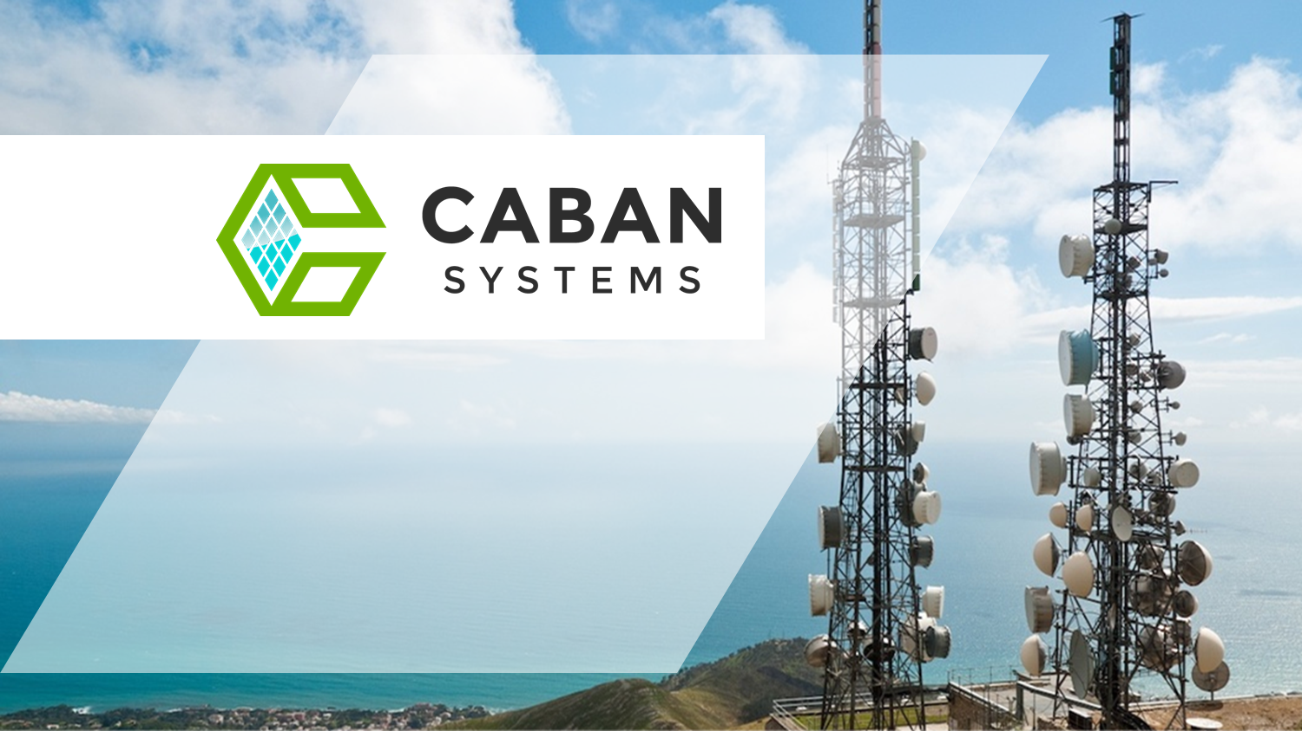
Reliable Cost-Effective Intelligent Energy Solutions Powering The Telecommunication Industry
info@cabansystems.com | cabansystems.com

Slide 2
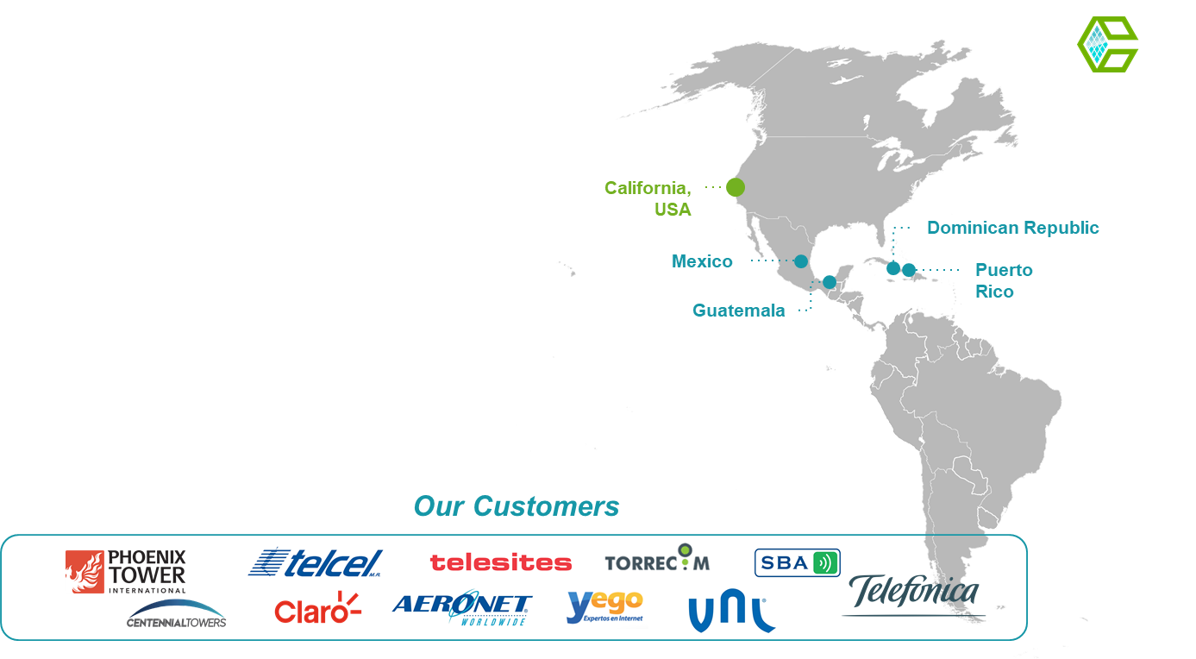
About Caban Systems
Caban Systems was founded in 2017 with over 50+ years of combined experience designing and manufacturing lithium-ion storage systems for a wide variety of applications, across numerous industries. As a team of conscious engineers, we reduce our customers’ energy expenses with our generation and storage systems that are cleaner and more reliable than existing solutions. We are passionate about sustainability, energy access, and helping communities receive the benefits of greater connection and communication. Caban Systems currently operates in several countries and has headquarters in Burlingame, CA.

Slide 3
Smart Energy Storage
Intelligent, efficient, software enabled lithium-ion Energy Storage Platform for the Telecommunication Industry
High Density and Vertically Integrated

Slide 4
Features
Reduce Costs.
Increase Uptime.
Energy Resilience And Reliability
Each system is built with Caban’s patented battery management system, giving your site supreme power reliability. Increased uptime means happy customers.
Low-Maintenance Power
With remote monitoring and control, Caban’s power solution reduces the need for on-site maintenance. Fewer man-hours mean thousands saved every year.
Simplified Operations
Frequent fuel delivery to remote sites is a thing of the past. Using cleaner energy sources reduces your footprint and simplifies your operations.

Slide 5
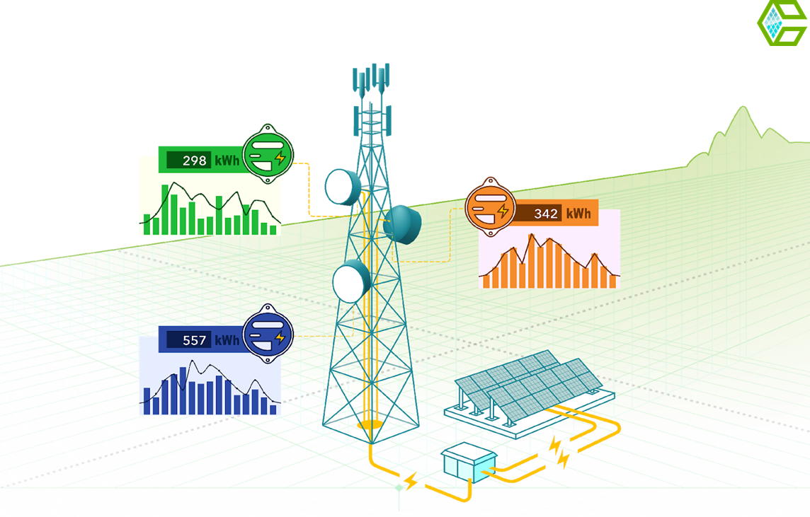
Dedicated Power Delivery
Multiple Loads.
One Power Source.
Tenant Submetering
Energy consumption individually metered for each tenant
Power Delivery Control
Remotely access and control individual loads
Maximized Real Estate
Single power source, reducing space required for power assets

Slide 6
Product Details
System Options

Slide 7
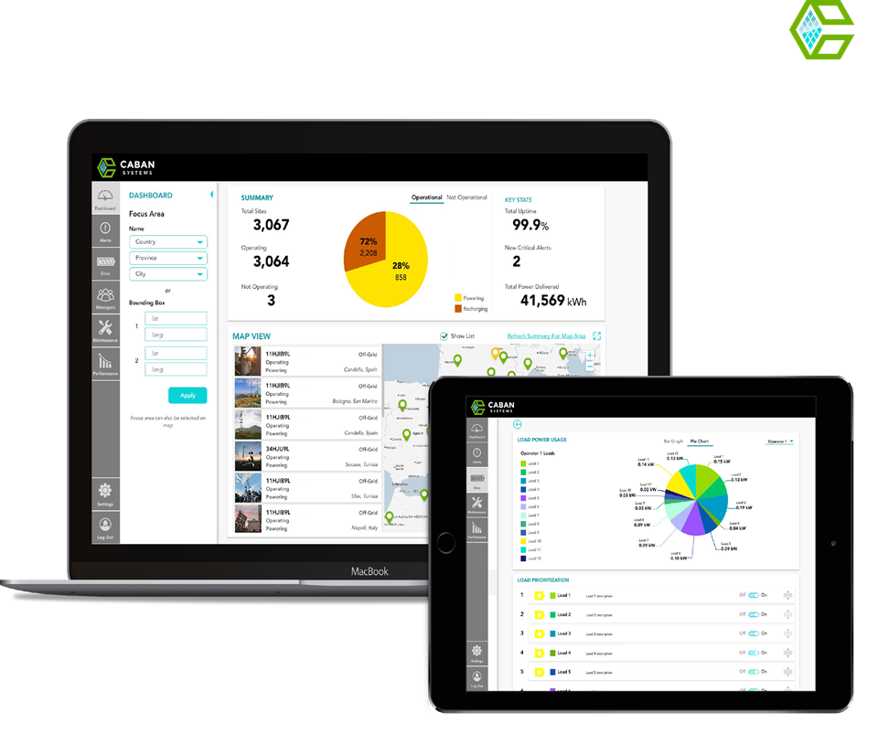
Remote Monitoring & Control
Monitor and Control.
Do It All Remotely.
Management Software Features
Vital stats dashboard
Interactive map and site list
Discrete load prioritization
Actionable real-time alerts
Maintenance scheduling & tracking
Tenant management
Historical performance reports

Slide 8
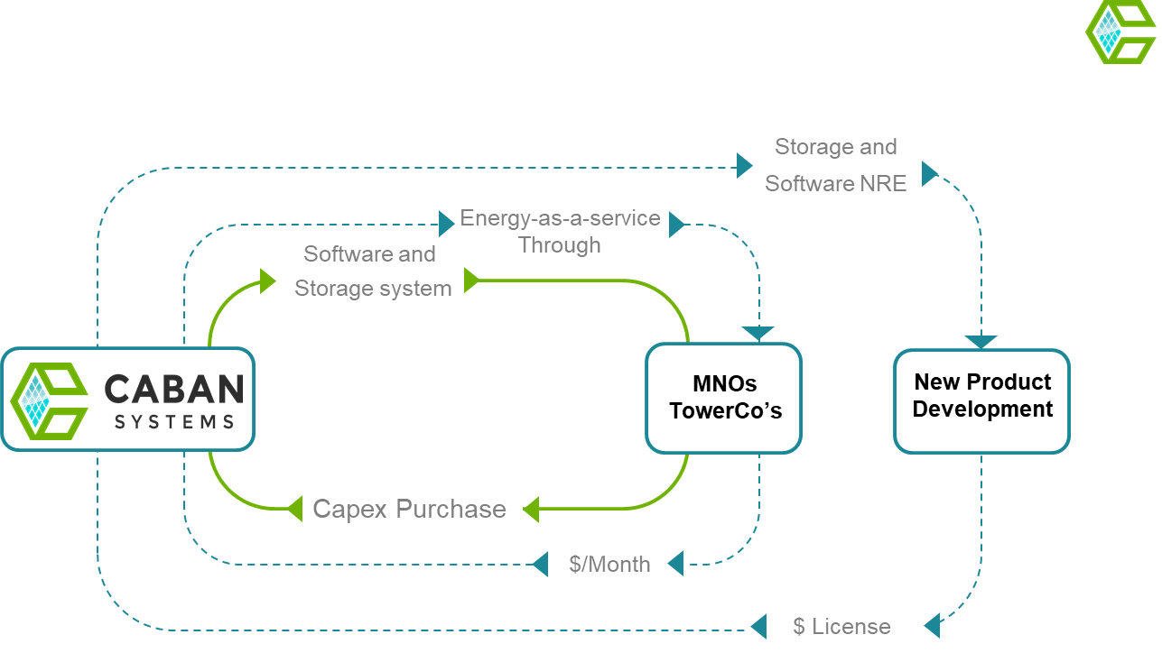
Business Model

Slide 9
CEC Project Background
California ratepayers are increasingly vulnerable to power outages due to critical infrastructure failures, wildfires, earthquakes, and storms.
Caban Systems’ Prototype to Production Project will enable the scaling of software enabled energy storage prototype to a Low-Rate Initial Production stage. These systems will provide reliable distributed energy that will add a new dimension of safety, cost savings, reliability and emission reductions for IOU ratepayers.
Additional benefits include increase coverage in national parks, rural communities and major highways.

Slide 10
CEC Grant Goals
Advance to a Manufacturing Readiness Level (MRL) 8
Remove the need and reduce the cost of grid extensions
Improve public safety and societal benefits
Provide greater reliability, lower costs, and increase safety for ratepayers.
Achieve the state’s statutory energy goals, including AB 32, AB 2514, and SB 350
Eliminate fossil fuel powered generators

Slide 11
Anticipated Benefits for California IOU Ratepayers
Manufacture and install 600 modular battery platforms, providing:
51,840 MWh in energy savings over the 10-year battery platform lifetime
$6 Million in energy cost savings
Peak load reduction savings over the units’ lifetime will be 5,715 MW and $45.7 Million
The 600 modular battery platforms will reduce the following GHG and criteria pollutants:
Over the products’ lifetime:
17 Billion grams CO2e
70 Million grams of Nox
Over the 10-year life of the battery systems:
171 Million grams of Sox
7 Million grams of PM10
1 Million grams of VOC

Slide 12
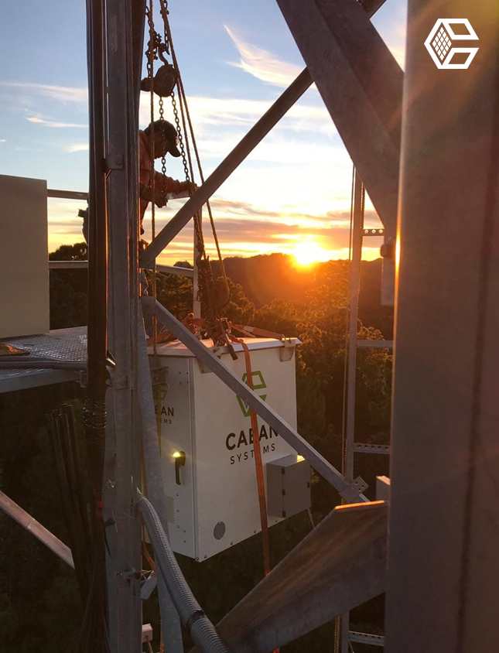
Case Study #1
Durango Cell Tower,
Single Operator
On an off-grid site in Durango, Mexico, Caban installed its robust power solution. The system has been maintenance-free since installation, thanks to its reliability and remote monitoring capabilities.
Coordinates: 23.720734° N, 105.483392° W
Installed: Nov. 22, 2018
Capacity: 24kWh, 7.2 kW solar
$3,000
Per Month Saved
100%
Uptime Since Installation
3,900
New Users Connected

Slide 13
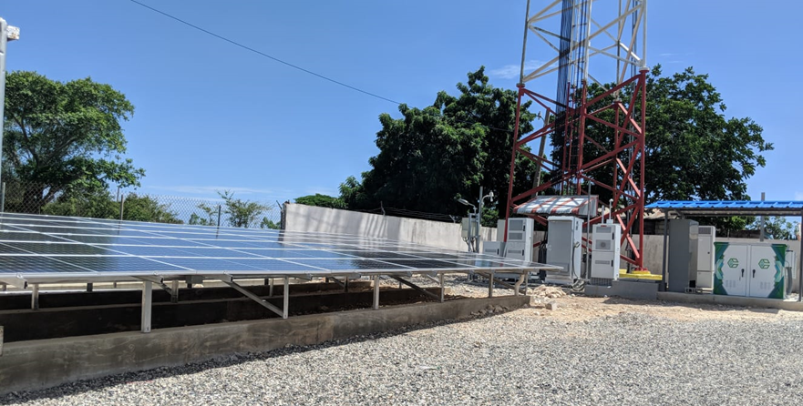
Case Study #2
Dominican Republic Infrastructure Sharing,
Multiple Operators
Coordinates: 18.24.23° N, 69.6.54° W
Installed: August 2019
Capacity: 60kWh, 14.4 kW solar
$12,100
Per Month Saved
100%
Uptime Since Installation
>10,210
New Users Connected
12,169 g CO₂e
CO₂e Avoided
On an on-grid site in Cumayasa, DR, Caban installed its robust energy generation and storage solution. The centralized system provides power to three operators, Altice, Vivia and Wind. The site has been maintenance-free since installation, thanks to its reliability and remote monitoring capabilities.

Slide 14
858 Stanton Ave Burlingame, CA 90401 info@cabansystems.com cabansystems.com

