Slide 1
EV Load Shape Presentation
Alexander Lonsdale
April 22, 2020

Slide 2
Order of Presentation
Overview of ADM’s EVIL model
What is the EVIL model?
How the model functions
Key model drivers
Compare base load shapes
2020 IEPR Update
Potential model improvement for 2021 IEPR
Model Improvement?
Closing remarks

Slide 3
What is The EVIL Model?
The Electric Vehicle Infrastructure Load Model or EVIL was constructed by ADM to provide CEC with transportation hourly electricity load shapes for commercial and residential sectors.
EVIL:
Model is a series of R executable scripts.
Utilizes a series of static and auxiliary model outputs to drive model output.
Works as a platform for future scenario building for utility electricity rate structures and transportation energy forecasts.

Slide 4
How the Model Functions
Elasticity.csv
PercentTOUbyYear.csv
Economic Inputs
Prices.csv
Rates.csv
Seasons.csv
LDV_Energy.csv
Base Loads
PersonalVehicleChargingLocationShares.csv
EVIL MODEL
NEV_Energy.csv
Transportation Electricity
Forecast
BaseLoadShapes.csv
GVWR3456_Energy.csv
GVWR78_Energy.csv
Bus_Energy.csv
“Figure 205: Schematic of EVIL Model”
Adapted From: ADM Associates, INC
ALL_EV.csv

Slide 5
Key Model Drivers
Transportation Energy Forecast
Economic Inputs
Generic Base Load Shapes

Slide 6
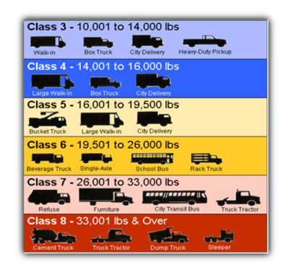
Driver 1: Transportation Electricity Demand Forecast
Aggregate electricity consumption from the TEDF for the following categories:
Light duty
GVWR 3456
GVWR 78
Bus

Slide 7
Driver 2: Economic Inputs
Economic Inputs
Price Elasticity
% TOU Participation
Price Ratios

Slide 8
Driver 2 : Economic Inputs
Economic Inputs adjust the base load in each forecast zone.
Adjustment factors are determined as follows:
$$A_{h}=\max\left(0,1+TOU\%×e×\left({PR}_{h}−1\right)\right)$$
Where:
$A_{h}$is the adjustment factor for hour h
TOU% is the percentage of customers that have a TOU rate
${PR}_{h}$ is the price ratio for hour h, defined as the price prevailing at hour h divided by the lowest available price for the given day, at the same location
$e$ is the Elasticity Factor
Source: ADM Associates, INC

Slide 9
Driver 2: Economic Inputs
Elasticity factors are an adjustable input to the model.
ADM determined default values by comparing ChargePoint data to Joint IOU report
TOU% requires a forecasted value by utility
Can model different participation possibilities
Adjustment factors decrease an hour’s base load percentage
In some cases where Price ratios are very large, adjustors may drive the base load percent of daily charge to zero

Slide 10
Driver 3: Base Load Shapes
Base load shapes are generic load shapes that distribute % of load across an 8760 hour year.
256 weekdays and 110 weekend days in a year.
Primary Data Sources:
ADM obtained data from one municipal fleet of fourteen heavy-duty buses, and five fleets of medium-duty shuttle buses
ChargePoint Data
500 single family residential accounts
2,000 commercial accounts, including 95 multifamily apartment complexes
The following mappings show which load shapes are combined to produce commercial and residential load shapes.

Slide 11
Residential Load Shape
Residential Load Shape
Multi Family
Single Family
PEV Load

Slide 12
Commercial Load Shape
Commercial Load Shape
MD-HD
GVWR 3456
GVWR 78
LDV
Personal Destination
BUS
Commercial
Government

Slide 13
IOU Load Shape Comparisons
A special thanks to the following IOUs for making this part of the presentation possible. We appreciate your team's work!
Pacific Gas and Electric (PG&E)
Southern California Edison (SCE)
San Diego Gas and Electric (SDG&E)
Comparisons are made between IOU and output data from the EVIL model.
Each IOU's data availability varies. Based on data availability, EVIL output was selected to align with IOU dimensionality.

Slide 14
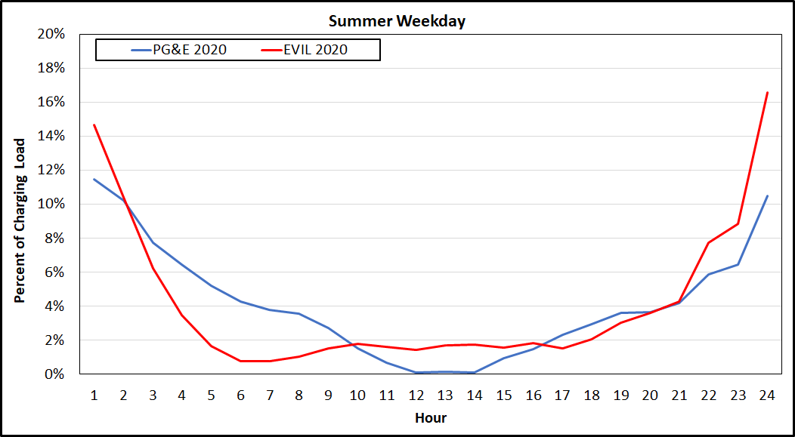
PG&E Residential Load Shape 2020

Slide 15
PG&E Residential Load Shape 2030

Slide 16
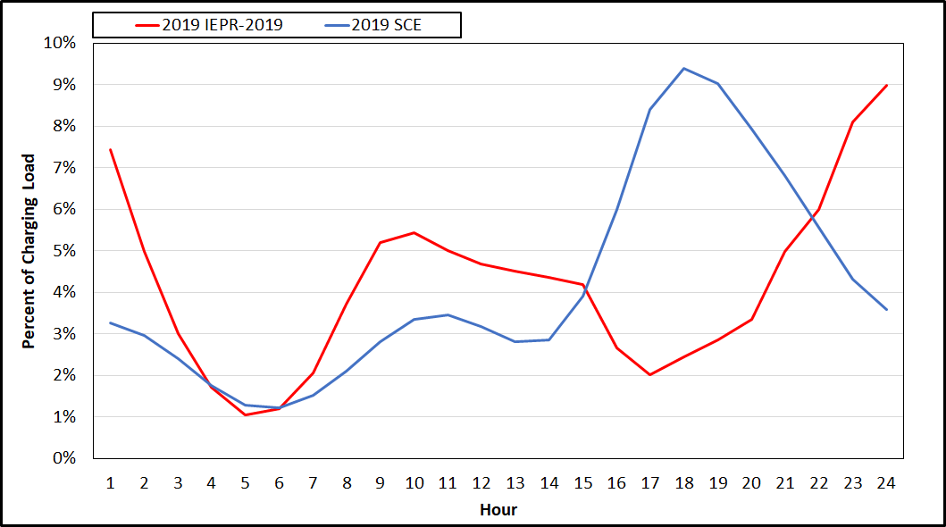
SCE LDV Load Shape 2019

Slide 17
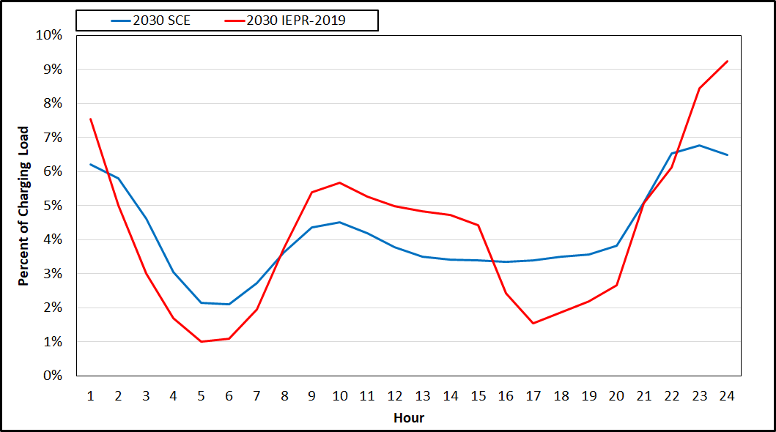
SCE LDV Load Shape 2030

Slide 18
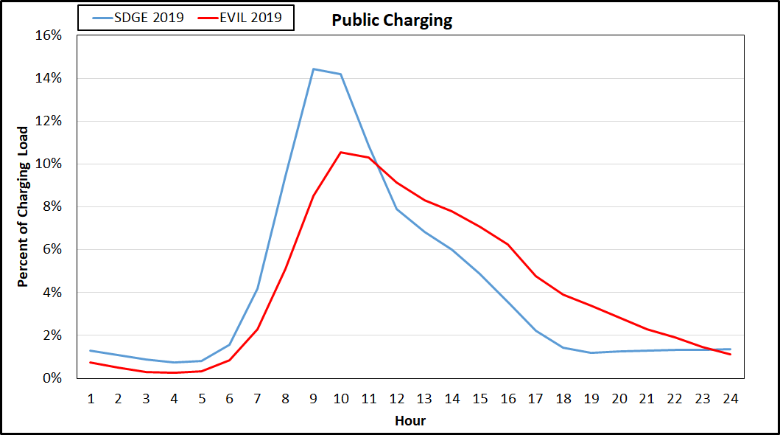
SDG&E LDV Load Shape 2019

Slide 19
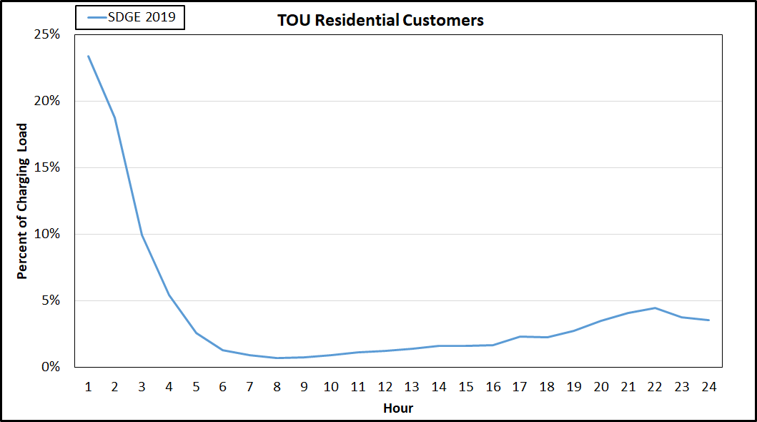
SDG&E LDV Load Shape 2019

Slide 20
Load shapes for 2020 IEPR
Using EVIL model as-is for the adopted forecast (low, mid, and high cases)
Exploratory worst-case charging scenario
What is the impact if peak charging load is coincident with the system peak?

Slide 21
Model Improvement?
We want to hear from you!
What recommendations would you make to enhance the EVIL model for the 2021 IEPR?
Consider different or additional economic factors?
Enhance base load dimensions?
Forecasting %TOU and elasticity?

Slide 22
Closing Remarks
Link to ADM’s complete documentation for the EVIL model, located in Chapter 10:
Link: https://ww2.energy.ca.gov/2019publications/CEC-500-2019-046/CEC-500-2019-046.pdf
Contact Information:
Email: Alexander.Lonsdale@energy.ca.gov
Phone: 916-651-0465

Slide 23
Thank You!

