Slide 1
Demand Analysis Working Group Transportation Energy Demand Forecast: 2020 and 2021 Updates
Heidi Javanbakht
April 22, 2020

Slide 2
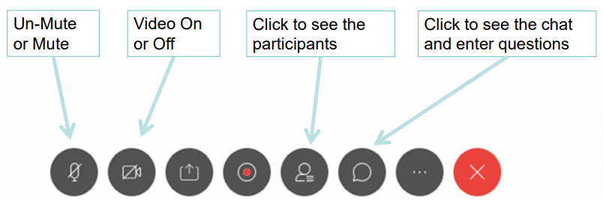
WebEx Overview
Everyone will be muted by default
Questions/Comments
Please submit questions in the comments box and we will address them after each presentation
Please include your name and the slide number
We will open the line after all presentations are completed for discussion

Slide 3
Scoping Order for 2020 IEPR
Transportation is the focus:
Evaluation of transportation trends and challenges
Discussion of how 3 Revolutions could impact energy demand and emissions
Role of PEVs in energy resilience
Status of ZEV market
Roadmap for PEV grid integration
Evaluation of ZEV fueling infrastructure
Role of near-ZEVs and fuels, particularly for commercial and off-road vehicles
Assessment of clean transportation funding programs
*Topics addressed by the Transportation Energy Demand Forecast are in green

Slide 4
Transportation Forecast Updates for 2020 IEPR
Consider disruptions due to COVID-19
Economic and demographic forecasts
Fuel prices
American Community Survey data
Incentives
CAFE standards
Forecast additions:
NOx and GHG tailpipe emissions
Exploratory scenario(s) for SCAQMD MD/HD ZEV planning
Exploratory scenario for “worst case” PEV charging load shapes

Slide 5
Transportation Forecast Updates for 2021 IEPR
Model Improvements
Explore improvements to PEV charging load shapes
Exploratory Scenarios
More DAWG meetings to discuss these

Slide 6
Timeline for 2020 IEPR Update
Transportation Forecasting
Tentative DAWG meeting in late June / early July
SCAQMD proposed MD/HD ZEV plan
Exploratory scenarios for the 2021 IEPR
Other topics that may come out of today’s meeting
Further DAWG meetings as needed
Fuels and Transportation Division IEPR Workshops (see next slide)
Demand Forecast
IEPR Workshop in August
IEPR Workshop late November/early December
Release final IEPR in January 2021
Adopt final IEPR in February 2021

Slide 7
Tentatively Scheduled IEPR Workshops
May 20 – Heavy-Duty ZEV Market Status
June 11 – Transportation Trends and LD ZEV Market Status
June 24 – VGI Roadmap and Charging Programs Funding
June 29 – Hydrogen Market Status
July 2 – Near-Zero Vehicles
July 7 – 3 Revolutions and ZE Resilience
August 4 – Charging Infrastructure
August 19 – Clean Transportation Funding Programs
(All dates tentative; may be split across consecutive days)

Slide 8
Today’s Agenda
LDV Forecast 2020 Updates – Mark Palmere
LDV Forecast 2021 Updates – Aniss Bahreinian
Trucks Forecast 2020 and 2021 Updates – Bob McBride
Fuel Price Forecast Updates – Ysbrand van der Werf
EV Charging Load Shapes – Alex Lonsdale

