Slide 1
Cross-Division Coordinated Analysis of EV Charging Infrastructure
Matt Alexander, Fuels and Transportation Division
July 22, 2020
Demand Analysis Working Group

Slide 2
Outline
Counting Chargers & SB 1000
Electric Vehicle Infrastructure Projections (EVI-Pro) 2
EVI-Pro RoadTrip
Medium- and Heavy-Duty Electric Vehicle Infrastructure Projections (HEVI-Pro)
Off-Road
Load Management
Electric Vehicle Supply Equipment Deployment and Grid Evaluation (EDGE)
Please Note: We will be hosting an IEPR workshop on charging infrastructure assessments (AB 2127) on August 4 & 6 to discuss these analyses in detail.

Slide 3
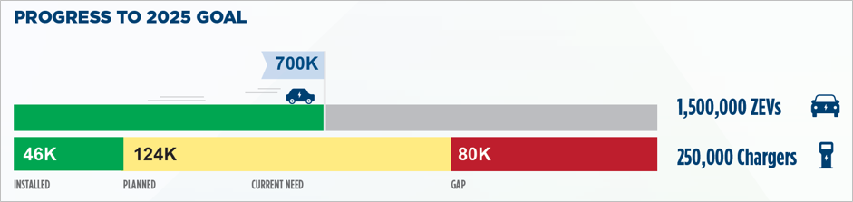
Counting Chargers & SB 1000
Goal: Determine public and shared private charger counts & assess charger deployment by population income, density, and geographical area to identify disparities across market segments
Collaborations with EAD:
PEV spatial distribution
Other Collaboration Efforts:
NREL, Go-Biz, CARB, and CPUC for counting chargers

Slide 4
EVI-Pro 2
Goal: Update 2018 EVI-Pro analysis to determine charging infrastructure needs for 2020-2030 in support of the 5 million ZEV target by 2030.
Collaborations with EAD:
2019 TEDF Aggressive Case
Incorporate forecast updates in fall
Other Collaboration Efforts:
CARB’s Mobile Sources Strategy
Vehicle attributes with CARB/EAD/NREL
CALeVIP Regional Incentives

Slide 5
EVI-Pro RoadTrip
Goal: Assess DC fast charging infrastructure needs to enable inter-regional long-distance travel (100+ miles) for 2020, 2025, and 2030.
Collaborations with EAD:
2019 TEDF Aggressive Case
Other Collaboration Efforts:
CalTrans CSTDM
Vehicle attributes with CARB/EAD/NREL
Light-duty BEV Origin-Destination Travel Flows in 2030

Slide 6
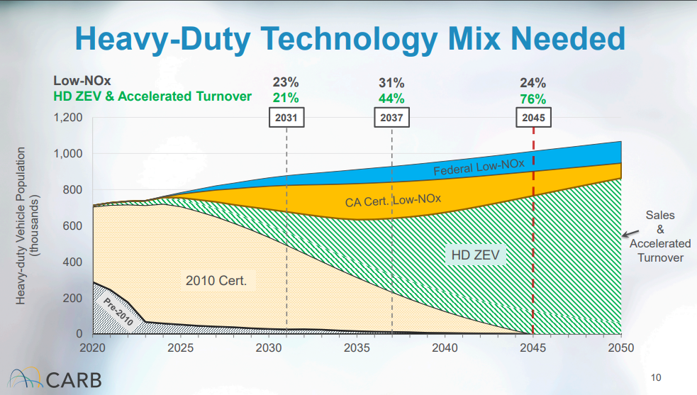
HEVI-Pro
Goal: Assess needed public and private on-road medium- and heavy-duty electric vehicles infrastructure projected (HEVI-Pro) for 2020-2030.
Collaborations with EAD & R&D
Transportation Energy Demand Forecast
Geospatial distribution for grid impacts
Transit Electrification EPIC Projects
Other Collaboration Efforts:
CARB Mobile Sources Strategy (SB 44),
MHDV regulations, research & programs
Caltrans traffic, freight & travel demand
Researchers, advocates, & consultants
2020 Mobile Source Strategy: A Vision for Clean Air (April 2020)
https://ww3.arb.ca.gov/board/books/2020/042320/20-4-3pres.pdf

Slide 7
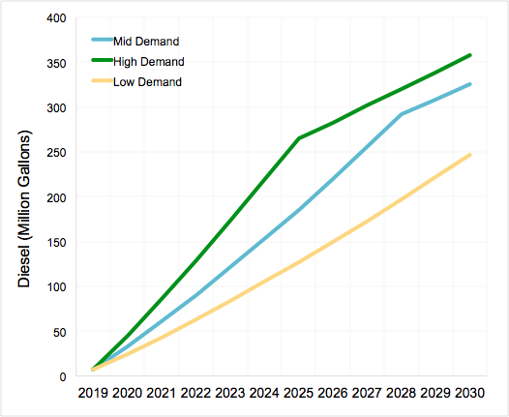
Off-Road
Reduction in annual diesel use due to off-road electrification
Goals: Assess charging infrastructure needs to support off-road electrification.
Collaborations with EAD:
  Transportation Energy Demand Forecast
Other Collaboration Efforts:
  Align with CARB Mobile Sources Strategy where applicable (existing vehicle populations, pending regulations)
California Off-Road Transportation Electrification Demand Forecast (2019)

Slide 8
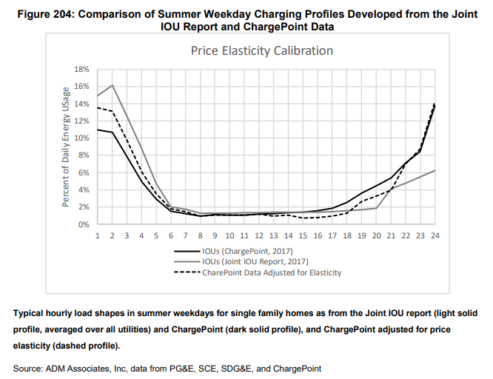
Load Management
Goal: Assess equipment hardware and software necessary to improve the flexibility and responsiveness of EV charging to time-varying prices, grid- or carbon management signals
Collaborations with EAD, Efficiency, & R&D:
CA IOU Electricity Load Shapes (TOU shifts)
PEV Owners Survey
Load Management Rulemaking
EPIC Vehicle-Grid Integration Research
Other Collaboration Efforts:
Vehicle-Grid Integration Roadmap Update
CPUC SB 676
California Investor Owned Utility Electricity Load Shapes (April 2019) https://ww2.energy.ca.gov/2019publications/CEC-500-2019-046/CEC-500-2019-046.pdf

Slide 9
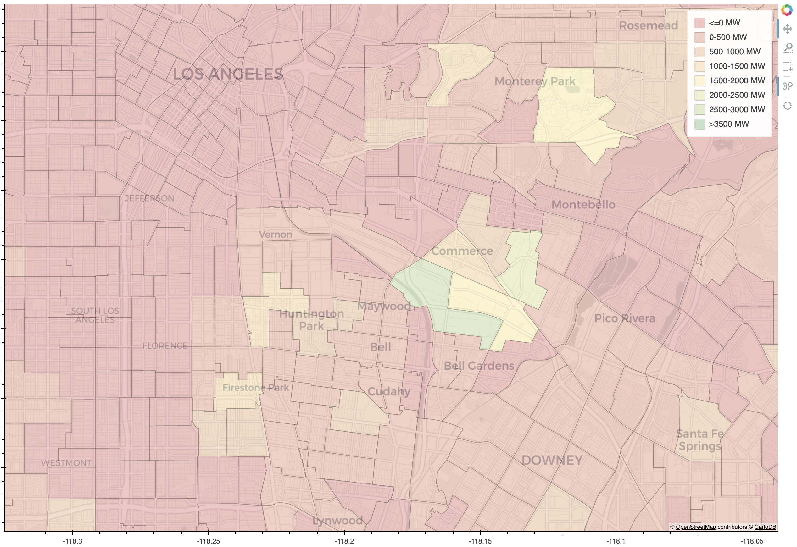
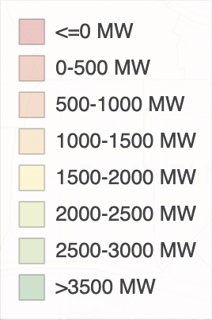
EDGE
EVSE Deployment and Grid Evaluation Tool Prototype in SCE
Goal: Develop a tool to focus deployment strategies and infrastructure investments to meet travel demand needs for charging, achieve air quality improvement goals, minimize impact to the electric grid, and ensure equitable EVSE deployment.
Collaboration with EAD:
PEV Spatial Distribution
Other Collaboration Efforts:
AB 2127 assessments
SB 1000 analysis
For reference on the origination of EDGE, see the June 2019 DAWG Meeting presentation https://www.energy.ca.gov/media/2409
Geographic Dispersion of EV Charging Considering Travel Needs, Emission Targets, and Grid Planning

Slide 10
Thank you!
Contacts:
SB 1000 – Tiffany.Hoang@energy.ca.gov
Counting Chargers – Thanh.Lopez@energy.ca.gov
EVI-Pro 2 & EVI-Pro RoadTrip – Matt.Alexander@energy.ca.gov
HEVI-Pro – Noel.Crisostomo@energy.ca.gov
Off-Road – Jeffrey.Lu@energy.ca.gov
Load Management – Noel.Crisostomo@energy.ca.gov
EDGE – Micah.Wofford@energy.ca.gov
New Webpage:
https://www.energy.ca.gov/programs-and-topics/programs/electric-vehicle-charging-infrastructure-assessment-ab-2127

