Slide 1
California Energy Commission
Business Meeting
September 9, 2020
10:00 am

Slide 2
Pledge of Allegiance

Slide 3

Keep California Healthy
Wash

Slide 4


Take the Census
Complete the form by mail, by phone 844-330-2020 or online @ my2020census.gov

Slide 5
Remote Compliance
Business Meeting held remotely, consistent with Executive Orders N-25-20 and N-29-20 and the recommendations from California Department of Public Health to encourage physical distancing to slow spread of COVID-19.
For remote participation instructions go to CEC’s Business Meetings webpage:
https://www.energy.ca.gov/proceedings/business-meetings
If Zoom’s toll-free phone numbers don’t work:
  Call: 669-900-6833
  Meeting ID: 938-6923-0237
If Zoom shuts down, Business Meeting will continue via Verizon.
  Call: 1-888-823-5065
  Passcode: business meeting

Slide 6
Public Comment Instructions
  Pursuant to California Code of Regulations Title 20 §1104(e), any person may make oral comment on any agenda item.
  Comments may be limited to 3 minutes per person and 1 person per organization.
  Any person wishing to comment on information items or reports (non-voting items) shall reserve their comment for the general public comment portion of the meeting agenda.
  Two ways to provide comments:
  Email PublicAdvisor@energy.ca.gov to have the CEC's Public Advisor verbally relate comments during the meeting.
  OR
  Call (888) 823-5065. Passcode: "business
  meeting”
    Tell Operator: name, organization and item number.
    Tell Operator if you represent: federal or state legislature; tribal nation or California tribal government; state agency; or county/city government.
    Spell your first and last name.
    Do not use speaker phone when talking.
    Mute Zoom while calling to comment.

Slide 7
Item 1 - Consent Calendar
a. NATIONAL ASSOCIATION OF STATE ENERGY OFFICIALS (NASEO).
  Contact: Brad Worster

Slide 8
Item 1a - Public Comment Instructions
  Two ways to provide comments:
  Email PublicAdvisor@energy.ca.gov to have the CEC's Public Advisor verbally relate comments during the meeting.
  OR
  Call (888) 823-5065. Passcode: "business
  meeting”
    Tell Operator: name, organization and item number.
    Tell Operator if you represent: federal or state legislature; tribal nation or California tribal government; state agency; or county/city government.
    Spell your first and last name.
    Do not use speaker phone when talking.
    Mute Zoom while calling to comment.
  For each voting item, public comments are limited to 3 minutes per person and 1 person per organization.

Slide 9
Item 1b-e – Consent Calendar
b. HATHITRUST DIGITAL LIBRARY.
  Contact: Nicole Waugh
c. SULPHUR SPRINGS UNION ELEMENTARY SCHOOL DISTRICT.
  Contact: Tomas Ortiz
d. DOWNEY UNIFIED SCHOOL DISTRICT.
  Contact: Tomas Ortiz
e. CALSTART, INC.
  Contact: Bill Kinney

Slide 10
Item 1b-e – Public Comment Instructions
  Two ways to provide comments:
  Email PublicAdvisor@energy.ca.gov to have the CEC's Public Advisor verbally relate comments during the meeting.
  OR
  Call (888) 823-5065. Passcode: "business
  meeting”
    Tell Operator: name, organization and item number.
    Tell Operator if you represent: federal or state legislature; tribal nation or California tribal government; state agency; or county/city government.
    Spell your first and last name.
    Do not use speaker phone when talking.
    Mute Zoom while calling to comment.
  For each voting item, public comments are limited to 3 minutes per person and 1 person per organization.

Slide 11
Item 2: Discussion of Energy Commission Progress on Joint Agency Report, Charting a Path to a 100 Percent Clean Electricity Future, Senate Bill 100 (2018)
September 9, 2020 Business Meeting
Terra Weeks, Sr. Advisor
Office of Chair Hochschild
Liz Gill, PhD, Electric Generation System Specialist
Energy Assessments Division

Slide 12
Benefits to California
Under Senate Bill 100, renewable energy and zero-carbon resources shall supply 100 percent of electric retail sales and electricity procured to serve state agencies by December 31, 2045.
  Public and environmental health benefits by reducing greenhouse gas emissions and air pollution from the electricity sector.
  Substantial economic and workforce opportunity.

Slide 13
Overview
The CEC, CPUC, and CARB are developing the Joint-Agency SB 100 report, due to the legislature by January 1, 2021, which will review the policy and provide recommendations for planning and implementation.
Activity​ | Estimated Date ​
Kickoff Workshop (Sacramento) ​ | September 2019​
Scoping Workshop 1: Central Valley (Fresno) ​ | September 2019​
Scoping Workshop 2: Northern California (Redding)​ | October 2019​
Scoping Workshop 3: Southern California (Diamond Bar)​ | October 2019​
Technical Workshop (San Francisco)​ | November 2019​
Modeling Inputs & Assumptions Workshop (Sacramento)​ | February 2020​
Draft Modeling Results Workshop (Remote Only)​ | September 2020​
Draft Report Workshop (Remote Only)​ | November 2020​
Report due to Legislature​ | January 1, 2021​

Slide 14
Draft Results Workshop - 9/2/20
  Remote attendance only with close to 400 attendees
  Session 1 included staff presentations on the modeling framework and results
  Session 2 included three stakeholder panels covering the following perspectives:
Resource Build Requirements
Grid Planning Implications
Equity, Workforce and Additional Considerations
Ric O’Connell, GridLab (M)
Danielle Mills, AWEA
Bernadette Del Chiaro, CALSSA
Alex Morris, CESA
Logan Goldie Scot, BNEF
Mateo Jaramillo, Form Energy
Shannon Eddy, Large-Scale Solar Association
Mike Florio, Gridworks (M)
Beth Vaughan, CalCCA
Delphine Hou, CAISO
James Barner, LADWP
Erica Bowman, SCE
Aleecia Gutierrez, CEC (M)
Shana Lazerow, CBE
Elena Krieger, PSE
Roger Lin, DACAG
Mark Specht, UCS
Shrayas Jatkar, CWDB

Slide 15
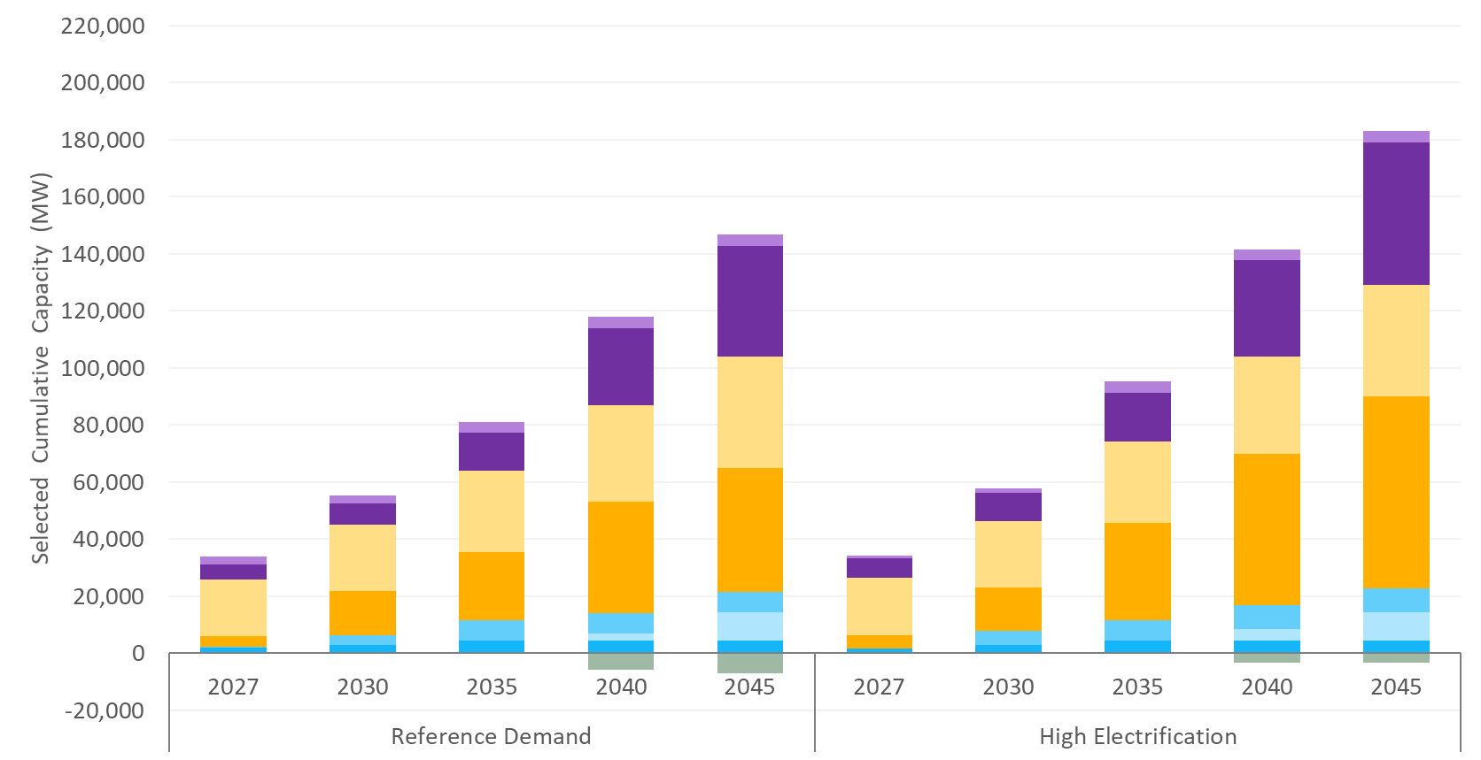
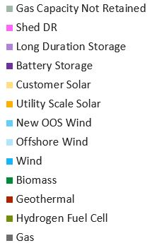
Core Scenario Results
As of 2019, there is 80 GW of in-state capacity in California.
Load Coverage: Core; Resource Options: All

Slide 16
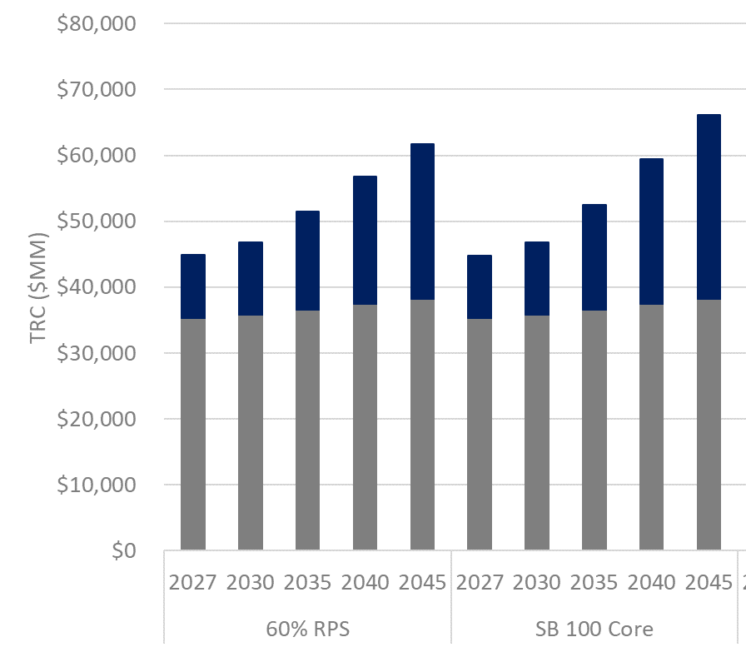

Total Resource Cost
2045 Scenario Costs
Scenario | Total Resource Cost ($B) | Average Cost (¢/kWh)
60% RPS | $62 | 14.8
SB 100 Core | $66 | 16.0
Total resource cost (TRC) includes existing system costs (baseline costs), capital investments and operation costs.
Demand: High Electrification; Resource Options: All

Slide 17
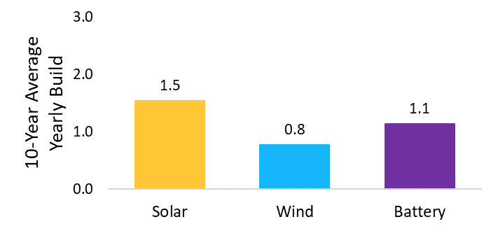
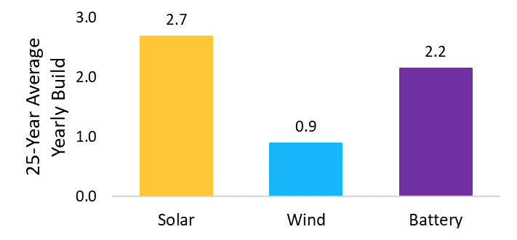
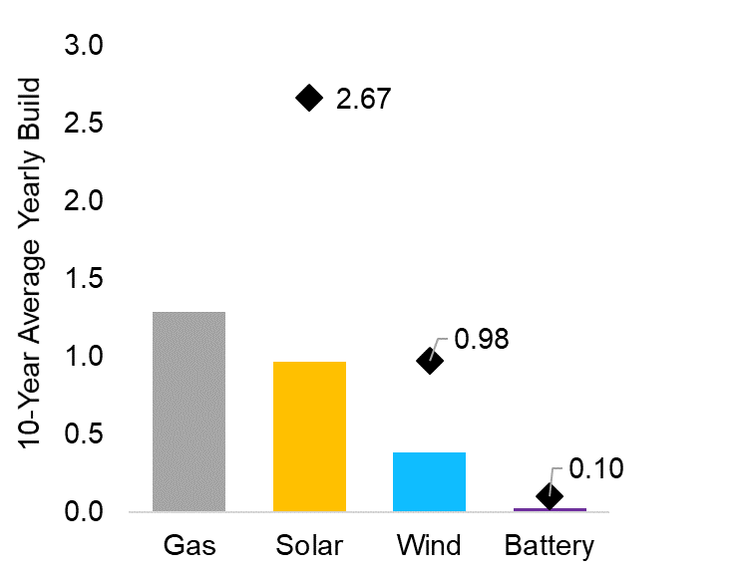
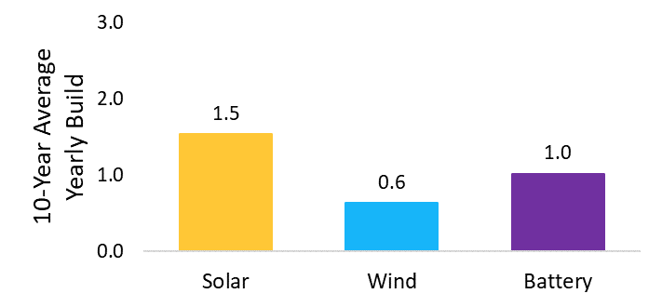
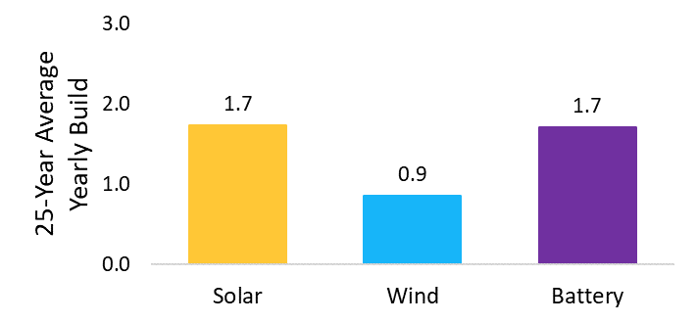
Resource Build Rates
All build rates shown in “GW/year”
Average Build Rate to 2030
Average Build Rate to 2045
High Electrification Demand
High Electrification Demand
Average Build Rate to Date
Maximum single year build
Reference Demand
Reference Demand
Load Coverage: Core; Resource Options: All

Slide 18
Key Takeaways from Draft Results
SB 100 is achievable with existing technologies.​
  Cost reductions and innovation in zero carbon technologies, as well as demand flexibility and energy storage development can further reduce implementation costs.​
Portfolio diversity is generally valued by the model.​
Sustained record setting resource build rates will be required to meet SB 100.​
Natural gas capacity is largely retained, but fleet-wide utilization decreases by 50% compared to a 60% RPS future.​
  Cost reductions and innovation in zero carbon firm resources and storage resources may reduce economic gas fleet retention.​

Slide 19
Workshop Comments
Achieving SB 100 is possible but will be a big push. Requires a coordinated regulatory environment for system planning and to address bottlenecks.
Results are directionally useful, but more work is needed to address specific implications, such as reliability, land-use and the location of resources, and equity.
Better capture resource potential of emerging and non-generation resources, such as hydrogen, lower-cost geothermal, behind the meter resources, long-duration energy storage, and demand flexibility.
Incorporate social costs and non-energy benefits
Explore the use of zero-carbon firming resources to further reduce remaining gas and prioritize retirements in disadvantaged communities.
Workforce programs require strong partnerships, including with employers. Pre-apprenticeship programs have been a successful model.
SB 100 provides a helpful forum to address a range of topics across agencies.

Slide 20
Next Steps
Staff will review additional written comments (due 9/15) and continue working with the joint agencies to develop the draft report.
Draft report workshop planned for later this fall.

Slide 21
Item Number 3: ZEV and EV Charger Dashboard
September 9, 2020, Business Meeting
Siva Gunda, Deputy Director
Energy Assessments Division

Slide 22
Overview
CEC launched a dashboard to track ZEV and EV charger statistics to track progress toward the state goals
  Vehicle on-road population
  ZEV annual and cumulative sales
  Public and shared-private EV charger counts
Provides most up-to-date, accurate and geographically disaggregated information for policy makers, researchers and the public
Developed in collaboration with DMV and CARB
https://www.energy.ca.gov/zevstats

Slide 23
Data Portal Demonstration

Slide 24
Next Steps
Vehicle Population dashboard will be updated annually at a minimum; staff are hoping to update more frequently
ZEV Sales dashboard will be updated quarterly, and the next update will occur at the end of October
EV Charger dashboard will also be updated quarterly
Dashboard will evolve as we receive input and feedback from users
https://www.energy.ca.gov/zevstats

Slide 25
Item Number: 5. Local Ordinance Applications (19-BSTD-06)
September 9, 2020 Business Meeting
Danuta Drozdowicz, Efficiency Specialist
Efficiency Division, Building Standards Office

Slide 26
Benefits to California
Reach Codes – local ordinances that exceed the Energy Code – provide the opportunity for local jurisdictions to participate directly in the state’s efforts to address climate change

Slide 27
Overview: The Local Ordinance Approval Process
For local building efficiency standards to be enforced:
Jurisdiction must file a determination that its standards are cost-effective
CEC must find that the local standards require a reduction of energy consumption levels compared to the current statewide Energy Code
Staff review application materials to confirm that these criteria are met, and make a recommendation based on the findings

Slide 28
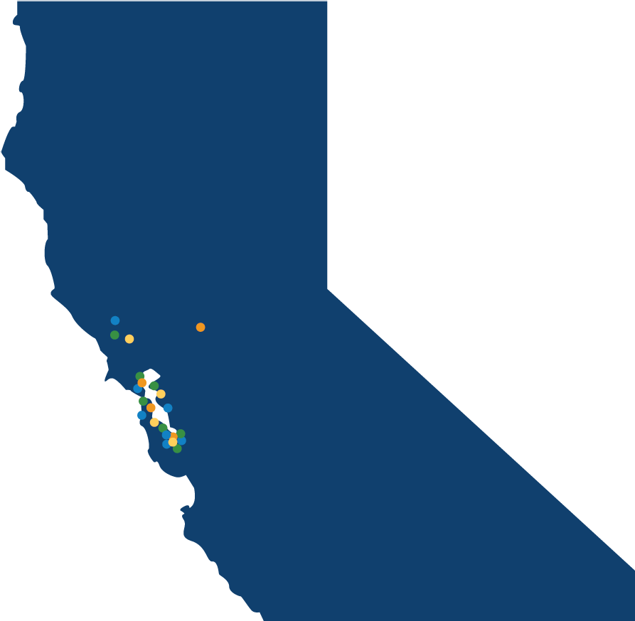


2019 Energy Code Approved Local Ordinances To Date
Berkeley
Brisbane
Cupertino
Davis (2)
Hayward
Healdsburg
Los Angeles County
Los Gatos
Marin County
Menlo Park
Mill Valley
Milpitas
Mountain View
Pacifica
Palo Alto
Richmond
San Francisco
San Jose
San Luis Obispo
San Mateo
Santa Monica
San Rafael
Santa Rosa
Saratoga
West Hollywood
Windsor

Slide 29
Local Ordinance Applications Submitted for Approval at this Business Meeting are from:
The Town of San Anselmo
The County of San Mateo

Slide 30

The Town of San Anselmo Local Ordinance Requires:
Newly constructed buildings shall be all-electric or, if mixed fuel, meet higher energy efficiency standards that the 2019 Energy Code.
Prewiring for future electric equipment and appliances is required where gas fueled equipment and appliances are installed.

Slide 31

The County of San Mateo Local Ordinance Requires:
All newly constructed buildings are all-electric with exceptions allowed for laboratories, commercial kitchens, publicly owned emergency shelters, and buildings for which there is no all-electric compliance pathway.
Prewiring for electric equipment and appliances is required where gas fueled equipment and appliances are installed.
Photovoltaic systems are required on all buildings not subject to the provisions of the Energy Code with exceptions allowed for buildings with vegetative roofs or with limited solar access.

Slide 32
Staff Recommendation
Staff reviewed application materials from the local jurisdictions
Staff found, based on the application material, that the criteria for approval are met
Staff recommends that the Town of San Anselmo and the County of San Mateo be approved to enforce its respective local ordinances

Slide 33
Item 5 - Public Comment Instructions
  Two ways to provide comments:
  Email PublicAdvisor@energy.ca.gov to have the CEC's Public Advisor verbally relate comments during the meeting.
  OR
  Call (888) 823-5065. Passcode: "business
  meeting”
    Tell Operator: name, organization and item number.
    Tell Operator if you represent: federal or state legislature; tribal nation or California tribal government; state agency; or county/city government.
    Spell your first and last name.
    Do not use speaker phone when talking.
    Mute Zoom while calling to comment.
  For each voting item, public comments are limited to 3 minutes per person and 1 person per organization.

Slide 34
Item 6: Charge Bliss. Demonstrating Long Duration and Title 24-Compatible Energy Storage Technologies – GFO-19-306
September 9, 2020 Business Meeting
Joseph Sit, Utilities Engineer
Energy Research and Development Division, Energy Systems Research Office

Slide 35
Benefits to California
Most current energy storage designed for 4 hours
Longer duration energy storage needed for:
  Resilience
  Use excess renewable generation
Notes:
at a hospital
30 year lifespan

Slide 36
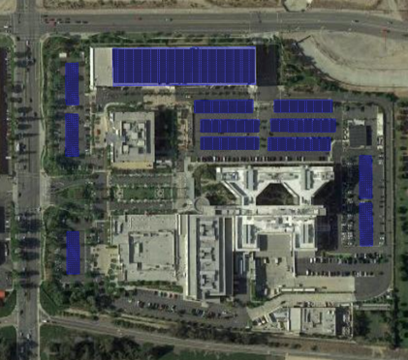


Overview
Solicitation required demonstration of 400kW, 10 hr+ non-lithium ion storage technology
  Demonstrate 800kW battery system in conjunction with onsite solar
  Kaiser Permanente Ontario Medical Center
  90% of essential power for over 10 hours
  Funding: $8.3M (CEC) and $7.5M (match)
Notes:
Vanadium redox flow battery

Slide 37
Staff Recommendation
Approval of this agreement
Approval of supporting CEQA documentation

Slide 38
Item 6 - Public Comment Instructions
  Two ways to provide comments:
  Email PublicAdvisor@energy.ca.gov to have the CEC's Public Advisor verbally relate comments during the meeting.
  OR
  Call (888) 823-5065. Passcode: "business
  meeting”
    Tell Operator: name, organization and item number.
    Tell Operator if you represent: federal or state legislature; tribal nation or California tribal government; state agency; or county/city government.
    Spell your first and last name.
    Do not use speaker phone when talking.
    Mute Zoom while calling to comment.
  For each voting item, public comments are limited to 3 minutes per person and 1 person per organization.

Slide 39


Item 10
Nominations due 9/30/20
Go to: www.energy.ca.gov

Slide 40
Public Comment Instructions
  Two ways to provide comments:
  Email PublicAdvisor@energy.ca.gov to have the CEC's Public Advisor verbally relate comments during the meeting.
  OR
  Call (888) 823-5065. Passcode: "business
  meeting”
    Tell Operator: name, organization and item number.
    Tell Operator if you represent: federal or state legislature; tribal nation or California tribal government; state agency; or county/city government.
    Spell your first and last name.
    Do not use speaker phone when talking.
    Mute Zoom while calling to comment.
  For each voting item, public comments are limited to 3 minutes per person and 1 person per organization.

Slide 41
Break
The September 9, 2020 Business Meeting
will not resume earlier than 1:30 PM.
We appreciate your patience.

Slide 42
Item No. 13: Small Power Plant Exemption for the Sequoia Backup Generating Facility
September 9, 2020
Susan Cochran, Hearing Officer
Hearing and Policy Unit, Chief Counsel’s Office

Slide 43
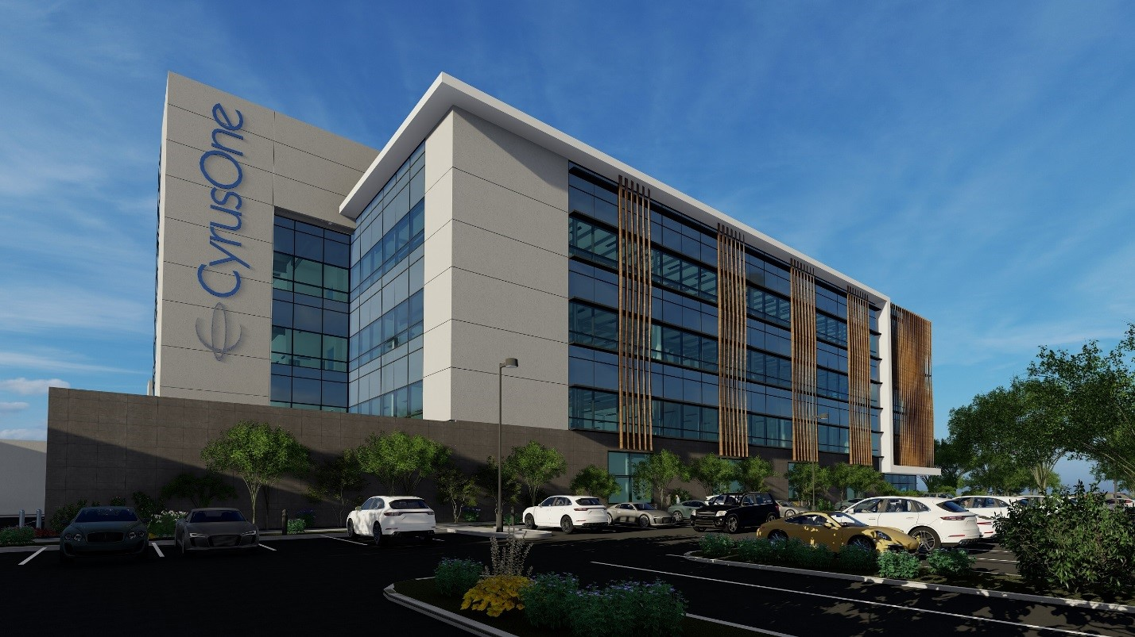
Sequoia Backup Generating Facility
19-SPPE-03
Application for Small Power Plant Exemption

Slide 44
Item 13 - Public Comment Instructions
  Two ways to provide comments:
  Email PublicAdvisor@energy.ca.gov to have the CEC's Public Advisor verbally relate comments during the meeting.
  OR
  Call (888) 823-5065. Passcode: "business
  meeting”
    Tell Operator: name, organization and item number.
    Tell Operator if you represent: federal or state legislature; tribal nation or California tribal government; state agency; or county/city government.
    Spell your first and last name.
    Do not use speaker phone when talking.
    Mute Zoom while calling to comment.
  For each voting item, public comments are limited to 3 minutes per person and 1 person per organization.

Slide 45
In Closed Session
Per Government Code Section 11126
The September 9, 2020 Business Meeting will resume shortly.
We appreciate your patience.

