Slide 1

Pre-Application Workshop:
GFO-20-304
Evaluating Bi-Directional Energy Transfers and Distributed Energy Resource Integration for Medium- and Heavy-Duty Fleet Electrification
Energy Research and Development Division
Elise Brown Ersoy & Ben Wender
October 14, 2020
California Energy Commission

Slide 2
Agenda
Time | Item
1:00 pm | Welcome and Introduction Housekeeping Diversity Survey Empower Innovation
1:15 pm | Solicitation Background and Content EPIC Research Program Purpose of Solicitation Available Funding
1:40 pm | Application Requirements Project Group Requirements Attachments Submission Process
2:00 pm | Q&As
3:00 pm | Adjourn

Slide 3
Housekeeping
Muting on Zoom
Zoom recording
Questions
Updates on solicitation documents including this presentation will be posted at the Grant Funding Opportunity’s webpage: https://www.energy.ca.gov/solicitations/2020-09/gfo-20-304-evaluating-bi-directional-energy-transfers-and-distributed-energy

Slide 4
Commitment to Diversity
The Energy Commission has adopted a resolution to strengthen its commitment to diversity in our funding programs. The Energy Commission continues to encourage disadvantaged and underrepresented businesses and communities to engage in and benefit from our many programs.
To meet this commitment, Energy Commission staff conducts outreach efforts and activities to:
Engage with disadvantaged and underrepresented groups throughout the state.
Notify potential new applicants about the Energy Commission’s funding opportunities.
Assist applicants in understanding how to apply for funding from the Energy Commission’s programs.
Survey participants to measure progress in diversity outreach efforts.

Slide 5
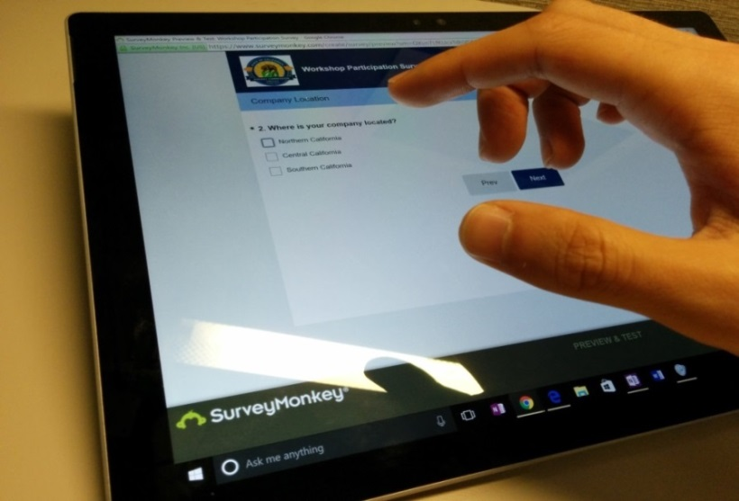
We Want to Hear From You!
One Minute Survey
The information supplied will be used for public reporting purposes to display anonymous overall attendance of diverse groups.
Please use the link in the chat box or type in:
https://www.surveymonkey.com/r/CEC-10-14-2020
Thanks!

Slide 6



Connect With Us

Slide 7
Find a Partner on EmpowerInnovation.net
Empower Innovation strives to accelerate your clean tech journey with easy access to funding opportunities from the Energy Commission and other funding providers, curated resources and events, and connections to people and organizations.
FIND A PARTNER
Announce your interest in this funding opportunity and message other interested parties to find potential partners.
RESOURCES & TOOLS
Browse the collection of resources for clean tech innovators including Resource Libraries, Funding Sources, Tools, and Databases.

Slide 8
EmpowerInnovation.net
Introduction to the Empower Innovation Network webpage

Slide 9
Solicitation Background and Content

Slide 10
EPIC Research Program Background
The Electric Program Investment Charge (EPIC) supports the development of new, emerging, and pre-commercialized clean energy technologies in CA
Funded by an electricity ratepayer surcharge established by the California Public Utilities Commission (CPUC) in December 2011 and renewed in August 2020
Projects designed to produce electric ratepayer benefits in the form of increased reliability, improved safety, and/or reduced costs for three investor-owned utilities*
Consists of three program areas: Applied Research and Development, Technology Demonstration and Deployment (TD&D), and Market Facilitation
Applied Research and Development
Technology Demonstration and Deployment
Market Facilitation
*Pacific Gas and Electric Co., San Diego Gas and Electric Co., and Southern California Edison Co.
This solicitation is TD&D

Slide 11
Policy Drivers for Transportation Electrification and Grid Decarbonization
Executive Orders N-79-20 and B-48-18:
  Goal for 100% passenger car and truck sales zero-emission vehicles (ZEVs) by 2035
  Where feasible, 100% drayage and off-road ZEV by 2035 all other MDHD ZEV by 2045
  1.5M ZEVs and 250k public fast charging stations by 2025; 5M ZEVs by 2030
Innovative Clean Transit Rule:
  Public transit agencies transition to 100% zero emission gradually over next decades
Advanced Clean Trucks and Advanced Clean Fleets Rules:
  Medium- and heavy-duty vehicle sales and fleets transition to ZEV over next decades
Electric Vehicle Grid Integration (SB 676, 2019):
  Strategies and metrics to maximize vehicle grid integration
Energy Storage Systems (AB 2514, 2010):
  Accelerate widespread deployment of distributed energy storage systems
Clean Energy and Pollution Reduction Act (SB 350, 2015):
  Increased use of zero-emission vehicles in disadvantaged communities
  Electricity sector greenhouse gas reduction goal of 40% below 1990 levels by 2030

Slide 12
Example Electric Load Growth Projections from Transportation Electrification
Representative weekday charging load profile for 5M passenger plug-in electric vehicles in 2030
Preliminary results from EVI-PRO 2
https://www.energy.ca.gov/event/workshop/2020-08/session3-modeling-and-projecting-charging-infrastructure-commissioner

Slide 13
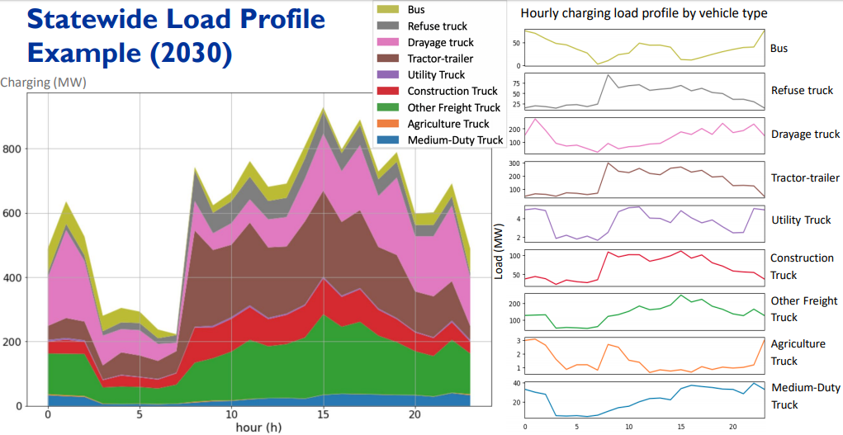
Example Electric Load Growth Projections from Transportation Electrification Contd.
Representative charging load profile for medium- and heavy-duty vehicles in CA in 2030
Preliminary results from HEVI-PRO
https://www.energy.ca.gov/event/workshop/2020-08/session3-modeling-and-projecting-charging-infrastructure-commissioner

Slide 14
VGI and DERs Can Help Transportation Electrification and Grid Decarbonization
Vehicle grid integration (VGI) – Altering the time, charging level, and location at which PEVs charge or discharge in a way that provides net benefits to ratepayer (See SB 676)
  A lot of recent activity in CA
  VGI Working Group Final Report and use case framework
Distributed Energy Resources (DERs) – Behind the meter generation, storage, or controllable loads (e.g. vehicles)
  Control charging load alongside behind the meter resources
See VGI Working Group Materials for additional background on VGI and specific use cases: https://gridworks.org/materials-produced-by-the-vgi-working-group-2/

Slide 15

How Can MDHD Fleets Combine DERs and VGI to Manage Load?
Charging Load, MW
Net load without VGI + DER
Net load with VGI + DER
Shifted/shaved load
Time of day
Some example barriers:
Ensuring that all operational needs are met, coordinate fleet management with site energy management
Interoperability between vehicles, controllers, and DERs
Lack of data on cost, performance, and benefits available
Few scalable, modular commercial systems available

Slide 16
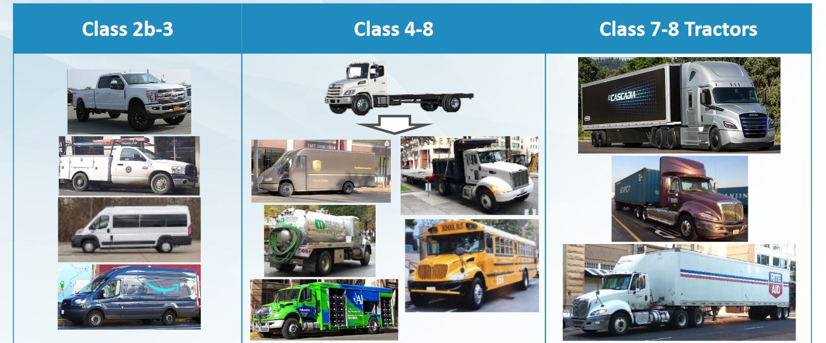
Diverse MDHD Vehicles with Different Operational Requirements
Medium-duty
Heavy-duty
Different operational needs will have different charging patterns
This solicitation is open for class 2b - 8
Drayage operations not allowed
Preliminary simulated charging profiles for two vehicle types from HEVI-Pro
https://twitter.com/AirResources/status/1276191182196887554

Slide 17
Purpose of Solicitation
Develop and demonstrate technologies to evaluate resilience, renewable integration, and cost management use cases for MDHD PEVs.
Collect cost, performance, and other data to analyze benefits, build confidence, and support broader market adoption.
Advance technologies toward commercialization, more standardized solutions available to other fleets.
Supports the 2018-2020 EPIC Investment Plan Initiatives:
  S2.3.1 “Development of Customers’ Business Proposition to Accelerate the Integrated Distributed Storage Market”
  S3.2.1 “Grid-friendly Plug-in Electric Vehicle Mobility”

Slide 18
Use Cases in this Solicitation
Cost management: The ability to optimize and control DERs and MDHD vehicle (dis)charging to minimize total site costs compared to fossil-fueled and unmanaged charging baselines.
Resilience: The ability to provide power to buildings or end loads (e.g. vehicles) independent of the utility grid or during outages such as public safety power shutoffs.
Renewable integration: The ability to reduce electric sector greenhouse gas emissions by charging MDHD vehicles mid-day when solar PV generation is high, and discharge later for mobility or other energy needs at times of system peak demand or higher GHG intensity (e.g., between 5:00-8:00 P.M.)
See VGI Working Group Materials for additional background on VGI and specific use cases: https://gridworks.org/materials-produced-by-the-vgi-working-group-2/

Slide 19
Solicitation Structure and
Available Funding
Project Group | Available Funding | Minimum Award Amount | Maximum Award Amount | Minimum Match Funding
Group 1: Bi-Directional Energy Transfer from Electric School Buses | $6,000,000 | $1,000,000 | $3,000,000 | 20%
Group 2: Integrated DER packages for Charging MDHD Fleets | $12,000,000 | $1,500,000 | $4,000,000 | 50%
Group 3: Integrated DER packages for Charging Electric School Buses | $4,000,000 | $2,000,000 | $4,000,000 | 20%

Slide 20
Requirements - All Groups
Project requirements to address in Project Narrative and other Attachments where specified:
Form strong partnerships with fleet(s); document baseline operational needs, costs; estimate potential for VGI and DER integration that doesn’t compromise operational requirements.
Describe a staged plan for site development and demonstration with major milestones and deliverables.
Collect and report cost, performance, and operational data for a minimum of one year for at least one of the three use-cases.
Projects that demonstrate multiple use cases are encouraged.

Slide 21
Requirements - All Groups (Cont.)
Project requirements to address in the Project Narrative and other Attachments where specified:
Describe which community-based organization the team plans to work with and what they will accomplish.
At least one demonstration site must be located in a Disadvantaged Community.
All demonstration sites must be located in a California electric investor-owned utility service territory.
Plug-in hybrid electric and hydrogen fuel-cell vehicles are not allowed in this solicitation. Heavy-duty trucks in drayage operations are not allowed in this solicitation.

Slide 22
Optional Activities - All Groups
Applicants for all groups are encouraged, but not required, to include the following:
Describe how the project will benefit disadvantaged or low-income communities.
Include a letter of support from the electric IOU that serves the site(s).
Include a letter of support from a professional or trade association associated with the site(s).
Demonstrate at sites that are identified as capacity constrained.

Slide 23
Group 1
Bi-Directional Energy Transfers from Electric School Buses

Slide 24
Group 1: Bi-Directional Energy Transfers from Electric School Buses
Award Range: $1M – $3M; Total for Group: $6M
Objectives:
Develop and demonstrate technologies for controlled, bi-directional energy transfer between electric school bus batteries and end-loads, grid-connected facilities, or distribution systems.
Use demonstration results to compare cost (e.g., $/kW and $/kWh) and performance (e.g., lifetime, response time, and round-trip efficiency) to an equivalently-sized stationary storage system.
Advance technologies toward commercialization with product offerings for other schools deploying bi-directional capable buses.

Slide 25
Group 1: Bi-Directional Energy Transfers from Electric School Buses
Requirements to address in Project Narrative and Scope of Work:
Describe the bi-directional system, vehicles, and demonstration site.
Utilize open standards for hardware and communications.
Describe a detailed data collection and reporting plan (see Section II.B.4 Measurement and Verification for additional details):
  Vehicle availability/usage characteristics and charger load profiles.
  Performance of the bi-directional system in specific use cases, with appropriate metrics.
  Vehicle battery state of health and any degradation associated with cycling for non-transportation uses.
Describe commercialization plans to make solution available for others.
Coordinate participation of key stakeholders

Slide 26
Groups 2 & 3

Slide 27
Group 2: Integrated DER Packages for Charging MDHD Fleets
Award Range: $1.5M – $4M;Total for Group: $12M
Objective: advance the market-readiness and replicability of the demonstrated DER package for MDHD PEV applications.
Tailor DER packages to fleets that have central (depot) charging, en-route fast charging, or a combination of both.
Focus on ease of integration, operation, scalability, and replicability at other sites.
Design a modular solution that can:
  scale to achieve significant market participation by 2035;
  accommodate multiple vehicle types, duty cycles; and
  achieve a less expensive system as compared to a grid-connected unmanaged charging system over the expected useful life of all equipment.

Slide 28
Group 3: Integrated DER Packages for Electric School Buses
Award Range: $2M - $4M; Total for Group: $4M
Objective: advance the market-readiness and replicability of the demonstrated DER package for MDHD PEV applications.
Tailor DER packages for electric school bus charging.
Bi-directional energy transfer is allowed in Group 3, but not required. Focus is on DER package.
Design a modular solution that can:
  scale to achieve significant market participation by 2035;
  accommodate multiple types of school buses makes/models; and
  achieve a less expensive system as compared to a grid-connected unmanaged charging system over the expected useful life of all equipment.

Slide 29
*Requirements: Groups 2 & 3
Distributed Energy Resource packages must include:
distributed renewable generation;
stationary storage;
multiple MDHD PEVs;
charging equipment with multiple charging ports;
software and hardware to enable islanded operation; and
secure behind-the-meter energy management system that can control components and respond to dispatch and price signals.
Respond to all requirements outlined in the solicitation (e.g., project design; technical performance metrics; measurement & verification plan, etc.)

Slide 30
Application Details

Slide 31
Eligible Applicants
This is an open solicitation for public and private entities, except for publicly-owned utilities.*
Applicants must accept the EPIC terms and conditions.
  https://energy.ca.gov/funding-opportunities/funding-resources
Applicants are required to register with the California Secretary of State and be in good standing to enter into an agreement with the Energy Commission.
  http://www.sos.ca.gov
*In accordance with CPUC Decision 12-05-037, funds administered by the Energy Commission may not be used for any purposes associated with publicly-owned utility activities.

Slide 32
Application Requirements
Each Applicant must complete and include the following:
1. Application Form (signature*) | 7. Budget
2. Executive Summary | 8. CEQA Compliance Form
3. Project Narrative | 9. References and Work Product Form
4. Project Team | 10. Commitment and Support Letters (signature*)
5. Scope of Work | 11. Project Performance Metrics
6. Project Schedule | 12. Applicant Declaration (signature*) (.docx)
*Check website for current requirements prior to submission: https://www.energy.ca.gov/funding-opportunities/solicitations

Slide 33
Project Narrative (Attachment 3)
This is your opportunity to explain the entirety of the project. The narrative should explain:
  Why is your project necessary and important to California?
  What is your project approach and how will each major task be implemented?
  Justify the need for EPIC funding. Would this work be done without the award?
  How will the project outcomes benefit electric ratepayers?
  Describe how your project team has the technical ability to successfully complete the project on time and on budget.
  Address the requirements as described in Section II.B, Project Requirements.
Review the scoring criteria described in Section IV, Evaluation and Award Process.

Slide 34
Scope of Work & Project Schedule (Attachments 5 & 6)
Tell us exactly what you are proposing to do in your project. Ensure that it matches what is proposed in the project narrative.
Identify what will be delivered to the Energy Commission.
Be sure to include in the technical tasks:
  At least one product deliverable per task.
  Address requirements in Section II.B. under Project Focus.
Be sure to include in the Project Schedule (Attachment 6):
  Product deliverables that correspond with the Scope of Work.
  Realistic dates by which product deliverables can be completed.

Slide 35
Budget (Attachment 7)
Identify how the Energy Commission funds and match funds will be spent to complete the project.
Subcontractors receiving $100,000 or more in Energy Commission funds must complete a separate budget form.
Ensure that all rates provided are maximum rates for the entire project term, which may go up to 03/31/2025.
Travel Restrictions:
  CEC funds should be limited to lodging and any form of transportation (e.g., airfare, rental car, public transit, parking, mileage).
  No travel to restricted states using CEC funds: https://oag.ca.gov/ab1887
  If an applicant plans to travel to conferences, including registration fees, they must use match funds.

Slide 36
Commitment and Support Letter Forms (Attachment 10)
Commitment letters are required for:
  any project partners that will make contributions to the project, including subcontractors;
  entities or individuals that commit match funding, including the Prime; and
  testing and pilot site hosts, including the Prime.
Support letters describe a project stakeholder’s interest or involvement in the project.
All applicants must submit at least one support letter.
Match funding must be supported by a match fund commitment letter.
Limit to two pages per letter, excluding the cover page.

Slide 37
Match Funding Requirements
20% match funding is required for Group 1 and Group 3.
50% match funding is required for Group 2.
Match funding contributors must submit commitment letters that meet the requirements of Attachment 10. Failure to do so will disqualify the match funding commitment from consideration.
Refer to Section I.K in the Solicitation Manual for more details on match funding.
Applications that include additional match funding will receive up to 10 additional points during the scoring phase.

Slide 38
Scoring Weights and Minimum Passing Requirements
Pass Screening Criteria
Pass/Fail
Pass Criteria 1 – 4
Minimum 52.5 out of 75 (70%)
Pass Criteria 1 – 7
Minimum 70 out of 100 (70%)
Pass Past Performance Criteria (Pass/Fail)
Pass Criterion 8
Minimum 35 out of 50 (70%)
Final Score
150 Maximum Points

Slide 39

Evaluation - Application Screening
Admin Screening Process
Energy Commission staff screens applications per stage one criteria in Section IV.D & past performance criteria in Section IV.E.
Stage one and past performance are scored on a pass/fail basis.
Applicants must pass all screening criteria, or the application will be disqualified.
Some Reasons for Disqualification
Application is not submitted by December 30 at 5:00 p.m.
Applicant did not meet signature requirements.
Application does not include required support letters.
Application contains confidential material.
Application does not meet match funding requirement.
Past Performance Screening
Pass/Fail
If passed screening, continue to scoring

Slide 40
Evaluation - Application Scoring
Scoring Criteria-Three Hurdles
Technical: Applications must obtain a minimum passing score for Criteria 1-4 of 70% or 52.5 points to continue evaluation.
Costs: Applications must obtain a minimum passing score for Criteria 1-7 of 70% or 70 points to continue evaluation.
DAC/LICs: Applications must obtain a minimum passing score for Criterion 8 of 70% or 35 points to be considered for funding.
Scoring Criteria | Maximum Points | Minimum Score
1. Technical Merit and Need | 15
2. Technical Approach | 25
3. Impacts and Benefits for CA IOU Ratepayers | 20
4. Team Qualifications | 15 | 52.5 / 75
5. Budget and Cost-Effectiveness | 10
6. Funds Spent in CA | 10
7. Ratio of Direct Labor to Loaded Labor Costs | 5 | 70/100
8. Benefits to Disadvantaged/Low-Income Communities and Localized Health Impacts | 50 | 35/50
Total | 150
Minimum Points to Pass | 105
Technical 70%
Technical + Costs 70%
DAC/LIC 70%

Slide 41
Benefits to Disadvantaged &
Low-Income Communities
AB 523 requires the CEC to:
Allocate 25 percent of EPIC TD&D funding for projects located in and benefiting disadvantaged communities.
Allocate an additional 10 percent of funding for projects located in and benefiting low-income communities.
Account for adverse localized health impacts of proposed projects to the greatest extent possible.
Scoring Criteria | Maximum Points
8. Benefits to Disadvantaged/Low-Income Communities and Localized Health Impacts
8.1 Benefits to Disadvantaged/Low-Income Communities | 15
8.2 Community Engagement Efforts | 10
8.3 Localized Health Impacts | 15
8.4 Technology Replicability | 5
8.5 Project Support Letters | 5
Total Possible Points for Criterion 8 (Minimum passing score is 70% or 35 points) | 50
Total Possible Points for Proposal | 150
If three hurdles passed, proposal goes on for additional match share points

Slide 42
Match Funding Bonus Points
Passing applications will be considered for match funding bonus points.
Scoring Criteria | Maximum Points
9. Match Funds | 10
Total Bonus Points | 10
Up to 5 points based on the ratio of proposed Cash and In-Kind contributions using the Cash Match Scoring Table (pg. 45).
Up to 5 points to applications that exceed the minimum match, up to 100%, using the Match Scoring table (pg. 45).
Refer to Section I.K in the Solicitation Manual for more details on the match funding scoring criteria.

Slide 43
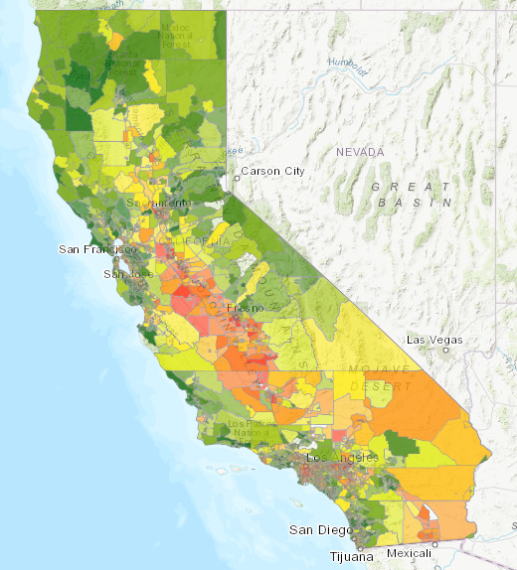
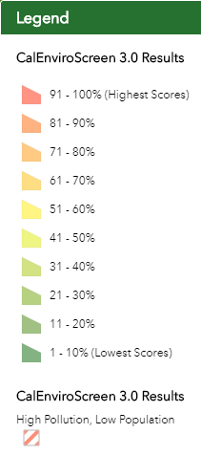
Identifying Disadvantaged Communities
A disadvantaged community is bound by census tract and represents the 25% highest scoring tracts in CalEnviroScreen 3.0.
Use the CalEnviroScreen 3.0 tool to identify disadvantaged communities.
https://oehha.ca.gov/calenviroscreen/report/calenviroscreen-30

Slide 44
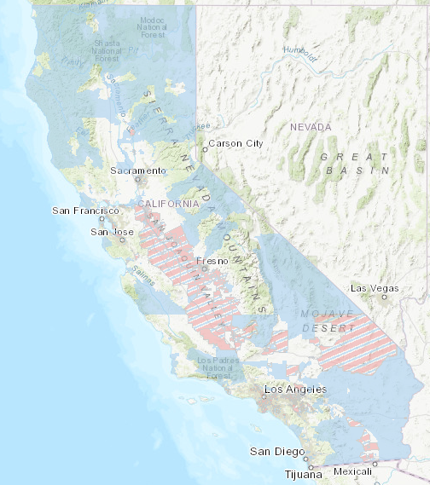
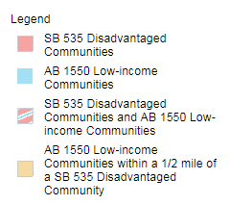
Identifying Low-Income Communities
Low-income communities are communities within census tracts with:
median household incomes at or below 80% of the statewide median income, or
at or below the threshold designated as low-income by the Department of Housing and Community Development.*
Use the Priority Population Maps from CARB to identify low-income communities:
https://www.arb.ca.gov/cc/capandtrade/auctionproceeds/communityinvestments.htm
*http://www.hcd.ca.gov/grants-funding/income-limits/index.shtml

Slide 45




Community Based
Organization Requirements
Has an office in the region and meets the demographic profile of the communities they serve
Has deployed projects and/or outreach efforts within the region
Employs staff specialized in and dedicated to – diversity, equity, inclusion, or is a 501(c)(3) non-profit
Has official mission and vision statements that expressly identifies serving DAC or LI communities

Slide 46
Application Submission Requirements
Method of submission is the Energy Commission Grant Solicitation System, available at: https://gss.energy.ca.gov/
  Hard copies will not be considered.
  Files must be in Microsoft Word (.doc, .docx), Microsoft Excel (.xls, .xlsx), and Adobe PDF formats.
  Attachments that require signature: check website for most up to date signature requirements https://www.energy.ca.gov/funding-opportunities/solicitations
  First-time users must register as a new user to access system.
  Application documents should meet formatting requirements, and page limits specified. See individual requirements for each attachment in Section III.D of solicitation manual
  “How to Apply” powerpoint: https://www.energy.ca.gov/funding-opportunities/funding-resources

Slide 47
Next Steps After Grant Award
Notice of Proposed Award: Shows total proposed funding amounts, rank order of applicants, and the amount of each proposed award.
Agreement Development: Proposal documents will be processed into a legal agreement.
Project Start: Recipients may begin work on the project only after the agreement is fully executed (approved at an Energy Commission business meeting and signed by the Recipient and the Energy Commission).
Failure to Execute: The Energy Commission reserves the right to cancel the pending award if an agreement cannot be successfully executed with an applicant. (See Section IV.B)

Slide 48
Key Activities Schedule
Activity | Date
Solicitation Release | September 23, 2020
Pre-Application Workshop | October 14, 2020
Deadline for Written Questions | October 21, 2020
Anticipated Distribution of Questions and Answers | November 6, 2020
Deadline to Submit Applications | December 30, 2020
Anticipated Notice of Proposed Award Posting | February 5, 2020
Anticipated Energy Commission Business Meeting | March 2021
Anticipated Agreement Start Date | April 2021
Anticipated Agreement End Date | March 31, 2025

Slide 49
Questions and Answers
Please introduce yourself by stating your name and affiliation.
Keep questions under 3 minutes to allow time for others.
Please follow up with your question in writing to ensure that it is captured properly.
Our official response will be given in writing and we anticipate it will be posted on the grant funding opportunity webpage in November 2020.

Slide 50
Additional Questions
Please send all questions related to GFO-20-304 to:
Brad Worster
Brad.Worster@energy.ca.gov
Deadline to submit questions:
October 21, 2020 at 5:00 PM

