Slide 1
Behind-the-Meter PV
& Storage Forecast
CEDU 2020
Sudhakar Konala
California Energy Commission
November 19, 2020

Slide 2
Changes in the 2020 Forecast
Revisions to historical PV installation data
  Began to use interconnection data provided by utilities
Improved PV system classification
  Better align with CEC sectors and subsectors
Incorporated system tilt / orientation data into PV capacity factors
  Previously used only one tilt / orientation for all PV systems
Refer to August 28th, IEPR workshop for more details on these changes
  https://efiling.energy.ca.gov/GetDocument.aspx?tn=234487&DocumentContentId=67313

Slide 3
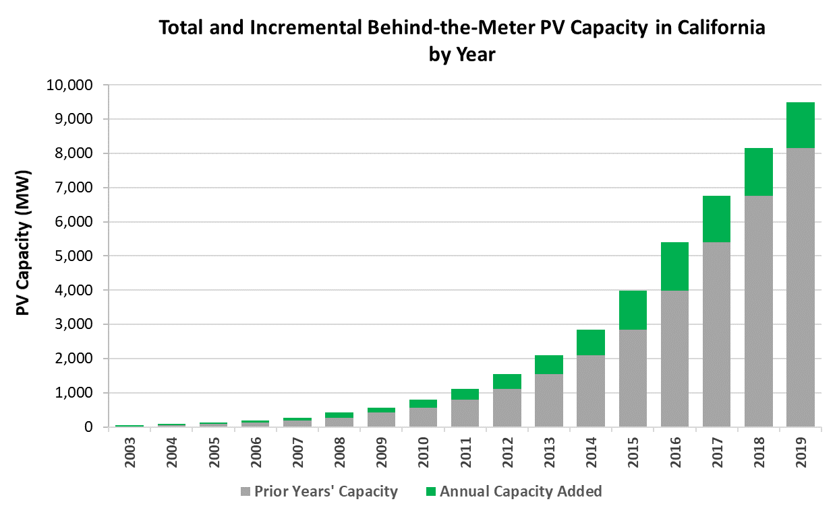
BTM PV Capacity Additions
Statewide BTM PV Capacity at the end of 2019: > 9,400 MW

Slide 4
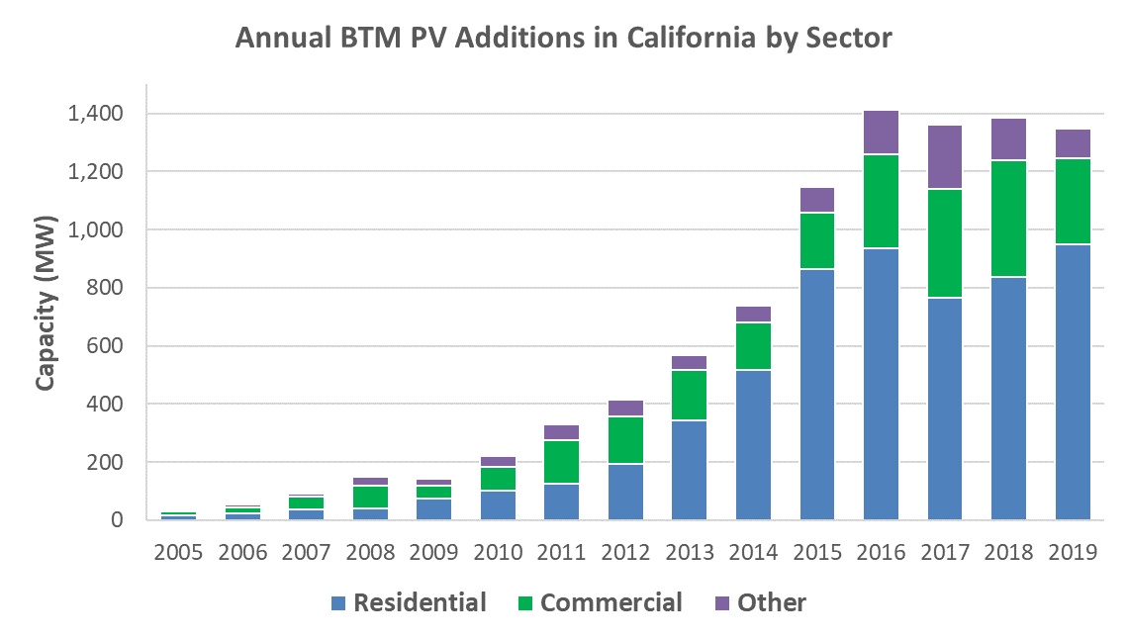
PV Capacity Additions by Sector
Maturing PV market: about 1,300-1,400 MW installed annually 2016-19

Slide 5
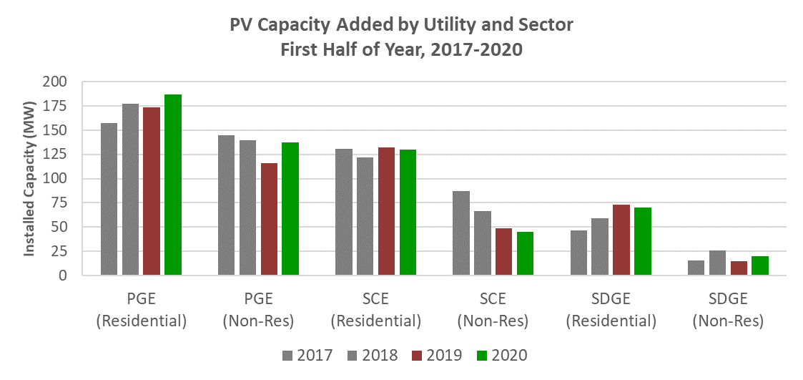
2020 Data Similar to 2019
New factors affecting solar adoption
  Drop in the federal ITC (from 30% to 26%)
  Title 24 PV requirements are now in full effect
  Pandemic (and the associated economic downturn)?
IOU Data through June 30, 2020
  Installations similar YoY
  Not enough data to understand what’s happening
Source: California Energy Commission analysis of NEM Interconnection Applications data sets.

Slide 6

Updates to 2020 PV Forecast
Demographic / economic data
  Household growth
    Slower compared to 2019 forecast
  Commercial floorspace
    Slightly lower growth compared to 2019 forecast
  GSP Deflator
Forecast of Electricity rates
  Similar to 2019 forecast
Included new commercial sector TOU tariffs
Notes:
Image showing the silhouette of California

Slide 7
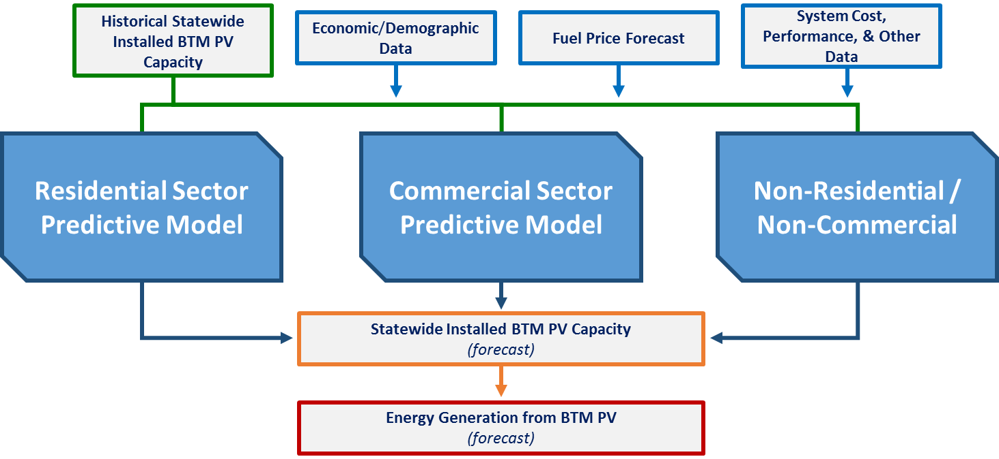
Energy Commission PV Model
Residential and commercial models predict PV penetration based on calculated payback / bill savings.

Slide 8
Scenario Definitions
High = High Electricity Demand Case
    High economic / demographic growth → high growth in building stock
    Low electricity rates
    Low PV adoption
Low = Low Electricity Demand Case
    Low economic / demographic growth → low growth in building stock
    High electricity rates
    High PV adoption
Mid = Mid Electricity Demand Case

Slide 9
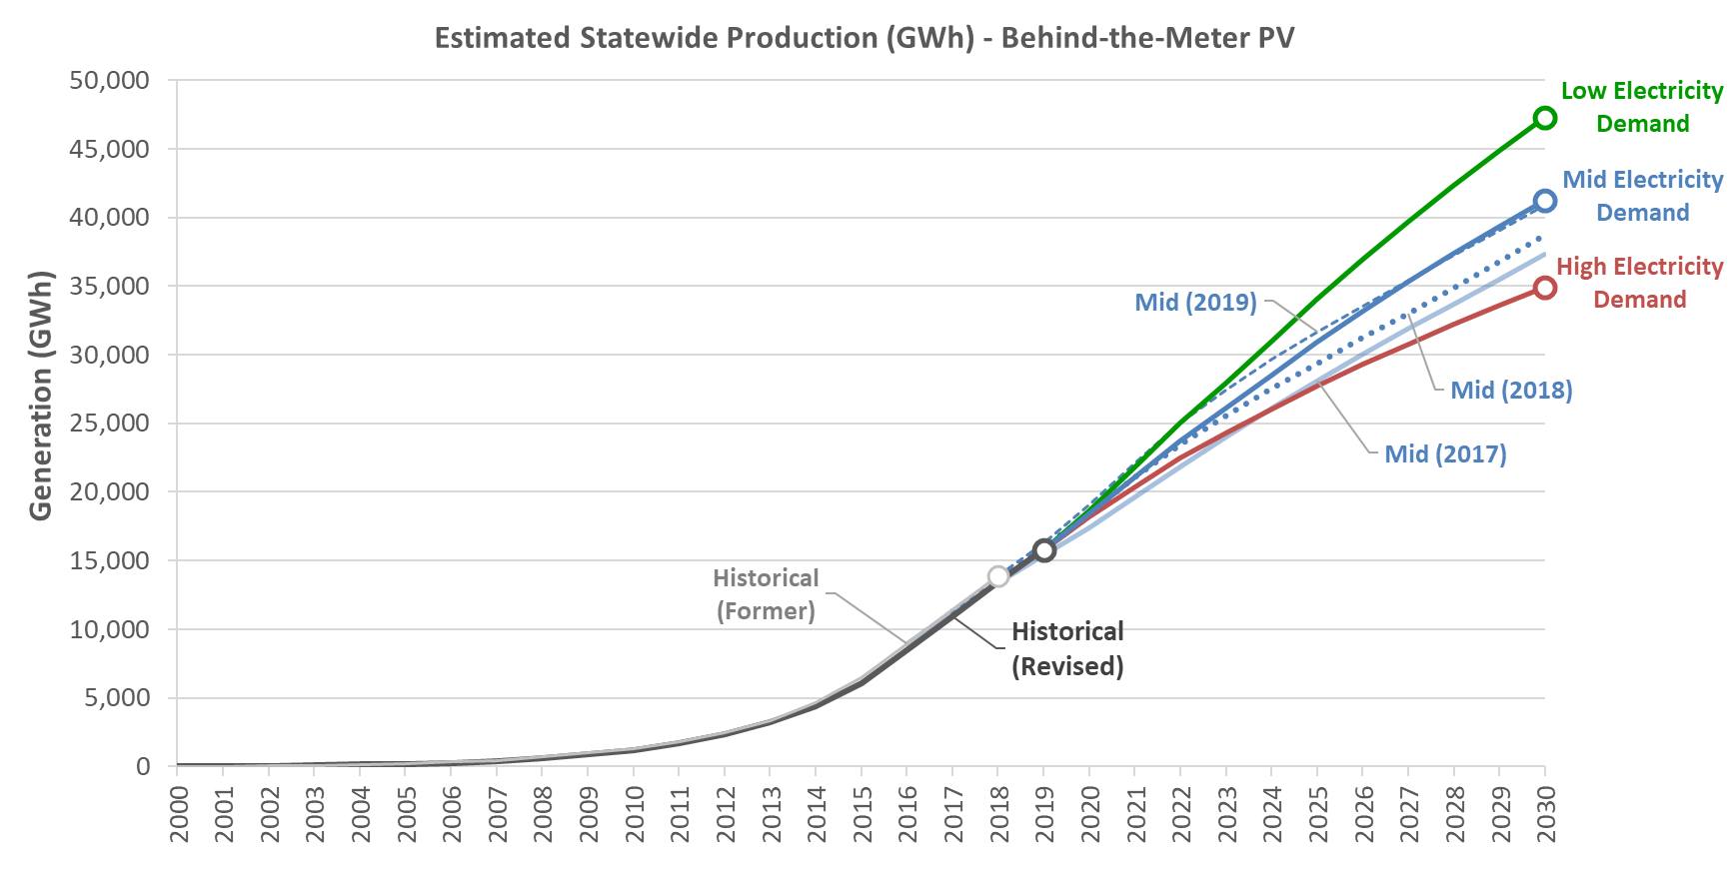
2020 Statewide BTM PV Forecast
47,300
41,200
34,900
15,800
Source: California Energy Commission.
Note: For consistency, 2017 and 2018 forecasts include AAPV forecast results.

Slide 10
Self-Generation Forecast
> 41,000 GWh
Historical
Forecast
~15,800 GWh
Source: California Energy Commission.
~14,000 GWh

Slide 11
UTILITY / PLANNING AREA FORECASTs

Slide 12
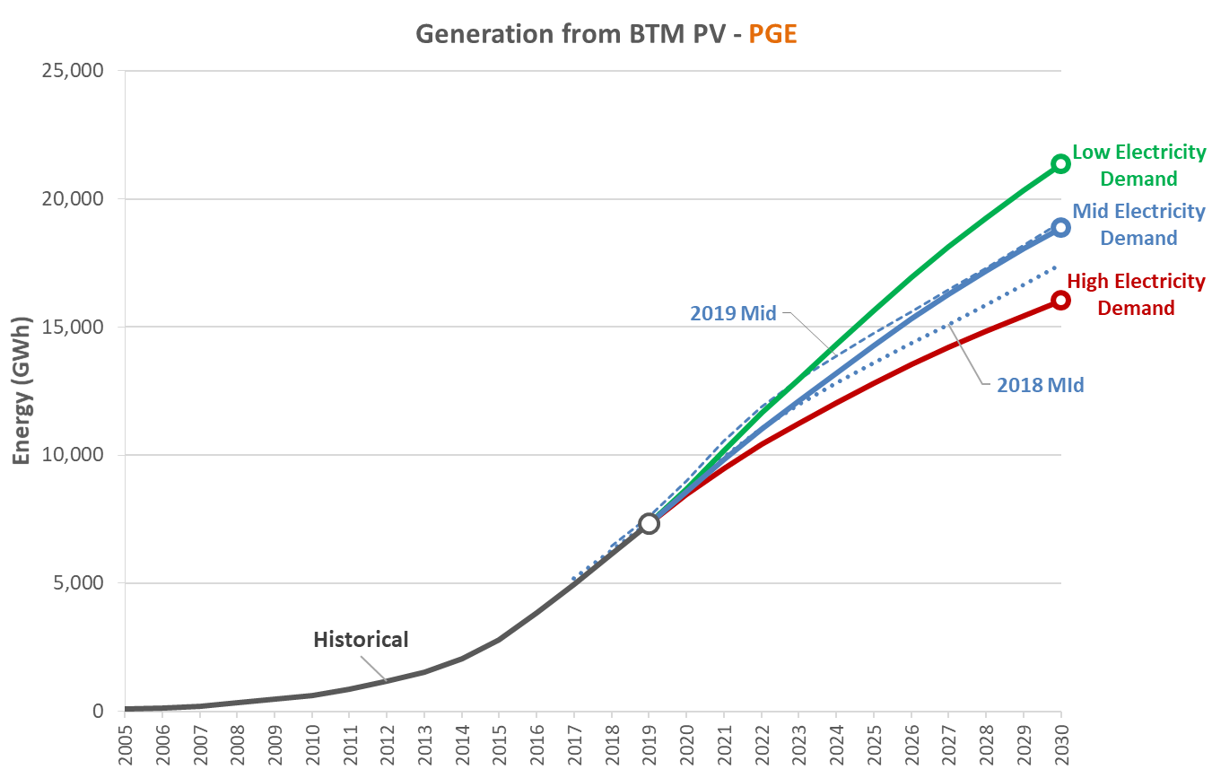
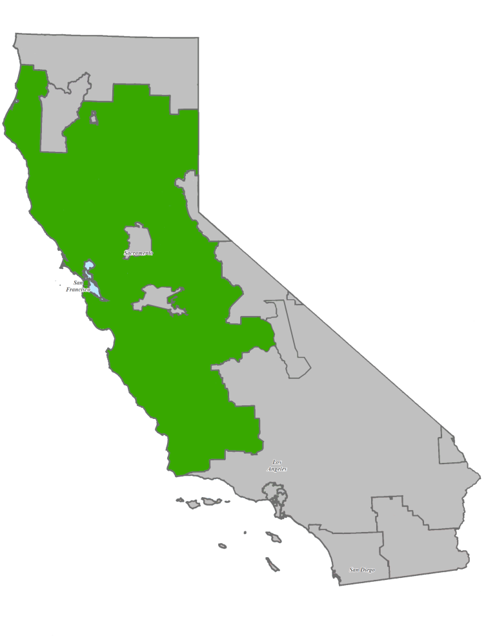
PG&E PV Forecast
PV Generation forecast to grow to ~19,000 GWh by 2030 in mid-case
18,900
7,300
NOTE: 2018 forecast includes AAPV forecast results.

Slide 13
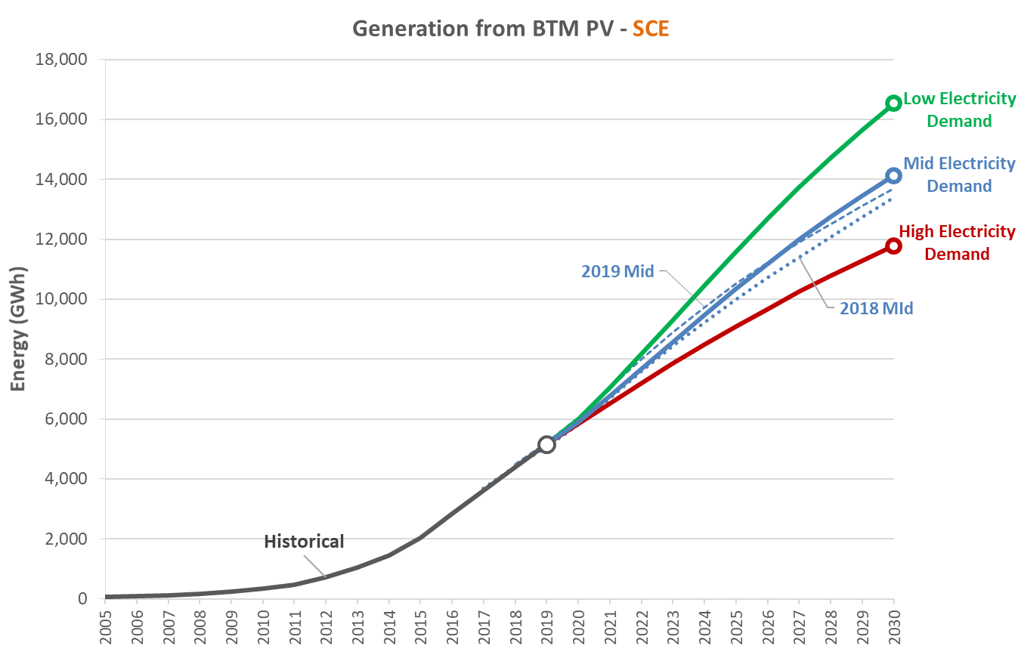
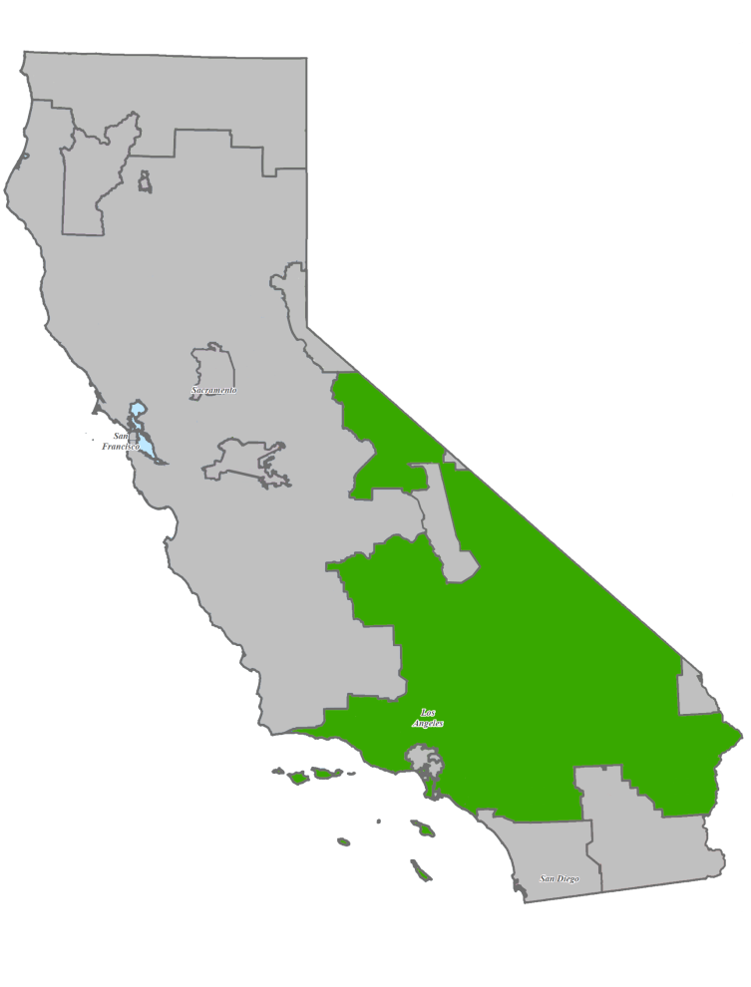
SCE PV Forecast
PV Generation forecast to grow to 14,100 GWh by 2030 in mid-case
14,100
5,100
NOTE: 2018 forecast includes AAPV forecast results.

Slide 14
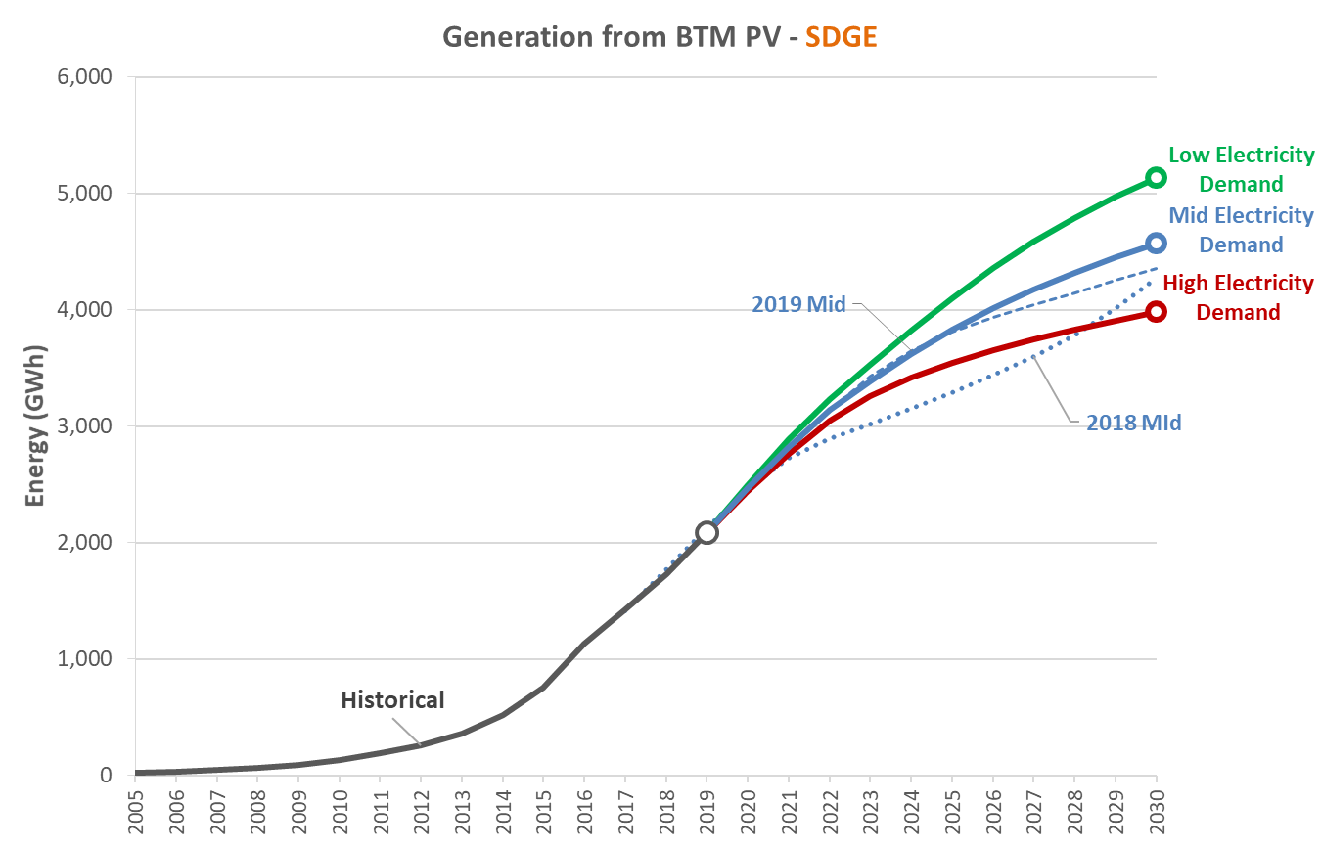
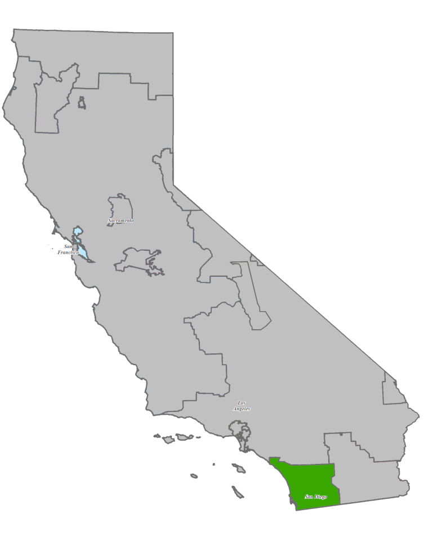
SDG&E PV Forecast
PV Generation forecast to increase to 4,500 GWh by 2030 in mid-case
4,500
2,080
NOTE: 2018 forecast includes AAPV forecast results.

Slide 15
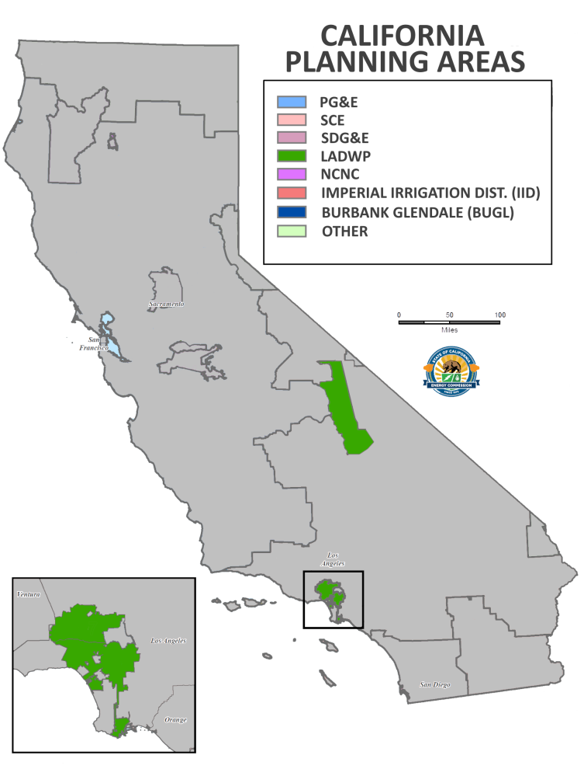
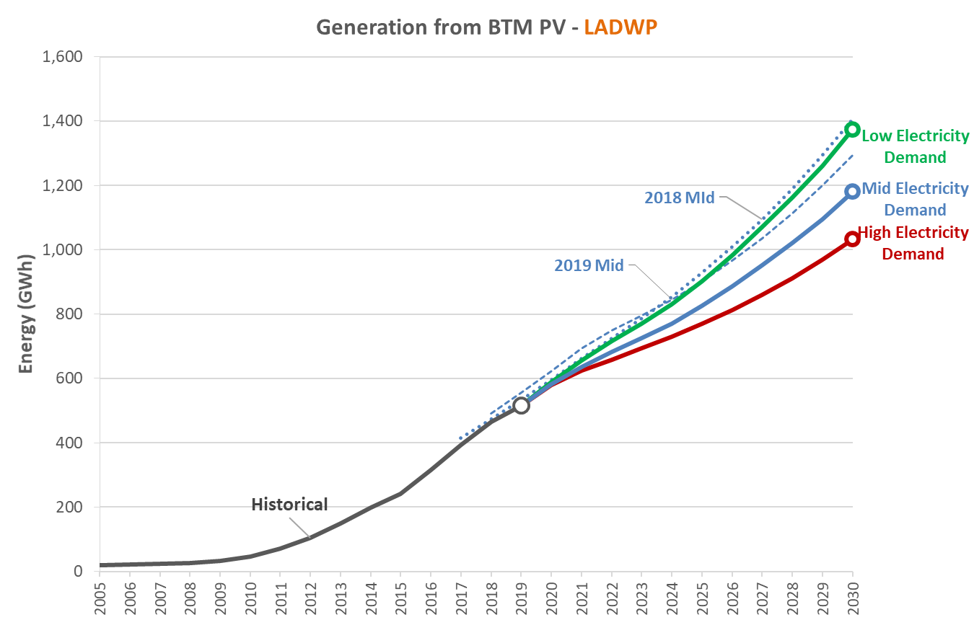
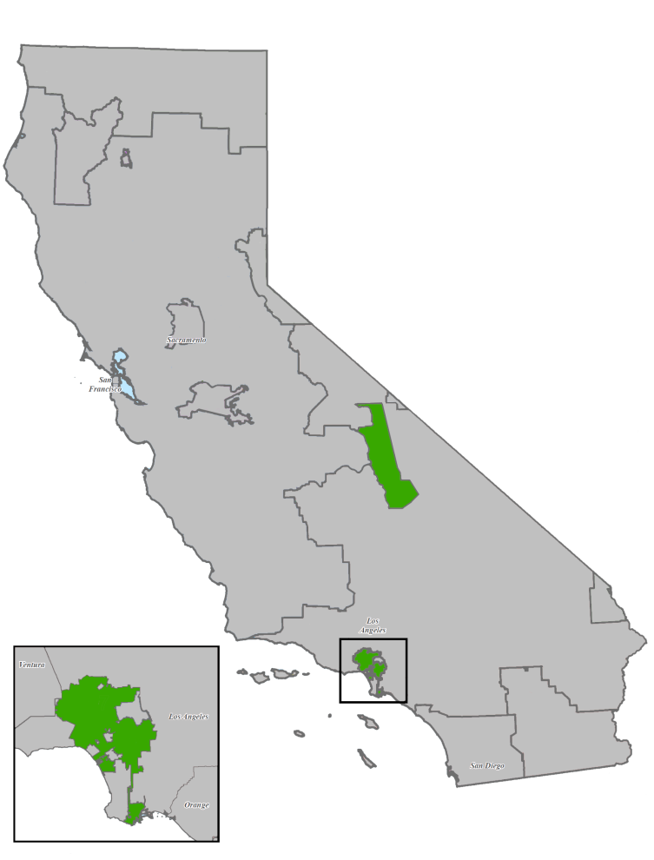
LADWP PV Forecast
PV Generation forecast to grow to ~1,200 GWh by 2030 in mid-case
1,180
516
NOTE: 2018 forecast includes AAPV forecast results.

Slide 16
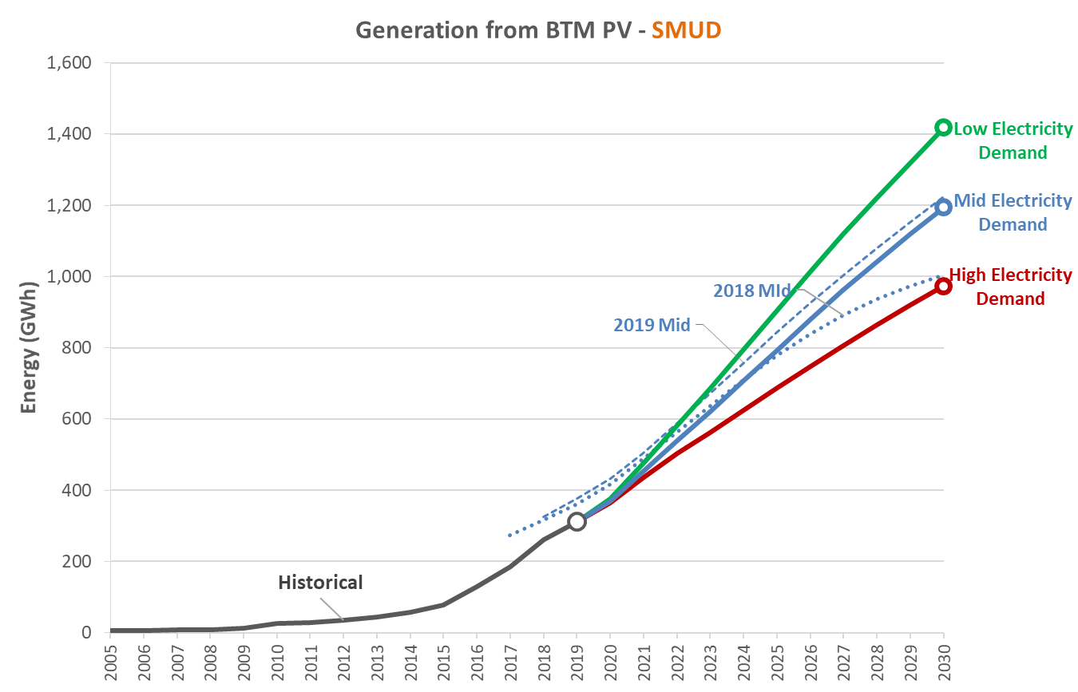
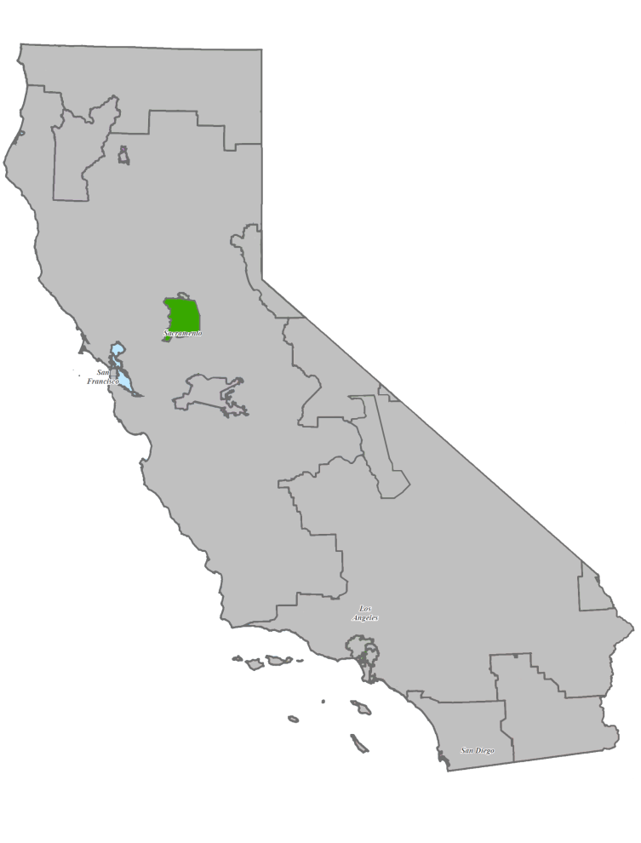
SMUD PV Forecast
PV Generation forecast to grow to 1,200 GWh by 2030 in mid-case
1,200
312
NOTE: 2018 forecast includes AAPV forecast results.

Slide 17
BTM Energy Storage Forecast

Slide 18
BTM Energy Storage Adoption
No methodological changes since 2019 in forecasting BTM storage adoption
Incorporated latest Rule 21 and SGIP storage installation data
Storage adoption in 2019 was higher than forecast.
  Forecast adoption for 2019:
    Low Demand: ~ 70 MW
    High Demand: ~ 78 MW
    Mid Demand: ~ 85 MW
  Actual 2019: ~ 130 MW
SGIP program shows significantly higher number of applications since a year ago.
  473 MW of outstanding funding reservations as of 11/02/2020
  73 MW of outstanding funding reservation as of 10/21/2019

Slide 19
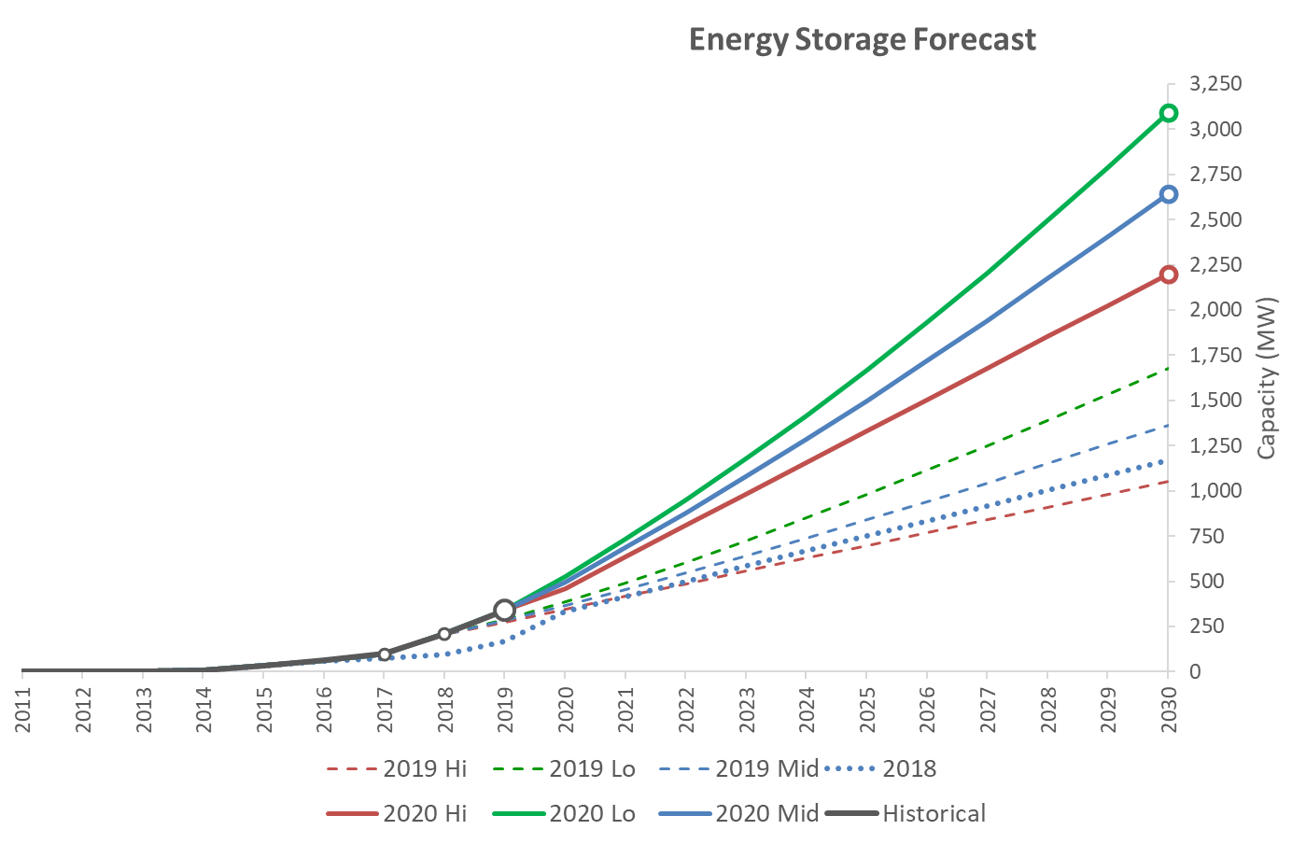
Storage Forecast Results
Approach for Forecasting Energy Storage Adoption (by Sector and Scenario)
Scenario | Residential | Non-Res
High Demand | Trend Analysis | Trend Analysis
Low Demand | % of PV capacity
Mid Demand | Avg. of High/Low

Slide 20
Deployment of BTM Storage
Non-residential storage systems
  Update charge / discharge profiles from the 2018 SGIP Storage Impact Evaluation report (released Jan 2020)
      www.cpuc.ca.gov/General.aspx?id=7890
  The 2019 forecast used the 2017 SGIP Storage Impact Evaluation report
Residential storage systems
  Subject to new SGIP eligible requirements
    “all new residential IOU and non-IOU customers are required to enroll in a time-varying rate with a peak period starting at 4 pm or later and with a summer peak to off-peak price differential of 1.69 or more, if such rate is available”
      www.selfgenca.com/documents/handbook/2020

Slide 21
SGIP Approved TOU Rates
For the PG&E, SCE, and SDG&E rate tariffs used to model storage deployment in CED 2019 would be ineligible for new SGIP funding.
For new residential applications, table below shows SGIP approved tariffs.
SDG&E: option 1 has similar TOU periods as tariff modeled in 2019…will keep residential charge / discharge profiles from 2019 forecast.
PG&E and SCE: options have different TOU periods from tariffs modeled in 2019 → requires new residential charge / discharge profiles.
 | PG&E | SCE | SDG&E | SMUD
CED 2019 | E-TOU-C | TOU-D-4-9 | Residential TOU DR-2 | Time of Day (5-8 p.m.)
Option 1 | EV-A | Residential TOU-D-Prime | Residential TOU DR-1 | Time of Day (5-8 p.m.)
Option 2 | EV-B | TOU-EV-1 Residential | EV-TOU | -
Option 3 | EV2-A | TOU-D-5-8 | EV-TOU-2-Residential | -
Option 4 | - | - | EV-TOU-4 | -
Approved by SGIP
Source: California Energy Commission, Self-Generation Incentive Program (www.selfgenca.com/home/resources/)

Slide 22
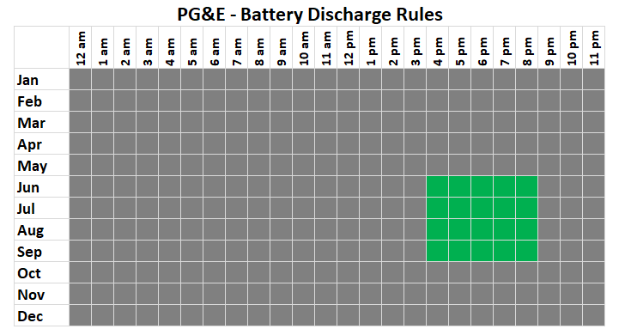
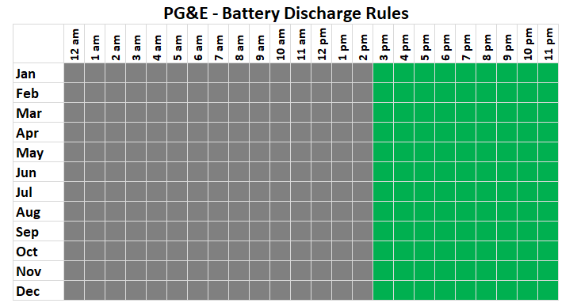
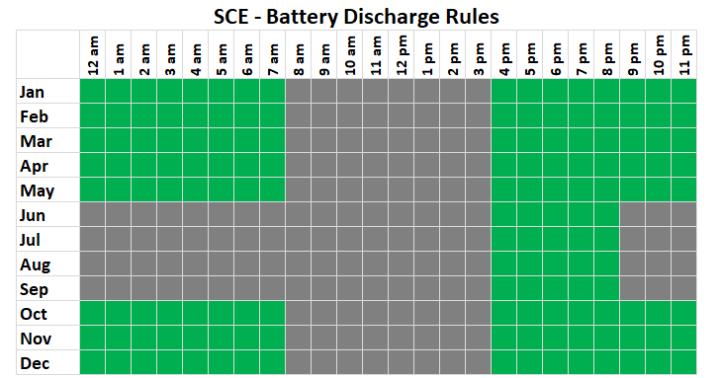
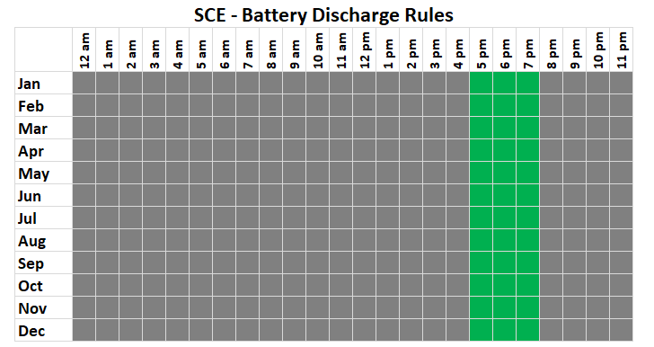
New Storage Profiles for PG&E and SCE
CED 2019 charge / discharge profiles New charge / discharge profiles
Tariff: EV2-A
Tariff: TOU-D-5-8
Note: Battery can only charge using a PV system

