Slide 1
Dashboard for 2020 IEPR Update Results for Light Duty PEVs
Liz Pham
California Energy Commission

Slide 2
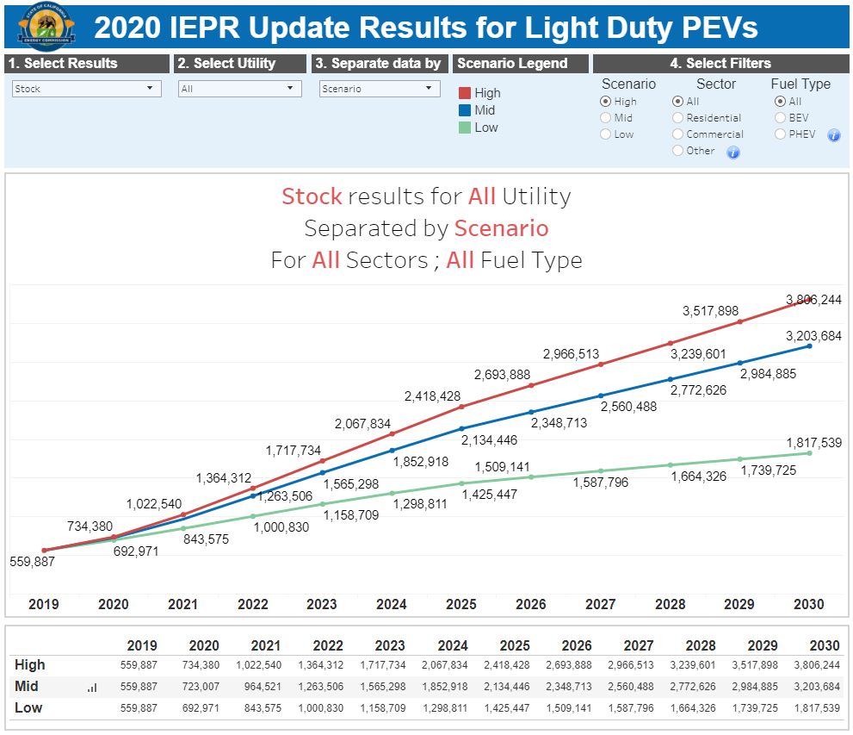
Screenshot of Light Duty PEV Dashboard

