Slide 1
CEDU 2020: Planning Area Sales Summary
Prepared for Demand Analysis Working Group
November 19, 2020
Cary.Garcia@energy.ca.gov
Demand Analysis Office

Slide 2
Review of input changes
Major economic drivers see a decline in 2020 due to COVID-19 with a recovery beginning partway through 2021 and continuing through 2023
Population and household forecasts from DOF have been lowered
Lower birth rate, increase deaths, and lower net migration
Household formation is delayed for millennials due to affordability in the near-term
On average electricity rate growth is similar to CED 2019
PG&E residential and commercial is somewhat higher, while SDG&E and SCE have lower expectations

Slide 3
Moody’s Outlook - June vs. Oct. 2020
Key differences:
Commercial and Manufacturing employment are now expected to be lower for 2020
Personal income and GSP outlook is somewhat more optimistic
Extraordinary uncertainty in recovery outcome dependent on federal stimulus and vaccine availability
Moody’s October baseline forecast assumes additional federal stimulus in Q1 2021
Outlook does not expect a significant second wave of the virus and anticipates a vaccine by Spring 2021

Slide 4
Major Planning Area Sales Summary
Years | CEDU 2020 – Baseline Mid Case Sales Growth
 | PG&E | SCE | SDG&E | LADWP | SMUD
2019-2020 | -3.5% | -2.0% | -3.6% | -4.3% | -1.4%
2020-2024 | 1.3% | 1.2% | 0.3% | 1.2% | 0.7%
2025-2030 | 0.4% | 0.4% | 0.6% | 0.3% | 0.6%

Slide 5
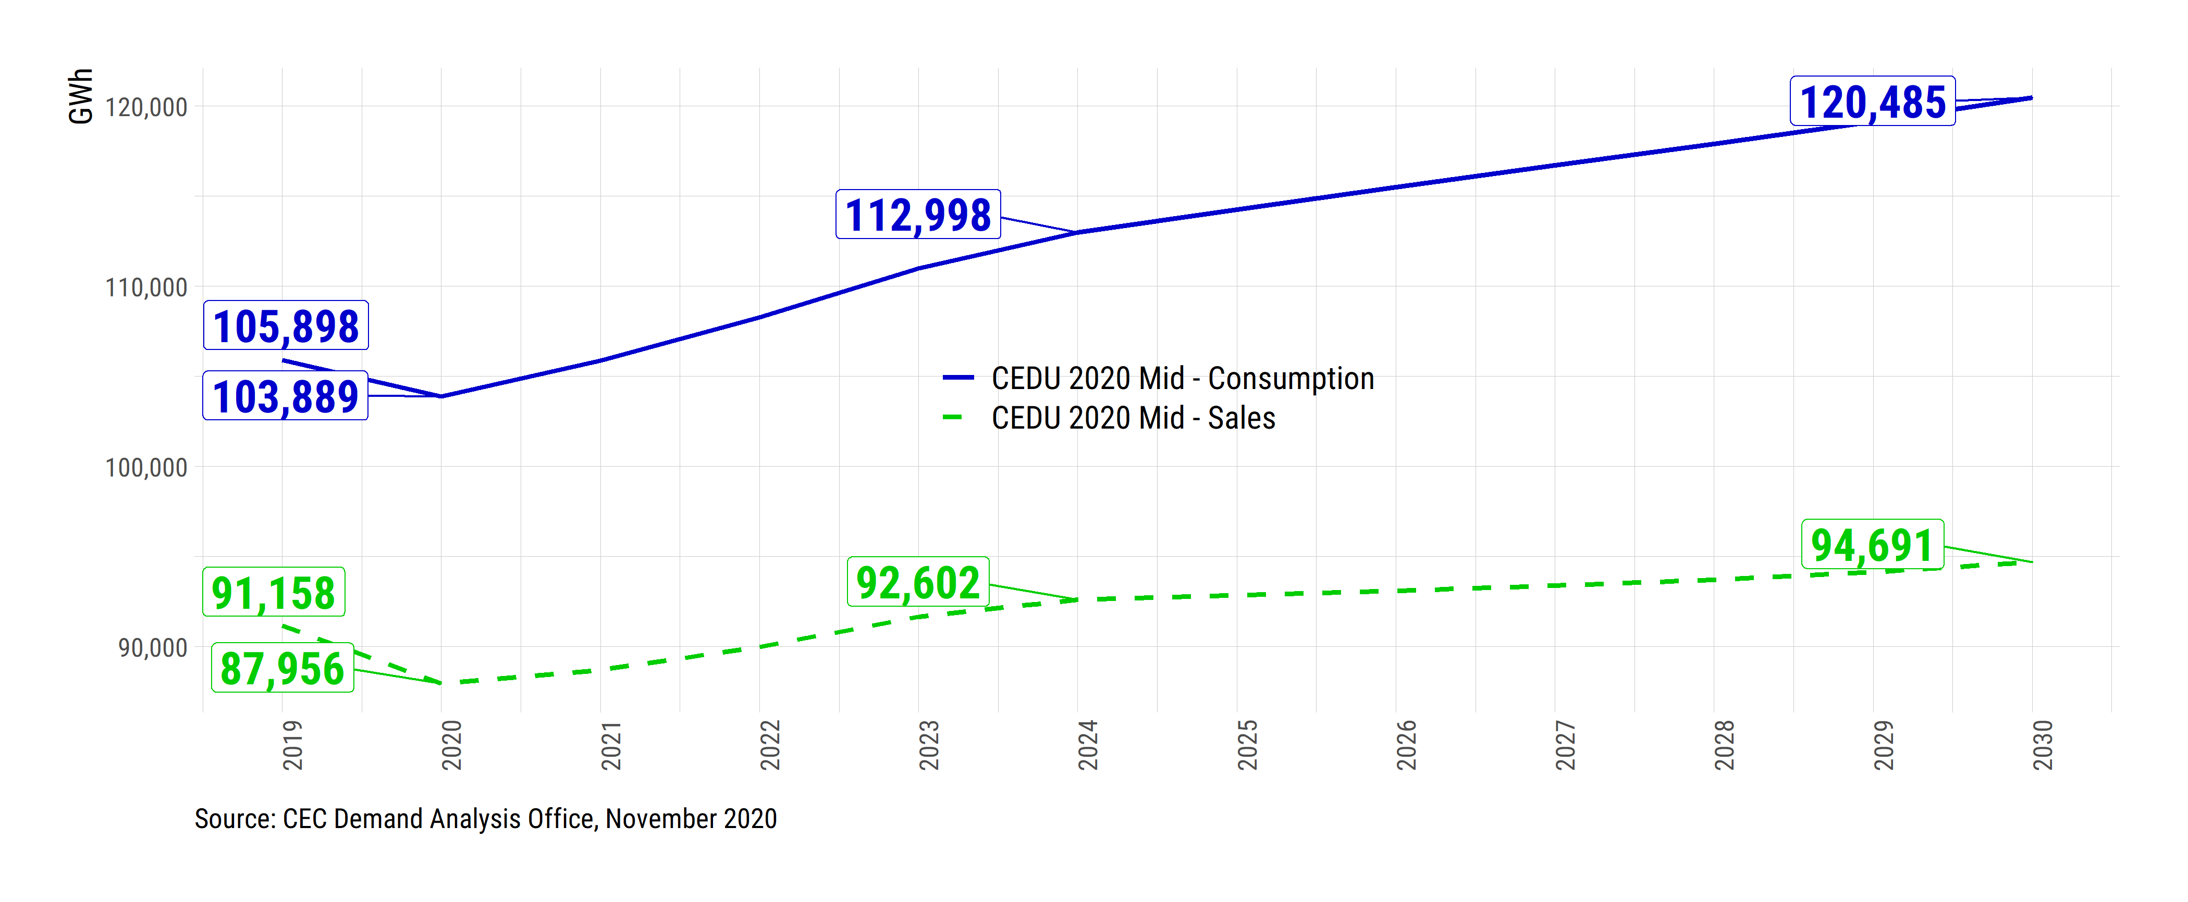
PG&E Planning Area Sales
EVs contribute 5,850 GWh by 2030
25,800 GWh of self generation by 2030 (18,900 GWh as PV)
0.7% average annual growth, 2020-2030

Slide 6
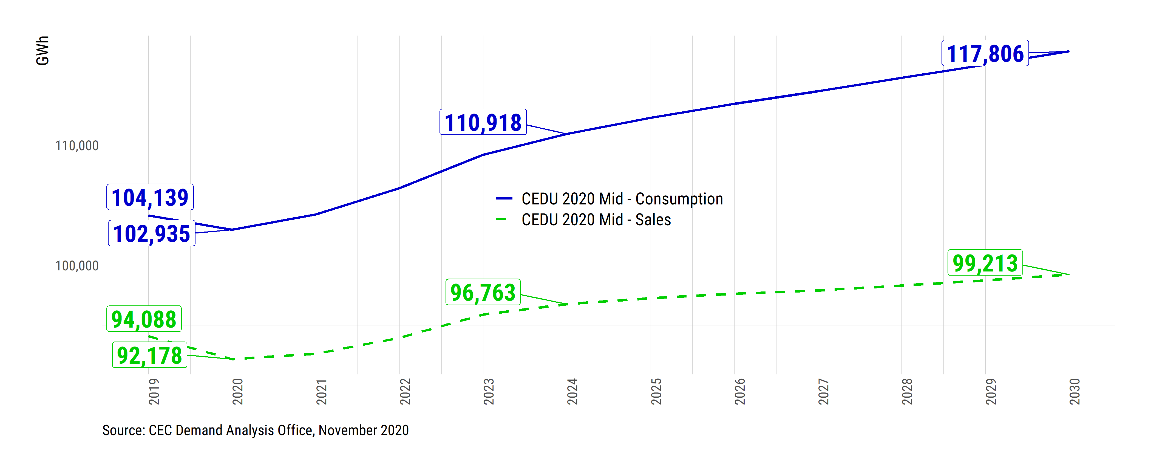
SCE Planning Area Sales
EVs contribute 4,647 GWh by 2030
~18,600 GWh of self generation by 2030 (14,100 GWh as PV)
Sales growth at 0.7% annually, 2020-2030

Slide 7
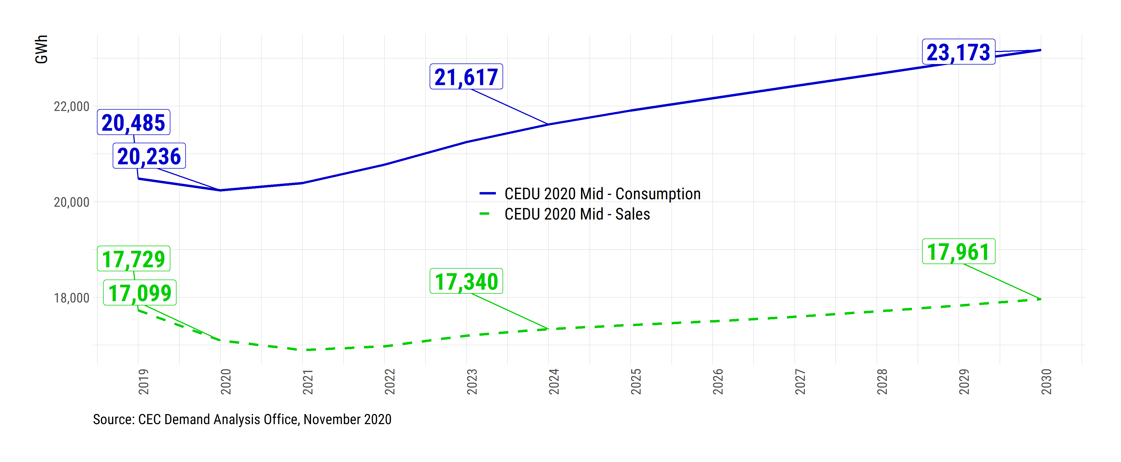
SDG&E Planning Area Sales
1,344 GWh contributed EVs by 2030
5,200 GWh of self generation by 2030 (4,570 GWh as PV)
Average annual growth of 0.5% for sales

Slide 8
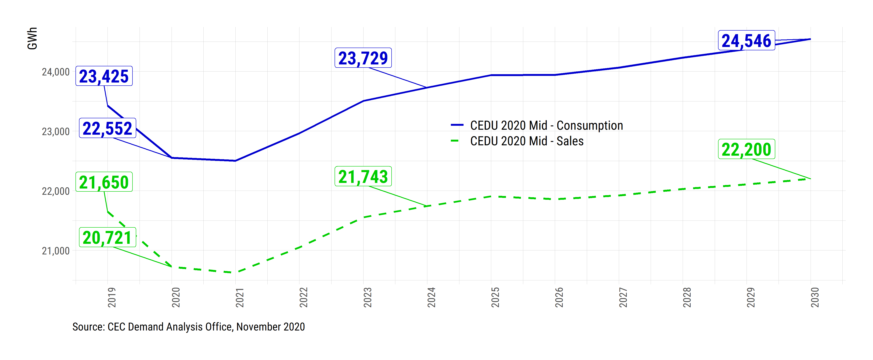
LADWP Territory Sales
1,408 GWh contributed by EVs by 2030
2,350 GWh of self generation by 2030 (50% from PV)
Sales growth at 0.7% annually, 2020-2030

Slide 9
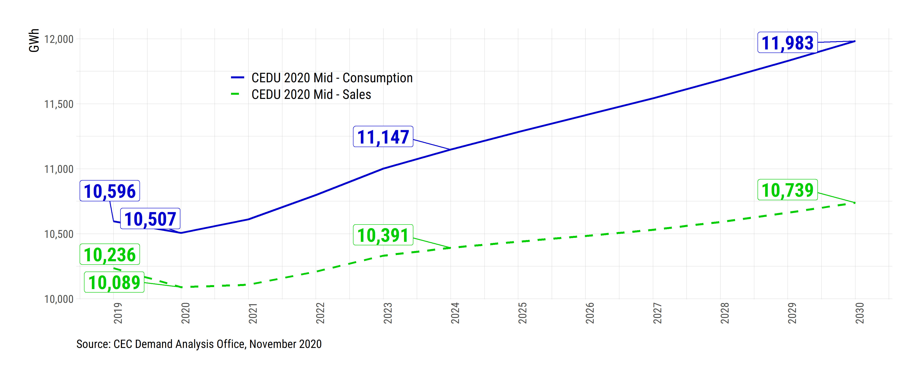
SMUD Territory Sales
371 GWh from EVs by 2030
1,244 GWh of self generation by 2030 (96% as PV)
0.6% growth annually, 2020-2030

Slide 10
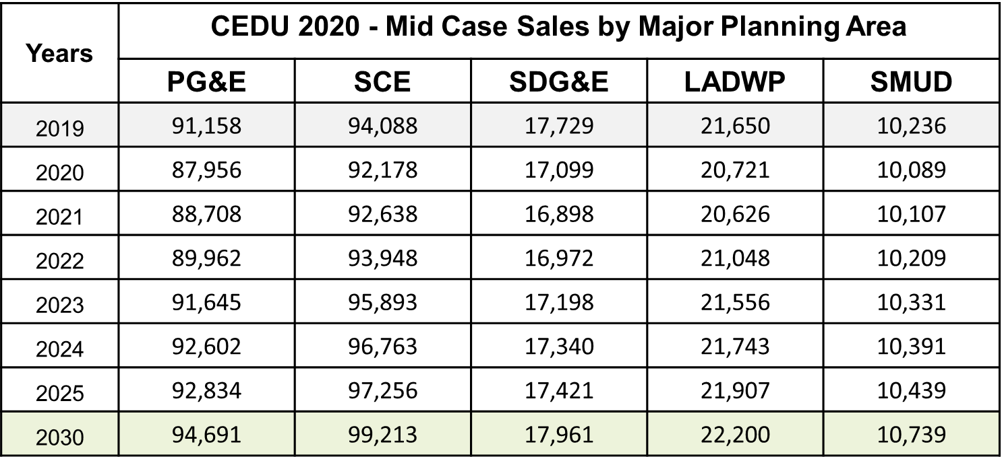
Appendix: Baseline Sales

