Slide 1


CEC EPC-19-056
Assessing Long Duration Energy Storage Deployment Scenarios to Meet California's Energy Goals
Introductory Public Workshop
December 3, 2020

Slide 2
Agenda
 | Description
5 minutes | Project Team Introduction E3 (Amber Mahone, Roderick Go) UCSD Center for Energy Research (Ryan Hanna) Form Energy (Scott Burger)
20 minutes | Project Purpose & Previous Work Key planning challenges for zero-carbon energy systems Key findings & limitations of relevant past work in California and other jurisdictions Limitations of current planning tools & data
30 minutes | Overview of Analytical Approach, Valuation Metrics & Outcomes Analytical strategy & timeline Proposed scenario design parameters Technology review Proposed analysis of long duration energy storage use-cases New Modeling Toolkit development Analytical outcomes
5 minutes | Next Steps
30 minutes | Q&A and Discussion

Slide 3





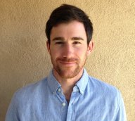

Overview of Project Team & Responsibilities
E3 will lead this team, leveraging expertise in deep decarbonization analyses
  Amber Mahone and Roderick Go will be serve as project managers
  Arne Olson will be principal investigator
  Nick Schlag will serve as project advisor
Form Energy will provide technology expertise on their long duration storage technology and analytical support valuing long duration storage assets
UCSD CER will draw on real-world testing expertise to assess the technical characteristics of long duration storage technologies and use the UCSD campus as a case study for low-carbon microgrids based on long duration storage
Overview of Project Team
E3 Consulting Staff
Jasmine Ouyang, Managing Consultant
Jessie Knapstein, Senior Consultant
Adrian Au, Consultant
Charlie Duff, Consultant
Anthony Fratto, Consultant
Charlie Gulian, Consultant
Xiaoxuan Hou, Consultant
Huai Jiang, Consultant
Rawley Loken, Consultant
Gabe Mantegna, Consultant
Manohar Mogadali, Consultant
Dr. Yuchi Sun, Consultant
Vignesh Venugopal, Consultant
Dr. Bill Wheatle, Consultant
Dr. Mengyao Yuan, Consultant
Prime Recipient: E3
Principal Investigator
Project Manager (External)
Arne Olson,
Senior Partner
Amber Mahone,
Partner
Project Advisor
Project Manager (Internal)
Nick Schlag,
Director
Roderick Go,
Technical Manager
Sub-Contractor 1:
University of California
San Diego Center for Energy Research
Mike Ferry,
Director of Energy Storage
and Systems
Ryan Hanna,
Research Scientist
Sub-Contractor 2:
Form Energy
Dr. Marco Ferrara,
Co-Founder & SVP of Analytics and Business Development
Mateo Jaramillo,
Co-Founder & Executive Chairman
Dr. Scott Burger,
Analytics Lead
Dr. Aly Eltayeb,
Manager of Business Development
Dr. Ben Jenkins,
Manager, Data and Optimization
Jason Houck,
Policy and Regulatory Affairs Lead

Slide 4
Project Purpose & Previous Work

Slide 5
Project Objectives
Evaluate the tradeoffs between energy storage duration, performance and cost, against a range of resource supply options and electric load conditions for various use-cases on California’s future grid.
Develop an updated publicly available dataset to characterize potential futures for California’s grid in the context of deep decarbonization, including characterization of new energy storage and energy generation technologies.
Develop a publicly available modeling toolkit that extends California’s capabilities to plan for a deeply decarbonized electric sector, incorporating long duration storage and new energy generation technologies into the resource mix.

Slide 6

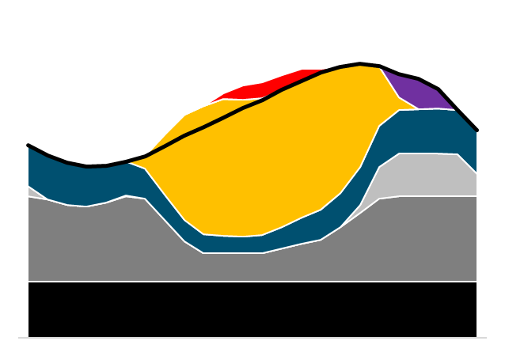
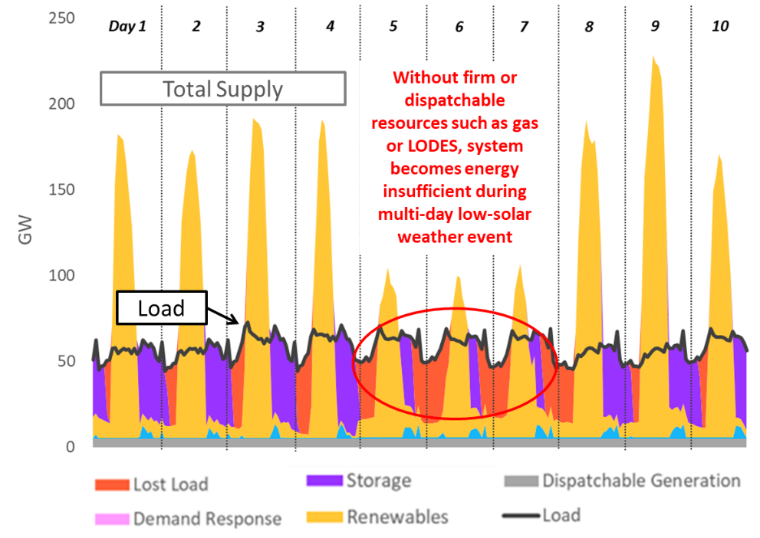
Project Purpose: Evolving Planning Needs
Yesterday’s Planning Paradigm
Today’s Planning Paradigm
Tomorrow’s Planning Paradigm
Heuristic approaches provide a reasonable means of screening for resource needs and investment options in thermal-dominated systems
Reliability driven by summer (or winter) peak demand
Tradeoff between capital-intensive resources with low operating costs and low capital resources with high operating costs
Understanding chronological system dispatch becomes necessary to evaluate investments & integration challenges for wind, solar, and batteries
Reliability driven by net peak demand, occurring in the evening/shoulder hours
Opportunities for energy arbitrage are largely intraday shifting
Increasing investment & operational uncertainty requires greater spatial & temporal granularity to capture system conditions & value streams for new technologies like long duration storage
Reliability driven by “dark doldrums” when renewables are unavailable to serve demand for extended periods
Significant opportunities for seasonal shifting of surplus energy
Renewable curtailment due to oversupply
Storage discharges to meet net peak
Peaking Resources
Surplus solar charges storage
Load Duration Curve
Wind
Solar
Peaking
Intermediate Resources
Intermediate
Resources
Baseload Resources
Baseload Resources

Slide 7
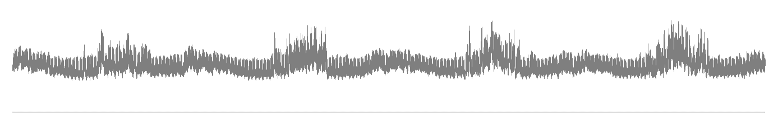

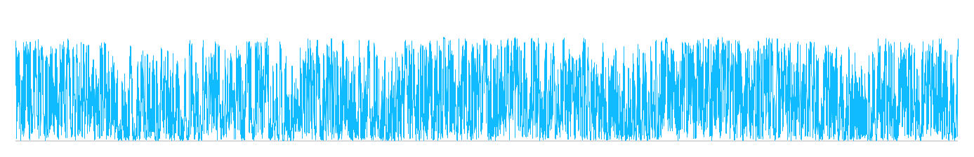
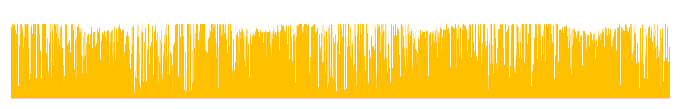
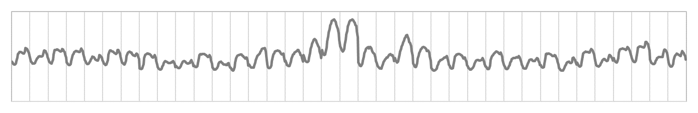
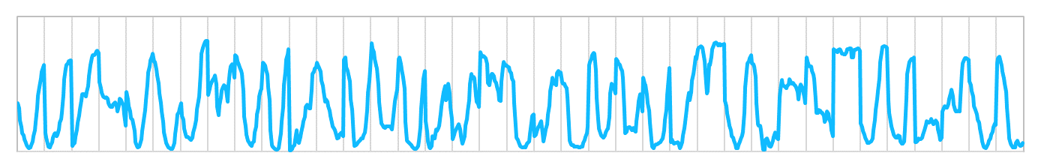
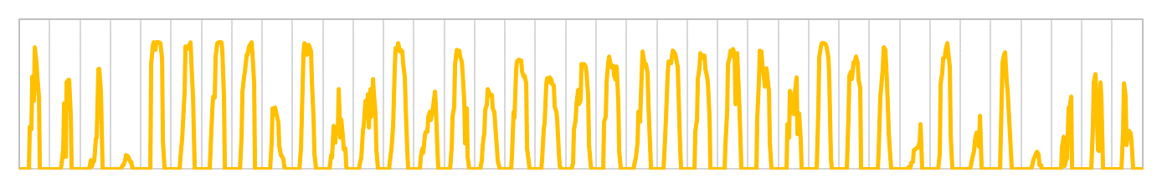
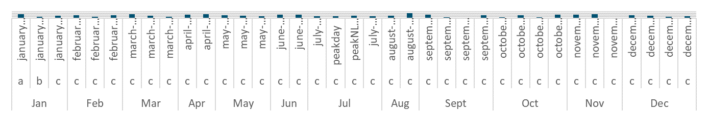
Common practice for operational modeling in resource planning uses a subset of representative intervals
Load
Wind
3-4 years
of time-synchronous hourly load & renewable profiles
Solar
Day selection algorithm selects optimized subsample of days & corresponding weights to match key characteristics observed in long-term record
Load
Wind
35-40 days selected as “representative” and modeled in RESOLVE’s operational simulation
Solar
Weights
Weights sum to represent
365 days

Slide 8
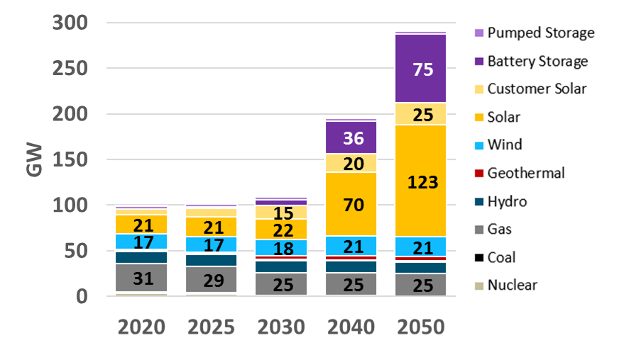
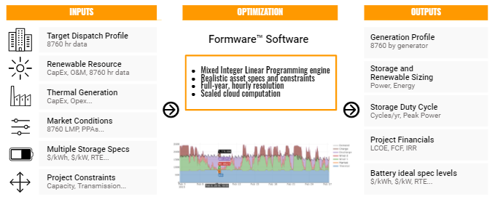
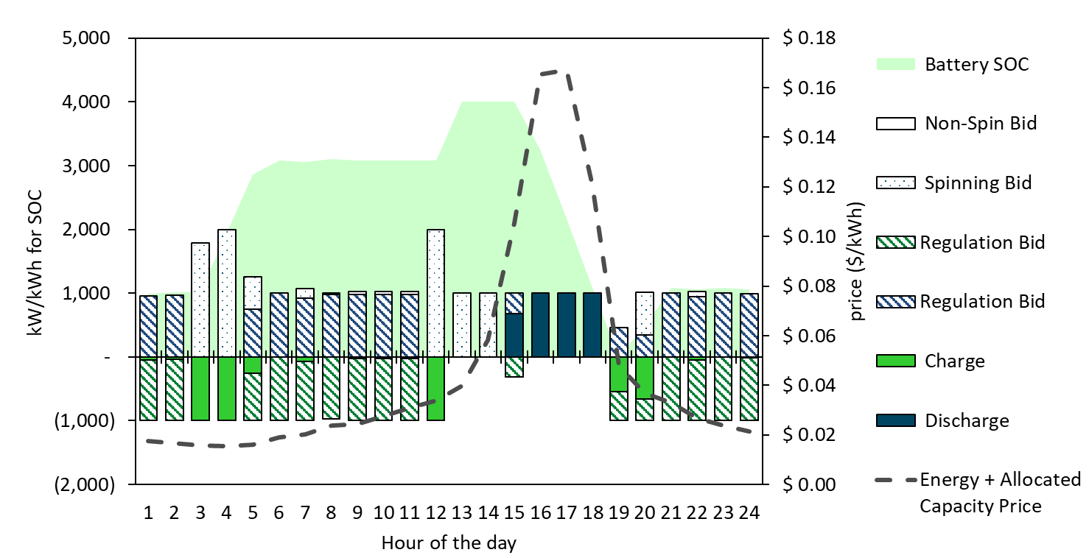
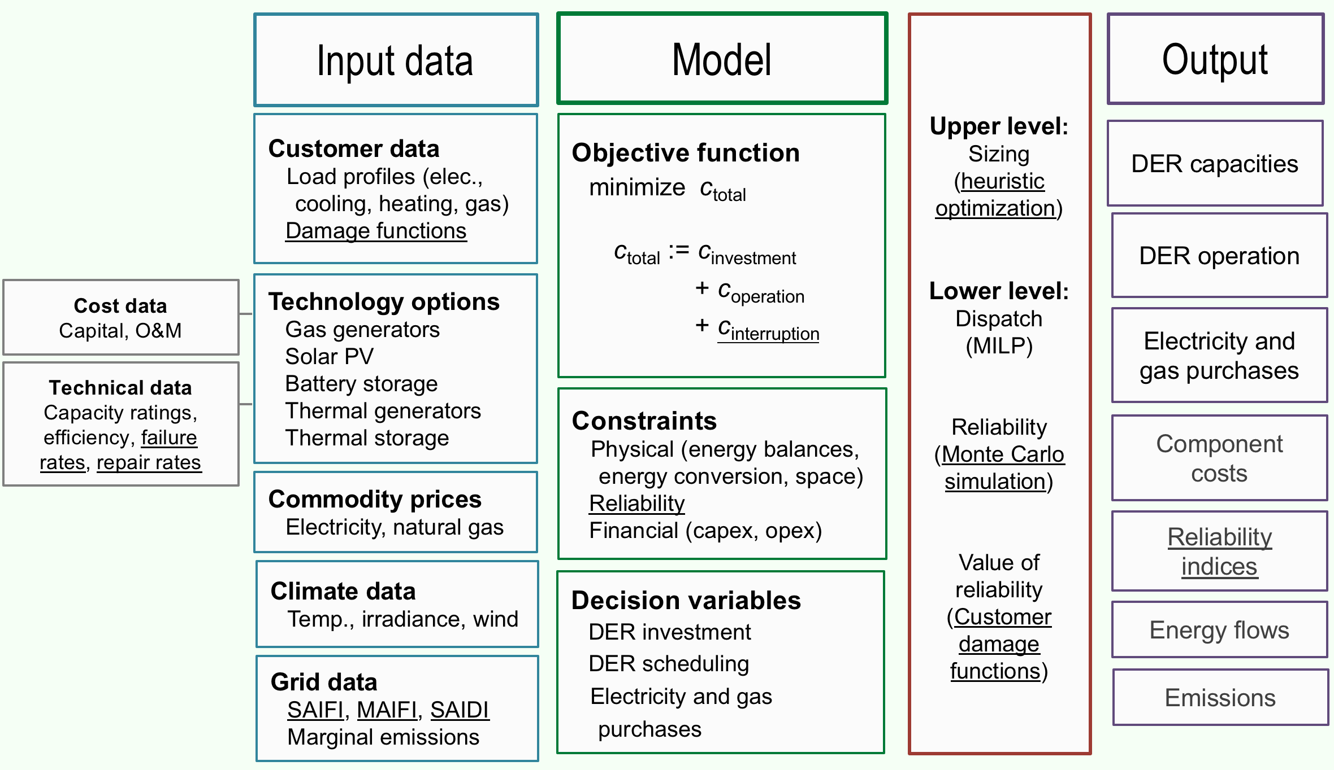
Overview of Existing Models
Our team will be using a suite of tools to perform our preliminary analysis of long duration storage & inform improvements to the analytical approach in the New Modeling Toolkit
No model is perfectly suited to answering our research question, but we can learn and improve on the tradeoffs they made by combining and comparing across different tools
RESOLVE
RECAP
Formware
RESTORE
UCSD Microgrid Model
Proactive, least-cost capacity expansion model for electric systems
Loss of load probability simulation capturing wide range of system conditions for resource adequacy
Stochastic, hourly capacity expansion & economic dispatch model
Optimal dispatch and cost-benefit analysis for storage & other DERs
DER-CAM-based optimal microgrid investment & operation of DERs, with 8760-h reliability evaluation

Slide 9
Key Findings from Previous Studies
Existing literature indicates that there is a role for some form of firm, zero-carbon resources in deeply decarbonized grids
However, previous studies have not fully captured the range of values & system conditions that drive LODES procurement
  Dowling, et al. show that considering more weather years significantly affects the estimated value of long duration storage
  Many studies focus on a specific part of the system (bulk grid, local area, microgrid) and make tradeoffs in representation of other areas
Related Studies | Key Findings | Modeling Limitations
CEC, E3 SB100 EFI, E3 New England | In zero-carbon systems, some form of firm, zero-carbon resource is needed to provide cost-effective capacity (system resource adequacy) | Limited representation of inter-day and seasonal energy shifting Limited T&D and local values captured Model hydrogen as drop-in fuel (for combustion or fuel cells)
Dowling et al. | LODES significantly lowers total system cost relative to renewables & batteries portfolio Value of LODES is sensitive to weather years captured | Generic seasonal storage option roughly representative of hydrogen Limited T&D and local values captured
E3 MHPS Guerra et al. | Capacity value is a major driver of storage value 2- to 14-day LODES is cost-effective in future systems | Price-taker dispatch model used to dispatch against exogenous value streams
CAISO 2025 LCTS | Storage of 5- to 11-hour duration can meet 2025 local reliability needs in CAISO | Not an economic analysis Generic battery storage technology modeled
E3 NY Peaker Formware Peaker | Storage can be dispatched to replace “peaker” plants located in load pockets like NYC | Not an economic analysis No modeling of grid impacts (e.g., local T&D constraints)
CEC, E3 Microgrid Arévalo-Cordero, et al. | Hybrid microgrids that incorporate storage are cost-effective relative to fossil-based | No modeling of grid impacts No modeling of zero-carbon microgrids Limited investigation of PSPS and other resiliency events

Slide 10
Overview of Analytical Approach,
Valuation Metrics & Outcomes

Slide 11
Analytical Strategy
Our fundamental strategy is to identify the highest value use-cases for LODES by deeply investigating how to model the different value streams that may drive storage procurement
  Energy, Capacity, and Operating Reserves
    How do technology characteristics affect the value proposition for meeting systemwide resource adequacy, decarbonization targets?
  Transmission, Distribution & Local Reliability
    How do technology characteristics affect the value proposition for local reliability and T&D deferral applications?
    Can storage procured to meet local needs inform systemwide planning & procurement?
  Resiliency & Customer Benefits
    How do technology characteristics affect the value proposition for microgrid applications?
    Can storage procured to meet customer needs inform local and systemwide planning & procurement?
We will assess other factors (e.g., renewable integration, land-use impacts, etc.) in addition to these economic values
Energy
Capacity (System RA)
Operating Reserves
Transmission Deferral
Bulk System Values
Peaking Capacity
Local Reliability
Distribution Deferral
DG Integration
Local Air Quality
Local Values
Backup Power & Resiliency
Bill Savings
Customer Values

Slide 12
Project Arc
Use existing tools to analyze long-duration storage
2
Refresh tools & data based on learnings from Phase 1
3
Analyze long-duration storage using new toolkit
1
Define scenarios
Identify future scenarios under which to study value of long-duration storage for California
Complete final analysis in new modeling toolkit
Develop optimized portfolios to meet California’s future energy needs that consider a broad range of options for long-duration storage
Analyze value of LODES in existing models
Compare approaches and results from multiple capacity expansion models (RESOLVE, Formware)
Use additional tools to analyze bulk system & local value streams (RECAP, RESTORE)
Analyze microgrid applications (UCSD Microgrid Model)
Update datasets
Refresh key inputs to study value of LODES
Focus on datasets that complement enhanced modeling functionality
Develop new modeling toolkit
Use Phase 1 learnings to inform model enhancements and new functionality
Key outputs
Quantitative taxonomy of the value of LODES of varying durations
Key outputs
Updated modeling platform capable of representing values identified in Phase 1
Key outputs
Optimized portfolios including LODES under a range of cost and duration assumptions

Slide 13
Potential Key Drivers of Long Duration Storage Scenarios
Lower LODES Need (High Flexibility)
Higher LODES Need (Low Flexibility)
High TE and BE flexibility (IRP cross-sector analysis)
Managed electrification loads
Low TE and BE flexibility (IRP RSP)
Load Flexibility
All resources: OSW, OOS wind, solar, geothermal, biomethane, hydrogen, nuclear, CCS
All resources excluding nuclear and CCS
All resources excluding nuclear, CCS, biomethane, hydrogen
No combustion/In-state resources focus (no nuclear, CCS, biomethane, hydrogen, OSW, limited new Tx)
Generation
Resources
Carbon Constraint
SB 100
(~90% zero-carbon)
Zero-carbon allowing combustion of biomethane/SNG/H2
Zero-carbon,
no combustion
Imports, Transmission
& RA
Regional RA, high internal transmission buildout
CA-only RA, low imports (BAU), low tx availability in-state
Resiliency
& Microgrids
Grid hardening
Mix of grid hardening and microgrids
Widespread microgrids for managing resilience
Other Sector
Linkages
Off-grid H2 only
Mix of on-grid and off-grid electrolysis (or vary flexibility of the H2 load)
On-grid hydrogen, synthetic fuels

Slide 14
Potential Scenario Designs
New Transmission, Regional Grid
Emerging Zero-Carbon Resources on a Regional Grid
WECC-wide development of diverse resources
(wind, solar, geothermal, offshore wind, new nuclear, CCS, etc.)
Widespread transmission development
Regional resource adequacy
Minimal microgrids
Existing Renewables on a Regional Grid
WECC-wide renewables & geothermal development
(no new nuclear, CCS)
Widespread transmission to access high capacity factor resources across region
Regional resource adequacy
Lower LODES Need
More emerging technologies available
Existing generation technologies only
Higher LODES Need
Emerging Zero-Carbon Resources on a CA-Centric Grid
California-focused development of diverse resources
(wind, solar, geothermal, offshore wind, new nuclear outside CA, CCS, etc.)
CA-only resource adequacy
Widespread deployment of microgrids & grid hardening for resiliency
Existing Renewables on a CA-Centric Grid
California-focused renewables & geothermal development
(no new nuclear, CCS)
CA-only resource adequacy
Widespread deployment of microgrids & grid hardening for resiliency
Limited Transmission, Local Grid

Slide 15
Technology Review
Our technology review will summarize the latest publicly available information, including:
  Operating characteristics (e.g., duration, efficiency losses, parasitic or self-discharge losses, ramp rates)
  Non-energy characteristics (e.g., land-use impacts, siting constraints, non-energy demands)
  Cost projections & learning curve analysis
Any other emerging technologies to include?
Long Duration Energy Storage Technologies
Other Technologies
Pumped hydro
Compressed air
Electrochemical (e.g., aqueous-air)
Thermal
Gravity
Zero-carbon fuels (e.g., hydrogen, biomethane, electrolytic fuels)
Nuclear generation (conventional & advanced)
Carbon capture & sequestration
  Pre-combustion (Allam cycle)
  Post-combustion
  Bioenergy with CCS (BECCS)
  Direct air capture (DAC)
Transmission

Slide 16
Preliminary Bulk System Analysis
RESOLVE
Formware
Compare methods and results of existing capacity expansion models
  Conduct parallel analysis in RESOLVE and Formware to develop optimized plans to meet California’s decarbonization goals
  Perform in/out cases to determine the price point at which various technologies become competitive
  Compare results and assess tradeoffs between different modeling methods
Proactive, least-cost capacity expansion model for electric systems
Stochastic, hourly capacity expansion
and economic dispatch model
RESTORE
RECAP
Use additional tools to investigate specific values offered by long-duration storage
  Use RECAP to quantify capacity value (i.e. reliability value or ELCC) of different storage durations
  Use RESTORE to analyze potential dispatch patterns and energy & AS revenues in specific portfolios
  Use results to inform a gap analysis of existing tools to identify functionality for New Modeling Toolkit
Optimal dispatch and cost-benefit analysis for storage & other DERs
Loss of load probability simulation to measure system resource adequacy
Hour of Day
High LOLP occurs in summer evenings when load is high but solar output declines
2018
Loss of Load Probability

Slide 17
Preliminary Local Area Analysis
Capacity expansion models typically do not have detailed representation of the T&D network, so additional tools are required to investigate:
  Local resource adequacy
  Transmission & distribution deferral
  Local air quality benefits
Compare net benefits of various technology options to address local RA and T&D deferral applications
  Use CAISO and utility filings to inform local needs
  Test different value streams (e.g., avoided costs vs. market revenues) and control strategies to calculate total benefit and inform breakeven cost of storage
  Compare RESTORE and Formware to investigate the impact of technological representation on modeled results
Formware
RESTORE
Stochastic, hourly capacity expansion & economic dispatch model with complete technological representation
Optimal dispatch and cost-benefit analysis for storage & other DERs

Slide 18
Preliminary Microgrid Analysis
The third piece of our analysis dives into customer considerations, such as microgrids, that may drive long duration storage adoption
  Bill savings
  Resiliency (defined as ability to supply critical loads during outage events such as PSPS)
Use UCSD’s microgrid model to compare least-cost microgrid configurations to meet customer-level reliability needs
  Our first case study will focus on the UCSD campus to understand critical loads, value of lost load, and available other value streams
  Calculated the breakeven cost of long duration storage-based microgrids compared to other fossil-backed systems
  Explore a range of stringent emissions constraints & PSPS events as drivers of long duration storage in low-carbon microgrids

Slide 19
New Modeling Toolkit Development
Today’s tools & modeling datasets are not capable of the kind of coherent, multi-level analysis of long duration storage that we are proposing through this project
We will develop and publish a New Modeling Toolkit, with flexible model structure that allows users to efficiently tradeoff between model speed, temporal resolution, and spatial extent
  Investigate new time domain reduction techniques to capture the value of multi-day and/or seasonal operations
  Represent more of the operating characteristics for emerging technologies (e.g., parasitic losses, degradation)
  Consider the interactive effects of various energy-limited resources toward resource adequacy
  Incorporate findings from local- and microgrid-level analyses to inform systemwide planning
We will also develop an accompanying public dataset of weather, load, and VER profiles using that captures a wider range of weather conditions than current modeling datasets
  Principal data sources will be DOE, EIA, FERC, NREL, National Labs, NOAA, and Lazard
  Refine methods for correlating load modifiers (such as heating loads) to underlying weather conditions to better capture the impact of new, potentially weather-driven loads on the resource needs.

Slide 20
Project Arc
Use existing tools to analyze long-duration storage
2
Refresh tools & data based on learnings from Phase 1
3
Analyze long-duration storage using new toolkit
1
Define scenarios
Identify future scenarios under which to study value of long-duration storage for California
Complete final analysis in new modeling toolkit
Develop optimized portfolios to meet California’s future energy needs that consider a broad range of options for long-duration storage
Analyze value of LODES in existing models
Compare approaches and results from multiple capacity expansion models (RESOLVE, Formware)
Use additional tools to analyze bulk system & local value streams (RECAP, RESTORE)
Analyze microgrid applications (UCSD Microgrid Model)
Update datasets
Refresh key inputs to study value of LODES
Focus on datasets that complement enhanced modeling functionality
Develop new modeling toolkit
Use Phase 1 learnings to inform model enhancements and new functionality
Key outputs
Quantitative taxonomy of the value of LODES of varying durations
Key outputs
Updated modeling platform capable of representing values identified in Phase 1
Key outputs
Optimized portfolios including LODES under a range of cost and duration assumptions

Slide 21
Illustrative Value/Breakeven Cost Results
Our final analysis will summarize the value of LODES of varying operating characteristics for different use-cases
  Some LODES technologies (e.g., pumped hydro) may not be suitable for some use-cases (e.g., microgrids)
We can compare the cost projections from our technology review to the calculated value of LODES to inform whether technologies are ready for economic deployment in different years
  Other “dimensions” of storage characteristics (e.g., efficiency, power rating) may also be interesting for different use-cases
Illustrative Comparison of Storage Value & Cost at Different Duration Needs (Snapshot Year)
Synthetic
Fuels
Pumped
Hydro
Value of Storage in 2045
Li-Ion
Electro-
chemical
Value / Projected Capital Cost ($/kW)
Duration (hours)

Slide 22
Next Steps

Slide 23

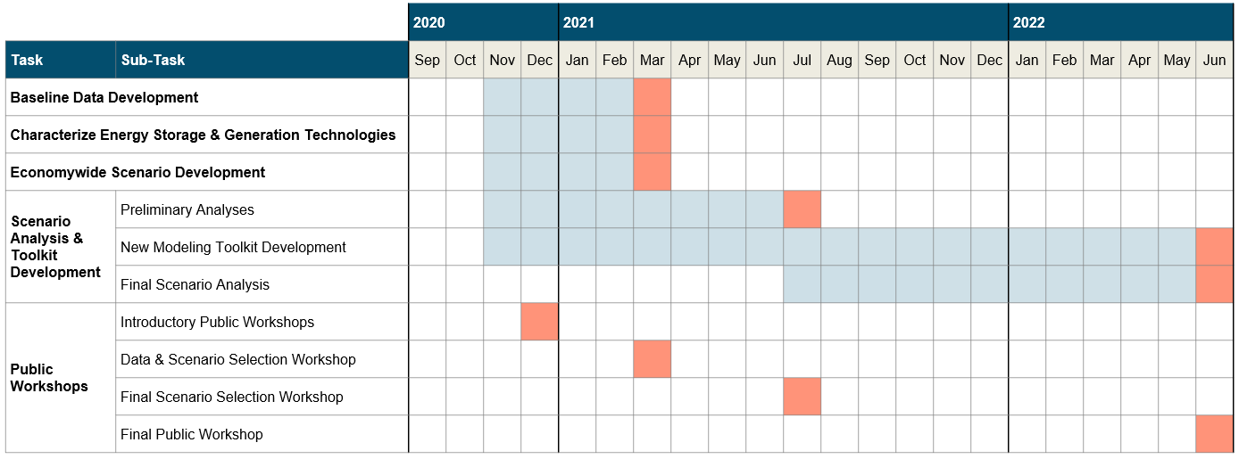
Preliminary Project Schedule & Tasks

Slide 24
Next Steps
Continue working on scenario design & technology review
Meet with Technical Advisory Committee to discuss refinements to approach
Begin preliminary analysis & data collection to support analysis of various long duration storage use-cases

Slide 25
Questions?
Roderick Go, roderick@ethree.com
Nick Schlag, nick@ethree.com
Amber Mahone, amber@ethree.com
Energy & Environmental Economics, Inc. (E3)
44 Montgomery Street, Suite 1500 | San Francisco, CA 94104

Slide 26
References
Arévalo-Cordero, P., Benavides, D. J., Juan Leonardo, Hernández-Callejo, L., & Jurado, F. (2020). Optimal energy management strategies to reduce diesel consumption for a hybrid off-grid system. Revista Facultad de Ingeniería Universidad de Antioquia, 98, 47–58.
CAISO. “Final 2025 Long-Term Local Capacity Technical Study Report” (2020).
California Energy Commission, E3. “Final Project Report: Santa Monica City Yards Advanced Energy District.”
California Energy Commission, E3. “Presentation – SB 100 Draft Results.” 19-SB-100 (2020).
Dowling, Jacqueline A., Katherine Z. Rinaldi, Tyler H. Ruggles, Steven J. Davis, Mengyao Yuan, Fan Tong, Nathan S. Lewis, and Ken Caldeira. "Role of Long-Duration Energy Storage in Variable Renewable Electricity Systems." Joule 4, no. 9 (2020): 1907-1928.
E3. “Least Cost Carbon Reduction Policies in PJM.” (2020).
E3. “Electric Reliability under Deep Decarbonization in New England.” Presentation at NEPOOL Meeting (2020).
EFI, E3. “Hydrogen Opportunities in a Low-Carbon Future.” (2020).
Glenk, Gunther, and Stefan Reichelstein. "Economics of converting renewable power to hydrogen." Nature Energy 4, no. 3 (2019): 216-222.
Guerra, Omar J., Jiazi Zhang, Joshua Eichman, Paul Denholm, Jennifer Kurtz, and Bri-Mathias Hodge. "The value of seasonal energy storage technologies for the integration of wind and solar power." Energy & Environmental Science (2020).
Lux Research. “Defining long-duration energy storage.” (2019).

