Slide 1
Medium- and Heavy-Duty Vehicle Attributes
Jeff Rosenfeld
Director, Transportation & Energy
May 5, 2021

Slide 2
Task overview
Purpose: Support Energy Commission transportation energy demand forecasting efforts by updating historic and forecast attributes of medium- and heavy-duty vehicles
Subtask 1. Administration
Subtask 2. Review of 2019 Forecast Attributes and Matrix of Available Fuel Types
Subtask 3. Update Historical Vehicle Attributes
Subtask 4. Vehicle Technology Forecast
Subtask 5. Forecast ZEV and Low-NOx Fueling/Charging Infrastructure Costs
Subtask 6. Forecast Vehicle Attributes
Subtask 7. Training Energy Commission Staff

Slide 3
Subtask 2. Review of 2019 Forecast Attributes and Matrix of Available Fuel Types
Methodology
Initial review of previous CEC matrix of technologies and implementation years
Literature review and public announcements of the current status of technologies
Conversations with MD/HD OEMs about technology status

Slide 4
Subtask 2. Review of 2019 Forecast Attributes and Matrix of Available Fuel Types

Slide 5
Subtask 3. Update Historical Vehicle Attributes
Methodology
Develop baseline fuel economy using EMFAC2021
Review EERs developed by HD Systems and those in GREET 2020 for alternative fuels
Gather conventional vehicle prices for top models of each vehicle category from Price Digest and DMV
Review cost multipliers developed by HD Systems
Examine new literature for incremental costs for alternative fuel vehicles

Slide 6
Subtask 3. Update Historical Vehicle Attributes
Price data is difficult to determine even for conventional vehicles
EERs for hydrogen and hybrids are higher in GREET than calculated by HD Systems
Sunline Transit Agency transit bus demonstration shows 1.70 EER
Hydrogen Fuel Cell EER comparisons
Vehicle Class | HD Systems | GREET
Class 8 Combo | 1.33 | 1.45
Transit Bus | 1.57 | 1.70

Slide 7
Subtask 4. Vehicle Technology Forecast
Overview
Develop an updated list of vehicle technologies used to calculate forecasts of fuel efficiency and purchase price (Subtask 6)
Will reflect recent technological advances, changes in California specific market conditions, and applicable state and federal regulations
Include a description of each vehicle technology that is used in the forecast and estimates of the technology’s current penetration in the market
Will serve to improve the reliability and defensibility of sub-task 6 forecasts
Deliverable – Vehicle technologies worksheet

Slide 8
Subtask 5. Forecast ZEV and Low-NOx Fueling/Charging Infrastructure Costs
Overview
Develop costs for refueling infrastructure based on fuel and average fleet size by year from 2017 - 2035
Potential Data Sources
EDF Report
ICF/CalETC Report, based on utility filing costs and other sources
ANL AFLEET model
Other Sources
Deliverable – worksheet of infrastructure costs by technology, vehicle type, fleet size by year, including itemized costs and rate of fueling/charging

Slide 9
Subtask 6. Forecast Vehicle Attributes
Overview
Forecast vehicle attributes by technology and fuel for each year between 2017 – 2035 for sales price, vehicle range, on-road fuel efficiency, maintenance costs, and fuel tank capacity and/or battery capacity
Potential data sources
BNEF and other sources for trajectory of battery prices
ICF/CalETC methodology for sales price – described on the follow slide
ARB electric trucks report
ANL AFLEET model (maintenance, sales costs)
Conversations with OEMs
Other sources
Deliverables – Worksheet with attributes by year for each technology/ vehicle size combination

Slide 10
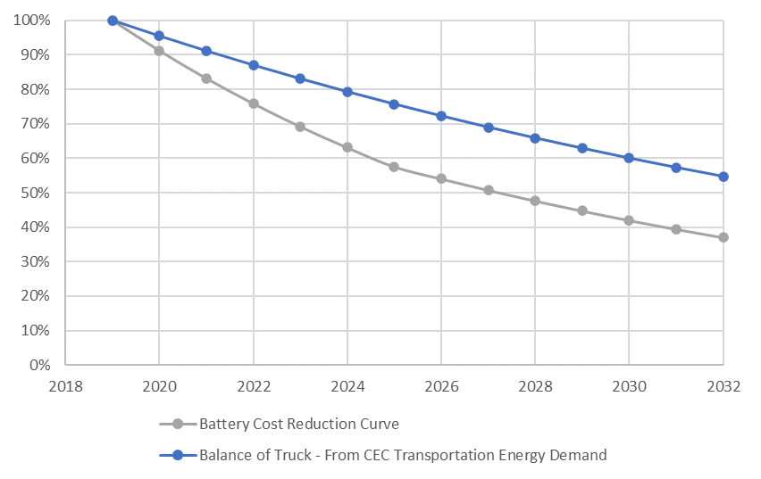
Subtask 6. Forecast Vehicle Attributes (cont.)
CalETC Electric Truck Forecast
Disaggregated current costs of trucks as battery and balance of truck (after removing estimated tariff costs, analysis done in 2019)
Developed separate cost reduction trajectories for battery and balance of truck based on BNEF cost reduction trajectories for batteries and CEC demand forecast for balance of truck (need updated data do confirm previous forecast)
For each Class 4-8 technologies developed separate curves to estimate cost reductions

Slide 11
Subtask 7. Training Energy Commission Staff
Overview
Two trainings facilitated by Aspen with identified CEC staff
Trainings will cover the historical and forecasted attributes were developed

Slide 12
Schedule
Draft completed for Tasks 5 and 6 in June to allow for an editing/updating after initial CEC modeling results
Task | Status | Estimated Completion
Task 2 | Completed | February 2021
Task 3 | On-going | May 2021
Task 4 | Started | May 2021
Task 5 | Not Begun | June 2021 (draft)
Task 6 | Not Begun | June 2021 (draft)

