Slide 1
Light Duty Vehicle Attribute Projections, 2020–2035
Catherine Ledna, Dong-Yeon (D-Y) Lee, and Aaron Brooker
National Renewable Energy Laboratory (NREL)
May 5, 2021

Slide 2
Approach
Model Inputs
Simulation
Post-Processing
Classification and
sales-weighted aggregation
CA Incentives
Technology Assumptions
ADOPT
Vehicle sales & specifications
Vehicle Attributes
Federal Tax Credit and CAFE
Fuel Prices
The results presented are preliminary and subject to revision.
We are continuing to refine our approach and input assumptions to improve validation to California historical data.
EVSE

Slide 3
Approach: ADOPT

Slide 4
Scenario Descriptions
Scenario Name | Low Electrification | Mid Electrification | High Electrification | High Electrification – with Extended ZEV Mandate**
Technology progress rate | Low | Moderate | High | High
State and Federal Policy | Limited federal PEV & FCEV tax credit. CVRP and Clean Fuel Reward extended to 2025. | Expanded federal PEV & FCEV tax credit. CVRP and Clean Fuel Reward extended to 2035. | Expanded federal PEV & FCEV tax credit and extended CAFE standards. CVRP and Clean Fuel Reward extended to 2035. | Expanded federal PEV & FCEV tax credit and extended CAFE standards. CVRP and Clean Fuel Reward extended to 2035.
ZEV Mandate | Held constant after MY2025. | Held constant after MY2025. | Held constant after MY2025. | Extended to require 100% ZEV and TZEV sales by 2035
** We do not present results on the High Electrification – with Extended ZEV Mandate scenario, but intend to include it as an exploratory scenario in future work.

Slide 5
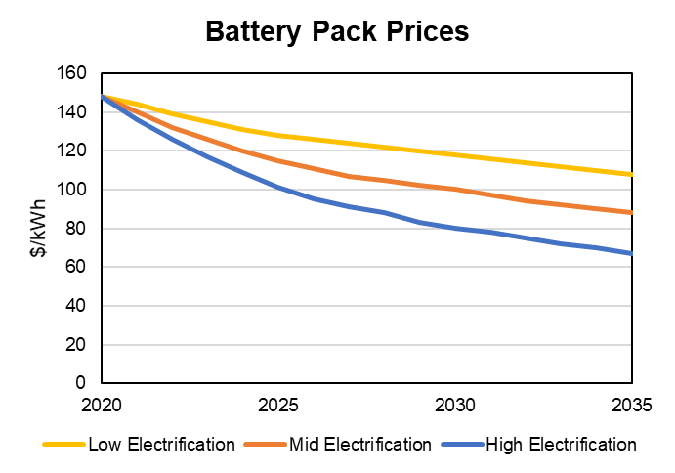
Input Battery Price Assumptions
Projected battery prices provided by the California Energy Commission.

Slide 6
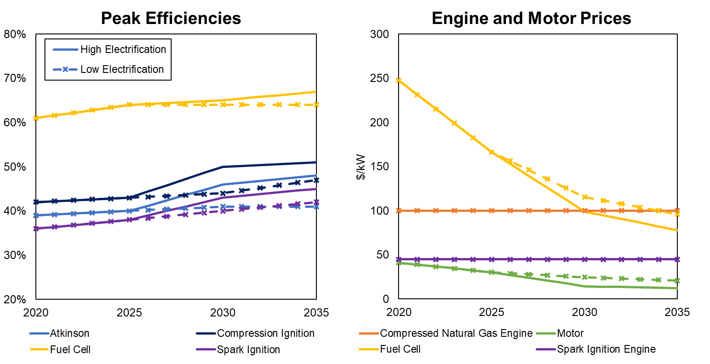
Additional Technology Assumptions
Assumptions from Department of Energy targets, ‘High’ and ‘Low’ scenarios (Islam et al, 2020). The ‘Mid’ electrification scenario uses a midpoint between ‘High’ and ‘Low’.

Slide 7
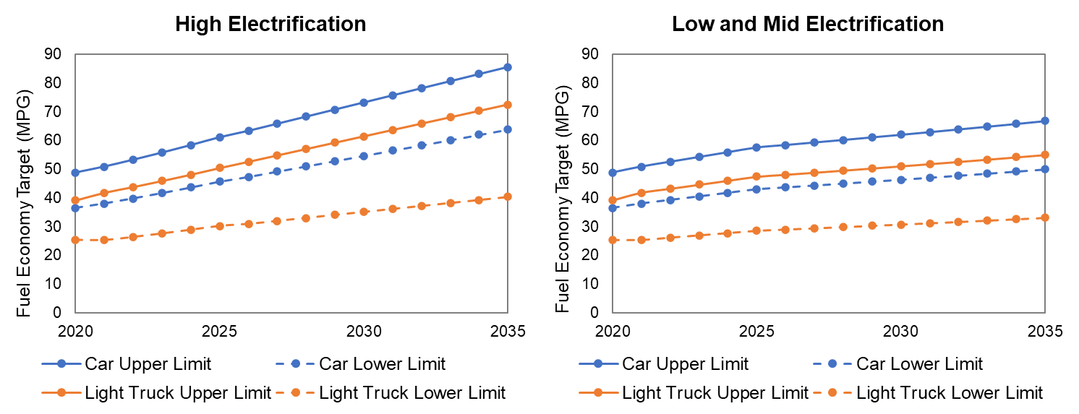
CAFE Assumptions
High Electrification CAFE assumptions assume a return to 2012 standards (77 Fed. Reg. 62624) for MY2022-2025, linearly increasing through 2035. Low and Mid Electrification MY2022-2025 standards reach the midpoint of agreed upon 2012 and 2020 standards (85 Fed. Reg. 24174) by MY2025 and increase at 1.5% per year in subsequent years.

Slide 8
Vehicle Classification & Sales-Weighted Aggregation
Powertrains evaluated:
ICEV (gasoline)
Hybrid (gasoline)
PHEV (gasoline)
BEV
FCEV
 | Class/Type | Standard | Premium
1 | Car–Subcompact | √ | √
2 | Car–Compact | √ | √
3 | Car–Midsize | √ | √
4 | Car–Large | √ | √
5 | Car–Sports | √ | √
6 | SUV–Subcompact | √ | √
7 | SUV–Compact | √ | √
8 | SUV–Midsize | √ | √
9 | SUV–Large | √ | √
10 | Van–Compact | √
11 | Van–Large | √
12 | Pickup–Compact | √
13 | Pickup–Standard | √
Acura | Lexus
Audi | Lincoln
Bentley | Mercedes-Benz
BMW | MINI
Cadillac | Porsche
Genesis | Rolls-Royce
Hummer | Saab
Infiniti | Tesla*
Jaguar | Volvo
Land Rover
* Except Model 3: Standard (not Premium).
Sales-weighted aggregation:
Classification and sales-weighted aggregation
$$a_{tech,class,MY}={\left(\frac{\sum_{m}{s_{m}×a_{m}}}{\sum_{m}{s_{m}}}\right)}_{tech,class,MY}$$
ADOPT
Vehicle sales & specifications
Vehicle attributes
a: attributes
m: make and model
s: sales
Vehicle technology penetration projections
By MY, make, and model
By MY and type/class

Slide 9
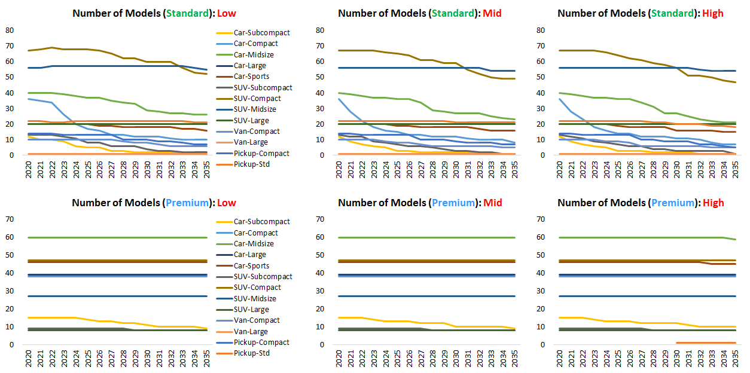
The Num. of Vehicle Models (MY2020–2035): ICEV
preliminary

Slide 10
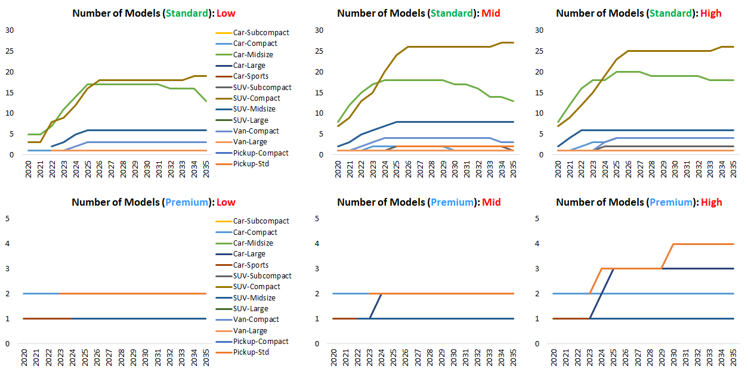
The Num. of Vehicle Models (MY2020–2035): PHEV
preliminary

Slide 11
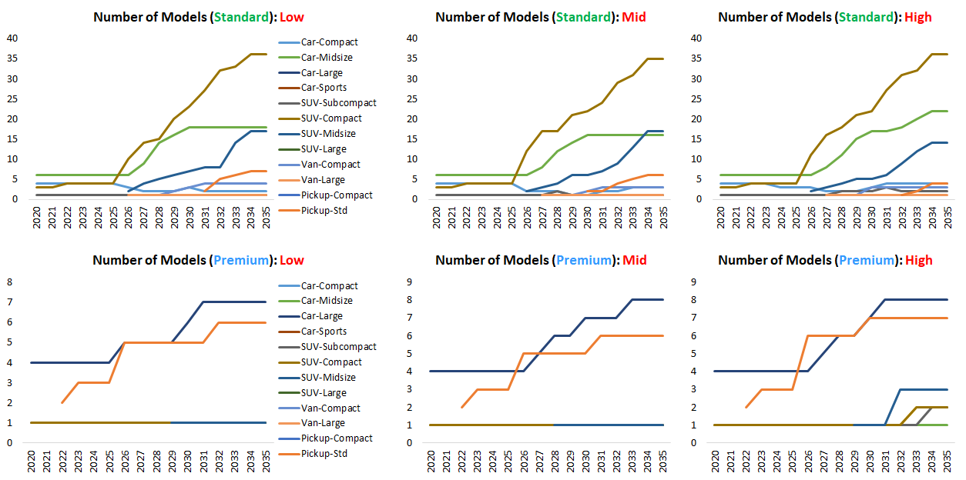
The Num. of Vehicle Models (MY2020–2035): BEV
preliminary

Slide 12
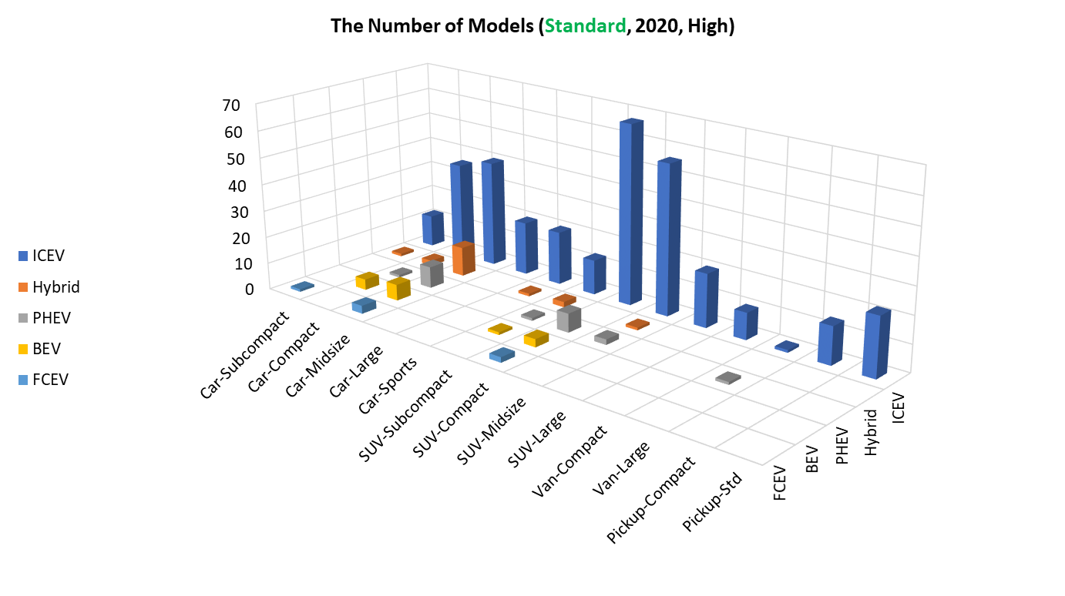
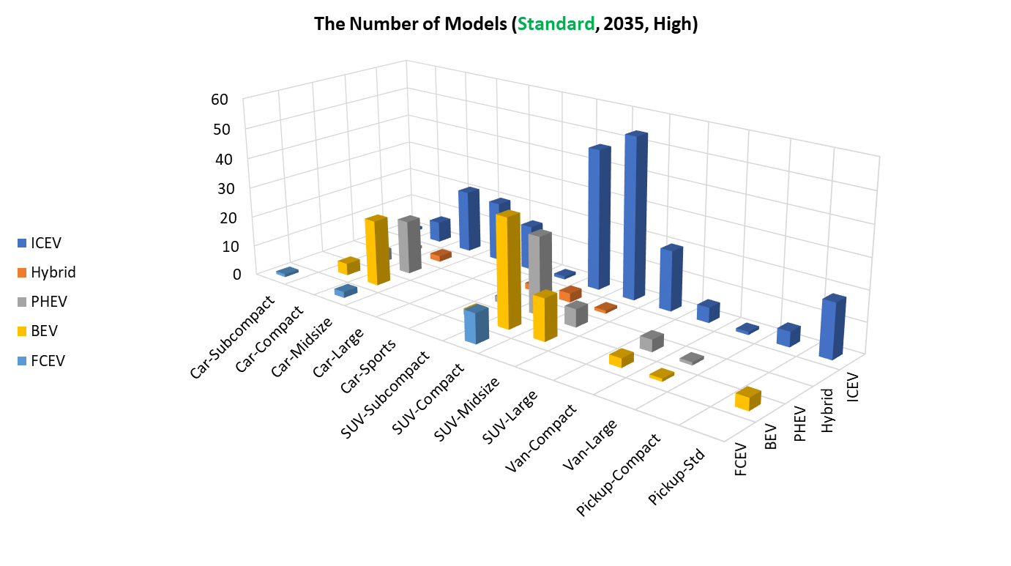
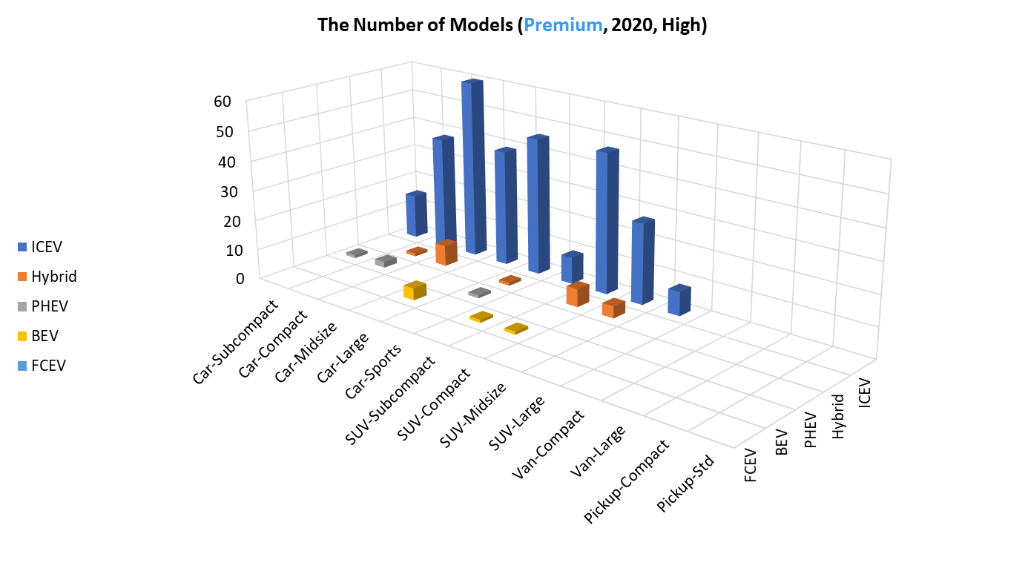
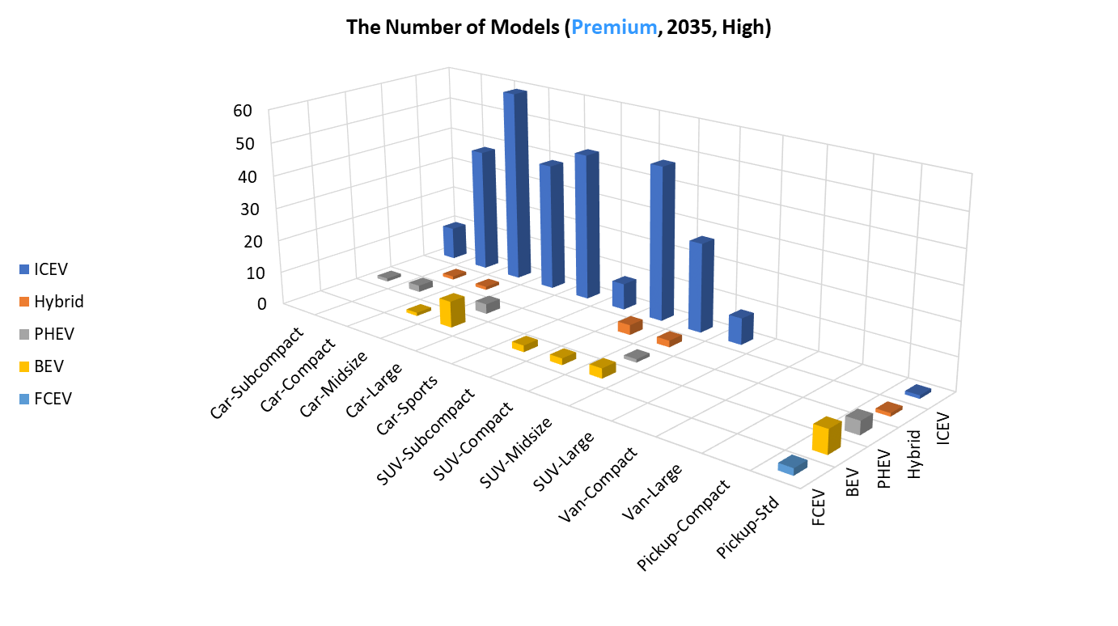
The Num. of Vehicle Models (MY2020–2035)
preliminary

Slide 13
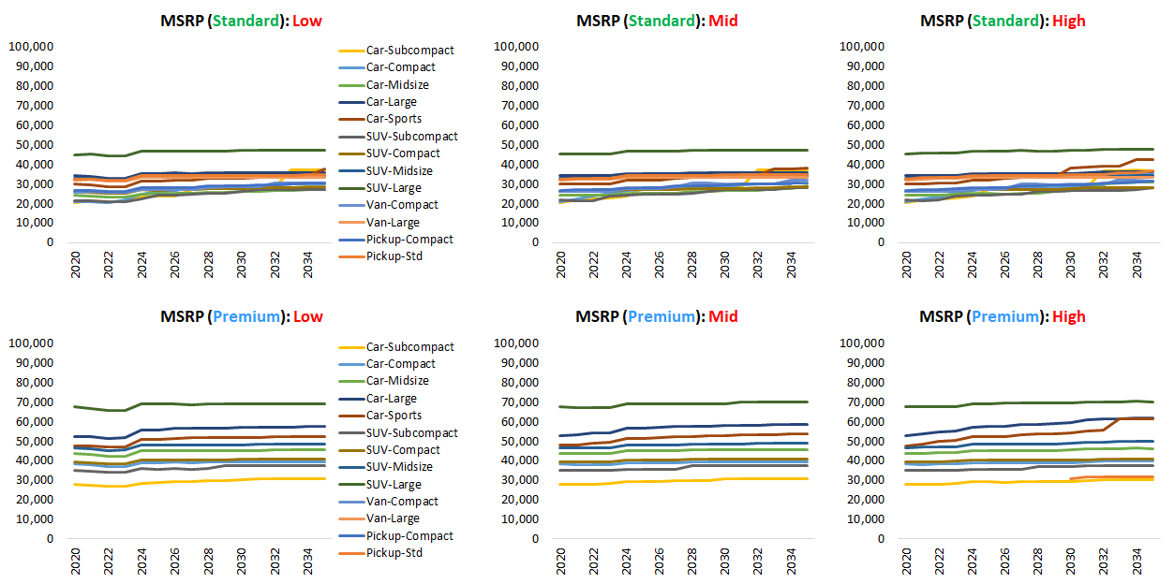
MSRP (MY2020–2035): ICEV
preliminary

Slide 14
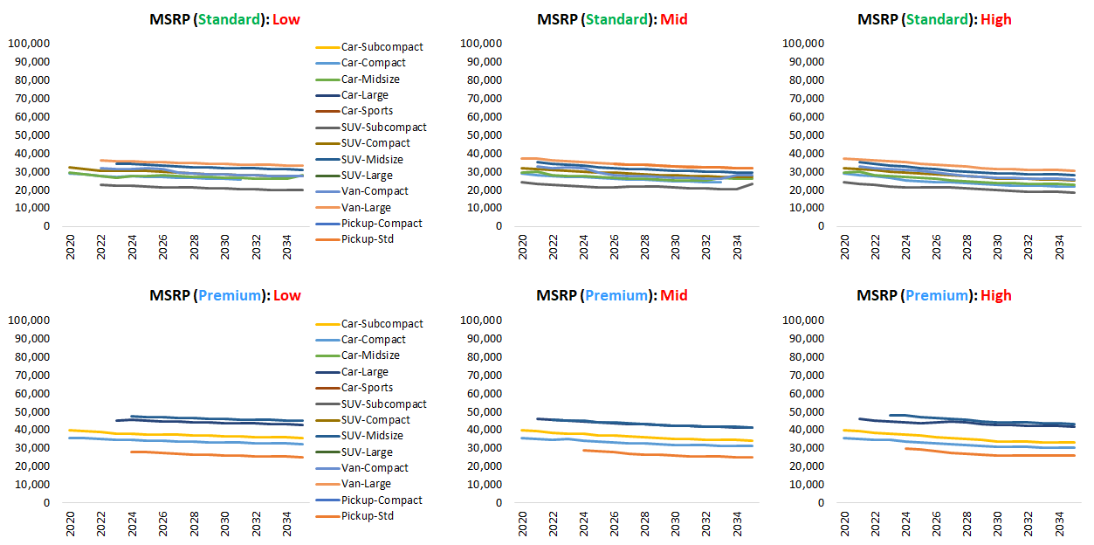
MSRP (MY2020–2035): PHEV
preliminary

Slide 15
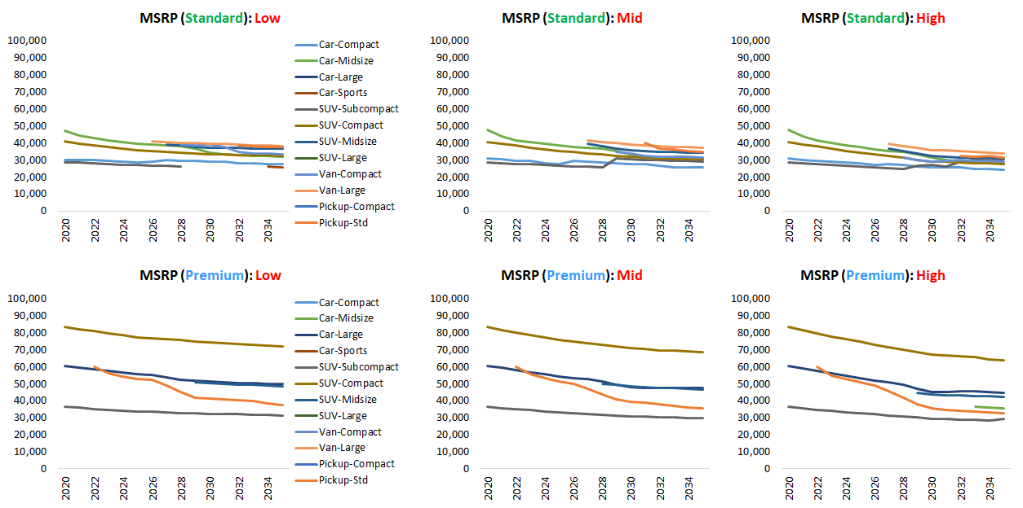
MSRP (MY2020–2035): BEV
preliminary

Slide 16
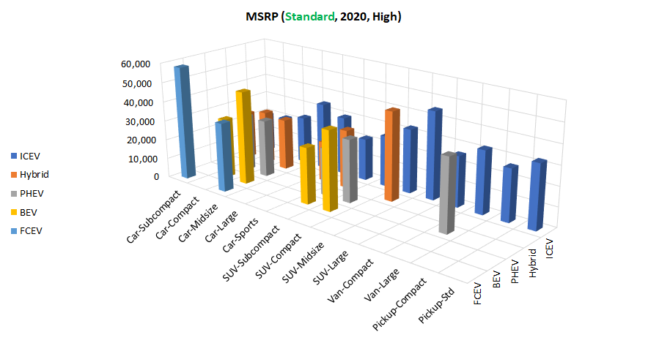
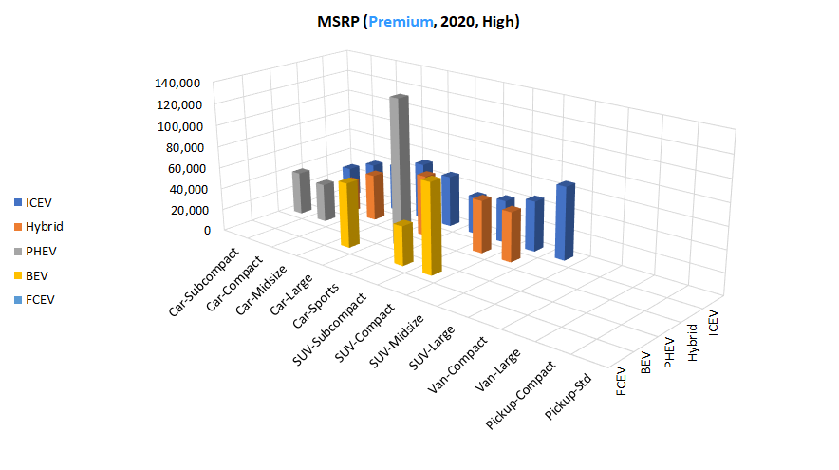
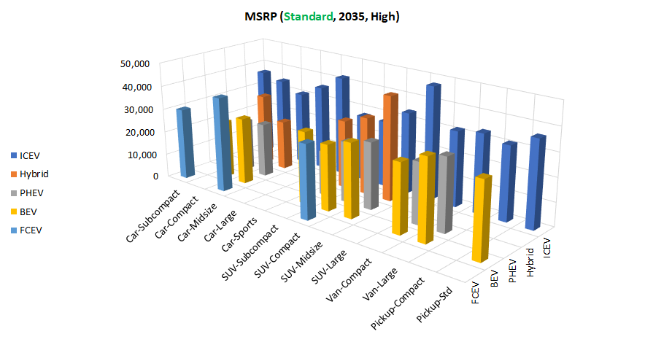
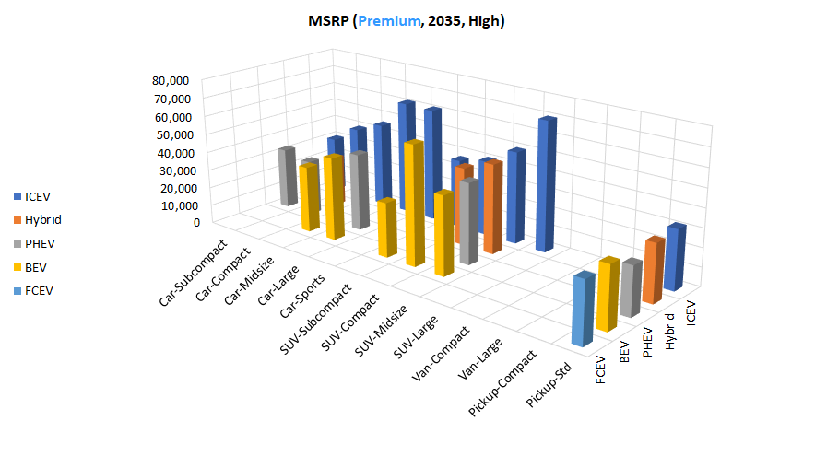
MSRP (MY2020–2035)
preliminary

Slide 17
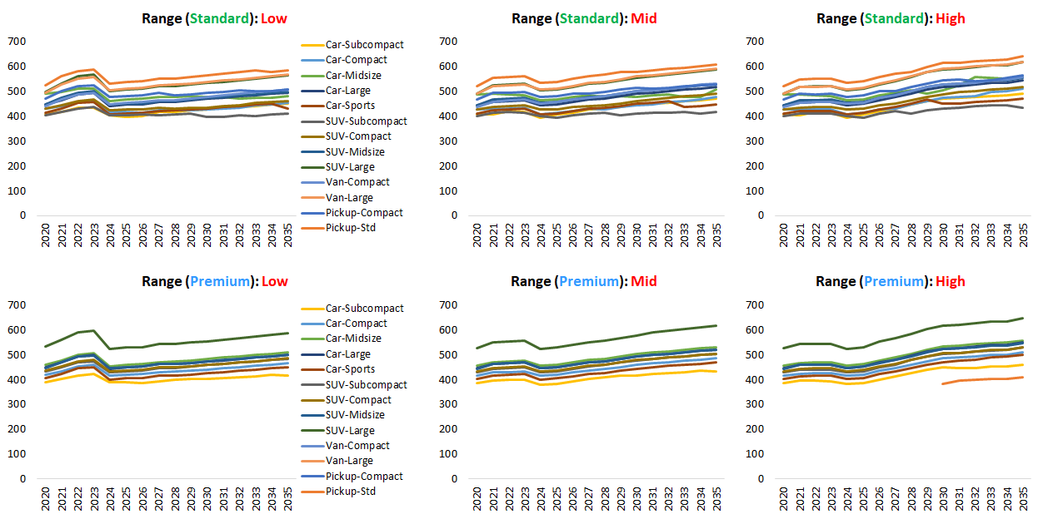
Total Driving Range (MY2020–2035): ICEV
preliminary

Slide 18
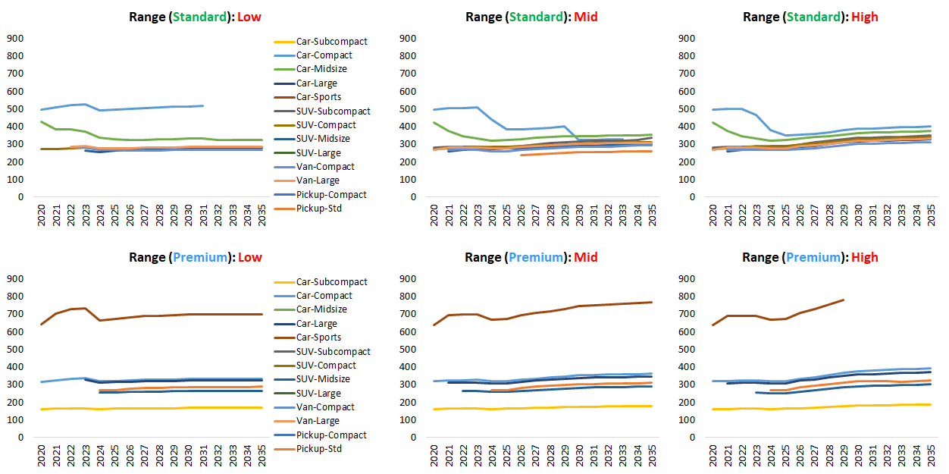
Total Driving Range (MY2020–2035): PHEV
preliminary

Slide 19
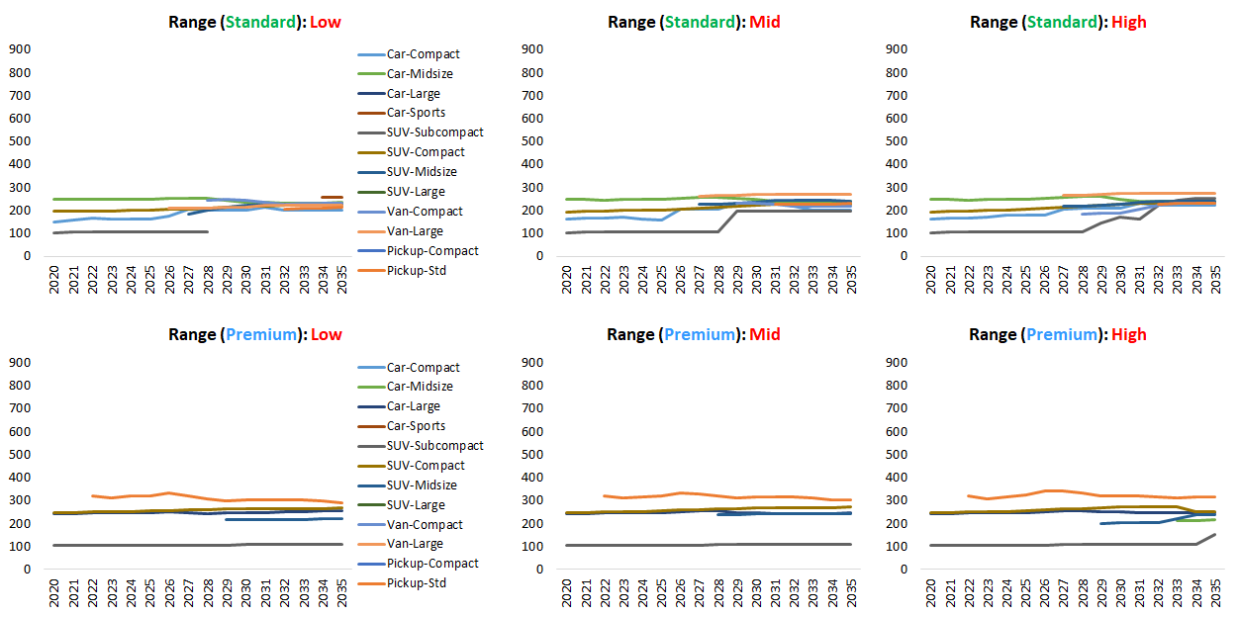
Total Driving Range (MY2020–2035): BEV
preliminary

Slide 20
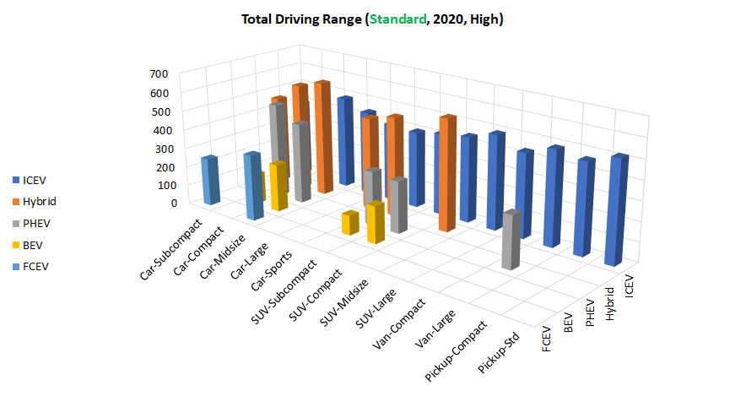
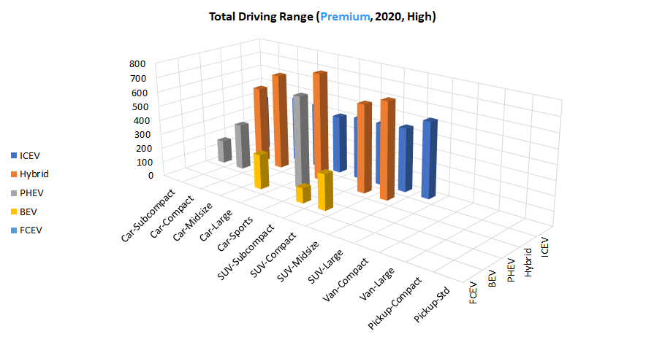
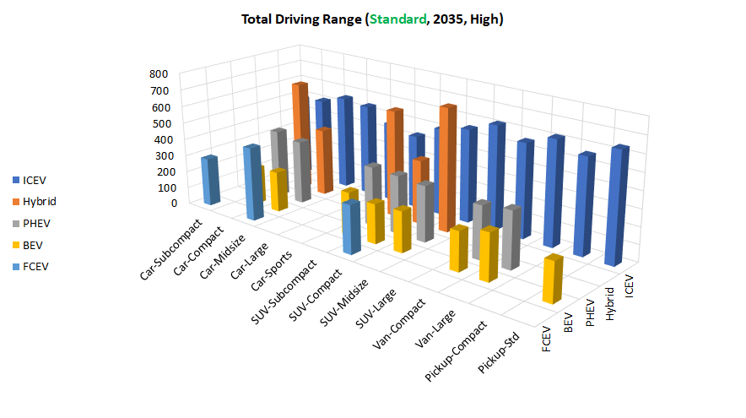
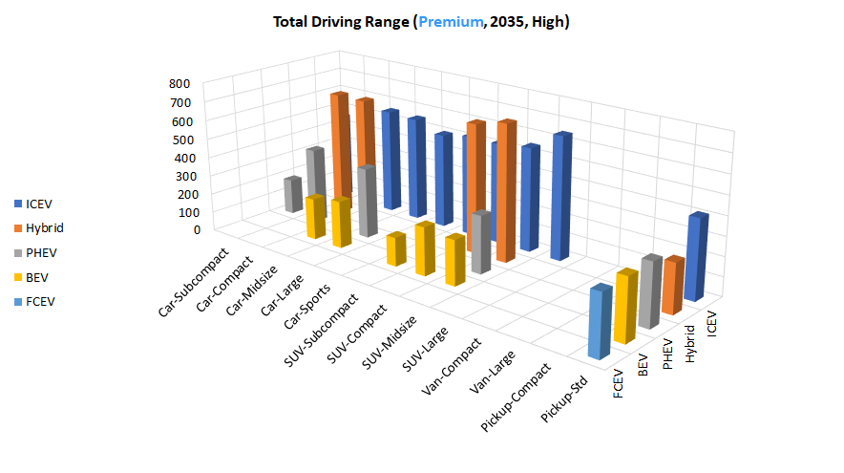
Total Driving Range (MY2020–2035)
preliminary

Slide 21
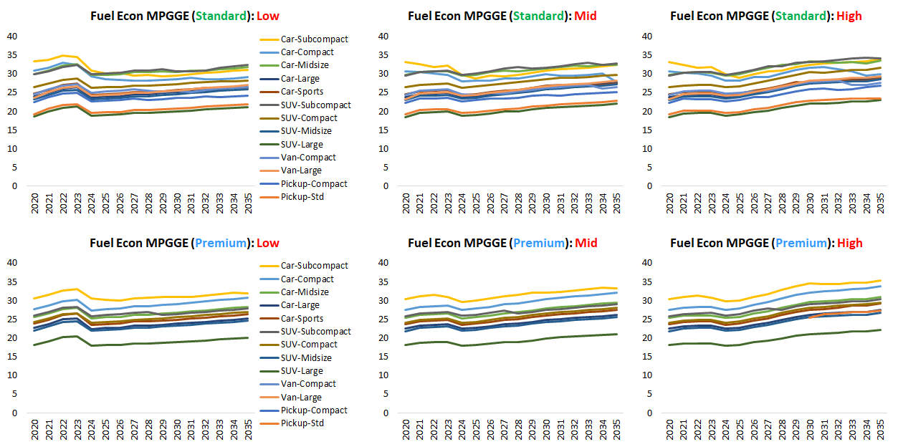
Fuel Economy MPGGE (MY2020–2035): ICEV
preliminary

Slide 22
Fuel Economy MPGGE (MY2020–2035): PHEV–CS
preliminary

Slide 23
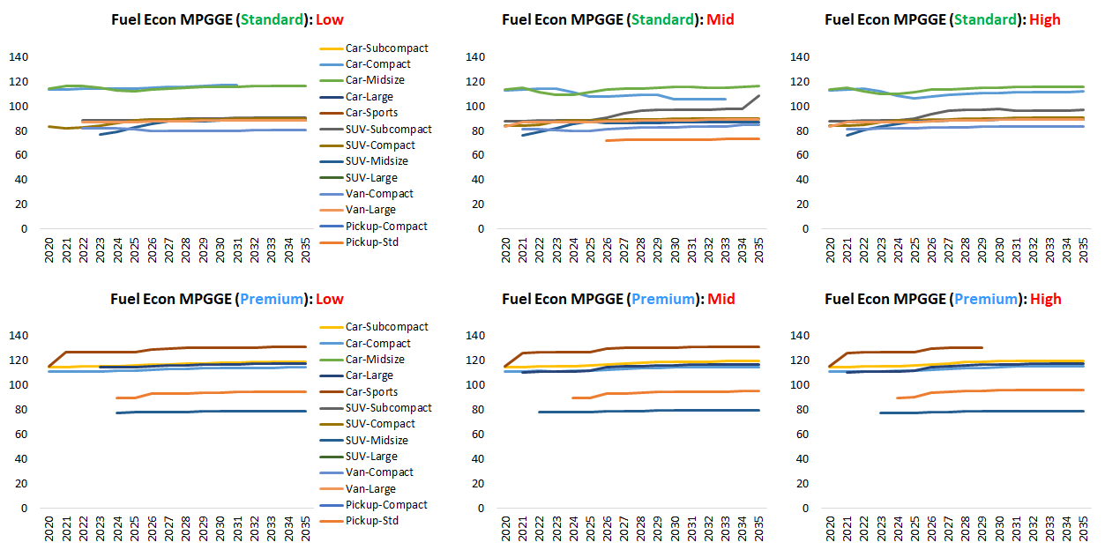
Fuel Economy MPGGE (MY2020–2035): PHEV–CD
preliminary

Slide 24
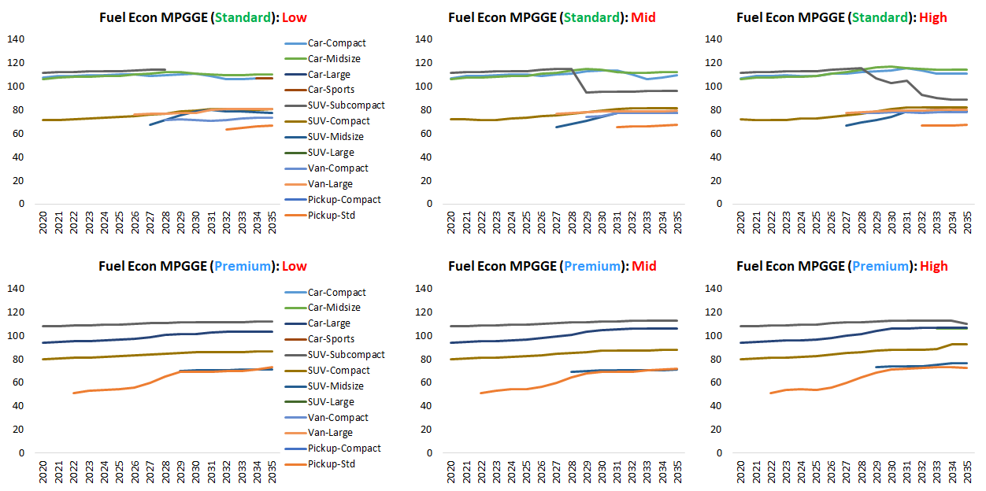
Fuel Economy MPGGE (MY2020–2035): BEV
preliminary

Slide 25
Appendix

Slide 26
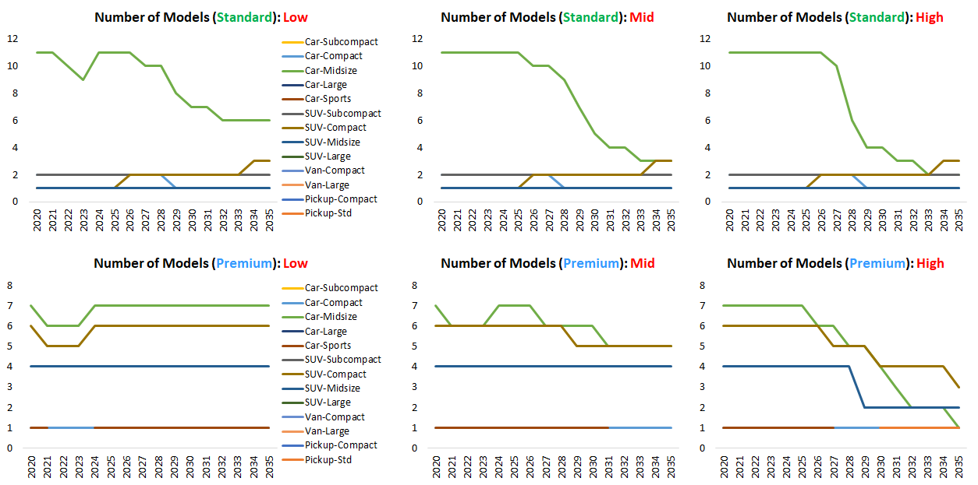
The Num. of Vehicle Models (MY2020–2035): Hybrid
preliminary

Slide 27
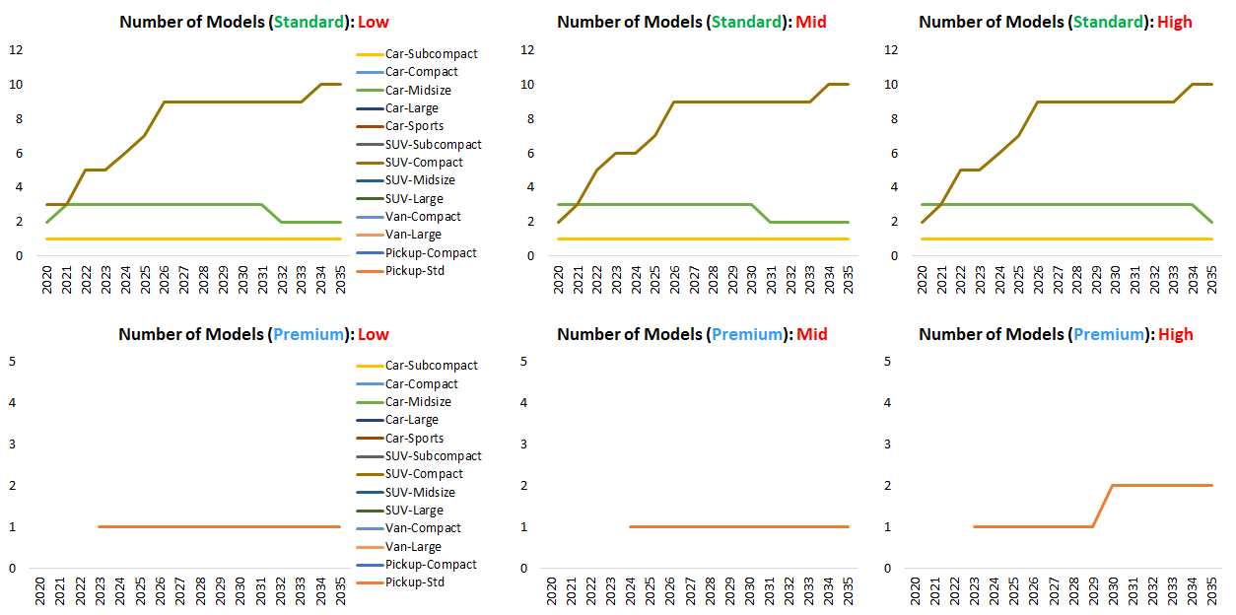
The Num. of Vehicle Models (MY2020–2035): FCEV
preliminary

Slide 28
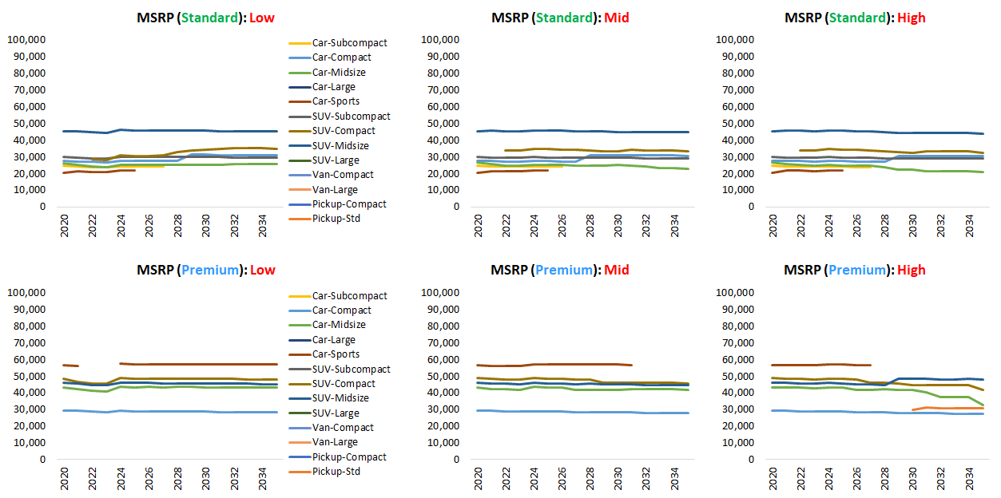
MSRP (MY2020–2035): Hybrid
preliminary

Slide 29
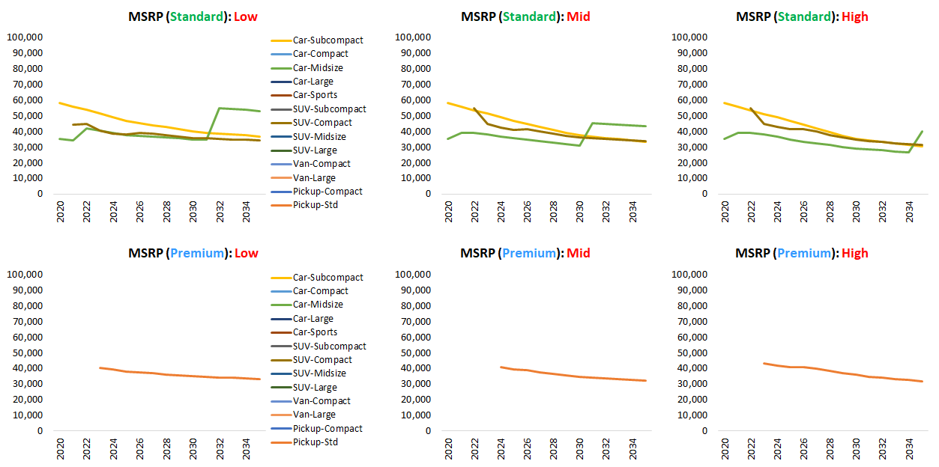
MSRP (MY2020–2035): FCEV
preliminary

Slide 30
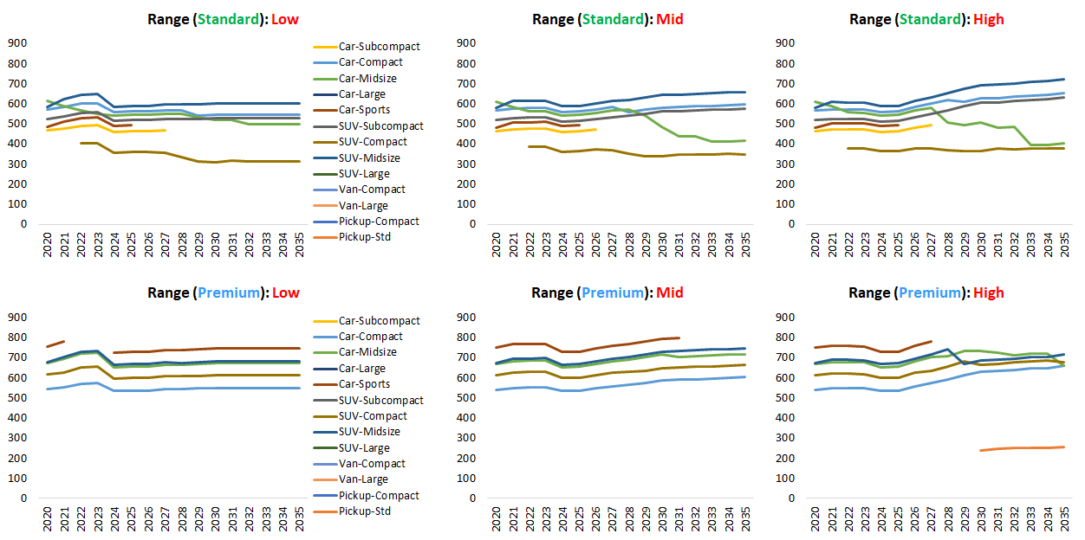
Total Driving Range (MY2020–2035): Hybrid
preliminary

Slide 31
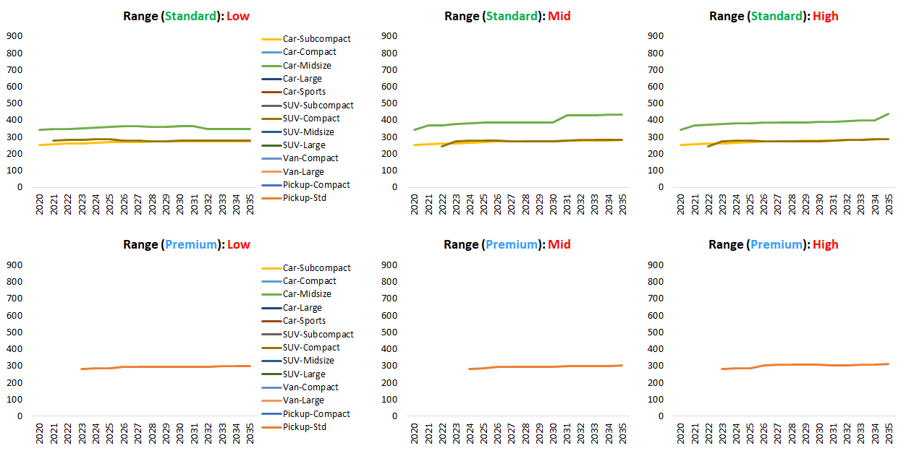
Total Driving Range (MY2020–2035): FCEV
preliminary

Slide 32
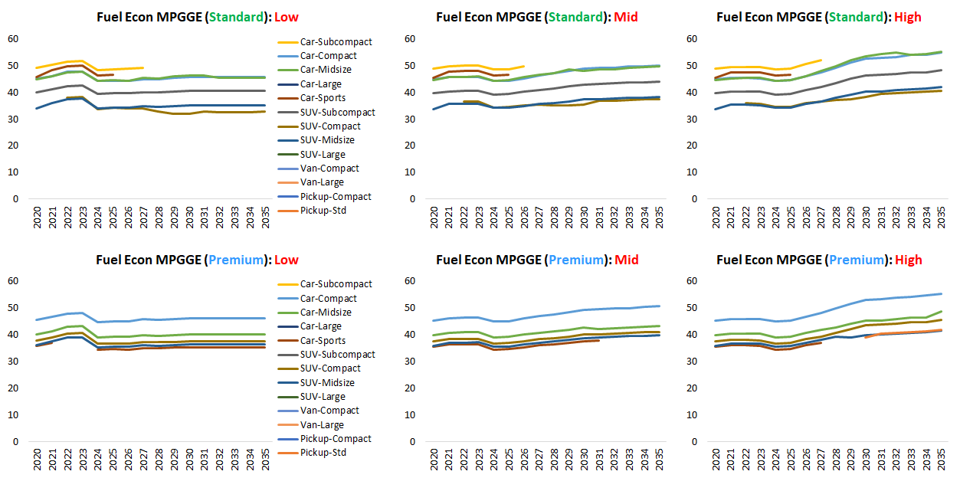
Fuel Economy MPGGE (MY2020–2035): Hybrid
preliminary

Slide 33
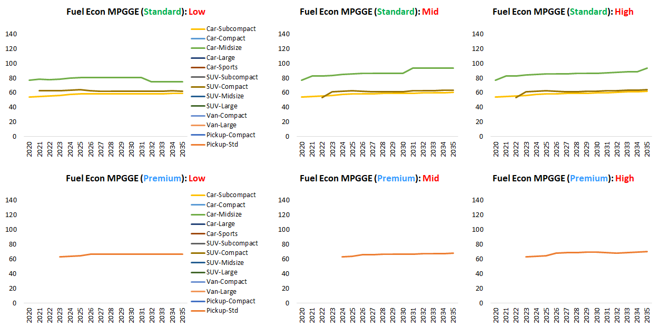
Fuel Economy MPGGE (MY2020–2035): FCEV
preliminary

Slide 34
References
Brooker, A., Gonder, J., Lee, D-Y, & Wang, L. 2020. Light-Duty Vehicle Choice Modeling and Benefits Analysis. DOE Vehicle Technologies Program 2020 Annual Merit Review and Peer Evaluation Meeting. https://www.energy.gov/sites/default/files/2020/05/f75/van018_brooker_2020_o_5.15.20_446PM_ LR.pdf
Environmental Protection Agency and National Highway Traffic Safety Administration; 2017 and Later Model Year Light-Duty Vehicle Greenhouse Gas Emissions and Corporate Average Fuel Economy Standards, 77 Fed. Reg. 62,624 (Monday, October 15, 2012).
Environmental Protection Agency and National Highway Traffic Safety Administration; The Safer Affordable Fuel-Efficient (SAFE) Vehicles Rule for Model Years 2021-2026 Passenger Cars and Light Trucks, 85 Fed Reg. 24,174 (April 30, 2020).
Islam, E., Moawad, A., Kim, N., & Rousseau, A. 2020. Energy Consumption and Cost Reduction of Future Light-Duty Vehicles through Advanced Vehicle Technologies: A Modeling Simulation Study Through 2050. (No. ANL/ESD-19/10). Argonne National Laboratory (ANL).

