Slide 1
Light-Duty Vehicle Battery Price Forecast
Presenter: Liz Pham
Date: May 05, 2021

Slide 2
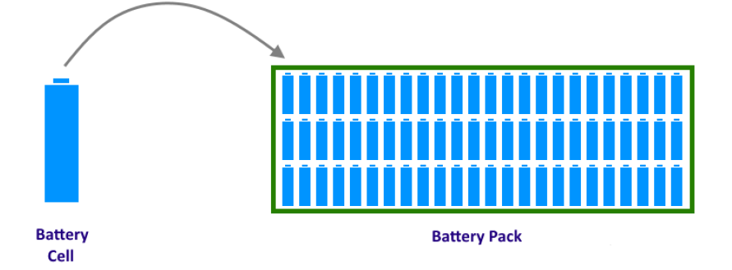
Background information
Scenarios based on estimates from publicly available battery price forecasts
Lithium-ion batteries only
Prices shown are for battery packs ($/kWh), not battery cells
Source: CEC Staff
Notes:
Source: CEC Staff

Slide 3
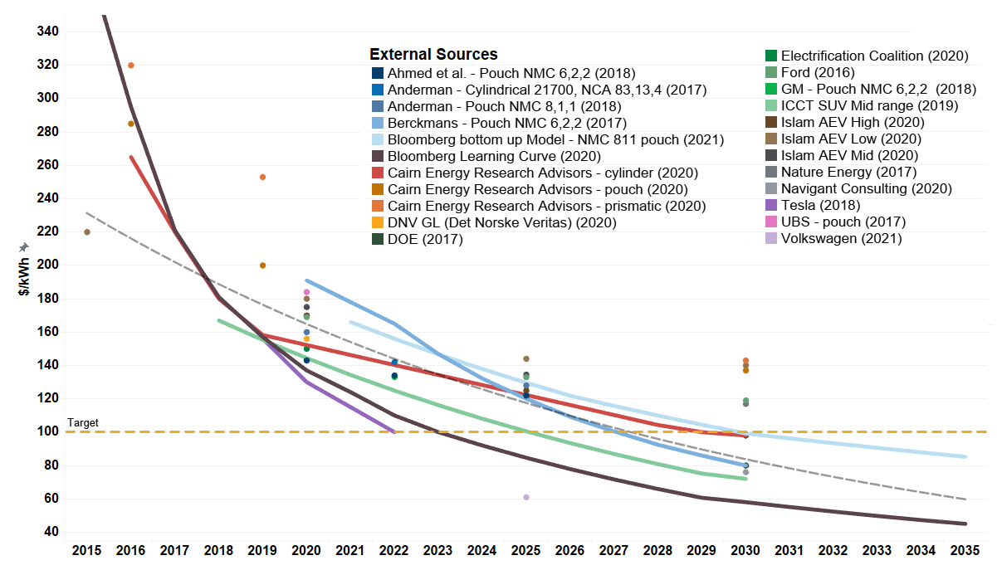
Estimates from External Sources
Source: CEC Staff

Slide 4
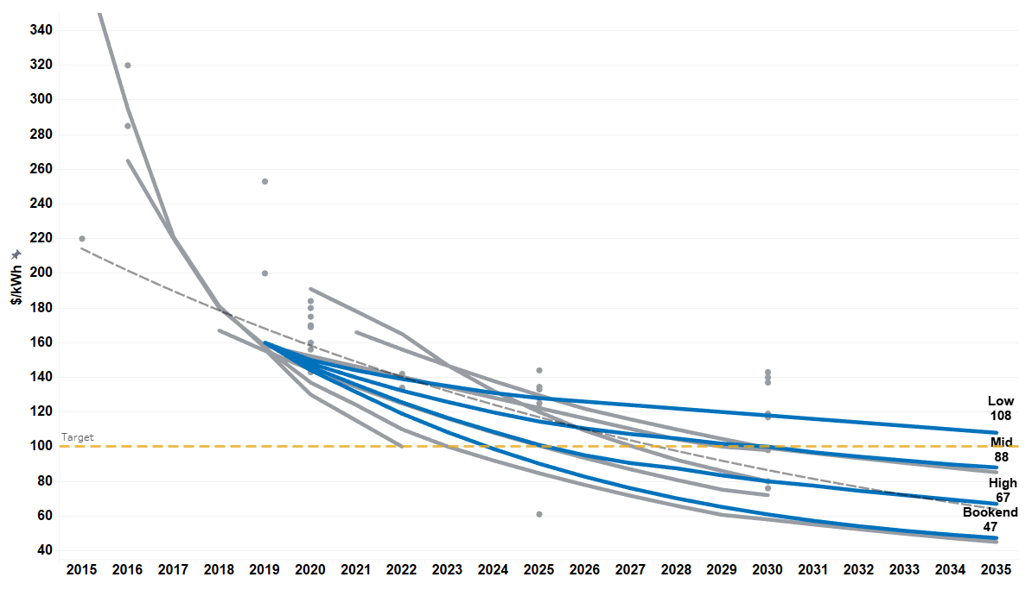
CEC Scenarios
Source: CEC Analysis
Notes:
Source: CEC Analysis

Slide 5
Questions?

