Slide 1
Incorporating
Building Electrification
- Fuel Substitution in the Forecast
DAWG Meeting June 23, 2021
Ingrid Neumann, Ph.D.
CEC - EAD

Slide 2
In Broad Strokes…

Slide 3
What was included in 2019?
  Used a “what-if” percentage of all electric new construction in 2019 Additional Achievable Energy Efficiency (AAEE)
  Used low for AAEE 1&2, mid AAEE 3&4, high AAEE 5&6
    Low: Assumed all electric penetration rate of 0.5% per year beginning 2020, ramping linearly to a cumulative of 5.5% in 2030
    Mid: Assumed all electric penetration rate of 1.5% per year beginning 2020, ramping linearly to a cumulative of 16.5% in 2030
    High: Assumed all electric penetration rate of 2.5% per year beginning in 2020, ramping linearly to a cumulative of 27.5% in 2030

Slide 4
What work has EAD done since then?
Developed “what-if” Fuel Substitution Scenario Analysis Tool (FSSAT)
Used the FSSAT to analyze building electrification scenarios in our AB 3232 Analysis described in the recently published California Building Decarbonization Assessment

Slide 5
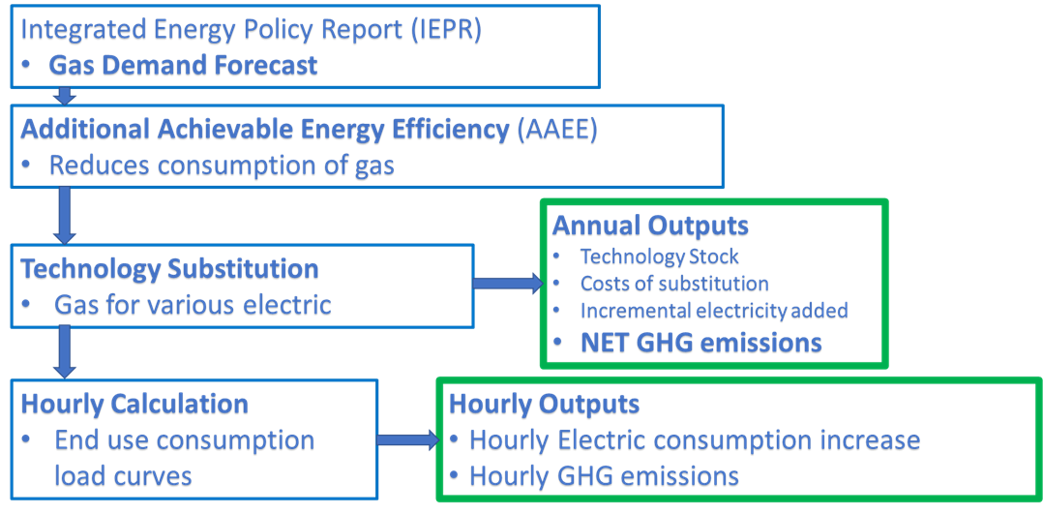
Modeling electrification:
Fuel Substitution Scenario Analysis Tool (FSSAT) main processes flow chart

Slide 6
Building end-use electrification scenarios:
Minimal, Moderate, Aggressive, Efficient Aggressive
Electrification Scenario Using FSSAT | New Construction (NC) | Replace on Burnout (ROB) | Early Replacement (RET) | Technology Efficiency | SB 1383 Goals Toggle
Minimal | 100% by 2030 | 15% | 5% | High-Efficiency Weighted Mix | Potential of reducing 7.5 MMTCO₂e of HFC Leakage in 2030
Moderate | 100% by 2030 | 50% | 5% | High-Efficiency Weighted Mix
Aggressive | 100% by 2030 | 90% | 70% | High-Efficiency Weighted Mix
Efficient Aggressive | 100% by 2030 | 90% | 70% | Single-Best Efficiency
Where:
  NC, ROB, and RET are percentages of eligible technologies by sector/end-use that will be electric in 2030
  The Minimal electrification scenario just meets the 40-percent AB 3232 target
  The impacts of the SB 1383 toggle are external to the FSSAT framework

Slide 7
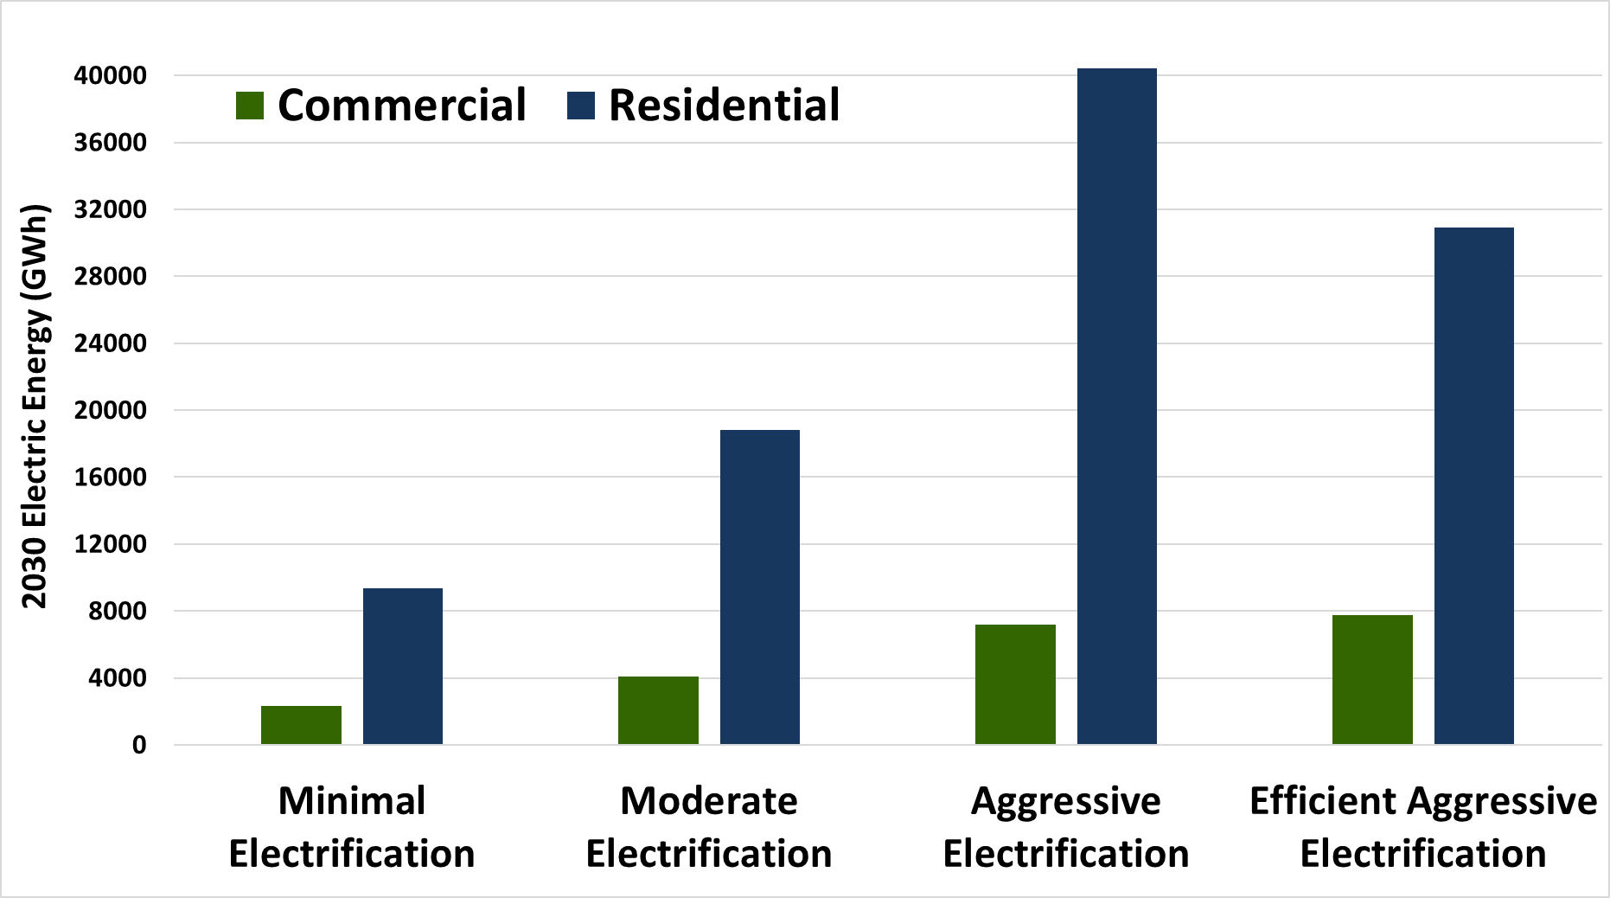
Statewide Annual Incremental Electricity Demand by Scenario-Specific Electrification in 2030
8% Com. & 40% Res.
8% Com. & 31% Res.
4% Com. & 19% Res.
3% of Commercial & 9% of Residential
Baseline consumption added

Slide 8
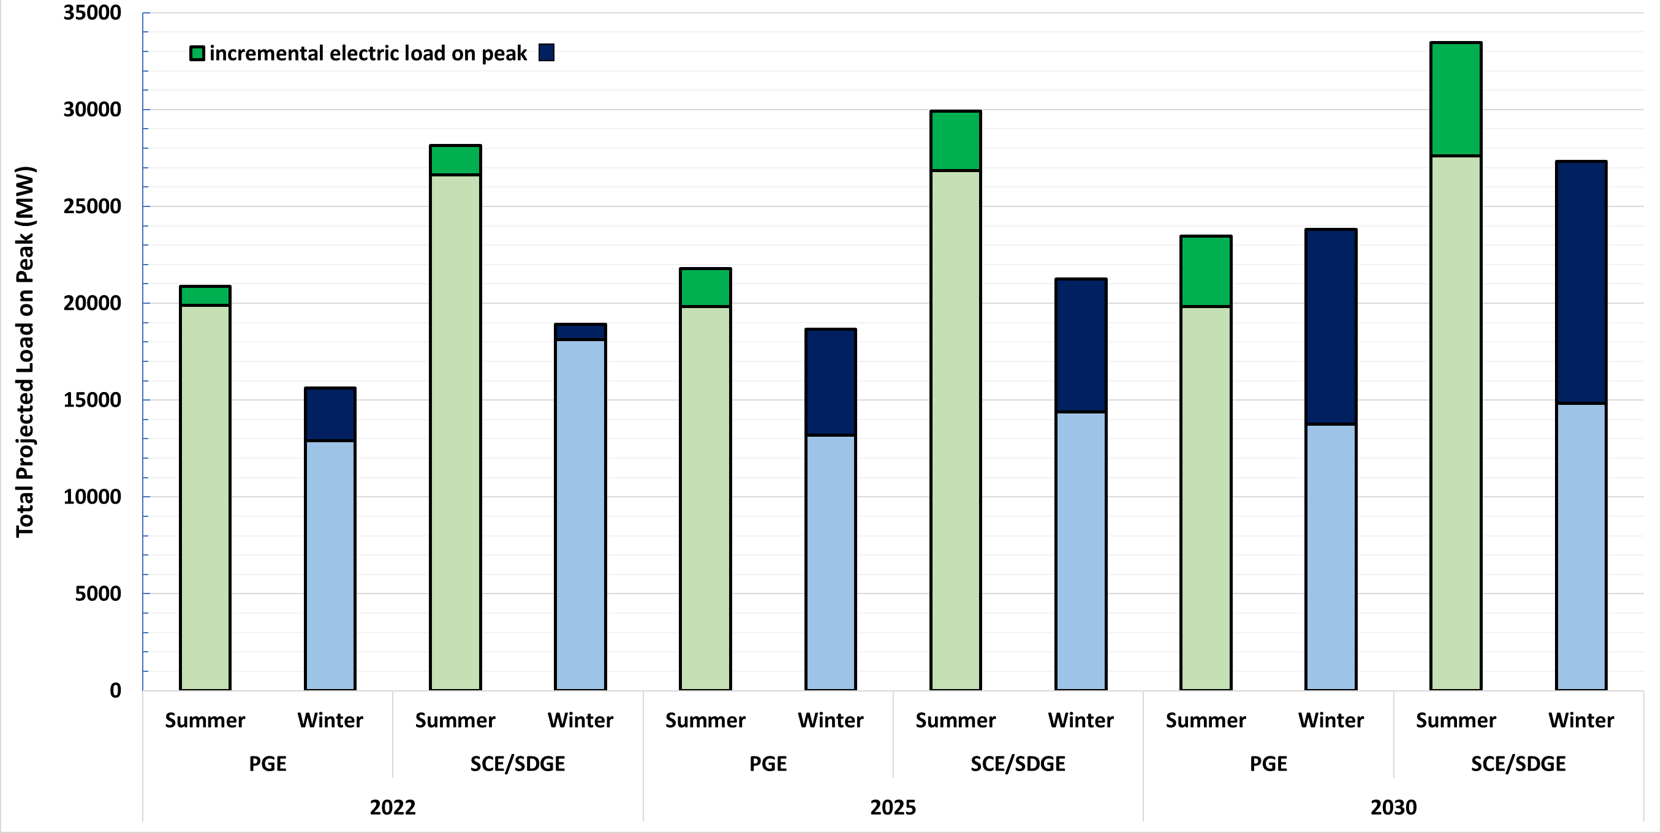
Summer and Winter Peak Load Impacts
after Aggressive Electrification
Dec 9 6pm
shifted to
Jan 3 7am
Nov 13 5pm
shifted to
Dec 2 6am

Slide 9
EAD Decarbonization Analysis to be updated for 2021 IEPR
Energy Efficiency (EE) tracking and projection/forecast scenarios
  Incorporate new data such as from utility and other incentive programs to update historical savings as improve projections
  Add new EE programs savings projections
  Incorporate updates to code and standards in savings projections
  Consider overlap in customer segments being targeted by different programs
  Consider market-based activities that may result in EE savings that are not being captured elsewhere
Building Electrification - Fuel Substitution projections…
AB 3232 “what-if scenarios”
SB 350 tracking towards EE doubling goal
Time Horizon for Analysis
2015 2020 2025 2030 2035
AAEE load modifier to IEPR forecast
AAEE load modifier to IEPR forecast

Slide 10
NEW EAD Decarbonization Analysis for 2021 IEPR
Energy Efficiency (EE) tracking/projections and hourly forecast load modifier
Building Electrification tracking/projections and hourly forecast load modifier
  Varying time horizons
  Varying uncertainties
  Varying uses
New long term demand scenarios are being developed to complement the traditional 10-year gas and electricity demand forecast used for energy planning and procurement purposes and may help inform future policy decisions towards California’s mid-century climate goals.
AB 3232 scenarios
SB 350 tracking towards EE doubling goal
Time Horizon for Analysis
2015 2020 2025 2030 2035 2040 2045
AAEE load modifier to IEPR forecast
AAEE & electrification load modifiers to IEPR forecast
long term demand scenarios

Slide 11
History for context & guidance

Slide 12
Compare to AAEE
For 2021 we wish to develop Additional Achievable Fuel Substitution (AAFS) as an hourly load modifier to the baseline demand forecast.
AAFS is conceptualized as separate from AAEE
We wish to use a manner similar to the one which was developed for AAEE for AAFS; ie. a “template”

Slide 13
Step back and look at the genesis of AAEE…
2009 | Initial CEC analysis of “incremental, uncommitted” EE savings for use in developing managed demand forecast
2010 | CPUC staff adjusts 2009 IEPR baseline demand forecast with Mid-Case “incremental, uncommitted” EE savings for use in 2010 LTPP assessments
2011 | ISO assesses CEC-prepared “incremental, uncommitted” energy efficiency savings mid case as a sensitivity analysis in 2011-12 TPP
2011 | CEC plans to include “incremental, uncommitted” EE savings adjustments to baseline forecast to create adopted managed demand forecasts in 2012 IEPR Update
2012 | Back and forth between CEC and CPUC about how to use “incremental, uncommitted” EE in conjunction with variations of the baseline demand forecast
2012 | CEC provides load bus impacts of “incremental, uncommitted” EE savings to ISO for use in power flow modeling for inter-agency AB 1318 study
2013 | CEC provides “incremental, uncommitted” EE savings by load bus to ISO for use in 2013-14 TPP power flow modeling
2013 | Discussions among CEC, CPUC, and ISO about “single forecast set” language
2013 | CPUC staff analysis showing EE impacts within SCE service area
2014 | Letter to legislature outlining “single forecast set” language

Slide 14
Single Managed Forecast Set
“Energy Commission, in consultation with the CPUC and the CAISO, considered public input in selecting a single or managed demand forecast from the adopted forecast report for use in transmission planning and procurement. This set of forecast numbers is a combination of two forecast components: a base case with weather variants and an additional achievable energy efficiency (AAEE) scenario. Combined together, these create the single or managed forecast.”
Three baseline cases and five scenarios of AAEE
The mid-AAEE forecast scenario will be used for system-wide and flexibility studies relied upon for procurement and transmission planning purposes.
Because of the local nature of reliability needs and the difficulty of forecasting locally disaggregated AAEE, the low-mid-AAEE scenario will be used for local studies.

Slide 15

Additional Achievable Energy Efficiency (AAEE) 2019 Process Flow Overview
Scenario Design
POU AAEE first year
Projections 2020-2030
Data Integration Tool for
Total Cumulative AAEE Projections by year 2020-2030
by utility, sector, end use & scenario
2017 CMUA PG Study
POU Projections
2020 CPUC PG Study
IOU Projections
Scenario Design
IOU AAEE first year
Projections 2020-2030
AAEE Hourly Tool
Total 8760 Hourly AAEE Projections by year 2020-2030
by utility, sector, end use & scenario
CEC Beyond Utility Programs tool allows scenario design for Beyond Utility AAEE first year Projections 2020-2030
AAEE

Slide 16
Scenario Development for 2019 AAEE
IOU Potential Program Savings
Codes and Standards Savings
Beyond Utility Program Savings
POU Potential Program Savings

Slide 17
Diving into the Deep End

Slide 18
Scenario Development for 2021 AAFS
    CEC is not at the stage where we are ready to make recommendations, but we are attempting to come to a common understanding of what we need to explore.
    The next step would be defining a mutually agreed upon process for incorporating building electrification into the IEPR Demand Forecast such that it is useful to the joint agencies and their stakeholders.

Slide 19
Scenario Development for 2021 AAFS
Desire is to eventually create a parallel scenario structure for AAFS to AAEE
Considerable uncertainties to consider in the current state
  SB 350 allows for Fuel Sub to count as EE
  2021 draft PG Study does not include much FS
    May change if “refreshed” with the 2021 ACC
Previous work has shown that we may expect a drastic change to the forecast in high electrification scenarios
  ie. such as winter peaking loads

Slide 20
Proposal for 2021 AAFS Development
Elements to be included in AAFS
    Potential AAFS data sources for scenario creation
    (different level of stringency for each, which have their own level of uncertainty)
    2021 PG Study measures
    Local ordinances encouraging electrification of some or all end-uses as well as local natural gas bans
    2022 Building Standards proposing all electric baselines for prescriptive compliance for new construction
    POU data on recent fuel substitution activities (especially SMUD, LADWP, Palo Alto)
    IOU data (CEDARS) on recent fuel substitution activities
    BUILD/TECH programs being rolled out per SB 1477
    Programs operating outside of Utility EE Portfolios (ex. SCE San Joaquin program electrifying propane)
    Incorporate transportation electrification (Governor’s E.O. banning sales of new ICE in 2035)
Notes:
especially POUs – that are aggressively undertaking fuel substitution programs but little program data collected thus far

Slide 21
Example Element: Local Ordinances

Slide 22
Proposal for 2021 AAFS Development
Elements to be included in AAFS
    Potential AAFS data sources for scenario creation
    (different level of stringency for each, which have their own level of uncertainty)
    2021 PG Study measures
    Local ordinances encouraging electrification of some or all end-uses as well as local natural gas bans
    2022 Building Standards proposing all electric baselines for prescriptive compliance for new construction
    POU data on recent fuel substitution activities (especially SMUD, LADWP, Palo Alto)
    IOU data (CEDARS) on recent fuel substitution activities
    BUILD/TECH programs being rolled out per SB 1477
    Programs operating outside of Utility EE Portfolios (ex. SCE San Joaquin program electrifying propane)
    Incorporate transportation electrification (Governor’s E.O. banning sales of new ICE in 2035)

Slide 23
Proposal for 2021 AAFS Development
Elements to be included in AAFS
    Question:
    Any additional FS elements we might be missing and should consider including?

Slide 24
Proposal for 2021 AAFS Development
Possible approach to Scenarios
AB 3232 analysis based on “what if”; can’t use AB 3232 scenarios as a starting point for AAFS
We are working on incorporating more program-oriented inputs for a “new and improved” FSSAT
As in the 2019 AAEE forecast, and before, the objective is to continue to focus on firm programs and projections since the core scenarios will be used for planning and procurement purposes
As in previous iterations, develop variations around these most probable futures to show other possible outcomes given less or more effort input to realize the potential of existing or proposed EE and FS programs

Slide 25
Proposal for 2021 AAFS Development
Possible approach to Scenarios
“Firm commitments” including only anticipated all electric new construction due to currently existing local ordinances and existing Utility programs with compliance rates, participation, and funding ratcheted down from standard values.
    Preliminary thoughts on what could go into a hypothetical set of AAFS scenarios 1-6 ranging from most conservative to most aggressive or optimistic

Slide 26
26
“Firm commitments”
Add all electric new construction as expected to be encouraged by the proposed T24 update to the below.

Slide 27
27
“Firm commitments”
new construction as expected from the proposed T24
The below using standard values for compliance rates, participation, and funding plus the addition of some firmer funded programs such as BUILD/TECH.

Slide 28
28
“Firm commitments”
new construction as expected from the proposed T24
addition of some firmer funded programs such as BUILD/TECH
Ratchet all of the below elements up beyond standard values for compliance rates, participation, and funding.

Slide 29
29
“Firm commitments”
new construction as expected from the proposed T24
addition of some firmer funded programs such as BUILD/TECH
Ratchet all of the below elements up beyond standard values for compliance rates, participation, and funding.
A scenario which includes the below and adds more speculative programs in order to meet minimum AB 3232 goals for the Residential and Commercial Sector.

Slide 30
30
“Firm commitments”
new construction as expected from the proposed T24
addition of some firmer funded programs such as BUILD/TECH
Ratchet all of the below elements up beyond standard values for compliance rates, participation, and funding.
Add more speculative programs to meet minimum AB 3232 goals
A scenario which includes the below and expands speculative programs further to meet economywide mid-century GHG reduction goals.

Slide 31
Proposal for 2021 AAFS Development
Possible approach to Scenarios
    Questions:
    What thoughts do you have about which elements are more or less certain?
    Are there planning and procurement purposes where including more uncertain FS elements may be appropriate?

Slide 32
Proposal for 2021 AAFS Development
Consideration of which AAFS & AAEE Scenario’s are compatible
Need to consider which combinations of AAEE/AAFS scenarios are compatible with each other given total gas displacement potential and program funding sources.
What quantifications need to be made to remove program double counting?
  Currently choose the AAEE Scenario first and give the baseline gas consumption forecast a “haircut” as part of designing an FSSAT scenario FS is only allowed for the remaining gas consumption after AAEE reduction.
    Pro: aligned with loading order
    Con: “low hanging fruit” may be better suited for FS than gas EE

Slide 33
Proposal for 2021 AAFS Development
Consideration of which AAFS & AAEE Scenario’s are compatible
Could one consider approaching this by designing gas AAEE and electric AAEE scenarios separately…?
  Would allow for pairing of a low gas AAEE with a high electric AAEE and a moderate AAFS scenario for example.
  Would this separation of AAEE be technically feasible given interactive effects from any increased EE in electric devices emitting waste heat (ex. Lighting)? Ie. Are the effects small enough to neglect (1-2%)?
Any other pitfalls to avoid or items to consider here?

Slide 34
Proposal for 2021 AAFS Development
Consideration of who will use 2021 AAFS and for what purpose
  By adding AAFS, we will need to revisit our common set forecasting agreement language after it has been determined what agencies want for what purpose.
Questions
What types of scenarios would agencies be interested in developing?
What type of scenario should be used for the single forecast set?
  Rationale for using more one case for local studies vs. another case for system studies
What, if anything, would agencies utilize the more aggressive/optimistic scenarios for?

Slide 35
Timeline
  August 5: IEPR Workshop Demand Forecast Inputs and Assumptions
  Late August: DAWG AAEE & AAFS Preliminary Scenario Designs
  Late September: DAWG AAEE & AAFS Preliminary Scenario Results
  Early to mid December: IEPR WS to share Final Results of Managed Forecast including AAEE & AAFS modifiers

