Slide 1
Price Discussion
Jul 15, 2021
Michael (Misho) Penev
National Renewable Energy Laboratory
Demand Analysis Working Group (DAWG) Meeting: California Transportation Energy Demand Forecast Inputs and Assumptions

Slide 2

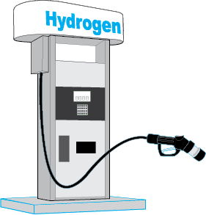
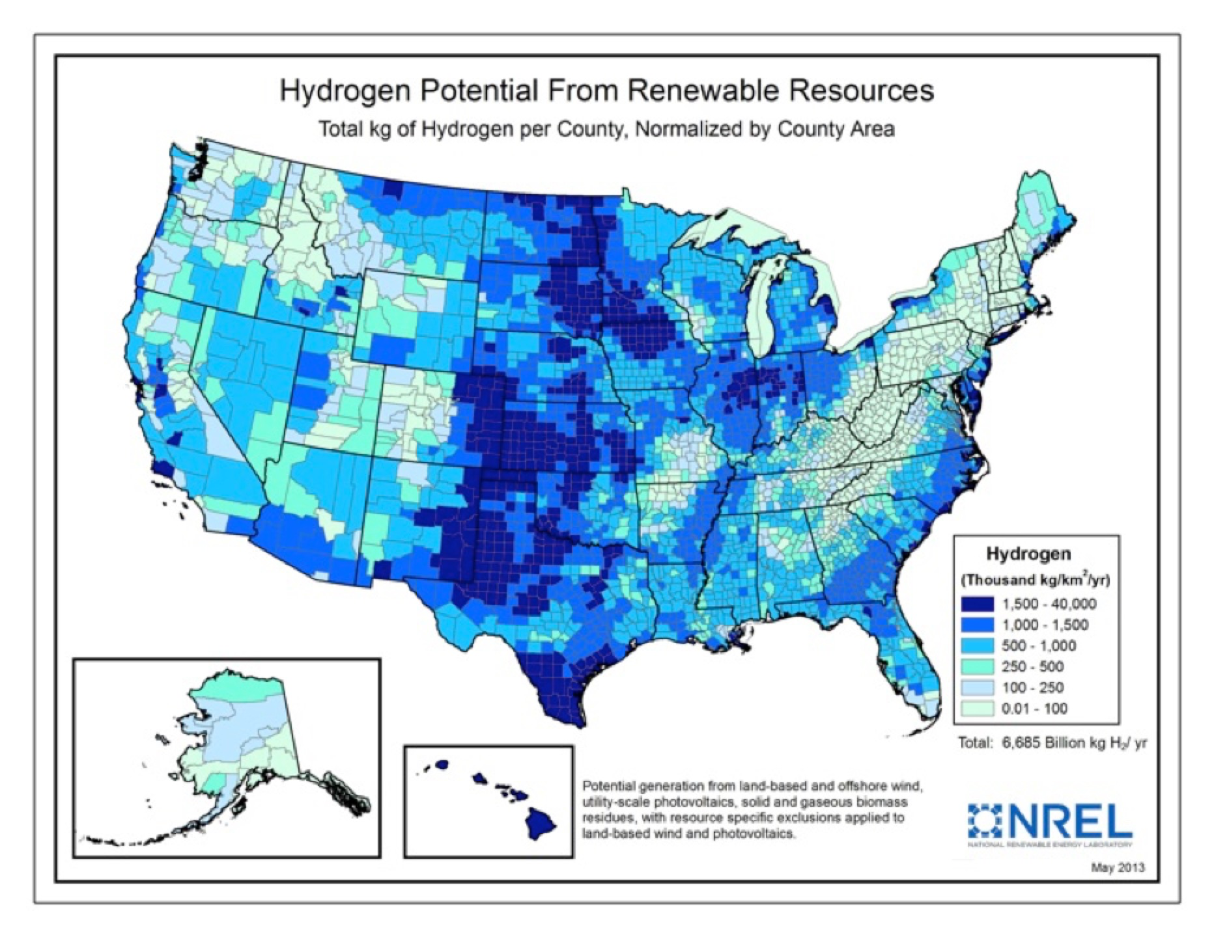
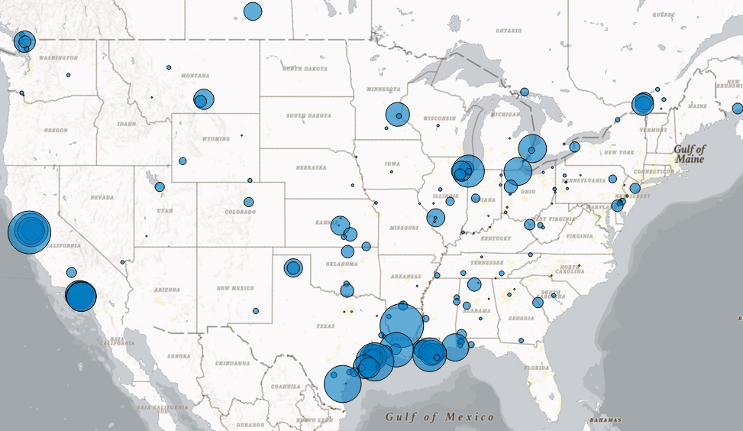
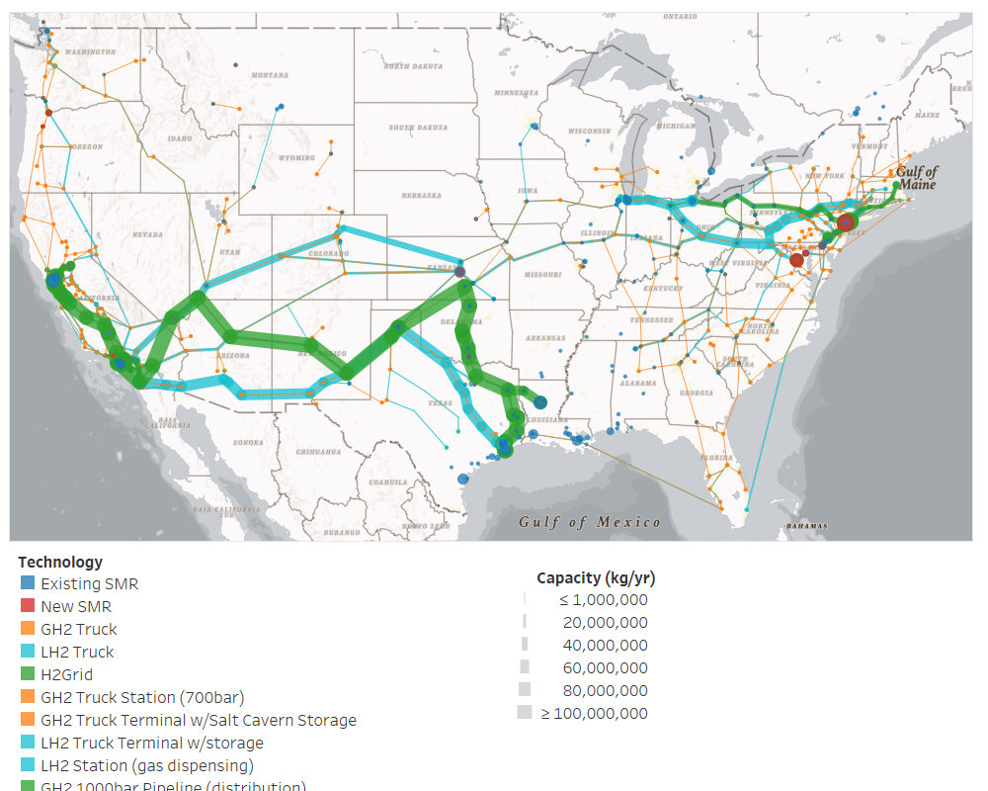
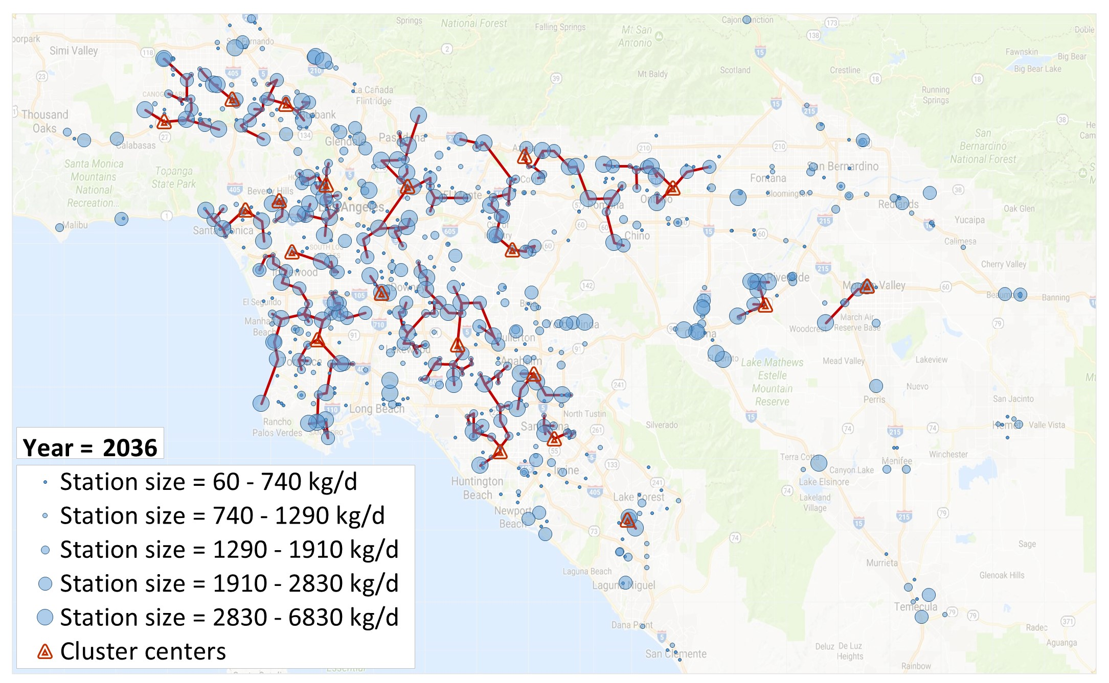
National Light-Duty FCEV Supply Chain:
Overview
The SERA model simulates least-cost hydrogen infrastructure supply systems for urban FCEV markets
Energy Resources
Hydrogen Production
Storage & Delivery
Retail Station Networks
Los Angeles
Energy prices (natural gas, electricity, etc.)
Renewables (biomass, solar, wind)
Terrain, rights of way, etc.
Central and onsite production facilities
Capacity sized to meet forecasted demand
Economies of scale balanced with delivery costs
Truck delivery, rail, and pipeline.
Cost is sensitive to volume, distance
Seasonal and weekly storage
Networked supply to multiple cities
Coverage stations for FCEV introductions
Station sizes increase with market growth
Liquid and pipeline delivery networks compete for large stations
https://www.nrel.gov/hydrogen/sera-model.html

Slide 3
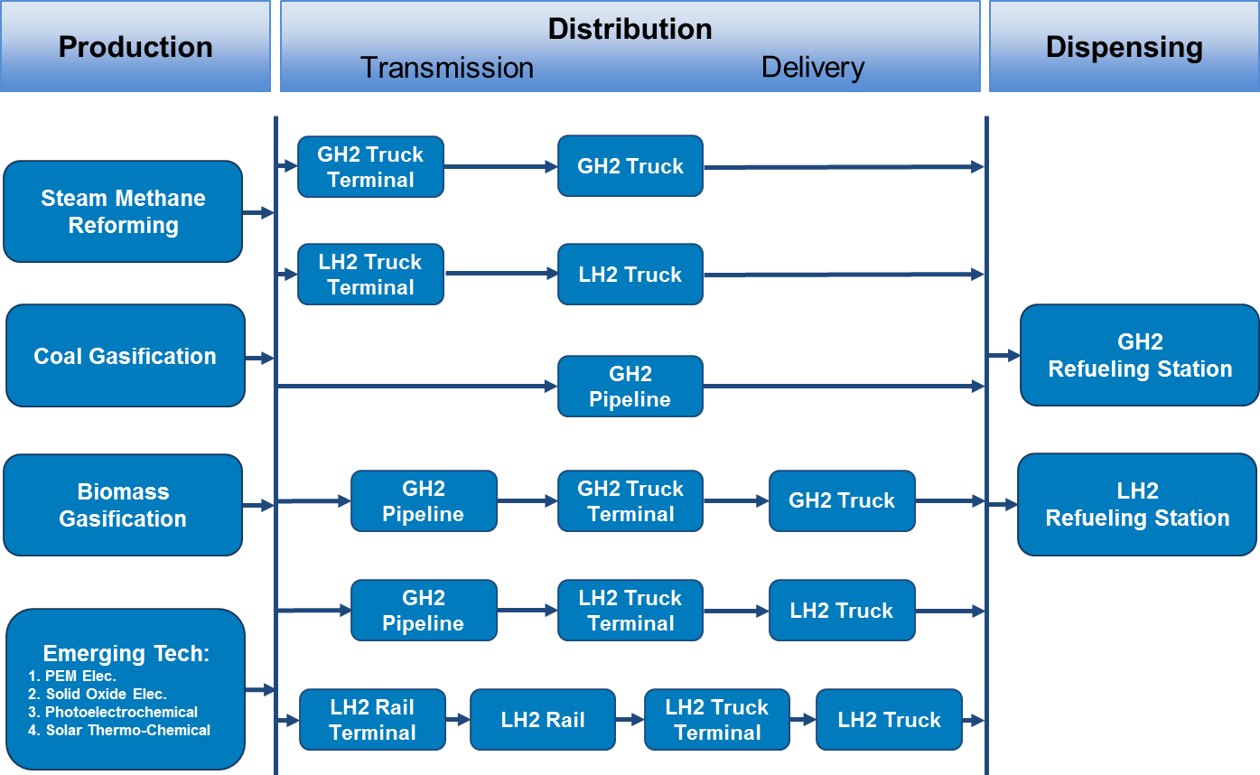
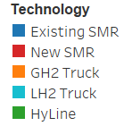
FCEV Supply Chain: SERA optimizes production, transmission, delivery and dispensing
Inputs: Resource prices, technology cost and resource data, FCEV demand
Optimization: SERA finds least-cost infrastructure to meet demand, technology, and resource constraints
Outputs: “blueprints” for hydrogen supply chain (production, transmission, delivery, dispensing)
Note:
GH2: Gaseous H2
LH2: Liquid H2
(Above) Example supply chain pathways for SERA to select from
(Right) Visualization of optimized light-duty vehicle hydrogen supply chain in 2050

Slide 4
2020 Hydrogen Price Projection
Analysis basis:
National analysis informs learning curves
CA analysis applies specific scenarios (% renewables, vehicle sale projections, existing stations)
Historic price informs near-term trajectory (no competitive market forces)
SERA computes future profited costs by scenario (assumes competitive market)
Transition between current and future price curves based on interpolation

Slide 5
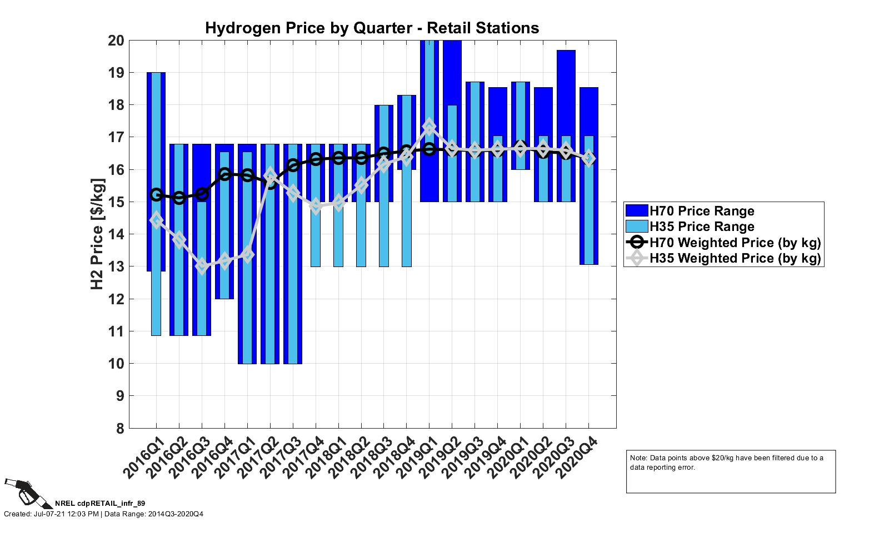
Historic H₂ Price Based on Reporting Agreements
Price entails pre-paid valuation of fuel included in first 3-year lease agreements
Drivers’ choice of fueling location is only based on convenience
Stations offering lower price fuel do not benefit from higher volume sales
Lower priced stations yield lower revenues
https://www.nrel.gov/hydrogen/assets/images/cdp-retail-infr-89.jpg

Slide 6

H2FAST Framework For Retail Station Analysis
The Hydrogen Financial Analysis Scenario Tool (H2FAST)
  Generally accepted accounting principles (GAAP) analysis of individual hydrogen infrastructure projects (production, distribution, retail)
  Annual computation of income statements, cash flow statements, balance sheets.
  Cost attribution by category
  Incentive policy analysis
  Risk analysis
Cost attribution
Incentives
scenarios
Risk analysis
Capital costs
Scenarios
Financial performance
Operating costs
Incentives impact
Incentives
Risk analysis
https://www.nrel.gov/hydrogen/h2fast.html
Financing

Slide 7
Single Station Cash Flow Analysis H2FAST
Base case financial performance analysis of hydrogen stations in a CA costs and incentive environment assume 8% nominal ROE (competitive market assumption)
600 kg/d station
(before 2021 update)
1,600 kg/d LH₂ station
(latest update)

Slide 8
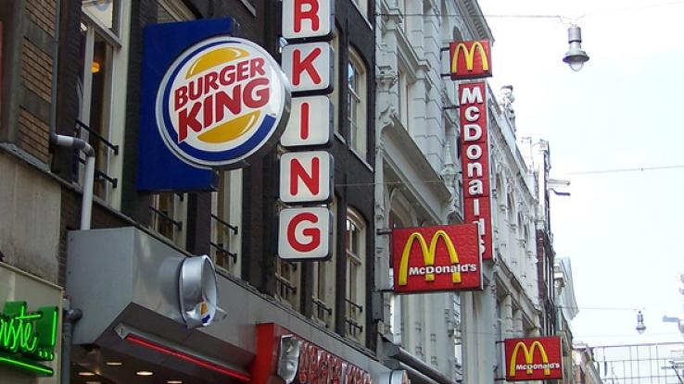
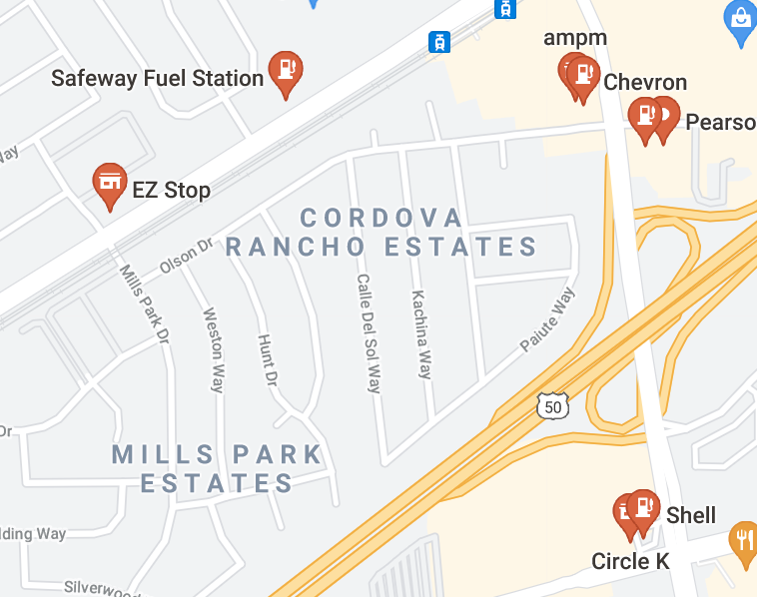
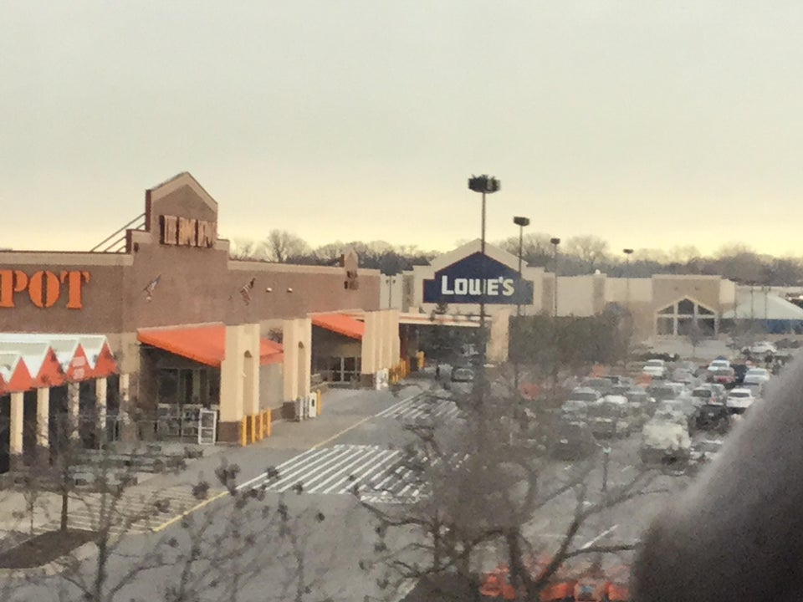
Competitive Consideration: Clustering vs. Coverage
https://www.planetizen.com/node/65765
https://www.reddit.com/r/mildlyinteresting/comments/aezmhd/lowes_and_home_depot_right_next_to_each_other/
Fast Food
Gas stations
Hardware stores
Hotelling's law
Attract customers based on cost & product differentiation by clustering with competitor
Minimize customer choice around product and price and not convenience of location
Evenly split market if prices and quality are identical
Other benefits
Realize sales volume vs. price differential
Redeem brand loyalty
Monetize market preference for product differentiation e.g. renewable content of H₂
H₂ infrastructure emphacises coverage.
Competitive markets emphacise clustering.

Slide 9
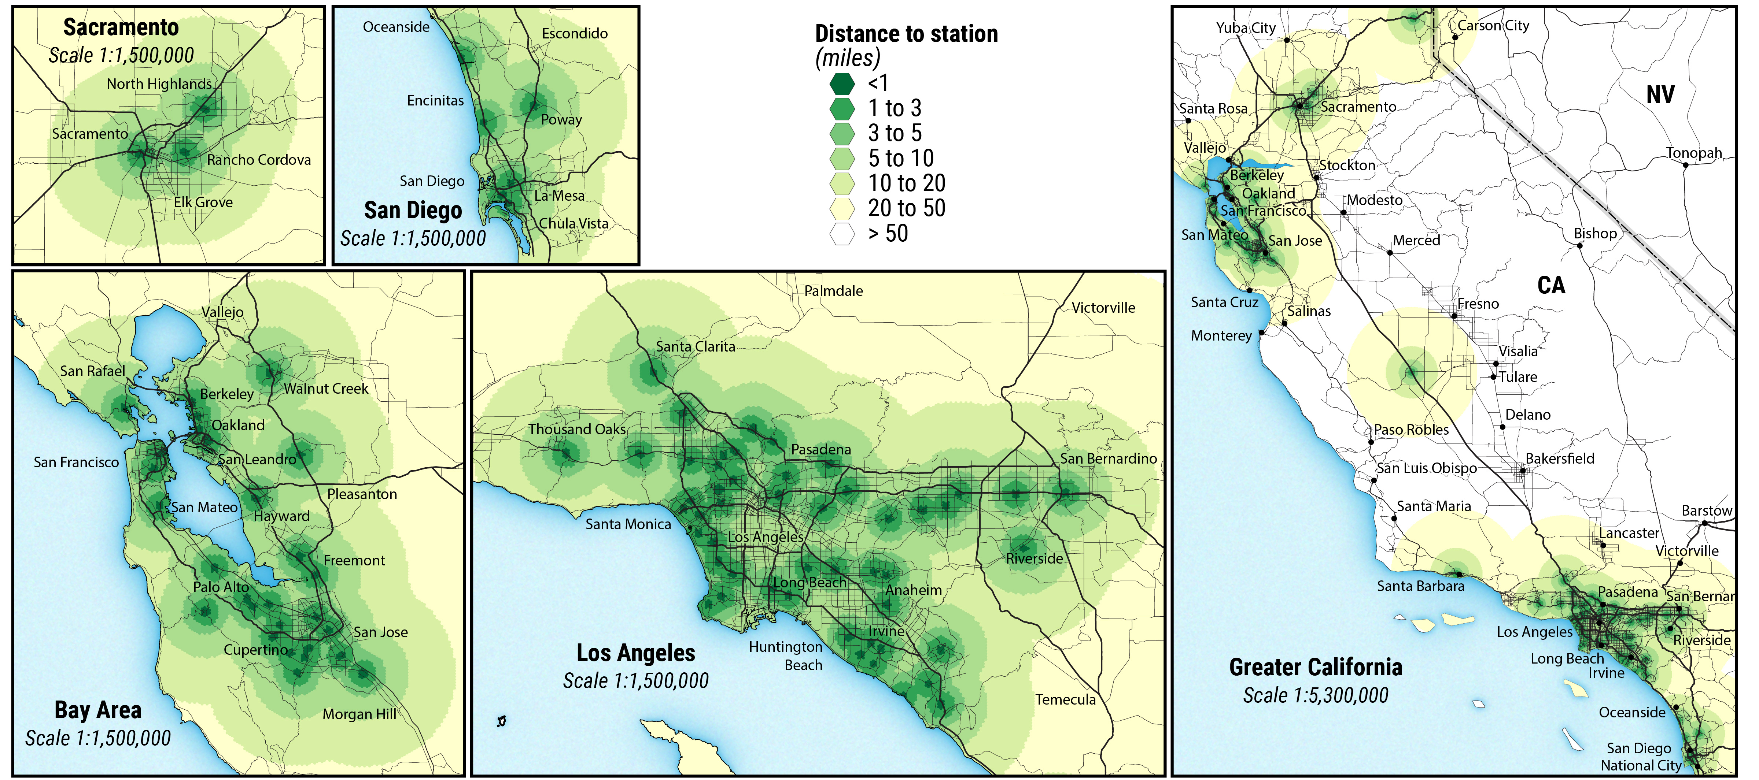
Station Coverage Status Bird’s Eye View
(Including planned stations)

Slide 10
Distance to Nearest Fueling Alternative
Coverage perspective
Competitive perspective
Linear distance among any stations (miles)
Includes planned stations
Average station-station distance = 4.7 miles
Excludes connectors
(Santa Barbara, Truckee, Harris Ranch)
Linear distance to nearest alternative operator station (miles)
Includes planned stations
Average distance between alternative fueling retailers = 6.7 miles

Slide 11




Monetization of Break-Even Savings to Alternate Station ($/kg)
Simple method (full round-trip cost):
Based on fuel used for round-trip & time value of the driver
Ave drive speed = 30mph
Detour factor = 1.4 (linear -> on-road distance)
Time value = $10/h
Fuel economy = 60mpg
Fuel cost= $16/kg
Refuel quantity = 3kg
B $/kg
B = Savings?
A $/kg
Example: 1 mile distance to alternative:
round-trip cost =
0.09h * $10/h
+ 2.8mile * $16/kg / 60 mpkg = $0.93 time val + $0.75 fuel
  min savings per kg = ($0.93+.75)/3kg = $0.56/kg
$$MinSavings=$$
$${LinDist∗Df∗2∗\left(\frac{TimeValue}{Speed}+\frac{FuelCost}{FuelEcon}\right)}/{FuelingKg}$$

Slide 12
Distribution of Break-Even Savings ($/kg)
Average break even price differential = $3.8 /kg
I’ll fuel at B for >$3.8/kg savings
I’ll fuel at B for >$1.9/kg savings
I’ll fuel at B for $0/kg savings
A $/kg
Halfway
point
B $/kg
On average, suppliers need to offer ~$1.9/kg savings to have significant impact on sales volume
Shorter distance to alternative suppliers reduces savings requirement

Slide 13
Retail Station Cost Dimensions With Incentives
Baseline scenario:
Delivered H2 = $7/kg
HRI credit = $2.3/kg
LCFS credit = $2.3/kg
Capital grant = $1.45M
Station life = 20 yrs
Long term utilization = 80%
Utilization growth = 5 yrs
Total station cap = $1,400/kg-day
Vertically integrated suppliers can look for efficiencies in full supply chain.
Extending station life, reducing capital and operating costs are desirable attributes for more competitive performance.
Baseline external parameters
Baseline retailer specific parameters

Slide 14
Retail Station Cost Dimensions Without Incentives
(Risk Averse View)
Baseline scenario:
Delivered H2 = $7/kg
HRI credit = $0.0/kg
LCFS credit = $0.0/kg
Capital grant = $0.0M
Station life = 20 10 yrs
Long term utilization = 80%
Utilization growth = 5 yrs
Total station cap = $1,400/kg-day
Baseline external parameters
Baseline retailer specific parameters

Slide 15
Price Downward Pressure Discussion
Driver out-of-pocket contribution is essential
enables market price response
consumer cost % too low: price-sales response too low
consumer cost % too high: reduces FCEV adoption rate
realistic price improves market optics and improves consumer planning on future expense profile
Station clustering vs. station coverage impact
short distance between suppliers magnifies sales volume impact of price differentials
availability of H₂ from multiple suppliers at a location improves resilience from supply disruptions and demand spikes
clustering enhances brand loyalty & product differentiation effect: e.g. % renewables content
price competitiveness
Station placement for clustering
Station placement for coverage

