Slide 1
Light-Duty ZEV Uptake in Government and Rental Segments
Jesse Gage, Energy Commission Specialist
July 15, 2021

Slide 2
Overview
Current makeup of LDV Government/Rental fleets
What makes these sectors unique
Government and Rental stock forecasting models
Policies driving government/rental push towards ZEVs
Questions for the group

Slide 3
Govt/Rental sectors small, but have anomalous ZEV penetration
Includes all light-duty vehicles model year 2000 and later. Source: Staff analysis of DMV Vehicle Registration Database.

Slide 4
Rental has very high “churn rate”
Data as of January 2020. Source: Staff analysis of DMV Vehicle Registration Database.

Slide 5
Most of the government fleet is local
Includes government light-duty vehicles model year 2000 and later. Source: Staff analysis of DMV Vehicle Registration Database.

Slide 6
More utility vehicles in government
Includes all light-duty vehicles model year 2000 and later. Source: Staff analysis of DMV Vehicle Registration Database.

Slide 7
Model Process
Calculate Fleet Size
Grow by Gross State Product
Gradually Retire Old Stock
Government: 10 Years
Allocate New Vehicle Purchases
Class Share Remains Constant
ZEV share determined exogenously
Rent: 4 Years

Slide 8
State-level directives
Executive Order B-16-12: Directs California’s state fleet to increase the purchase of ZEVs through the normal course of fleet replacement. It required that at least 10 percent of light-duty vehicle purchases be ZEVs by 2015. The requirement increased to 25 percent by 2020.
2016 ZEV Action Plan: Requires that 50 percent of all state agency light-duty vehicle procurements be ZEV by 2025.
State Administrative Manual Sections 4121 – 4121.6: Instituted a “ZEV and hybrid vehicle first” purchasing policy and increased the ZEV purchasing mandate annually by 5 percent so that it will be 50 percent by 2025.
Executive Order N-79-20: ”It shall be a goal of the State that 100 percent of in-state sales of new passenger cars and trucks will be zero-emission by 2035.
Sources: Green Fleet Major Initiatives, EO N-79-20

Slide 9
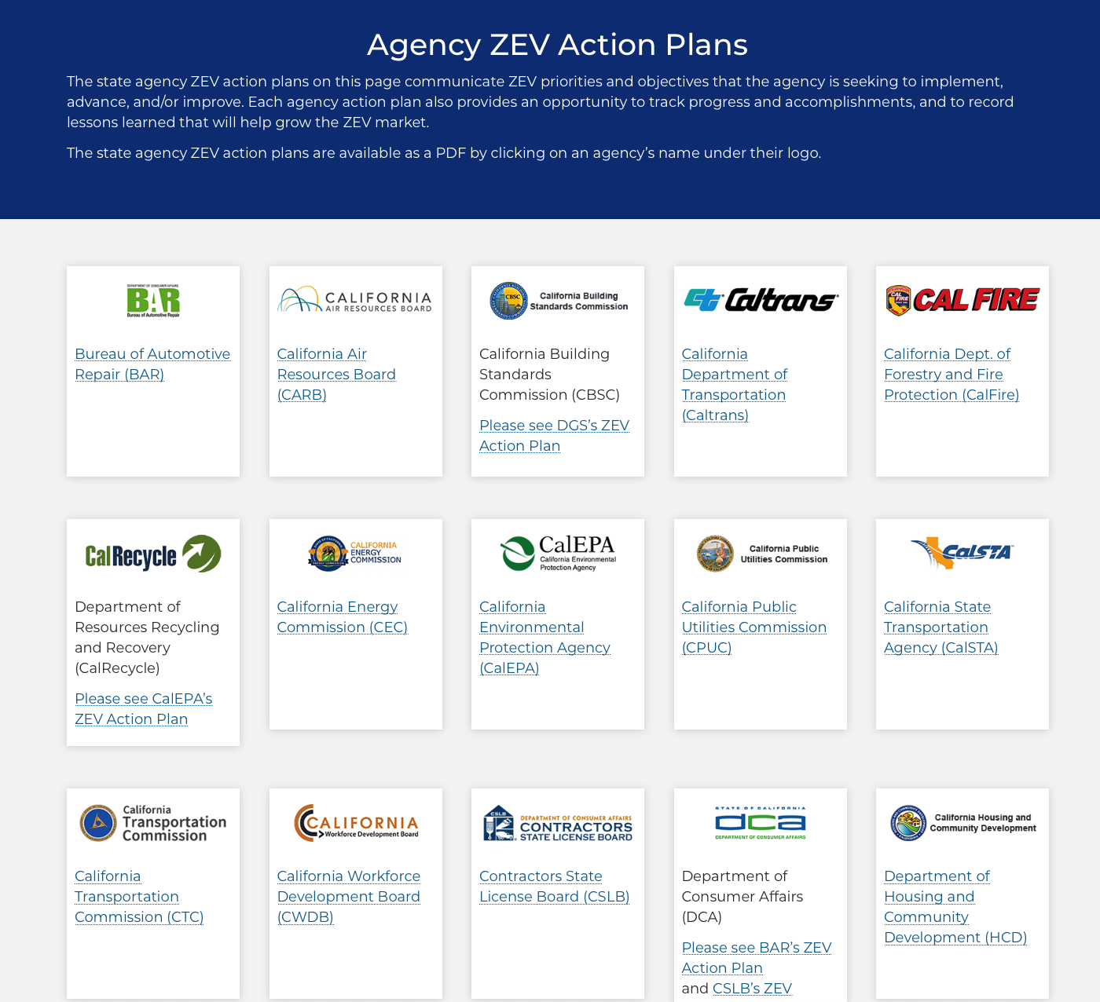
State-level ZEV development strategy
Source: Zero-Emission Vehicle Market Development Strategy

Slide 10
Local level
“California has 482 cities, 58 counties, 35 air districts, 18 metropolitan planning organizations, and 26 regional transportation agencies, each with different realities and constituencies. The… objectives are high-level and directional — their application will vary across the state.”
DGS to “enable non-state public entities to leverage state contracts to purchase ZEVs and supporting equipment.”
Air districts take lead: “Indirect Source Rules requiring ZEVs, incentives and creative market expansion programs; support ZEV Mobile Source Measures and Transportation Control Measures in updates to pollutant plans…”

Slide 11
Remaining questions
Policies/metrics targeted at the city/county level? Would like input from cities and other stakeholders on what their action plans are, or if these have been compiled.
Anything at all toward rentals, other than airport shuttles?
Rental car companies sold half their fleet in 2020 in response to COVID-19 demand reduction. How might this sell-off affect ZEV uptake in the near term?
What should the ZEV curves look like? When should we expect 100% ZEV purchases in the government (all segments) and rental fleets?

