Slide 1
Medium- and Heavy-Duty Vehicle Attributes
Jeff Rosenfeld
Director, Transportation & Energy
July 15, 2021

Slide 2
Task overview
Purpose: Support Energy Commission transportation energy demand forecasting efforts by updating historic and forecast attributes of medium- and heavy-duty vehicles
Subtask 1. Administration
Subtask 2. Review of 2019 Forecast Attributes and Matrix of Available Fuel Types
Subtask 3. Update Historical Vehicle Attributes
Subtask 4. Vehicle Technology Forecast
Subtask 5. Forecast ZEV and Low-NOx Fueling/Charging Infrastructure Costs
Subtask 6. Forecast Vehicle Attributes
Subtask 7. Training Energy Commission Staff

Slide 3
Subtask 3. Update Historical Vehicle Attributes
Focus for Today
Fuel Economy
Vehicle Prices
Data Source
DMV/Price Digest top models by category
AFLEET model (Argonne)
ICF/CalETC research data sources
HD Systems vehicle costs and cost multipliers
HVIP Delivered Prices
Goal for Today
Please provide comments on the alternative fuel vehicle prices

Slide 4
Review Subtask 2. Review of 2019 Forecast Attributes and Matrix of Available Fuel Types
Initial review of previous CEC matrix of technologies and implementation years
Literature review and public announcements of the current status of technologies
Conversations with MD/HD OEMs about technology status

Slide 5
Subtask 3. Update Historical Vehicle Attributes
Presentation will focus on three vehicle segments – Class 3, 6, and 8 Combo

Slide 6
Subtask 3. Update Historical Vehicle Attributes
Class 3 EERs in 2019
Fuel Type
Source | Gasoline | Diesel | Electric | Hybrid | Propane
EMFAC | 1.00 | 1.337 | 4.407
HD Systems | 1.00 | 1.237 | 4.525 | 1.320 | 1.001
ANL GREET | 1.00 | 1.343 | 4.479 | 1.400 | 1.000
EER = Energy Economy Ratio – Gasoline Baseline – Red value used in analysis
Please Provide Comments

Slide 7
Subtask 3. Update Historical Vehicle Attributes
Class 6 EERs in 2019
Fuel Type
Source | Gasoline | Diesel | Diesel-Electric | Electric | Natural Gas | Propane | Hydrogen FC
EMFAC | 1.00 | 1.279 |  | 4.129 | 1.075
HD Systems | 1.00 | 1.279 | 1.535 | 4.685 | 1.087
ANL GREET | 1.00 | 1.312 | 1.837 | 4.877 | 1.115 | 1.000 | 2.683
EER = Energy Economy Ratio – Gasoline Baseline – Red value used in analysis
Please Provide Comments

Slide 8
Subtask 3. Update Historical Vehicle Attributes
Class 8 Combo EERs in 2019
Fuel Type
Source | Diesel | Electric | Hydrogen FC | Natural Gas | PHEV
EMFAC | 1.000 | 2.501 |  | 0.873
HD Systems | 1.000 | 1.834 | 0.841 | 0.950
ANL GREET | 1.000 | 1.666 | 1.363 | 0.900 | 1.371
EER = Energy Economy Ratio – Diesel Baseline – Red value used in analysis
Please Provide Comments

Slide 9
Subtask 3. Update Historical Vehicle Attributes
Class 3 in 2019
Fuel Type | Price (MY 2021) | DMV/Price Digest | ICF/CALETC | AFLEET | HD System
Gasoline | $36,330 | $36,330 |  | $42,000 | $45,250
Diesel | $47,305 | $47,305 |  | $53,000 | $53,650
Propane |  |  |  | $50,000 | $56,250
BEV | $93,000 |  | $100,000 | $93,000 | $78,955
Hybrid |  |  |  |  | $55,050
orange = no new data; yellow = need to decide on final price, but have limited data
Please Provide Comments

Slide 10
Subtask 3. Update Historical Vehicle Attributes
Class 6 in 2019
Fuel Type | Price (MY 2021) | DMV/Price Digest | ICF/CALETC | AFLEET | HD System
Gasoline | $59,183 | $59,183 |  |  | $59,450
Diesel | $87,346 | $87,346 |  | $75,000 | $68,450
Diesel Electric Hybrid |  |  |  | $90,000 | $86,156
Natural Gas |  |  |  | $115,000 | $103,450
BEV | $165,000 |  | $165,000 | $185,000 | $135,297
orange = no new data; yellow = need to decide on final price, but have limited data
Please Provide Comments

Slide 11
Subtask 3. Update Historical Vehicle Attributes
Class 8 Combination in 2019
Fuel Type | Price (MY 2021) | DMV/Price Digest | ICF/CALETC | AFLEET | HD System | HVIP | Other
Diesel | $153,969 | $153,969 |  | $130,000 | $124,820
Natural gas | $177,065 | $177,065 |  | $170,000 | $199,820 | $187,045
BEV | $350,000 |  | $434,642 | $480,000 | $338,990 | $224,975 | $350,000
Hydrogen |  |  | $480,000 |  | $287,368
orange = no new data; yellow = need to decide on final price, but have limited data
Please Provide Comments

Slide 12
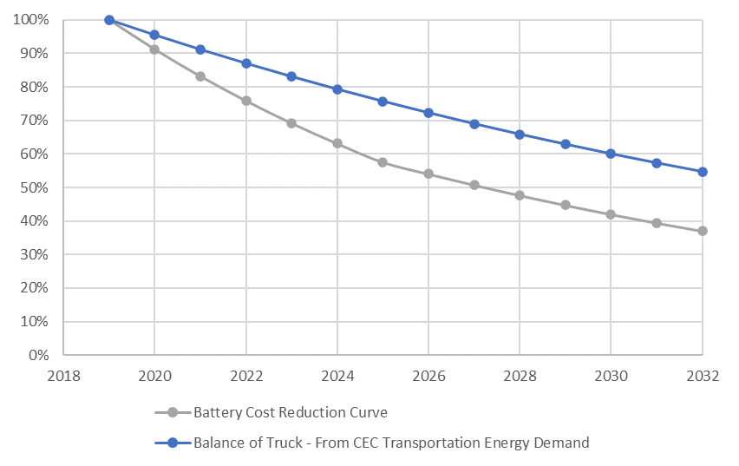
Subtask 6. Forecast Vehicle Attributes
CalETC Electric Truck Forecast
Disaggregated current costs of trucks as battery and balance of truck (after removing estimated tariff costs, analysis done in 2019)
Developed separate cost reduction trajectories for battery and balance of truck based on BNEF cost reduction trajectories for batteries and CEC demand forecast for balance of truck (need updated data do confirm previous forecast)
For each Class 4-8 technologies developed separate curves to estimate cost reductions

Slide 13
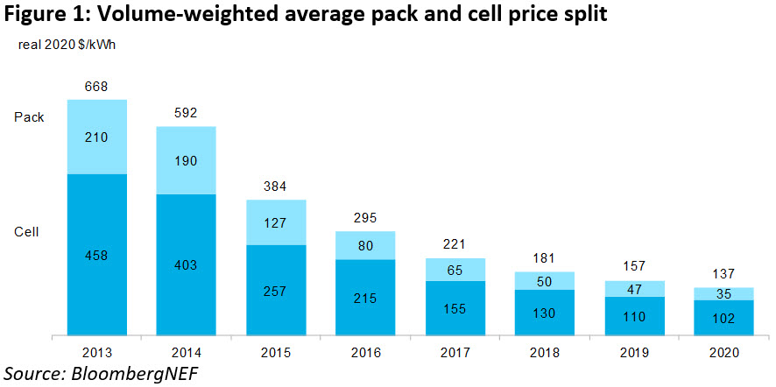
Subtask 6. Forecast Vehicle Attributes
Combine Battery Price Projections with disaggregation of current vehicle prices
Total
https://about.bnef.com/blog/battery-pack-prices-cited-below-100-kwh-for-the-first-time-in-2020-while-market-average-sits-at-137-kwh/

Slide 14
Subtask 5. Forecast ZEV and Low-NOX Fueling/ Charging Infrastructure Costs
Methodology
Review existing data sources and create costs per general charging category/type – Level 2, DC Fast Charging (50 kW, 150 kW, 350 kW, 800 kW), Hydrogen
Data Sources
AFLEET model (Argonne) – EV and H2
EDF/GNA Report (2019)
RMI (2020)
ICCT, 2 Report in 2019 – EV and H2
NREL (2015)
Goal for Today
Please provide additional sources for fueling infrastructure prices

Slide 15
Next Steps
Feedback
Please provide and send feedback on vehicle prices
The 2021 prices provide the starting point for vehicle price forecasts which are the most critical element in the modeling

Slide 16
Schedule
Task | Description | Status | Estimated Completion
Task 2 | Review 2019 Forecast Attributes/ Matrix | Completed | February 2021
Task 3 | Update Historical Vehicle Attributes | Almost Complete | July 2021
Task 4 | Vehicle Technology Forecast | Complete | June 2021
Task 5 | Forecast ZEV and Low-NOX Fueling/ Charging Infrastructure Costs | Almost complete | July 2021
Task 6 | Forecast Vehicle Attributes | Ongoing | August 2021

Slide 17
Subtask 3. Update Historical Vehicle Attributes
Class 4/5 in 2019
Fuel Type | Price (MY 2021) | DMV/Price Digest | ICF/CALETC | AFLEET | HD System
Gasoline | $41,287 | $41,287 |  |  | $47,560
Diesel | $50,725 | $50,725 |  |  | $55,460
Natural Gas |  |  |  |  | $60,060
Propane |  |  |  |  | $58,560
BEV | $100,000 |  | $100,000
Hybrid |  |  |  |  | $59,200
Please Provide Comments
orange = no new data; yellow = need to decide on final price, but have limited data

Slide 18
Subtask 3. Update Historical Vehicle Attributes
Class 7 in 2019
Fuel Type | Price (MY 2021) | DMV/Price Digest | ICF/CALETC | AFLEET | HD System
Diesel | $91,583 | $91,583 |  |  | $98,534
Diesel Electric Hybrid |  |  |  |  | $121,814
Natural Gas |  |  |  |  | $133,534
Please Provide Comments
orange = no new data; yellow = need to decide on final price, but have limited data

Slide 19
Subtask 3. Update Historical Vehicle Attributes
Class 8 Dump Truck in 2019
Fuel Type | Price (MY 2021) | DMV/Price Digest | ICF/CALETC | AFLEET | HD System
Diesel | $187,219 | $187,219 |  | $300,000 | $98,600
Natural gas | $220,000 |  |  | $220,000 | $153,600
BEV | $370,000 |  |  | $370,000 | $257,930
Please Provide Comments
orange = no new data; yellow = need to decide on final price, but have limited data

Slide 20
Subtask 3. Update Historical Vehicle Attributes
Class 8 Refuse/Recycling in 2019
Fuel Type | Price (MY 2021) | DMV/Price Digest | ICF/CALETC | AFLEET | HD System | HVIP
Diesel | $300,000 | $306,000 |  | $300,000 | $192,930
Diesel Electric Hybrid |  |  |  | $350,000 | $228,342
Natural Gas | $335,000 |  |  | $335,000 | $247,930 | $305,746
BEV | $500,000 |  | $395,000 | $500,000 |  | $408,750*
Please Provide Comments
orange = no new data; yellow = need to decide on final price, but have limited data

