Slide 1
DEMAND ANALYSIS WORKING GROUP (DAWG)
Additional Achievable Energy Efficiency (AAEE) & Additional Achievable Fuel Substitution (AAFS) Preliminary Scenario Designs
September 9, 2021 10am-12pm
Ingrid Neumann, Ph.D.
CEC - EAD

Slide 2
Remote-Only Format
In compliance with Governor Newsom's Executive Orders N-25-20 and N-29-20, and the recommendations from California Department of Public Health, we are utilizing a remote-only format today.
DAO Staff efforts to update inputs, revise and enhance elements of, and add new capabilities to the Additional Achievable Energy Efficiency (AAEE) Forecast load modifier for the 2021 IEPR Demand Forecast (AAEE is limited to the Building Sector)
Proposed Preliminary Scenario Designs for the 2021 AAEE Forecast
DAO Staff efforts to introduce electrification load modifiers for the 2021 IEPR Demand Forecast for both the Building and Transportation Sectors
Proposed Preliminary Scenario Designs for the 2021 Additional Achievable Fuel Substitution (AAFS) Forecast (limited to the Building Sector for 2021)
Materials will be posted at CEC DAWG webpage

Slide 3
Housekeeping: Zoom Overview
Everyone will be muted by default
Questions/Comments
  Please submit questions in the chat box and we will address them after the presentation during the discussion
  Please include your name and the slide number
  We will call on stakeholders by name and unmute them so they may ask a question after the presentation is completed.
Un-Mute or Mute
Video will be Off
Click to See Participants
Click to See the Chat and Enter Questions

Slide 4
NEW EAD Decarbonization Analysis for 2021 IEPR
Energy Efficiency (EE) tracking/projections and hourly forecast load modifier
Building Electrification tracking/projections and hourly forecast load modifier
  Varying time horizons
  Varying uncertainties
  Varying uses
New long term demand scenarios are being developed to complement the traditional 10-year gas and electricity demand forecast used for energy planning and procurement purposes and may help inform future policy decisions towards California’s mid-century climate goals.
AB 3232 scenarios
SB 350 tracking towards EE doubling goal
Time Horizon for Analysis
2015 2020 2025 2030 2035 2040 2045
AAEE load modifier to IEPR forecast
AAEE & electrification load modifiers to IEPR forecast
long term demand scenarios

Slide 5
Additional Achievable Energy Efficiency
(AAEE)

Slide 6
Single Managed Forecast Set
“Energy Commission, in consultation with the CPUC and the CAISO, considered public input in selecting a single or managed demand forecast from the adopted forecast report for use in transmission planning and procurement. This set of forecast numbers is a combination of two forecast components: a base case with weather variants and an additional achievable energy efficiency (AAEE) scenario. Combined together, these create the single or managed forecast.”
Three baseline cases and five scenarios of AAEE
The mid-AAEE forecast scenario will be used for system-wide and flexibility studies relied upon for procurement and transmission planning purposes.
Because of the local nature of reliability needs and the difficulty of forecasting locally disaggregated AAEE, the low-mid-AAEE scenario will be used for local studies.

Slide 7

Additional Achievable Energy Efficiency (AAEE) 2019 Process Flow Overview
Scenario Design
POU AAEE first year
Projections 2020-2030
Data Integration Tool for
Total Cumulative AAEE Projections by year 2020-2030
by utility, sector, end use & scenario
2017 CMUA PG Study
POU Projections
2020 CPUC PG Study
IOU Projections
Scenario Design
IOU AAEE first year
Projections 2020-2030
C&S
AAEE Hourly Tool
Total 8760 Hourly AAEE Projections by year 2020-2030
by utility, sector, end use & scenario
CEC Beyond Utility Programs tool allows scenario design for Beyond Utility AAEE first year Projections 2020-2030
AAEE

Slide 8
Scenario Development for 2019 AAEE
IOU Potential Program Savings
Codes and Standards Savings
Beyond Utility Program Savings
POU Potential Program Savings

Slide 9
Additional Achievable Energy Efficiency (AAEE) 2019 Scenario Design
Beyond Utility Program Savings
Codes and Standards Savings
2020 2030
IOU and POU Committed
Program Savings
IOU Potential Program Savings
POU Potential Program Savings
Committed C&S savings

Slide 10
Additional Achievable Energy Efficiency (AAEE) 2019 Scenario Design
Beyond Utility Program Savings
  eliminate duplication with baseline forecast
  eliminate any other duplication between savings streams
Codes and Standards Savings
2020 2030
IOU and POU Committed
Program Savings
IOU Potential Program Savings
POU Potential Program Savings
Committed C&S savings

Slide 11
Proposed 2021 AAEE
For 2021 we will be using the same saving accounting, aggregation, and extrapolation methodology & tools as were developed for 2019 with the addition of some new capabilities
  Hourly GHG savings from gas and electric EE
  Extrapolation of potential savings out to 2050
Historical data and potential savings projections are being updated
Some beyond utility workbooks are being removed while others are being added or enhanced based on recent programmatic activities

Slide 12
2021 Additions and Enhancements
Removed workbooks
Benchmarking
  flat energy consumption so no EE savings could be directly attributed to benchmarking efforts
Fuel Substitution
  Supplanted by Additional Achievable Fuel Substitution (AAFS)
ADDED new workbooks
CCA and REN Program Savings (not yet modeled in PG Study)
T24 Res & Com New Construction Fuel Sub
Clean Energy Optimization Program (CEOP)
IOU Low Income Fuel Sub
POU Fuel Sub
SGIP HPWH Incentives
TECH-BUILD (SB 1477 Low Emissions Buildings and Sources of Heat Energy))
Food Processing Investment Program (FPIP)

Slide 13
Additional Achievable Energy Efficiency (AAEE) 2021 Process Flow Overview
Scenario Design
POU AAEE first year
Projections 2022-2041
Data Integration Tool for
Total Cumulative AAEE Projections by year 2022-2035
by utility, sector, end use & scenario
2021 CMUA PG Study
POU Projections
2021 CPUC PG Study
IOU Projections
Scenario Design
IOU AAEE first year
Projections 2022-2032
C&S
AAEE Hourly Tool
Total 8760 Hourly AAEE Projections by year 2022-2035
by utility, sector, end use & scenario
CEC Beyond Utility Programs tool allows scenario design for Beyond Utility AAEE first year Projections 2022-2035
AAEE

Slide 14
Scenario Development for 2021 AAEE
IOU Potential Program Savings
POU Potential Program Savings
Codes and Standards Savings
Beyond Utility Program Savings

Slide 15
2019 IOU AAEE Scenario Design
Goal was to design a spread of IOU Program AAEE Scenarios from conservative to optimistic

Slide 16
Proposed 2021
IOU AAEE Scenario Design

Slide 17
POU AAEE Scenario Design
Goal was to design a spread of POU Program AAEE Scenarios from conservative to optimistic

Slide 18
Proposed 2021
POU AAEE Scenario Design
For each of the 38 California POUs, energy efficiency savings projections were defined for the years 2022 to 2041 by GDS Associates on behalf of the CMUA
Savings were characterized by sector, by end use, and by program name
  Behavorial Programs were named
  Fuel Substitution impacts were not included
first-year Cumulative Market Potential was used as the reference level
to create POU potential scenarios, the team calculated sector-by-sector (Residential, Commercial, Industrial, and Agricultural) ratios from the 2021 PG study IOU data

Slide 19
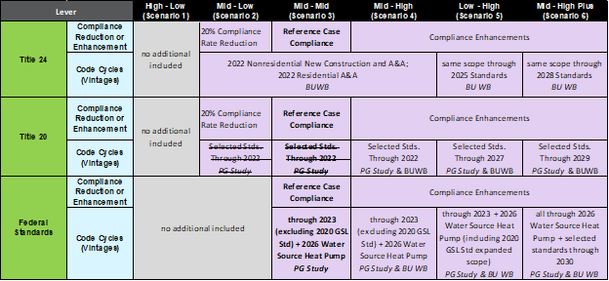
Code and Standards Scenario Design
statewide savings are allocated to each IOU, IRP POU or smaller POU grouping
  essential for the small POU’s inside CAISO planning area

Slide 20
Proposed 2021
C&S AAEE Scenario Design

Slide 21
Beyond Utility AAEE Scenario Design
Program specific levers are adjusted within each Beyond Utility program workbook and are grouped to define low, mid and high BU AAEE Scenarios.

Slide 22
Proposed 2021
Beyond Utility AAEE Scenario Design

Slide 23


5-minute break

Slide 24
Additional Achievable Fuel Substitution
(AAFS)

Slide 25
What FS was included in 2019?
  Used a “what-if” percentage of all electric new construction in 2019 Additional Achievable Energy Efficiency (AAEE)
  Used low for AAEE 1&2, mid AAEE 3&4, high AAEE 5&6
    Low: Assumed all electric penetration rate of 0.5% per year beginning 2020, ramping linearly to a cumulative of 5.5% in 2030
    Mid: Assumed all electric penetration rate of 1.5% per year beginning 2020, ramping linearly to a cumulative of 16.5% in 2030
    High: Assumed all electric penetration rate of 2.5% per year beginning in 2020, ramping linearly to a cumulative of 27.5% in 2030

Slide 26
What work has EAD done since then?
Developed “what-if” Fuel Substitution Scenario Analysis Tool (FSSAT)
  Used the FSSAT to analyze building electrification scenarios in our AB 3232 Analysis described in the recently published California Building Decarbonization Assessment
Each of the electrification scenarios meeting or exceeding the AB3232 target have substantial incremental electric energy added due to electrification efforts
  In addition to increasing peak loads electrification can shift the dates and times of these peaks; winter loads are affected more than summer loads
AB 3232 analysis based on “what if”; can’t use AB 3232 scenarios as a starting point for AAFS
We are currently completing work with GH on incorporating more program-oriented inputs in our improved EE/FS analysis tools for use in the 2021 IEPR

Slide 27
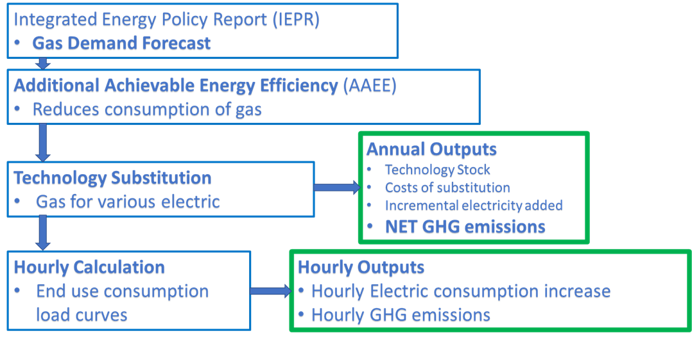
Modeling electrification:
Fuel Substitution Scenario Analysis Tool (FSSAT) main processes flow chart

Slide 28
Building end-use electrification scenarios:
Minimal, Moderate, Aggressive, Efficient Aggressive
Electrification Scenario Using FSSAT | New Construction (NC) | Replace on Burnout (ROB) | Early Replacement (RET) | Technology Efficiency
Minimal | 100% by 2030 | 15% | 5% | High-Efficiency Weighted Mix
Moderate |  | 50%
Aggressive |  | 90% | 70%
Efficient Aggressive |  |  |  | Single-Best Efficiency
Where:
  NC, ROB, and RET are percentages of eligible technologies by sector/end-use that will be electric in 2030
  The Minimal electrification scenario just meets the 40-percent AB 3232 target

Slide 29
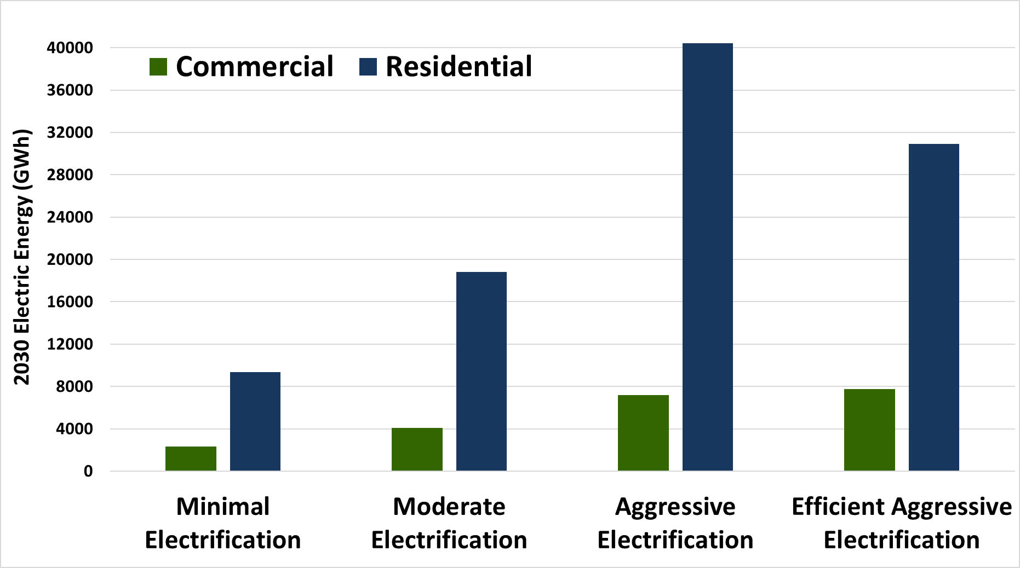
Statewide Annual Incremental Electricity Demand by Scenario-Specific Electrification in 2030
8% Com. & 40% Res.
8% Com. & 31% Res.
4% Com. & 19% Res.
3% of Commercial & 9% of Residential
Baseline consumption added

Slide 30
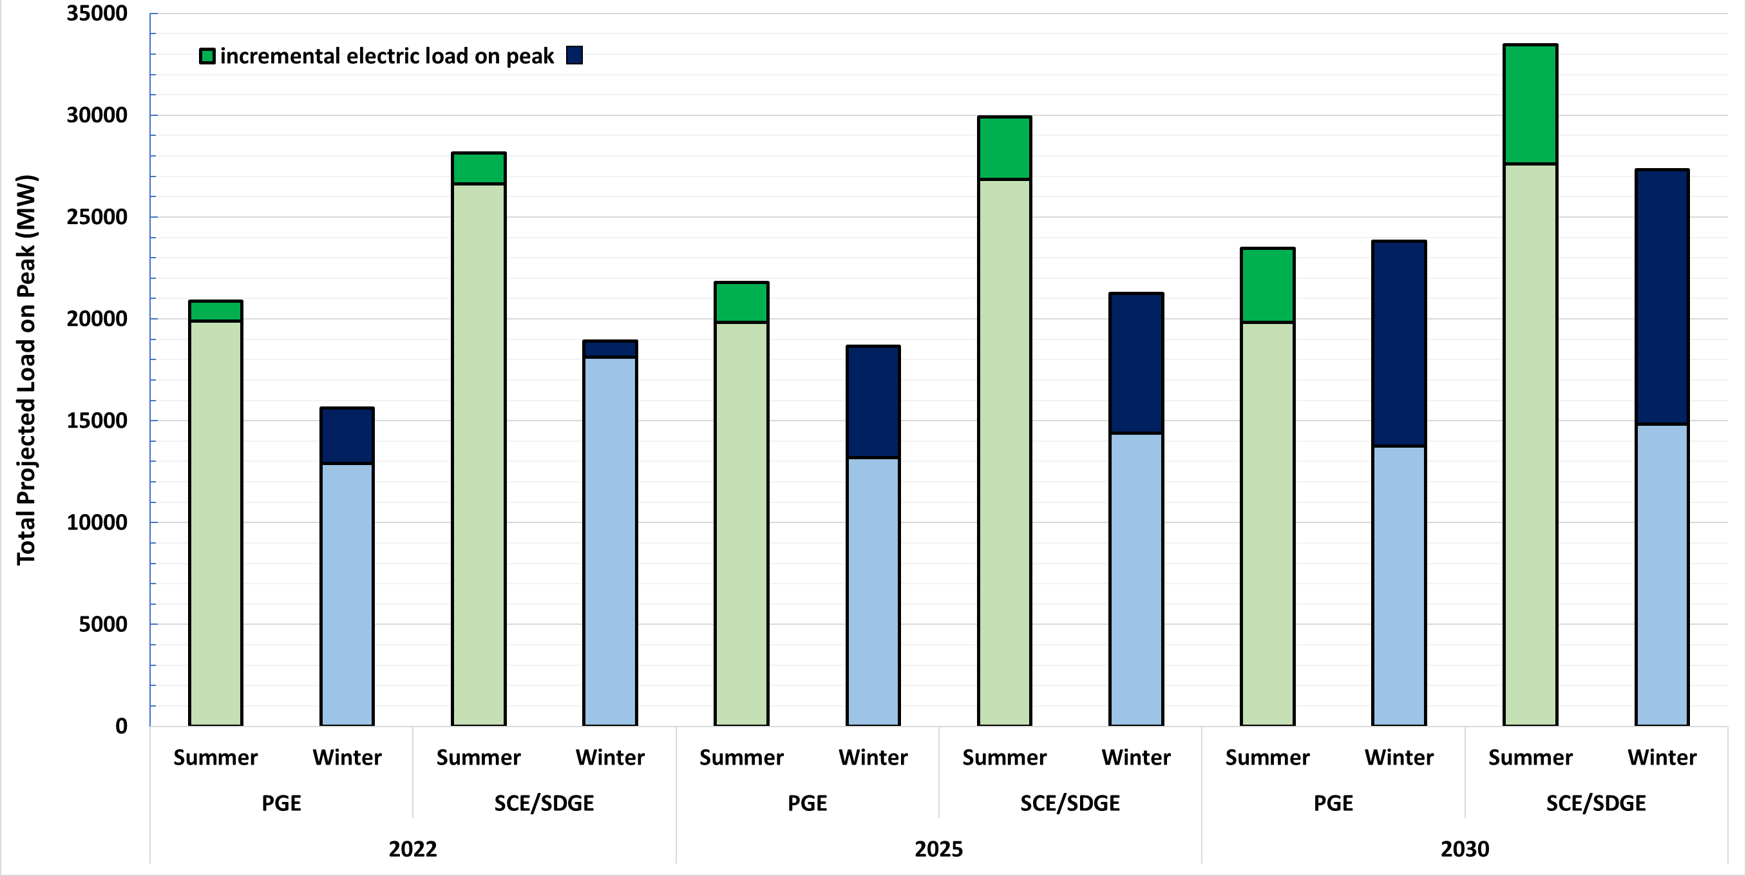
Summer and Winter Peak Load Impacts
after Aggressive Electrification
Dec 9 6pm
shifted to
Jan 3 7am
Nov 13 5pm
shifted to
Dec 2 6am
Notes:
Northern CA and Southern CA proxies
Electrification increases peak loads, which grow in magnitude by 2030. Dark blue and green stacked on top of the lighter columns of the same color are the added incremental loads due to electrification.
While winter loads are affected more than summer loads, peak incremental electrification additions are not coincident with managed peak load dates and hours and these impacts become significant enough to shift those dates and hours by 2030.
For example, neither AAEE, nor electrification have coincident peaks with the baseline hourly load forecast but while AEEE diminishes the managed peak loads by 4 to 5 percent in 2030, FS increases peak loads by a 4-43%.

Slide 31
Use AAEE as a template for AAFS
For 2021 we wish to develop Additional Achievable Fuel Substitution (AAFS) as an hourly load modifier to the baseline demand forecast.
AAFS is conceptualized as separate from AAEE
We wish to use a manner similar to the one which was developed for AAEE for AAFS; ie. a “template”
  AAEE genesis occurred in 2009 with an analysis of “incremental, uncommitted” EE savings
  2013 the Joint Agencies developed the “single forecast set” language and formalized it in 2014

Slide 32
Scenario Development for 2021 AAFS
DAWG stakeholder workshop June 23
IEPR Commissioner Workshop August 5 Electricity & Natural Gas Demand Forecast: Inputs and Assumptions
The next step would be defining a mutually agreed upon process for incorporating building electrification into the IEPR Demand Forecast such that it is useful to the joint agencies and their stakeholders.
As in the 2019 AAEE forecast, and before, the objective is to continue to focus on firm programs and projections since the core scenarios will be used for planning and procurement purposes
As in previous iterations, develop variations around these most probable futures to show other possible outcomes given less or more effort input to realize the potential of existing or proposed EE and FS programs

Slide 33
Proposal for 2021 AAFS Development
CEC approach to Scenarios
“Firm commitments” including only anticipated all electric new construction due to currently existing local ordinances and existing Utility programs with compliance rates, participation, and funding ratcheted down from standard values.
    AAFS scenarios 1-6 ranging from most conservative to most aggressive or optimistic

Slide 34
34
“Firm commitments”
Add all electric new construction as expected to be encouraged by the proposed T24 update to the below.

Slide 35
35
“Firm commitments”
new construction as expected from the proposed T24
The below using standard values for compliance rates, participation, and funding plus the addition of some firmer funded programs such as BUILD/TECH.

Slide 36
36
“Firm commitments”
new construction as expected from the proposed T24
addition of some firmer funded programs such as BUILD/TECH
Ratchet all of the below elements up beyond standard values for compliance rates, participation, and funding.

Slide 37
37
“Firm commitments”
new construction as expected from the proposed T24
addition of some firmer funded programs such as BUILD/TECH
Ratchet all of the below elements up beyond standard values for compliance rates, participation, and funding.
A scenario which includes the below and adds more speculative programs in order to meet minimum AB 3232 goals for the Residential and Commercial Sector.

Slide 38
38
“Firm commitments”
new construction as expected from the proposed T24
addition of some firmer funded programs such as BUILD/TECH
Ratchet all of the below elements up beyond standard values for compliance rates, participation, and funding.
Add more speculative programs to meet minimum AB 3232 goals
A scenario which includes the below and expands speculative programs further to meet economywide mid-century GHG reduction goals.

Slide 39
Scenario Development for 2021 AAFS
IOU Potential Program Savings
POU Potential Program Savings
Codes and Standards Savings
Beyond Utility Program Savings

Slide 40
Proposed 2021
IOU AAFS Scenario Design

Slide 41
Proposed 2021
POU AAFS Scenario Design
Interviewed all willing POU’s…
Relied on preliminary pilot program data from LADWP projected for 2021-2052 and data from SMUD, Pasadena, Palo Alto on reasoned cost projections, number of participant projections, or estimated future GHG reductions
assigned a fuel substitution delay or ‘head start’ to each POU, relative to the LADWP fuel substitution timeline. SMUD, for example, was judged to be two years ahead of LADWP in fuel substitution implementation, while most other POUs were judged to be two years behind LADWP

Slide 42
Proposed 2021
C&S AAFS Scenario Design
In accordance with the CPUC’s 2020 and 2030 zero-net-energy goals, we originally considered the zero-net-energy requirements for residential and nonresidential buildings for the 2019 and 2028 standards, respectively.
Since then, the state began focusing on decarbonization, the CEC implemented changes for the 2022 Title 24 standards to include a GHG metric. To this end two new workbooks were created: Nonres/Com New Construction Fuel Sub and Residential Fuel Sub, Residential A&A was modified to have an EE path and a FS path with an uptake percentage for each adding to 100%

Slide 43
Proposed 2021
Beyond Utility AAFS Scenario Design
  Programmatic FS may not be of the magnitude needed to meet various policy goals
  Programmatic FS can be input to the FSSAT to determine what remaining gas displacement remains
  we can add speculative “what if” technology-based FS to show what additional types of programmatic efforts may be necessary to reach these goals

Slide 44
Proposal for 2021 AAFS Development
Consideration of which AAFS & AAEE Scenario’s are compatible
Need to consider which combinations of AAEE/AAFS scenarios are compatible with each other given total gas displacement potential and program funding sources.
Able to proportionately scale down natural gas savings in cases where the total penetration of FS savings exceeds a specified proportion of the total IEPR demand for a given year and sector
  In the future if the penetration of FS over the next ten years exceeds a substantial portion of the reference electric consumption and the new electric equipment will reach the end of its useful life, then an adjustment of electric savings potential would also need to be considered

Slide 45
Consideration of who will use 2021 AAFS and for what purpose
Consideration of who will use 2021 AAFS and for what purpose
By adding AAFS, we will need to revisit our common set forecasting agreement language after it has been determined what agencies and their stakeholders will desire and for what purpose.
For the Transportation Energy Demand Forecast we are considering a framework for Additional Achievable Transportation Electrification (AATE), to be introduced in 2022.
  No changes for 2021 but doing exploratory work within the Demand Scenarios which will be discussed at the Demand Scenarios DAWG Wed 9/15 10am-12pm
Notes:
we are doing exploratory / demand scenarios. it is too late to change the mid case to a baseline (committed funding) and AATE mid case (extending incentives out). Our mid case has always assumed incentives continue out, so it'd be difficult to communicate that change at this late stage
but essentially what we currently call exploratory scenarios would become AATE scenarios in the future

Slide 46
Timeline for 2021 AAEE & AAFS
  Late September/Early October:
  DAWG AAEE & AAFS
  Preliminary Scenario Results
  December 2: IEPR Workshop to share Final Results of Managed Forecast including AAEE & AAFS modifiers

Slide 47

Thank you!
Ingrid.Neumann@energy.ca.gov

