Slide 1
California Energy Commission
Title: ECAMS Invoice Process Training
Presenter: Benson Gilbert
Date: November 19, 2021
Notes:
Good morning everyone. I am Benson Gilbert from the California Energy Commission’s Research and Development Division.
I will be providing this training on the invoice process for ECAMS.
I apologize to the veteran recipients – there will be a lot of basic information you may already know, but I ask that you bear with me.

Slide 2
Invoice Training Overview
Invoice Instructions
Invoice Templates (Training & Standard)
CBE and Funds Spent in California Form
Forms
Invoice Example
Submitting and Reviewing Invoices Electronically
ECAMS Resources
Questions
Notes:
Just an overview of this session, we will go over some invoicing instructions and then the invoice templates.
Then after that, I will go over the California Based Entities and Funds Spent in California form along with some additional forms you may need to submit with your invoice.
Next, I will demonstrate how to fill out the invoice template with an example.
After we familiarize ourselves on how to complete an invoice, I will go over the process to submit the invoice and some basic steps the CAM will do to process the invoice.
And finally, I will close with some links to the documents and a Q&A session where we encourage you to enter your questions into the Q&A window, or you can raise your hand to ask your question.
Feel free to enter your questions into the Q&A window during the presentation. However, we will wait to address your questions after the presentation has ended.

Slide 3
Instructions
For the first invoice of the agreement, the Training Invoice and Training Invoice Questionnaire are submitted together.
Please review the “Training Invoice Questionnaire” before starting the invoice process (https://www.energy.ca.gov/media/4496).
All subsequent invoices are submitted with the Standard Invoice template.
Major Subrecipients must fill out separate invoice templates.
Major Subrecipients can only use the Standard Invoice template if they first used the Training Invoice one time.
Email invoices to invoices@energy.ca.gov, as instructed in the Procedures for Submitting and Reviewing Grant Invoices Electronically guidelines (https://www.energy.ca.gov/media/4469).
Notes:
Alright. Diving in… We ask that you submit your first invoice, after joining the ECAMS process, using the Training Invoice template, as well as the Training Invoice Questionnaire.
The training invoice questionnaire can be found at the shown link here.
And all invoices afterwards should be submitted using the Standard Invoice template.
If you have major subrecipients, they must also fill out their own invoice template.
Major subrecipients are also required to use the Training Invoice template, with the Training Invoice Questionnaire, the first time they submit an invoice under ECAMS.
Once you have put your invoice together, please submit them electronically via email to invoices@energy.ca.gov as instructed in the Procedures for Submitting and Reviewing Grant Invoices Electronically, which we will go over in more detail at the end of the presentation.

Slide 4
Instructions (Pt. 2)
Input invoice information into BLUE highlighted cells only.
Avoid using formulas when possible in BLUE highlighted cells.
If you need to use a formula, enclose your formula in the MS Excel rounding function and limit it to 2 decimal places.
Formula Bar Example: =ROUND(formula,2)
Round dollar values to the nearest cent ($0.01).
Round quantity values to the second decimal place (0.01).
Extra rows are available. If needed, unhide rows as necessary.
Notes:
Now for some instructions on the templates.
Only input information in cells highlighted blue.
We highly recommend against using formulas in the blue highlighted cells, as this often leads to rounding errors.
However, if you do need to use a formula, please enclose it within the Excel rounding function and round to 2 decimal places.
And speaking of rounding, please round dollar values to the nearest penny and round other quantity values to the nearest hundredth decimal place.
And use the unhide function if you need extra rows.

Slide 5
Invoice Templates
Training Invoice Template (One-Time Only)
Purpose: Used to ensure Recipients are capturing all of the necessary information required to calculate category totals, and to ensure Recipients have a clear understanding of Energy Commission Requirements.
Submit a Training Invoice Questionnaire.
Sheets to fill out:
Cover Sheet
Invoice Summary
Direct Labor & Fringe Benefits
Travel
Equipment
Materials & Miscellaneous
Subrecipients & Vendors
Indirect Costs & Profit
Standard Invoice Template
Purpose: Used for the majority of the agreement, this template is significantly simplified to streamline the invoice process.
Sheets to fill out:
Cover Sheet
Invoice Summary
Equipment
Materials & Miscellaneous
Subrecipients & Vendors
Find Templates at: https://www.energy.ca.gov/funding-opportunities/funding-resources/ecams-resources
Notes:
There are two types of invoice templates.
We have the Training Invoice Template that will be used to ensure recipients and subrecipients understand what billing information is required and how to calculate category totals.
This template is more extensive, but is only required for the first invoice.
Then we have the Standard Invoice template that you will be using for the remainder of the agreement.
This template was designed to help streamline the invoice approval process and doesn’t require as much information.
The templates can be found under the “Invoice Templates” section in the “Resources” accordion option on the ECAMS Resources website at the shown link.

Slide 6
Invoice Cover Sheet
Fields to fill out the first time:
Organization Logo
Physical Address
Organization Name
Organization Address
City, State, Zip Code
Remittance Address
Organization Name
Organization Address
City, State, Zip Code
Federal Tax ID
CEC Agreement Number
1
2a
2b
5
2c
3a
3b
3c
4
Notes:
Now going over the actual templates, we start with the invoice cover sheet.
[1 to 5] The fields highlighted on this slide are not expected to change as recipients continue to invoice.
If any of this information is going to change, please inform your CAM so that the invoice is paid correctly.

Slide 7
Invoice Cover Sheet (Pt. 2)
Fields to fill out every invoice:
Invoice Date
Invoice Number
Organization Tracking Number (Optional)
Period Covered by Request
Authorized Representative’s Printed Name
Have an authorized representative sign each invoice with an approved method.
Please follow the “Procedures for Submitting and Reviewing Grant Invoices Electronically” guidelines when filling out this section (https://www.energy.ca.gov/media/4469).
1
2
3
4
5
Notes:
[1 to 5] The fields highlighted on this slide will have to be updated with every invoice. However, the company tracking number is optional.
Also, each invoice requires a signature from an authorized representative.
The signature does not have to be a wet signature and can be a digital or scanned signature.

Slide 8
Invoice Summary (Training)
CEC Agreement Reimbursable Budget
CEC category values that should match the most recently approved budget.
Match Agreement Reimbursable Budget
Match category values that should match the most recently approved budget.
CEC Cumulative Expenses Billed to Date
CEC expenses previously billed, and expenses being billed this invoice.
Match Cumulative Expenses Billed to Date
Match expenses previously billed, and expenses being billed this invoice.
1
3
2
4
Notes:
Now moving on to the Invoice summary page for the Training Template. [1 and 2] In column B, you will need to provide CEC and Match budget values from the most recently approved agreement budget.
[3 and 4] And in column D, you will need to keep track of cumulative expenses billed to date and cumulative match spent to date.

Slide 9
Invoice Summary (Training Pt. 2)
Retention Method
Select the method of retention agreed upon with CAM:
Retention withheld at the end of the agreement (Last 10% of funds invoiced).
Retention withheld with every invoice (10% withheld from every invoice).
Retention is not required (Specific agreements only).
Retention Release Invoice
Select “Yes” if you and your CAM agree to release retention this invoice and select “No” if retention is not being released.
Typically submitted separately from the Final Invoice.
Retention Release Amount*
The amount of retention funds requested to be released.
1
2
3
*Option is only available when selecting “Yes” in Retention Release Invoice.
Notes:
A new feature on the Summary sheet is Retention Method.
This is where Recipients will select which method of retention they wish to use for their agreement.
[1] The options are:
To withhold the 10% retention with every invoice
To withhold the 10% retention at the end of the agreement
Or retention is not required
However, the no retention option can only be applied to specific agreements.
[2] Next, you will need to determine if this is the retention release invoice. However, retention release is typically only allowed at the end of the agreement and is submitted separately from the final invoice.
[3] If this is the retention release invoice, you will need to specify the amount of retention to be released.
If you are unsure how much retention has been withheld to date, you can ask your CAM to provide that number to you.

Slide 10
Invoice Summary (Training Pt. 3)
End of Agreement Retention Scenario*
Select the scenario your invoice falls under:
Percentage of CEC Reimbursable Spent to Date is below 90 percent, including this invoice.
This invoice brings the Percentage of CEC Reimbursable Spent to Date from below 90 percent to above 90 percent.
Percentage of CEC Reimbursable Spent to Date is above 90 percent prior to the billing of this invoice, and all funds billed will be withheld for retention.
*Option is only available when selecting “Retention will be withheld at the end of the agreement” in Retention Method.
1
Notes:
Now I want to go over some specific retention scenarios when the recipient selects to withhold the 10% retention at the end of the agreement.
This option only applies when the recipient selects to withhold retention at the end of the agreement.
[1] For most of the agreement, the recipient will select the option where the Percentage of CEC Reimbursable Spent to date is below 90% of the toward award amount.
But once the CEC reimbursable spent to date gets closer to 90%, there will most likely be one invoice that will need to have part of the invoice withheld for retention. Unless the recipient somehow perfectly bills up to 90% of the CEC budget.
But even then, there will be a scenario where an invoice begins with the CEC Reimbursable spent to date already at or above 90% and all of the invoiced CEC reimbursable expenses will be subject to retention.

Slide 11
Invoice Summary (Training Pt. 4)
Manual Entry Retention Amount
Manual input for amount of retention to be withheld when Percentage of CEC Reimbursable Spent to Date shifts from below 90 percent to above 90 percent (All billed funds above 90 percent).
In situations with National Labs as subrecipients, when they are NOT subject to retention, you can subtract the National Lab’s CEC reimbursable amount from the total CEC Reimbursable Expenses This Period and then multiply by 10%.
Note: The exempted retention amounts for National Labs will be automatically taken out of the retention calculation in the other retention methods and retention scenarios.
1
Notes:
[1] And only in the case where the CEC reimbursable spent to date is moving from below 90% to above 90%, will manual entry of the retention amount be necessary.
Something to keep in mind when doing manual entry are the subrecipients that are exempt from retention.
Usually only national labs are exempt subrecipients, but subrecipients exempt from retention need to be removed from the retention calculation, which will be discussed later in this presentation.
For example, if the CEC agreement budget is for 1 million dollars, and a subrecipient exempt from retention has $200,000 of that budget, retention will only apply to the $800,000.
This means that only $80,000 will be withheld at the end of the agreement.

Slide 12
Invoice Summary (Training Pt. 5)
Final Invoice
Select “Yes” if this is the last billing invoice of the project.
Select “No” if the Recipient or Subrecipients plan on invoicing in the future.
Typically submitted prior to the Retention Release Invoice.
1
Notes:
[1] The last feature on the Invoice Summary page is the Final Invoice option.
Select whether or not this will be the final invoice.
Again, the retention release is usually submitted separately.

Slide 13
Invoice Summary (Standard)
Note that the Standard Invoice Template only requires the Recipient/Subrecipient to fill out the following sheets:
Invoice Payment Cover Sheet
Invoice Summary
Equipment
Materials & Miscellaneous
Subs & Vendors
Manual Inputs for Reimbursable Expenses This Period
Requires manual inputs for both CEC and Match:
Direct Labor
Fringe Benefits
Travel
Indirect Costs
Profit (Subrecipients Only)
2
1
Notes:
For the Standard Invoice Template, I mentioned before that there will be less sheets to fill out.
[1 & 2] However, on the summary page, you will need to manually input total expenses for Direct Labor, Fringe Benefits, Travel, Indirect Costs, and Profit, as these sheets do not exist in the Standard template.
Also note, that only Subrecipients are allowed to charge profit.

Slide 14
Budget Worksheet Reference ID
The Budget Reference ID is a new column of information added on the invoice template to help connect invoice items to the line items on the budget.
Use corresponding ID from the most recently approved budget.
Recipients can use the Budget Reference ID to label their receipts.
If a line item is not associated with a Budget Reference ID, take the following actions:
Travel – Submit “Travel Form” with invoice for approval.
Equipment – Submit “Form to Add Equipment/Materials and Miscellaneous” with invoice for approval.
Materials & Miscellaneous – For items $5,000 or more, submit Form to Add Equipment/Materials and Miscellaneous” with invoice for approval.
Subrecipients & Vendors – Request approval from CAM via email.
Notes:
Now I want to highlight a new feature in the invoice templates… the Budget Worksheet Reference ID.
This column is used to link each invoiced line item back to the agreement budget.
But it should also be used to label receipts for easier review.
But if you are invoicing a line item that is not associated with a Reference ID, then for Travel, Equipment and Materials, you will need to submit an appropriate approval form with the invoice.
And for new subrecipients and vendors, you will need to request approval via email.

Slide 15
Budget Worksheet Reference ID (Pt. 2)
The following sheets require the use of the Budget Worksheet Reference ID:
Travel (Training only)
Equipment (Training & Standard)
Materials & Miscellaneous (Training & Standard)
Subrecipients & Vendors (Training & Standard)
For Recipients using the older version of the budget template, reference the budget with the following IDs:
Travel: T-Row#
Equipment: E-Row#
Materials & Miscellaneous: M-Row#
Subrecipients: S-Row#
Vendors (If applicable): S-Row#
Notes:
For Recipients using older versions of the budget, configure the Reference ID with the associated letter… hyphen… row… and then the row number on the budget.
For example, for travel a line item can be T dash Row6.
And for vendors, use S for the associated budget sheet letter.

Slide 16
DL & FB (Training)
Notes:
Now we will go over the individual sheets starting with the Direct Labor and Fringe Benefits Sheet.
This sheet is only required for the Training Invoice template, but you can use it to help calculate the total Category amounts for the Standard invoice.
You may have also noticed that the Task column is no longer on this sheet. It is no longer required for the invoice.

Slide 17
DL & FB (Training Pt. 2)
Use the top section for employees with hourly rates and use the bottom section for employees with monthly or annual rates.
Employee Name
First and last name of employee(s) at either a specific direct labor or at a specific fringe benefit rate.
Each employee must be on their own line item, even if they have the same classification, direct labor rate and fringe benefits rate.
Job Classification
Specific job classifications designated from the most recently approved budget.
1
2
Notes:
This sheet is divided into two sections… the top section is for the hourly rate employees and the bottom section is for the monthly or annual rate employees.
[1] In column A, you will need to input employee names.
And for the Training Invoice, you must put each individual employee on their own line, whether or not they have the same rates.
[2] In column B, you will need to input the employee’s job classification.
These job classifications should be on the most recently approved budget.

Slide 18
DL & FB (Training Pt. 3)
1
2
3
Actual Direct Labor Rate
Use actual direct labor rates used during the billing period.
If an employee has multiple rates for the billing period, use a separate row for each rate (i.e. raises or match rates).
Actual Fringe Benefit Rate
Use actual fringe benefits rates for each employee for the billing period.
If an employee has multiple rates for the billing period, use a separate row for each rate (i.e. raises or match rates).
If all employees have the same rate, copy the rate for each line item.
Actual Number of Hours/Months/Years this Invoice Period
We recommend rounding the number of hours/months/years to the nearest hundredth decimal place (0.01). However, you can enter what is required to equal the actual expense when calculated. The grayed-out columns will automatically round to the nearest hundredth decimal place.
1
2
3
Notes:
[1] In column C, input the ACTUAL direct labor rate for each employee.
If one employee had multiple direct labor rates during the billing period, please use separate rows for each rate.
[2] In column D, input the ACTUAL fringe benefit rate for each employee.
If all employees have the same rate, please copy and paste the rate for each employee.
Just like the actual direct labor rate, please use separate rows if an employee has multiple rates in the billing period.
[3] In column E, input the actual labor time for each employee.
We recommend that this time be rounded to the hundredth decimal place, but values can go beyond the hundredth decimal place to ensure accurate calculation, but the grayed out sections will be automatically rounded to the nearest penny.

Slide 19
DL & FB (Training Pt. 4)
Actual CEC Reimbursable DL Expenses
The amount of labor expenses charged to the CEC for each employee.
Actual Match Reimbursable DL Expenses
The amount of labor expenses invoiced as Match for each employee.
Actual CEC Reimbursable FB Expenses
The amount of FB expenses charged to the CEC for each employee.
Cells in this column will turn red when FB Expenses are higher than the CEC DL Expenses times the Actual FB Rate.
Actual Match Reimbursable FB Expenses
The amount of FB expenses invoiced as Match for each employee.
1
3
2
4
Notes:
[1] In column H, input the total amount of CEC direct labor expense for each employee during the bill period.
[2] And in column I, input the total amount of Match direct labor expense for each employee for the same billing period.
[3 & 4] In columns J and K, you will input the CEC and Match fringe benefit expenses for each employee also for the same billing period.
One thing to keep in mind is that the CEC fringe benefit amount can not exceed the fringe rate multiplied by the CEC base amount, or cells will turn red if that is the case.

Slide 20
Travel (Training)
Notes:
Next, we will go over the Travel page.
And again, this sheet is only used on the Training Invoice and is not required for the Standard Invoice template.

Slide 21
Travel (Training Pt. 2)
If a trip is not on the budget, write “See Travel Form” in the Budget Worksheet Reference ID space: https://www.energy.ca.gov/media/4472
Traveler Name and Job Classification
Name of employee(s) and their job classification(s) on the trip.
Dates of Travel
Day of departure to the day of return.
Departure and Destination
Departure and Destination should match the locations designated in the budget with the corresponding Reference ID.
If locations have changed, inform your CAM and ask if approval for the Travel Form is required.
1
2
3
Notes:
However, Recipients and Major Subrecipients will need to submit a Travel Form for every trip whose expenses are claimed on the invoice.
If a trip is not on the budget, the Travel Form will require CEC approval, and it would be best to communicate with the CAM prior to taking a non pre-approved trip.
[1] Moving on with the invoice template, column B is where you will need to identify the employees and their job classification, and you may have multiple employees on a single line item.
[2] And column C, will be where you will put the trip’s start and end date.
[3] In column D, you will identify the place of departure and all of the destinations included in the trip.
If the locations changed from the most recently approved budget, inform your CAM and ask if CEC approval will be required for the Travel form.

Slide 22
Travel (Training Pt. 3)
Trip Purpose
The reason for traveling that can be tied to an item on the Project Schedule.
Billed CEC Expenses
See the Travel Section of the Budget Category Guidance on ECAMS website for guidance on what can be reimbursed by the CEC.
Match Share Expenses
Travel expenses invoiced as match funding.
Expenses exceeding the Travel Per Diem can be charged as match.
1
2
3
Notes:
[1] In Column E, briefly describe the purpose of the trip.
[2 & 3] And in columns F and G, input the amount of the travel expenses that are being billed to the CEC and the amount being invoiced as Match share, respectively.

Slide 23
Equipment (Training & Standard)
Notes:
Moving on, we have the equipment page that will be required for BOTH the Training template and Standard template.

Slide 24
Equipment (Training & Standard Pt. 2)
Legal Name of Entity Providing Equipment
The entity that the invoiced equipment is either purchased from or provided by.
If the Recipient plans to use an alternate entity to provide the equipment, communicate the change to your CAM prior to purchasing the equipment.
Description
Describe the invoiced equipment or pieces of equipment being invoiced.
Purpose
Explain what purpose the equipment or pieces of equipment serves in the project.
1
2
3
Notes:
[1] In column B, input the entity in which the equipment was purchased from.
If you plan on going with an alternate entity to provide the equipment, communicate with your CAM prior to purchasing the equipment to avoid any potential issues.
[2] In column C, describe the equipment being invoiced.
[3] And in column D, briefly explain what the equipment will be used for in the project.

Slide 25
Equipment (Training & Standard Pt. 3)
Number of Units Billed/Match
Number of units invoiced of the described equipment.
If this is a partial payment, input the number of units for the full cost.
Unit Cost Billed/Match This Period
The cost of a single unit of the described equipment.
Even when invoicing partial payments, use the overall cost of the equipment for the Unit Cost.
Billed CEC Expenses
The amount of the equipment expense being charged to the CEC.
Match Share Expenses
The amount of the equipment expense being invoiced as Match.
1
2
3
4
Notes:
[1] In column E, input the number of units that are being purchased.
Even for partial payments use the number of units that have been incurred.
[2] In column F, provide the actual unit cost and not the cost paid per unit if making only partial payments.
[3 & 4] In columns H and I, input the amount of expense being billed to the CEC and invoiced as match, respectively.

Slide 26
Equipment (Training & Standard Pt. 4)
Equipment backup documentation requirements:
$100k per invoice line-item Threshold
Based off column H “Total # of Units x Unit Cost”.
Includes both CEC and Match expenses.
If over $100k per line item, proof of payment is required when submitting the invoice.
$500k Threshold
When a line-item total (column H) is valued at $500k or more; or when equipment valued at $500k or more is purchased from a single entity (add all line items with the same entity), use the “Equipment Verification Email Template” to request verification information from the equipment supplier (https://www.energy.ca.gov/media/4470).
1
2
Note: To add equipment not on the budget, submit an “Form to Add Equipment/Materials and Miscellaneous” either before or with the next invoice: https://www.energy.ca.gov/media/4471
Notes:
Now if the resulting amount from number of units multiplied by the unit’s cost is over 100,000 dollars, back up documentation will be required.
[1] The cells in column G will be highlighted in yellow if backup documentation is required for the equipment, regardless of how much match is contributed.
[2] And equipment verification via email will be required for when either the unit number multiplied by the unit cost is equal to or over 500,000 dollars or if the total for a single entity across all line items values is 500,000 dollars or more.
The verification email template can be found on the ECAMS Resources page at the link shown.
And for adding new equipment to the budget, submit the Form to Add Equipment /Materials and Miscellaneous either before or with the next invoice. The form can also be found on the ECAMS resource page on the other link shown.

Slide 27
Equipment (Training & Standard Pt. 5)
Partial payments is a new feature on the invoice template that informs the CEC when a piece of equipment or material is being paid in installments.
Partial Payment Check Box
Check the box if the described equipment is being paid in installments.
Only check this box if the Total (column K) is less than the Total # of Units x Unit Cost (column H).
Prior Payments
For the same piece of equipment, list the prior payments with the amount of CEC funds and amount of Match previously invoiced. Also include the invoice number it was previously invoiced in.
1
2
Notes:
A newly added feature is the partial payment fields.
[1] Column K is a check box field asking if this line item is being paid in partial payment installments.
[2] And in column L you will put the previous CEC reimbursed amounts, previous match amounts and the invoice number on which they were billed on.
If it is the first installment, then input “None Prior”.

Slide 28
Materials & Miscellaneous (Training & Standard)
Materials & Miscellaneous line items with a combined CEC and Match invoiced amounts of $5,000 or more will require proof of payment or proof of incurred costs when submitting the invoice.
Cells under the “Total: # of Units x Unit Cost” and “Total” columns will turn red when backup documentation is required.
Notes:
Moving on to the Materials & Miscellaneous page….
This page is also required on both the Training and the Standard invoice templates.
For materials, back up documentation is required for LINE ITEMS that have a combined CEC and Match value of 5,000 dollars or more.
This means if either the value under column G or the value under column J are 5,000 or more, then back up documentation is required.
And the cells under these columns will turn red if this is the case.

Slide 29
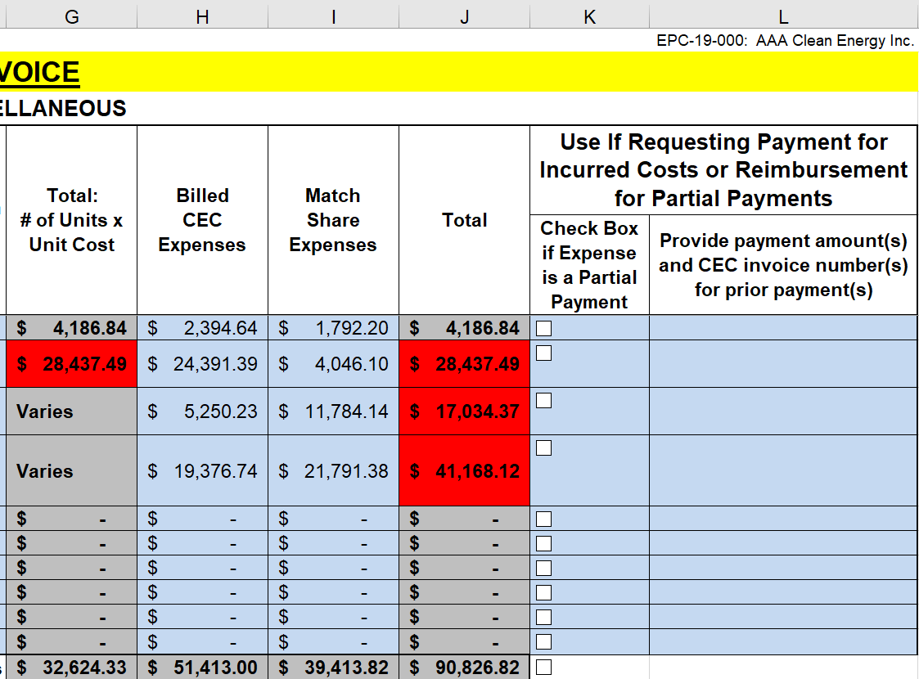
Materials & Miscellaneous (Training & Standard Pt. 2)
2
3
4
5
The Materials & Miscellaneous invoice sheet is filled out similarly to the Equipment invoice sheet. Materials & Miscellaneous invoice sheet has the same columns as the Equipment invoice sheet:
Legal Name of Entity Providing the Item
Description
Purpose
Number of Units Billed/Match
Unit Cost Billed/Match This Period
Billed CEC Expenses
Match Share Expenses
Partial Payment Check Box
Prior Payments
1
6
7
8
9
Notes:
[1 to 9] Other than the different backup documentation requirements, the Materials & Miscellaneous page is filled out exactly like the Equipment page.
New materials of 5,000 dollars or more can be added with the Add Equipment/Materials and Miscellaneous From.
Any materials under 5,000 dollars does not require the Form to be filled out.

Slide 30
Subrecipients & Vendors (Training & Standard)
Summary of changes:
Subcontractors have been divided into Subrecipients and Vendors.
Each Subrecipient and Vendor line item contains a row for CEC information and a row for Match information.
“Sub-Subrecipients” are Subrecipients of Major Subrecipients.
Vendors are people or entities that provide goods or services and do not have decision making responsibility on the project.
Work done by replacement subrecipients prior to CEC’s approval will NOT be reimbursed. Recipients must receive CEC approval of the Subrecipient change before the replacement Subrecipient can begin work.
When changing a Subrecipient from in-state to out-of-state, approval from the CEC required prior to invoicing.
When changing a Vendor from in-state to out-of-state, communicating with the CAM prior to invoicing is highly recommended.
Notes:
Now moving on to the Subrecipients and Vendors page that used to be known as the subcontractors page.
And this page is also required for both the Training and Standard invoice templates.
Vendors are entities that provide goods or services, but do not have any decision-making responsibilities in the project.
Recipients must seek approval from the CEC when changing out subrecipients. Work done by replacement subrecipient’s prior to CEC approval is not reimbursable.
When changing a subrecipient from in-state to out of state, approval from the CEC is required prior to invoicing for that subrecipient.
However, changing vendors from in-state to out-of-state does not require CEC approval prior to invoicing, but it is highly recommended to communicate the change with your CAM beforehand.

Slide 31
Subrecipients & Vendors (Training & Standard Pt. 2)
Subrecipient Section:
Subrecipient Name
Subrecipient name that matches the entity in the budget under the same Reference ID.
If adding or changing a subrecipient, seek CEC approval prior to invoicing for the new subrecipient.
Subrecipient Agreement Budget
Budgeted amount for each subrecipient in the most recently approved budget.
Subrecipient Request This Period
The amount of CEC funds and Match funds invoiced for each subrecipient.
1
2
3
4
Subrecipient Cumulative Expenses Billed to Date
The amount of CEC funds and Match funds spent to date, including this invoice.
Notes:
[1] Now shifting our focus on the subrecipient section, column B is where you input the subrecipient’s legal name.’
New additions of subrecipients also require CEC approval before they can begin work.
[2] In column D, you will have to input the CEC and Match budget amounts from the most recently approved CEC budget.
[3] In column E, you will input the amount of CEC funds requested and the amount of match share for each subrecipient.
[4] And in column F, you will keep track of the total amount of CEC funds and Match funds that have been billed to date.
This will include the amounts being billed with the current invoice.

Slide 32
Subrecipients & Vendors (Training & Standard Pt. 3)
Subrecipients Section:
Subrecipient Retention Exemption
Certain Subrecipients are exempt from retention and are to be taken out of the retention calculation.
If a Subrecipient is exempt, select “Yes” and the Billed CEC Expenses for that Subrecipient will be automatically taken out for this invoice.
If retention is being withheld at the end of the agreement, remember to begin retention at 90% of CEC funds that exclude the exempt Subrecipients.
1
Notes:
[1] As mentioned earlier, there are some subrecipients that are exempt from retention.
This feature helps remove the exempt Subrecipient’s expenses from each invoice.
However, if retention is being withheld at the end of the agreement, Recipients and CAMs will have to manually keep track of when to start withholding retention.
Using the previous example with the 1 million dollar agreement, and 200,000 dollars going to an exempt subrecipient…
If the Recipient’s overall CEC expenses billed to date is 900,000 dollars, but 150,000 dollars is from an exempt Subrecipient, then the Recipient can bill up to 50,000 dollars more before retention starts to kick in.
I know this may be pretty confusing, but feel free to ask questions about this after this presentation.

Slide 33
Subrecipients & Vendors (Training & Standard Pt. 4)
Vendors Section:
Vendor Name
Vendor name that matches the entity in the budget under the same Reference ID.
If adding or changing a vendor, it is recommended to notify your CAM.
Vendor Agreement Budget
Budgeted amount for each vendor in the most recently approved budget.
Vendor Request This Period
The amount of CEC funds and Match funds invoiced for each vendor.
1
2
3
4
Vendor Cumulative Expenses Billed to Date
The amount of CEC funds and Match funds spent to date, including this invoice.
Notes:
[1] Moving on to the Vendors section, we ask for the vendor’s legal name in column B.
And it is recommended that you notify your CAM prior to invoicing, if you are adding or changing a vendor.
[2 to 4] Columns D, E, and F function the same way as for Subrecipients.
But all vendors are subject to retention and are not to be taken out of the retention calculation.

Slide 34
Indirect & Profit (Training)
Notes:
Next, we will go over the Indirect and Profit page.
This page is only required for the Training Invoice, but can be used to calculate the category totals for the Standard Invoice Template.
Just don’t submit this sheet with the Standard Invoice Template.

Slide 35
Indirect & Profit (Training Pt. 2)
Name of Indirect Cost
Only for the Indirect Cost section, input the type of indirect cost referred in the most recently approved budget.
IDC/Profit Base CEC Share Billed This Period
For both indirect costs and for profit, input CEC billed category totals from this invoice that are included in the most recently approved budget’s base calculation.
The Indirect Cost line is for when other indirect costs are part of the base calculation.
IDC/Profit Base Match Share Expenses This Period
For both indirect costs and for profit, input Match invoiced category totals from this invoice that are included in the most recently approved budget’s base calculation.
The Indirect Cost line is for when other indirect costs are part of the base calculation.
1
2
3
Notes:
[1] In column A, for the Indirect Cost section, you will need to identify the type of indirect cost that is being billed.
I recommend using the same names from the most recently approved budget to avoid confusion.
[2] Then in column C, you will input the CEC category billed amounts that are to be included in the base calculation for the indirect cost or profit.
[3] And in column D, you will do the same for Match claimed this billing period.

Slide 36
Indirect & Profit (Training Pt. 3)
IDC Actual/Profit Rate Billed/Match This Period
Input the actual indirect cost rate being used and not the budget rate (This actual rate may be the best estimated rate at the time. You may “true up” your indirect costs at the time you close your records).
For all non-federal indirect rates, rates can not exceed the budgeted rate.
Federal indirect rates are allowed to change with the annual change of federal rates (see Section 5.B.2 of the Streamlining Grant Terms and Conditions). If increasing an indirect rate due to federal rate increase, request CEC budget update approval prior to invoicing.
Billed CEC Expenses (IDC/Profit)
Input the amount of IDC/Profit being billed to the CEC.
CEC Expense amount can NOT exceed the CEC Base X Rate amount (both IDC and Profit). The cell will turn red if so and will not be approved for payment.
Match Share Expenses (IDC/Profit)
Input the amount of IDC/Profit being invoiced as match share.
1
2
3
Notes:
[1] Column H is where you will put the actual Indirect Cost rates, or the Profit rate.
However, profit is capped at 10% and is only allowed for Subrecipients.
These rates can be your best estimated rate for the billing period, but should be trued up towards the end of the agreement.
You should also be aware that non-federal actual indirect rates can not exceed the rate in the most recently approved budget.
However, federal indirect rates are allowed to increase or decrease with the federal rate changes that occur annually.
If the federal rate is increased, seek CEC approval to change the indirect cost rate before invoicing with the new rate.
[2 & 3] Now in columns J and K, you will input the amount of expenses that will be billed to the CEC and the amount that is contributed as match.
The amount being billed to the CEC can not exceed the rate multiplied by the CEC base amount.
If it does, the cell will turn red and the invoice will not be approved.

Slide 37
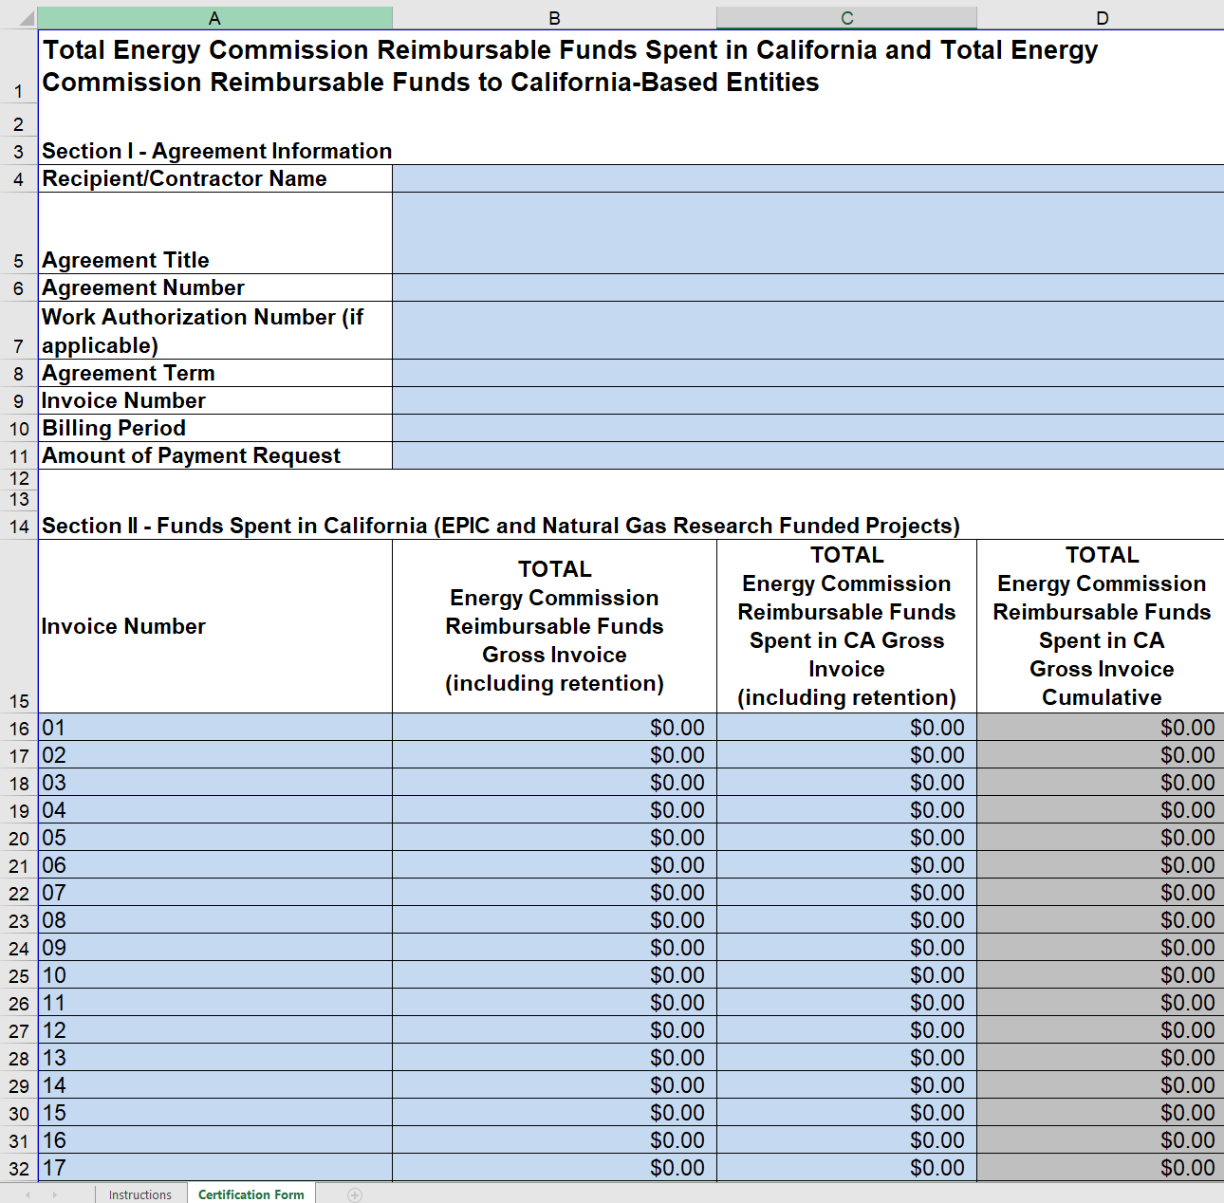
CBE & Funds Spent in CA
This form is required for the Research and Development agreements only.
The California Based Entities (CBE) and Funds Spent in California form can be found here: https://www.energy.ca.gov/media/4474
The CBE and Funds Spent in CA form must be submitted with every invoice (Training & Standard) to verify the amount of CEC funds going to each category.
Section II is for both EPIC and Natural Gas agreements.
Section III is for Natural Gas agreements only.
Notes:
Now I will go over a few forms that may be included with your invoice.
I will start with the California Based Entity and Funds Spent in California form.
It is important to note that this form is only required for the Research and Development Division’s EPIC and Natural Gas agreements and must be submitted with every invoice.

Slide 38
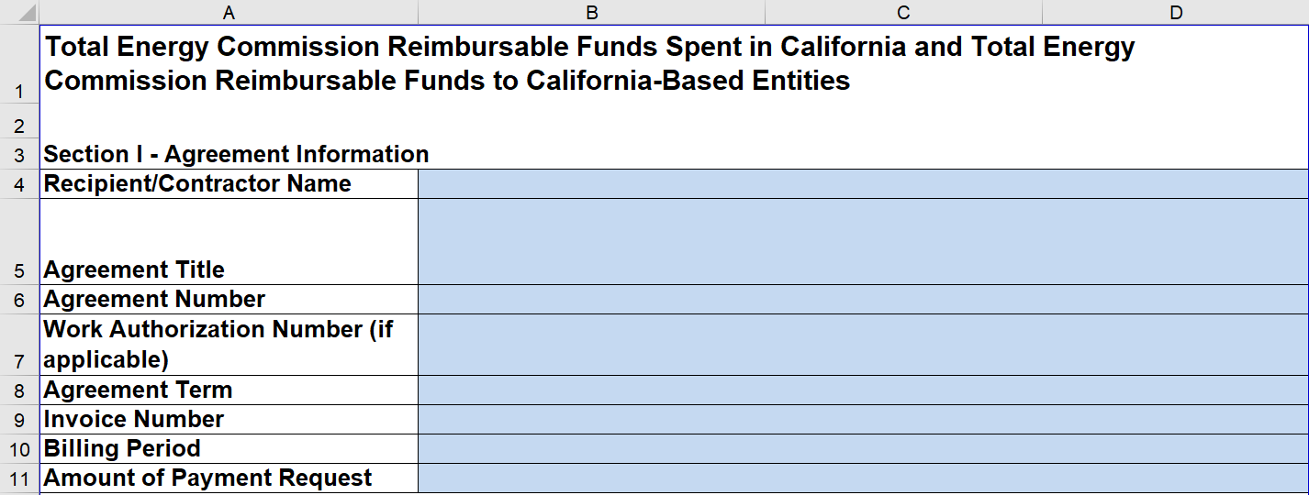
CBE & Funds Spent in CA (Pt. 2)
Section I – Agreement Information
Recipient/Contractor Name
Agreement Title
Agreement Number
Work Authorization Number (If Applicable)
Agreement Term
Current Invoice Information
Invoice Number
Billing Period
Amount of Payment Request
1
2
3
4
5
6
7
8
Notes:
In section 1, you will need to fill out information pertaining to the agreement.
[1 to 5] Items 1 through 5 in this section should be the same on every invoice.
[6 to 8] Items 6 through 8 will require updating for each invoice.

Slide 39
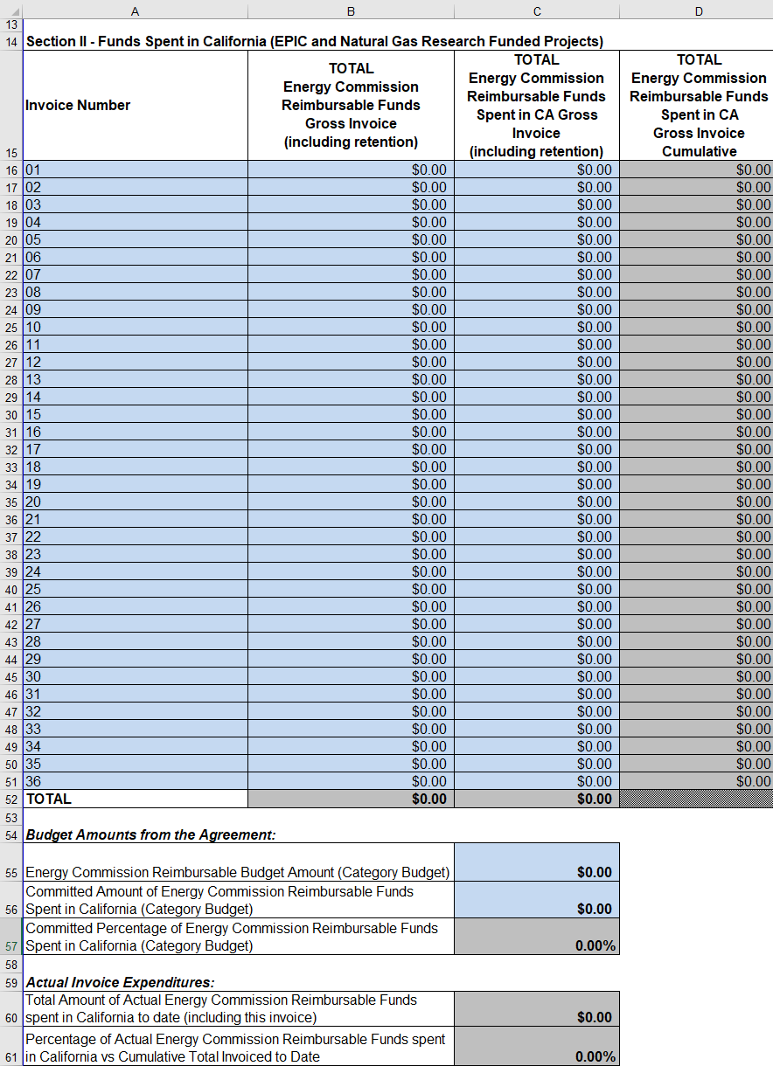
CBE & Funds Spent in CA (Pt. 3)
Section II – Funds Spent in California
Invoice Number
Change the Invoice Number to match the number on the submitted invoice.
Ask your CAM if you need more rows.
Total CEC Reimbursable Funds
Input the total CEC reimbursable amount before retention taken out.
Total CEC Reimbursable Funds Spent in California
Input the total CEC reimbursable amount that was spent in California before retention was taken out.
Energy Commission Reimbursable Budget Amount
Pull the CEC budget amount from the most recently approved budget.
Committed Energy Commission Funds to be Spent in California
Pull the amount of CEC funds committed to be spent in California from the most recently approved budget.
2
1
3
4
5
Notes:
In Section 2, Funds Spent in California is required by both EPIC and Natural Gas agreements.
[1] You will need to update Column A to reflect the invoice number used on the invoice coversheet.
[2] Column B is where you input the total amount of funds being billed to the CEC for this invoice before retention is taken out.
[3] And Column C is where you input the portion of CEC funds actually being spent in California in this invoice.
[4] Item 4 in this section is the overall CEC budget amount for this agreement.
[5] And Item 5 is the amount of CEC funds committed to being spent in California.

Slide 40
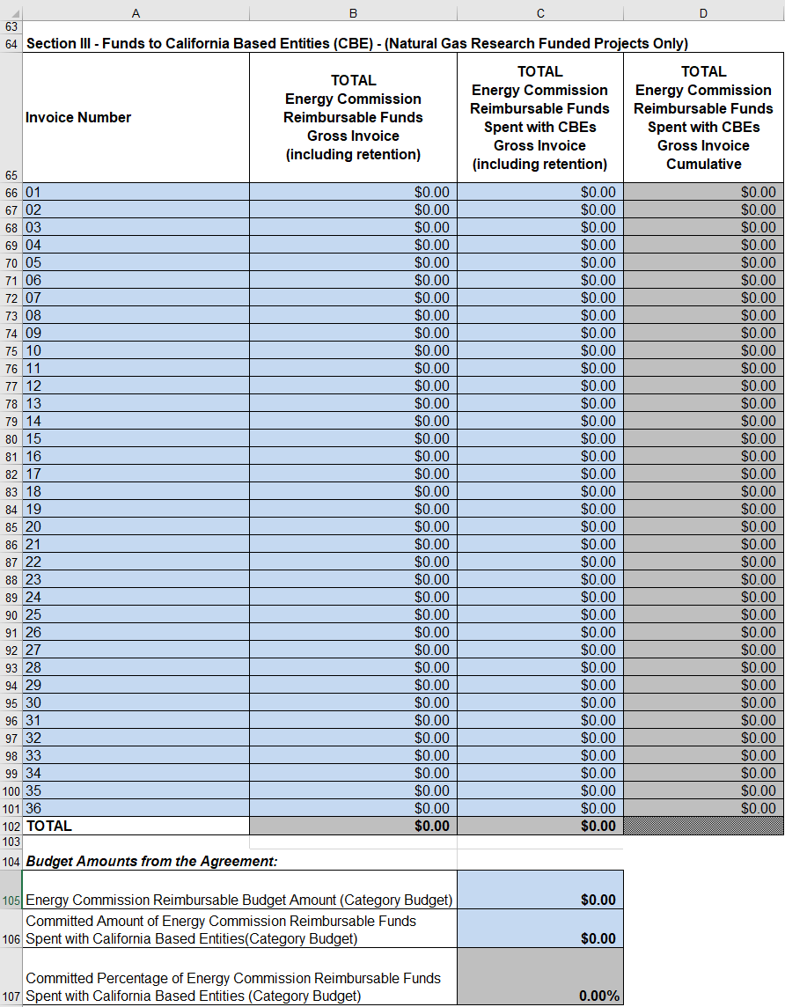
CBE & Funds Spent in CA (Pt. 4)
Section III – Funds to California Based Entities
Invoice Number
Change the Invoice Number to match the number on the submitted invoice.
Ask your CAM if you need more rows.
Total CEC Reimbursable Funds
Input the total CEC reimbursable amount before retention taken out.
Total CEC Reimbursable Funds Spent with CBEs
Input the total CEC reimbursable amount that was spent with CBEs before retention was taken out.
Energy Commission Reimbursable Budget Amount
Pull the CEC budget amount from the most recently approved budget.
Committed Energy Commission Funds to be Spent with CBEs
Pull the amount of CEC funds committed to be spent with CBEs from the most recently approved budget.
2
1
3
4
5
Notes:
[1 to 5] Section 3 is only required for the Research and Development Division’s Natural Gas agreements and is filled out the exact same way as Section 2 but for California Based Entities.

Slide 41
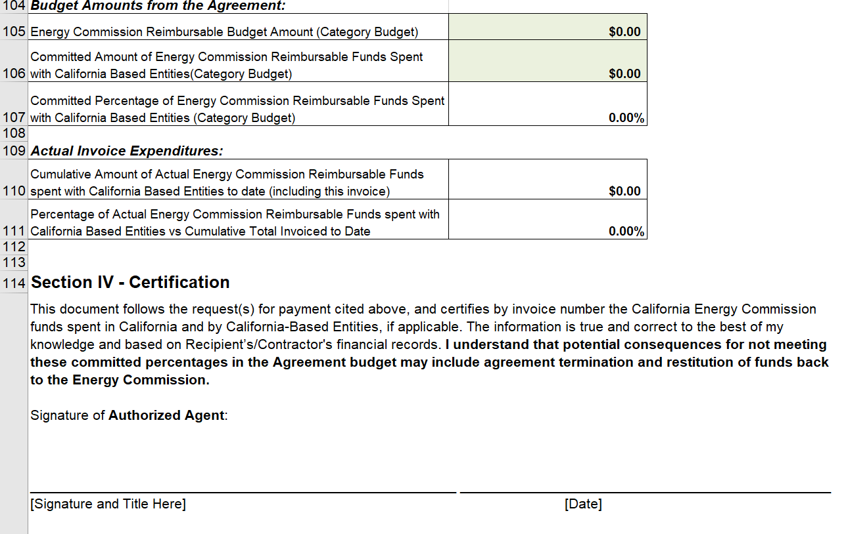
CBE & Funds Spent in CA (Pt. 5)
Section IV – Certification
Please review the Certification Statement before signing.
The Authorized Agent must sign Section IV to validate the claims.
Notes:
In section 4, an authorized representative will need to review the certification statement before signing.
This document can be signed digitally or as a scanned copy, but must be signed to validate the claims in sections 2 and 3.

Slide 42
Travel Form
Submit an individual Travel Form for every pre-approved and non pre-approved trip with the following invoice. It is recommended to communicate with your CAM before a non pre-approved trip is taken.
Section 1 – Travel Logistics
Agreement Number
Recipient’s Name
Travel Start Date
Travel End Date
Itinerary
Input starting location and all destinations in the trip.
Travel Type
Select all travel types that apply to California.
1
2
6
3
4
5
Notes:
Now we move on to the Travel Form.
This form must be submitted for every trip taken in the project, even for trips that have been pre-approved in the budget.
And it is recommended to communicate upcoming non pre-approved trips with the CAM to ensure that the CEC can reimburse expenses.
In section 1, you will need to fill out the logistics of the trip and the agreement it is associated with.
If a trip is being taken for two different agreements, either split the expenses to each agreement or claim all expenses for one agreement.
You are not allowed to double claim your travel expenses.

Slide 43
Travel Form (Pt. 2)
1
Section 2 – Travel Purpose and Details
Traveler Information
Name all travelers and their job classification.
Include the purpose for each traveler for the trip.
Reference ID
Input the Reference ID from the budget this trip is for or put “N/A” if this trip is not on the budget in section Q2A.
If a Reference ID is used, skip Q3 and move on to Section 3. As long as the trip is approved in the budget, Section 4 does not need to be completed.
Q2B does not need a response.
2
3
Travel Justification
If there isn’t a Reference ID for the trip, then include travel justification is required.
Include purpose of the trip and how it is related to the tasks in the scope of work and why this trip is needed.
Notes:
Section 2 requires a bit more explanation.
[1] To answer the first question, input all employees participating in the trip and the reason they attended the trip.
[2] For the second question, if you have a Budget Worksheet Reference ID number for this trip input it here and move on to section 3 of this form.
However, if this trip is not on the budget, then put N/A for the answer and go to question 3.
[3] In your response to question 3, briefly describe how the trip helps the project and will advance the agreement.

Slide 44
Travel Form (Pt. 3)
2
1
Section 3 – Itemized Travel Expenses and Totals
Number of Travelers
Expense Description and Details
For Transportation, describe the mode of transportation (i.e. airfare, rental car, bus/train).
For lodging, reasonable travel expenses, even if above the budget estimates, is approvable by the CAM. Include the number of nights.
Check Section 5.C.7 of the Streamlining Grant Terms and Conditions for eligible items for CEC reimbursement for per diem.
Cost Totals
For Transportation, Lodging and Per Diem, include costs that will be covered by match.
For Total CEC Reimbursable Share, input how much of the Total Cost the CEC will be charged.
For Total Match Share, input how much of the Total Cost will be match contribution.
The Total of CEC Reimbursable Share plus Total Match Share should equal the Total Cost.
3
Notes:
Section 3 is where you will give details about the trip expenses.
[1] For item 1, on the top right, enter the number of travelers on this trip.
[2] For item 2, include details of the expenses being invoiced for transportation, lodging and per diem.
When planning lodging, keep in mind that the CEC will only reimburse for standard room rates and will not reimburse past them.
And when detailing lodging, include the number of nights.
For per diem, check which items are eligible for reimbursement in section 5.C.7 of the Streamlining Grant Terms and Conditions.
[3] When tallying the expenses for transportation, lodging and per diem, include match share expenses in the subtotal.
[3] Then in the lower part of this section, divide the amount of expenses being billed to the CEC and the amount of expenses being covered by match.

Slide 45
Travel Form (Pt. 4)
Section 4 – CEC Approvals
Approvals are only needed for travel that is not already approved on the budget.
Check the Changes Approval Chart for level of approval that will be required.
If you want to a copy of the approved Travel Form for your records, request the signed version from your CAM.
Notes:
Now section 4 is not required for trips that have a reference ID and are approved on the budget.
However, check the Changes Approval Chart to see the level of approval required for non pre-approved trips.
And if you would like a copy of the approved Travel Form after the CEC has reviewed it, please request it from your CAM.

Slide 46
Form to Add Equipment/Materials and Miscellaneous
Submit this form when adding equipment and/or materials to the budget with the next invoice.
For materials, use this form only for line items of $5,000 or more in value.
Section 1 – General Information and Purpose
Agreement Number
Recipient’s Name
Date of Request
Purpose
Write a brief justification on how the equipment/material will contribute to the project.
2
1
3
4
Notes:
The last form I will go over is the Form to Add Equipment and Materials.
This form is only required when new equipment is being added to the budget or when new material line items over 5,000 dollars or more are being added to the budget.
Material line items less the 5,000 dollars do not require this form, but should be communicated to the CAM.
[1 to 4] Section 1 of this form asks you to give a brief explanation on how these items will help the project and where it fits in the scope of work.

Slide 47
Form to Add Equipment/Materials and Miscellaneous (Pt. 2)
2
3
4
Section 2 – Itemized New Equipment/Materials & Miscellaneous
Task Number
The number associated with the task(s)/subtask(s) from the Scope of Work the equipment/material is associated with.
Name of Entity
The entity that the invoiced equipment is either purchased from or provided by.
Description
Describe the invoiced equipment or pieces of equipment being invoiced.
Purpose
Explain what purpose the equipment or pieces of equipment serves in the project.
1
2
3
4
Notes:
Section 2 is where you will itemize the equipment and/or materials being added to the budget.
[1 to 4] You will need to include the scope of work task number the items are associated with, the entity providing the items, the description of the items, and the purpose these items serve in the project.

Slide 48
Form to Add Equipment/Materials and Miscellaneous (Pt. 3)
1
2
Section 2 – Itemized New Equipment/Materials & Miscellaneous Pt. 2
Unit Number
Number of units being added for each specific equipment/material.
Unit Cost
The cost of a single unit of the described equipment/material.
Total Costs
Total Cost: Overall costs of the added equipment/materials.
Total CEC Reimbursable Share: The portion of Total Cost the CEC will fund.
Total Match Share: The portion of Total Cost covered by match share.
Total of CEC Reimbursable Share plus Total Match Share: Should equal Total Cost.
3
2
1
3
Notes:
[1 & 2] You will also need to provide the number of units being added to the budget and the unit costs.
[3] After adding the costs for each section, you will need to determine how much of the costs are going to be billed to the CEC and how much will be covered by match funds… for both the equipment and materials sections.

Slide 49
Form to Add Equipment/Materials and Miscellaneous (Pt. 4)
Section 3 – CEC Approvals
This section is for CEC staff only.
See Changes Approval Chart for budget reallocation approval requirements.
If you want to a copy of the approved Form to Add Equipment/Materials and Miscellaneous for your records, request the signed version from your CAM.
3
Notes:
And section 4 is for CEC staff only.
But I would suggest reviewing the Changes Approval Chart to see if there are any reallocation approvals required.
And like the Travel Form, if you want a copy of the approved form, please ask your CAM for a copy.

Slide 50
Submitting and Reviewing Invoices Electronically (Recipient)
Verify that the remittance address is accurate.
Sign and date the cover page of the completed invoice.
Scan the signed invoice and all supporting documentation into a PDF document.
Name the PDF document using the following naming convention: Agreement Number.invoice Number (Example: ARV-19-001.invoice 3).
Attach the named PDF document to a new email.
In the email subject line, use the following naming convention: Agreement Number invoice Number (Example: ARV-19-001 invoice 3).
Email scanned PDF invoice packet to: invoices@energy.ca.gov
*Please see “Procedures for Submitting and Reviewing Grant Invoices Electronically”
Notes:
As the Recipient, once you have filled out the invoice template and have gathered all of the required supporting documents, you will first need to verify that the remittance address is accurate. We want to make sure the funds will be sent to the right address.
Then be sure to sign and date the cover page of the completed invoice. As of today, acceptable signatures include:
A scanned electronic copy of the completed and signed hard copy invoice with an original wet signature.
An electronic copy of the completed invoice with a certified electronic signature (created using a software such as Adobe Acrobat or DocuSign that locks the file after signing).
The SCO will not accept electronic signatures that are font signatures (i.e. signatures created with font text).
After signing, scan the completed invoice template and all supporting documents into a PDF document.
You will need to name the PDF starting with the Agreement Number dot”invoice” and the Invoice Number, as shown in the example on item 4 [4].
Then send the PDF document to invoices@energy.ca.gov with a subject line similar to the PDF document as shown in the second example on item 6 [6].

Slide 51
Submitting and Reviewing Invoices Electronically (Recipient)
If the file is too large to email and must be sent in batches, split the file into multiple files and number each file within the file name. Example below for the first of three files, split from one file.
Example: ARV-19-001.invoice 3, 1 of 3
For invoices that must be sent via multiple emails, use the following subject line naming convention:
Agreement Number invoice Number, Email Number of Total Number of Emails
Example: ARV-19-001 invoice 3, 1 of 3
Notes:
However, if your invoice is too large to be sent in one email, then you will need to split the file into multiple files and add the ending naming convention as shown in the example.
The emails that you will send will also require the same additional naming convention to identify the invoice document order, convention as shown in the example.

Slide 52
Submitting and Reviewing Invoices Electronically (CAM)
Updating Remittance Address
If a remittance address needs to be updated, please send a request to gordon.kashiwagi@energy.ca.gov.
If the mailing address is the same as the remittance address, only State Form STD 204 is required. If Recipient’s remittance address is different than the mailing address on the STD 204, please submit a STD 205.
STD 204 Payee Data Record: Payee Data Record Form
STD 205 Payee Data Record Supplement: Payee Data Record Supplement Form
Notes:
For CAMs, if the remittance address needs to be updated, you will need to submit a request to Gordon Kashiwagi in CGL.
If the remittance address is the same as the mailing address, then only a Standard (STD) 204 form will be required.
But if the remittance address is different from the mailing address, then the Standard (STD) 205 form will also be required.
It is suggested that the recipients fill out the form(s) and submit them to the CAM for review, before the CAM sends them to Gordon.

Slide 53
Submitting and Reviewing Invoices Electronically (CAM)
CAM Invoice Review
CAM reviews invoice PDF file using the Training or Standard Invoice Review Checklist (MS Forms version).
Adjusting Invoice Amount: The CAM can adjust the overall invoice total down (-, negative) any amount dependent upon supporting documentation. However, any positive (+) adjustments will require the invoice to be cancelled and resubmitted, per the State Controller's Office (SCO) requirements.
Notes:
After reviewing an invoice, CAMs are required to fill out the MS Forms Training or Standard Invoice Review Checklist, that can be found on the ECAMS Resources page.
If CAMs need to make an adjustment to the invoice, any negative adjustments of the overall total can be done by editing the submitted invoice.
However, any adjustments that increase the overall CEC billed amount will require the invoice to be cancelled and resubmitted, per the State Controller's Office (SCO) requirements.

Slide 54
Submitting and Reviewing Invoices Electronically (CAM)
Editing Electronically Signed Invoices: The process of electronically signing a PDF locks the file from further editing. Therefore, in order to make edits to an invoice that is electronically signed, first print the invoice to PDF, then make edits using the “Comment” tool as described below, and finally initial the revisions using the “Fill & Sign” feature. The file will be re-locked once CGL signs the invoice with a certified electronic signature.
Notes:
If the CAM does need to make an adjustment, the CAM will need to print the invoice to PDF, to make another copy before making edits.
When making adjustments, CAMs will need to strikethrough the incorrect information, and next to it put the correct information in red.
After making the edits, CAMs will need to use the “Fill & Sign” feature to put their initials next to each adjustment.

Slide 55
Submitting and Reviewing Invoices Electronically (CAM)
CAM Invoice Approval Process
CAM approves invoice in PIMS and forwards the invoice to: cglinvoices@energy.ca.gov (signing the invoice cover page is no longer needed. Email approval and approval in PIMS only).
Please use the following example language when forwarding the email approval to CGL: (add “Reverting Fund Invoice” to the subject line ONLY if applicable): ARV-19-001 invoice 3 has been approved (Reverting Fund Invoice)
If any changes are made to the invoice during the review process, the CAM must send a copy of the modified and fully-approved invoice to the Recipient for their records.
Notes:
1. CAMs will approve the invoice by approving the invoice in PIMs and by forwarding the approved invoice via email to CGLinvoices@energy.ca.gov.
2. CAMs do not need to sign the coversheet, but will need to add language to the subject line as shown in the example.
3. If adjustments were made, the CAM will need to send the adjusted invoice to the Recipient after it has been fully-approved for their records.

Slide 56
ECAM Resources
ECAMS Resources
https://www.energy.ca.gov/funding-opportunities/funding-resources/ecams-resources
Training Invoice Template
https://www.energy.ca.gov/media/4511
Standard Invoice Template
https://www.energy.ca.gov/media/4510
Invoice Review Checklist
Training: https://www.energy.ca.gov/media/4491
Standard: https://www.energy.ca.gov/media/4492
CBE and Funds Spent in California Template
https://www.energy.ca.gov/media/4474
Travel Form
https://www.energy.ca.gov/media/4472
Form to Add Equipment/Materials and Miscellaneous
https://www.energy.ca.gov/media/4471
Budget Category Guidance
https://www.energy.ca.gov/funding-opportunities/funding-resources/ecams-resources/budget-category-guidance?auHash=cEItgat6JNbO9BFGeVqe4E5T6koCOgTaqliFX6bmwtg
ECAMS Support Contact: ECAMS.support@energy.ca.gov
Notes:
Here is a list of links to the invoice templates and some of the ECAMS materials mentioned during this presentation.
If you have some administrative questions about the ECAMS process, or need some assistance, you can contact our ECAMs support at ECAMS.support@energy.ca.gov.

Slide 57
Questions
Zoom
Enter questions into the Q&A window; or
Use the Raise Hand function, and you will be called on to unmute yourself.
Calling-in
Press *9 to raise your hand.
Press *6 to unmute yourself when called on.
Please submit written questions to the ECAMS support email.
ECAMS.Support@energy.ca.gov
Notes:
We will now take questions.
For those of you who would like to speak your question, please use the raise hand function and we will unmute you.
If on a phone, you can raise your hand by pressing *9, and unmute by pressing *6 when called upon to ask your question.
And if you prefer to ask your question through text, please use the Q&A pop-up window and ask away.
To kick off the Q&A session I will ask the first question that I am sure some of you may be thinking about.
[Q1] The question is: "Can a recipient use the ECAMS process for expenses incurred prior to their signing the ECAMS Terms & Conditions?"
The answer to my question is that after the recipient has signed the ECAMS Terms and Conditions, they can invoice for expenses incurred using the ECAMS policies, processes and procedures, even if the expenses were incurred before the recipient signed the ECAMS Terms and Conditions.

Slide 58
Thank You!

