Slide 1
Climate Data and Analysis Working Group: Purpose, Ongoing Research, Future Topics
Energy-Related Environmental Research
Energy Research & Development Division
April 28, 2022

Slide 2
Housekeeping
Meetings are not recorded
Welcome candid exchange
Please “raise hand” to speak
Please mute when not speaking

Slide 3
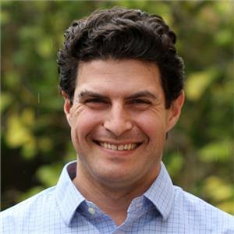
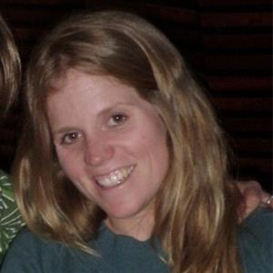
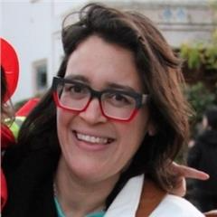
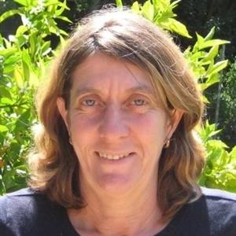
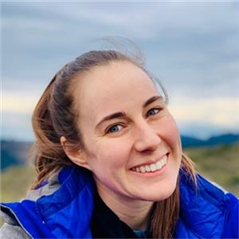
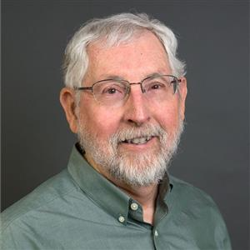
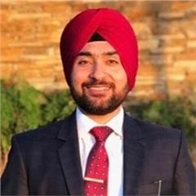
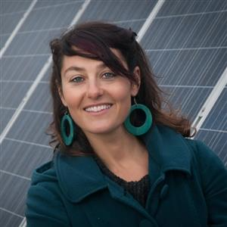
Welcome
Mike Mastrandrea, Chief Advisor for Energy & Climate Research
Susan Wilhelm, Technical Lead, Energy-Related Environmental Research
Alex Horangic, Supervisor, Energy-Related Environmental Research
Martine Schmidt-Poolman, Research Manager
Mithra Moezzi,
Research Manager
Alex Kovalick,
Research Manager
David Stoms,
Research Manager
Joe O’Hagan,
Research Manager
Maninder Thind,
Research Manager
Julia Harnad,
Research Manager
Notes:
Brief intro of team, pointing out people with roles germane to C-DAWG

Slide 4
Purpose
Bridge gaps between climate researchers, energy stakeholders who need to use climate-related data, and CEC staff.
Promote knowledge exchange.
Elicit input on key decisions (e.g., related to analytical methodologies or scenario choices).
Promote deep coordination within our portfolio.
Notes:
Why are we here?

Slide 5
Vision
Recipients of CEC grants: increase impact of your work.
Research community: help inform future CEC research efforts.
Users of all stripes: articulate needs and opportunities for impact.
Everybody: collaborate toward delivery of relevant products.
Notes:
Entice people to participate…

Slide 6
CEC’s Climate Research Supports Energy Sector Adaptation
CEC-funded climate scenarios & data: foundational to California’s Climate Change Assessments
CPUC’s Decision 19-10-054* on Phase 1 of Adaptation Rulemaking, issued Nov. 2019:
Anchors acceptable data to California’s Climate Change Assessments
Directs IOUs to Cal-Adapt as a source of data and tools
Establishes criteria for acceptability of additional data or models.
IOUs have used data on Cal-Adapt (https://cal-adapt.org/ ) for vulnerability assessments & to support adaptation efforts.**
Publicly available data on Cal-Adapt: used by stakeholders beyond energy sector, recognized by legislation and guidance, used by government agencies.**
* http://docs.cpuc.ca.gov/PublishedDocs/Published/G000/M319/K075/319075453.PDF
** Thomas, N., Mukhtyar, S., Galey, B., Kelly, M. (2018). (UC Berkeley). Cal-Adapt: Linking Climate Science with Energy Sector Resilience and Practitioner Need. California’s Fourth Climate Change Assessment, CEC. Publication Number: CCCA4-CEC-2018-015.
Notes:
Role of CEC-funded climate/energy research

Slide 7
Ongoing CEC-funded Research to Support Energy Resilience in a Changing Climate
Past and projected climate
Develop high-resolution (3 km × 3 km) climate projections and hydrologic scenarios
Reconstruct historical climate at high resolution (hourly, 2 km × 2 km)
Characterize climate trends of interest, compound events
Quality-controlled, near-real time historical station data
Wildfire https://pyregence.org/
Future climate fire risk scenarios
Open and free, real-time fire risk and spread modeling
Wildfire science advancements: extreme weather, fuel mapping, fire behavior
Weather station optimization
Computational resources and analytics http://analytics.cal-adapt.org/
Vigorous stakeholder engagement
Identify “stress test” weather events; analyze climate extremes
Help transform large data into inputs & insights
Notes:
A number of efforts underway to provide climate scenarios and data, and support their effective use

Slide 8
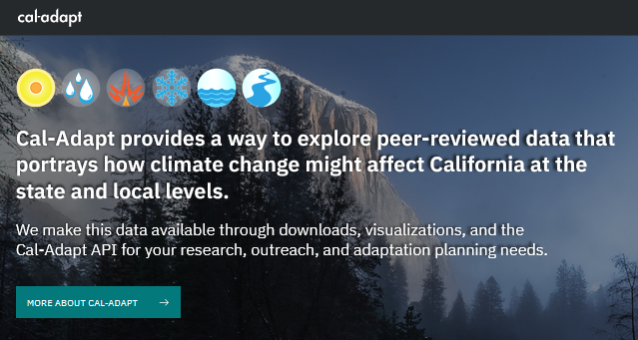
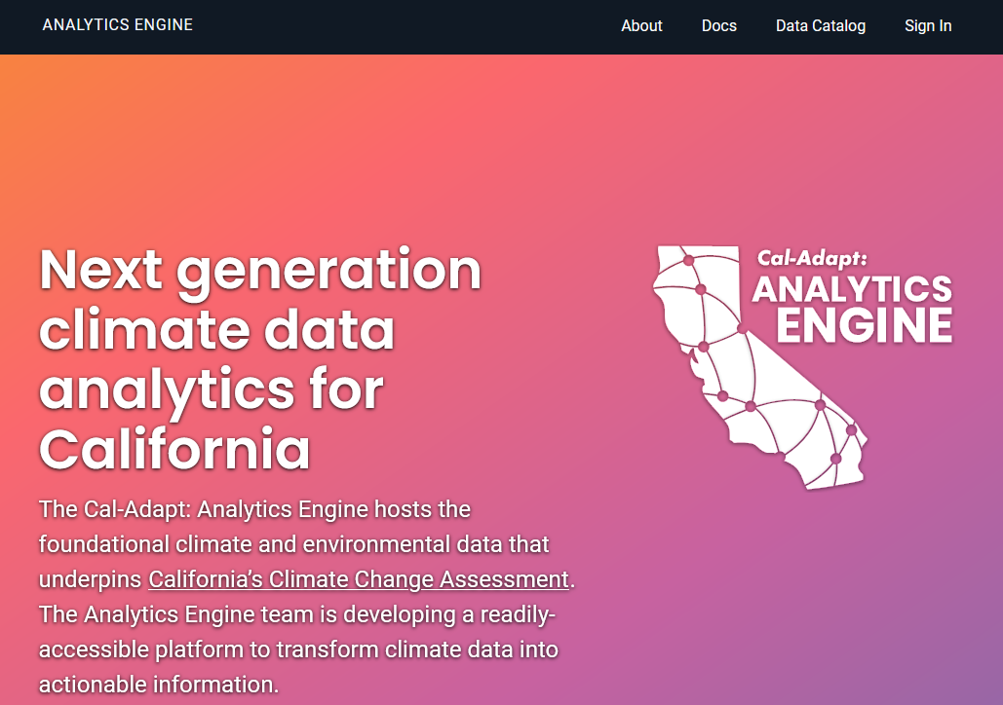
An Expanded Cal-Adapt Enterprise
Analytics engine
~ 1 Pb data
Serve energy resilience needs.
CEC-funded
Local governments and less technical users rely on an easy-to-use, interactive web application
Visualizations + web application
Interactive, easy-to-use
Designed for ~ 10 Tb data
TN239123 (p. 3), docketed August 2, 2021: describes expanded Cal-Adapt enterprise.
TN239954, docketed October 12, 2021: Cal-Adapt governance, responsibilities, data management.
Notes:
Expanded Cal-Adapt enterprise is part of our effort to move beyond providing data, and to provide support in effective application of that data

Slide 9
Planned CEC-funded Research to Support Electricity Sector Resilience
Forthcoming efforts under recent EPIC solicitation (GFO-21-302)
Parameterize emerging relationships between climate, supply, & demand
Support enhanced demand forecasting, integrated resource planning
Develop hourly solar & wind generation profiles
Explore climate-related changes to hydroelectric generation resources
Align Cal-Adapt’s easy-to-use interface with next-generation projections
Additional CEC research at the climate/energy interface anticipated:
Valuation of Resilience (interim EPIC plan)
Solicitation anticipated Q2 or Q3 2022
See November 2021 workshop
EPIC 4 investment plan (proposed plan)
Initiative 43: Evaluating Air Quality, Health, and Equity in Clean Energy Solutions
Initiative 44: Integrating Climate Resilience in Electricity System Planning
Initiative 45: Advancing the Environmental Sustainability of Energy Deployments
Notes:
Where we’re headed with our work, what sorts of efforts you can engage in through C-DAWG

Slide 10
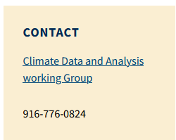
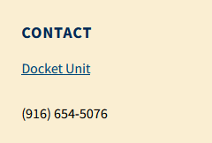
Opportunities to Engage
Anticipate approximately quarterly meetings of C-DAWG
Let us know if you have topics of interest! (Mike will open discussion later)
Email (cdawg@energy.ca.gov) or call us!
Stakeholder engagement and working groups of ongoing grants
Solicitation scoping workshops (prior to solicitation release)
Submit* to docket (docket@energy.ca.gov)
* Please include “19-ERDD-01” and a brief description in subject line
Notes:
Quarterly-ish meetings, opportunity to suggest discussion items; welcome hearing from you!

Slide 11
Possible Future Topics
Characterizing future climate at locations used in demand and energy system models
Climate scenario choices (SSPs, land use/land cover)
Use of a “warming level” framework
Observed data sources for elusive parameters of importance to a high-renewables electricity sector (e.g., hub height windspeed & direction, ground-level solar)
Climate issues pertinent to CEC’s Demand Analysis Working Group (DAWG)
Other ideas?
Please raise hand and unmute yourself to talk.
Phone controls: press *6 to mute/unmute, *9 to raise hand.
Notes:
Group brainstorm on discussion items; welcome hearing from you!

Slide 12
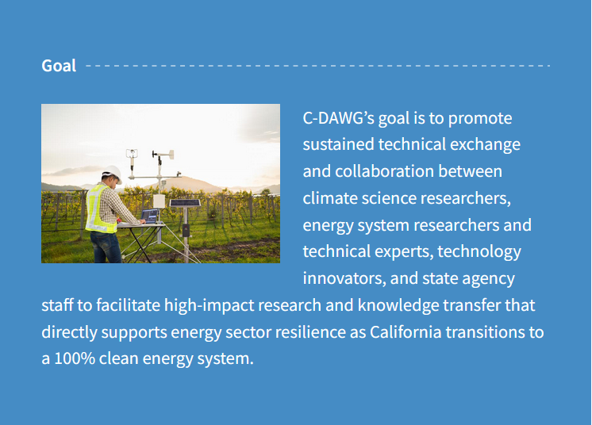
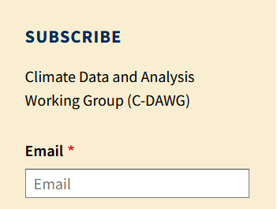
Thank you!
cdawg@energy.ca.gov
https://www.energy.ca.gov/programs-and-topics/topics/research-and-development/climate-data-and-analysis-working-group-c-dawg

