Slide 1
GFO-21-901 Pre-Application Workshop
Cost Share for Federal Clean Energy Funding Opportunities
Energy Research and Development Division, California Energy Commission
Presenter: Josh Croft, Energy Commission Specialist II
Date: 4/8/2022

Slide 2
Agenda
Time | Item
1:35 pm | Welcome and Introduction
1:40 pm | Solicitation Background EPIC Research Program Purpose of Solicitation Available Funding
1:50 pm | Application Requirements Project Group Requirements Attachments Submission Process Evaluation Process
2:00 pm | Q&As
2:30 pm | Adjourn

Slide 3
Housekeeping
This workshop will be recorded.
Participants will be muted during the presentation. Please chat your question in the Q&A window.
Updates on solicitation documents including this presentation will be posted at the Grant Funding Opportunity’s webpage: https://www.energy.ca.gov/solicitations/2022-03/gfo-21-901-cost-share-federal-clean-energy-funding-opportunities

Slide 4
Commitment to Diversity
The Energy Commission adopted a resolution strengthening its commitment to diversity in our funding programs. The Energy Commission continues to encourage disadvantaged and underrepresented businesses and communities to engage in and benefit from our many programs.
To meet this commitment, Energy Commission staff conducts outreach efforts and activities to:
Engage with disadvantaged and underrepresented groups throughout the state.
Notify potential new applicants about the Energy Commission’s funding opportunities.
Assist applicants in understanding how to apply for funding from the Energy Commission’s programs.
Survey participants to measure progress in diversity outreach efforts.

Slide 5
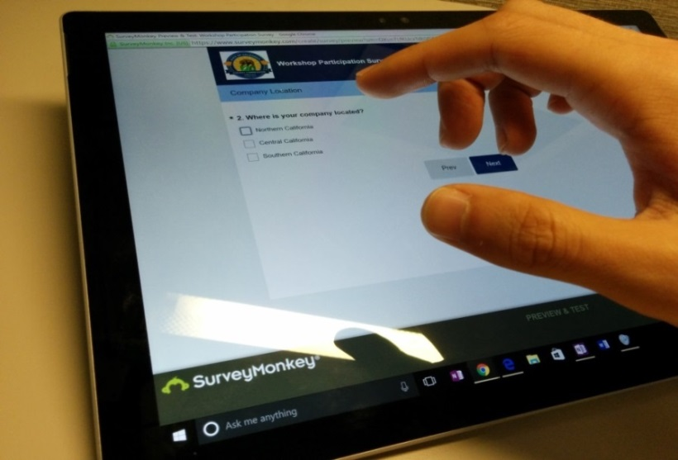
We Want to Hear From You!
Participation Survey
Survey responses will be summarized anonymously to track attendance of underrepresented groups in our workshops for public reporting purposes.
Online participants, please use this link:
https://forms.office.com/g/uwRz7AeFem
Thanks!

Slide 6
EPIC R&D Program Background
The Electric Program Investment Charge (EPIC) Program is funded by an electricity ratepayer surcharge established by the California Public Utilities Commission (CPUC) in December 2011.
The purpose of the EPIC program is to benefit the ratepayers of the three investor-owned utilities (IOUs)
The EPIC program funds clean energy technology projects that promote greater electricity reliability, lower costs, and increased safety:
  Applied research and development (ARD)
  Technology demonstration and deployment (TDD)
  Market facilitation (MF)

Slide 7
Purpose of Solicitation
The purpose of this solicitation is to provide cost share funding to applicants that apply for and receive one of the following:
An award under an eligible federal Funding Opportunity Announcement (FOA) and meet the requirements of this solicitation, or
Follow-on funding from the U.S. Department of Energy to continue research from a previously awarded federal grant that also received Energy Commission federal cost share funding under PON-14-308, GFO-18-902, or this GFO and the proposed project meets the requirements of this solicitation.

Slide 8
General Process to Receive Cost Share
Phase I – Application for Cost Share
Federal Funding Opportunity Announced
The Energy Commission Elects to Provide Cost Share for that FOA
Applications for CEC Cost Share are Evaluated and Awarded
Federal Award is Achieved and Proof of Award is Given to CEC
Slide 1 of 2 about General Process to Receive Cost Share

Slide 9
General Process to Receive Cost Share
(Optional Phase III and IV in the case of Federal follow-on funding)
Phase II – Post Federal Award Application and Agreement
CEC Confirms and Develops Agreement between Awardee and CEC
Awardee Carries Out Project
If There is a Federal Follow-On Award, CEC Will Evaluate Follow-On Cost Share
Slide 2 of 2 about General Process to Receive Cost Share

Slide 10
Available Funding
Check Section II.A of the solicitation manual and subscribe for list-serve updates
Funding Opportunity Announcement (FOA) Number and Title | CEC Application Due Date (Phase One – Pre Federal Award) | Minimum CEC Cost Share Award* | Maximum CEC Cost Share Award*
Example: DE-FOA-0001905: Energy-Water Desalination Hub | Example: March 15, 2019 at 11:59 pm | Example: $1 million | Example: $3 million
*Minimum and maximum award amounts are also based on other factors such as the amount of match funding the applicant proposes and the amount of CEC funds available.

Slide 11
Cost Share Requirements
The Energy Commission will provide no more than half the cost share of the project.
The Energy Commissioner award is contingent on confirmation of the Federal award.

Slide 12
Changes in Scope, Project Site, or Funding Amount
Changes to the proposal may result in the Energy Commission re-scoring the application
As part of the federal award confirmation process, the applicant will summarize changes via Attachment 9.

Slide 13
Eligible Applicants
This is an open solicitation for public and private entities except local publicly owned utilities.
Applicants must accept the EPIC terms and conditions.
  Standard, UC, and DOE T&Cs available online: https://www.energy.ca.gov/funding-opportunities/funding-resources
Applicants are encouraged to register with the California Secretary of State, as all recipients must be registered and in good standing to enter into an agreement with the Energy Commission: http://www.sos.ca.gov

Slide 14
Phase I Application Requirements
Each Applicant must complete and | including the following:
1. Application Form (.pdf) | 11. Project Performance Metrics
2. Project Narrative (.docx) | 12. Applicant Declaration (.docx)
3. Project Team (.docx)
4. Budget(s) (.xlsx)
5. CEQA Compliance Form (.docx)
6. References and Work Product Form (.docx, .pdf)
8. Commitment and Support Letters (.pdf)

Slide 15
Project Narrative (Attachment 3)
This is your opportunity to explain the entirety of the project. The narrative should explain:
  Why is your project necessary and important to California?
  What is your project approach and how will each major task be implemented?
  How will the project be completed in the term proposed
  How will the project outcomes benefit electric ratepayers?
  Address the requirements for your group as described in Section I.C.
  Respond to the scoring criteria described in Section IV.F.

Slide 16
Budget (Attachment 4)
Identify how the Energy Commission funds and match funds be spent to complete the project
Subcontractors receiving $100,000 or more Energy Commission funds must complete a separate budget form.
Travel Restrictions:
  CEC funds should be limited to lodging and any form of transportation (e.g., airfare, rental car, public transit, parking, mileage).
  If an applicant plans to travel to conferences, including registration fees, they must use match funds.

Slide 17
Commitment and Support Letter Forms (Attachment 8)
Follow guidelines provided for commitment and support letters.
  Commitment letters are required for entities or individuals that are committing match funding, testing/demonstration sites, including the Prime.
  Support letters describe a project stakeholder’s interest or involvement in the project.
All applicants must submit at least one support letter.
Match funding must be supported by a match fund commitment letter.
Any project partners that will make contributions to the project (other than match and sites) must submit a commitment letter.
Limit to two pages per letter, excluding the cover page.

Slide 18
GFO Submission
Requirements
Method of Delivery is the Energy Commission Grant Solicitation System, available at: https://gss.energy.ca.gov/
Electronic files must be in Microsoft Office Word (.doc, .docx) and Excel (.xls, .xlsx) formats, unless originally provided in solicitation in another format.
Application documents should meet formatting requirements, and page recommendations.
Attachments requiring signatures (Application Form and Support/Commitment Letters) may be scanned and submitted in PDF format.
First-time users must register as a new user to access system.
Grant Solicitation System (GSS) How to Apply presentation: https://www.energy.ca.gov/media/1654

Slide 19
GSS WARNING
START THE PROCESS EARLY!
Applications must be fully submitted BEFORE the deadline listed in the solicitation manual
The GSS system will shut off at the deadline
Applications in the process of being submitted prior to the deadline will NOT be accepted after the deadline
Applications will NOT be accepted after the deadline

Slide 20
GSS Structure
Register as a New User
Log In
3 Step Application Process:
Select Solicitation
Upload Files
• Select documents for upload
    Tag files with document type
    Designate confidential documents (if applicable)
    Review and Submit
    All three steps must be complete BEFORE the deadline

Slide 21

How will my Application be Evaluated?
Application Screening
Admin Screening Process
Energy Commission staff screens applications per criteria in Section IV.E.
Criteria are evaluated on a pass/fail basis.
Applicants must pass all screening criteria or the application will be disqualified.
Some Reasons for Disqualification
Application is not submitted by the specified due date and time.
Application does not include one or more support letters.
Application contains confidential material.

Slide 22
How will my Application be Evaluated?
Application Scoring
[ Modify when using EPIC TD&D criteria 8]
Evaluation Committee applies the scoring scale to the scoring criteria.
Applications must obtain a minimum passing score of 52.5 points for Criteria 1-4 in order to continue evaluation.
Applications must obtain a minimum passing score of 70 points for Criteria 1-7 in order to be considered for funding.
Review Section IV of the manual and ensure the application provides a clear and complete response to each scoring criteria.
Scoring Criteria | Maximum Points
1. Technical Merit | 15
2. Technical Approach | 10
3. Impacts and Benefits for CA IOU Ratepayers | 30
4. Team Qualifications, Capabilities, and Resources | 10
5. Budget and Cost-Effectiveness | 5
6. CEC Funds Spent in California | 30
Total | 100
Minimum Points to Pass | 70

Slide 23
How will my Application be Evaluated?
Application Scoring – Preference Points
[ Modify when using EPIC TD&D criteria 8]
Passing applications (score of 70 or more from Criteria 1-7) will be considered for bonus points. Criteria for bonus points include:
  Match Funding
  Disadvantaged Communities
  California Based Entities (delete if EPIC)
Scoring Criteria | Maximum Points
Disadvantaged & Low-income Communities | 5
Total Bonus Points | 20

Slide 24
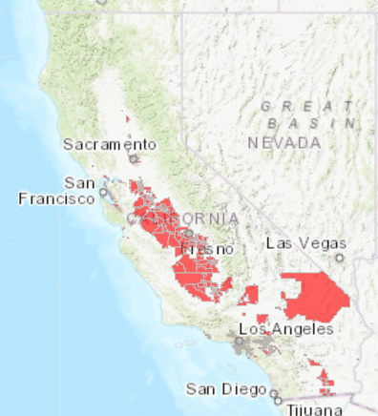
Identifying Disadvantaged Communities
[To be used only for EPIC TD&D criteria 8 delete otherwise]
These areas represent the 25% highest scoring census tracts in CalEnviroScreen, along with other areas with high amounts of pollution and low populations.
https://oehha.ca.gov/calenviroscreen/sb535

Slide 25
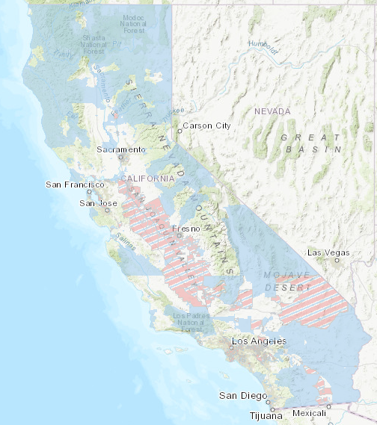
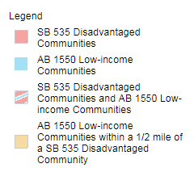
Identifying Low-Income Communities
[To be used only for EPIC TD&D criteria 8 delete otherwise]
Energy Commission staff proposes to use the existing low-income mapping tool developed by ARB to determine AB 523 low-income communities
https://www.arb.ca.gov/cc/capandtrade/auctionproceeds/communityinvestments.htm

Slide 26
Phase II – Post Federal Award Activities
Additional documentation: Expanded budget (Full ECAMS budget), a Scope of Work, Updated Commitment and Support Letters
Federal Award: Proof of Federal award, the Federal Scope of Work, and the Federal budget
Attachment 9: A summary of how the proposed project changed as a result of the Federal award process

Slide 27
Next Steps After Grant Award
Notice of Proposed Award: Shows total proposed funding amounts, rank order of applicants by project group, and the amount of each proposed award.
Agreement Development: Proposal documents will be processed into a legal agreement.
Failure to Execute: The Energy Commission reserves the right to cancel the pending award if an agreement cannot be successfully executed with an applicant.
Project Start: Recipients may begin work on the project only after the agreement is fully executed (approved at an Energy Commission business meeting and signed by the Recipient and the Energy Commission).

Slide 28
Key Dates
Activity | Date
Solicitation Release | March 2022
Pre-Application Workshop | April 8, 2022 at 1:30 pm
Deadline for Written Questions | Ongoing
Deadline to Submit Applications | Check Section II. A of the manual

Slide 29
Questions and Answers
Please chat your question in the Question and Answers window or raise your hand and you will be called on to unmute yourself. Please remember to introduce yourself by stating your name and affiliation. (Feature found under the Participants panel)
Keep questions under 2 minutes to allow time for others.
Note that our official response will be given in writing and posted on the GFO webpage.

Slide 30
Additional Questions
Please send all questions related to GFO-21-901 to:
Marissa Sutton
Commission Agreement Officer
1516 Ninth Street, MS-18
Sacramento, CA 95814
marissa.sutton@energy.ca.gov

Slide 31
Thank You!

