Slide 1
GFO-22-401 Pre-Application Workshop
Advancing Environmental Monitoring Technologies for Floating Offshore Wind
Energy Research and Development Division, California Energy Commission
Presenter: Kaycee Chang
Date: September 1, 2022

Slide 2
Agenda
Time | Item
10:00 am | Welcome and Introduction
10:05 am | Solicitation Background EPIC Research Program Purpose of Solicitation Available Funding
10:25 am | Application Requirements Project Requirements Attachments Submission Process Evaluation Process
11:00 am | Q&As
12:00 pm | Adjourn

Slide 3
Virtual Housekeeping
This workshop will be recorded.
Participants will be muted during the presentation. Please enter your question in the Q&A window.
Updates on solicitation documents including this presentation will be posted at the Grant Funding Opportunity’s webpage: https://www.energy.ca.gov/solicitations/2022-08/gfo-22-401-advancing-environmental-monitoring-technologies-floating-offshore

Slide 4
Commitment to Diversity
The Energy Commission adopted a resolution strengthening its commitment to diversity in our funding programs. The Energy Commission continues to encourage disadvantaged and underrepresented businesses and communities to engage in and benefit from our many programs.
To meet this commitment, Energy Commission staff conducts outreach efforts and activities to:
Engage with disadvantaged and underrepresented groups throughout the state.
Notify potential new applicants about the Energy Commission’s funding opportunities.
Assist applicants in understanding how to apply for funding from the Energy Commission’s programs.
Survey participants to measure progress in diversity outreach efforts.

Slide 5
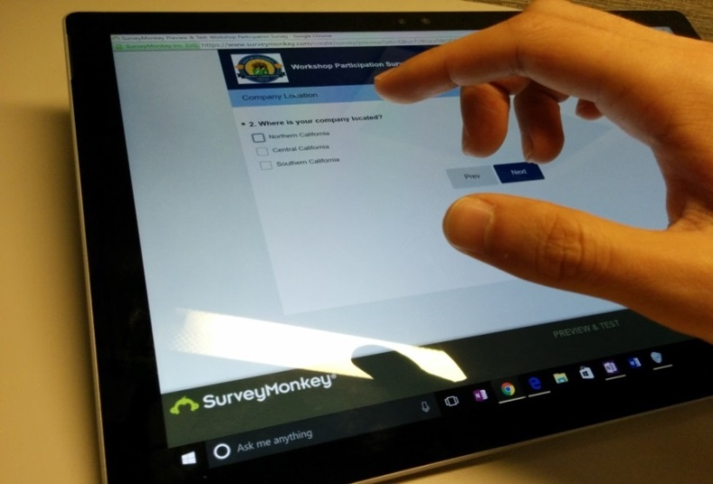
We Want to Hear From You!
Participation Survey
Survey responses will be summarized anonymously to track attendance of underrepresented groups in our workshops for public reporting purposes.
Online participants, please use this link: https://forms.office.com/g/MsC6TMkfum
Thanks!

Slide 6
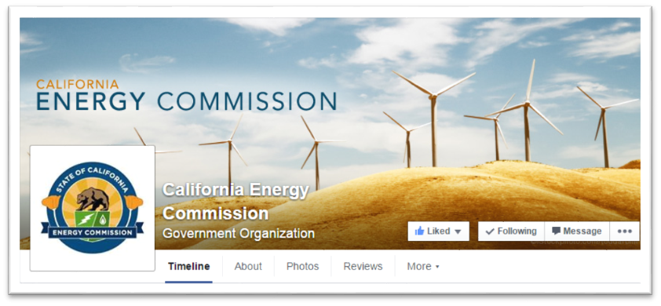
Connect With Us

Slide 7
Find a Partner on EmpowerInnovation.net
Empower Innovation strives to accelerate your clean tech journey with easy access to funding opportunities from the Energy Commission and other funding providers, curated resources and events, and connections to people and organizations.
FIND A PARTNER
Announce your interest in this funding opportunity and message other interested parties to find potential partners.
RESOURCES & TOOLS
Browse the collection of resources for clean tech innovators including Resource Libraries, Funding Sources, Tools, and Databases.
Solicitation-Specific Empower Innovation link:
https://www.empowerinnovation.net/en/custom/events/view/34162

Slide 8
EmpowerInnovation.net

Slide 9
EPIC R&D Program Background
The Electric Program Investment Charge (EPIC) Program is funded by an electricity ratepayer surcharge established in 2011 by the California Public Utilities Commission.
Projects must lead to technological advancement and breakthroughs to overcome barriers that prevent the achievement of the state’s statutory energy goals.
Greater Electricity Reliability
Lower Costs
Increased Safety

Slide 10
Policy Drivers
SB 100 (De León, 2018), The 100 Percent Clean Energy Act of 2018​
Ensure that California’s transition to a zero-carbon electric system does not cause or contribute to increases in greenhouse gas emissions.​
Executive Order B-55-18, Carbon Neutrality (2018) ​
Achieve economy-wide carbon neutrality by 2045.
AB 525, Offshore Wind Generation
Requires the CEC to establish offshore wind planning goals for 2030 and 2045.​

Slide 11
Background
California’s offshore wind technical potential is 201 GW.
Current two Wind Energy Areas’ potential is over 4 GW.
California’s current technical feasibility (five locations) is 21.8 GW.
Humboldt Wind Energy Area. BOEM 2022
Morro Bay Wind Energy Area. BOEM 2022

Slide 12
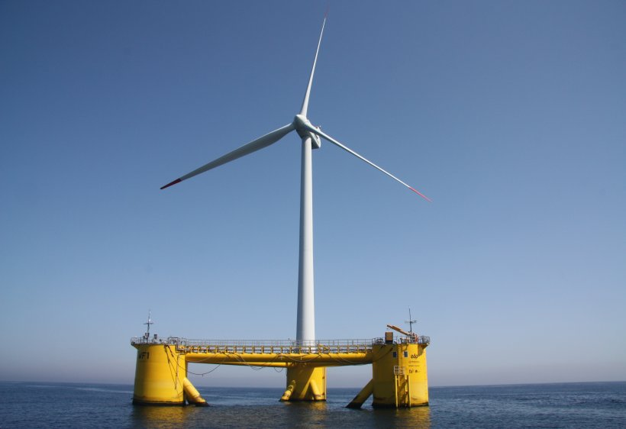
Purpose of Solicitation
Fund applied research and development projects that advance environmental monitoring technologies.​
Support California state agencies considering ecological impacts of floating offshore wind.​
Support long term monitoring and management of these ecosystems.
Source: National Renewable Energy Laboratory

Slide 13
Purpose of Solicitation
Environmental monitoring technologies require additional advancements to improve durability, data validation, and performance.
Source: National Oceanographic & Atmospheric Administration

Slide 14
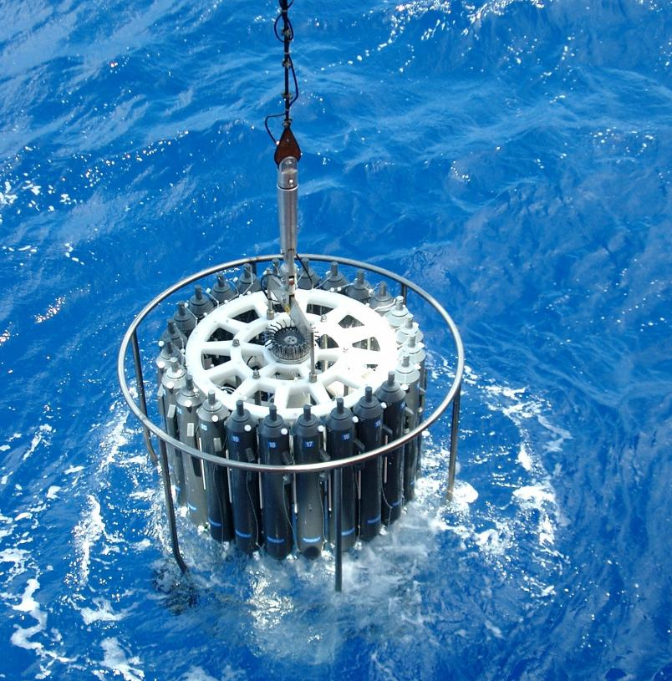
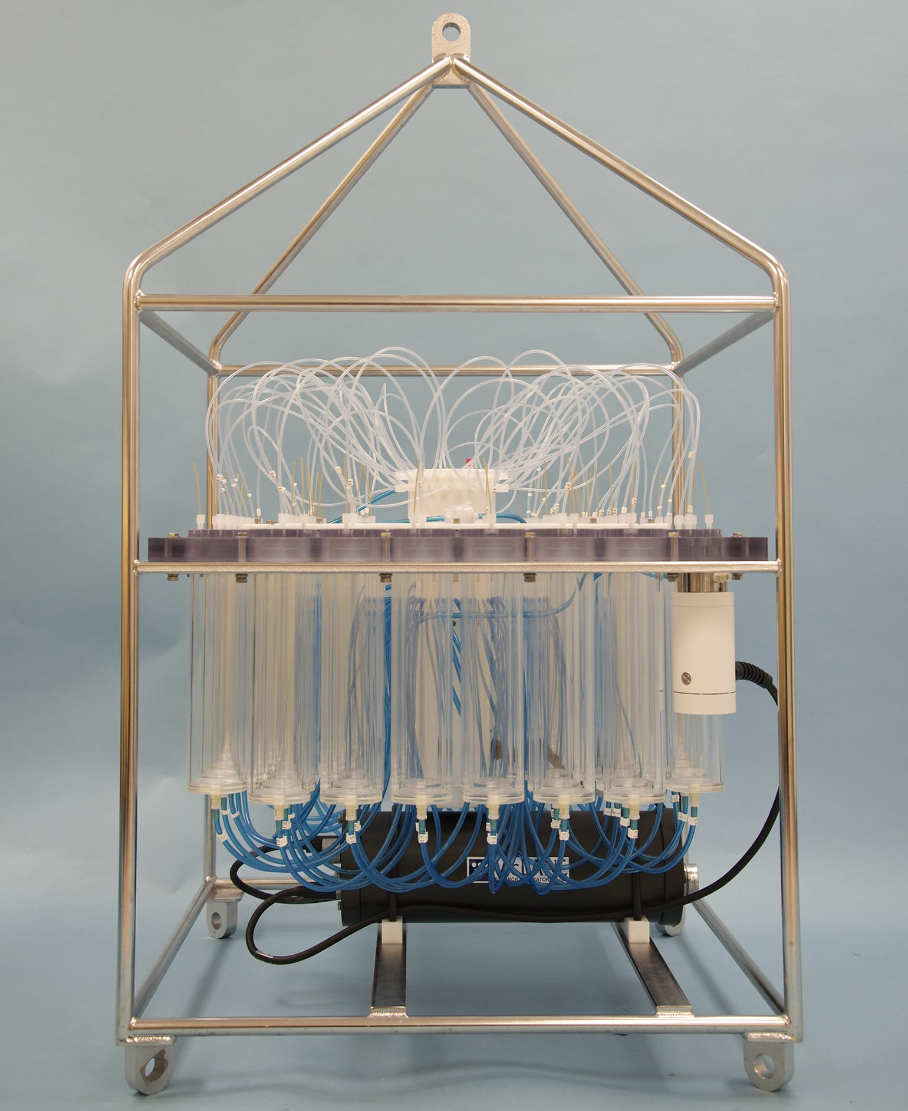
Approach
Facilitate efficient data collection, transmission, analysis, and validation.
Sampling
Quantify ocean parameters
Sampling
Monitor species presence
Detection
Evaluate species prevalence
Estimate risk of impacts
Imaging
Detect impacts
Monitor benthic ecosystems
Conductivity, temperature, & depth sampler.
Source: NOC UK
Biological sampler.
Source: Woods Holes
LiDAR image.
Source: IMDEA
Whale detected by infrared camera.
Source: MMOA

Slide 15
Requirements*
Integrate at least two complementary technologies to assess risk and monitor impacts to commercially important and potentially vulnerable species.
Durable in Humboldt and/or Morro Bay Wind Energy Areas.
Advance from TRL 3 to TRL 4 or 5.
Proposed project activities cannot be tested in state waters or federal Wind Energy Areas.
Include team members with expertise in environmental impacts, monitoring, and/or mitigation.
*Refer to the Solicitation Manual for all requirements.

Slide 16
Additional Requirements*
Include the following in Project Narrative (Attachment 3):
Describe technical specifications.
Demonstrate how the technologies may reduce costs.
Provide a baseline of current technologies and anticipated end-of-project performance targets, such as:
Transmission of data to operators
Accuracy of detection/tracking and species identification
Durability and functionality
*Refer to the Solicitation Manual for all requirements.

Slide 17
Available Funding
2021 EPIC Interim Investment Plan: ​
“Inspection and Monitoring Systems for FOSW Applications” ​
“Environmental Research for FOSW Development”
Available Funding | Minimum Award Amount | Maximum Award Amount
$7,000,000 | $2,000,000 | $3,500,000

Slide 18
Match Funding
10% of match funding is required.
Applications that include match funding will receive additional points during the scoring phase.
Match funding contributors must submit match funding commitment letters that meet the requirements. Failure to do so will disqualify the match funding commitment from consideration.
Refer to the Solicitation Manual for more details on match funding.

Slide 19
Eligible Applicants
This is an open solicitation for public and private entities.
Applicants must accept the EPIC terms and conditions.
Standard, UC, and DOE T&Cs available online: https://www.energy.ca.gov/funding-opportunities/funding-resources
Applicants are encouraged to register with the California Secretary of State, as all recipients must be registered and in good standing to enter into an agreement with the Energy Commission: http://www.sos.ca.gov

Slide 20
Application Requirements
Each Applicant must complete and | include the following:
1. Application Form (.pdf) | 8. CEQA Compliance Form (.docx)
2. Executive Summary (.docx) | 9. References and Work Product Form (.docx, .pdf)
3. Project Narrative (.docx) | 10. Commitment and Support Letters (.pdf)
4. Project Team (.docx, .pdf) | 11. Project Performance Metrics (.docx)
5. Scope of Work (.docx) | 12. Applicant Declaration (.docx)
6. Project Schedule (.xlsx)
7. Budget (.xlsx)

Slide 21
Project Narrative (Attachment 3)
This is your opportunity to explain the entirety of the project. The narrative should explain:
Why is your project necessary and important to California?
What is your project approach and how will each major task be implemented?
How will the project be completed in the term proposed
How will the project outcomes benefit electric ratepayers?
Address the requirements for your group as described in Section I.C.
Respond to the scoring criteria described in Section IV.F.

Slide 22
Scope of Work (Attachment 5)
Tell us exactly what you are proposing to do in your project.
Identify what will be deliver to the Energy Commission.
Be sure to include in the technical tasks:
At least one product deliverable per task.
Address requirements in Section I.C. under Project Focus.
Be sure to include in the Project Schedule (Attachment 6):
Product deliverables that correspond with the Scope of Work.
Realistic dates on when product deliverables can be completed.

Slide 23
Budget (Attachment 7)
Identify how the Energy Commission funds and match funds be spent to complete the project
Subcontractors receiving $100,000 or more Energy Commission funds must complete a separate budget form.
Ensure that all rates provided are maximum rates for the entire project term.
Travel Restrictions:
CEC funds should be limited to lodging and any form of transportation (e.g., airfare, rental car, public transit, parking, mileage).
If an applicant plans to travel to conferences, including registration fees, they must use match funds.

Slide 24
Commitment and Support Letter Forms (Attachment 10)
Follow guidelines provided for commitment and support letters.
Commitment letters are required for entities or individuals that are committing match funding, testing/demonstration sites, including the Prime.
Support letters describe a project stakeholder’s interest or involvement in the project.
All applicants must submit at least one support letter.
Match funding must be supported by a match fund commitment letter.
Any project partners that will make contributions to the project (other than match and sites) must submit a commitment letter.
Limit to two pages per letter, excluding the cover page.

Slide 25
GFO Submission Requirements
Method of Delivery is the Energy Commission Grant Solicitation System, available at: https://gss.energy.ca.gov/
Electronic files must be in Microsoft Office Word (.doc, .docx) and Excel (.xls, .xlsx) formats, unless originally provided in solicitation in another format.
Application documents should meet formatting requirements, and page recommendations.
Attachments requiring signatures (Application Form and Support/Commitment Letters) may be scanned and submitted in PDF format.
First-time users must register as a new user to access system.
Grant Solicitation System (GSS) How to Apply presentation: https://www.energy.ca.gov/media/1654

Slide 26
GSS WARNING
START THE PROCESS EARLY!
Applications must be fully submitted BEFORE the deadline listed in the solicitation manual
The GSS system will shut off at the deadline
Applications in the process of being submitted prior to the deadline will NOT be accepted after the deadline
Applications will NOT be accepted after the deadline

Slide 27
GSS Structure
Register as a New User
Log In
3 Step Application Process:
Select Solicitation
Upload Files
• Select documents for upload
Tag files with document type
Designate confidential documents (if applicable)
Review and Submit
All three steps must be complete BEFORE the deadline

Slide 28
How will my Application be Evaluated? Application Screening
Admin Screening Process
Energy Commission staff screens applications per criteria in Section IV.E.
Criteria are evaluated on a pass/fail basis.
Applicants must pass all screening criteria or the application will be disqualified.
Some Reasons for Disqualification
Application is not submitted by the specified due date and time.
Application does not include one or more support letters.
Application contains confidential material.

Slide 29
How will my Application be Evaluated? Application Scoring
Evaluation Committee applies the scoring scale to the scoring criteria.
Applications must obtain a minimum passing score of 52.5 points for Criteria 1-4 in order to continue evaluation.
Applications must obtain a minimum passing score of 70 points for Criteria 1-7 in order to be considered for funding.
Review Section IV of the manual and ensure the application provides a clear and complete response to each scoring criteria.
Scoring Criteria | Maximum Points
1. Technical Merit | 15
2. Technical Approach | 25
3. Impacts and Benefits for CA IOU Ratepayers | 20
4. Team Qualifications, Capabilities, and Resources | 15
5. Budget and Cost-Effectiveness | 10
6. CEC Funds Spent in California | 10
7. Ratio of Direct Labor Costs to Indirect Costs | 5
Total | 100
Minimum Points to Pass | 70

Slide 30
How will my Application be Evaluated? Application Scoring – Preference Points
Passing applications (score of 70 or more from Criteria 1-7) will be considered for bonus points. Criteria for bonus points include:
Match Funding
Disadvantaged Communities
Scoring Criteria | Maximum Points
8. Match Funds | 10
9. Disadvantaged & Low-income Communities | 5
Total Bonus Points | 15

Slide 31
Match Funding Points
Applicants may receive up to 10 additional preference points based on the criteria below:
Up to 5 points will be awarded based on the percentage of proposed cash relative to the total match contributions using the Match Scoring Table in the Scoring Criteria.
The remaining 5 points may be awarded to applications that exceed the minimum match requirements up to 100 percent using the Exceeds Minimum Match Scoring table.
Refer to the Solicitation Manual for more details on the match funding scoring criteria.

Slide 32
Next Steps After Grant Award
Notice of Proposed Award: Shows total proposed funding amounts, rank order of applicants by project group, and the amount of each proposed award.
Agreement Development: Proposal documents will be processed into a legal agreement.
Failure to Execute: The Energy Commission reserves the right to cancel the pending award if an agreement cannot be successfully executed with an applicant.
Project Start: Recipients may begin work on the project only after the agreement is fully executed (approved at an Energy Commission business meeting and signed by the Recipient and the Energy Commission).

Slide 33
Key Dates
Activity | Date
Solicitation Release | August 17, 2022
Pre-Application Workshop | September 1, 2022 at 10:00 am
Deadline for Written Questions | September 8, 2022 at 5:00 pm
Anticipated Distribution of Questions and Answers | Week of September 26, 2022
Deadline to Submit Applications | October 17, 2022 at 11:59 pm
Anticipated Notice of Proposed Award Posting | Week of December 19, 2022
Anticipated Energy Commission Business Meeting | April 12, 2023
Anticipated Agreement Start Date | May 1, 2023
Anticipated Agreement End Date | March 31, 2027

Slide 34
Questions and Answers
Please chat your question in the Question and Answers window or raise your hand and you will be called on to unmute yourself. Please remember to introduce yourself by stating your name and affiliation. (Feature found under the Participants panel)
Keep questions under 3 minutes to allow time for others.
Note that our official response will be given in writing and posted on the GFO webpage.

Slide 35
Additional Questions
Please send all questions related to GFO-22-401 to:
Phil Dyer
Commission Agreement Officer
1516 Ninth Street, MS-18
Sacramento, CA 95814
(916) 891-8474
Phil.Dyer@energy.ca.gov
Deadline to submit questions:
Thursday, September 8, 2022 at 5:00 PM

Slide 36
Thank You!

