Slide 1
GFO-22-301 Pre-Application Workshop
Commercializing Industrial Decarbonization
Energy Research and Development Division, California Energy Commission
Michael Lozano, Senior Mechanical Engineer
October 26, 2022

Slide 2
Agenda
Time | Item
10:00 am | Welcome and Introduction
10:05 am | Solicitation Background EPIC Research Program Purpose of Solicitation Available Funding
10:25 am | Application Requirements Project Group Requirements Attachments Submission Process Evaluation Process
11:00 am | Q&As
12:00 pm | Adjourn

Slide 3
Housekeeping
This workshop will be recorded.
Participants will be muted during the presentation. Please chat your question in the Q&A window.
Updates on solicitation documents including this presentation will be posted at the Grant Funding Opportunity’s webpage:
https://www.energy.ca.gov/solicitations/2022-10/gfo-22-301-commercialization-industrial-decarbonization-2022-cid-program?utm_medium=email&utm_source=govdelivery

Slide 4
Commitment to Diversity
The Energy Commission adopted a resolution strengthening its commitment to diversity in our funding programs. The Energy Commission continues to encourage disadvantaged and underrepresented businesses and communities to engage in and benefit from our many programs.
To meet this commitment, Energy Commission staff conducts outreach efforts and activities to:
Engage with disadvantaged and underrepresented groups throughout the state.
Notify potential new applicants about the Energy Commission’s funding opportunities.
Assist applicants in understanding how to apply for funding from the Energy Commission’s programs.
Survey participants to measure progress in diversity outreach efforts.

Slide 5
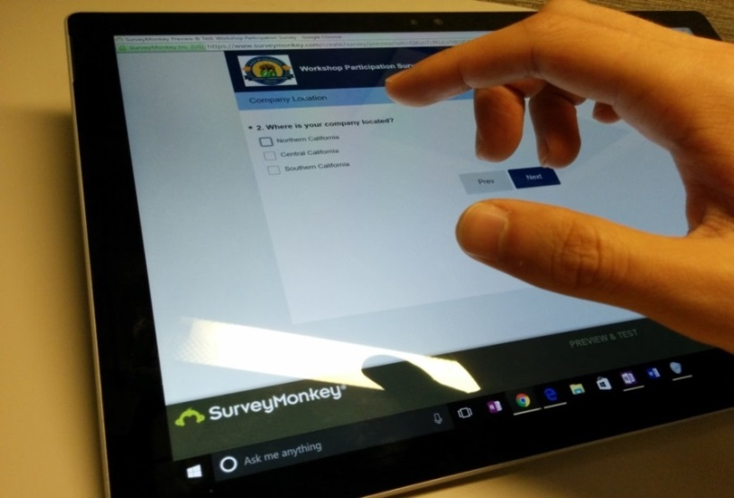
We Want to Hear From You!
Participation Survey
Survey responses will be summarized anonymously to track attendance of underrepresented groups in our workshops for public reporting purposes.
Online participants, please use the link below: https://forms.office.com/g/xZsRTauTjU
Thanks!

Slide 6
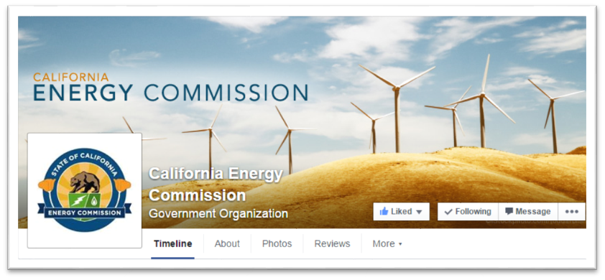
Connect With Us

Slide 7
Find a Partner on EmpowerInnovation.net
Empower Innovation aims to accelerate your clean tech journey with easy access to funding opportunities from the CEC and other funding providers, curated resources and events, and connections to people and organizations.
FIND A PARTNER
Announce your interest in this funding opportunity and message interested parties to find potential partners.
RESOURCES & TOOLS
Browse the collection of resources for clean tech innovators including Resource Libraries, Funding Sources, Tools, and Databases.
https://www.empowerinnovation.net/en/custom/funding/view/35748

Slide 8
EmpowerInnovation.net

Slide 9
Research Program Background
The Electric Program Investment Charge (EPIC) program is funded by an electricity ratepayer surcharge established by the California Public Utilities Commission (CPUC) in December 2011.
The purpose of the EPIC program is to benefit the ratepayers of the three investor-owned utilities (IOUs).
The EPIC program funds clean energy technology projects that promote greater electricity reliability, lower costs, and increased safety.
Projects must lead to technological advancement and breakthroughs to overcome barriers that prevent the achievement of the state’s statutory energy goals.

Slide 10
Policy Drivers
SB 32: reduction of GHG emission to 40 percent below 1990 levels by 2030.
SB 100: ensure that California’s transition to a zero-carbon electric system does not cause or contribute to greenhouse gas emissions (GHG) increases.
2019 California Energy Efficiency Action Plan: expands the SB 350 doubling energy efficiency by 2030 to include agriculture, industry, and electrification.

Slide 11
Purpose of Solicitation
To fund technology development and demonstration projects of promising pre-commercial technologies to accelerate industrial decarbonization and increase overall energy efficiency to reach statewide goals.
Projects must fall within one of the following groups:
Group 1: Low-Carbon, High-Temperature Industrial Heating
Group 2: Energy Efficiency and Decarbonization of Concrete Manufacturing
Group 3: Energy Efficient Separation Processes

Slide 12
Available Funding
Project Group | Available Funding | Minimum Award Amount | Maximum Award Amount
Group 1: Low-Carbon, High-Temperature Industrial Heating | Up to $5M | $2M | $5M
Group 2: Energy Efficiency and Decarbonization of Concrete Manufacturing | Up to $20M | $2M | $12M
Group 3: Energy Efficient Separation Processes | Up to $15M | $2M | $12M
Up to $40M

Slide 13
Match Funding
A minimum of 20% match funding is required.
Applicants that provide more than 20% match funding may receive additional points during the scoring phase.
Match funding contributors must submit match funding commitment letters that meet the requirements of Attachment 10. Failure to do so may disqualify the match funding commitment from consideration.
Refer to Section I.D.2 in the Solicitation Manual for more details on match funding.

Slide 14
Group 1: Low-Carbon, High-Temperature Industrial Heating Overview
Develop, test and demonstrate low-carbon, high-temperature industrial heating solutions in the following areas:
Direct Electrification of Heating
Zero-Carbon Heat Sources
Targeted energy-intensive industries such as cement, glass, chemicals, metals, and processes that use heat over 800ºC.
Examples of processes – melting, smelting, curing, and calcining.
Technologies sought are either pre-commercial or commercialized but underutilized and at TRL levels of 6-8 and progress one or more levels up by the end of the project.

Slide 15
Group 1: Low-Carbon, High-Temperature Industrial Heating Direct Electrification of Heating
Develop, test, and demonstrate new electric or hybrid equipment for high-temperature industrial heating
Potential Research Areas:
Develop and demonstrate electrotechnologies:
Emerging and ready for scale-up to the next TRL level, such as microwave, infrared, radio frequencies, ultrasound, pressure-assisted heating and others.
Integration with renewable energy sources/conventional heating/ and/or thermal energy storage.
Combined with advanced controls to minimize grid impacts of electrotechnologies under real-world industrial settings.

Slide 16
Group 1: Low-Carbon, High-Temperature Industrial Heating Zero Carbon Heat Sources
Develop, test and demonstrate High-Temp Heat Pumps (HTHP) that advance electrification and improve energy efficiency by recovering waste-heat.
Potential Research Areas:
Components and refrigerants for HTHP systems that upgrade waste heat for medium temp industrial process (150-230ºC).
Emerging heat pump technologies.
Industrial-scale heat pump equipment to reduce capital and operating costs.
Integration of industrial heat pumps with direct or indirect heating systems including thermal energy storage.

Slide 17
Group 2: Energy Efficiency and Decarbonization of Concrete Manufacturing
Develop and demonstrate energy efficiency and decarbonization technologies for concrete manufacturing
Potential Research Areas:
Technologies for increasing efficiency of electricity-driven carbon capture and utilization.
Use of alternative raw materials and processes of cement/concrete production that enable electrification.
Fuel substitution with electricity in production process.

Slide 18
Group 3: Energy Efficient Separation Processes
Develop, test, and demonstrate advanced electrically-driven separation technologies for the industrial, water and wastewater sectors.
Potential Research Areas:
Separation technologies for direct air capture of CO2.
Equipment that replaces thermal separation with non-thermal separation.
Energy efficiency improvements to existing non-thermal separation processes to improve economics and market viability.
Advanced separation technologies for wastewater treatment of biosolids/sludge.
Novel separation technologies with potential for water reclamation.

Slide 19
Eligible Applicants
This is an open solicitation for public and private entities.
Applicants must accept the EPIC terms and conditions.
Standard, UC, and DOE T&Cs available online: https://www.energy.ca.gov/funding-opportunities/funding-resources
Applicants are encouraged to register with the California Secretary of State, as all recipients must be registered and in good standing to enter into an agreement with the Energy Commission: http://www.sos.ca.gov

Slide 20
Application Requirements
Each Applicant must complete and | including the following:
1. Application Form (.pdf) | 7. Budget (.xlsx)
2. Executive Summary (.docx) | 8. CEQA Compliance Form (.docx)
3. Project Narrative (.docx) | 9. References and Work Product Form (.docx, .pdf)
4. Project Team (.docx, .pdf) | 10. Commitment and Support Letters (.pdf)
5. Scope of Work (.docx) | 11. Project Performance Metrics
6. Project Schedule (.xlsx) | 12. Applicant Declaration (.docx)

Slide 21
Project Narrative (Attachment 3)
This is your opportunity to explain the entirety of the project. The narrative should explain:
Why is your project necessary and important to California?
What is your project approach and how will each major task be implemented?
How will the project be completed in the term proposed.
How will the project outcomes benefit electric ratepayers?
Address the requirements for your group as described in Section I.C.
Respond to the scoring criteria described in Section IV.F.

Slide 22
Scope of Work (Attachment 5)
Tell us exactly what you are proposing to do in your project.
Identify what will be delivered to the Energy Commission.
Be sure to include in the technical tasks:
At least one product deliverable per task.
Address requirements in Section I.C. under Project Focus.
Be sure to include in the Project Schedule (Attachment 6):
Product deliverables that correspond with the Scope of Work.
Realistic dates on when product deliverables can be completed.

Slide 23
Budget (Attachment 7)
Identify how the Energy Commission funds and match funds will be spent to complete the project.
Subcontractors receiving $100,000 or more Energy Commission funds must complete a separate budget form.
Ensure that all rates provided are maximum rates for the entire project term.
Travel Restrictions:
CEC funds should be limited to lodging and any form of transportation (e.g., airfare, rental car, public transit, parking, mileage).
If an applicant plans to travel to conferences, including registration fees, they must use match funds.

Slide 24
Commitment and Support Letter Forms (Attachment 10)
Follow guidelines provided for commitment and support letters.
Commitment letters are required for entities or individuals that are committing match funding, testing/demonstration sites, including the Prime.
Support letters describe a project stakeholder’s interest or involvement in the project.
All applicants must submit at least one support letter.
Match funding must be supported by a match fund commitment letter.
Any project partners that will make contributions to the project (other than match and sites) must submit a commitment letter.
Limit to two pages per letter, excluding the cover page.

Slide 25
GFO Submission Requirements
Method of Delivery is the Energy Commission Grant Solicitation System, available at: https://gss.energy.ca.gov/
Electronic files must be in Microsoft Office Word (.doc, .docx) and Excel (.xls, .xlsx) formats, unless originally provided in solicitation in another format.
Application documents should meet formatting requirements, and page recommendations.
Attachments requiring signatures (Application Form and Support/Commitment Letters) may be scanned and submitted in PDF format.
First-time users must register as a new user to access system.
Grant Solicitation System (GSS) How to Apply presentation: https://www.energy.ca.gov/media/1654

Slide 26
GSS WARNING
START THE PROCESS EARLY!
Applications must be fully submitted BEFORE the deadline listed in the solicitation manual.
The GSS system will shut off at the deadline.
Applications in the process of being submitted prior to the deadline will NOT be accepted after the deadline.
Applications will NOT be accepted after the deadline.

Slide 27
GSS Structure
Register as a New User
Log In
3 Step Application Process:
Select Solicitation
Upload Files
• Select documents for upload
Tag files with document type
Designate confidential documents (if applicable)
Review and Submit
All three steps must be complete BEFORE the deadline

Slide 28
How will my Application be Evaluated? Application Screening
Admin Screening Process
Energy Commission staff screens applications per criteria in Section IV.E.
Criteria are evaluated on a pass/fail basis.
Applicants must pass all screening criteria or the application will be disqualified.
Some Reasons for Disqualification
Application is not submitted by the specified due date and time.
Application does not include one or more support letters.
Application contains confidential material.

Slide 29
How will my Application be Evaluated? Application Scoring
Evaluation Committee applies the scoring scale to the scoring criteria.
Applications must obtain a minimum passing score of 52.5 points for Criteria 1-4 in order to continue evaluation.
Applications must obtain a minimum passing score of 70 points for Criteria 1-7 in order to be considered for funding.
Review Section IV of the manual and ensure the application provides a clear and complete response to each scoring criteria.
Scoring Criteria | Maximum Points
1. Technical Merit | 15
2. Technical Approach | 25
3. Impacts and Benefits for CA IOU Ratepayers | 20
4. Team Qualifications, Capabilities, and Resources | 15
5. Budget and Cost-Effectiveness | 10
6. CEC Funds Spent in California | 10
7. Ratio of Direct Labor Costs to Indirect Costs | 5
Total | 100
Minimum Points to Pass | 70

Slide 30
How will my Application be Evaluated? Application Scoring – Preference Points
Passing applications (score of 70 or more from Criteria 1-7) will be considered for bonus points. Criteria for bonus points include:
Match Funding
Disadvantaged Communities
Scoring Criteria | Maximum Points
8. Match Funds | 10
9. Disadvantaged & Low-income Communities | 5
Total Bonus Points | 15

Slide 31
Match Funding Points
Applicants may receive up to 10 additional preference points based on the criteria below:
Up to 5 points will be awarded based on the percentage of proposed cash relative to the total match contributions using the Match Scoring Table in the Scoring Criteria.
The remaining 5 points may be awarded to applications that exceed the minimum match requirements up to 100 percent using the Exceeds Minimum Match Scoring table.
Refer to the Solicitation Manual for more details on the match funding scoring criteria.

Slide 32
Disadvantaged Communities
Projects with all test or demonstration sites located in disadvantaged and/or low-income communities and justifies how the project will benefit these communities may receive additional points.
A disadvantaged community is identified by census tract and represents the 25% highest scoring tracts in CalEnviroScreen 4.0 or later versions: https://oehha.ca.gov/calenviroscreen/report/calenviroscreen-40
Low-income communities are defined as communities within census tracts with median household incomes at or below 80 percent of the statewide median income, or at or below the threshold designated as low-income by the California Department of Housing and Community Development. http://www.hcd.ca.gov/grants-funding/income-limits/index.shtml
Applicants have letters of support from technology partners, community-based organizations, environmental justice organizations, or other partners

Slide 33
Next Steps After Grant Award
Notice of Proposed Award: Shows total proposed funding amounts, rank order of applicants by project group, and the amount of each proposed award.
Agreement Development: Proposal documents will be processed into a legal agreement.
Failure to Execute: The Energy Commission reserves the right to cancel the pending award if an agreement cannot be successfully executed with an applicant.
Project Start: Recipients may begin work on the project only after the agreement is fully executed (approved at an Energy Commission business meeting and signed by the Recipient and the Energy Commission).

Slide 34
Key Activities Schedule
This solicitation may include up to three application rounds if funds remain after the close of a round.
Applicants that submit a proposal for the first application round and are not awarded may reapply to the subsequent application rounds.
Applicants that receive an award in one application round can submit a proposal for the subsequent application rounds, if the application is for a distinct project.
2nd round to be announced after 1st round NOPA posting.

Slide 35
Key Dates – Round 1
Activity | Date
Solicitation Release | October 13th
Pre-Application Workshop | October 26th at 10 am
Deadline for Written Questions | November 14th at 5:00 pm
Anticipated Distribution of Questions and Answers | Week of December 5th
1st Round Deadline to Submit Applications | March 6, 2023 at 11:59 pm
Anticipated Notice of Proposed Award Posting (Round 1) | April 2023
Anticipated Energy Commission Business Meeting | May 2023
Anticipated Agreement Start Date | June 2023
Anticipated Agreement End Date | June 2027

Slide 36
Questions and Answers
Please chat your question in the Question and Answers window or raise your hand and you will be called on to unmute yourself. Please remember to introduce yourself by stating your name and affiliation. (Feature found under the Participants panel).
Keep questions under 2 minutes to allow time for others.
Note that our official response will be given in writing and posted on the GFO webpage. Strongly recommend that you submit all questions in writing to us.

Slide 37
Additional Questions
Please send all questions related to GFO-22-301 to:
Crystal Willis
Commission Agreement Officer
715 P Street, MS-18
Sacramento, CA 95814
(916) 529-1108
crystal.willis@energy.ca.gov
Deadline to submit questions:
November 14th by 5:00 PM

Slide 38
Thank You!

