Slide 1
GFO-22-302 Pre-Application Workshop
Valuation of Investments in Electricity Sector Resilience
Energy Research and Development Division, California Energy Commission
Presenters: Dr. Mithra Moezzi; Dr. Susan Wilhelm; Dr. Martine Schmidt-Poolman – Energy-Related Environmental Research Team
Date: November 17, 2022

Slide 2
Housekeeping
Zoom recording
Updates on solicitation documents including this presentation will be posted: https://www.energy.ca.gov/solicitations/2021-10/gfo-21-302-research-support-climate-resilient-transition-clean-electricity
Muting on Zoom
Questions

Slide 3
Agenda
Time | Item
10:00 am | Welcome and Introduction
10:05 am | Solicitation Background EPIC Research Program Purpose of Solicitation Available Funding
10:25 am | Application Requirements Project Requirements Attachments Submission Process
10:40 am | Q&As
12:00 am | Adjourn

Slide 4
Commitment to Diversity
The Energy Commission adopted a resolution strengthening its commitment to diversity in our funding programs. The Energy Commission continues to encourage disadvantaged and underrepresented businesses and communities to engage in and benefit from our many programs.
To meet this commitment, Energy Commission staff conducts outreach efforts and activities to:
Engage with disadvantaged and underrepresented groups throughout the state.
Notify potential new applicants about the Energy Commission’s funding opportunities.
Assist applicants in understanding how to apply for funding from the Energy Commission’s programs.
Survey participants to measure progress in diversity outreach efforts.

Slide 5
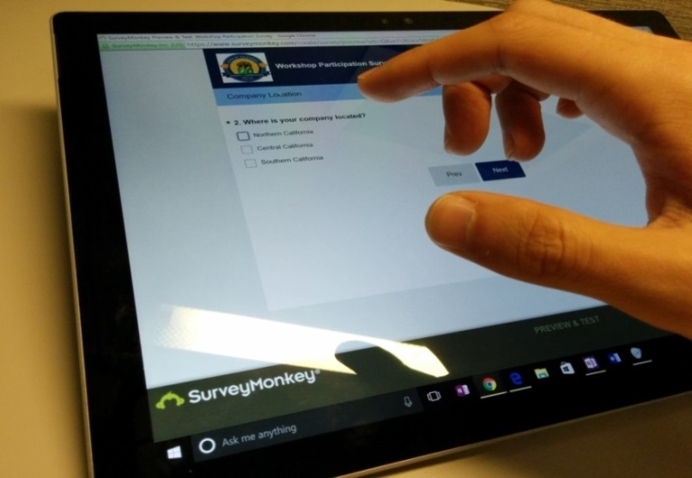
We Want to Hear From You!
1 Minute Survey
The information supplied will be used for public reporting purposes to display anonymous overall attendance of diverse groups.
Zoom participants, please use this link:
https://forms.office.com/g/qaXtNLjFM2
Thanks!

Slide 6
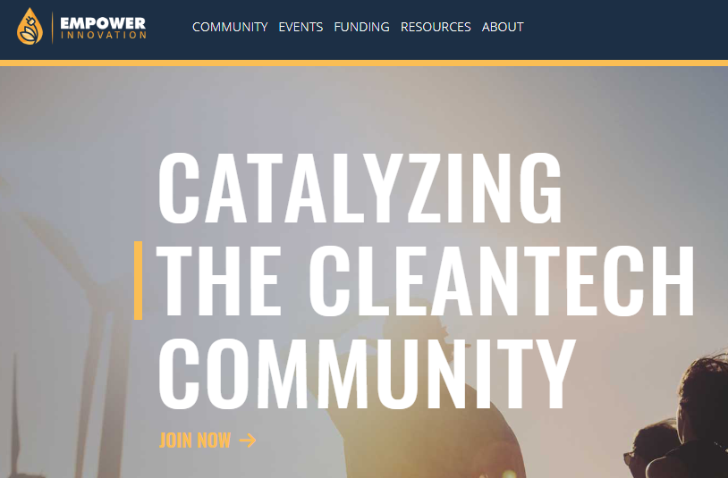
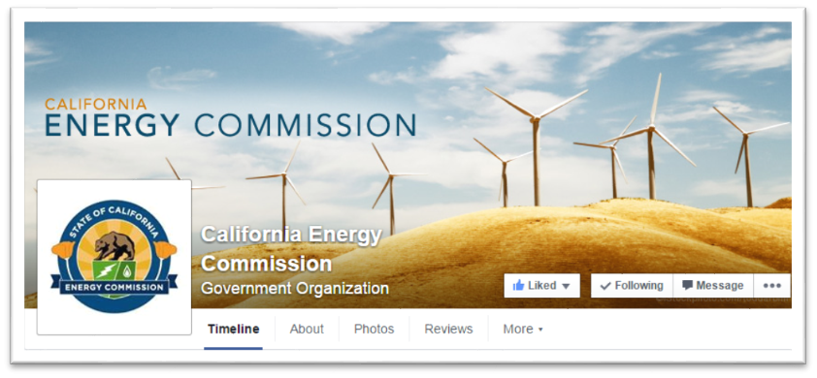
Connect With Us

Slide 7
Find a Partner on EmpowerInnovation.net
Empower Innovation strives to accelerate your clean tech journey with easy access to funding opportunities from the Energy Commission and other funding providers, curated resources and events, and connections to people and organizations.
FIND A PARTNER
Announce your interest in this funding opportunity and message other interested parties to find potential partners.
RESOURCES & TOOLS
Browse the collection of resources for clean tech innovators including Resource Libraries, Funding Sources, Tools, and Databases.
https://www.empowerinnovation.net/en/custom/funding/view/36234

Slide 8
EmpowerInnovation.net

Slide 9
Policy Drivers
SB 32, California Global Warming Solutions Act of 2006: emissions limit: statewide GHG emissions to be reduced to 40% below the 1990 level by 2030.
SB 100, The 100 Percent Clean Energy Act of 2018: requires that 60% of California’s electricity be powered by renewable & zero-carbon sources by 2030 and 100 % by 2045.
Integrated Energy Policy Report (IEPR): California Public Resources Code Section 25302 requires the Energy Commission to release a biennial report that provides an overview of major energy trends and issues facing the state.
CPUC Decision 19-10-054: This decision defines climate change adaptation for energy utilities in California; identifies the California Fourth Climate Assessment and any subsequent assessments as the primary source of climate projections and scientific studies; and establishes the criteria for any further data or models that energy utilities may develop to understand climate impacts.
CPUC Microgrids Rulemaking. Considers how to implement the requirements of SB 1339. Includes a resiliency and microgrids working group.
Executive Order N-19-19: requires “every aspect of state government redouble its effort to reduce greenhouse gas emissions and mitigate impacts of climate change while building a sustainable, inclusive economy.”
SB 100 Joint Agency Report: includes a review of the policy to provide 100 percent of electricity retail sales and state loads from renewable and zero-carbon resources in California by 2045.

Slide 10
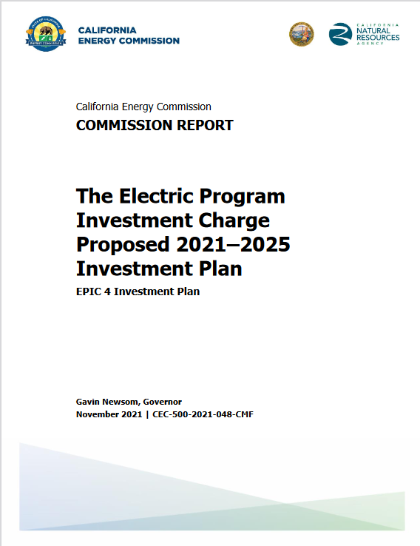
EPIC Funding Source
CEC’s Electric Program Investment Charge Interim Investment Plan 2021* includes an initiative for:
“Valuation of Investments in Electricity Sector Resilience” (Initiative 6)
This supports two themes:
Resilience and reliability
Equity
* See Appendix C of the EPIC 4 (2021-2025) investment plan: https://www.energy.ca.gov/proceedings/energy-commission-proceedings/electric-program-investment-charge-2021-2025-investment

Slide 11
Available Funding
Project | Available Funding | Minimum Award Amount | Maximum Award Amount | Minimum Match Funding (% of EPIC Funds Requested)
Valuation of Investments in Electricity Sector Resilience | $1,200,000 | $1,000,000 | $1,200,000 | 5%

Slide 12
Match Funding
A minimum of 5% of match funding is required.
Match funding contributors must submit match funding commitment letters that meet the requirements of Attachment 10. Failure to do so will disqualify the match funding commitment from consideration.
Refer to Section I.K in the Solicitation Manual for more details on match funding.

Slide 13
Background
Many efforts to characterize and improve electricity system reliability and electricity resilience
Little empirical work from which to systematically characterize the range and structure of social costs of outages or how resilience to power outages work in action
Address gap to better inform technology investments and resilience strategies overall

Slide 14
Purpose of Solicitation
Fund applied research contributing to the practical understanding and valuation of electricity system resilience by:
Providing empirically-based analysis of experiences with and social costs of extended weather-related power outages across varied circumstances, in a way that supports resilience valuation and planning
Considering a corresponding range of investments and strategies to increase resilience, including reducing negative impacts when extended outages do occur
Addressing equity concerns, including in Disadvantaged Vulnerable Communities (DVCs) as defined by CPUC for the climate vulnerability context and IOU adaptation planning.
The concept of Disadvantaged Vulnerable Communities (DVC) outlined by CPUC recognizes climate vulnerability as a matter of both exposure to climate-driven impacts and socioeconomic characteristics; see Decision 20-08-046 (https://docs.cpuc.ca.gov/PublishedDocs/Published/G000/M346/K285/346285534.PDF).
Complementing recent and ongoing work focused on estimating the costs of extended outages

Slide 15
Funded projects must, at a minimum:
Include empirical data collection that supports characterization of the social costs of power outages in California, especially widespread long-duration power outages associated with weather-related conditions, including analysis of how people, businesses, and other organizations cope with outages, emphasizing costs that are not currently priced by markets or regulatory frameworks.
Analyze this data with respect to a range of measures for improved resilience and reliability, including electricity generation and storage technologies, improved functioning of electricity-dependent infrastructure and services, and other technical and social measures including community preparedness, considering both short-term and longer-term time scales.
Analyze a broad spectrum of contexts, including across geography, populations, sectors, event characteristics (e.g., length and timing of outages), and criticality of load (e.g., critical, essential, and non-essential loads and refinements within these categories).
Provide insights to CEC in a manner that is relevant to CPUC’s climate adaptation proceeding (CPUC Rulemaking 18-04-019)

Slide 16
Successful applicants must demonstrate:
A clearly articulated and scientifically-justified approach to empirical data collection that advances knowledge toward improving future electricity resilience.
Expertise in electric grid technologies and systems and consideration of social science insights relevant to energy resilience technology (e.g., from disaster research, sociology).
Plan and capacity to foster strong coordination between any different components of the proposed research (e.g., between a technology-oriented team and a social sciences team).
Strong approach to how resilience and fragility in DVCs will be specifically considered, including any engagement with DVC communities and Community Based Organizations in DVCs.
Capacity to synchronize with related ongoing research, planning, and tool development efforts (e.g., reliability efforts, CPUC Microgrids Rulemaking implementing the requirements of SB 1339, etc.) to the extent reasonable.

Slide 17
Eligible Applicants
This is an open solicitation for public and private entities.
Applicants must accept the EPIC terms and conditions.
Standard, UC, and DOE T&Cs available online: https://www.energy.ca.gov/funding-opportunities/funding-resources
Applicants are encouraged to register with the California Secretary of State http://www.sos.ca.gov

Slide 18
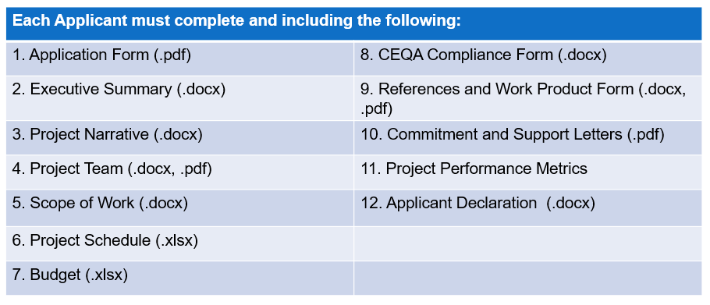
Application Requirements

Slide 19
Project Narrative (Attachment 3)
This is your opportunity to explain the entirety of the project. The narrative should explain:
Why is your project necessary and important to California?
What is your project approach and how will each major task
be implemented?
How will the project be completed in the term proposed
How will the project outcomes benefit electric ratepayers?
Address the requirements for your group as described in
Section II.B.
Respond to the scoring criteria described in Section IV.F.

Slide 20
Scope of Work (Attachment 5)
Tell us exactly what you are proposing to do in your project.
Identify what will be deliver to the Energy Commission.
Be sure to include in the technical tasks:
At least one product deliverable per task.
Address requirements in Section I.C. under Project Focus.
Be sure to include in the Project Schedule (Attachment 6):
Product deliverables that correspond with the Scope of Work.
Realistic dates on when product deliverables can be completed.

Slide 21
Budget (Attachment 7)
Identify how the Energy Commission funds and match funds be spent to complete the project
Subcontractors receiving $100,000 or more Energy Commission funds must complete a separate budget form.
Ensure that all rates provided are maximum rates for the entire project term.
Travel Restrictions:
CEC funds should be limited to lodging and any form of transportation (e.g., airfare, rental car, public transit, parking, mileage).
If an applicant plans to travel to conferences, including registration fees, they must use match funds.

Slide 22
Commitment and Support Letter Forms (Attachment 10)
Follow guidelines provided for commitment and support letters.
Commitment letters are required for entities or individuals that are committing match funding, testing/demonstration sites, including the Prime.
Support letters describe a project stakeholder’s interest or involvement in the project.
All applicants must submit at least one support letter.
Match funding must be supported by a match fund commitment letter.
Any project partners that will make contributions to the project (other than match and sites) must submit a commitment letter.
Limit to two pages per letter, excluding the cover page.

Slide 23
GFO Submission Requirements
Method of Delivery is the Energy Commission Grant Solicitation System, available at: https://gss.energy.ca.gov/
Electronic files must be in Microsoft Office Word (.doc, .docx) and Excel (.xls, .xlsx) formats, unless originally provided in solicitation in another format.
Application documents should meet formatting requirements, and page recommendations.
Attachments requiring signatures (Application Form and Support/Commitment Letters) may be scanned and submitted in PDF format.
First-time users must register as a new user to access system.
Grant Solicitation System (GSS) How to Apply presentation: https://www.energy.ca.gov/media/1654

Slide 24
GSS WARNING
START THE PROCESS EARLY!
Applications must be fully submitted BEFORE the deadline listed in the solicitation manual
The GSS system will shut off at the deadline
Applications in the process of being submitted prior to the deadline will NOT be accepted after the deadline
Applications will NOT be accepted after the deadline

Slide 25
GSS Structure
Register as a New User
Log In
3 Step Application Process:
Select Solicitation
Upload Files
• Select documents for upload
Tag files with document type
Designate confidential documents (if applicable)
Review and Submit
All three steps must be complete BEFORE the deadline

Slide 26
How will my Application be Evaluated? Application Screening
Admin Screening Process
Energy Commission staff screens applications per criteria in Section IV.E.
Criteria are evaluated on a pass/fail basis.
Applicants must pass all screening criteria or the application will be disqualified.
Some Reasons for Disqualification
Application is not submitted by the specified due date and time or is unsigned.
Application does not include one or more support letters.
Application contains confidential material.

Slide 27
How will my Application be Evaluated? Application Scoring
Evaluation Committee applies the scoring scale to the scoring criteria.
Applications must obtain a minimum passing score of 52.5 points for Criteria 1-4 in order to continue evaluation.
Applications must obtain a minimum passing score of 70 points for Criteria 1-7 in order to be considered for funding.
Review Section IV of the manual and ensure the application provides a clear and complete response to each scoring criteria.
Scoring Criteria | Maximum Points
1. Technical Merit | 15
2. Technical Approach | 25
3. Impacts and Benefits for CA IOU Ratepayers | 20
4. Team Qualifications, Capabilities, and Resources | 15
5. Budget and Cost-Effectiveness | 10
6. CEC Funds Spent in California | 10
7. Ratio of Direct Labor Costs to Indirect Costs | 5
Total | 100
Minimum Points to Pass | 70

Slide 28
How will my Application be Evaluated? Application Scoring – Preference Points
Passing applications (score of 70 or more from Criteria 1-7) will be considered for bonus points. Criteria for bonus points include:
Match Funding
Scoring Criteria | Maximum Points
8. Match Funds | 10
Total Bonus Points | 10

Slide 29
Match Funding Points
Applicants may receive up to 10 additional preference points based on these criteria:
Up to 5 points will be awarded based on the proposed cash match relative to the total match (cash + in-kind) contributions using the Cash Match Scoring Table. The remaining 5 points will be awarded to applications that exceed the minimum match requirements based on the percentage above minimum using the Exceeds Minimum Match Scoring table.
Refer to Section IV.F in the Solicitation Manual for more details on the match funding scoring criteria.
Reminder: Only the total amount pledged in the commitment letter(s) will be considered for match funding points.

Slide 30
Next Steps After Grant Award
Notice of Proposed Award (NOPA): Shows total proposed funding amounts, rank order of applicants by project group, and the amount of each proposed award.
Agreement Development: Proposal documents will be processed into a legal agreement.
Failure to Execute: The Energy Commission reserves the right to cancel the pending award if an agreement cannot be successfully executed with an applicant.
Project Start: Recipients may begin work on the project only after the agreement is fully executed (approved at an Energy Commission business meeting and signed by the Recipient and the Energy Commission).

Slide 31
Key Dates
Activity | Date
Solicitation Release | November 8, 2022
Pre-Application Workshop | November 17, 2022, at 10 am.
Deadline for Written Questions | November 30, 2021, at 5:00 pm
Anticipated Distribution of Questions and Answers | Week of December 12, 2022
Deadline to Submit Applications | January 11, 2023, at 11:59 pm
Anticipated Notice of Proposed Award Posting | Week of March 7, 2023
Anticipated Energy Commission Business Meeting | May 10, 2023
Anticipated Agreement Start Date | May 17, 2023
Anticipated Agreement End Date | March 31, 2026

Slide 32
Questions and Answers
Please chat your question in the Question and Answers window or raise your hand and you will be called on to unmute yourself. Please introduce yourself by stating your name and affiliation.
Keep questions under 3 minutes.
Note that our official response will be given in writing and posted on the GFO webpage.

Slide 33
Thank you!
Please send all questions related to GFO-22-302 to:
Crystal Willis
Commission Agreement Officer
715 P Street, MS-18
Sacramento, CA 95814
(916) 529-1108
crystal.willis@energy.ca.gov
Deadline to submit questions:
Wednesday, November 30, 2022, 5:00 PM

