Slide 1
California Vehicle Survey Pre-bid Conference Request for Proposal RFP-22-804
Pre-bid Conference
March 15, 2023

Slide 2
Purpose of RFP
Select a contractor to conduct California Household and Commercial LDV fleet owner surveys.
Conduct household surveys to target 4,000 completed stated preferences (SP) surveys for households, representing population distribution in California.
Conduct commercial surveys to target 2,000 completed SP surveys for commercial fleet owners, corresponding to distribution of commercial fleet in California.
Conduct ZEV owner add-on surveys to result in 600 completed SP surveys for households and 280 for commercial segment.
https://www.energy.ca.gov/solicitations/2023-03/rfp-22-804-2023-california-vehicle-survey
2

Slide 3
Proposal Requirements
REQUIRED FORMAT FOR PROPOSAL RESPONSE
Consists of Two Sections
Section 1 – Administrative Response
Section 2 – Technical and Cost Proposal

Slide 4
Section 1, Administrative Response
Every Proposer must complete and include the following in Section 1, Administrative Response:
Cover Letter
Table of Contents
Contractor Status Form
Small Business Preference Certification (if applicable) (Or Non-Small Business Preference)
Completed DVBE Form Std. 843
Bidder Declaration Form GSPD-05-105

Slide 5
Section 1, Administrative Response
Signed Contractor Certification Clauses
Target Area Contract Preference Act Forms (if applicable)
Enterprise Zone Act Form (if applicable)
Local Agency Military Base Recovery Act Forms (if applicable)

Slide 6
Section 2, Technical Proposal
Every Proposer must complete and include the following in Section 2.
Team Organizational Structure
Project Team Experience and Qualifications
Past Work Products
Client References
Approach to Tasks in Scope of Work
Quality Assurance

Slide 7
Section 2, Cost Proposal
Every Proposer must complete and include the budget forms found in Attachment 7 of the solicitation.
Task Summary
Category Summary
Prime Labor Rates
Labor Rates for each Subcontractor
Prime Non-Labor Rates
Non-Labor Rates for each Subcontractor
Direct Operating Expenses
Loaded Rate Calculation – Att 7-a (for evaluation purposes)
Total Expected Labor Cost – Att 7-b (for evaluation purposes)

Slide 8
Small/Non-Small Business Preference
Small Business Preference – Certified Small Businesses or microbusinesses can claim the five percent preference when submitting a proposal.
Non-Small Business Preference – Bidder commits to small or micro business subcontractor participation of 25% of net bid price.

Slide 9
DVBE Incentive Program
The DVBE Incentive Program gives a contractor an opportunity to improve their bid status based on the efforts attained from the DVBE Participation Program.
The incentive computation is only applied during the evaluation process and only to responsible Bidders.

Slide 10
Disabled Veteran Business Enterprise (DVBE) Requirements
This RFP is subject to a mandatory certified DVBE participation of at least three percent (3%).
Bidders that both receive the minimum passing score and include DVBE participation in the Bid will receive the DVBE Incentive.
The incentive points for awards based on high score are as follows:
DVBE Participation Level | DVBE Incentive Points
3.01% - 3.99% | 1
4.00% - 4.99% | 2
5.00% - 5.99% | 3
6.00% - 6.99% | 4
7.00% or over | 5

Slide 11
Evaluation Process
Stage One: Administrative and Completeness Screening
Stage Two: Technical and Cost Evaluation of Proposals
The Maximum Points Available under this RFP are 100 with Maximum 70 points for technical and Maximum 30 points for cost components.​
Minimum Passing Score
For the technical criteria 49 points (70%)
For the whole proposal 70 points (70%)

Slide 12
Tentative Key Activities and Dates
ACTIVITY | ACTION DATE
RFP Release | March 2, 2023
Deadline for Written Questions * | March 15, 2023
Pre-Bid Conference * | March 15, 2023 10am-12pm
Distribute Questions/Answers and Addenda (if any) to RFP | March 21, 2023
Deadline to Submit Proposals by 5:00 p.m. * | April 3, 2023
Clarification Interviews | Week of April 10, 2023 by 5pm
Notice of Proposed Award | May 16, 2023
Commission Business Meeting | June 15, 2023
Contract Start Date | September 1, 2023
Contract Termination Date | March 30, 2025

Slide 13
Eligible Bidders​
Bidders must meet all solicitation requirements.
Private entities, non-profit organizations, and public sector entities that meet the solicitation requirements. ​
Private sector entities must agree to the Energy Commission’s standard terms and conditions.​
The University of California or the U.S. DOE National Laboratories must use either the standard or the pre-negotiated terms and conditions.​
Public entities may participate as subcontractors if they cannot meet requirements or agree to the terms.​
All corporations, LLCs and LPs are required to register and be in good standing with the California Secretary of State. ​

Slide 14
About the project

Slide 15
Background
The California Energy Commission is directed by Public Resources Code Section 25301 to prepare a forecast of transportation fuel demand, every two years.
The Transportation Energy Forecasting Unit prepares:
Forecast of vehicle demand, fuel demand and fuel prices;
Assessment of shifts in consumer preferences for vehicle fuel and technology types, in response to changes in incentives and regulatory environment, as well as economic conditions and technology, based on analysis of California commercial and household vehicle survey data.

Slide 16
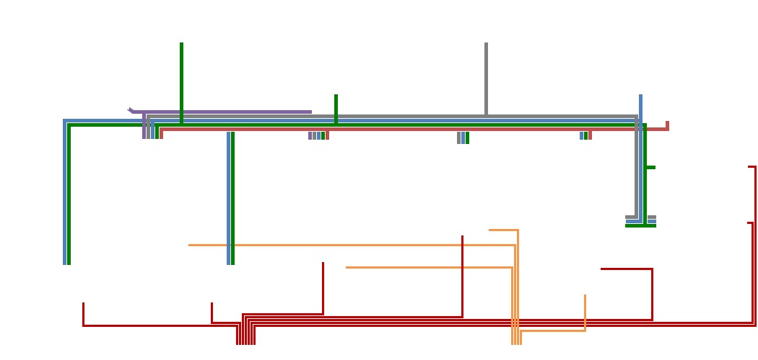
Personal and Commercial Light Duty Vehicle Choice Models in the Context of Transportation Demand Forecasting Models
Economic/Demographic Forecasts & Other Data
Fuel Price Forecast
(from U.S. EIA)
2017 Vehicle Population
(from California DMV, NTD)
Regulatory Impact
Corporate Avg. Fuel Economy
California ZEV Program
2017 California Vehicle Survey
(Household, Commercial, PEV)
CA Transportation
Energy Price Forecasts
Vehicle Attributes
(forecast)
Incentives
Personal Vehicle Choice
Commercial Vehicle Choice
Government Rental & NEV
Truck Choice
Aviation
Freight Movement
Other Bus
LDV Stock & Fuel (forecast)
LDV Stock
(forecast)
LDV Stock & Fuel (forecast)
Freight Stock & Fuel (forecast)
Urban Travel
Intercity Travel
MD/HD Stock
(forecast)
California On-road/rail
Transportation Energy Demand
California Vehicle Population
(forecast)

Slide 17
What Is California Vehicle Survey?
California Energy Commission periodically conducts a survey of household and commercial vehicle fleet owners to evaluate consumer preferences for near term vehicle transactions and the type of vehicles they plan to purchase.
The survey collects data on both revealed preferences (RP) and stated preferences (SP).
RP and SP data are then used to estimate parameters of vehicle ownership, transaction and choice utility equations.
The estimated parameters are input into existing vehicle demand forecasting models that are used to forecast transportation energy demand in California.
17

Slide 18
Survey Project: Not Just a Survey
The survey project is composed of:
The light duty vehicle owner Surveys
The light duty vehicle choice Models
Survey
Designed Around Models
Models
Defined by Survey Data

Slide 19
Project Products
Survey (in 3 phases)
Models
Focus Group
Design
Test
Pretest
Design
Test
Main Survey
Design
Execute
Survey Data
Clean
QC
Choice Models
Household
Commercial

Slide 20
Personal and Commercial Light Duty Vehicle Demand Models
Commercial model includes a vehicle type choice equation for the commercial segment.
Residential model includes the following behavioral equations for the residential segment:
Vehicle quantity
Vehicle transaction
New/used vehicle
Vehicle type choice
VMT

Slide 21
Vehicle Technologies in the 2023 Surveys
Gasoline
Gasoline Hybrid
Flex Fuel Vehicle (E85)??
Diesel
Battery Electric Vehicle (BEV)
Plug-in Hybrid Electric Vehicle (PHEV)
Hydrogen Fuel Cell Vehicle (FCEV)
Plug-in Hybrid Fuel Cell (PFCV)
Autonomous Vehicles (AV)

Slide 22
2023 Survey
Includes autonomous vehicles in the vehicle type choice model.
Includes additional questions on V2G behavior.
Improve upon charging infrastructure questions.
The RP and SP phases of the survey are combined into one phase, for the web-only survey participants, with the help of an algorithm embedded in the survey software.
The data collection phase should be completed and cleaned up by mid-year 2024.
Models should be completed by February 2025.

Slide 23
Household Vehicle Choice Model
Vehicle Quantity (RP)
Should this be changed/augmented IF using Autonomy Level 5? How about TNC impact?
Vehicle Transaction (RP)
New/Used
Vehicle Type (Class/Fuel Type) Choice (SP)
Should this be augmented with Autonomy levels as attribute, or ….?
Can we improve forecast accuracy by augmenting it with our detailed new vehicle sales data 2010-2022?
VMT (RP)

Slide 24
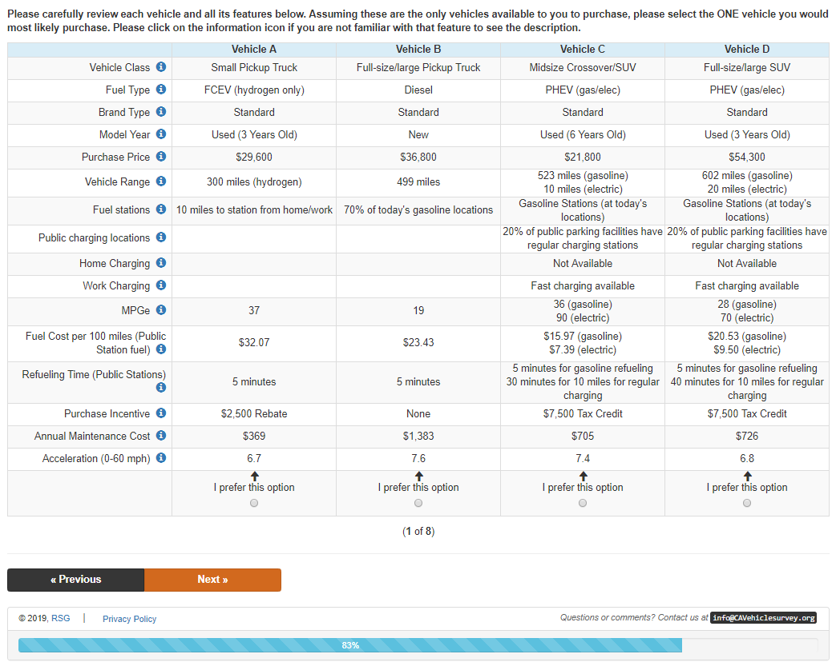
2019 Stated Preferences Survey Instrument

Slide 25
Information Provided by CEC
Prior survey reports (2017 survey) and data (2013, 2017 and 2019 survey data) can be accessed on the California Vehicle Survey Webpage. The 2017 reports include survey methodology, LDV choice models, as well as the questionnaires.
https://www.energy.ca.gov/publications/2017/2015-2017-california-vehicle-survey
The 2017 staff report provides the context in which the resulting light duty vehicle choice models are used in forecasting transportation energy demand.
Transportation Energy Demand Forecast, 2018-2030 - Staff Report | California Energy Commission
Actual New Vehicle Sale data New ZEV Sales in California

Slide 26
Scope of Work
Task 1: Agreement Management
Task 2: Work Plan
Task 3: Survey Website, and Database design
Task 4: Survey Design
Task 5: Focus Groups
Task 6: Survey Pretest
Task 7: Main Survey
Task 8: Analysis of Data Quality and Survey Results
Task 9: Logistic Equations

Slide 27
Scoring
Technical | Possible Points
Organizational Structure & Labor Hours by Task | 7
Past Work Products, experiences and Client References | 13
Bidder’s Approach to the Tasks in the Scope of Work | 27
Work Plan and Incentive plan | 8
Proposal Comprehensiveness & Quality Assurance | 15
Total (Minimum Passing Score of 56) | 70
Cost | Possible Points
Total Cost Components | 30
Total (Minimum Passing Score of 70) | 100

Slide 28
How To Submit The Proposals
Method of submission is the Energy Commission Grant Solicitation System, available at: https://gss.energy.ca.gov/
Hard copies will not be accepted.
Files must be in Microsoft Word (.doc, .docx), Microsoft Excel (.xls, .xlsx), and Adobe PDF formats.
Attachments that require signature: check website for most up to date signature requirements https://www.energy.ca.gov/funding-opportunities/solicitations
First-time users must register as a new user to access system.
Application documents should meet formatting requirements, and page limits specified. See individual requirements for each attachment in Section III of solicitation manual
“How to Apply” PowerPoint: https://www.energy.ca.gov/funding-opportunities/funding-resources
Deadline to Submit Proposals is by 5:00 p.m. on April 3, 2023

Slide 29
Questions and Answers
Please introduce yourself by stating your name and affiliation.
Please follow up with your question in writing to ensure that it is captured properly.
Our official response will be given in writing, and we anticipate it will be posted on the funding opportunity Solicitations webpage the week of March 21, 2023.
Questions are Due by 5 PM today, March 15, 2023

Slide 30
Whom to Contact?
Lisa Linares
California Energy Commission
715 P Street, MS-18
Sacramento, California 95814
Telephone: (916) 805-7461
E-mail: Lisa.Linares@energy.ca.gov

