Slide 1
2020 Light-Duty ZEV Update & Vehicle Reclassification​
Presenter: Jesse Gage, Energy Commission Specialist
Date: May 5, 2021

Slide 2
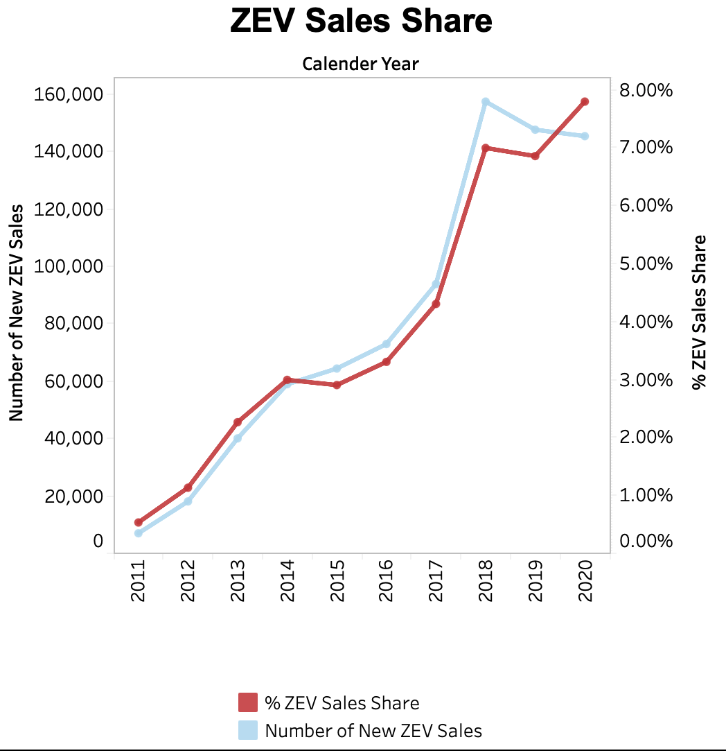
2020 in ZEVs
Little change in overall ZEV sales versus 2019
Drop in overall light-duty (LDV) sales led to higher ZEV share of total LDV
PHEV sales down 40% from their 2018 peak
Source: Zero Emission Vehicle and Infrastructure Statistics (ca.gov)

Slide 3
PHEV Stock Stagnates
BEV stock continues rise
PHEV stock growth nearly flat since discontinuation of Volt
Some signs of PHEV life in 1Q 2021 Prius Prime
Source: CEC analysis

Slide 4
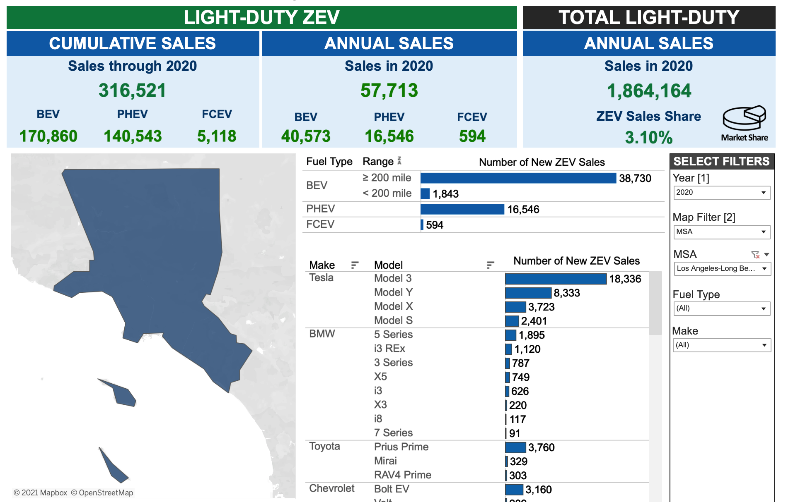
Check out our ZEVStats Portal
Source: Zero Emission Vehicle and Infrastructure Statistics (ca.gov)

Slide 5
Legacy Vehicle Classes
Cars
Subcompact (<89 cu. Ft.)
Midsize (95-105)
Sport (power/weight ratio)
Crossover SUV
Small-A (wagon, foldable seats)
Compact (89-95)
Large (105+)
Small-B (unibody, <140)
Midsize (unibody, >140)
SUV
Compact (body-on-frame, <140)
Midsize (BoF, 140-180)
Large (BoF, >180)
Heavy (GVWR2)
Van
Compact (<180)
Large (>180)
Heavy (GVWR2)
Pickup
Compact (Inertia weight <4,250)
Standard (Inertia weight >4,250)
Heavy (GVWR2)
Source: CEC staff

Slide 6
Issues With Legacy Classes
Inconsistency with models over time
Power-to-weight ratio for sport cars ignores muscle cars such as Mustang or Camaro
Body-on-frame SUVs are largely extinct
Inertia weight for pickups is obscure, hard-to-research

Slide 7
New Vehicle Classes
Cars
Subcompact (Nissan Versa)
Midsize (Tesla Model 3)
Sport (Ford Mustang)
Compact (Honda Civic)
Large (Mercedes E-Class)
SUV
Compact (Toyota RAV4)
Midsize (Toyota Highlander)
Large (Chevy Traverse)
Van
Compact (Dodge Grand Caravan)
Large (Honda Odyessy)
Heavy (Ford Transit)
Pickup
Compact (Toyota Tacoma)
Heavy (Ford F-250)
Subcompact (Subaru Outback)
Standard (Ford F-150)
Source: CEC staff

