Slide 1
GFO-23-501 Pre-Application Workshop
Quantifying Exposures to Indoor Air Pollutants in Multifamily Homes that Cook with Gas or Alternatives
Energy Research and Development Division, California Energy Commission
Presenter: Maninder Thind, PhD, Research Manager
Date: November 20, 2023

Slide 2
Housekeeping
This workshop will be recorded.
Participants will be muted during the presentation.
Please chat your question in the Q&A window.
Updates on solicitation documents including this presentation will be posted at the Grant Funding Opportunity’s webpage: https://www.energy.ca.gov/solicitations/2023-11/gfo-23-501-quantifying-exposures-indoor-air-pollutants-multifamily-homes-cook

Slide 3
Agenda
Time | Item
10:00 am | Welcome and Introduction
10:05 am | Solicitation Background Gas Research and Development Program Purpose of Solicitation Available Funding
10:25 am | Application Requirements Project Group Requirements Attachments Submission Process Evaluation Process
11:00 am | Q&As
12:00 pm | Adjourn

Slide 4
Commitment to Diversity
The Energy Commission adopted a resolution strengthening its commitment to diversity in our funding programs. The Energy Commission continues to encourage disadvantaged and underrepresented businesses and communities to engage in and benefit from our many programs.
To meet this commitment, Energy Commission staff conducts outreach efforts and activities to:
Engage with disadvantaged and underrepresented groups throughout the state.
Notify potential new applicants about the Energy Commission’s funding opportunities.
Assist applicants in understanding how to apply for funding from the Energy Commission’s programs.
Survey participants to measure progress in diversity outreach efforts.

Slide 5
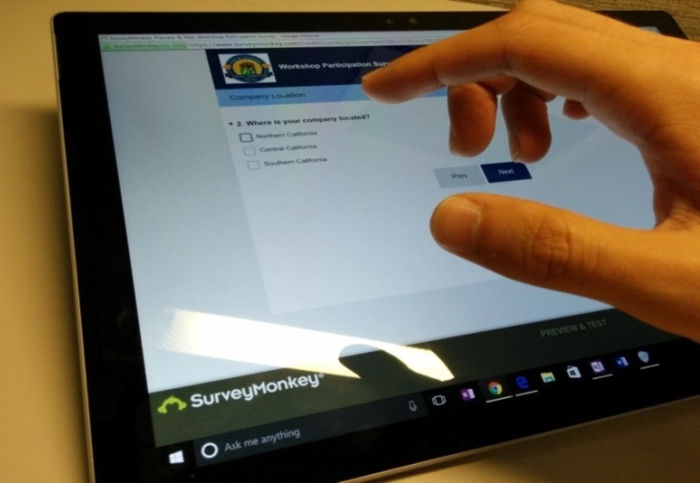
We Want to Hear From You!
Participation Survey
Survey responses will be summarized anonymously to track attendance of underrepresented groups in our workshops for public reporting purposes.
Online participants, please use this link:
https://forms.office.com/g/fCLiJcjAfH
Thank you!

Slide 6




Connect With Us

Slide 7
Find a Partner on EmpowerInnovation.net
Empower Innovation strives to accelerate your clean tech journey with easy access to funding opportunities from the Energy Commission and other funding providers, curated resources and events, and connections to people and organizations.
FIND A PARTNER
Announce your interest in this funding opportunity and message other interested parties to find potential partners.
RESOURCES & TOOLS
Browse the collection of resources for clean tech innovators including Resource Libraries, Funding Sources, Tools, and Databases.
https://www.empowerinnovation.net/en/custom/funding/view/40511

Slide 8

EmpowerInnovation.net

Slide 9
Research Program Background
This solicitation will award projects funded by the Gas Research and Development Program; a gas ratepayer surcharge established by the California Public Utilities Commission (CPUC) in December 2004. ​
The purpose of the program is to benefit California gas ratepayers by funding public interest research and development activities, which the CPUC has defined as “developing science or technology, the benefits of which accrues to California citizens and are not adequately addressed by competitive or regulated entities.”​
See CPUC Decision 04-08-010, August 19, 2004, http://docs.cpuc.ca.gov/PublishedDocs/WORD_PDF/FINAL_DECISION/39314.PDF.​
Program: https://www.energy.ca.gov/programs-and-topics/programs/gas-research-and-development-program

Slide 10
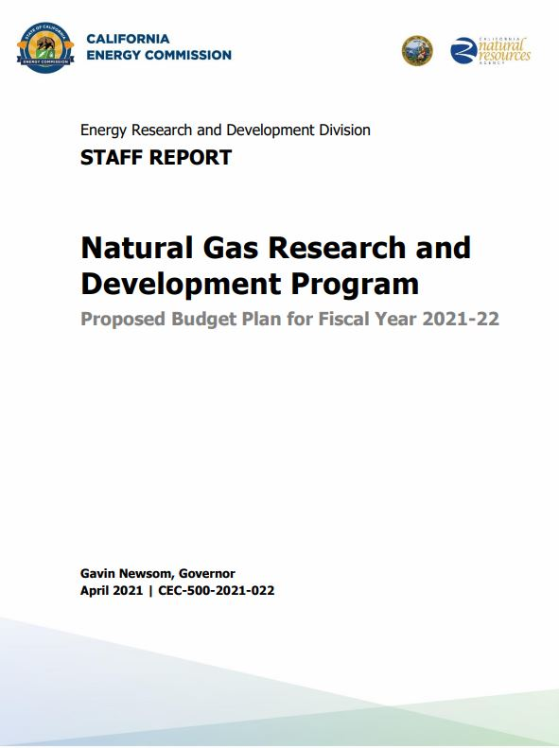
CEC’s Gas Research and Development Program
CEC’s Gas Research and Development Program supports public interest R&D
FY 2021-2022 Natural Gas R&D Funding Plan includes a research initiative to support efforts to minimize air pollutant impacts to California residents
Specifically, this research responds to the initiative:
Quantify Exposures to Indoor Air Pollutants in Multifamily Homes that Cook with Gas or Alternatives.
Gas Research and Development Program: https://www.energy.ca.gov/programs-and-topics/programs/gas-research-and-development-program

Slide 11
Policy Drivers
AB 3232, Zero-emissions buildings and sources of heat energy: requires a feasibility assessment to assess the potential for California to reduce GHG’s from buildings by 40 percent below 1990 levels by 2030.
California Energy Code: ensures that new and existing buildings achieve energy efficiency and preserve outdoor and indoor environmental quality through use of the most energy efficient technologies and construction.
AB 758, Building Efficiency: develop a comprehensive program to achieve greater energy and water savings in existing residential and nonresidential buildings.
SB 1477, Low-emissions Buildings and Sources of Heat Energy: requires the CPUC to develop two programs (Building Initiative for Low-Emissions Development and Technology and Equipment for Clean Heating) aimed at reducing greenhouse gas emissions associated with buildings.

Slide 12

Purpose of Solicitation
Field study to quantify and characterize residents’ exposure to indoor air pollutants generated from kitchen stoves in multifamily homes.
Help guide future intervention policies such as building ventilation and electrification.
Cooking process can be source of many health-damaging pollutants including NO₂ and PM_{2.5} ​

Slide 13
Available Funding
Project | Available Funding | Minimum Award Amount | Maximum Award Amount
Quantifying Exposures to Indoor Air Pollutants in Multifamily Homes that Cook with Gas or Alternatives | $2,000,000 | $1,900,000 | $2,000,000

Slide 14
Match Funding
Match funds of at least 5% requested CEC funds are required.
Applications that include match funding will receive additional points during the scoring phase.
Match funding contributors must submit match funding commitment letters that meet the requirements. Failure to do so will disqualify the match funding commitment from consideration.
Refer to the Solicitation Manual for more details on match funding.

Slide 15
Quantifying Exposures to Indoor Air Pollutants in Multifamily Homes that Cook with Gas or Alternatives
Background
Use of gas stoves in tightly sealed homes can contribute to concentrations of NO₂ & PM_{2.5} that exceed ambient air quality thresholds.
These pollutants have been associated with negative human health impacts.
Understanding exposure to pollutants is important to estimate health impacts.
Smaller homes – including MF homes – are associated with higher pollutant concentrations.

Slide 16
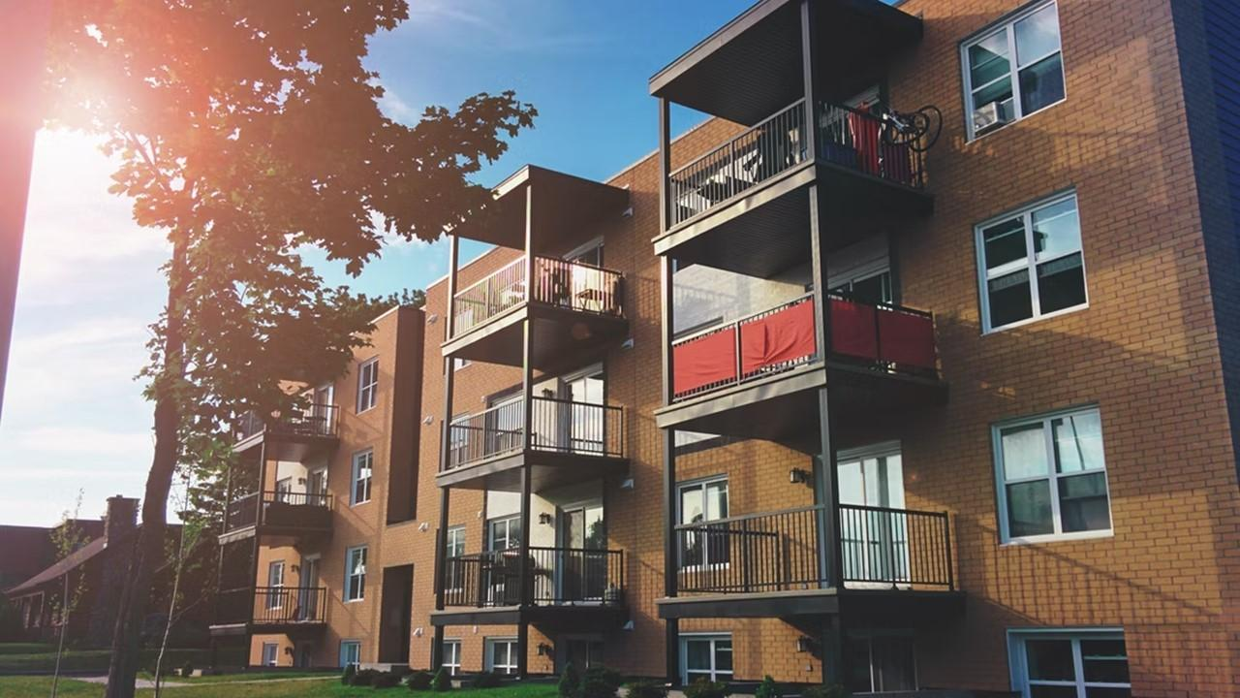

Quantifying Exposures to Indoor Air Pollutants in Multifamily Homes that Cook with Gas or Alternatives
Successful applicants must:
design and implement a field study of multifamily homes in California to determine human exposures to pollutants from residential cooking.
Focus on multi-family homes
Pollutant concentrations and exposure

Slide 17
Quantifying Exposures to Indoor Air Pollutants in Multifamily Homes that Cook with Gas or Alternatives
Research must, at a minimum:
Contribute to an empirical basis for exposure assessment from a meaningful sample of multifamily units
Quantify the actual human pollutant exposure from residential gas cooking
Contribute to understanding the differences in residents’ exposures to cooking with gas vs electric stoves
Inform the benefits of dwelling unit ventilation and other controls

Slide 18
Quantifying Exposures to Indoor Air Pollutants in Multifamily Homes that Cook with Gas or Alternatives
Desirable considerations to strengthen the proposal:
Quantify actual human pollutant exposure to other pollutants of interest such as benzene and acrolein
Evaluate affordable methods for reducing kitchen-generated pollutant exposure in existing homes
Quantify the exposures across various seasons, including during relevant extreme weather events (e.g., heatwaves, wildfires)
Anticipate how research can contribute to a future lab study that sheds further light on exposure characterization of health-damaging pollutants
Evaluate and determine the most appropriate and accurate tools and methods for measuring source pollutants

Slide 19
Eligible Applicants
This is an open solicitation for public and private entities.
Applicants must accept the PIER terms and conditions.
  Standard, UC, and DOE T&Cs available online: https://www.energy.ca.gov/funding-opportunities/funding-resources
Applicants are encouraged to register with the California Secretary of State, as all recipients must be registered and in good standing to enter into an agreement with the Energy Commission: http://www.sos.ca.gov

Slide 20
Application Requirements
Each Applicant must complete and | including the following:
1. Application Form (.pdf) | 8. CEQA Compliance Form (.docx)
2. Executive Summary (.docx) | 9. References and Work Product Form (.docx, .pdf)
3. Project Narrative (.docx) | 10. Commitment and Support Letters (.pdf)
4. Project Team (.docx, .pdf) | 11. Project Performance Metrics
5. Scope of Work (.docx) | 12. Applicant Declaration (.docx)
6. Project Schedule (.xlsx) | 13. California Based Entity Form (.docx)
7. Budget (.xlsx)

Slide 21
Project Narrative (Attachment 3)
This is your opportunity to explain the entirety of the project. The narrative should explain:
  Why is your project necessary and important to California?
  What is your project approach and how will each major task be implemented?
  How will the project be completed in the term proposed
  How will the project outcomes benefit natural gas ratepayers?
  Address the requirements for your group as described in Section I.C.
  Respond to the scoring criteria described in Section IV.F.

Slide 22
Scope of Work (Attachment 5)
Tell us exactly what you are proposing to do in your project.
Identify what will be deliver to the Energy Commission.
Be sure to include in the technical tasks:
  At least one product deliverable per task.
  Address requirements in Section I.C. under Project Focus.
Be sure to include in the Project Schedule (Attachment 6):
  Product deliverables that correspond with the Scope of Work.
  Realistic dates on when product deliverables can be completed.

Slide 23
Budget (Attachment 7)
Identify how the Energy Commission funds and match funds will be spent to complete the project
Subcontractors receiving $100,000 or more Energy Commission funds must complete a separate budget form.
Ensure that all rates provided are maximum rates for the entire project term.
Travel Restrictions:
  If an applicant plans to travel to conferences, including registration fees, they must use match funds.

Slide 24
Commitment and Support Letter Forms (Attachment 10)
Follow guidelines provided for commitment and support letters.
  Commitment letters are required for entities or individuals that are committing match funding, testing/demonstration sites, including the Prime.
  Support letters describe a project stakeholder’s interest or involvement in the project.
All applicants must submit at least one support letter.
Match funding must be supported by a match fund commitment letter.
Any project partners that will make contributions to the project (other than match and sites) must submit a commitment letter.
Limit to two pages per letter, excluding the cover page.

Slide 25

How will my Application be Evaluated?
Application Screening
Admin Screening Process
Energy Commission staff screens applications per criteria in Section IV.E.
Criteria are evaluated on a pass/fail basis.
Applicants must pass all screening criteria or the application will be disqualified.
Some Reasons for Disqualification
Application is not submitted by the specified due date and time.
Application does not include one or more support letters.
Application contains confidential material.

Slide 26
How will my Application be Evaluated?
Application Scoring
Evaluation Committee applies the scoring scale to the scoring criteria.
Applications must obtain a minimum passing score of 52.5 points for Criteria 1-4 in order to continue evaluation.
Applications must obtain a minimum passing score of 70 points for Criteria 1-7 in order to be considered for funding.
Review Section IV of the manual and ensure the application provides a clear and complete response to each scoring criteria.
Scoring Criteria | Maximum Points
1. Technical Merit | 15
2. Technical Approach | 25
3. Impacts and Benefits for CA IOU Ratepayers | 20
4. Team Qualifications, Capabilities, and Resources | 15
5. Budget and Cost-Effectiveness | 10
6. CEC Funds Spent in California | 10
7. Ratio of Direct Labor Costs to Indirect Costs | 5
Total | 100
Minimum Points to Pass | 70

Slide 27
How will my Application be Evaluated?
Application Scoring – Preference Points
Passing applications (score of 70 or more from Criteria 1-7) will be considered for bonus points. Criteria for bonus points include:
  Match Funding
  Disadvantaged Communities
  California Based Entities
Scoring Criteria | Maximum Points
8. California Based Entities Funding | 5
9. Match Funds | 10
10. Disadvantaged & Low-income Communities | 5
Total Bonus Points | 20

Slide 28
Match Funding Points
Applicants may receive up to 10 additional preference points based on the criteria below:
  Up to 5 points will be awarded based on the percentage of proposed cash relative to the total match contributions using the Match Scoring Table in the Scoring Criteria.
  The remaining 5 points may be awarded to applications that exceed the minimum match requirements up to 100 percent using the Exceeds Minimum Match Scoring table.
  Refer to the Solicitation Manual for more details on the match funding scoring criteria.

Slide 29
Disadvantaged Communities
Projects with all test or demonstration sites located in disadvantaged and/or low-income communities and justifies how the project will benefit these communities may receive additional points.
  A disadvantaged community is identified by census tract and represents the 25% highest scoring tracts in CalEnviroScreen 4.0 or later versions: https://oehha.ca.gov/calenviroscreen/report/calenviroscreen-40
  Low-income communities are defined as communities within census tracts with median household incomes at or below 80 percent of the statewide median income, or at or below the threshold designated as low-income by the California Department of Housing and Community Development. http://www.hcd.ca.gov/grants-funding/income-limits/index.shtml

Slide 30
GFO Submission Requirements
Method of Delivery is the Energy Commission Grant Solicitation System, available at: https://gss.energy.ca.gov/
Electronic files must be in Microsoft Office Word (.doc, .docx) and Excel (.xls, .xlsx) formats, unless originally provided in solicitation in another format.
Application documents should meet formatting requirements, and page recommendations.
Attachments requiring signatures (Application Form and Support/Commitment Letters) may be scanned and submitted in PDF format.
First-time users must register as a new user to access system.
Grant Solicitation System (GSS) How to Apply presentation: https://www.energy.ca.gov/media/1654

Slide 31
GSS WARNING
START THE PROCESS EARLY!
Applications must be fully submitted BEFORE the deadline listed in the solicitation manual
The GSS system will shut off at the deadline
Applications in the process of being submitted prior to the deadline will NOT be accepted after the deadline
Applications will NOT be accepted after the deadline

Slide 32
GSS Structure
Register as a New User
Log In
3 Step Application Process:
Select Solicitation
Upload Files
• Select documents for upload
    Tag files with document type
    Designate confidential documents (if applicable)
    Review and Submit
    All three steps must be complete BEFORE the deadline

Slide 33
Next Steps After Grant Award
Notice of Proposed Award: Shows total proposed funding amounts, rank order of applicants by project group, and the amount of each proposed award.
Agreement Development: Proposal documents will be processed into a legal agreement.
Failure to Execute: The Energy Commission reserves the right to cancel the pending award if an agreement cannot be successfully executed with an applicant.
Project Start: Recipients may begin work on the project only after the agreement is fully executed (approved at an Energy Commission business meeting and signed by the Recipient and the Energy Commission).

Slide 34
Key Dates
Activity | Date
Solicitation Release | November 6, 2023
Pre-Application Workshop | November 20 at 10 am
Deadline for Written Questions | November 27 December 1 at 5:00 pm
Anticipated Distribution of Questions and Answers | Week of December 22, 2023
Deadline to Submit Applications | January 31, 2024 at 11:59 pm
Anticipated Notice of Proposed Award Posting | March 18, 2024
Anticipated Energy Commission Business Meeting | May 8, 2024
Anticipated Agreement Start Date | May 27, 2024
Anticipated Agreement End Date | March 31, 2028

Slide 35
Questions and Answers
Please chat your question in the Question and Answers window or raise your hand and you will be called on to unmute yourself. Please remember to introduce yourself by stating your name and affiliation. (Feature found under the Participants panel)
Keep questions under 2 minutes to allow time for others.
Note that our official response will be given in writing and posted on the GFO webpage.

Slide 36
Additional Questions
Please send all questions related to GFO-23-501 to:
Pierre Washington
Commission Agreement Officer
1516 Ninth Street, MS-18
Sacramento, CA 95814
(916) 654-8974
pierre.washington@energy.ca.gov
Deadline to submit questions:
Friday, December 1, 5:00 PM

Slide 37
Thank You!

