Slide 1
GFO-23-302 Pre-Application Workshop
Power Electronics for Zero-Emission Residential Resiliency (PEZERR)
Energy Research and Development Division, California Energy Commission
Presenter: Tanner (Tahn-ehr) Kural, Electric Generation System Specialist
Date: December 6, 2023

Slide 2
Agenda
Time | Item
10:00 am | Welcome and Introduction
10:05 am | Solicitation Background EPIC Research Program Purpose of Solicitation Project Requirements Available Funding
10:30 am | Application Requirements Two-Phase Process Attachments Submission Process Evaluation Process
11:00 am | Q&As
12:00 pm | Adjourn

Slide 3
Virtual Housekeeping
This workshop will be recorded.
Participants will be muted during the presentation until the Q&A session.
Please send your questions in the Q&A window of Zoom.
Updates on solicitation documents including this presentation will be posted at the Grant Funding Opportunity’s webpage: https://www.energy.ca.gov/solicitations/2023-11/gfo-23-302-power-electronics-zero-emission-residential-resilience-pezerr

Slide 4
Commitment to Diversity
The Energy Commission adopted a resolution strengthening its commitment to diversity in our funding programs. The Energy Commission continues to encourage disadvantaged and underrepresented businesses and communities to engage in and benefit from our many programs.
To meet this commitment, Energy Commission staff conducts outreach efforts and activities to:
Engage with disadvantaged and underrepresented groups throughout the state.
Notify potential new applicants about the Energy Commission’s funding opportunities.
Assist applicants in understanding how to apply for funding from the Energy Commission’s programs.
Survey participants to measure progress in diversity outreach efforts.

Slide 5
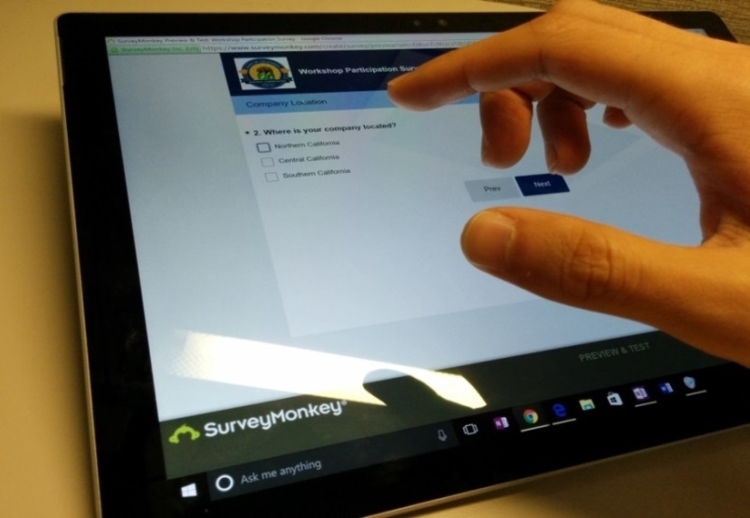
We Want to Hear From You!
Participation Survey
Survey responses will be summarized anonymously to track attendance of underrepresented groups in our workshops for public reporting purposes.
Online participants, please use this link: https://forms.office.com/g/a2ja6KxLns
Thanks!

Slide 6
Connect With Us

Slide 7
Find a Partner on EmpowerInnovation.net
Empower Innovation strives to accelerate your clean tech journey with easy access to funding opportunities from the Energy Commission and other funding providers, curated resources and events, and connections to people and organizations.
FIND A PARTNER
Announce your interest in this funding opportunity and message other interested parties to find potential partners.
RESOURCES & TOOLS
Browse the collection of resources for clean tech innovators including Resource Libraries, Funding Sources, Tools, and Databases.
https://www.empowerinnovation.net/en/custom/funding/view/40667

Slide 8
EmpowerInnovation.net

Slide 9
Research Program Background
The Electric Program Investment Charge (EPIC) Program is an electricity ratepayer surcharge established by the California Public Utilities Commission (CPUC) in December 2011
The purpose of the EPIC program is to benefit the ratepayers of the three investor-owned utilities (IOUs)*
The EPIC program funds clean energy technology projects that promote greater electricity reliability, lower costs, and increased safety
Applied Research and Development
Technology Demonstration and Deployment
Market Facilitation
*Pacific Gas and Electric Co., San Diego Gas and Electric Co., and Southern California Edison Co.

Slide 10
Key Policy Drivers
SB 100: 100 Percent Clean Electricity by 2045
AB 3232: 40 Percent Reduction in Greenhouse Gas Emissions From Buildings by 2030
Research results could inform:
CEC’s Distributed Electricity Backup Assets (DEBA) and the Demand Side Grid Support (DSGS) Programs created through AB 205.
Intended to incentivize DERs as grid reliability support during extreme events
CPUC’s Rule 21 interconnection proceeding (R.17-07-007).
Preventing unintentional backflow onto the grid and managing safe reconnection to the utility grid
CPUC’s Vehicle-Grid Integration (VGI) activities under the Transportation Electrification proceeding (R. 18-12-006).
CPUC’s Microgrid proceeding (R.19-09-009).
CPUC Microgrid Track 2 Decision

Slide 11
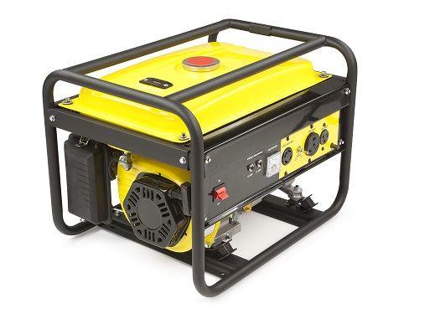
Research Need
Affordable solutions are needed for meeting critical loads as California faces more challenges in maintaining a reliable grid.
Common solution is installing diesel generators, which result in greenhouse gas and criteria pollutant emissions.
Ensuring clean, affordable backup power solutions is imperative to meet California’s environmental justice goals as power outages disproportionately impact low-income, rural, and Disadvantaged communities.
One portable gas generator emits as much carbon monoxide (CO) as ~ 450 cars in an hour. (U.S. Consumer Product Safety Commission 2016)

Slide 12
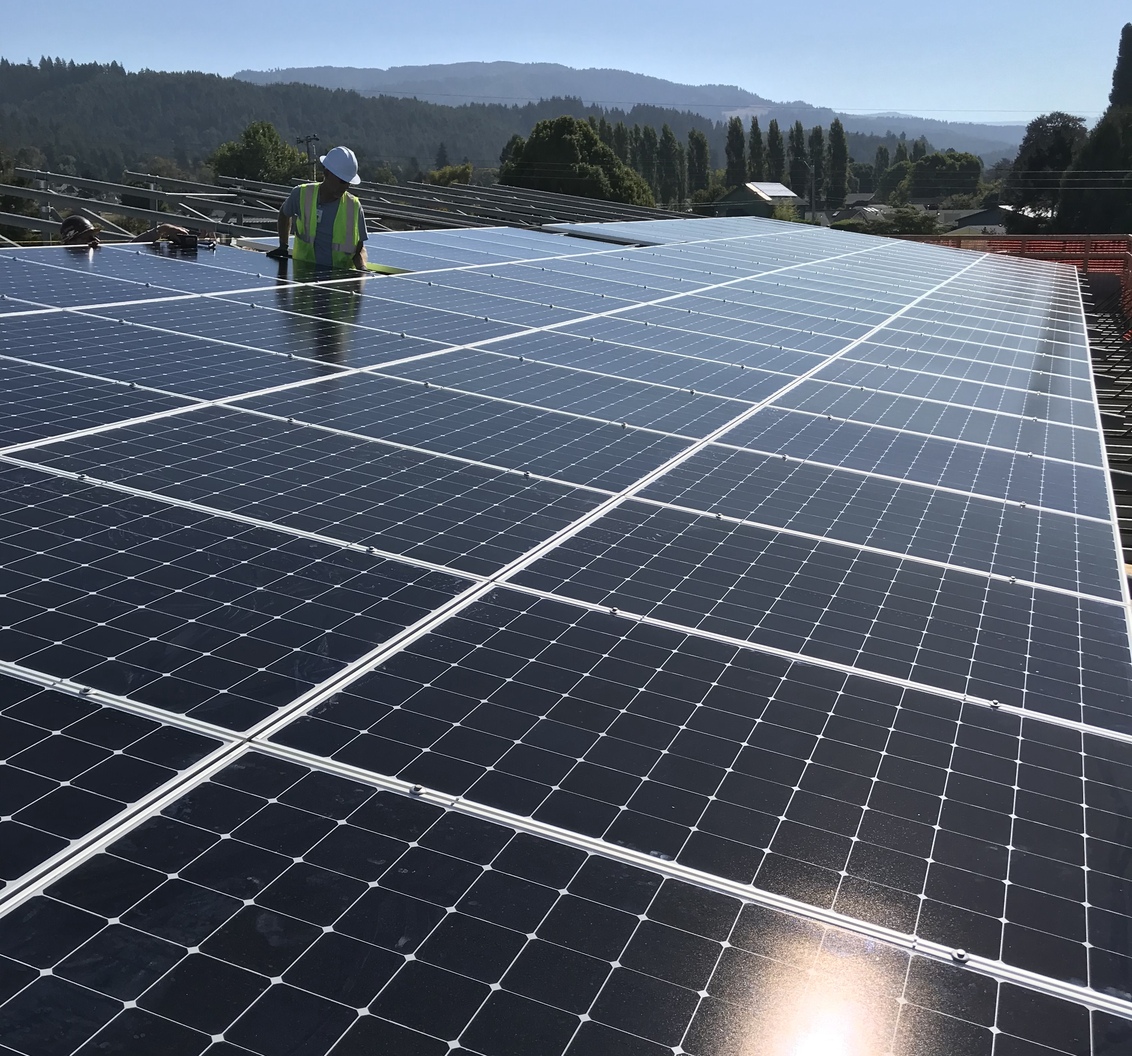
Problem Statement
Current zero-emission behind-the-meter backup power solutions (e.g., solar and storage) have high balance-of-system (BOS) costs, making 70% of the total system costs.
Current offerings of resiliency-enabling power electronics require expensive customization, are at early stages of product development, or do not have adequate functionality to meet most customers’ needs.
Examples of BOS costs include wiring, control systems, and other equipment, as well as installation labor, permits, and engineering design.
Image source: Blue Lake Rancheria and Schatz Energy Research Center under agreement EPC-17-002

Slide 13
Emerging Technologies
Emerging solutions leveraging power electronics hold promise in offering straightforward-to-implement and low-cost solutions to enable greater access to zero-emission backup power.
Examples of emerging power electronics technologies include (but are not limited to):
Smart electric panels
Meter collar adaptors
Multi-mode inverters
Standardized switchgears
Modular power components

Slide 14
Purpose of Solicitation
Demonstrate emerging power electronics technologies that reduce the time, cost, and complexity of installing and integrating zero-emission backup power systems (e.g., solar and battery systems).
Key research objectives include:
Minimizing customization required for installing backup power at residences with varying characteristics.
Validating ability to safely island during grid outages and reconnect when grid power resumes, autonomously.
Projects must demonstrate how the technology helps make zero-emission BTM backup power more affordable for communities disproportionately impacted by power outages.*
*Disadvantaged Communities, low-income communities, Tribal communities

Slide 15
Available Funding
Available Funding | Minimum Award Amount | Maximum Award Amount
$6,000,000 | $1,500,000 | $2,000,000

Slide 16
Match Funding
Match funding is required in the amount of at least 20% of the requested CEC funds.
Example Calculation:
An Applicant requests $2,000,000 of CEC funds for a project.
They must contribute at least $400,000 in match share.
Applications with additional match and higher proportions of cash match will receive additional points during scoring.
Match funding contributors must submit match funding commitment letters that meet the requirements. Failure to do so will disqualify the match funding commitment from consideration.

Slide 17
Key Technology Requirements
Automatic safe islanding, ensuring continuous power to critical loads and preventing unintentional backflow onto the grid.
Feature modular design: replicable and rapidly deployable in a variety of residential use cases with minimal alterations required (i.e., “plug-and-play ready”).
Allow customer to prioritize critical loads for outage ride-through.
Prevent the BTM backup power system from triggering a utility service upgrade.
Interoperable communication
See Part I Section C for complete list of project requirements.

Slide 18
Technology Readiness Level
1
6
7
Basic Principles
Preliminary Concept
Experimental Proof-of-Concept
Validation in Lab Environment
Bench Test in Relevant Environment
Prototype Pilot Demonstration
Field Test in Operational Environment
Deployment and Scale-up
Proven in Real-World Conditions
2
5
8
3
4
9
Initial technology readiness level of TRL 6 - 8

Slide 19
Demonstration Requirements
Projects must be sited in a Low-income or Disadvantaged Community or located within a California Native American Tribal territory (Tribe).
Definitions for Disadvantaged Community and low-income community are presented on a future slide.
California Climate Investments Priority Populations Map (right; illustrative)
Key | Community Represented
Blue | Low-income communities
Yellow | Disadvantaged Communities and Lands under control of federally recognized Tribes
Green | Low-income and Disadvantaged
Purple | Low-income adjacent communities

Slide 20
Recommendations for Research Design and Methodology
Collect and analyze 12 months of operational data after installation.
Demonstrate performance through at least six islanding events.
At least one during peak hours (4pm – 9pm).
Test system in multiple buildings that have varying characteristics (e.g., building size, occupancy use, load consumption).
Demonstrate reduction in time and complexity for an electrician to install backup power systems in an existing residence.
Conduct financial analysis for reducing BOS costs for customer compared to conventional backup power systems.
Demonstrate technology at existing residences with a main electrical panel size of 100A or less.
See Part I Section C for complete list of project requirements.

Slide 21
Additional Desirable Features
Bonus points will be awarded for projects that have sites in Tier 2/3 High Fire Threat Districts as defined by CPUC.
Demonstration sites located in areas that have historically high frequency of PSPS events.
Participation in grid service events like daily rate arbitrage, flex alerts, demand response, emergency load reduction, and CEC’s Market Informed Demand Automation Server (MIDAS).
Ascertain utility acceptance of product within all three IOU’s.
User-friendly interface that allows customers to flexibly prioritize critical loads.
Enable additional capacity for further electrification of the residential unit.

Slide 22
Eligible Applicants
This is an open solicitation for public and private entities.
Applicants must accept the EPIC terms and conditions.
Standard, UC, and DOE T&Cs available online: https://www.energy.ca.gov/funding-opportunities/funding-resources
Applicants are encouraged to register with the California Secretary of State, as all recipients must be registered and in good standing to enter into an agreement with the Energy Commission: http://www.sos.ca.gov

Slide 23
Two-Phase Evaluation Process
The evaluation process will consist of two phases:
Phase 1 – Technical Abstract Screening
Phase 2 – Full Application Evaluation and Scoring

Slide 24
Phase 1: Technical Abstracts
GFO-23-302: PEZERR
Due Date: January 19, 2024

Slide 25
Technical Abstract Requirements
Each Applicant must complete and include the following: | Page Limit:
Abstract Project Summary (.docx) Innovation Methodology Market Competitiveness | Limit response to eight pages
Comparison Table(s) Photos of Proposed Technology | Not subject to page limit

Slide 26
Pre-Application Project Abstract (Attachment A)
This is your opportunity to describe your proposed technology to be demonstrated under this grant. The abstract should describe:
Innovation:
How the technology works and how it addresses the GFO’s goals of reducing cost, time, and complexity in installing BTM zero-emission backup power systems
Key innovation and technology readiness level
Methodology:
Technical approach of the proposed demonstration
Measurement and verification strategy
Project team qualifications and prior/planned community engagement activities
Market Competitiveness:
How the technology addresses key market needs and customer adoption barriers
Path-to-Market Strategy
Financial- and energy-related customer benefits
See Attachment A for full prompt, consisting of ten questions.

Slide 27
Technical Abstract Appendix (Att. A-IV)
Comparison Tables. Compare your proposed technology to current leading and competing technologies under the following attributes to the best of your ability:
Quantity of loads powered as energy capacity
Time duration that critical loads can be powered
Levelized cost of energy for the full backup power solution
Cost of permits for the full backup power solution
Cost of utility interconnection requirements (as applicable)
Costs incurred from electrician’s billed labor hours for installation
Operational Steps for customers to shift into island mode
Annual maintenance requirement

Slide 28
Technical Abstract Appendix (Att. A-V)
Photos of Proposed Technology
Submit pictures and/or diagrams that illustrate how your technology functions and operates.
Detail components that are to be installed under your proposed demonstration.
Do not submit confidential information.

Slide 29
Phase 2: Full Application
GFO-23-302: PEZERR
Due Date: April 19, 2024

Slide 30
Application Requirements
Each Applicant must complete and | include the following:
1. Executive Summary (.docx) | 7. CEQA Compliance Form (.docx)
2. Project Narrative (.docx) | 8. Past Project Information (.docx, .pdf)
3. Project Team (.docx, .pdf) | 9. Commitment and Support Letters (.pdf)
4. Scope of Work (.docx) | 10. Project Performance Metrics
5. Project Schedule (.xlsx) | 11. Applicant Declaration (.docx)
6. Budget (.xlsx)

Slide 31
Project Narrative (Attachment 2)
This is your opportunity to explain the entirety of the project. The narrative should explain:
Why is your project necessary and important to California?
What is your project approach and how will each major task be implemented?
How will the project be completed in the term proposed
How will the project outcomes benefit electric IOU ratepayers?
Address the requirements for your group as described in Section I.C.
Respond to the scoring criteria described in Section IV.F.

Slide 32
Scope of Work (Attachment 4)
Tell us exactly what you are proposing to do in your project.
Identify what will be deliver to the Energy Commission.
Be sure to include in the technical tasks:
At least one product deliverable per task.
Address requirements in Section I.C. under Project Focus.
Be sure to include in the Project Schedule (Attachment 5):
Product deliverables that correspond with the Scope of Work.
Realistic dates on when product deliverables can be completed.

Slide 33
Budget (Attachment 6)
Identify how the Energy Commission funds and match funds be spent to complete the project
Subcontractors receiving $100,000 or more Energy Commission funds must complete a separate budget form.
Ensure that all rates provided are maximum rates for the entire project term.
Travel Restrictions:
CEC funds should be limited to lodging and any form of transportation (e.g., airfare, rental car, public transit, parking, mileage).
If an applicant plans to travel to conferences, including registration fees, they must use match funds.

Slide 34
Commitment and Support Letter Forms (Attachment 9)
Follow guidelines provided for commitment and support letters.
Commitment letters are required for entities or individuals that are committing match funding, testing/demonstration sites, including the Prime.
Support letters describe a project stakeholder’s interest or involvement in the project.
All applicants must submit at least one support letter.
Match funding must be supported by a match fund commitment letter.
Any project partners that will make contributions to the project (other than match and sites) must submit a commitment letter.
Limit to two pages per letter, excluding the cover page.

Slide 35
GFO Submission Requirements (1)
Applications will be submitted through the Energy Commission Agreement Management System, available at: https://ecams.energy.ca.gov/
Applicants must have or create a user account in order to apply for this solicitation. To create an account, please see the guidance document titled User Registration Instructions
Note: One account manager per organization, but users can be added by account manager

Slide 36
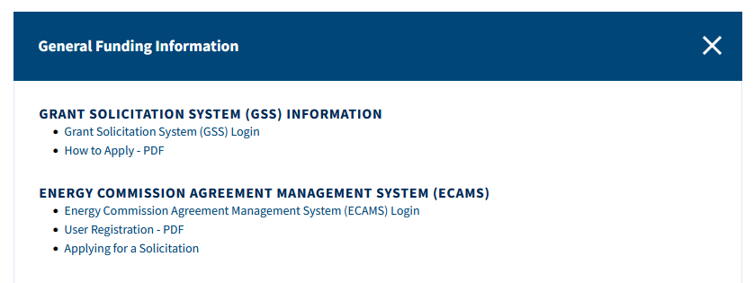
GFO Submission Requirements (2)
For detailed instructions on how to submit an application, please see the Applying for a Solicitation guidance document.
Both of the referenced guidance documents are available at https://www.energy.ca.gov/funding-opportunities/funding-resources under General Funding Information.
Any questions about the ECAMS system can be sent to ECAMS.SalesforceSupport@Energy.ca.gov

Slide 37
GFO Submission Requirements (3)
Electronic files, other than those requiring signatures, must be in the format that they are provided in the solicitation.
Application documents should meet formatting requirements, and page recommendations provided in the solicitation manual.
Attachments requiring signatures (Support/Commitment Letters) may be scanned and submitted in PDF format.

Slide 38
APPLICATION WARNING
START THE PROCESS EARLY!
Applications must be fully submitted BEFORE the deadline listed in the solicitation manual
The ECAMS system will not allow submission after the deadline
Applications in the process of being submitted prior to the deadline will NOT be accepted after the deadline
Applications will NOT be accepted after the deadline

Slide 39
Application Review
We recommend you carefully review your application both before and after submission.
Verify that all necessary documents have been uploaded.
Verify that all documents uploaded are the accurate version you intend to submit as your final.
Verify that your documents are not marked "confidential.” This solicitation does not allow submission of confidential information.
Verify that your match commitment letters accurately reflect the match amounts included in your budgets, including the match provided by the prime applicant.
Verify that support and commitment letters are included, if required.
Verify that amounts entered within the system's budget (if any) concur with information included on uploaded budget worksheets.

Slide 40
How will my Application be Evaluated? Application Screening (Phases 1 and 2)
Admin Screening Process
Energy Commission staff screens applications per criteria in Section IV. E and F (Phases 1 and 2, respectively).
Criteria are evaluated on a pass/fail basis.
Applicants must pass all screening criteria or the application will be disqualified.
Some Reasons for Disqualification
Application is not submitted by the specified due date and time.
Application does not include one or more support letters.
Application contains confidential material.

Slide 41
How will my Application be Evaluated? Phase 1: Technical Evaluation of Abstract
Technical Evaluation Process
Energy Commission staff screens applications per criteria in Section IV.E.
Criteria are evaluated on a “Pass” and “Do Not Pass” basis.
Applicants must pass all screening criteria to be invited to submit a Phase 2 Full Application.
Evaluation Criteria
Innovation meets Project Focus requirements
Methodology is strategic and feasible
Market Competitive
Comparison Table
Abstract is responsive to prompts within Attachment A

Slide 42
How will my Application be Evaluated? Phase 2: Full Application Scoring
Scoring Criteria | Maximum Points
1. Technical Merit | 15
2. Technical Approach | 25
3. Impacts and Benefits for CA IOU Ratepayers | 20
4. Team Qualifications, Capabilities, and Resources | 15
5. Budget and Cost-Effectiveness | 10
6. CEC Funds Spent in California | 10
7. Ratio of Direct Labor Costs to Indirect Costs | 5
8. Benefits to Disadvantaged/Low-Income Communities/Tribes | 50
Total | 150
Minimum Points to Pass | 105
Evaluation Committee applies the scoring scale to the scoring criteria.
Applications must obtain a minimum passing score of 52.5 points for Criteria 1-4 in order to continue evaluation.
Applications must obtain a minimum passing score of 70 points for Criteria 1-7 in order to be considered for funding.
Review Section IV of the manual and ensure the application provides a clear and complete response to each scoring criteria.

Slide 43
Evaluating Criteria 8
Proposed Scoring Criteria | Maximum Points
Benefits to Disadvantaged/Low-Income Communities/Tribes and Localized Health Impacts
8.1 Benefits to Disadvantaged/Low-Income Communities/Tribes 8.2. Community Engagement Efforts 8.3. Localized Health Impacts 8.4. Technology Replicability 8.5. Project Support Letters | 15 10 15 5 5
Total Possible Points for criteria 8 (Minimum Passing Score for criteria 8 is 70% or 35.00) | 50
Total Possible Points for Proposal | 150

Slide 44
How will my Application be Evaluated? Application Scoring – Preference Points
Passing applications (score of 70 or more from Criteria 1-7) will be considered for bonus points. Criteria for bonus points include:
Match Funding
Projects sited in High Fire-Threat Districts
Scoring Criteria | Maximum Points
9. Match Funds | 10
10. Wildfire Criteria Demonstration located in Tier 2 or 3 High Fire-Threat District as defined by CPUC | 5
Total Bonus Points | 15

Slide 45
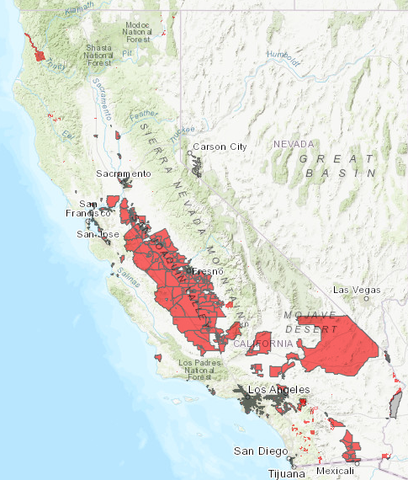
Identifying Disadvantaged Communities
Census tracts receiving the highest 25% of CalEnviroScreen 4.0
Census tracts lacking scores due to data gaps, but receiving highest 5% of CalEnviroScreen 4.0 cumulative pollution burden scores
Census tracts identified prior as Disadvantaged within 2017 DAC designation
Lands under control of federally recognized Tribes
https://oehha.ca.gov/calenviroscreen/sb535

Slide 46
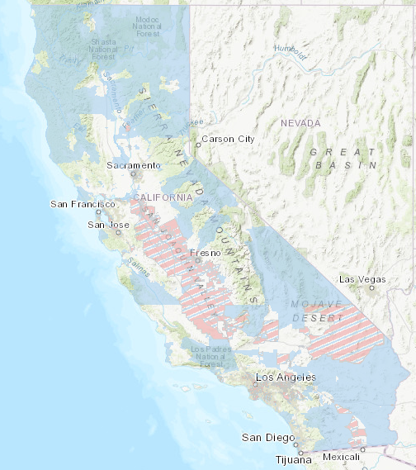
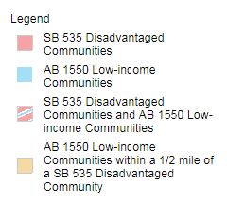
Identifying Low-Income Communities
Communities within census tracts with median household incomes at or below 80% of the statewide median income, or at or below the threshold designated as low-income by the California Department of Housing and Community Development:
https://www.arb.ca.gov/cc/capandtrade/auctionproceeds/communityinvestments.htm (California Air Resources Board)

Slide 47
Community Based Organization Requirements
Has an office in the region and meets the demographic profile of the communities they serve
Has deployed projects and/or outreach efforts within the region
Employs staff specialized in and dedicated to – diversity, equity, inclusion, or is a 501(c)(3) non-profit
Have official mission and vision statements that expressly identifies serving DAC or LI communities

Slide 48
Match Funding Points
Applicants may receive up to 10 additional preference points based on the criteria below:
Up to 5 points will be awarded based on the percentage of proposed cash relative to the total match contributions using the Match Scoring Table in the Scoring Criteria.
The remaining 5 points may be awarded to applications that exceed the minimum match requirements up to 100 percent using the Exceeds Minimum Match Scoring table.
Refer to the Solicitation Manual for more details on the match funding scoring criteria.

Slide 49
High Fire Threat District – Bonus Pts. (Criteria 10)
Projects with demonstration sites located in a Tier 2 or 3 High Fire Threat District (HFTD) and justifies how the project will benefit these communities may receive additional points.
Percent of sites located in HFTD | Bonus Points
80 to 100% | 5
60 to <80% | 4
40 to <60% | 3
20 to <40% | 2
10 to <20% | 1
Defined by CPUC Fire Safety Rulemaking: https://www.cpuc.ca.gov/industries-and-topics/wildfires/fire-threat-maps-and-fire-safety-rulemaking

Slide 50
Next Steps After Grant Award
Notice of Proposed Award: Shows total proposed funding amounts, rank order of applicants by project group, and the amount of each proposed award.
Agreement Development: Proposal documents will be processed into a legal agreement.
Failure to Execute: The Energy Commission reserves the right to cancel the pending award if an agreement cannot be successfully executed with an applicant.
Project Start: Recipients may begin work on the project only after the agreement is fully executed (approved at an Energy Commission business meeting and signed by the Recipient and the Energy Commission).

Slide 51
Key Activities and Dates
Activity | Date
Solicitation Release | November 17, 2023
Pre-Application Workshop | December 6, 2023, at 10:00 am
Deadline for Written Questions | December 14, 2023, at 5:00 pm
Anticipated Distribution of Questions and Answers | Week of January 1, 2024
Deadline to Submit Technical Abstracts | January 19, 2024, at 11:59 pm
Anticipated Notice of Phase One Results (NOPOR) Posting Date | Week of February 16, 2024
Deadline to Submit Full Applications | April 19, 2024, at 11:59 pm
Anticipated Notice of Proposed Award (NOPA) Posting | Week of May 17, 2024
Anticipated CEC Business Meeting | June 12, 2024
Anticipated Agreement Start Date | July 1, 2024
Anticipated Agreement End Date | March 31, 2027

Slide 52
Questions and Answers
Please chat your question in the Question and Answers window or raise your hand and you will be called on to unmute yourself. Please remember to introduce yourself by stating your name and affiliation. (Feature found under the Participants panel)
Keep questions under 2 minutes to allow time for others.
Note that our official response will be given in writing and posted on the GFO webpage.

Slide 53
Questions and Answers
Three ways to ask questions:
Use the raise hand feature in Zoom:
Zoom phone controls:
*6 – Toggle mute/unmute
*9 – Raise hand
Introduce yourself by stating your name and affiliation
Keep questions under 3 minutes to allow time for others
Type questions in the Q&A Box in Zoom:
Please provide name and affiliation.
Submit written questions:
Send written questions to phil.dyer@energy.ca.gov by December 14, 2023, at 5pm
Note that an official CEC response will be provided in writing and posted on the GFO webpage in ~3 weeks.

Slide 54
Additional Questions
Please send all questions related to GFO-23-302 to:
Phil Dyer
Commission Agreement Officer
715 P St, MS-18
Sacramento, CA 95814
phil.dyer@energy.ca.gov
Deadline to submit questions: Thursday, December 14 at 5:00 PM
Deadline to submit Phase 1 Abstracts: Friday, January 19 at 11:59 PM
Deadline to submit Phase 2 Full Applications: Friday, April 19 at 11:59 PM

Slide 55
Thank You!

