Slide 1
Climate Data and Analysis Working Group
Energy-Related Environmental Research
Energy Research & Development Division
September 14, 2023

Slide 2
Overarching Purpose of C-DAWG
Bridge gaps between climate researchers, energy stakeholders who need to use climate-related data, and CEC staff.
Promote knowledge exchange.
Elicit input on key decisions (e.g., related to analytical methodologies or scenario choices).
Promote deep coordination within our portfolio.

Slide 3
Housekeeping
Meetings are not recorded
Welcome candid exchange
Please “raise hand” to speak
Please mute when not speaking

Slide 4
Today’s Agenda

Slide 5
Draft Process for Adoption of Fifth Assessment Data
Neil Matouka,
Governor’s Office of Planning and Research (OPR)

Slide 6
Proposed Data Adoption Timeline
Data Becomes Available
[Month 0]
Technical Justification Memo
[Month 3]
Some data may require peer review that can be facilitated through the Assessment
Assessment Team Reviews Submission Materials
[Month 4]
Technical Justification Memo Published and Data Marked as Adopted
[Month 6]

Slide 7
Proposed Metadata Standards
Analytics Engine Metadata Standards
https://analytics.cal-adapt.org/overview/metadata/
Does not guarantee inclusion in the Analytics Engine
FAIR Principles
https://www.go-fair.org/fair-principles/
CARE Principles
When working with Indigenous data
https://www.gida-global.org/care

Slide 8
Proposed Technical Justification Memo
High-level description of methods & prior related work (~200-300 words)
Curated list of references substantiating or using related methods (e.g., LOCA related to LOCA2, NCA uses LOCA, etc)
If/as appropriate, might describe in plain English how the current method has evolved from/added value to prior, accepted, peer-reviewed approaches
QA/QC, uncertainty
Brief summary of any quality control methods or assessment of outputs
If uncertainty/performance has been quantified, please share
Guidance, pointers, caveats
Where guidance exists (not asking you to produce anything additional to planned efforts/funded scopes), please point to it
If you have pointers or caveats (even if general) as to how to appropriately use (or avoid mis-using) data, that’s great too!
Forthcoming/in press publications
List of anticipated publications (e.g., topic and lead author) or publications in press associated with the “new” data

Slide 9
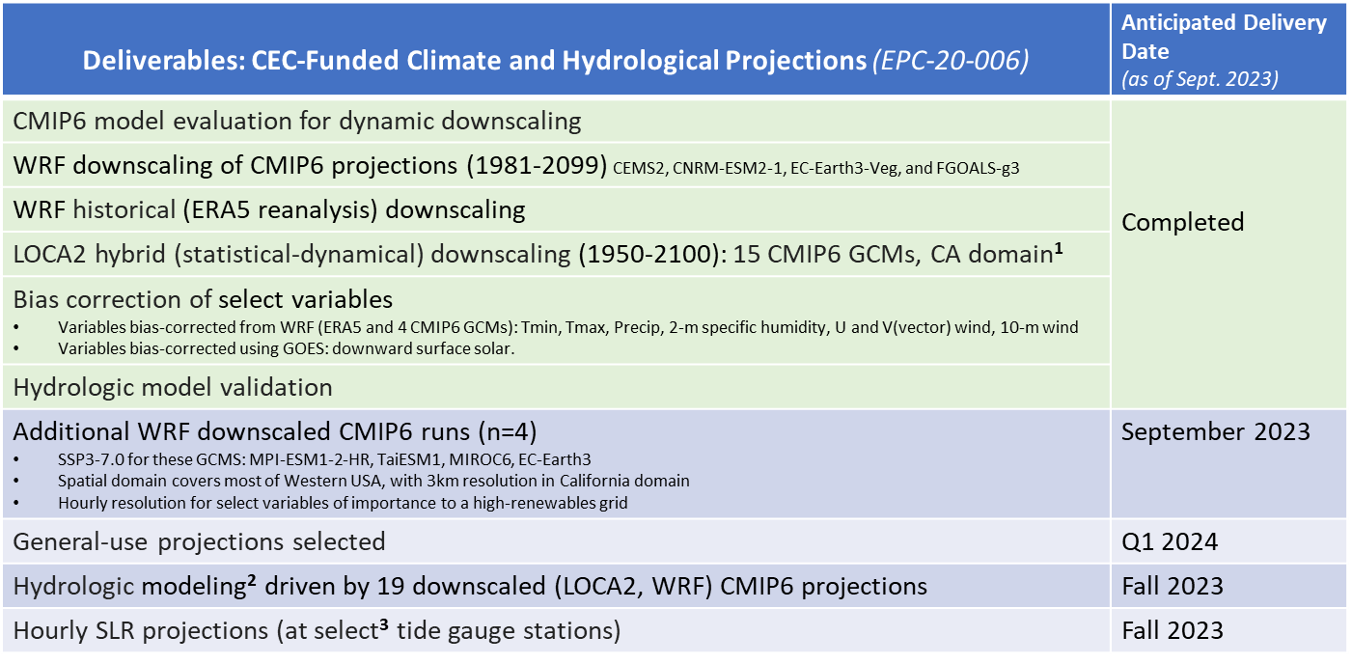
Deliverables: CEC-Funded Climate and Hydrological Projections (EPC-20-006)
Daily output of bias-corrected temperature, precipitation, humidity, wind, surface solar radiation, 3 km × 3 km resolution. Multiple runs for some GCMs, with 199 ensemble members spanning 3 SSPs (2-4.5, 3-7.0, 5-8.5).
Hydrological models: variable infiltration capacity (VIC), Noah-MP.
A total of 9 tide gauge stations along the California Coast.

Slide 10
Deliverables: CEC-Funded Long-Term Wildfire Projections (EPC-18-026)
Deliverables: CEC-Funded Long-Term Wildfire Projections (EPC-18-026) | Anticipated Delivery Date (as of Sept. 2023)
Historic reconstructions* of: vegetation/carbon historic wildfire * These historical reconstructions are used to train the long-term wildfire risk projections. | Complete
Long-term** wildfire risk projections portraying: fire presence (3 km grid), fire size, number of fires, fire severity, and smoke emissions ** Limited projections extending through end-century, more projections through mid-century. | Available on a rolling basis, beginning summer 2024

Slide 11
Proposed Milestones for Data Adoption
12/8/2023: Projections team submits data memos for projections and historical data (LOCA2, WRF-ERA5, WRF-CMIP6)
3/8/2024: Anticipated adoption of projections & historical data.
6/30/2024: Anticipated adoption of hydrological data, hourly SLR, “general use” projections.
8/31/2024: Anticipated adoption of long-term wildfire scenarios.
9/14/2023 (today!)
12/8/2023: Pyregence team submits data memos for historical vegetation and fire data used to train long-term wildfire projections
3/31/2024: Projections team submits data memos for hydrological scenarios (VIC, NOAH-MP), hourly SLR, “general use” projections
7/31/2024: Pyregence team submits data memo for long-term wildfire scenarios

Slide 12
General User-Needs Assessment Results for Cal-Adapt: Report out from OPR
Climate Data And Analysis Working Group – Sept 14, 2023
Ben McMahan, PhD – ben.mcmahan@opr.ca.gov
Office Of Planning & Research
Integrated Climate Adaptation & Resiliency Program

Slide 13
Cal-Adapt General User Needs Assessment
Initial Goals
Content: Assess/Improve prior generation, develop new resources
Reach: Expand network – increase relevance of resources
Preliminary Gaps
Structure: Improve user experience – optimize navigation
Content: Streamline workflow and path to technical assistance
Expanded Goals
Improved Connections: Between pages and resources
Accessibility: Framework for data/tool use & decision support

Slide 14
Preliminary Findings
Mid-Level users – falling through the cracks
Users taken out of flow – lack of additional context or seamless connections to data
Limited guidance and technical assistance means inconsistent user experience and unmet needs
Gaps & Comparative Analysis
User Interviews
Prototype Testing

Slide 15
High Level Recommendations
Users need content and resources that match their realities (Relevant data & connections)
Users need easier ways to find the info they're looking for (User focused workflow)
Users need a helping hand in deciding what resources to use (Technical assistance and guidance)
Contractor Deliverables: Gap Analyses, Competitive Analysis, & Development Guidebook

Slide 16
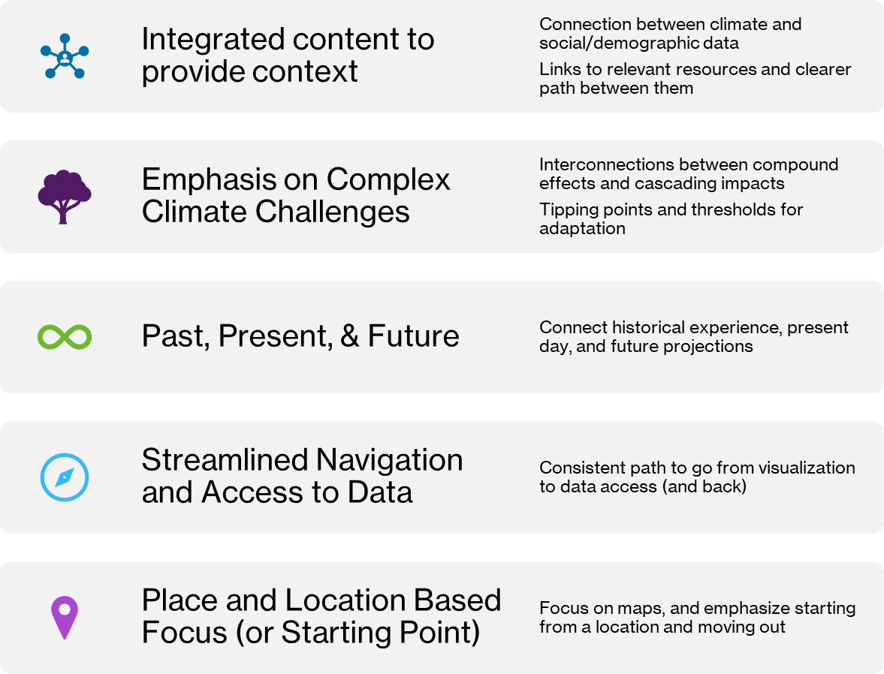
Cal-Adapt General User Needs Key Findings on Priorities

Slide 17
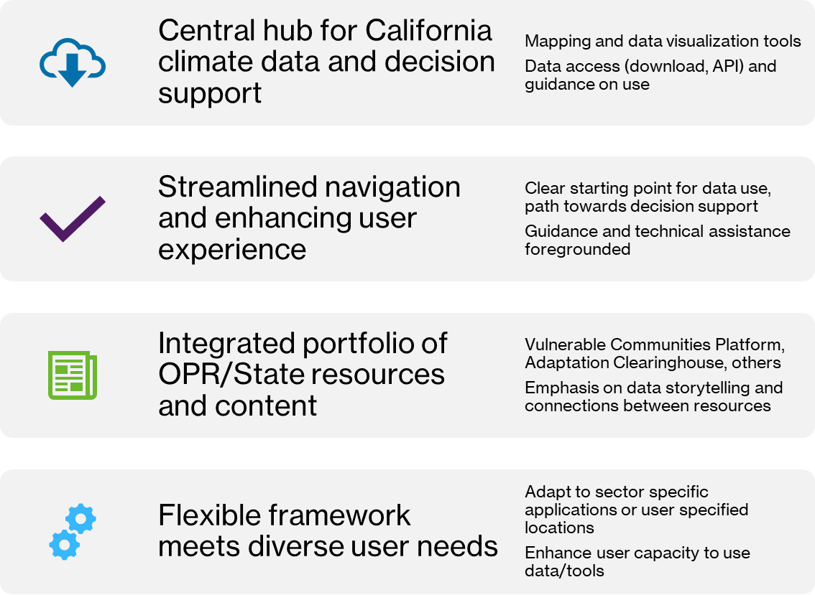
Goals

Slide 18
Challenges & Questions Raised General User Focused Cal-Adapt Platform
Balancing ease of use and flexibility/power
Decision focused tools or decision support framework
How to draw from current platform, and leverage advances with Analytics Engine?
How to provide guidance on use & develop a support framework, to expand user base and build capacity?
What are top priorities given resource and time constraints?

Slide 19
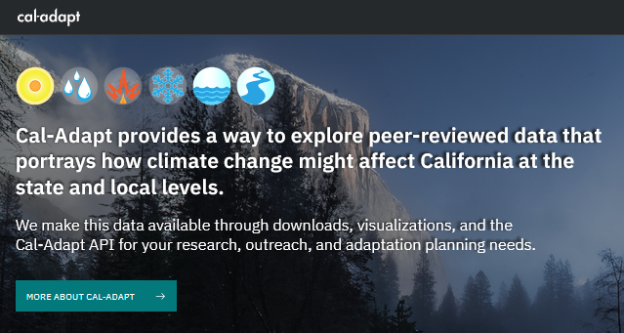
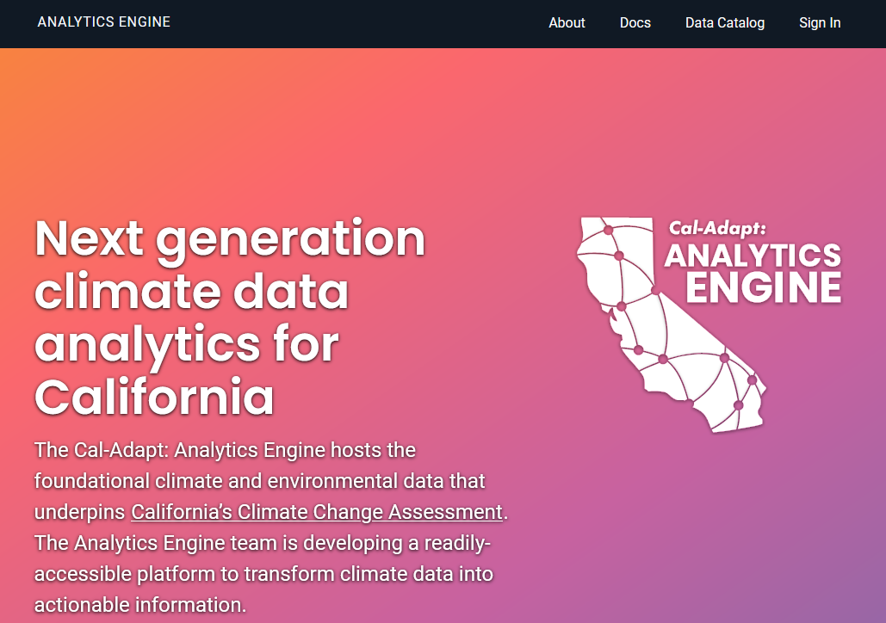
Multiple Grants Support the Expanded Enterprise
Analytics engine
- EPC-20-007, Susan Wilhelm, CEC manager
Visualizations + web application
- EPC-21-038, Mithra Moezzi, CEC manager
- OPR funding forthcoming, Ben McMahan
Observation platform
- PIR-19-006, Mithra Moezzi, CEC manager
See TN239954, docketed October 12, 2021: Cal-Adapt governance, responsibilities, data management.
Notes:
Broad enterprise is supported by multiple grants and funding streams…

Slide 20
Timeline
User Needs Assessment
Sept. 2022 – July 2023
Cal Adapt Web Application RFI/RFP Fall 2023
Updated Cal-Adapt Web Application 2024->
Notes:
User needs assessment over the last year
Council presentation
Results finalized in july
July clearinghouse redev begins
Release RFP later in the fal
Climate services general expansion
Use lessons learned to inform overall climate services programming
Inform VCP development
OPR strategic planning for tools & resources

Slide 21
Questions / Brief Discussion
Ben McMahan, PhD – ben.mcmahan@opr.ca.gov

Slide 22
Today’s Agenda

Slide 23
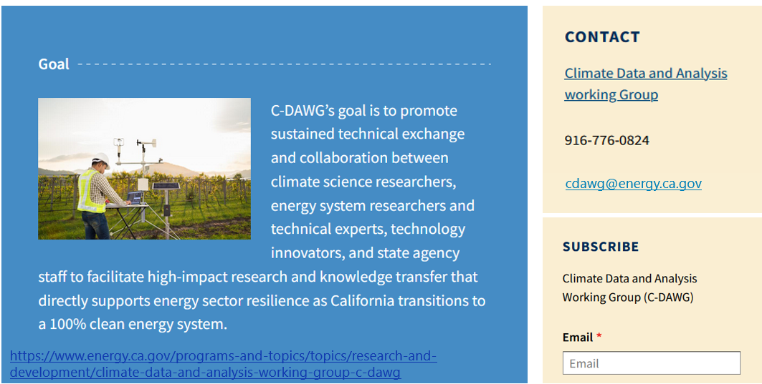
Thank you!

