Slide 1
Climate Data and Analysis Working Group
Sustainability & Health Unit
Energy Research & Development Division
May 17, 2024

Slide 2
Overarching Purpose of C-DAWG
Bridge gaps between climate researchers, energy stakeholders who need to use climate-related data, and CEC staff.
Promote knowledge exchange.
Elicit input on key decisions (e.g., related to analytical methodologies or scenario choices).
Promote deep coordination within our portfolio.

Slide 3
Housekeeping
Meetings are not recorded
Welcome candid exchange
Please “raise hand” to speak
Please mute when not speaking

Slide 4
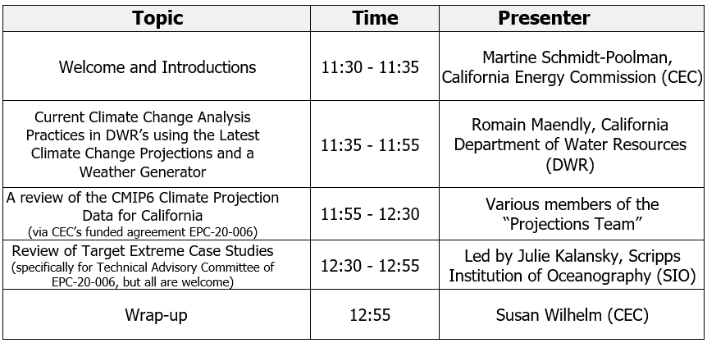
Today’s Agenda

