Slide 1
General Use Projections
Discussion of Process & Models

Slide 2
General Use Projections 1-01
What are General Use Projections?
A minimum subset of the 199 downscaled LOCA Hybrid GCM runs that can reasonably capture the range of future projections
Why have General Use Projections?
Provide a starter-set of models for those less comfortable with large amounts of data
Allows the use of a uniform set of projections across different analyses to support coordination, comparisons and collaboration across jurisdictional and other types of boundaries
Should I only use the General Use Projections?
No, it is always better to use the full set of runs if you are able
Using the General Use Projections is the minimum number of projections that should be used in any analysis

Slide 3
Large Set of CMIP6 Downscaled Climate Projection Data

Slide 4
Considerations for Selection of General Use Projections
Target SSP370 with a 2045-2074 mid-century period, which many users have identified as a high priority and is far enough in future to capture climate change signals.
Favor including projections that have WRF data available
Pare down metrics to a small number because too many uncorrelated metrics would reduce the ability of the metrics to usefully distinguish between models.
Metrics include temperature, precipitation and wind.
Favor metrics that are simple variables; avoid those that are derivatives of several variables.
Ensure the models selected capture the range of GCMs and ensemble members.
Selection did not consider time series/sequences (special cases will cover, e.g., droughts)
Exclude GCMs that have an unrealistically high climate sensitivity based on Tokarska et al., 2020 and Hausfather et al., 2022

Slide 5
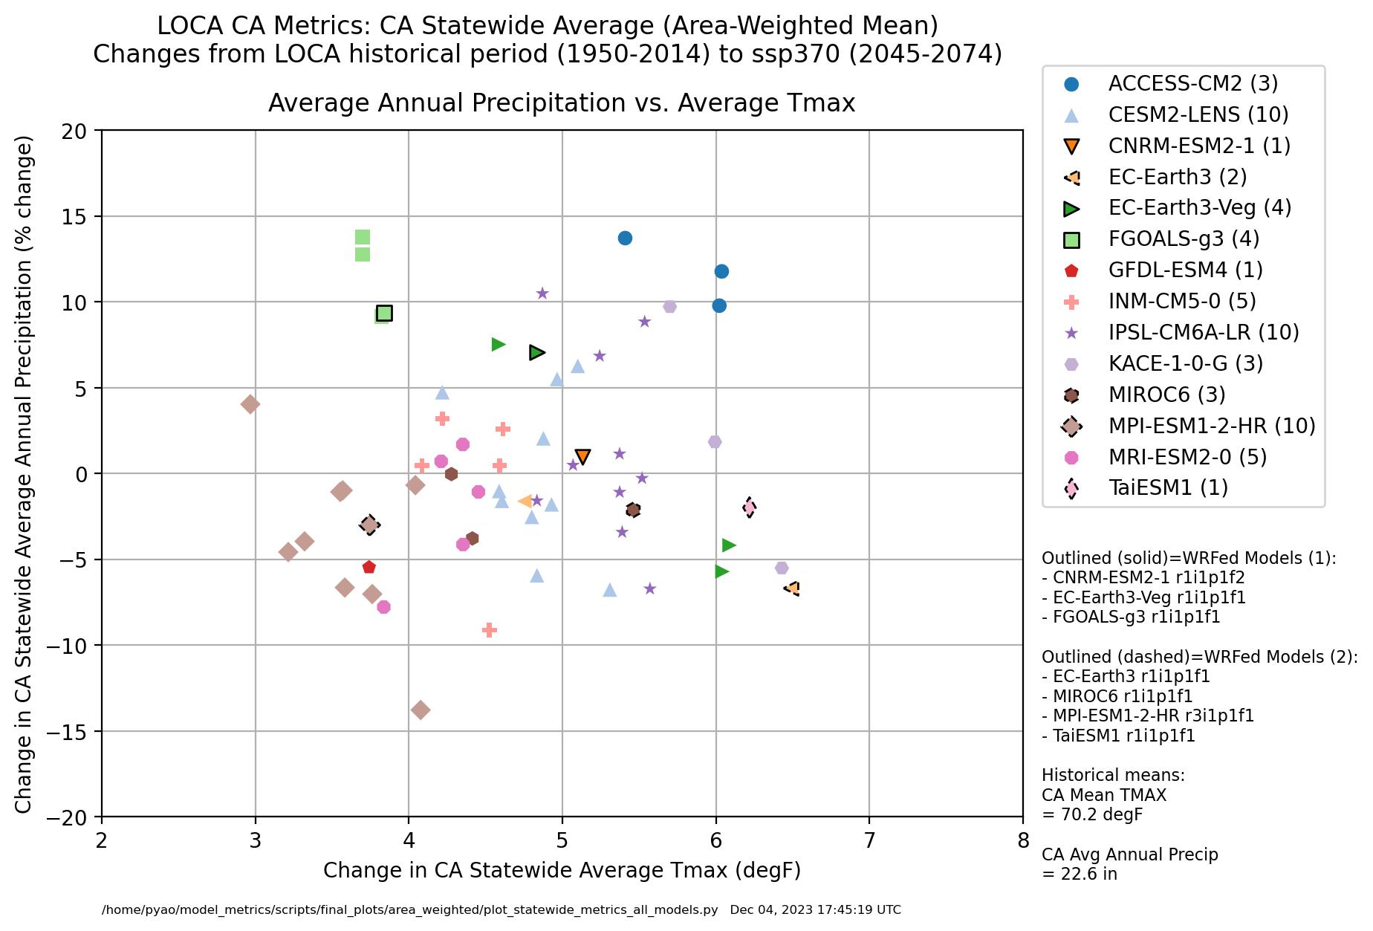
Proposed General Use Projections
-> Annual T and P changes are largely independent

Slide 6
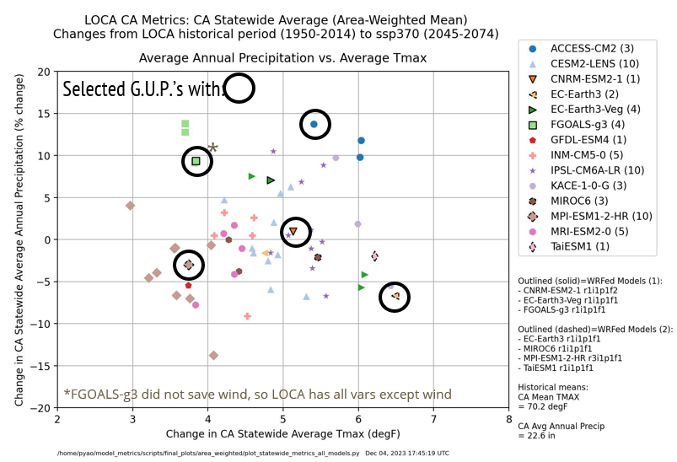
Proposed General Use Projections

Slide 7
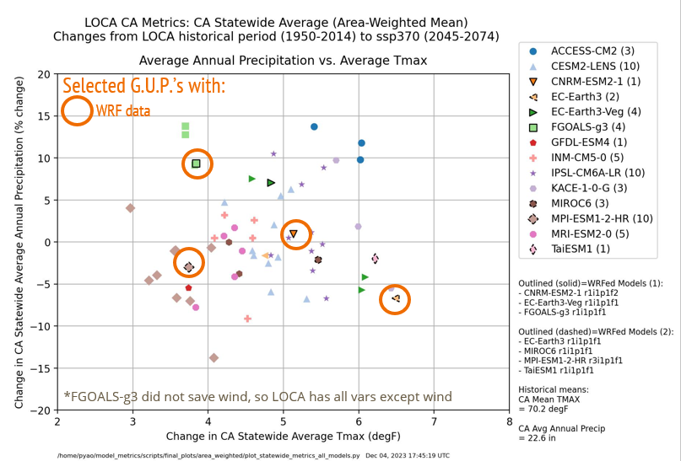
Proposed General Use Projections

Slide 8
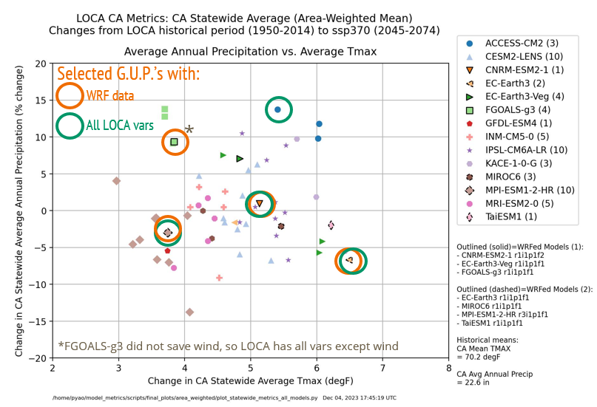
Proposed General Use Projections

Slide 9
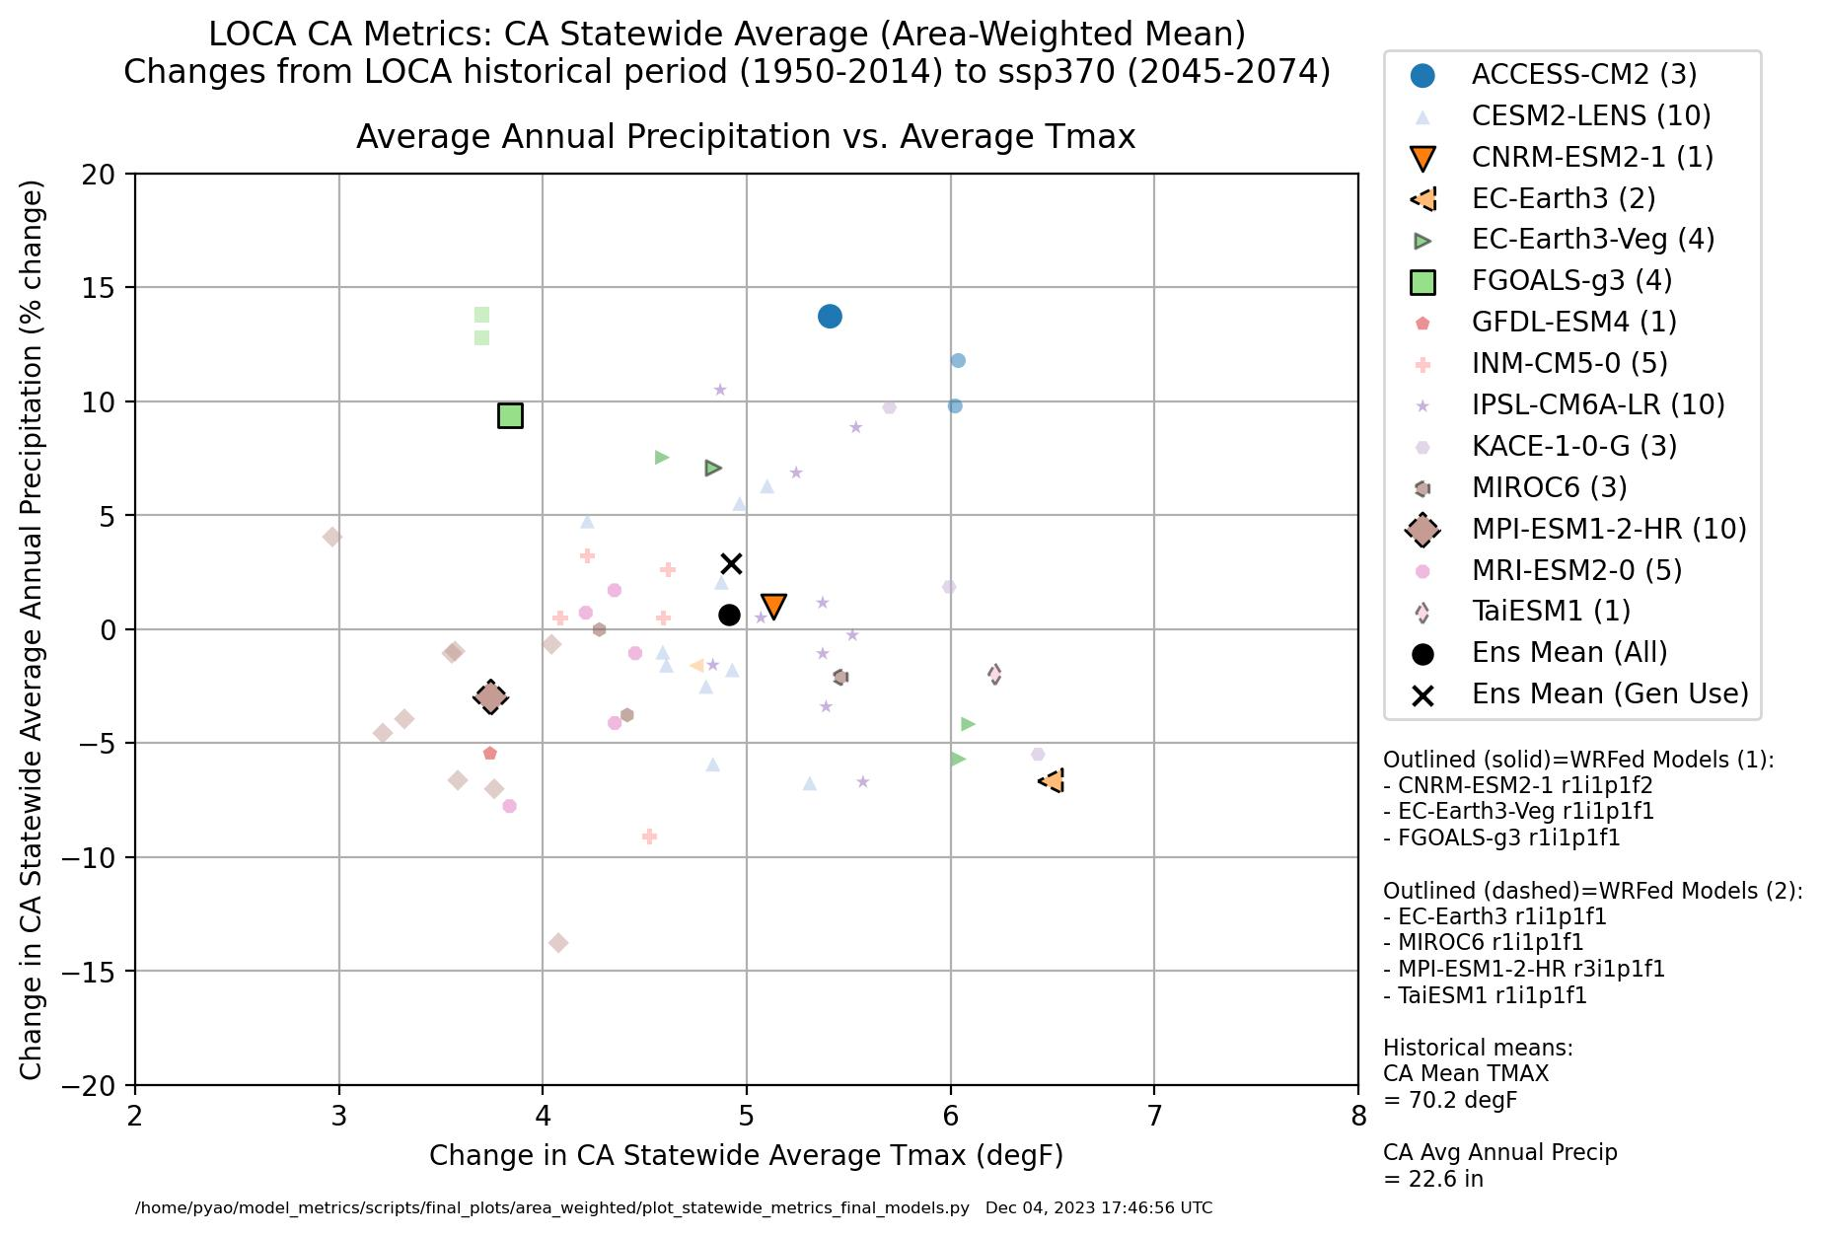
Proposed General Use Projections
*FGOALS-g3 did not save wind, so LOCA has all vars except wind

Slide 10
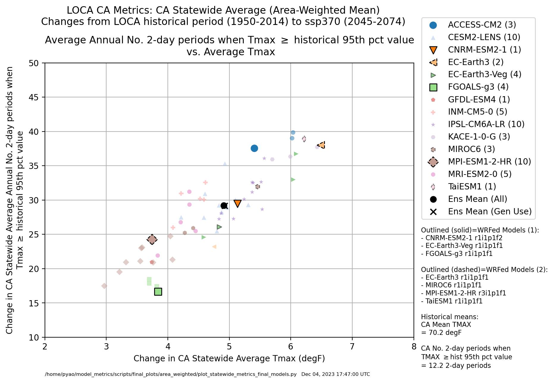
Tmax & Heatwaves Relationship
-> Annual T changes correlate well with 2-day heat waves

Slide 11
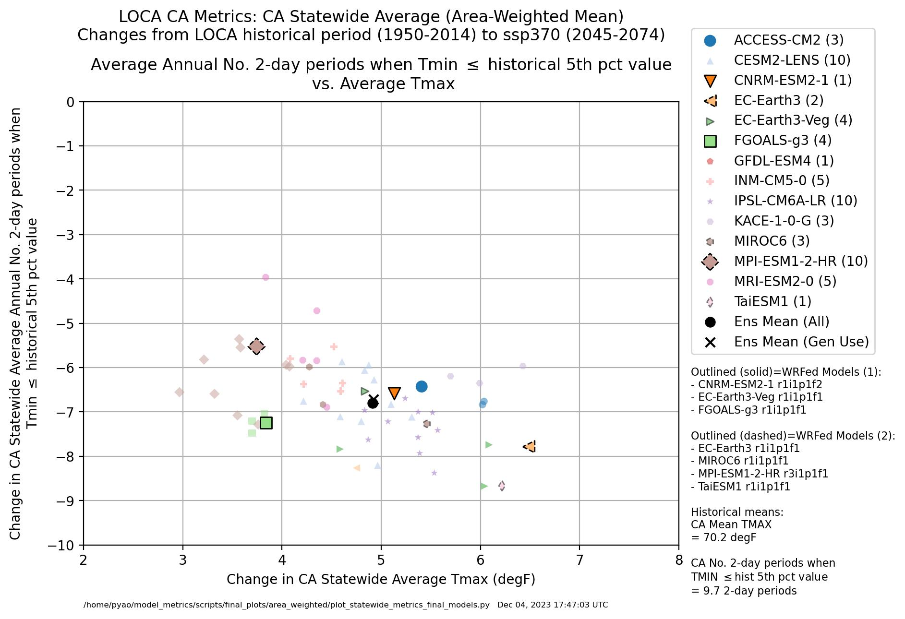
Tmax & Cold Snap Relationship
-> Annual T changes correlate with 2-day cold snaps

Slide 12
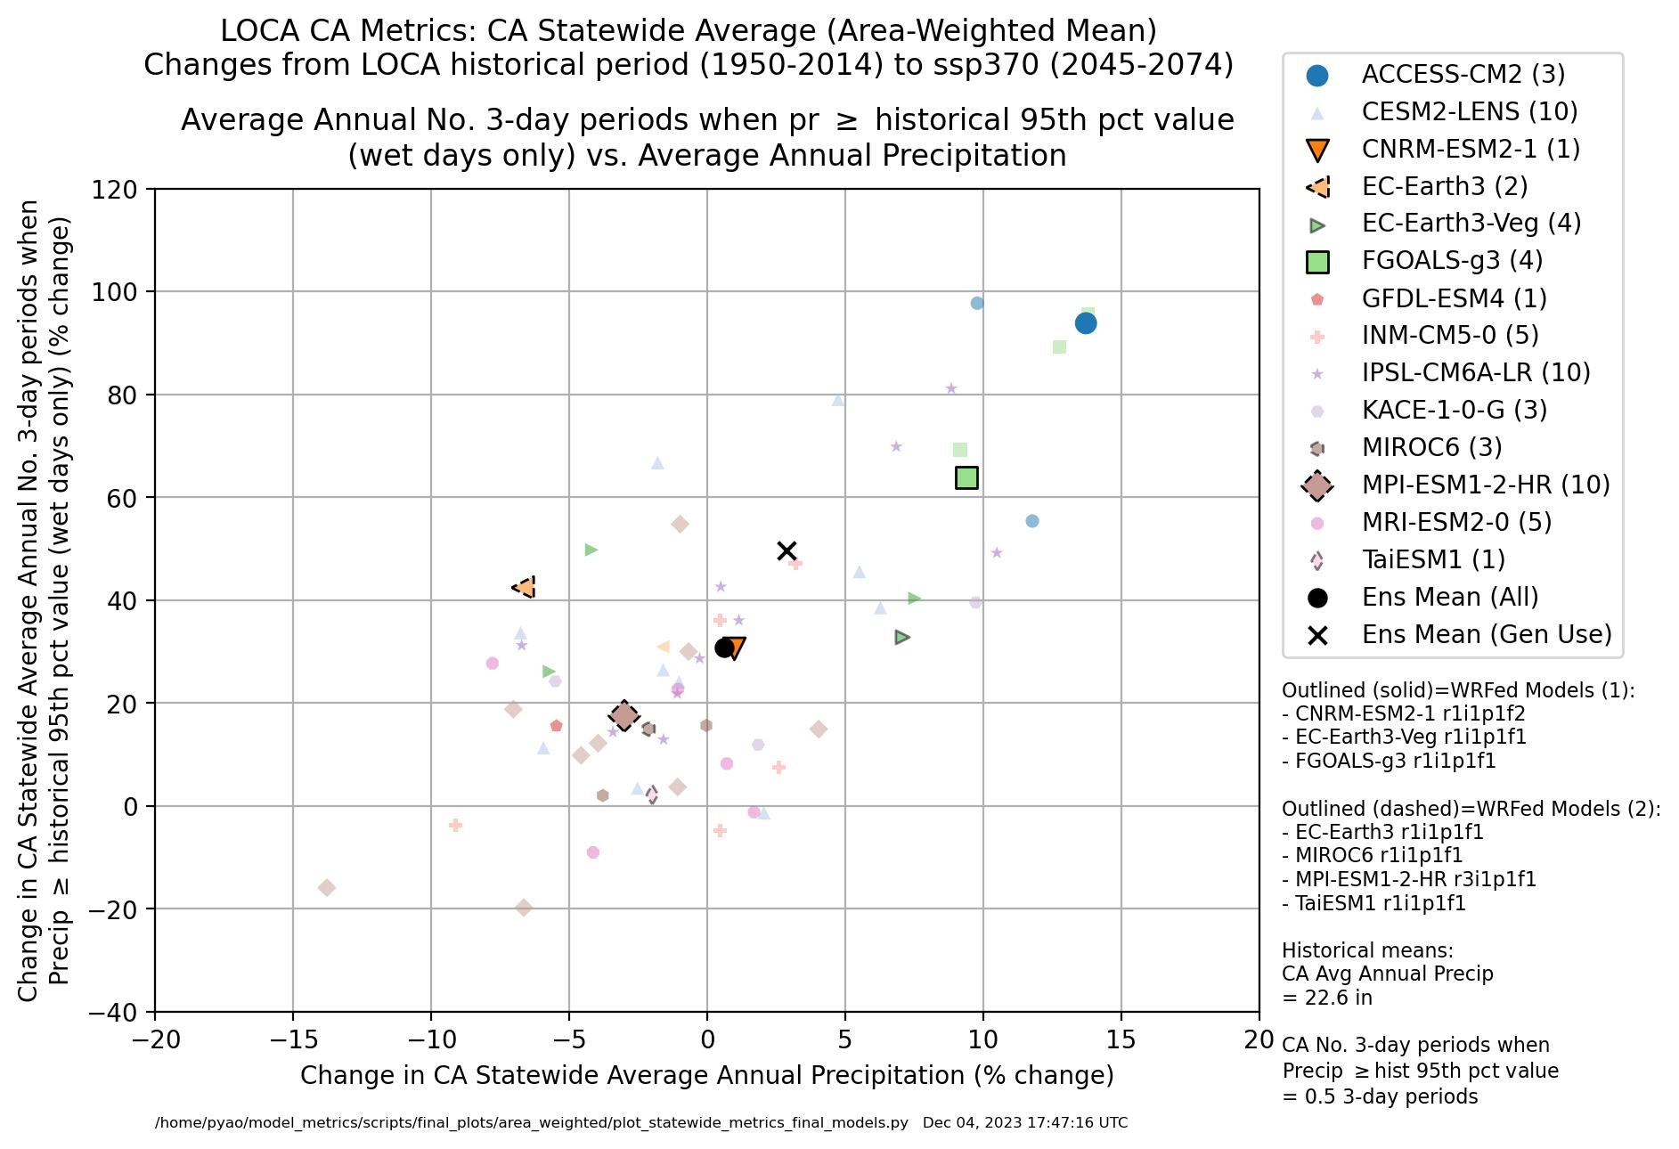
Precip & Wet Extremes (Flood)
-> Annual P changes correlate well with 3-day wet periods

Slide 13
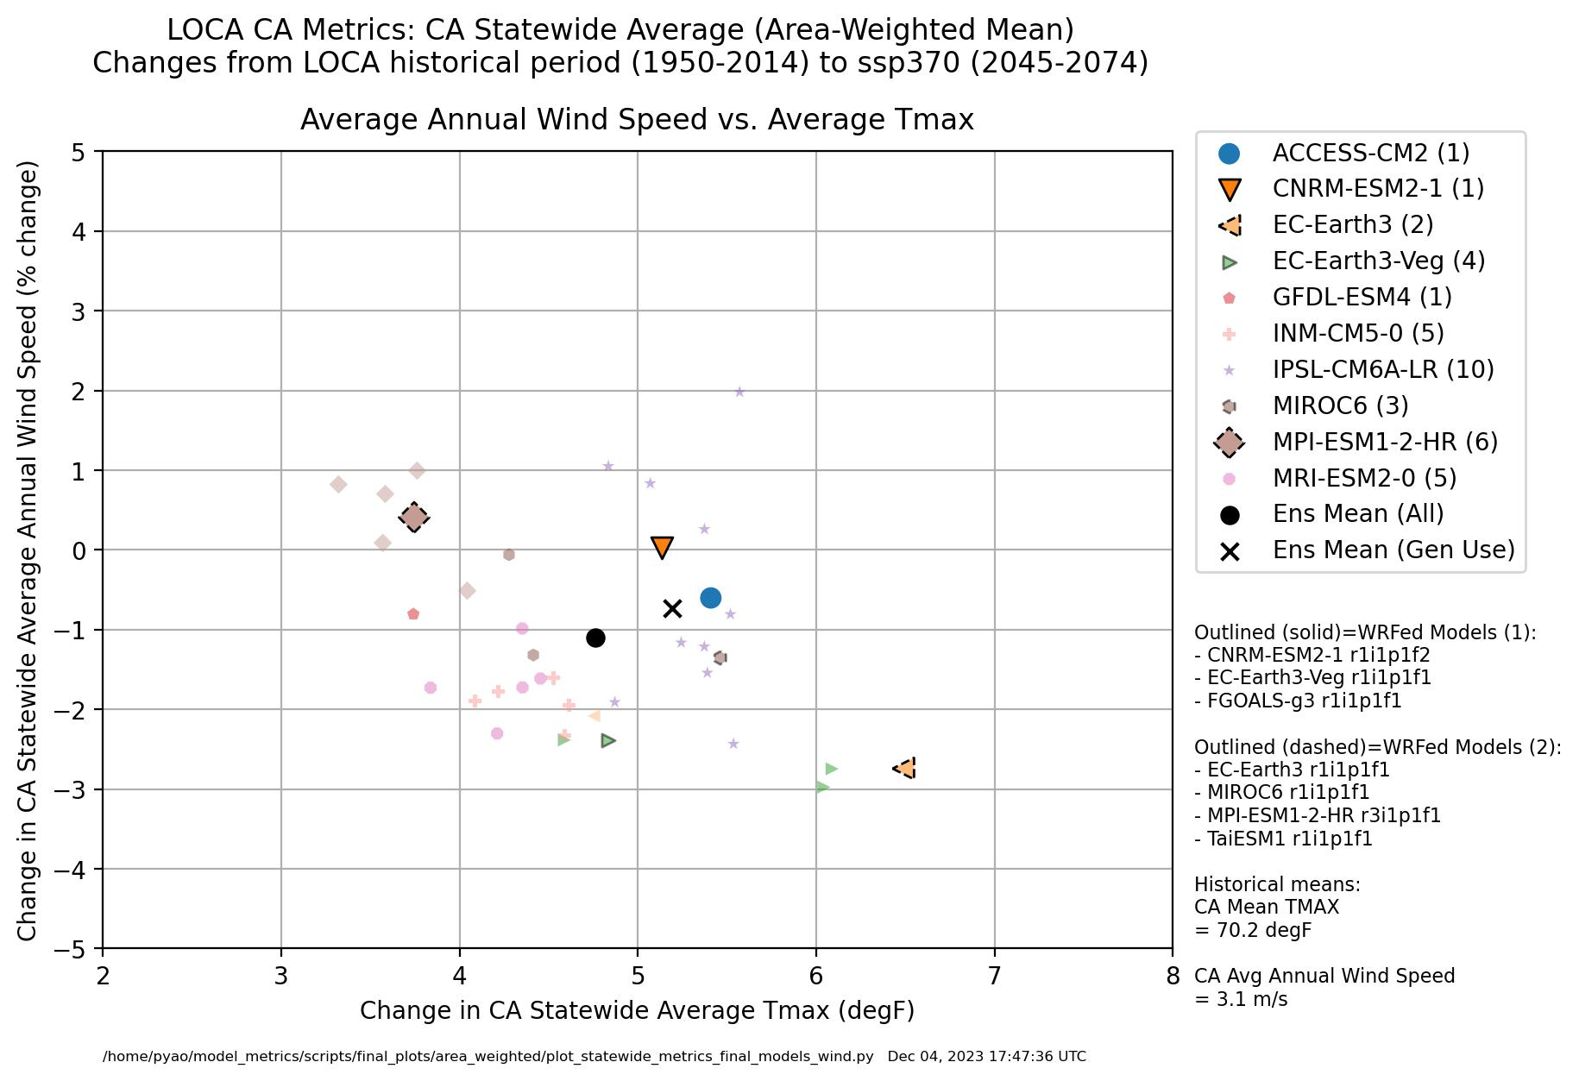
Temp & Wind Speed
-> Some correlation of annual T changes and wind speed

Slide 14
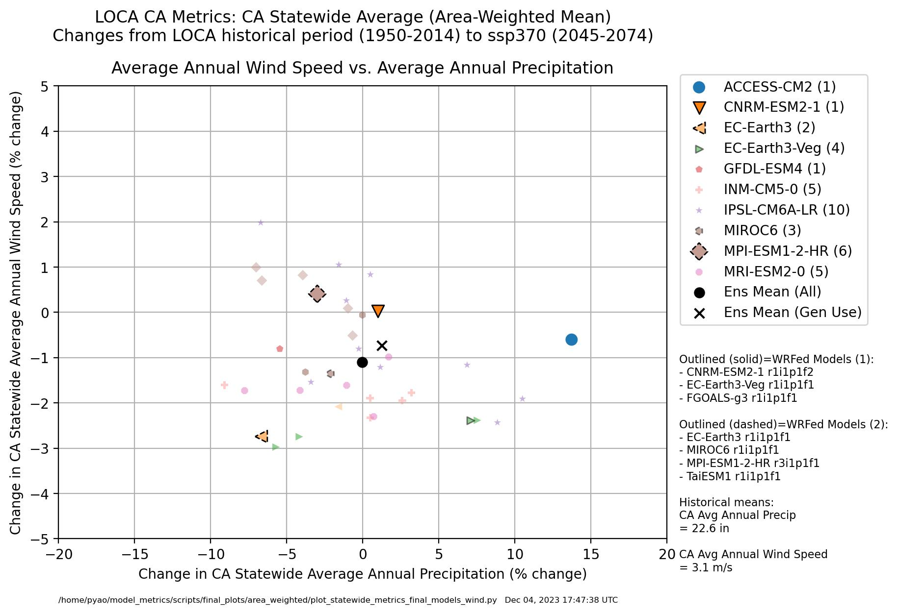
Precip & Wind

Slide 15
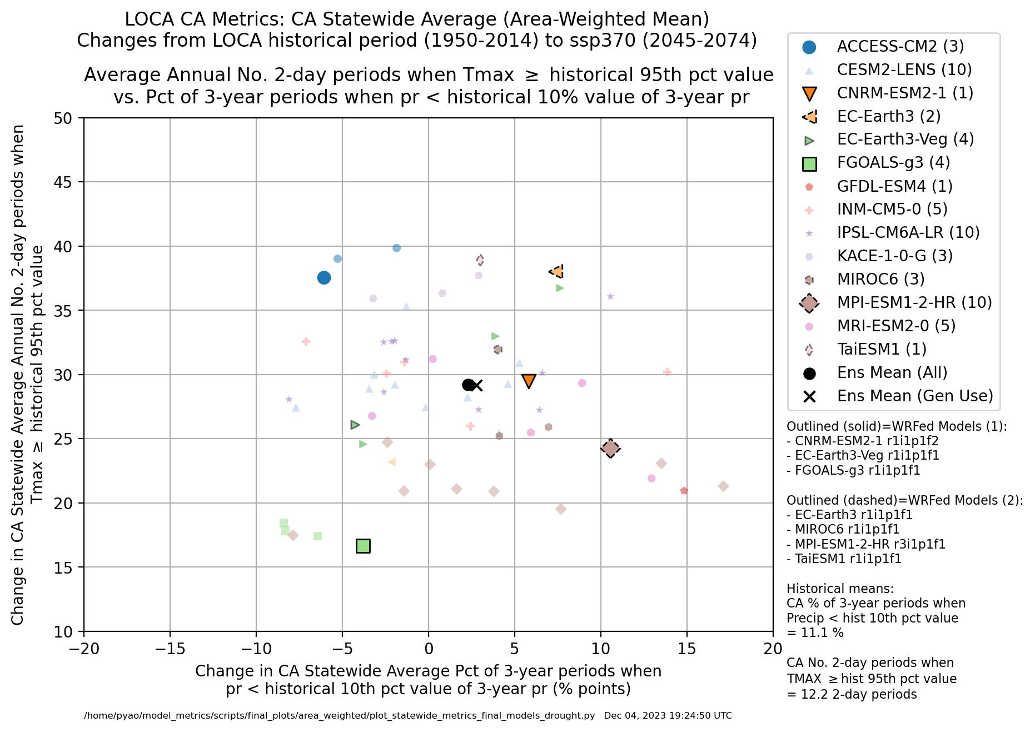
Drought & Heatwaves

Slide 16
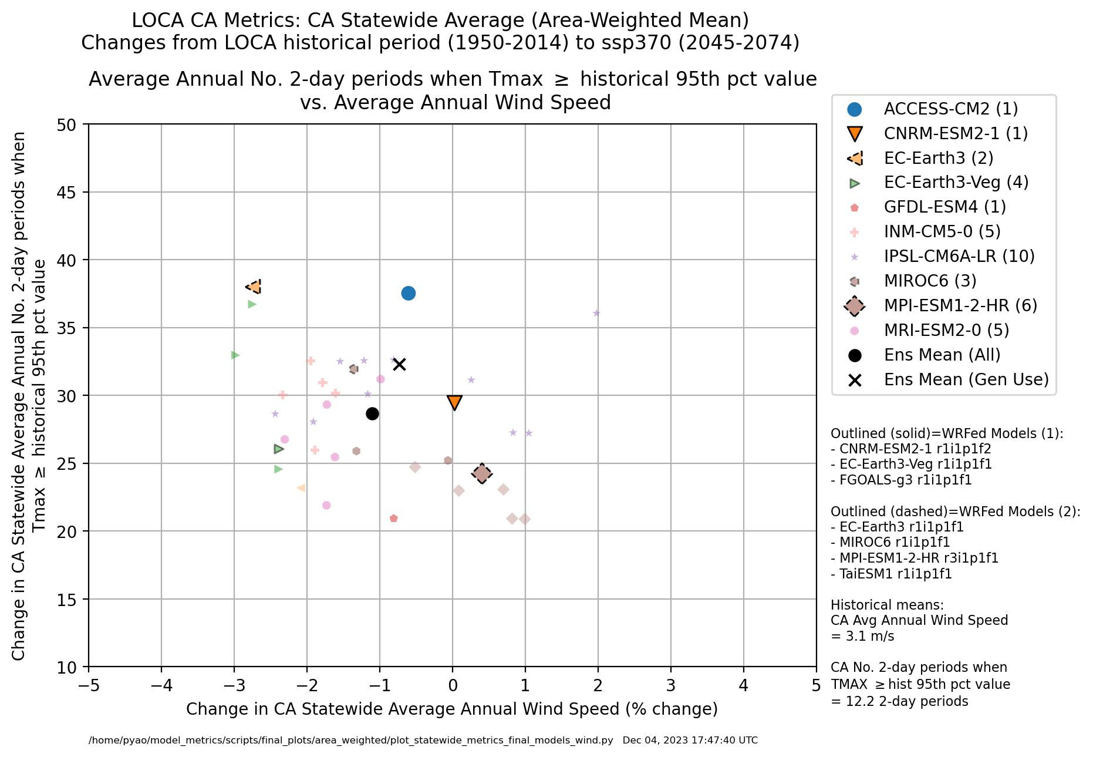
Wind Speed & Heatwaves

Slide 17
Limitations of General Use Projections
General use projections are, by design, meant to be limited
Models evaluated for a limited set of metrics, scales and scenarios
Mid-century, SSP370, all of CA, and largely for temperature and precipitation
May not cover all user-relevant ranges
e.g. different time periods, SSP scenarios, locations, and/or variables
Wherever possible, it is recommended to use a larger set of runs to analyse the range of plausible outcomes for specific applications
For frequency of extreme events, especially the most extreme, a few GCM simulations may not capture the variability in extremes well
Forthcoming Analytics Engine tools will help to more easily conduct preliminary analyses with larger datasets

Slide 18
Final Thoughts…
The 5 selected G.U.P.’s capture the range of projected temperature and precipitation changes for SSP370, all of CA & mid-century; capture the wind except the quadrant of greatest decrease in wind
Access-CM2 r1i1p1f1
CNRM-ESM2-1 r1i1p1f2
EC-Earth3 r1i1p1f1
FGOALS-g3 r1i1p1f1
MPI-ESM1-2-HR r3ilp1f1
Did not select on extremes, annual mean precipitation and temperature changes correlate with changes in extremes (heatwaves, cold snaps, floods, droughts)
Changes in wind speed by GCM vary regionally (not shown)

Slide 19
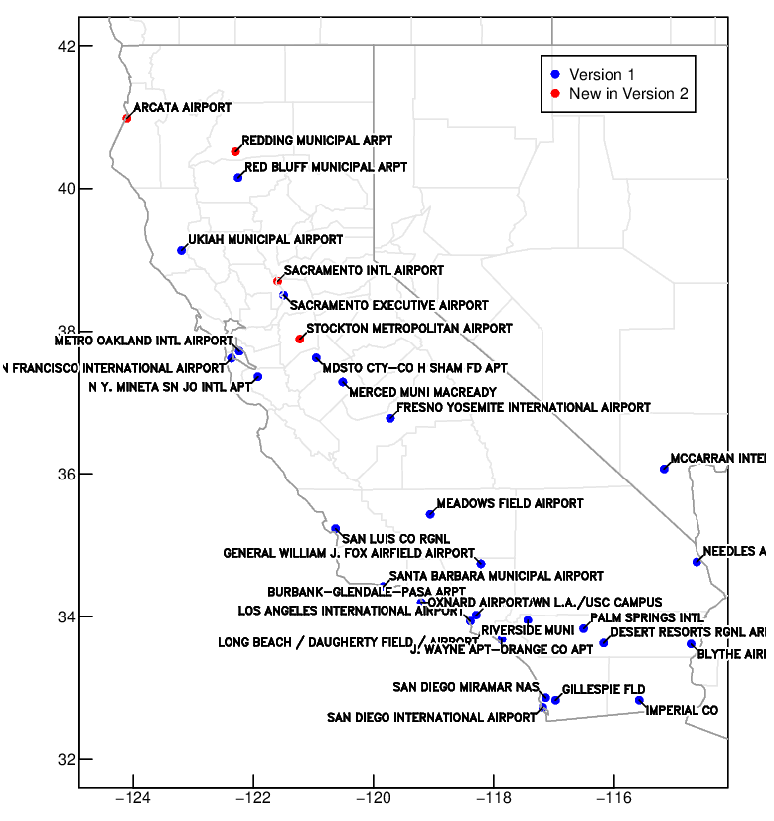
LOCA2 Hourly Temperature Projections for Individual CEC Requested Stations
Overview
Projections of hourly surface temperatures from 1950-2100 at individual locations
Based on LOCA method* and existing LOCA2 gridded 3km downscaled CMIP6 daily Tmax and Tmin results
33 stations
32 CA + Las Vegas station locations of importance requested by CEC demand forecast unit
Includes all models from LOCA CA dataset
(15 GCMs with up to 10 ensemble members each, depending on SSP2-4.5, SSP3-7.0, or SSP5-8.5)
Analog matching method
Better represents hourly variability compared to traditional climatological diurnal cycle approach
Map of the 33 stations, 4 new stations in this version labeled red
*Pierce and Cayan 2019 https://cirrus.ucsd.edu/~pierce/tmp/Hourly_data_interpolation_2019-05-23.pdf

Slide 20
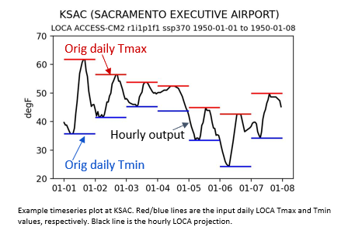
LOCA2 Hourly Temperature Projections for Individual CEC Requested Stations (2)
Projections are complete
129 total simulations for each of the 33 stations = 4,257 total
Next steps are to finalize documentation and share data with the Analytics Engine team
What’s new in Version 2
Projections based on LOCA2 (CMIP6), featuring latest generation of available models, SSP scenarios, and ensemble members compared to Version 1 (CMIP5)
4 additional stations in northern California
Longer period of record for most stations from HadISD, the historical hourly temperature training data provided by Eagle Rock Analytics
Method improved to better represent difference between wet vs. dry days
Method improved to ensure that hourly values more closely match the input LOCA Tmax and Tmin

Slide 21
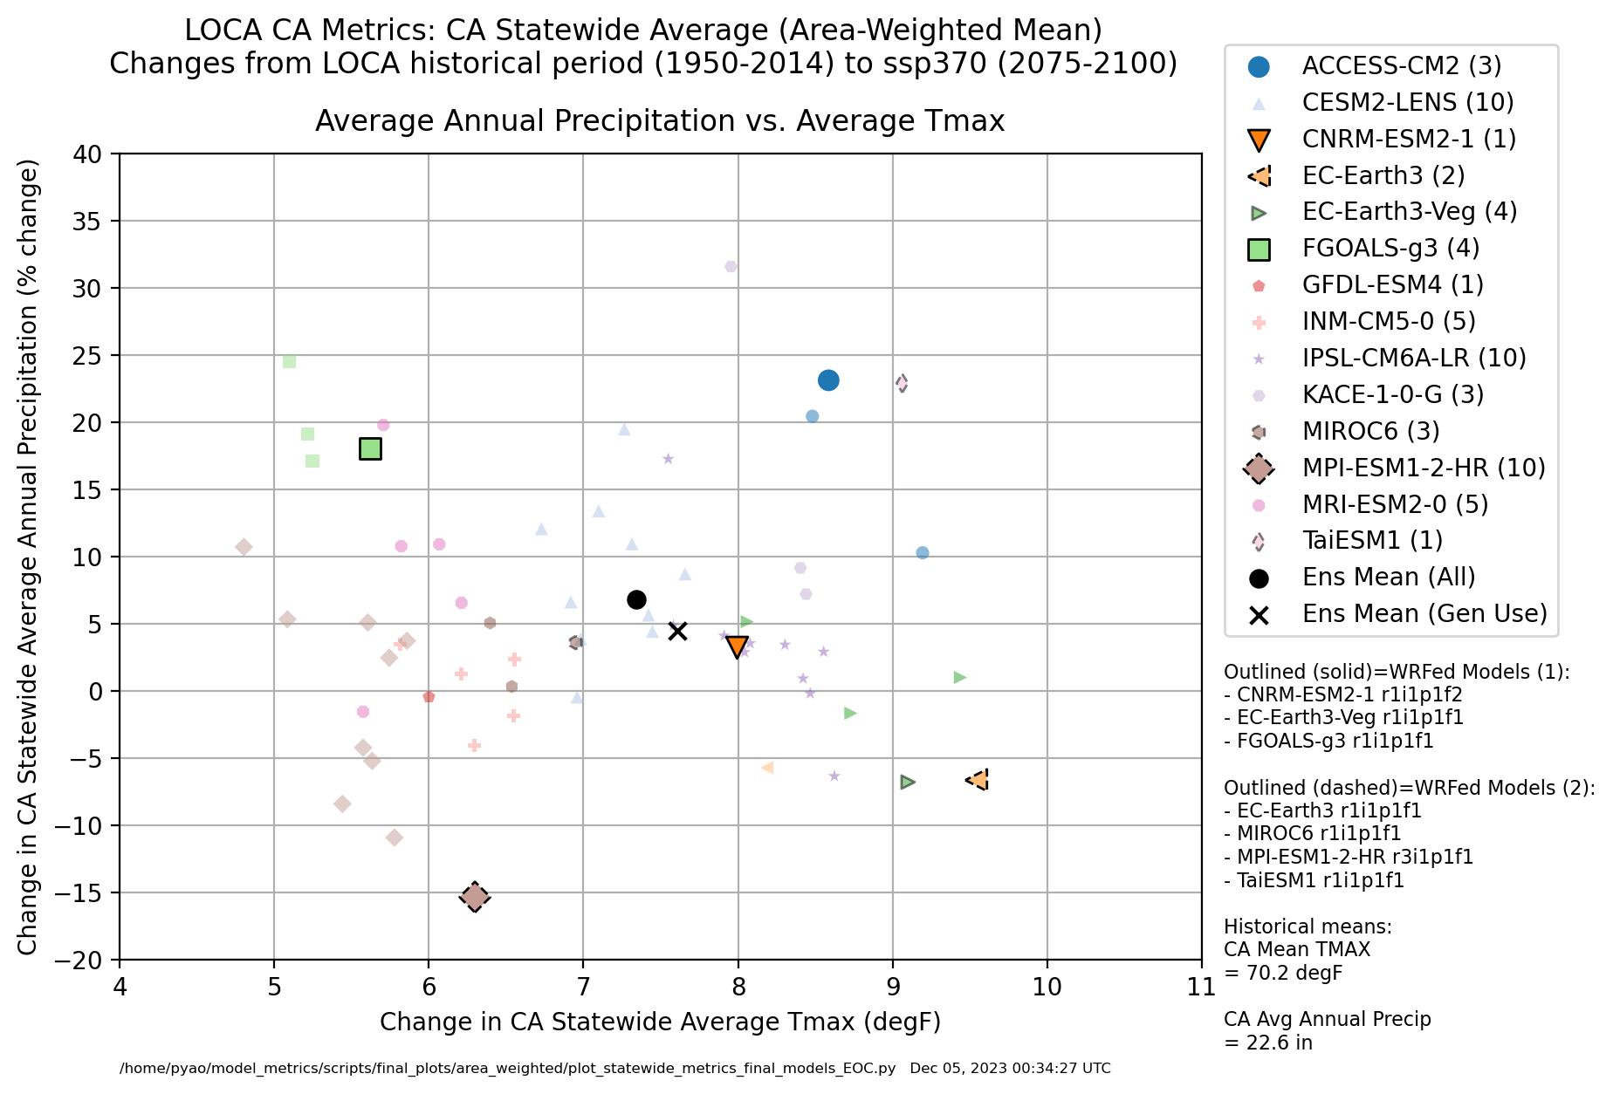
Appendix:
Proposed General Use Projections
(End of Century)

