Slide 1
Current Climate Change Analysis Practices in DWR’s using the Latest Climate Change Projections and a Weather Generator
May 17th, 2024
C-DAWG
Romain Maendly
Climate Action Coordinator
CA DWR / Executive Division

Slide 2
Presentation Outline
1. Motivation
Why combine a stochastic weather generator and downscaled General Circulation Models directly?
Weather-Regime Based Stochastic Weather Generator
Basic description of the weather generator
Scenario Generation
Demonstration of climate change scenarios generation with the Stochastic Weather Generator model
Latest Use Case
Draft – State Water Project Delivery Capability Report 2023

Slide 3
1. Motivation

Slide 4
Why combine a stochastic weather generator and downscaled General Circulation Models directly?
Notes:
Top-down approaches generally result in scenarios of future conditions that are easy to explain and can provide a range of impacts that explore possible outcomes. But, these scenarios, by themselves, are difficult to place in a probabilistic context and are generally not informed by specific factors that drive system risk or vulnerability. They are also highly sensitive to decisions about which climate models are included and cannot easily explore sensitivity to model selection.

Slide 5
Planning Water Systems for Future Climate Conditions
Realized Hydroclimate:
+
Noise
Signal
(Natural variability)
(Climate change trends)
Magnitude, frequency, timing, and sequencing of droughts and floods
Long-term, quasi- or aperiodic dry periods and pluvials
Space-time distribution of precipitation and temperature across a heterogeneous landscape
Shifting snow accumulation / melt dynamics, rain-on-snow
Higher ET and soil moisture loss
Intensification of extreme precipitation
Shifts in location and frequency of storm tracks

Slide 6
2. Weather-Regime Based Stochastic Weather Generator

Slide 7
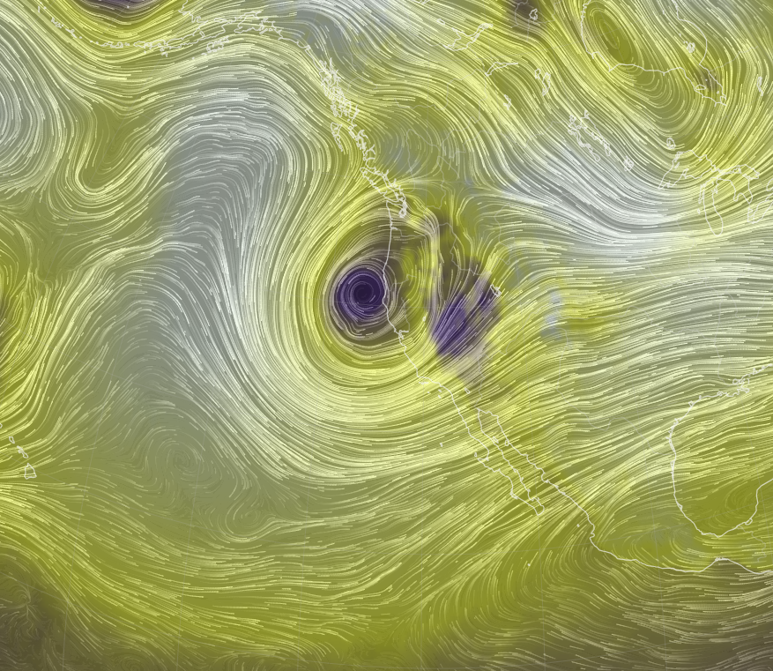
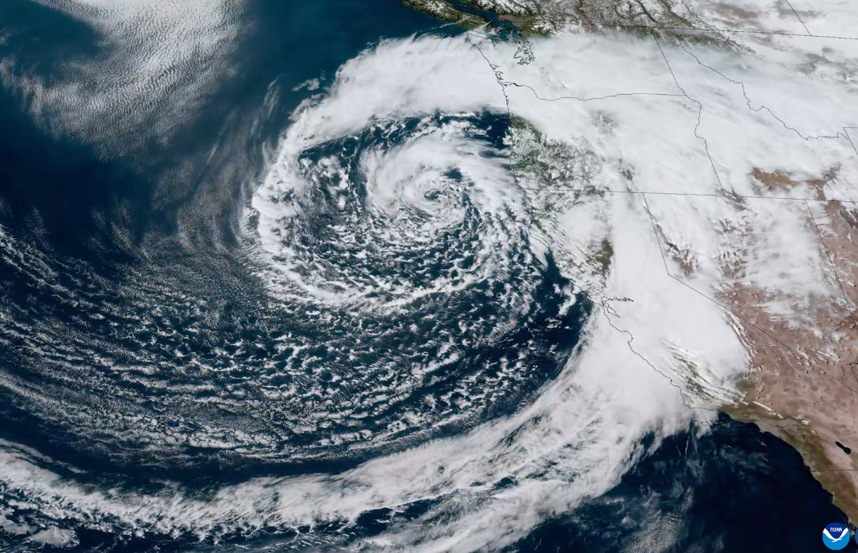
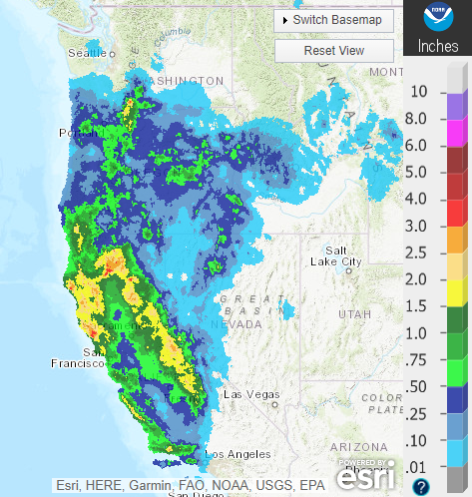
Weather Regime Based Stochastic Weather Generation
Weather Regime - Mid‐latitude atmospheric intra‐seasonal variability is characterized by large‐scale flow patterns (“weather regimes”)
Organize mid‐latitude storms
Appear repeatedly at fixed geographical locations
Persist beyond the lifetime of individual synoptic‐scale storms (days-weeks)
Exhibit rapid transitions associated with nonlinear atmospheric dynamics
Respond to external forcings (e.g., ENSO or anthropogenic effects)

Slide 8
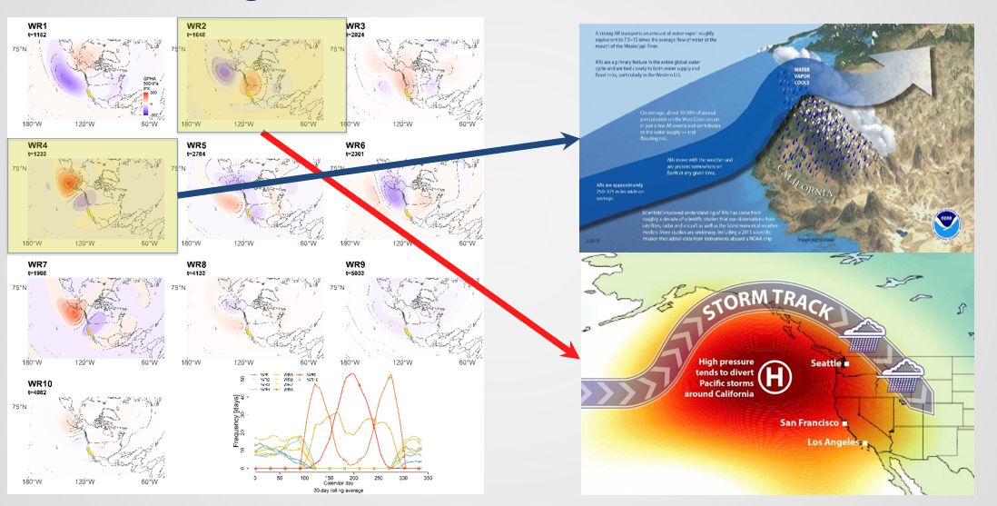
Weather Regimes
Notes:
Ridiculously Resilient Ridge or persistent anticyclone
https://www.kqed.org/science/26293/ridiculous-ridge-may-be-back-to-prolong-california-drought

Slide 9
3. Scenario Generation

Slide 10
Process-Based Understanding of Climate Change
Thermodynamic VS. Dynamic
Shifts in location of storm tracks
More frequent storm events
Shift in the frequency, duration, or transition probabilities of weather regimes
Changes in the dynamics of ENSO
Shifting snow accumulation / melt dynamics, rain-on-snow
Higher ET and soil moisture loss
Intensification of extreme precipitation

Slide 11
Thermodynamic Precipitation-Temperature Scaling

Slide 12
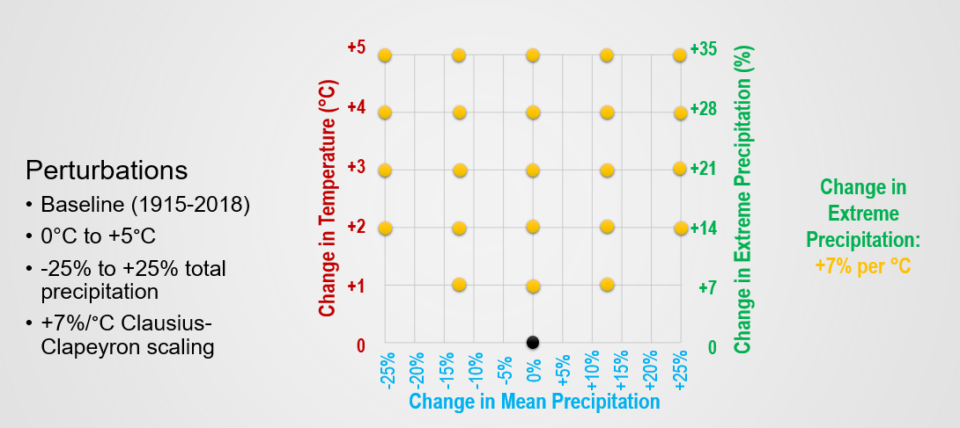
Climatic Scenarios

Slide 13
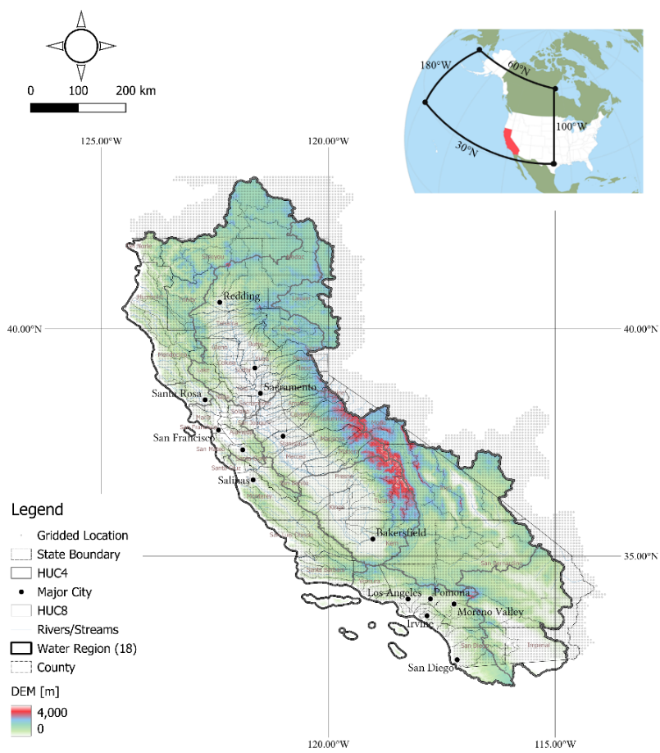
Weather Regimes Support California-Wide Model Development and Deployment
Perturbed Historical Time series (1915-2018)
Inputs: Livneh Untrimmed Precipitation & Livneh Detrended (1991-2020) Temperature
Outputs: 23 Scenarios based on the historical period (Tmin, Tmax and Precip) with extreme precipitation scaling of 7% per °C.
WGEN Thermodynamic Time Series Only
Inputs: Same as above, trained on the historical period (1948-2018)
Outputs:
1,000year daily weather-generated data (Tmin, Tmax and Precip)
23 scenarios with extreme precipitation scaling of 7% per °C, +6 scenarios for sensitivity analysis

Slide 14
4. Latest Use Case

Slide 15
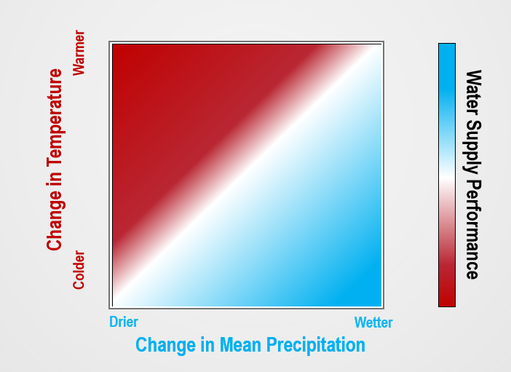
Bottom-Up Climate Vulnerability Analysis with a Stochastic Weather Generator

Slide 16
Bottom-Up Climate Vulnerability Analysis with a Stochastic Weather Generator (2)

Slide 17
State Water Project (SWP) Delivery Capability Report
Bi-annual report of Existing and Future delivery capability
Key Planning Information for SWP water users (UWMP, IRWM, SGMP, AWMP, etc.)
Serve as the default climate change scenario for SWP planning (future energy resource, asset maintenance and management studies, EIR, etc.)
Notes:
Over a range of hydrologic conditions
Historic extended dry cycle
Long-term average

Slide 18
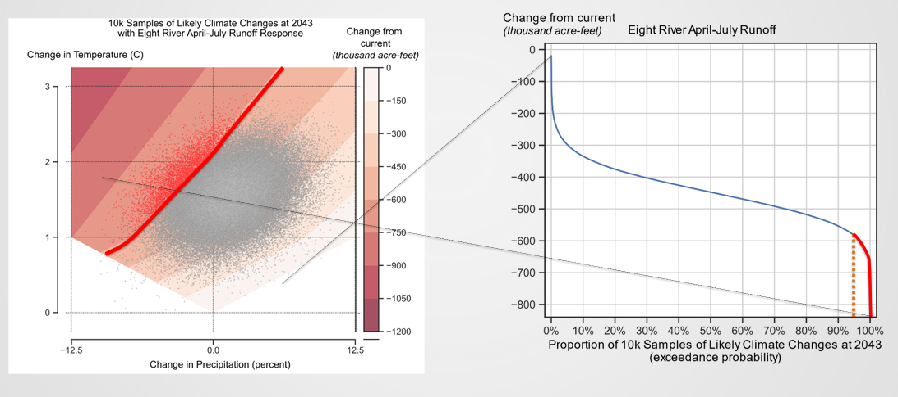
Link Stress Test and Climate Space and Assess Risk

Slide 19
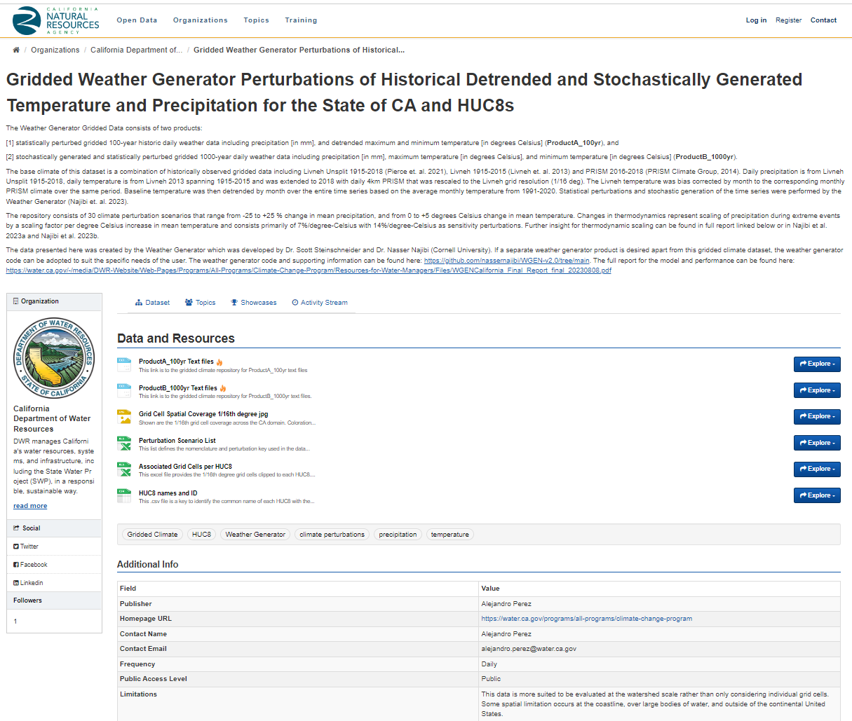
Model/Data Availability and Resources
DWR Climate Change Program Website: Resources for Water Managers
https://water.ca.gov/Programs/All-Programs/Climate-Change-Program/Resources-for-Water-Managers
Final Report
California Natural Resources Agency Data Library: https://data.cnra.ca.gov/dataset/ca-weather-generator-gridded-climate-pr-tmin-tmax-2023
Weather Generator Tool Public Seminar
YouTube Channel: https://www.youtube.com/watch?v=QQZ1MIoC2_0

Slide 20
Introduction to Ca Water Plan Update 2021
Thank you!
Romain.Maendly@water.ca.gov

