Slide 1
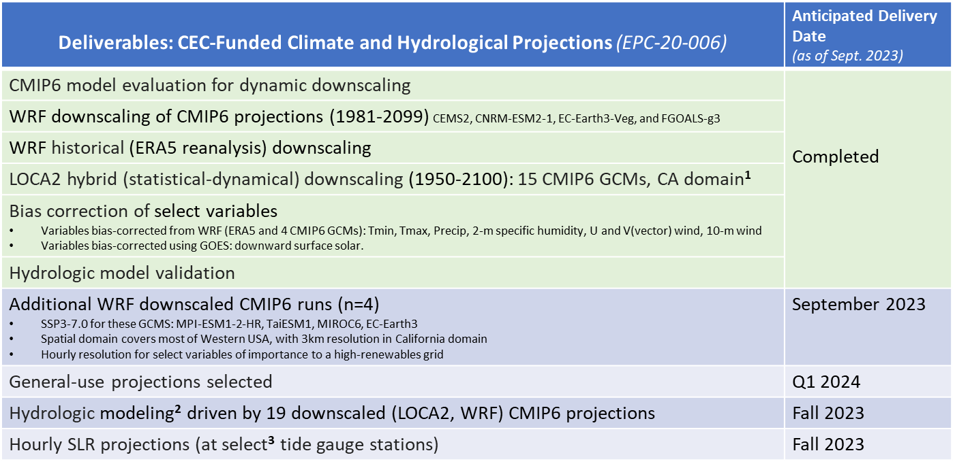
Deliverables: CEC-Funded Climate and Hydrological Projections (EPC-20-006)
Daily output of bias-corrected temperature, precipitation, humidity, wind, surface solar radiation, 3 km × 3 km resolution. Multiple runs for some GCMs, with 199 ensemble members spanning 3 SSPs (2-4.5, 3-7.0, 5-8.5).
Hydrological models: variable infiltration capacity (VIC), Noah-MP.
A total of 9 tide gauge stations along the California Coast.

Slide 2
Deliverables: CEC-Funded Long-Term Wildfire Projections (EPC-18-026)
Deliverables: CEC-Funded Long-Term Wildfire Projections (EPC-18-026) | Anticipated Delivery Date (as of Sept. 2023)
Historic reconstructions* of: vegetation/carbon historic wildfire * These historical reconstructions are used to train the long-term wildfire risk projections. | Complete
Long-term** wildfire risk projections portraying: fire presence (3 km grid), fire size, number of fires, fire severity, and smoke emissions ** Limited projections extending through end-century, more projections through mid-century. | Available on a rolling basis, beginning summer 2024

Slide 3
Proposed Milestones for Data Adoption
12/8/2023: Projections team submits data memos for projections and historical data (LOCA2, WRF-ERA5, WRF-CMIP6)
3/8/2024: Anticipated adoption of projections & historical data.
6/30/2024: Anticipated adoption of hydrological data, hourly SLR, “general use” projections.
8/31/2024: Anticipated adoption of long-term wildfire scenarios.
9/14/2023 (today!)
12/8/2023: Pyregence team submits data memos for historical vegetation and fire data used to train long-term wildfire projections
3/31/2024: Projections team submits data memos for hydrological scenarios (VIC, NOAH-MP), hourly SLR, “general use” projections
7/31/2024: Pyregence team submits data memo for long-term wildfire scenarios

