Slide 1
Sea Level Projections from CMIP6 climate and weather
EPC-20-006 Climate Scenarios Project funded by CEC
Sam Iacobellis, Julie Kalansky, David Pierce, Dan Cayan - Scripps Institution of Oceanography, UCSD
December, 2023
Hourly sea level projections over the 21st century at sites along the California coastline and within the San Francisco Bay/Delta.
Projections underpinned by sea level rise scenarios adopted by the California Sea Level Rise Guidance Update (Ocean Protection Council, forthcoming).
The hourly projections augment the SLR Guidance (forthcoming) results with fine scale (hourly) detail. These projections could be used to explore plausible event-scale occurrences within the longer term trajectory of possible sea level futures.
The hourly time sequences were developed from global earth system models used in the downscaled weather and climate projections and associated hydrologic modeled land surface hydrology over California.

Slide 2
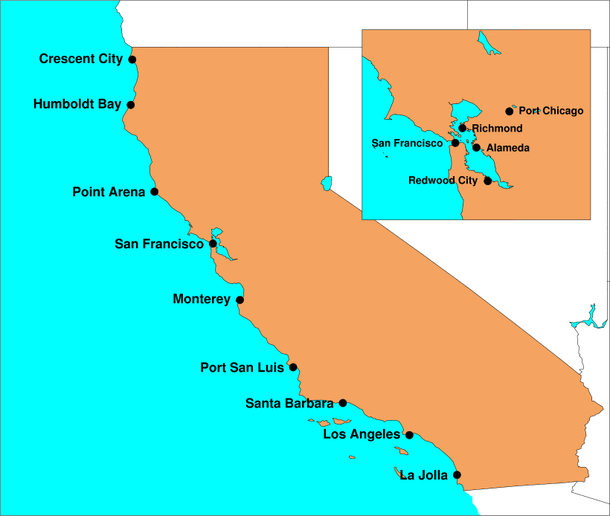
Sea Level Projections at 13
California locations
Locations with >3 decades of hourly observations

Slide 3
Components of sea level height and Uncertainties
Hourly sea level height is estimated (Cayan et al 2008) as a combination of:
long-term sea level rise
uncertainties small in short term but grow large over 21st Century because of uncertain future warming and especially uncertain ice melt from Greenland and Antarctica. Global SLR is greatest uncertainty in long term planning beyond mid-century.
meteorological and short period climate variability (HMET)
natural variation of weather and short period (months to a few decades) climate persists
and possibly grows slightly through 21st Century. Details of weather (e.g. winter storms)
and climate events (e.g. El Nino) is impossible to know beyond near term—models provide a
statistical envelope of possible outcomes but no precision on timing. Modeling attempts to
capture extremes but linear approach is imperfect. Unpredictable weather and short period
climate are most serious sources of uncertainty within next few decades.
astronomical tides
high degree of certainty of major tidal constituents. Predictability informs cautionary measures
during high tide windows (e.g. winter king tide events).

Slide 4
EPC-20-006 hourly projections follow a low, medium and high sea level rise scenarios adopted by the California Sea Level Rise Guidance Update, forthcoming.

Slide 5
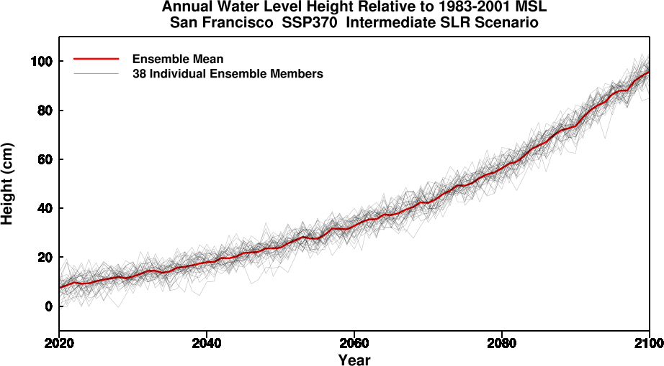
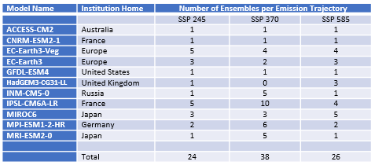
Envelope of projected
annual SL outcomes

Slide 6
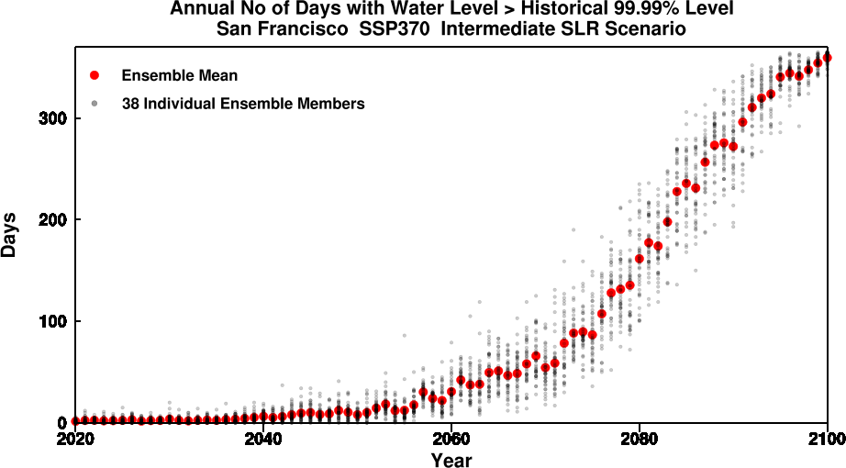
More numerous hourly projections
enable more effective
perspective upon possible extremes

