Slide 1
General User-Needs Assessment Results for Cal-Adapt: Report out from OPR
Climate Data And Analysis Working Group – Sept 14, 2023
Ben McMahan, PhD – ben.mcmahan@opr.ca.gov
Office Of Planning & Research
Integrated Climate Adaptation & Resiliency Program

Slide 2
Cal-Adapt General User Needs Assessment
Initial Goals
Content: Assess/Improve prior generation, develop new resources
Reach: Expand network – increase relevance of resources
Preliminary Gaps
Structure: Improve user experience – optimize navigation
Content: Streamline workflow and path to technical assistance
Expanded Goals
Improved Connections: Between pages and resources
Accessibility: Framework for data/tool use & decision support

Slide 3
Preliminary Findings
Mid-Level users – falling through the cracks
Users taken out of flow – lack of additional context or seamless connections to data
Limited guidance and technical assistance means inconsistent user experience and unmet needs
Gaps & Comparative Analysis
User Interviews
Prototype Testing

Slide 4
High Level Recommendations
Users need content and resources that match their realities (Relevant data & connections)
Users need easier ways to find the info they're looking for (User focused workflow)
Users need a helping hand in deciding what resources to use (Technical assistance and guidance)
Contractor Deliverables: Gap Analyses, Competitive Analysis, & Development Guidebook

Slide 5
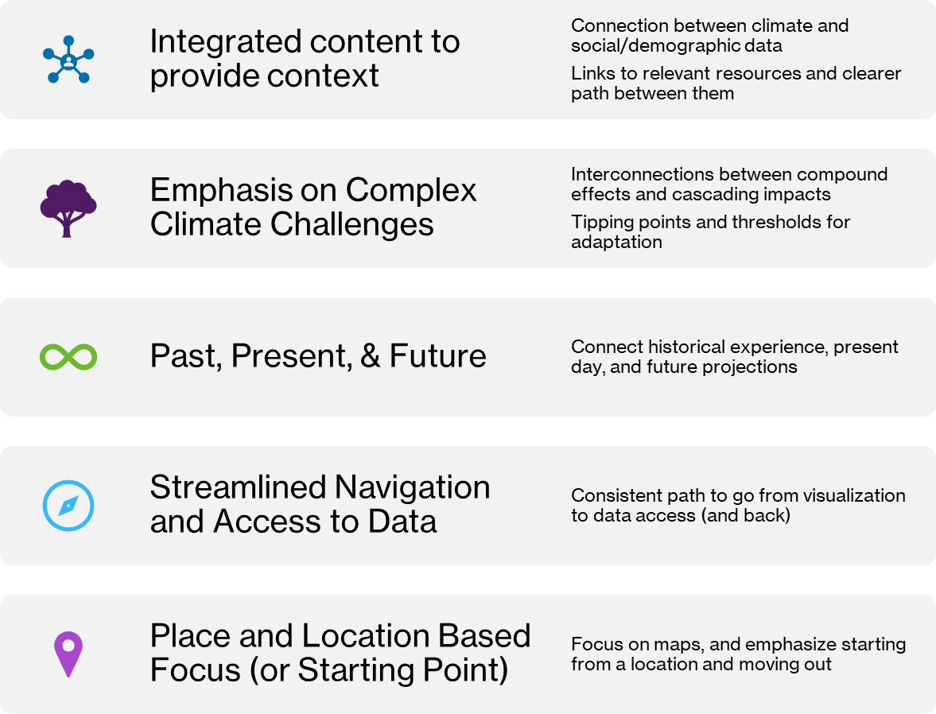
Cal-Adapt General User Needs Key Findings on Priorities

Slide 6
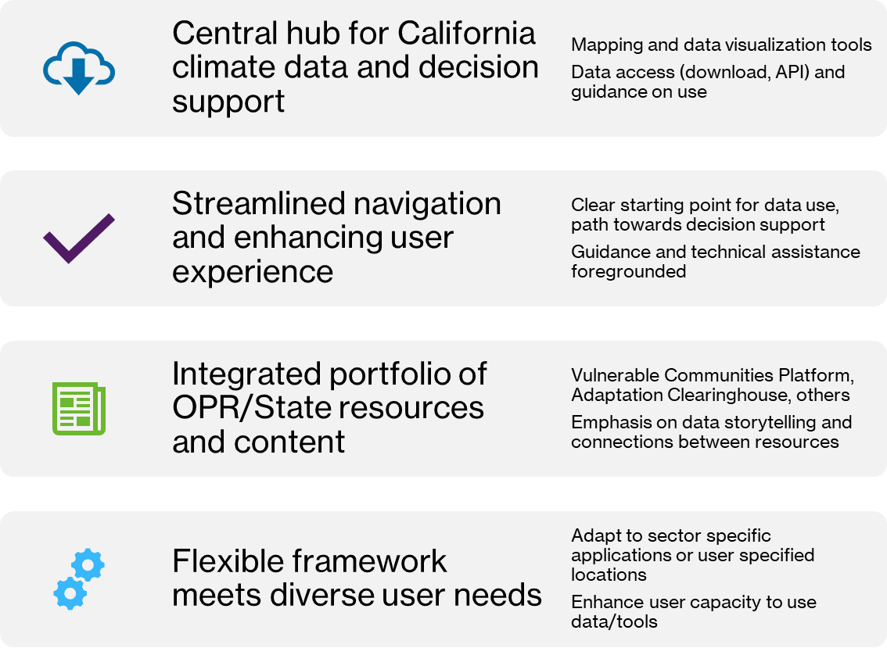
Goals

Slide 7
Challenges & Questions Raised General User Focused Cal-Adapt Platform
Balancing ease of use and flexibility/power
Decision focused tools or decision support framework
How to draw from current platform, and leverage advances with Analytics Engine?
How to provide guidance on use & develop a support framework, to expand user base and build capacity?
What are top priorities given resource and time constraints?

Slide 8
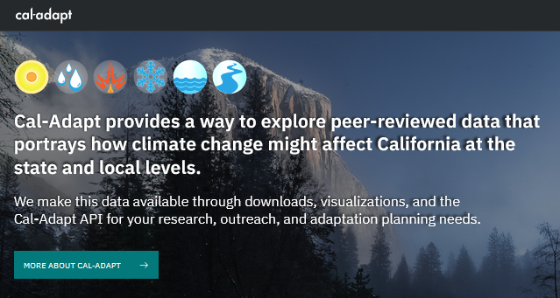
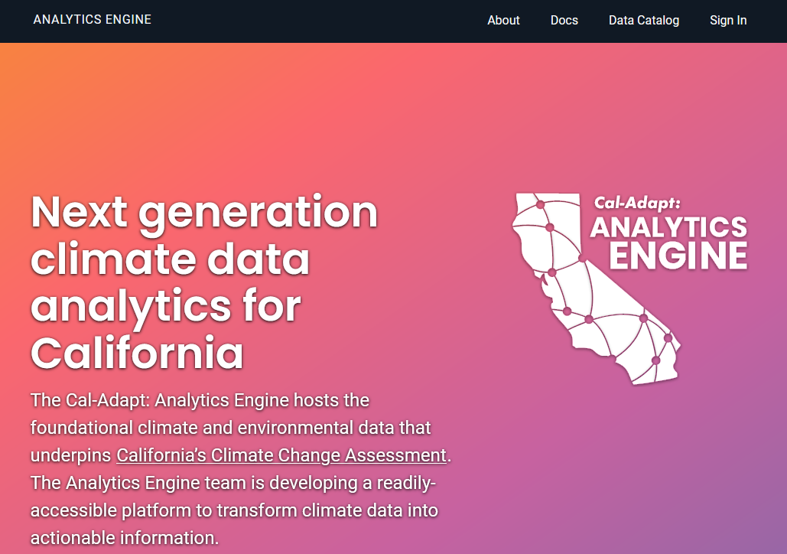
Multiple Grants Support the Expanded Enterprise
Analytics engine
- EPC-20-007, Susan Wilhelm, CEC manager
Visualizations + web application
- EPC-21-038, Mithra Moezzi, CEC manager
- OPR funding forthcoming, Ben McMahan
Observation platform
- PIR-19-006, Mithra Moezzi, CEC manager
See TN239954, docketed October 12, 2021: Cal-Adapt governance, responsibilities, data management.
Notes:
Broad enterprise is supported by multiple grants and funding streams…

Slide 9
Timeline
User Needs Assessment
Sept. 2022 – July 2023
Cal Adapt Web Application RFI/RFP Fall 2023
Updated Cal-Adapt Web Application 2024->
Notes:
User needs assessment over the last year
Council presentation
Results finalized in july
July clearinghouse redev begins
Release RFP later in the fal
Climate services general expansion
Use lessons learned to inform overall climate services programming
Inform VCP development
OPR strategic planning for tools & resources

Slide 10
Questions / Brief Discussion
Ben McMahan, PhD – ben.mcmahan@opr.ca.gov

