Slide 1
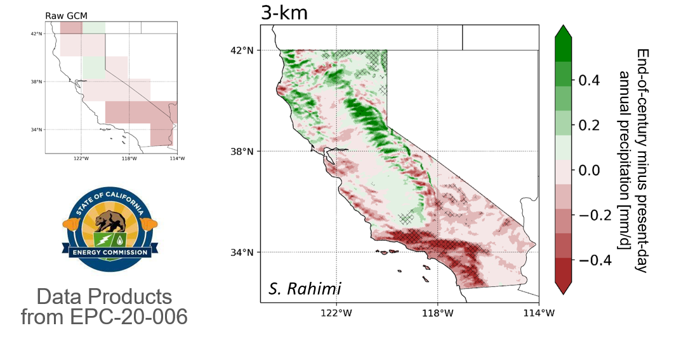
CMIP6 Climate Projections for California

Slide 2
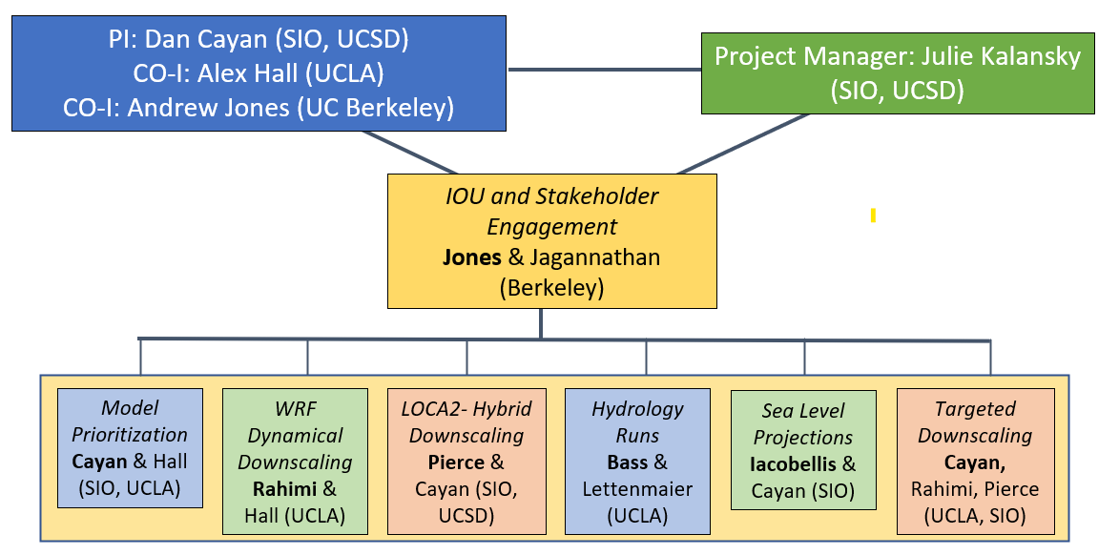
Project Team and Data Developed

Slide 3
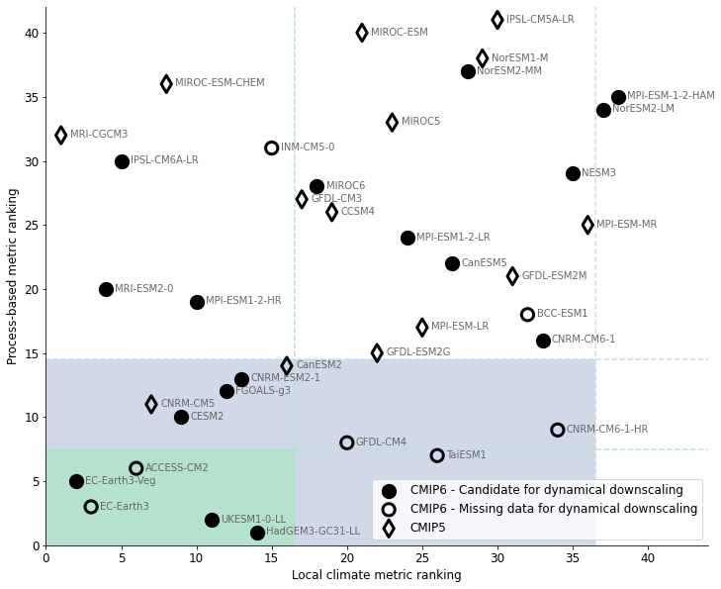
Evaluation of Global Climate Models for CA
Krantz et al., 2021
W. Krantz, D. Peirce

Slide 4
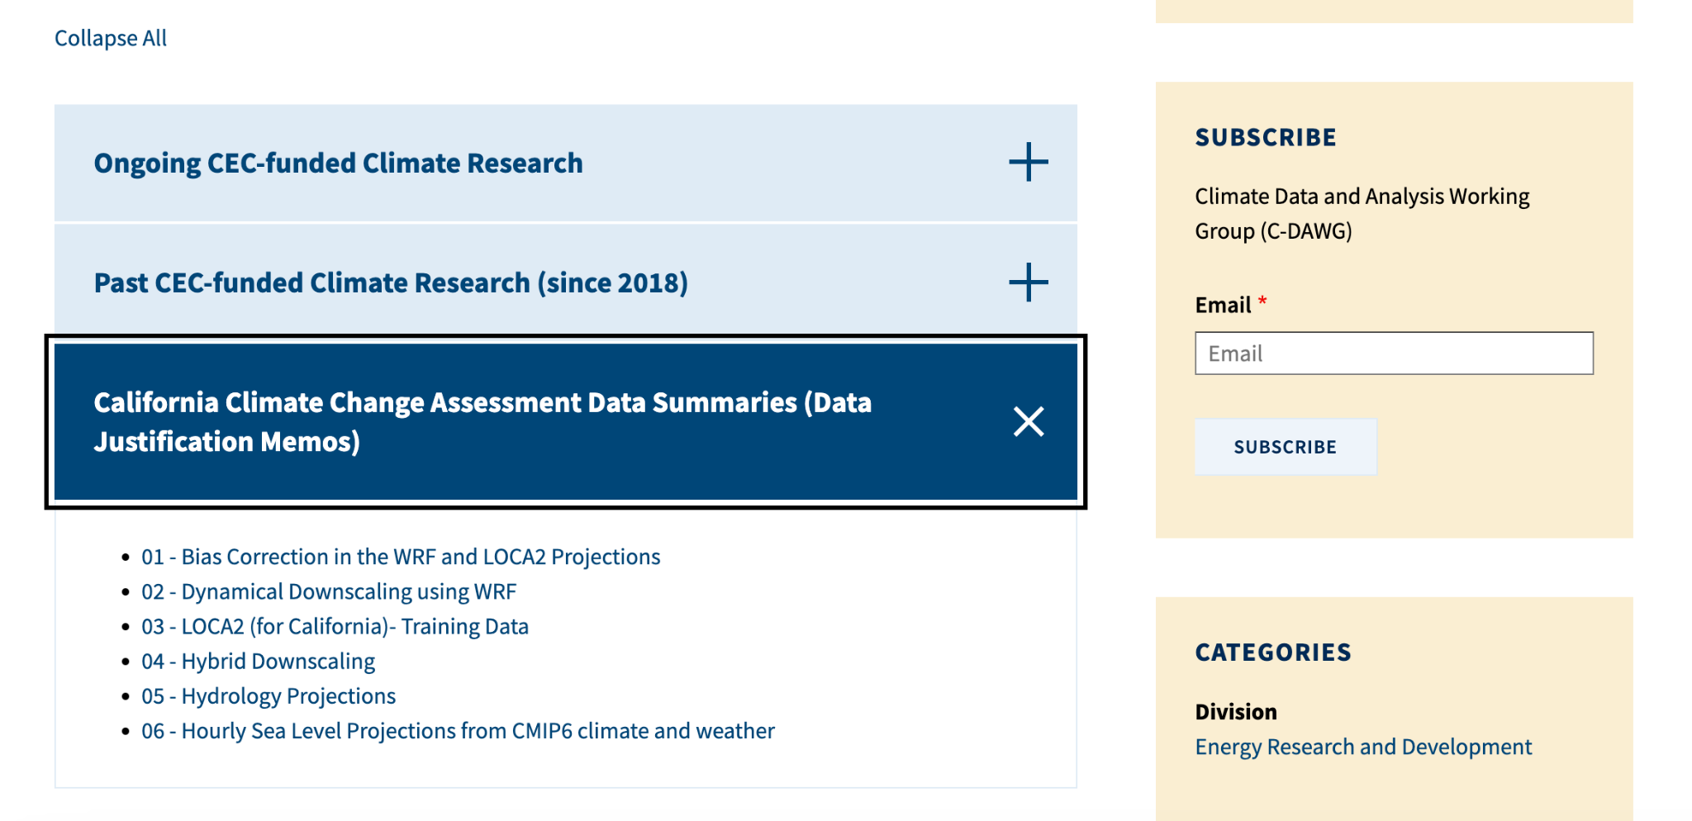
Summaries of Data on C-DAWG Website

Slide 5
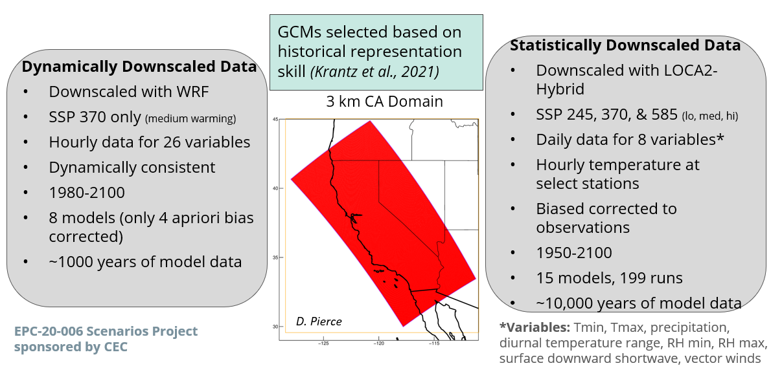
Large Set of CMIP6 Downscaled Climate Projection Data

Slide 6
LOCA2-Hybrid: Improvements from last 4th CA Assessment
Improved, higher resolution training data set
New approach better depicts effects of California’s topography; 3 km vs. 6 km in version 1
Uses WRF to interpolate between points
Improved representation of precipitation extremes
Critical for flooding and water management
Hybrid downscaling scheme
More realistic projections for coming decades
Relaxes stationarity assumption
More variables
Supports a wider range of stakeholder applications
Tmin, Tmax, P, 10-meter wind speed; daily min and max of relative humidity; downward solar radiation, 10-meter U, V wind components (vector wind), specific humidity
More runs, multiple ensemble members (see LOCA2- Hybrid Page for details)
Allows better understanding of uncertainty, natural variability, and extremes
More emissions scenarios
Better understanding of possible future human/societal/policy choices

Slide 7
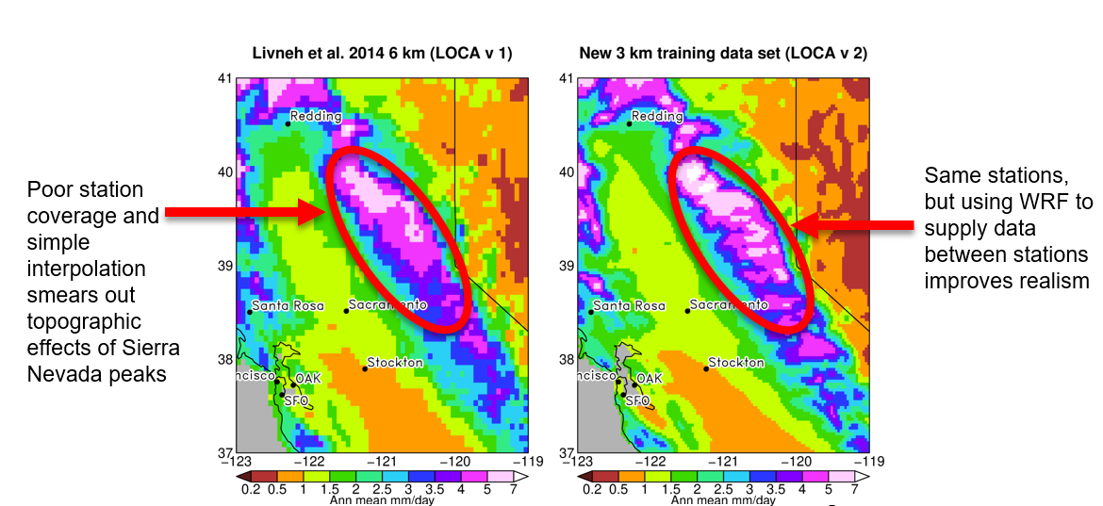
LOCA2-Hybrid: New, higher resolution training data uses WRF to interpolate between stations for more realistic precipitation
D. Pierce

Slide 8
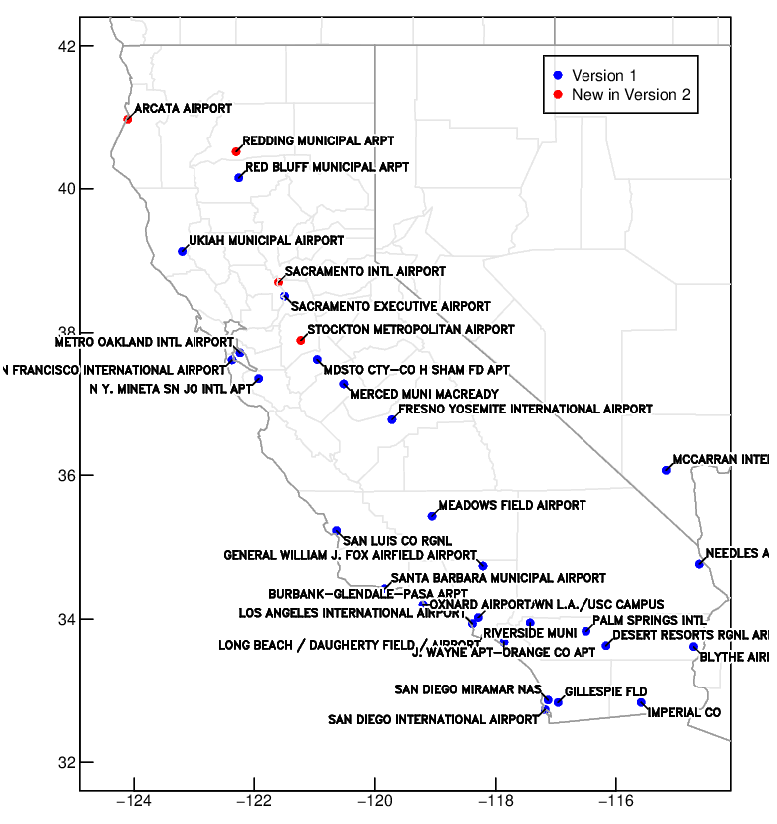
LOCA2 Hourly Temperature Projections for Individual CEC Requested Stations
Overview
Projections of hourly surface temperatures from 1950-2100 at individual locations
Based on LOCA method* and existing LOCA2 gridded 3km downscaled CMIP6 daily Tmax and Tmin results
33 stations
32 CA + Las Vegas station locations of importance requested by CEC demand forecast unit
Includes all models from LOCA CA dataset
(15 GCMs with up to 10 ensemble members each, depending on SSP2-4.5, SSP3-7.0, or SSP5-8.5)
Analog matching method
Better represents hourly variability compared to traditional climatological diurnal cycle approach
Map of the 33 stations, 4 new stations in this version labeled red
*Pierce and Cayan 2019 https://cirrus.ucsd.edu/~pierce/tmp/Hourly_data_interpolation_2019-05-23.pdf

Slide 9
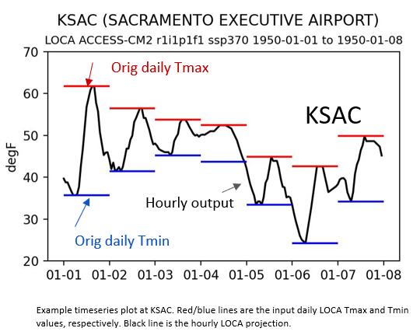
LOCA2 Hourly Temperature Projections for Individual CEC Requested Stations (2)
Projections are complete
129 total simulations for each of the 33 stations = 4,257 total
What’s new in Version 2
Projections based on LOCA2 (CMIP6), featuring latest generation of available models, SSP scenarios, and ensemble members compared to Version 1
4 additional stations in northern California
Longer period of record for most stations from HadISD, the historical hourly temperature training data provided by Eagle Rock Analytics
Method improved to better represent difference between wet vs. dry days
Method improved to ensure that hourly values more closely match the input LOCA Tmax and Tmin

Slide 10
LOCA2-Hybrid Applications
Recommend using LOCA2-Hybrid data for analyses unless dynamical downscaled data is required (e.g. hourly data, variable not available from LOCA2-Hybrid; see more detail on Slide 12)
Use LOCA2-Hybrid to compare future scenarios (different SSPs)
Use LOCA2-Hybrid to examine internal or natural variability using ensemble members
LOCA2-Hybrid has more models so is better able to represent the possible range of future projections and capture possible extremes

Slide 11
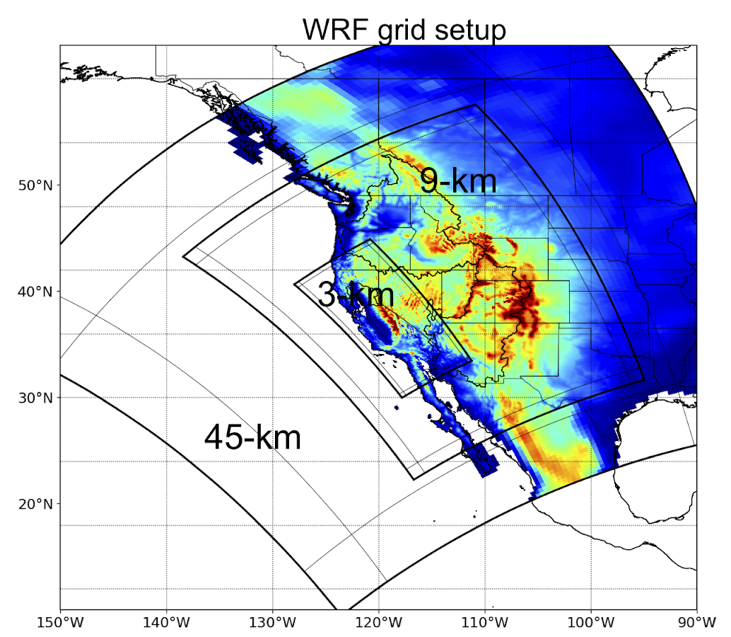
Dynamical Downscaling (WRF)
26 or 21* Hourly Variables
37 Daily Variables (including IVT, evapotranspiration)
All models are SSP3-70 for 3 km runs
a-priori Bias Corrected Models
MIROC6 r11i1p1f1
TaiESM1 r1i1p1f1
EC-Earth3 r1i1p1f1
MPI-ESM1-2-HR r3i1p1f1
EC-Earth3-Veg r1i1p1f1*
Notes:
Hourly Variables
2-m temperature, 2-m specific humidity, Surface pressure, 10-m u-component of the wind (grid relative), 10-m v-component of the wind (grid relative), Snow water equivalent, Skin temperature, Non-convective precipitation (cumulative). Convective precipitation (cumulative), Cumulative snowfall equivalent, Diffuse downwelled solar radiation, Surface upwelled solar radiation (all sky), Surface upwelled solar radiation (clear sky), Surface downwelled solar radiation (all sky)Surface downwelled solar radiation (clear sky), Surface upwelled longwave radiation (all sky), Surface upwelled longwave radiation (clear sky), Surface downwelled longwave radiation (all sky), Surface downwelled longwave radiation (clear sky),Surface runoff, Sub-surface runoff

Slide 12
Dynamical Downscaling: Uses
Suggest using a-priori bias corrected WRF models unless implications of biases have been carefully considered and factored into analyses and results.
Research indicates that the non-a-priori bias corrected models produce results that are not physically plausible.
Apriori Bias Corrected Models
MIROC6 r11i1p1f1
TaiESM1 r1i1p1f1
EC-Earth3 r1i1p1f1
MPI-ESM1-2-HR r3i1p1f1
EC-Earth3-Veg r1i1p1f1
Without Bias Corrected Models
CESM2 r11i1p1f1
CNRM-ESM2-1 r1i1p1f2
EC-Earth3-Veg r1i1p1f1
FGOALS-g3 r1i1p1f1
When to use WRF dynamically downscaled projections:
Need hourly data that is not temperature at station location
Need data beyond CA (9 km grid - there are many 9 km simulations with bias correction)
Need a variable that is not part of the LOCA2-Hybrid data set
Need to capture an event with dynamical consistency across several variables

Slide 13
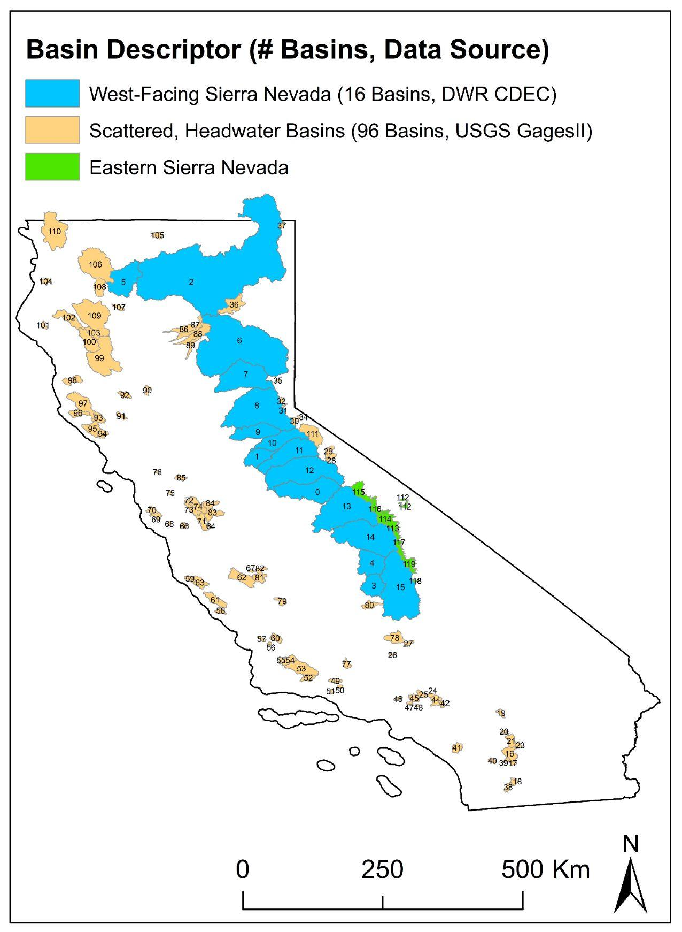
Hydrologic Simulations
TWO hydrologic models: Noah-MP and VIC
14 of the LOCA2-Hybrid Models
13 SSP3-7.0; 4 SSP2-4.5; 4 SSP5-8.5 LOCA2
And 4 of the non-a-priori BC WRF GCMs
Complete Spreadsheet linked here
Daily output from 10/1/1954 to 09/30/2100
Example output land surface variables include: runoff, SWE, evapotranspiration
Calibration for runoff performed across entire state of California
First for basins with natural flow observations
And then extended to HUC10 basins based on hydroclimate similarities between calibrated and ungauged basins
Using standard measures, VIC vs Noah-MP performance similar, but varies slightly depending on time-resolution and location

Slide 14
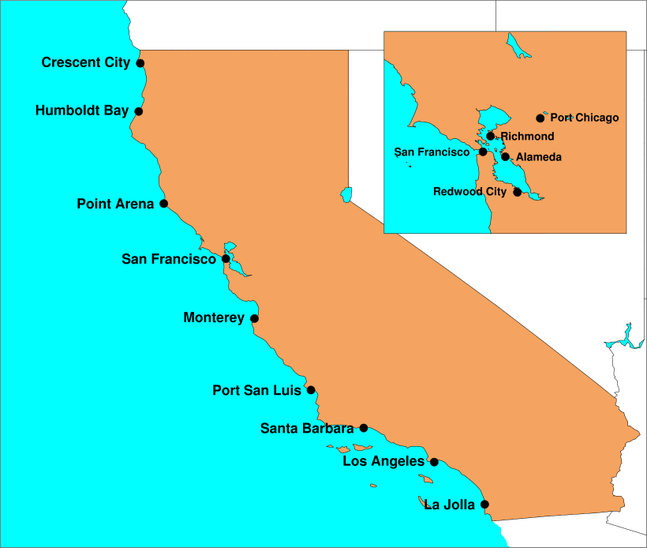
Hourly Sea Level Data
Hourly total water level from 1/1/1950 through 12/31/2099 for 9 locations along California coast and 4 locations in SF Bay and upper Delta shown on map, RHS.
Accounts for tides, weather, and ENSO as well as long term sea level rise
11 GCMs for 3 SSPs & multiple ensemble members
Provides projections corresponding to three different long term sea level rise scenarios from updated California Sea Level Rise Guidance, adopted from NOAA 2022 Report "Global and Regional Sea Rise Scenarios for the United States

Slide 15
Recommendations
Use LOCA2-Hybrid for analyses unless WRF data is needed.
Use SSP370 for analyses unless investigating impact of mitigation. Recommend using SSP245 to compare.
For many investigations of changes, use one ensemble member from each GCM. For analyses of natural/internal variability, use multiple ensemble members of the same GCM and across GCMs; for example use multiple ensemble members of multiple GCMs to investigate extremes.
If using WRF data, prioritize a-priori bias corrected model projections unless other (non-a-priori bias corrected) WRF simulations are warranted and implications of biases have been carefully considered.
Determine time periods depending on application (e.g. planning horizon, risk threshold, etc)
Evaluate both hydrologic models, considering the location and time resolution. Similar to weather variables, use multiple hydrological model projections to capture uncertainty.

Slide 16
How to access the Data
Hydrology data is located on AWS server
NOAH-MP
https://wrf-cmip6-noversioning.s3.amazonaws.com/index.html#ben_temp/d03_3km/CEC/2_NOAH_MP_SIMULATIONS/
VIC
https://wrf-cmip6-noversioning.s3.amazonaws.com/index.html#lusu/CEC/VIC_SIMULATIONS/

Slide 17
Toward Targeted Case Studies of Extremes
Dave Pierce, Julie Kalansky, Stefan Rahmimi, Josh Mumford, Peter Yao, Dan Cayan
and many others

Slide 18
Concept: Identify Target Extremes to use in Scenario planning and Stress Tests
Screen Models to identify precipitation and temperature extremes based on input from CEC, public utilities and downstream grants
Subsequent activity, based on feedback from Utilities, Agencies and others, will target extremes of drought, flood and extreme temperatures.

Slide 19
Extremes LOCA2 Downscaled CMIP6
1951-2014 2015-2040 2041-2070 2071-2100 SSPs 245 370 585
WETTEST
Wettest 1WY
Wettest 2WY
Wettest 3WY
Wettest 5WY
Wettest 10WY
Wettest 20WY
HOTTEST
Hottest 1-Day
Hottest 2-Day
Hottest 3-Day
Hottest 7-Day
Hottest 14-Day
Hottest 30-Day
DRIEST
Driest 1WY
Driest 2WY
Driest 3WY
Driest 5WY
Driest 10WY
Driest 20WY
COLDEST
Coldest 1-Day
Coldest 2-Day
Coldest 3-Day
Coldest 7-Day
Coldest 14-Day
Coldest 30-Day

Slide 20
15 ESMs
3 SSPs (245 370 585)
1-10 Ensemble Members
4 time periods (1951-2014, 2015-2040, 2041-2070, 2071-2100)
Basin | Model | Ensemble Member | Future Pathway | Years | Driest 1WY | Driest 1WY Precip [mm] | Share of WY Avg [%] | Driest 2WY (Start) | Driest 2WY Precip [mm] | Share of WY Avg [%]2 | Driest 3WY (Start) | Driest 3WY Precip [mm] | Share of WY Avg [%]3 | Driest 5WY (Start) | Driest 5WY Precip [mm] | Share of WY Avg [%]4 | Driest 10WY (Start) | Driest 10WY Precip [mm] | Share of WY Avg [%]5 | Driest 20WY (Start) | Driest 20WY Precip [mm] | Share of WY Avg [%]6 | Avg WY Precip [mm] | Hist Avg Precip [mm] | Dynamically Downscaled
CtrCal | ACCESS-CM2 | r1i1p1f1 | ssp245 | 1951-2014 | 1996 | 167.7 | 44.0 | 1970 | 184.3 | 48.4 | 1969 | 185.6 | 48.7 | 1994 | 260.1 | 68.3 | 1989 | 302.0 | 79.3 | 1952 | 351.9 | 92.4 | 380.8 | 380.8 | no
CtrCal | ACCESS-CM2 | r2i1p1f1 | ssp585 | 2071-2100 | 2082 | 255.0 | 67.4 | 2078 | 312.4 | 82.6 | 2078 | 326.0 | 86.2 | 2078 | 360.1 | 95.2 | 2078 | 374.4 | 99.0 | 2068 | 395.9 | 104.7 | 426.7 | 378.2 | no
CtrCal | CNRM-ESM2-1 | r1i1p1f2 | ssp245 | 1951-2014 | 2005 | 156.0 | 40.9 | 2010 | 200.7 | 52.7 | 2003 | 257.9 | 67.7 | 2001 | 276.9 | 72.7 | 1996 | 333.9 | 87.6 | 1992 | 349.3 | 91.7 | 381.1 | 381.1 | no
CtrCal | CNRM-ESM2-1 | r1i1p1f2 | ssp245 | 2015-2040 | 2036 | 191.3 | 50.2 | 2035 | 265.1 | 69.6 | 2034 | 307.9 | 80.8 | 2013 | 320.7 | 84.2 | 2009 | 362.3 | 95.1 | 1996 | 352.5 | 92.5 | 398.3 | 381.1 | no
CtrCal | CNRM-ESM2-1 | r1i1p1f2 | ssp245 | 2041-2070 | 2057 | 182.1 | 47.8 | 2050 | 273.8 | 71.8 | 2049 | 306.6 | 80.5 | 2047 | 334.7 | 87.8 | 2042 | 338.7 | 88.9 | 2032 | 368.9 | 96.8 | 410.4 | 381.1 | no
CtrCal | CNRM-ESM2-1 | r1i1p1f2 | ssp245 | 2071-2100 | 2079 | 138.2 | 36.3 | 2074 | 187.3 | 49.1 | 2082 | 257.1 | 67.5 | 2079 | 304.8 | 80.0 | 2079 | 355.0 | 93.1 | 2056 | 400.5 | 105.1 | 428.8 | 381.1 | no
CtrCal | CNRM-ESM2-1 | r1i1p1f2 | ssp370 | 1951-2014 | 2005 | 156.0 | 40.9 | 2010 | 200.7 | 52.7 | 2003 | 257.9 | 67.7 | 2001 | 276.9 | 72.7 | 1996 | 333.9 | 87.6 | 1992 | 349.3 | 91.7 | 381.1 | 381.1 | yes
CtrCal | CNRM-ESM2-1 | r1i1p1f2 | ssp370 | 2015-2040 | 2023 | 178.9 | 47.0 | 2039 | 184.0 | 48.3 | 2038 | 240.8 | 63.2 | 2036 | 324.2 | 85.1 | 2031 | 364.6 | 95.7 | 1996 | 354.7 | 93.1 | 382.5 | 381.1 | yes
CtrCal | CNRM-ESM2-1 | r1i1p1f2 | ssp370 | 2041-2070 | 2044 | 159.2 | 41.8 | 2040 | 223.1 | 58.5 | 2039 | 208.8 | 54.8 | 2038 | 281.0 | 73.7 | 2035 | 319.2 | 83.8 | 2028 | 364.0 | 95.5 | 399.6 | 381.1 | yes
CtrCal | CNRM-ESM2-1 | r1i1p1f2 | ssp370 | 2071-2100 | 2072 | 106.2 | 27.9 | 2072 | 162.8 | 42.7 | 2072 | 208.5 | 54.7 | 2070 | 242.3 | 63.6 | 2068 | 295.1 | 77.4 | 2058 | 351.0 | 92.1 | 385.5 | 381.1 | yes
CtrCal | CNRM-ESM2-1 | r1i1p1f2 | ssp585 | 1951-2014 | 2005 | 156.0 | 40.9 | 2010 | 200.7 | 52.7 | 2003 | 257.9 | 67.7 | 2001 | 276.9 | 72.7 | 1996 | 333.9 | 87.6 | 1992 | 349.3 | 91.7 | 381.1 | 381.1 | no
CtrCal | CNRM-ESM2-1 | r1i1p1f2 | ssp585 | 2015-2040 | 2024 | 185.0 | 48.6 | 2024 | 202.0 | 53.0 | 2038 | 247.5 | 65.0 | 2036 | 286.4 | 75.2 | 2021 | 345.3 | 90.6 | 2010 | 352.8 | 92.6 | 369.5 | 381.1 | no
CtrCal | CNRM-ESM2-1 | r1i1p1f2 | ssp585 | 2041-2070 | 2054 | 185.5 | 48.7 | 2053 | 209.3 | 54.9 | 2053 | 240.0 | 63.0 | 2051 | 265.6 | 69.7 | 2051 | 323.9 | 85.0 | 2036 | 340.9 | 89.5 | 381.6 | 381.1 | no
CtrCal | CNRM-ESM2-1 | r1i1p1f2 | ssp585 | 2071-2100 | 2094 | 155.4 | 40.8 | 2094 | 202.1 | 53.0 | 2075 | 231.0 | 60.6 | 2073 | 241.7 | 63.4 | 2074 | 252.0 | 66.1 | 2067 | 299.0 | 78.5 | 307.6 | 381.1 | no

Slide 21
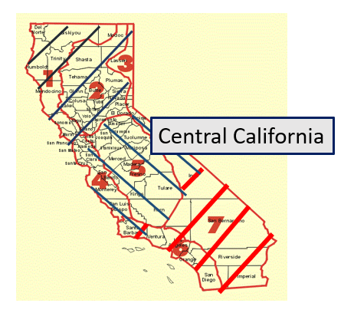
Map of California

Slide 22
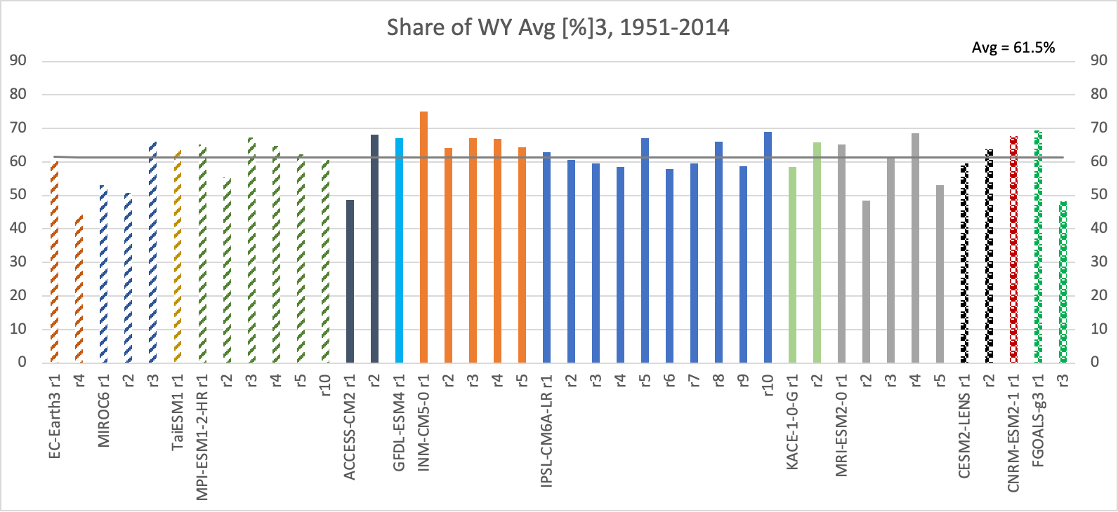
LOCA2 CMIP6 Driest 3WYr 1951-2014
%
Wyr mean

Slide 23
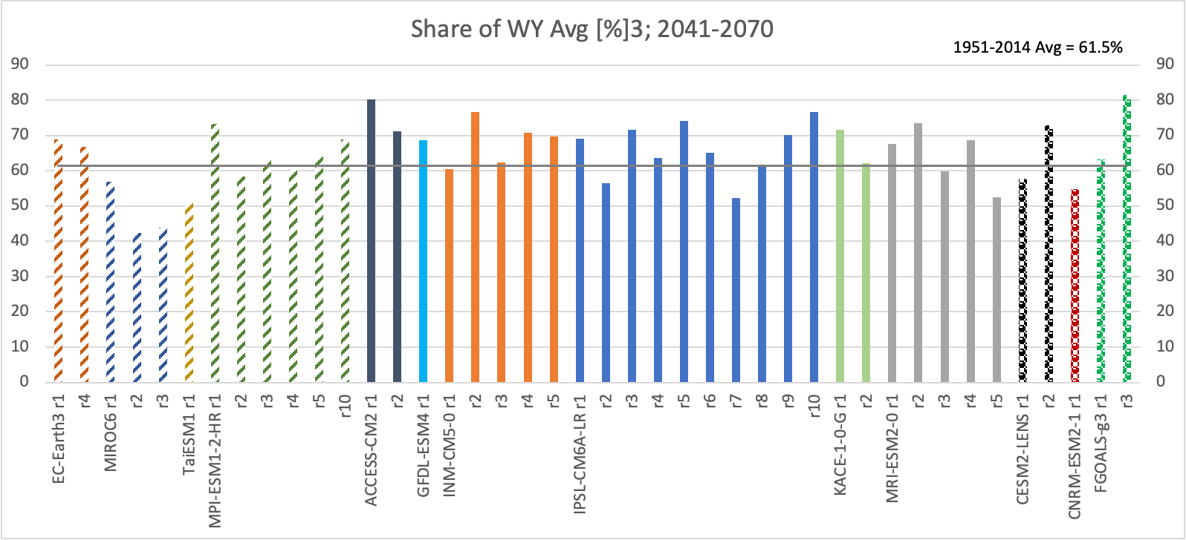
LOCA2 CMIP6 Driest 3WYr 2041-2070
%
Wyr mean

Slide 24
LOCA2 CMIP6 Hottest 2-Day 1951-2014
Anom
ºC
Anomaly w.r.t. 1951-2014 JJA Tmax mean

Slide 25
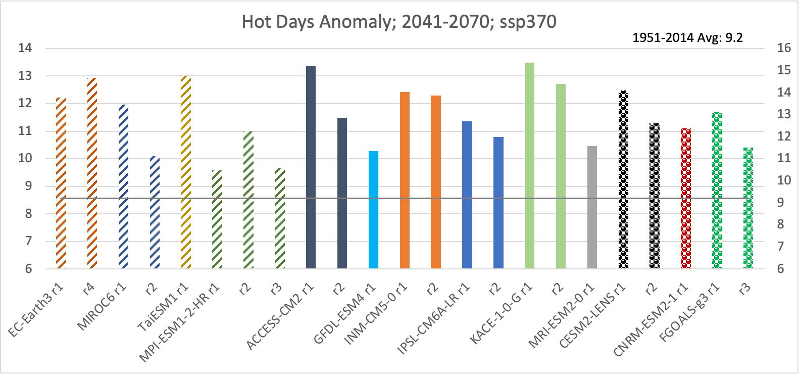
LOCA2 CMIP6 Hottest 2-Day 2041-2070
Anom
ºC
Anomaly w.r.t. 1951-2014 JJA Tmax mean

Slide 26
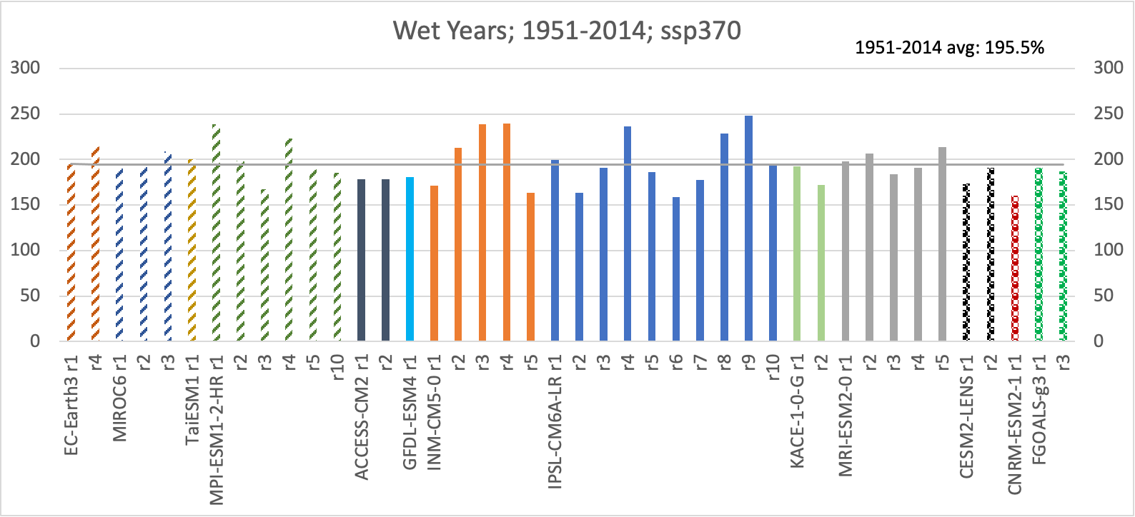
LOCA2 CMIP6 Wettest WYr 1951-2014
%
Wyr mean

Slide 27
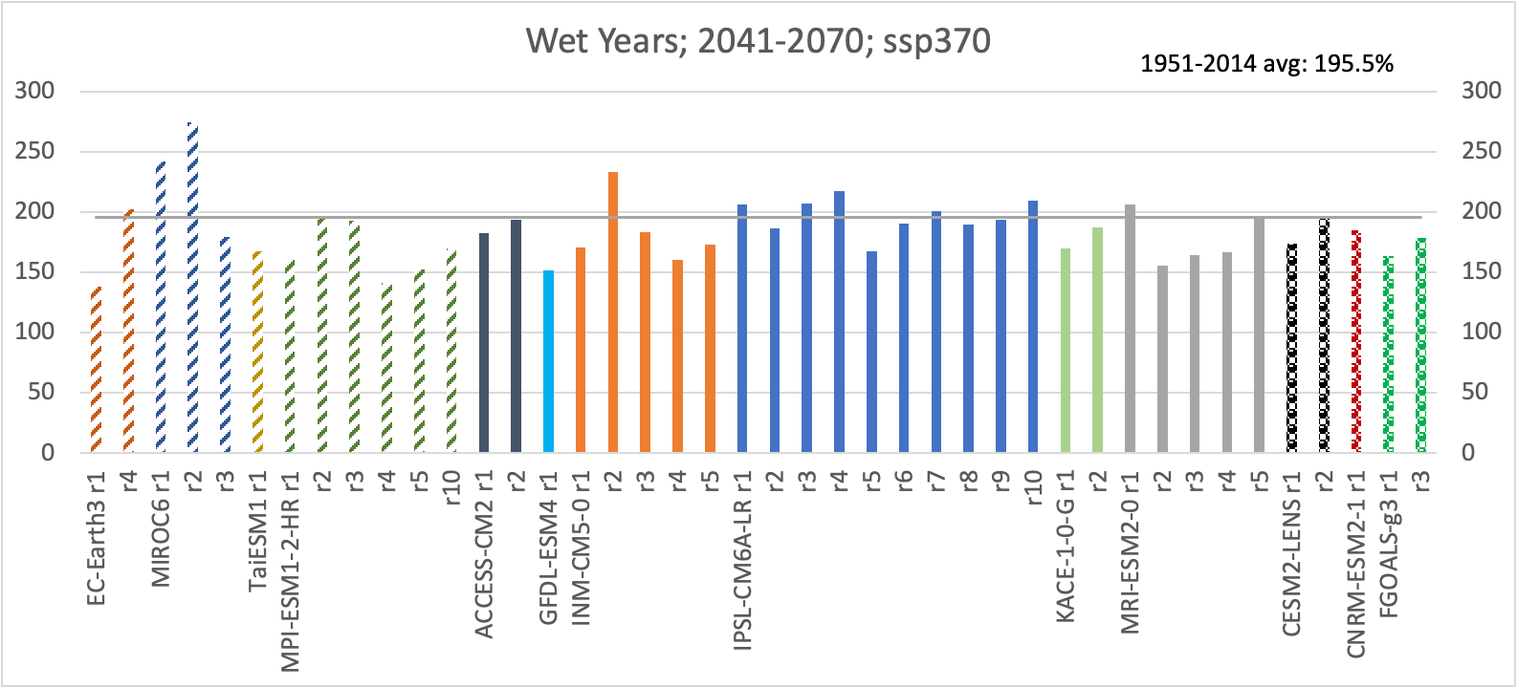
LOCA2 CMIP6 Wettest WYr 2041-2070
%
Wyr mean

Slide 28
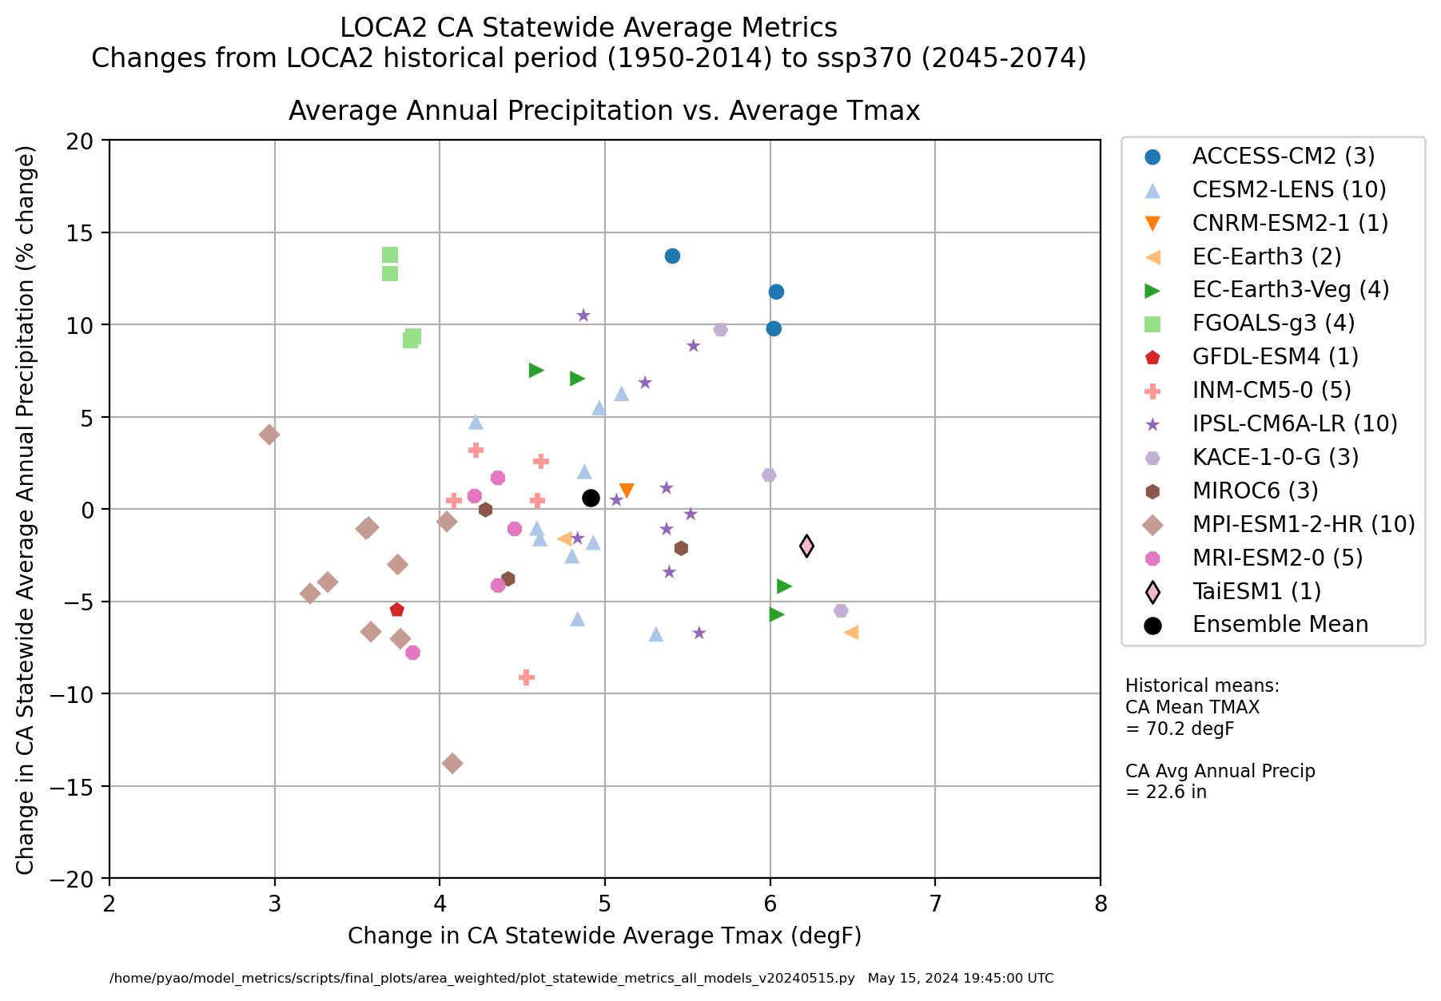
LOCA2-Hybrid CA Statewide Average Metrics

